Slide 1
The Causes of Weather
12.1

Slide 2
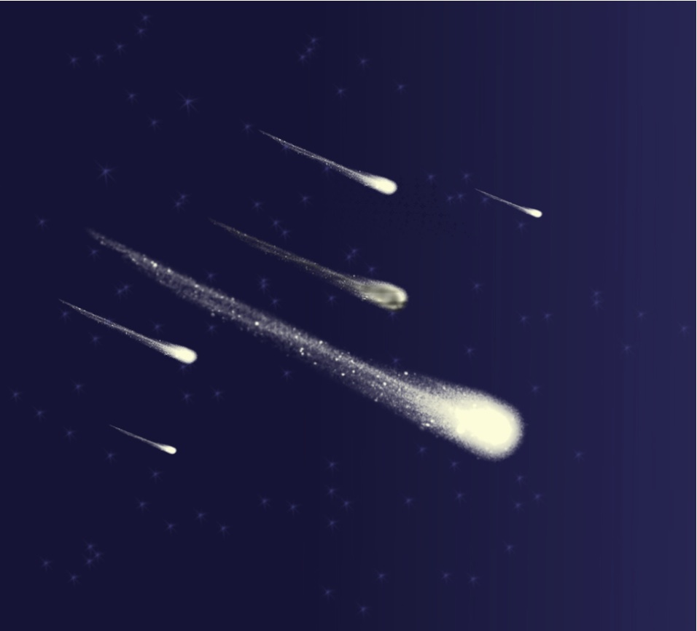
What is meteorology?
Meteorology is the study of the physics, chemistry, and dynamics of atmospheric phenomena.
The root word of meteorology is the Greek word meteoros, which means high in the air.
Atmospheric phenomena are classified as types of meteors.
Precipitation (rain, snow, sleet, hail) area classified as hydrometers.
Smoke, haze, dust, and other particles are lithometeors.

Slide 3
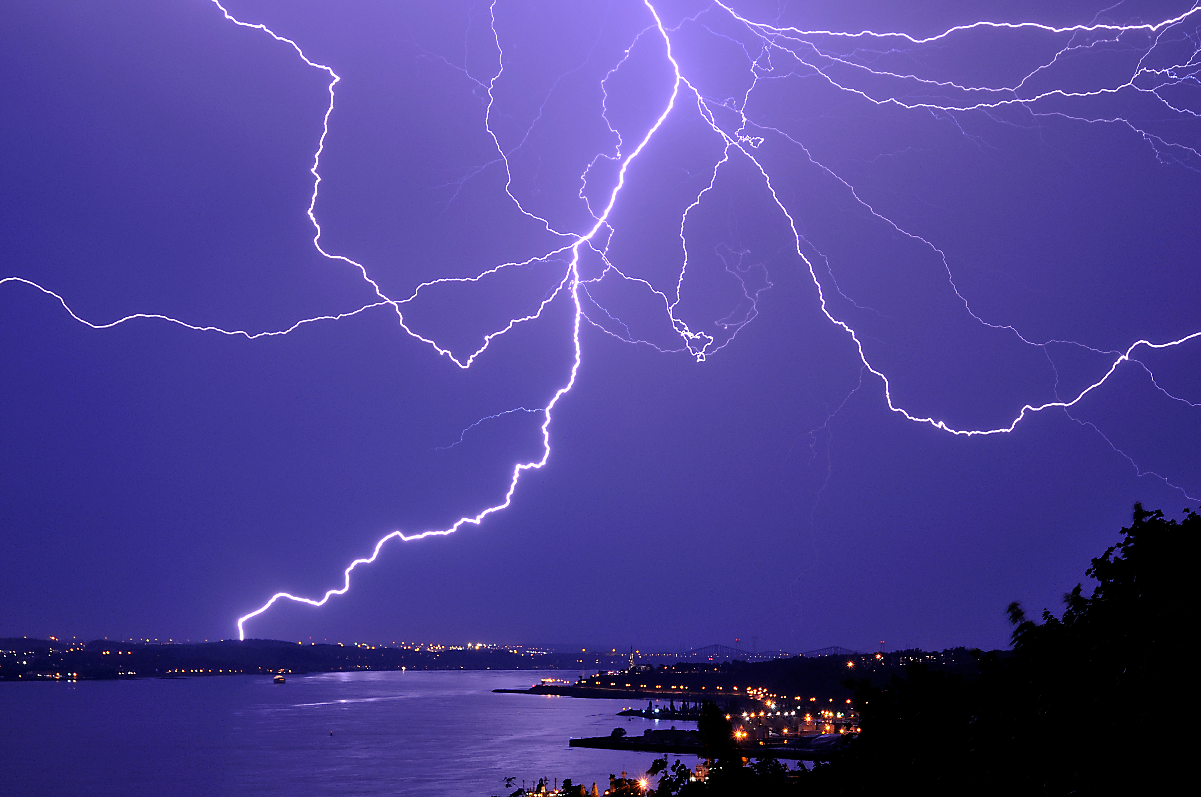
Weather vs. Climate
Short-term variation in atmospheric phenomena that interact and affect the environment and life on earth are called WEATHER
  These variations can happen over minutes, hours, week, months, or even years!
CLIMATE is the long-term average of variation in weather for a particular AREA.
  Meteorologists used weather-data averages over 30 years to define an area’s climate.

Slide 4

Imbalanced heating
Why are the average January temperatures in Miami higher than in Detroit?
  Part of the explanation is that Earth’s axis of rotation is tilted relative to the plane of Earth’s orbit
    SO……… the number of hours of daylight and amount of solar radiation is greater in Miami during January than in Detroit!
  Another factor is that the Earth is a sphere so different places on Earth are at different angles to the sun (Figure 2).
    For most of the year, the amount of solar radiation that reaches a given area at the equator covers a larger area of altitudes nearer the poles.
      In short, the greater area covered, the smaller the amount of heat per unit of area.
    Since Detroit is farther from the equator, the same amount of heat that hits Miami will heat Detroit less

Slide 5
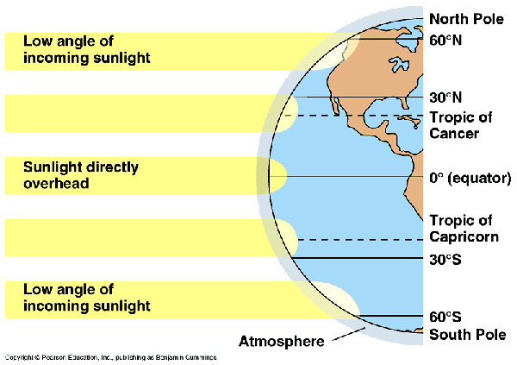

Slide 6

Thermal Energy Redistribution
Areas around Earth maintain around the same average temperatures over time due to the constant movement of air and water.
The constant movement of air on Earth’s surface redistributes thermal energy around the world.
  Weather is part of this redistribution (THUNDERSTORMS)

Slide 7

Air MASSES
Heated air rises because it is less dense than the surrounding air.
On Earth, this process can take place over thousands square kilometers for days or even WEEKS.
An air mass is a large volume of air that has the same characteristics, such as humidity and temperature, as its source region.
  Source region is the area over which the air mass forms.
  Most air masses form over tropical regions or polar regions!

Slide 8
Types of air masses
Air Mass Type | Weather Map Symbol | Source Region | Winter characteristics | Summer characteristics
Arctic | A | Siberia, Arctic Basin | Bitter cold, dry | Cold, dry
Continental Polar | cP | Interiors of Canada and Alaska | Very cold, dry | Cool, dry
Continental Tropical | cT | Southwest US and Mexico warm, dry |  | Hot, dry
Maritime Polar | mP | North Pacific Ocean | Mild, humid | Mild, humid
 |  | North Atlantic Ocean | Cool, humid | Cool, humid
Maritime Tropical | mT | Gulf of Mexico, Caribbean Sea | Warm, humid | Hot, humid

Slide 9
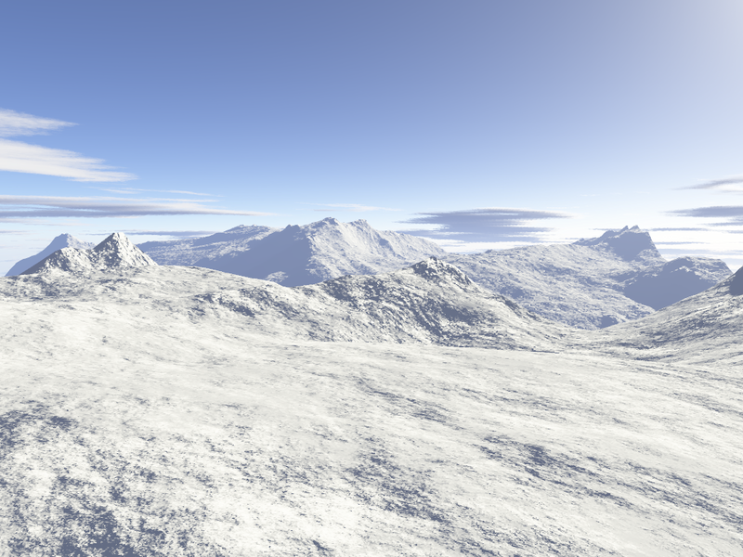
Air Mass Modification
Air Masses do not stay in one place indefinitely. They will move, transferring thermal energy form one area to another.
When air masses travel over land or region, the air masses can acquire come of those characteristics different from its source region.
Example: When a polar air mass travels over a relatively warm body of water, the modified air mass might produce lake-effect snows. When an air mass undergoes modification, it exchanges thermal energy, moisture, or both.

Slide 10
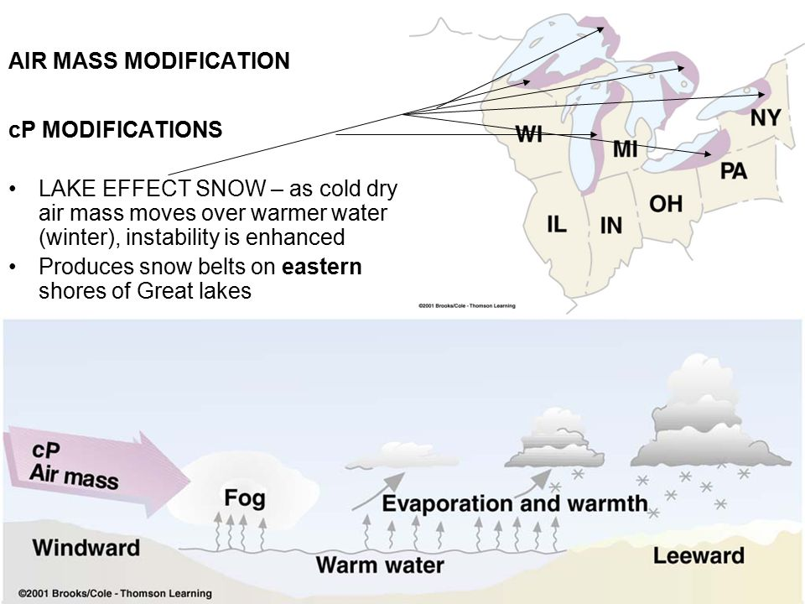

Slide 11
Air Masses (missing slide)
Heated air rises because it is less dense than the surrounding air
On Earth, this process can take place over thousands square kilometers for days or even WEEKS.
An air mass is a large volume of air that has the same characteristics, such as humidity and temperature, as its source region.
  Source region: the area over which an air mass forms
Most air masses form over tropical regions or polar regions

