Slide 1
Weather Systems
12.2

Slide 2
Global Wind Systems
The directions of Earth’s winds are influenced by Earth’s rotation.
This Coriolis Effect results in fluids and objects moving in an apparent curved path rather than a straight line.
Moving air curves to the right in the northern hemisphere and curves to the left in the southern hemisphere.
The Coriolis Effect at the heat imbalance on Earth create distinct global wind systems.
Global wind systems help to equalize the thermal energy on Earth.

Slide 3
Wind Systems
There are three basic zones, or wind systems, at Earth’s surface:
Polar Easterlies: wind zone between 60N and the North Pole and 60S and the South Pole; weak and sporadic
Prevailing westerlies: wind systems on Earth located between latitudes 30N and 60N & 30S and 60S. Originate from the west. Steady winds across US.
Between polar easterlies and prevailing westerlies is an area called a polar front. Polar Fronts contain stormy weather. The Earth has 2 of them.
Trade Winds: Between 30N and 30S are two circulation belts of wind; these winds sink and move towards the equator in an easterly direction. When it reaches the equator, is rises and moves back to original location

Slide 4
Horse Latitudes
Near latitudes 30N and 30S, the sinking air associated with the trade winds creates a high pressure area. This results in a belt of weak surface winds called the horse latitudes.
Earth’s major deserts, like the Sahara, are under these high-pressure areas

Slide 5
Intertropical Convergence Zone
Near the equator, trade winds from North and South meet
The air is forced upward which creates an area of low pressure
This is called convergence
Can occur on a large or small scale
Near the equator, it is on a large scale called the intertropical convergence zone (ITCZ)
The ITCZ drifts south and north of the equator as the seasons change.
Directly above the equator in March and September
Since it is a region of rising air, it has bands of cloudiness and thunderstorms which deliver moisture to many of the world’s tropical rain forests.

Slide 7
Jet Streams
Recall that warmer air has higher pressure than cooler air and the difference in these air pressures causes wind.
Jet Stream: narrow wind band that occurs above large temperature contrasts.
Position varies with season
Generally located in the region with the strongest temperature differences on a line from the equator to the north pole.

Slide 8
Types of Jet Streams
The major jet streams are called the polar jet streams.
They separate the polar easterlies from the prevailing westerlies
Occur at latitudes 40N to 60N and 40S to 60S.
The minor jet streams are the subtropical jet streams.
Occur where the traded winds meet the prevailing westerlies, around 20N to 30N and 20S to 30S.

Slide 9
Jet Streams and Weather Systems
Large-scale weather systems form along jet streams
They affect the intensity of the systems by moving air of different temperatures from one region of Earth to another

Slide 10
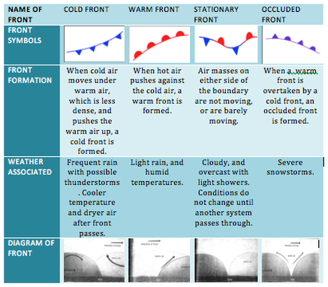
F R O N T S

Slide 11
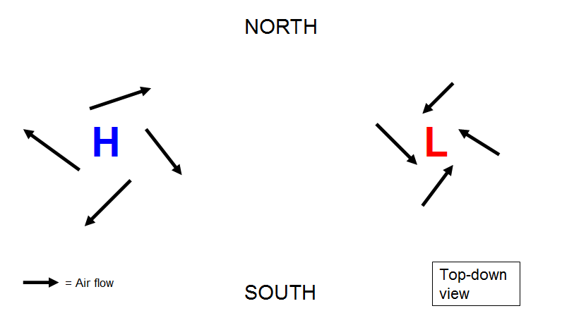
Pressure Systems
Low-pressure systems are often associated with cloudy weather and precipitation
High-pressure systems are usually associated with “pleasant” weather.

