Slide 1
Gathering Weather Data
12.3

Slide 2
Temperature and Air Pressure
Thermometer: measures temperature
Liquid in glass or bimetallic-strip thermometers
Liquid in glass thermometers contain a column of alcohol sealed in a glass tube that expands when heated, causing the column to rise, and contracts when it is cold, causing the column to fall.
Bimetallic-strip thermometer has a dial with a pointer. Contains a strip of metal made from 2 different metals that expand at different rates when heated. The strip is long and coiled into a spiral, which makes it more sensitive to temperature change
Barometer: measures air pressure
Some barometers have a column off mercury in a glass tube. One end of the tube is submerged in an open container of mercury. Changes in air pressure change the column height.
An “aneroid” barometer has a sealed metal chamber with flexible sides. Most of the air is removed, so the chamber contracts or expands with change in pressure.

Slide 3
Wind Speed and Relative Humidity
Anemometer: measures wind speed
The wind speed is calculated by the number of revolutions of the cups over a given amount of time.
Hygrometer: measures humidity
Contain a wet bulb thermometer and a dry bulb thermometer, which requires a conversion table to determine the relative humidity.
When water evaporates from the wet bulb, the bulb cools. The difference in thermometers is noted and then compared to the relative humidity table.

Slide 4
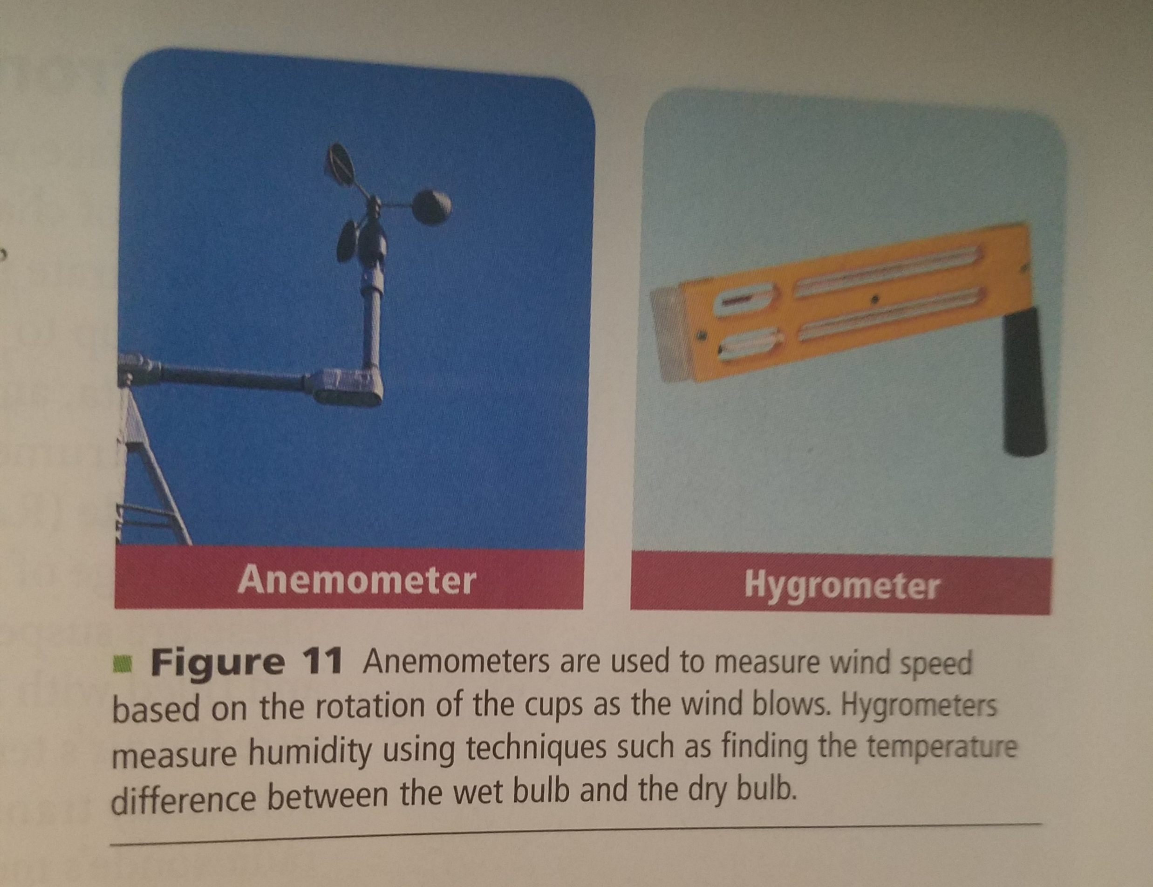

Slide 5
Automated Surface Observing System (ASOS)
Established in the US by the National Weather Service (NWS), the Federal Aviation Administration, and the Department of Defense.
Gathers consistent data 24 hours a day.
Provides weather data for forecasting, aviation, and research.

Slide 6
Data from the Upper Atmosphere
Weather is a large result of changes in the troposphere
Radiosonde: balloon-borne weather instrument whose sensors measure air pressure, humidity, temperature, wind speed, and wind directions in upper atmosphere
Radio signals constantly transmit the data to a ground station that tracks its movement

Slide 7
Weather Observation Systems
Weather Radar: detects specific locations of precipitation
A radio system generates radio waves and transmits them through an antenna at the speed of light. The transmitters is programmed to generate waves that only reflect from particles larger than a specific size.
Doppler effect: the change in wave frequency that occurs due to the relative motion of the wave as it moves toward or away from an observer.
Analysis of Doppler data can be used to determine the speed at which precipitation moves toward or away from a radar station.
Since movement of precipitation is caused by wind, the Doppler radar can also provide wind speeds with precipitation areas.
This gives it an advantage over conventional weather radar systems

Slide 8
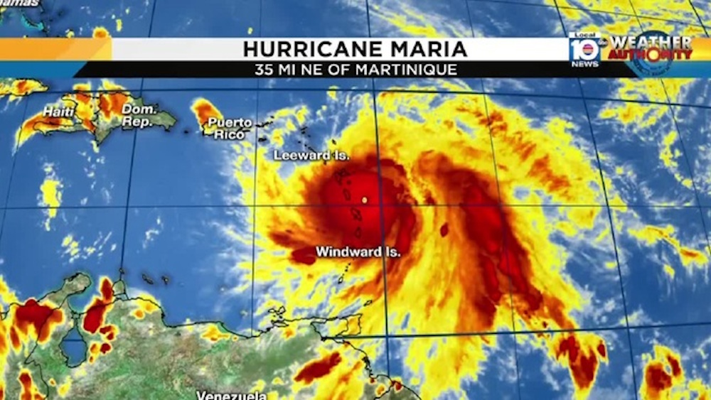
Weather Satellites
Cameras are mounted aboard weather satellites
Uses infrared, visible-light, or water-vapor imagery to observe the atmosphere

Slide 9
Infrared imagery
Objects radiate thermal energy at slightly different frequencies. Infrared imagery detects these differences and map either cloud cover or surface temperatures.
Since clouds form at different altitudes and have different temperatures, meteorologists can determine the cloud’s temperature, it’s type, and its altitude.
Useful in detecting strong thunderstorms.
Since the troposphere cools with increasing altitude, they appear as cold areas on an infrared image.
The strength of a storm depends on its altitude that it reaches, infrared imagery can help us establish its severity.

Slide 10
Visible-light imagery
The satellites track clouds, but not necessarily precipitation.
Show differences in shading of clouds, which can relate to cloud thickness.
By combining radar and visible imagery data, meteorologists can determine where both clouds and precipitation are occurring.

Slide 11
Water-vapor imagery
Water vapor is an invisible gas and cannot be photographed directly, but it absorbs and emits infrared radiation at certain wavelengths.
Many weather satellites contain sensors that can measure water vapor in the atmosphere.
Shows moisture in the air, not just clouds.
Because air currents that guide weather systems are often well defined by tails of water, meteorologists can closely monitor the development and change in storm systems even if clouds are not present.

Slide 12
Weather Analysis and Prediction
12.4

Slide 13
Surface Weather Analysis
Station Model: a record of weather data for a particular site at a particular time
Isobars: lines of equal pressure
Isobars that are close together indicate a large pressure difference over a small area, which means strong winds.
Isobars that are far apart indicate a small difference in pressure and light winds.
Isotherms: lines of equal temperature

Slide 14
Types of Forecasts
Digital Forecast: created by applying physical principles and mathematics to atmospheric variables and then predicting how these variables will change over time.
Analog Forecast: based on the comparison of current weather patterns to similar patterns from the past.
Similar means analogous

Slide 15
Short-Term Forecasts
1-3 day forecasts are no longer based on the movement of observed clouds and precipitation, which change by the hour.
Instead, these forecasts are based on the behavior of larger surface and upper-level features.

Slide 16
Long-Term Forecasts
Less reliable than short-term forecasts
Meteorologists use changes in surface weather systems based on circulation patterns throughout the troposphere and lower-stratosphere for 4-7 day forecasts.
There are only estimations and not exact.
One to two week forecasts are based on changes in large-scale circulation patterns.

