Slide 1
Thunderstorms
13.1

Slide 2
How Thunderstorms Form
There must be an abundant source of moisture in the lower levels of the atmosphere.
Second, there must be some mechanisms for condensing moisture to release its latent heat.
This occurs when a warm air mass is lifted into a cooler region of the atmosphere.
Dense, cold air along a cold front can push warmer air upward.
Warm land areas, heat islands such as cities, and bodies of water can also provide heat for lifting an air mass.
Third, stability is needed. If the surrounding air remains cooler than the rising air mass, unstable conditions arise.

Slide 3
Types of Thunderstorms Air Mass Thunderstorms
Air-mass thunderstorm: when air rises because of unequal heating of Earth’s surface within a single air mass.
Mountain thunderstorm: occur when an air mass rises by orographic lifting.
Sea-breeze thunderstorm: local air-mass thunderstorms that occur because land and water store and release thermal energy differently.

Slide 4
Types of Thunderstorms Frontal Thunderstorms
Frontal thunderstorms: produced by advancing cold fronts and rarely warm fronts.
In a cold front, dense, cold air pushes under warm air, which is less dense, rapidly lifting it up a steep cold-front boundary. This rapid upward motion can produce a thin line of thunderstorms.

Slide 5
Thunderstorm Development
Three stages:
Cumulus stage: consists of updrafts
Mature stage: characterized by strong updrafts and downdrafts
Dissipation stage: energy loss occurs

Slide 6
Lightning
The channel of partially charged air is called a stepped leader.
Generally moves from the center of the cloud toward the ground
When the stepped leader nears the ground, a branched channel of positively charged particles , called the return stroke, rushes upward to meet it.
The return stroke surges from the ground to the cloud, illuminating the connecting channel with about 100 million volts of electricity.

Slide 7
Lightning continued…
A lightning bold heats its surrounding area to about 30,000C.
The thunder you hear is the sound of produced as this superheated air rapidly expands and contracts.
Lightning causes about 12,000 wildfires a year in the US
They also cause about 300 injuries and 58 deaths in the US

Slide 8
Vocabulary

Slide 9
Severe Weather
13.2

Slide 10
Supercells are extremely powerful, self-sustaining thunderstorm characterized by intense, rotating updrafts
Downbursts: Violent downdrafts that are concentrated in a local area.
Classified as either microbursts or macrobursts
Hail forms because of 2 characteristics:
First, water droplets enter parts of the cumulonimbus cloud where the temperature is below freezing. When they encounter ice pellets, the water droplets freeze on contact and cause the ice pellets to grow larger.
Second, an abundance of strong updrafts and downdrafts existing side by side within a cloud. The growing ice pellets are caught alternately in the updrafts and downdrafts so that they encounter more supercooled water droplets.
They keep growing until they are too heavy to keep afloat and finally fall as hail.

Slide 11
Tornadoes
Tornado: violent, whirling column of air in contact with the ground.
When a tornado does not reach the ground, it is called a funnel cloud.
A tornado develops when pockets of rising air are rotated horizontally like a rolling-pin between layers of air with varying wind speeds or directions. The twisting column of wind is tilted from horizontal to vertical. As updrafts stretch the column, the rotation is accelerated.
Most violent tornadoes form in the spring during late afternoon and evening, when the temperature contrasts between polar air and tropical air are the greatest.
Large temperature contrast occur most frequently in the Midwest US in “tornado valley”

Slide 12
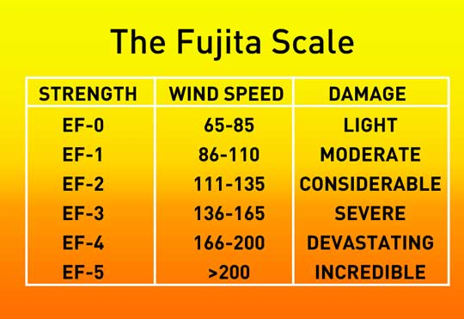
Tornado Classification
Enhanced Fujita Tornado Damage scale ranks tornados according to their destruction and estimated wind speed.
Classification ranges from EF0-EF5.
This Photo by Unknown Author is licensed under CC BY-SA

Slide 13
Vocabulary

Slide 14
Tropical Storms
13.3

Slide 15
Tropical cyclones: large, rotating , low-pressure tropical storms.
When it occurs in the western Pacific Ocean, it is known as a typhoon.
When it the Indian Ocean, it is known as a cyclone
When it occurs in the North Atlantic Ocean, the Caribbean Sea, the Gulf of Mexico, and along the western coast of Mexico it is known as a hurricane.

Slide 16
Cyclone Formation
Require two conditions to form: an abundant supply of warm ocean water and some sort of mechanism to lift warm air and keep it rising.
Three stages in development of a full tropical cyclone:
Formative stage – with a mixture of warm, dense air a cyclonic rotation (counterclockwise) is produced. At this stage, it is known as a tropical depression.
Mature stage – wind speeds increase, air pressure in the center decreases, the calm center of the storm (the eye) forms. Now, it is known as a tropical cyclone
The strongest winds in a hurricane are concentrated in the eyewall –a tall band of strong winds and dense clouds that surrounds the eye.
Dissipation stage – loses energy once it gets on land or on colder water.

Slide 17
Hurricane Hazards
Saffir-Stimpson Hurricane Wind scale classifies hurricanes according to wind speed.
Most of the damage caused by hurricanes is associated with violent winds
Winds are responsible for storm surges- when hurricane force winds drive a mound of ocean water toward coastal areas where it washes over land.

Slide 18
Recurrent Weather
13.4

Slide 19
Floods- low-lying areas are most susceptible to flooding, making coastal areas more vulnerable.
Droughts- extended periods of well-below-average rainfall.
Heat waves (side effect of droughts) are extended periods of above-average temperatures.
Increasing humidity adds to the potential danger of a heat wave, so we use the heat index to combine the relative humidity with the air temperature to give us an estimate of what the air actually feels like to us.
When air is humid, the bodies rate of evaporation from the surface skin is reduced. (Evaporation is how we “cool” ourselves in the heat)

Slide 20
This Photo by Unknown Author is licensed under CC BY-SA

Slide 21
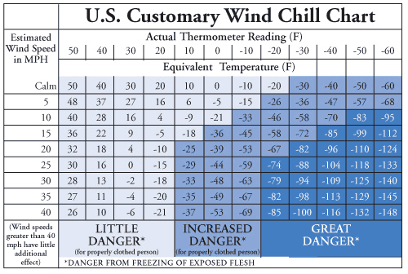
Cold Waves & Wind Chill
The opposite of a heat wave is a cold wave – extended period of below-average temperatures.
Windchill index – measures the windchill factor, by estimating the heat loss from human skin caused by combination of wind and cold air.
This Photo by Unknown Author is licensed under CC BY-SA

