Slide 1
Chapter 12
Nonrenewable Energy Resources
Friedland and Relyea Environmental Science for AP®, second edition
© 2015 W.H. Freeman and Company/BFW
AP® is a trademark registered and/or owned by the College Board®, which was not involved in the production of, and does not endorse, this product.

Slide 2
Module 34 Patterns of Energy Use
After reading this module, you should be able to
describe the use of nonrenewable energy in the world and in the United States.
explain why different forms of energy are best suited for certain purposes.
understand the primary ways that electricity is generated in the United States.

Slide 3
Nonrenewable energy is used worldwide and in the United States
Fossil fuel A fuel derived from biological material that became fossilized millions of years ago.
Nonrenewable energy resource An energy source with a finite supply, primarily the fossil fuels and nuclear fuels.
Nuclear fuel Fuel derived from radioactive materials that give off energy.

Slide 4
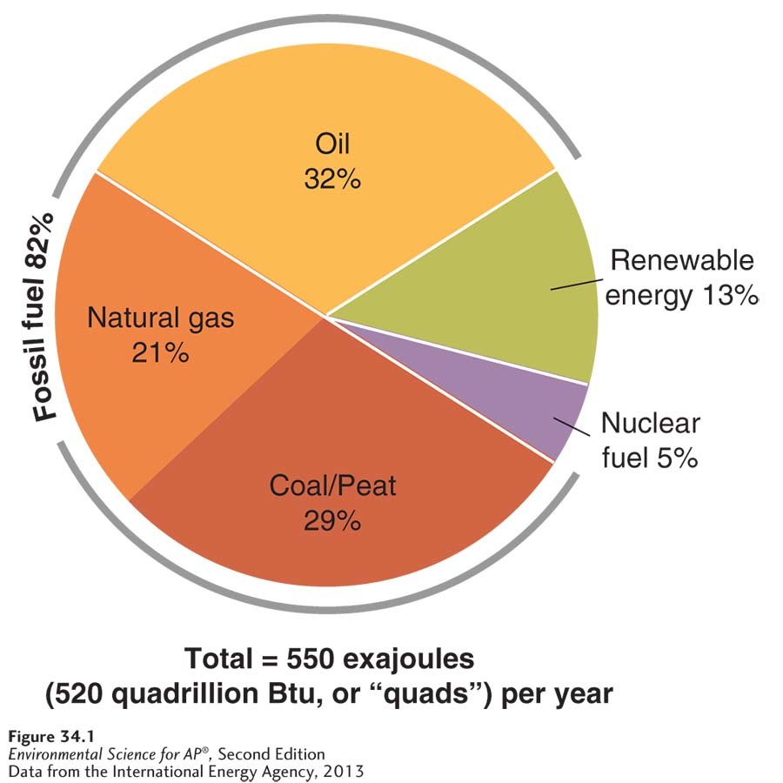
Worldwide Patterns of Energy Use
Worldwide annual energy consumption, by resource, in 2011.
Oil, coal and peat, and natural gas are the major
sources of energy for the world.

Slide 5
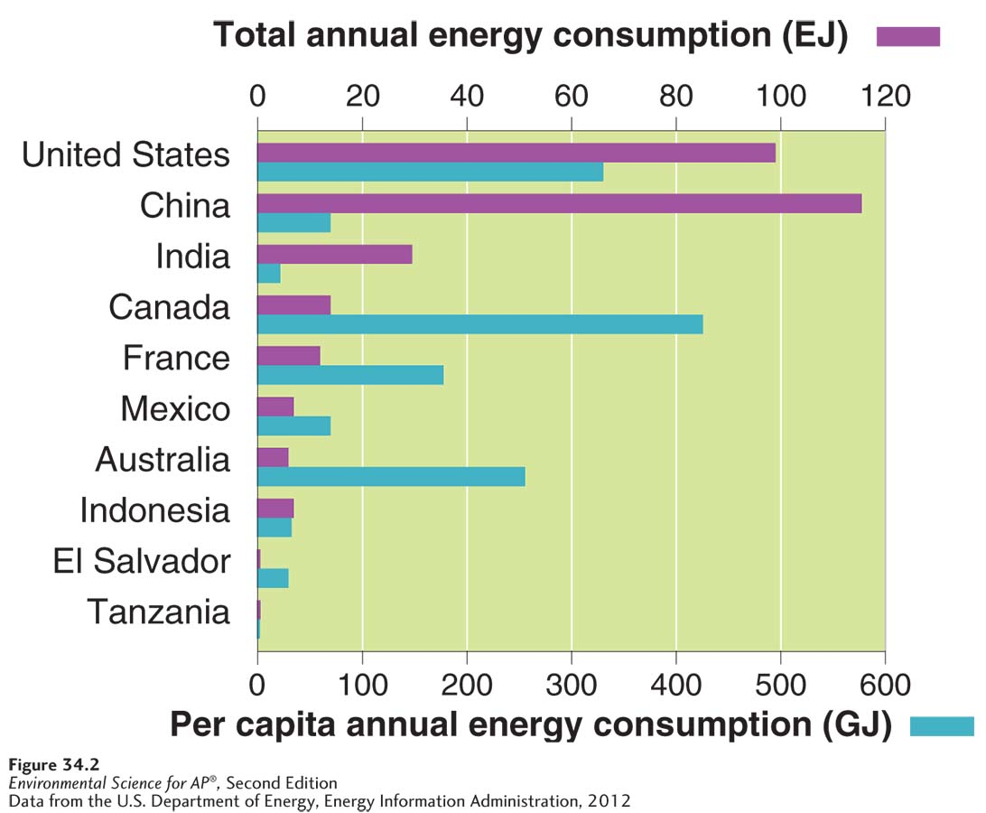
Worldwide Patterns of Energy Use
Global variation in total annual energy consumption and per capita energy consumption. The 10 countries shown are among the largest and the smallest energy users in the world.

Slide 6
Worldwide Patterns of Energy Use
Commercial energy source An energy source that is bought and sold.
Subsistence energy source An energy source gathered by individuals for their own immediate needs.

Slide 7
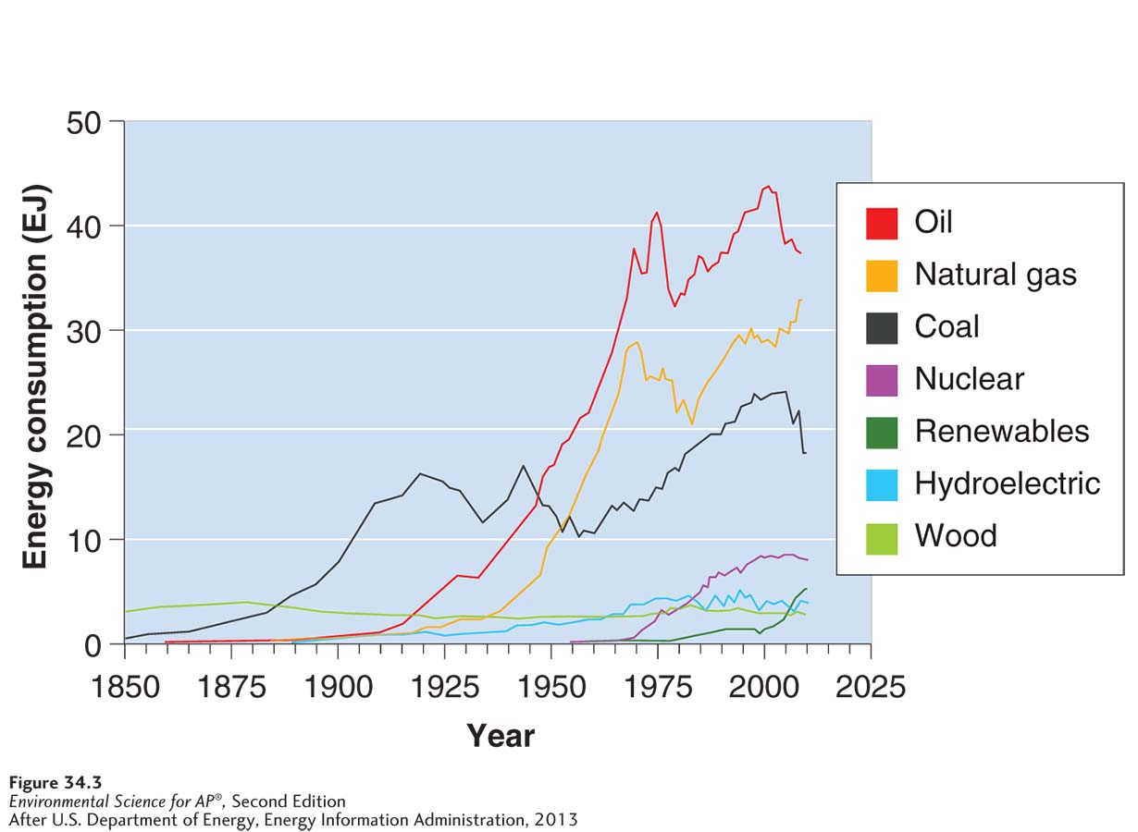
Worldwide Patterns of Energy Use
Energy consumption in the United States from 1850 through 2012. Wood and then coal once dominated our energy supply. Today a mix of three fossil fuels accounts for most of our energy use. The recent increase in natural gas and decrease in oil and coal is quite evident.

Slide 8
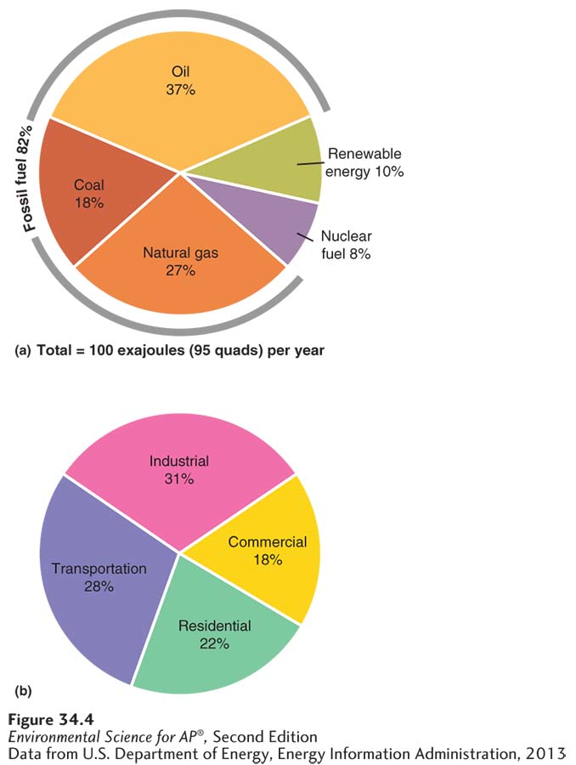
Worldwide Patterns of Energy Use
United States annual energy consumption by resource and end use in 2012.
These graphs show energy
consumption and end use in the United States. (a) United States annual energy consumption by fuel type in 2012. (b) United States end use energy sectors in 2012. Commercial includes businesses and schools.

Slide 9
Different energy forms are best suited for specific purposes
The best form of energy to use depends on the particular purpose for which it is needed.
It is possible to determine energy efficiency by calculating the energy return on energy investment (EROEI)
EROI = Energy obtained from fuel ÷ Energy invested to obtain fuel
The larger the value of EROI, the more efficient the fuel.

Slide 10
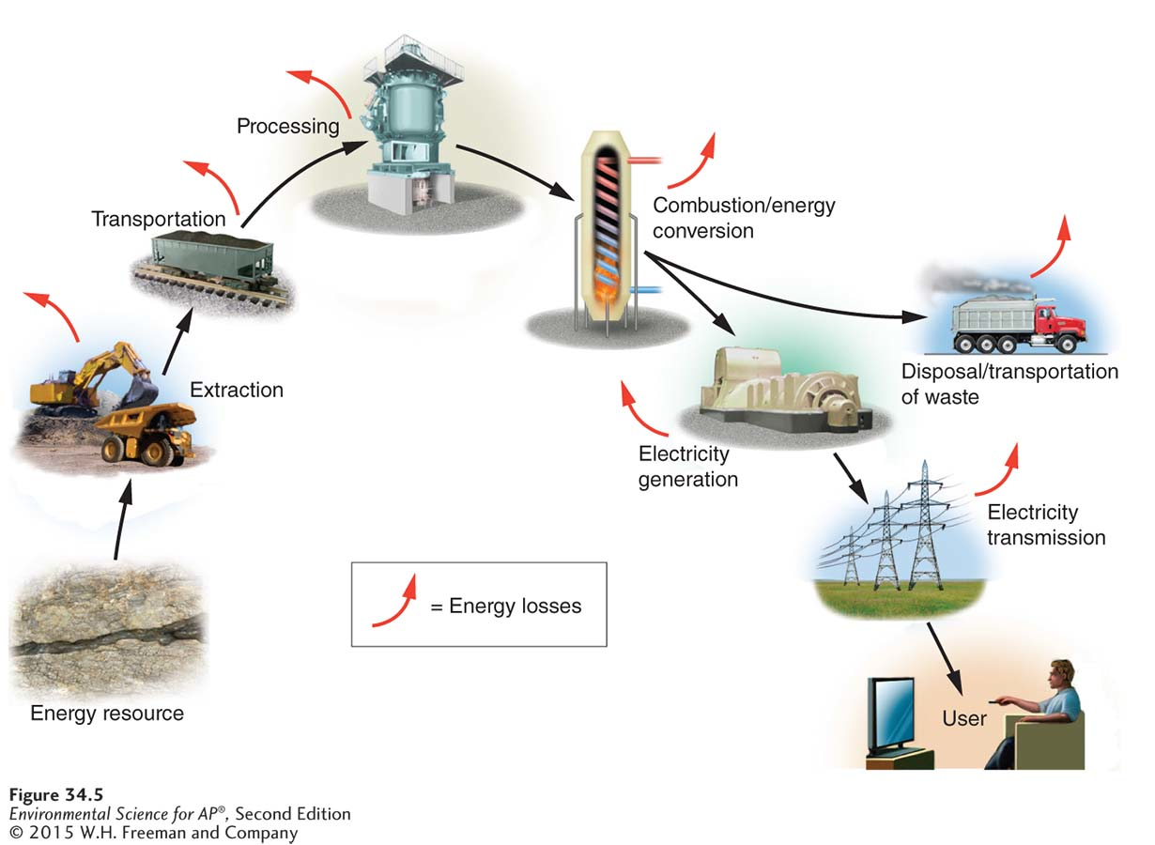
Quantifying Energy Efficiency
Inefficiencies in energy extraction and use. Coal provides an example of inefficiencies in energy extraction and use. Energy is lost at each stage of the process, from extraction, processing, and transport of the fuel to the disposal of waste products.

Slide 11
Efficiency and Transportation
Nearly 30 percent of energy use in the United States is for transportation, This is an area in which efficiency is particularly important.
Transportation is achieved primarily through the use of vehicles fueled by petroleum products, such as gasoline and diesel.

Slide 12
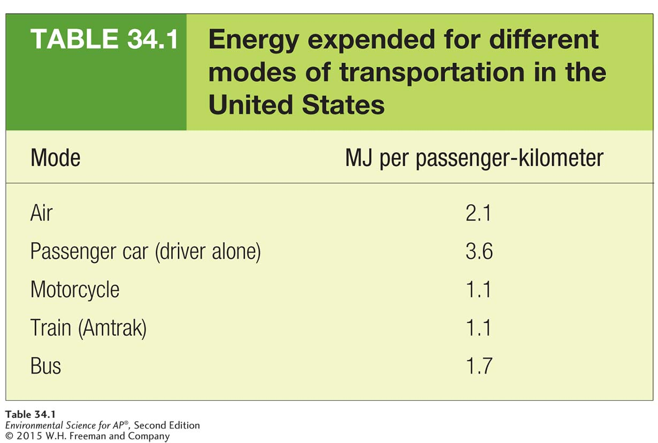
Efficiency and Transportation

Slide 13
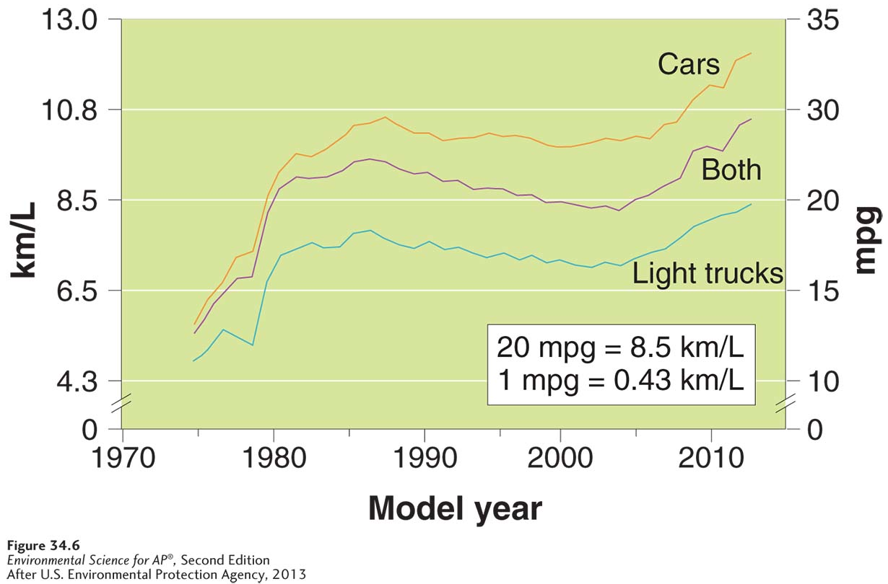
Efficiency and Transportation
Overall fuel efficiency of U.S. automobiles from 1975 through 2013. As more buyers moved from cars to light trucks (a category that includes pickup trucks, minivans, and SUVs) for their personal vehicles, the fuel economy of the total U.S. fleet declined. Only recently has it begun to increase.

Slide 14
Electricity accounts for 40 percent of our energy use
Electricity can be generated from many different sources
Energy carrier Something that can move and deliver energy in a convenient, usable form to end users.

Slide 15
The Process of Electricity Generation
All thermal power plants convert the potential energy of a fuel into electricity.
Turbine A device with blades that can be turned by water, wind, steam, or exhaust gas from combustion that turns a generator in an electricity-producing plant.
Electrical grid A network of interconnected transmission lines that joins power plants together and links them with end users of electricity.

Slide 16
The Process of Electricity Generation
Steps for using coal to produce electricity:
The burning fuel from coal transfers energy to water, which becomes steam.
The kinetic energy contained within the steam is transferred to the blades of a turbine, a large device that resembles a fan.
As the energy in the steam turns the turbine, the shaft in the center of the turbine turns the generator.
This mechanical motion generates electricity.

Slide 17
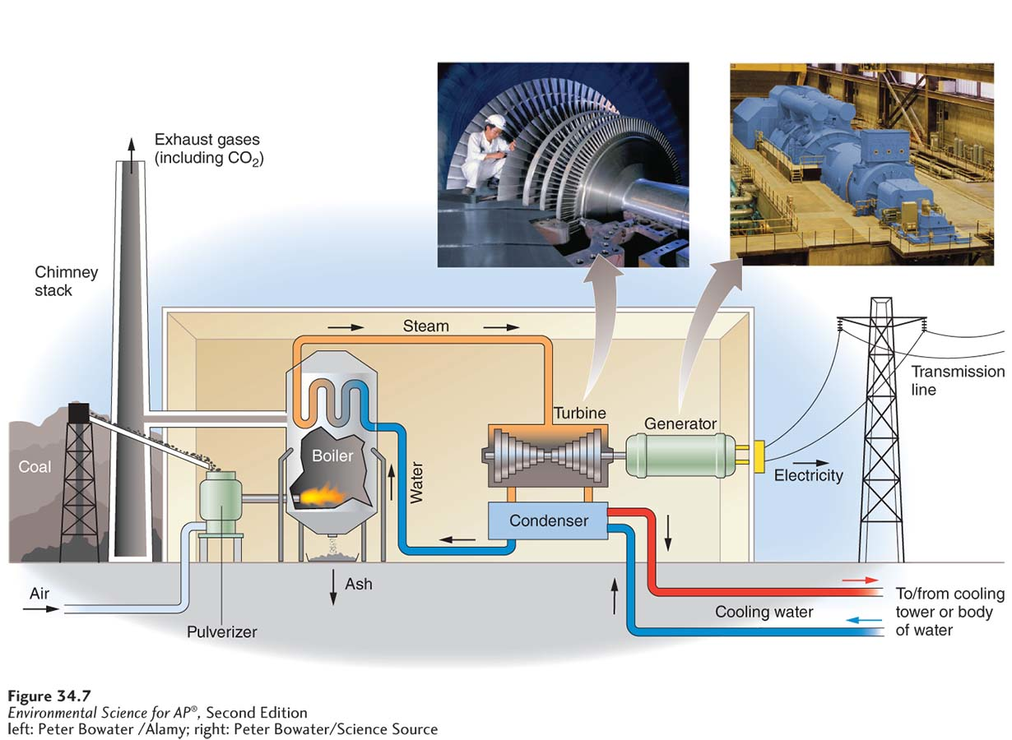
The Process of Electricity Generation
A coal-fired electricity generation plant. Energy from coal combustion converts water into steam, which turns a turbine. The turbine turns a generator, which produces electricity.

Slide 18
Efficiency of Electricity Generation
Combined cycle A power plant that uses both exhaust gases and steam turbines to generate electricity.
Capacity In reference to an electricity-generating plant, the maximum electrical output.
Capacity factor The fraction of time a power plant operates in a year.

Slide 19
Efficiency of Electricity Generation
Cogeneration The use of a fuel to generate electricity and produce heat. Also known as combined heat and power.
For example, if steam is used for industrial purposes or to heat buildings it is diverted to turn a turbine first.
This improves the efficiency to as high as 90 percent.

Slide 20
Module 35 Fossil Fuel Resources
After reading this module, you should be able to
discuss the uses of coal and its consequences.
discuss the uses of petroleum and its consequences.
discuss the uses of natural gas and its consequences.
discuss the uses of oil sands and liquefied coal and their consequences.
describe future prospects for fossil fuel use.

Slide 21
Coal is the most abundant and dirtiest of the fossil fuels
Coal A solid fuel formed primarily from the remains of trees, ferns, and other plant materials preserved 280 million to 360 million years ago.
There are four types of coal:
lignite
sub-bituminous
bituminous
anthracite.
The largest coal reserves are in the United States, Russia, China, and India.

Slide 22
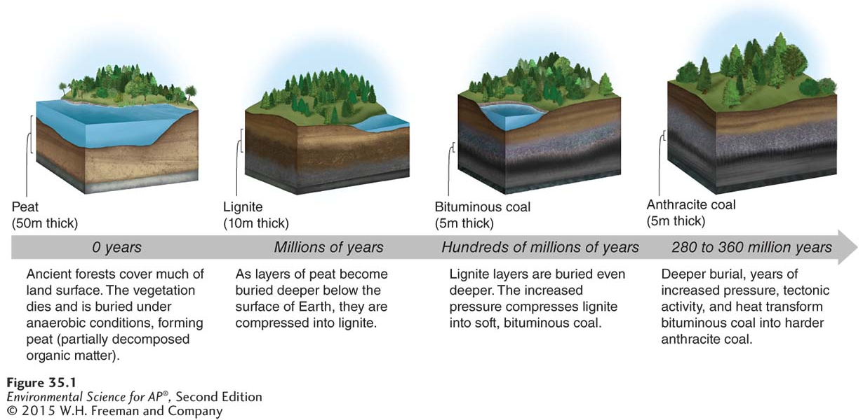
Coal
The coal formation process. Peat is the raw material from which coal is formed. Over
millions of years and under increasing pressure due to burial under more and more layers of rock and sediment, various types of coal are formed.

Slide 23
Advantages of Coal
Energy-dense
Plentiful
Easy to exploit by surface mining
Needs little refining
Inexpensive
Easy to handle and transport

Slide 24
Disadvantages of Coal
Contains impurities
Releases impurities into air when burned
Trace metals like mercury, lead, and arsenic are found in coal
Combustion leads to increased levels air pollutants
Ash is left behind, leads to possible runoff
Carbon is released into the atmosphere

Slide 25
Petroleum is cleaner than coal
Petroleum A fossil fuel that occurs in underground deposits, composed of a liquid mixture of hydrocarbons, water, and sulfur.
Crude oil Liquid petroleum removed from the ground.

Slide 26
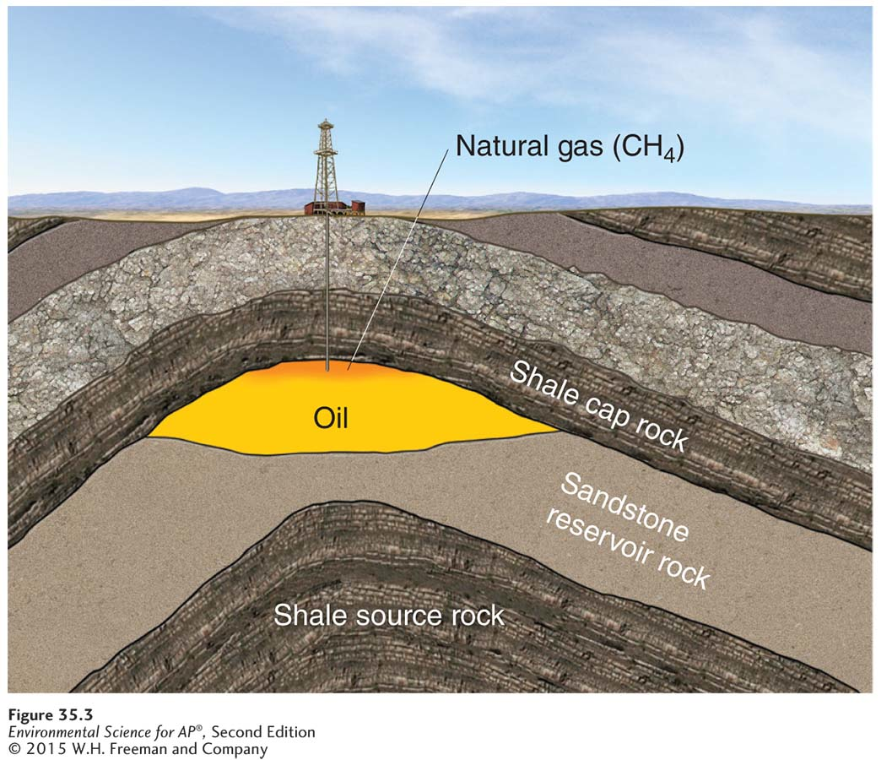
Petroleum
Petroleum accumulation underground. Petroleum migrates to the highest point in a formation of porous rock and accumulates there. Such accumulations of petroleum can be removed by drilling a well.

Slide 27
Advantages of Petroleum
Convenient to transport and use
Relatively energy-dense
Cleaner-burning than coal
Oil is used in many other applications

Slide 28
Disadvantages of Petroleum
Releases carbon dioxide into atmosphere
Possibility of leaks when extracted and transported
Runoff enters marine waterways
Releases sulfur, mercury, lead, and arsenic into the atmosphere when burned

Slide 29
Disadvantages of Petroleum
Arctic National Wildlife Refuge (ANWR):
Debates continue over the trade-off between extracting oil domestically and the consequences for habitat and species living near oil wells or pipelines.
Proponents of exploration suggest that ANWR might yield 25 million gallons to 378 billion gallons of oil and substantial quantities of natural gas.

Slide 30
Natural Gas is the Cleanest of the Fossil Fuels
Natural gas exists as a component of petroleum in the ground as well as in gaseous deposits separate from petroleum.
Natural gas contains 80 to 95 percent methane and 5 to 20 percent ethane, propane, and butane.
The two largest uses of natural gas in the United States are electricity generation and industrial processes.
Natural gas is also used to manufacture nitrogen fertilizers and in residences for heating homes and cooking.

Slide 31
Advantages of Natural Gas
Contains fewer impurities, emits almost no sulfur dioxide or particulates
Emits only 60 percent as much carbon dioxide as coal

Slide 32
Disadvantages of Natural Gas
Methane that escapes into the atmosphere is a potent greenhouse gas
Exploration for natural gas can contaminate groundwater

Slide 33
Oil sands and liquefied coal are also fossil fuels
Oil sands Slow-flowing, viscous deposits of bitumen mixed with sand, water, and clay.
Bitumen A degraded petroleum that forms when petroleum migrates to the surface of Earth and is modified by bacteria.
CTL (coal to liquid) The process of converting solid coal into liquid fuel.

Slide 34
Fossil fuels are a finite resource
Energy intensity The energy use per unit of gross domestic product.
Our energy use per capita has been dropping, but with rising population numbers, total energy use continues to rise.

Slide 35
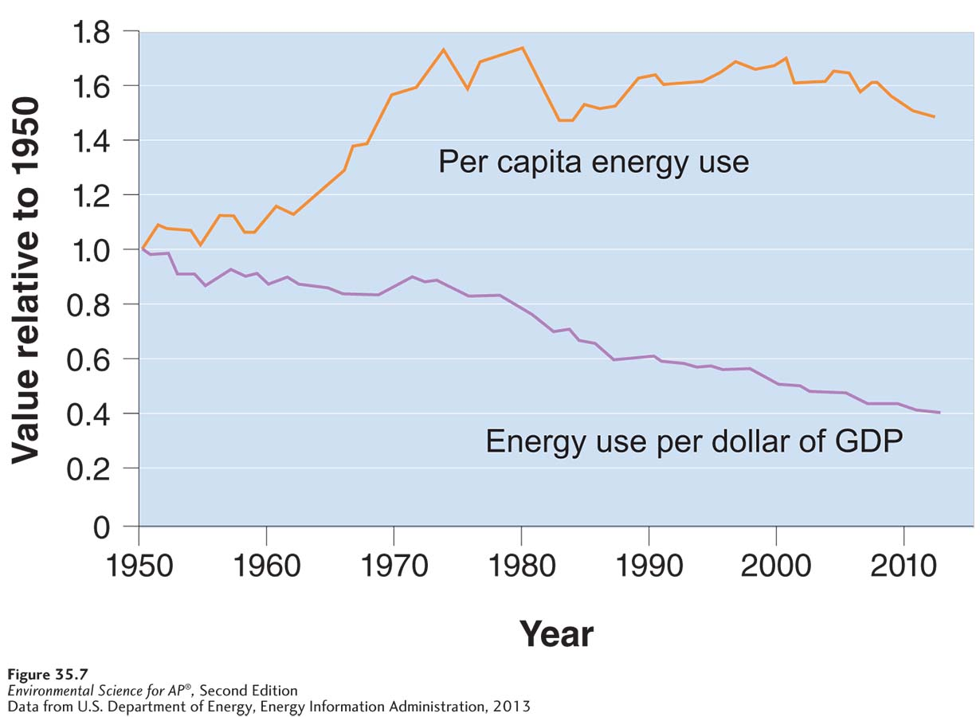
Energy Intensity
U.S. energy use per capita and energy intensity. Our energy use per capita was level and has been dropping in recent years. Our energy intensity, or energy use per dollar of GDP,
has been decreasing steadily since 1980. However, because of the increasing U.S. population, total energy use of the nation has been roughly constant between 2000 and 2012.

Slide 36
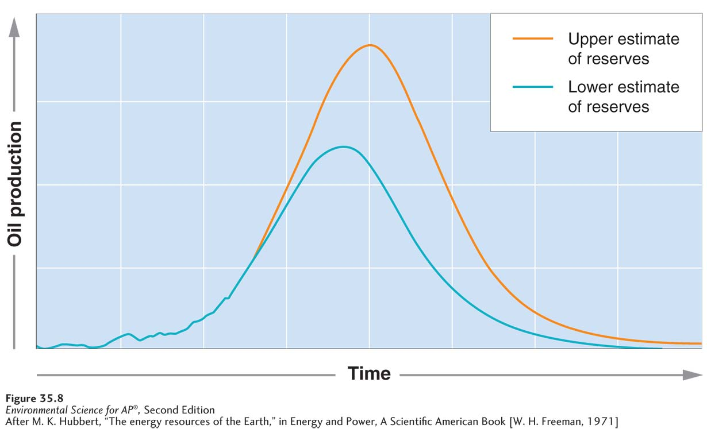
The Hubbert Curve
A generalized version of the Hubbert curve. Whether an upper estimate or a lower estimate of total petroleum reserves is used, the date by which petroleum reserves will be depleted does not change substantially.

Slide 37
The Future of Fossil Use
If current global use continues without significant additional discovery, we may run out of conventional oil in less than 50 years.
Coal supplies will last for at least 200 years, and probably much longer.
New technology and concern about the release of greenhouse gases is encouraging people to explore alternative energy sources.

Slide 38
Module 36 Nuclear Energy Resources
After reading this module, you should be able to
describe how nuclear energy is used to generate electricity.
discuss the advantages and disadvantages of using nuclear fuels to generate electricity.

Slide 39
Nuclear reactors use fission to generate electricity
Electricity generation from nuclear fuel uses uranium-235 as a fuel source.
Fission A nuclear reaction in which a neutron strikes a relatively large atomic nucleus, which then splits into two or more parts, releasing additional neutrons and energy in the form of heat.
A nuclear power plant uses heat from nuclear fission to boil water. This water produces the steam to turn the turbine, which turns a generator.

Slide 40
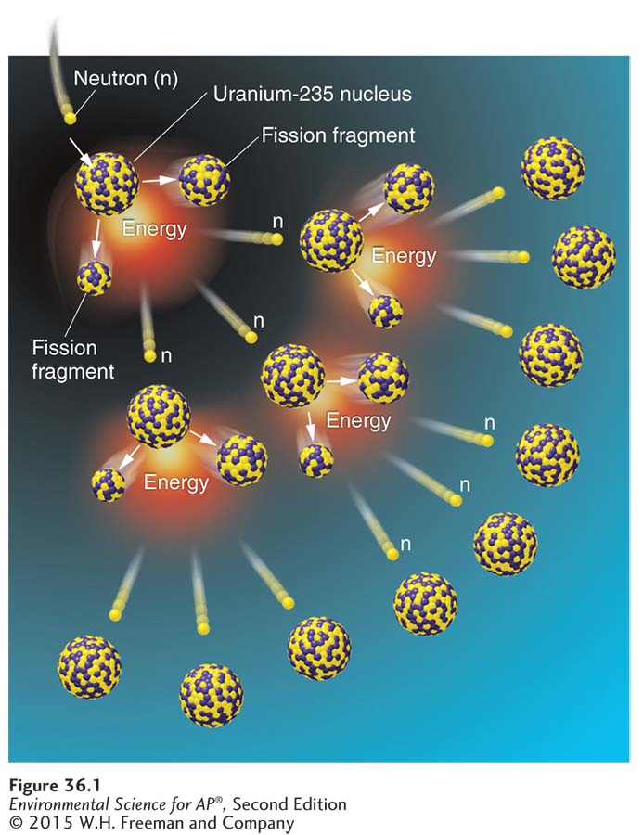
Nuclear Fission
Nuclear fission. Energy is released when a neutron strikes a large atomic nucleus, which then splits into two or
more parts.

Slide 41
Nuclear reactors use fission to generate electricity
Fuel rod A cylindrical tube that encloses nuclear fuel within a nuclear reactor.
Control rod A cylindrical device inserted between the fuel rods in a nuclear reactor to absorb excess neutrons and slow or stop the fission reaction.

Slide 42
Nuclear energy has advantages and disadvantages
Advantages:
No air pollution
Reduces need to import oil
Disadvantages:
Possibility of accidents
Difficult to dispose of waste
Concern about nuclear material being misused

Slide 43
Radioactive waste
Radioactive waste Nuclear fuel that can no longer produce enough heat to be useful in a power plant but continues to emit radioactivity.
Becquerel (Bq) Unit that measures the rate at which a sample of radioactive material decays; 1 Bq = decay of 1 atom or nucleus per second.
Curie A unit of measure for radiation; 1 curie = 37 billion decays per second.

Slide 44
Radioactive Waste
High-level radioactive waste comes from used in fuel rods.
Low-level radioactive waste is found on the protective clothing, tools, rags, and other items used in routine plant maintenance.
Uranium mine tailings are the residue left after uranium ore is mined and enriched.
In each case, disposal must be handled with great care.

Slide 45
Fusion Power
Nuclear fusion A reaction when lighter nuclei are forced together to produce heavier nuclei.
Nuclear fusion powers the Sun and other stars.
Fusion is a promising, unlimited source of energy in the future, but so far scientists have had difficulty containing the heat that is produced.

Slide 46
