Slide 1
Weathering, Erosion, and Soil
Chapter 7

Slide 2
Section 7.1 Weathering
Weathering is the process by which rocks on or near Earth’s surface break down and change.
Erosion is the removal and transport of weathered material from one location to another.
These two processes have been occurring for millions of years, constantly changing the surface of the Earth.

Slide 3
Types of Weathering
Two Types of Weathering:
Mechanical (Physical)
Chemical

Slide 4
Mechanical Weathering
Also called physical weathering
Process by which rocks and minerals break down into smaller pieces
No change in rock composition
Definite change in size and shape
Occurs mostly where it is cool and dry

Slide 5
Factors that affect Mechanical Weathering
Temperature – Water can freeze and expand in the cracks of rocks (Frost Wedging)
Pressure – All of the pressure from bedrock above layers, when removed, can expand forming long cracks in the bedrock
Exfoliation – the process by which outer rock layers are stripped away
Tree and Plant Roots – wedge into cracks of rocks and cause them to split
Notes:
Pot holes
Trees roots are an example of pressure

Slide 6
Chemical Weathering
Process by which rocks and minerals undergo changes in their composition as the result of chemical reactions
Reactions result in the formation of new minerals and release of dissolved substances
Results in new chemical composition
Occurs greatest where it is warm and wet

Slide 7
Agents that affect Chemical Weathering:
Water – the reaction of water with other substances is called hydrolysis
Oxygen – The chemical reaction of oxygen and other substances is called oxidation
Carbon Dioxide – combines with water in the atmosphere to form weak carbonic acid which dissolves calcite found in limestone and other minerals
Acids – caused mainly by the oxidation of sulfur dioxide and nitrogen oxides emitted by cars. (Many times this leads to acid rain.)

Slide 8
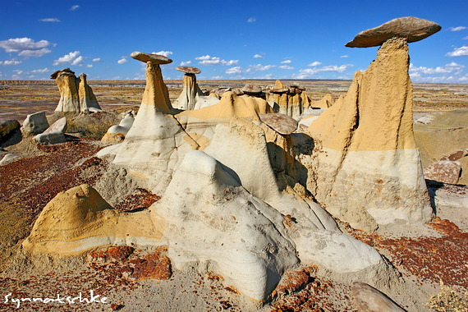
What affects the rate of Weathering?
Climate
Rock Type and Composition
Surface Area
Topography and Other Variables

Slide 9
Climate
Rock Type and Composition
Climate affects areas of precipitation, temperature, and evaporation
Chemical Weathering occurs greatest in warm/wet climates
Mechanical Weathering occurs greatest in cool/dry climates
Characteristics of rocks, including how hard or resistant they are, depends on their type and composition.
Sedimentary rock are more easily weathered than igneous or metamorphic rocks

Slide 10
Surface Area
Topography / Other Variables
Mechanical weathering breaks rocks into smaller pieces.
As these pieces get smaller, their surface area increases.
As result, more surface area is available for chemical weathering.
So, the greater the surface area… the more weathering occurs
Materials on level surfaces remain in place as they undergo changes.
Materials on sloped surfaces tend to move as result of gravity.
As materials move downward, they expose underlying rock surfaces and provide more opportunities for weathering to occur.
Animals also increase weathering through the release of carbon dioxide during decay.
Living plants release carbon dioxide as well, which combines with water to produce acid.

Slide 11
Section 7.2 Erosion and Deposition
As noted previously, erosion is the process that transports the Earth’s materials from one place to another.
At some point, the movement of materials slows and the minerals are “dropped” in a new location (deposition).
Gravity is a huge factor in many erosional agents, such as streams and glaciers, because the force of gravity pulls materials downslope.

Slide 12
Erosional Agents
Water
More power to move large particles than most winds.
Greater the volume of water, the more material that can be eroded.
The steeper the slope, the increase of erosional ability
Much erosion takes place every day within the ocean

Slide 13
Glacial Erosion
Although glaciers cover less than 10% of the Earth’s surface, their erosional effects are large-scale and dramatic.
They scrape out and gouge large sections of landscape.
They are so powerful, they have the ability to pick up large rocks and move them over great distances.

Slide 14
Wind Erosion
Major erosional agent in areas on Earth that experience limited precipitation and high temperatures.
As result, these areas have minimal vegetation cover, so there is little to hold soil in place.
This allows wind to easily pick up and transport these fine, dry particles.
The effects of wind erosion can be damaging and dramatic, although wind erosion is relatively insignificant to erosion by water and glaciers.

Slide 15
Erosion by Plants, Animals, and Humans
Plants, animals and humans all have activities in their daily lives that affect and move Earth’s materials from one place to another.
For example, plants move surface materials as they carry on their life process (roots grow). Animals burrow into soil – relocating the Earth’s materials. Humans relocate soil every time they plant a garden or build a new development

Slide 16
Section 7.3 Formation of Soil

Slide 17
Soil is the loose covering of broken rock particles and decaying organic matter, called humus, overlying the bedrock of the Earth’s surface.
Soil is the result of mechanical and chemical weathering over long periods of time. Found almost everywhere on Earth, supporting many life forms.
During soil development, layers form…
Horizon A
Horizon B
Horizon C
Parent Material / Bedrock

Slide 18
Soil Development A Step by Step Process
The soil forming process begins when weathering breaks solid bedrock into smaller pieces.
Pieces then continue to undergo weathering and break down into smaller and smaller pieces.
Many organisms (bacteria included) begin to live in these weathered materials.
Over time, the organisms die, decay, and add nutrients to the weathered materials to form soil, such as dead fungi, bacteria, and protozoa.
In general, soil formation occurs over a long period of time. It can take hundreds of years for only a centimeter of soil to form.

Slide 19
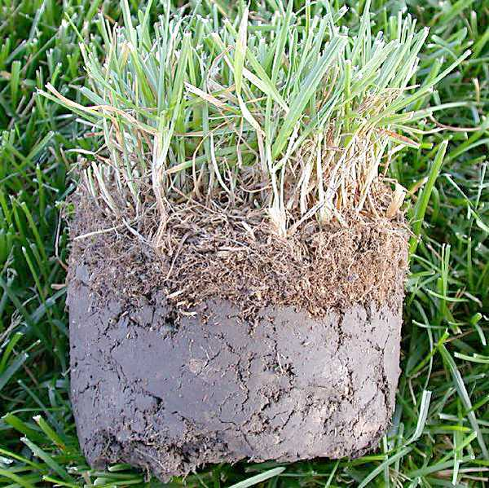
Soil Composition
While the parent bedrock determines the type of minerals in a soil, the proportion of minerals may not be the same.
Differences may occur as the result of chemical weathering.
The length of time it takes for soil to form also depends on the type of parent rock, as well as the climatic conditions of an area.
Soil located above it’s parent material is called residual soil.
Soil that has been moved to a location away from its parent bedrock is called transported soil.

Slide 20
Soil Profiles
Soil Profile: Vertical sequence of soil layers
Soil Horizon: A distinct layer within a soil profile
Horizon A - Lots of organic matter, darkest and richest… “topsoil”
Horizon B - Subsoils enriched with clay minerals, red or brown
Horizon C - Contains weathered parent materials, just above the bedrock
Soils tend to be thin, coarse, and infertile on slopes, and tend to be thick and fertile in valleys.

Slide 21
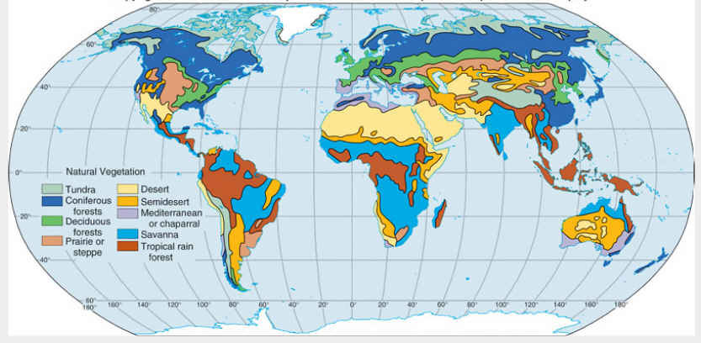
Types of Soil
Four major types of soil around the world:
Polar
Temperate
Desert
Tropical

Slide 22
Polar
Temperate
Form at high latitudes and high elevations
Good drainage
No distinct horizons
Very shallow (sometimes only a few cm deep)
Permanently frozen (permafrost)
Found in Greenland, Canada, and Antarctica
Vary greatly
Able to support diverse environments (forests, grasslands, prairies)
Most experience annual rainfall amounts of 50-60cm per year
Can be thick and fertile
Can be Aluminum rich
Found in Eastern USA, Northern Europe, Eastern Australia

Slide 23
Desert
Tropical
Low levels of precipitation – less than 25 cm per year
High level of accumulated salts
Can only support limited amount of vegetation
Little or no organic matter and very thin A Horizon
Abundant nutrients
Light-colored, coarse
May contain salts and gypsum
High temperatures and heavy rainfall
Intensely weathered , often infertile
High degree of bacterial activity
Little humus and few nutrients
High concentrations of iron and aluminum
Red color due to iron oxidation
Poor growth conditions but high grade iron ore
Brazil, Australia, Jamaica

Slide 24
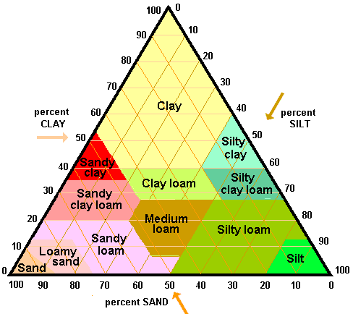
Soil textures are classified by the size of the particle, from very coarse sand to fine clay.
Soil fertility is a measure of how well a soil can support the growth of plants
Soil color is determinate of the climate in which it develops as well as the composition of the soil. Color alone is unreliable in determination of fertility of the soil

