Slide 1
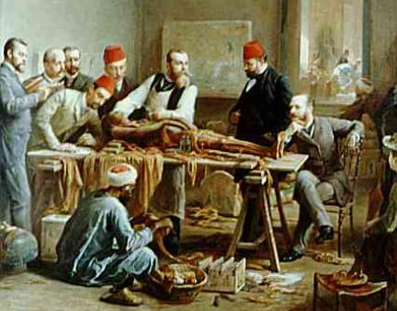
Introduction to Human Anatomy and Physiology (Chapter 1)
Notes for these slides can be printed.
Notes:
To edit slides, download a copy to your own drive.

Slide 2
In 2007, Kati Mori took part in the London Marathon – her fourth, and the hottest on record, with temperatures peaking at 75 F. Conscious of the repeated advice to maintain fluid intake, she took frequent drinks at the water stations along the route.
By the 18th mile, Kati felt bad but was determined to finish, Near the end, she needed help from other runners to stay upright; hours later she was in the hospital, suffering from severe diarrhea, headache, vomiting and increasing confusion, with her legs endlessly mimicking a running motion. “I thought I was still in the marathon,” she says.
Essential Question: What happened to Kati Mori at the London Marathon?
Notes:
Science Practice 8: Constructing Explanations; HS-LS1-3 Plan and conduct an investigation to provide evidence that feedback mechanisms maintain homeostasis.

Slide 3
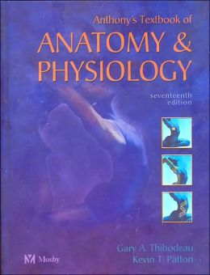
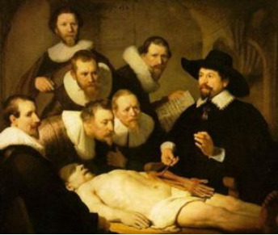
Anatomy – the structure of body parts (also called Morphology)
Physiology – the function of the body parts, what they do and how they do it
The structure determines the function.

Slide 4
Characteristics of Living Things
1. Movement - self initiated change in position, motion of internal parts
2. Responsiveness - Ability to sense changes and react to them
3. Growth - increase in body size
4. Reproduction - Parents produce offspring / passing DNA to new individuals
5. Respiration - Obtaining oxygen (O₂), using it to release energy from food substances, and getting rid of wastes

Slide 5
6. Digestion - Chemically changing (breaking down) food substances, and getting rid of wastes
7. Absorption - Passage of Digested products (food substances) through membranes and into body fluids
8. Circulation - Movement of substances throughout the body
9. Assimilation - Changing absorbed substances into chemically different substances
10. Excretion - Removal of wastes

Slide 6
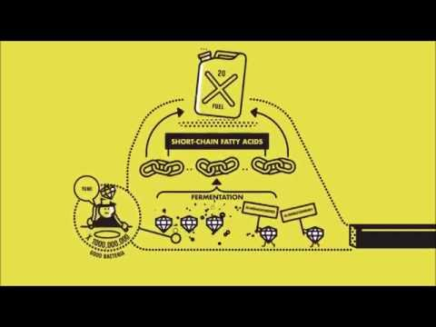
Why do beans make you fart?
Which life processes we discussed are shown in this short video?
Notes:
http://vimeo.com/103721959 / new location added: https://youtu.be/Ad476vgzDmo

Slide 7
Review the list of life processes and consider Kati Mori’s symptoms.
Choose three of the processes that you think might be related.

Slide 8
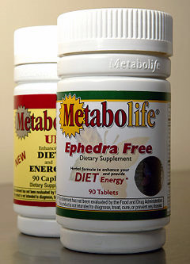
Metabolism = all the chemical changes that occur in the body to maintain life.
Ultimately all of these processes require ENERGY
How do we obtain energy?

Slide 9
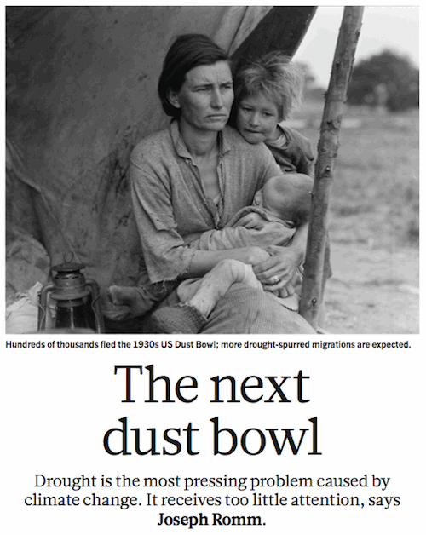
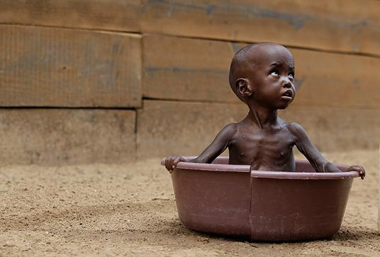
Bodily needs = food, oxygen, water, heat, pressure

Slide 10
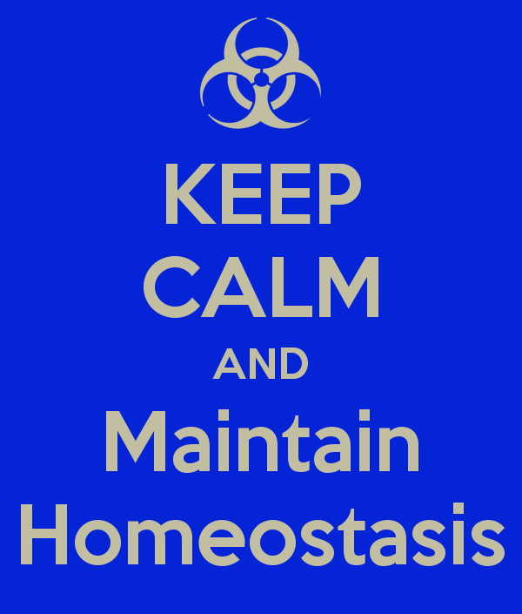
Homeostasis = tendency of the body to maintain a stable, balanced, internal environment. “Sameness”
Energy is required to keep the body in working order. Where does this energy come from?

Slide 11
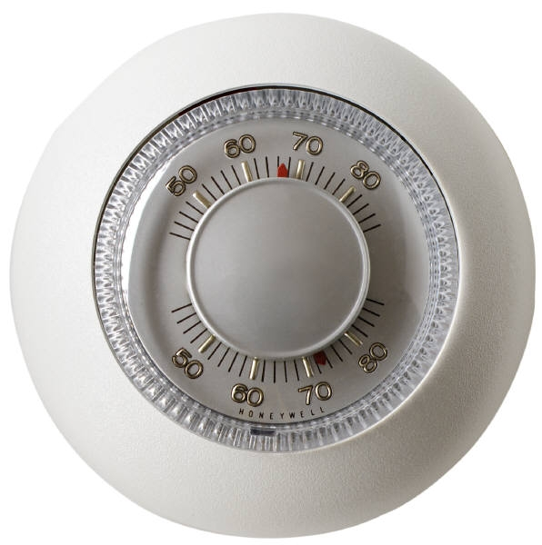
How does a negative feedback loop maintain homeostasis?
Receptors – detect certain environmental parameters within the body such as temperature, information is relayed to the brain
Set point – the normal range that an environmental parameter is to be controlled
Effectors – muscle or glands that respond to deviation from the set point. Glands might initiate sweating to cool the body back to its set point.

Slide 12
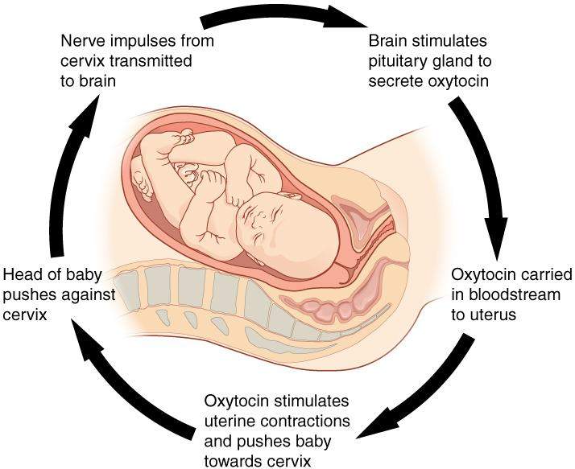
How does a positive feedback loop maintain homeostasis?
As the baby suckles on the nipple there is a nerve response into the spinal cord and up to the brain, which then stimulates the pituitary gland to produce more prolactin to produce more milk
Positive feedback loops amplify or increase the occurrence of events.
Homework: Feedback Loops

Slide 13
When Kati arrived at the hospital, doctors immediately began to take data on her vitals.
Vital Signs | Normal | Kati
Respiration | 12-20 bpm | 11
Heart Rate | 60-100 bpm | 75
Pulse Oxygen | 95-100% | 98%
Serum Sodium Levels (urine) | 135-145 mEq/L | 95
Which vital sign provides a clue to Kati’s problem?

Slide 14
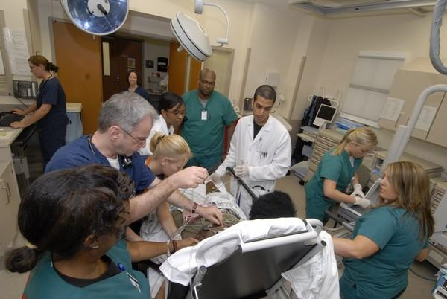
When Kati arrived at the hospital and doctors began to collect information, they discovered that she weighed 128 lbs. Oddly, when she checked in to the race, she weighed 126 lbs.
The doctor suggests that Kati might have “hyponatremia.”
What do you think that is?

Slide 15
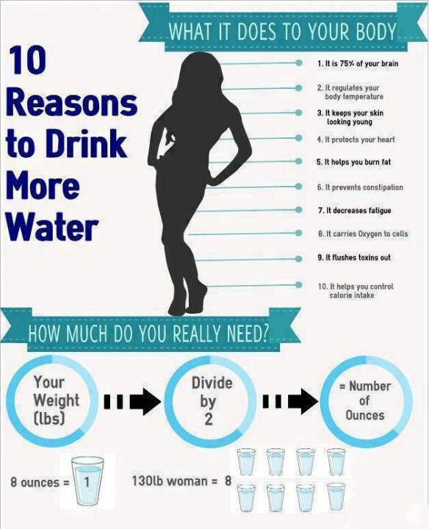
In cases of water intoxication, it is extreme hyponatremia that can ultimately cause coma and death.
The doctor orders a drug that increases urination. Kati is able to clear the extra water from her body and recovers.
How does Kati’s story relate to HOMEOSTASIS?
Which of the 10 life processes were compromised in Kati’s situation?

Slide 16
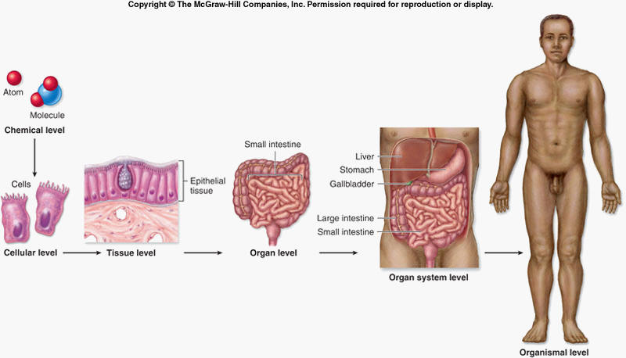

Slide 17
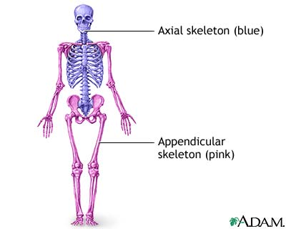
General Organization of the Body
Axial Portion - head, neck, trunk
Appendicular Portion - arms & legs
(VISCERA = internal organs. "Visceral organs")

Slide 18
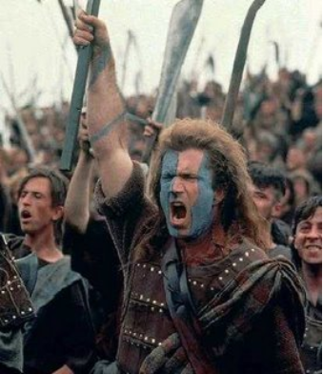
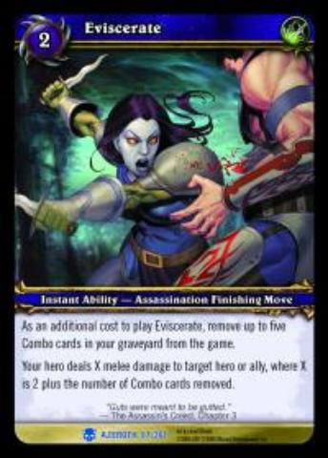
EVISCERATE
Popular in horror movies and games
Photo Source: https://www.flickr.com/photos/pietroizzo/7478162336/in/photostream/

Slide 19
Body Cavities
Dorsal = back side
Ventral = front side
Thoracic = chest (heart, trachea, lungs..)
Abdomen = stomach area (spleen, intestines)
Pelvic = lower abdomen (bladder, reproductive organs)
DIAPHRAGM: Separates the thoracic and pelvic region

Slide 20
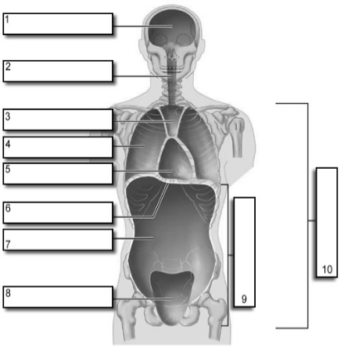
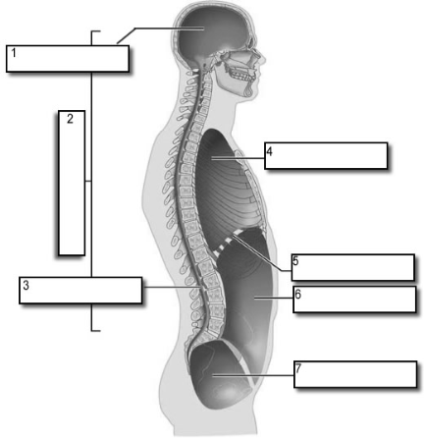
It's easier to visualize the body cavities on pictures

Slide 21
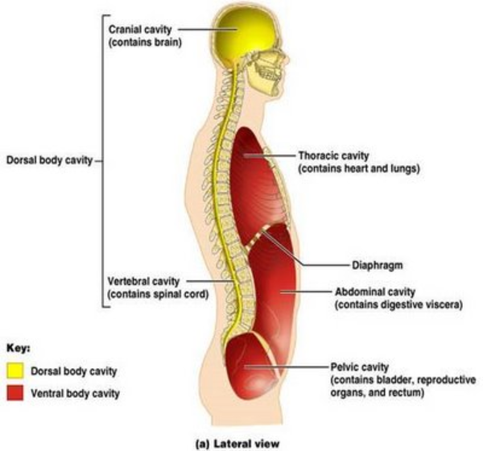

Slide 22
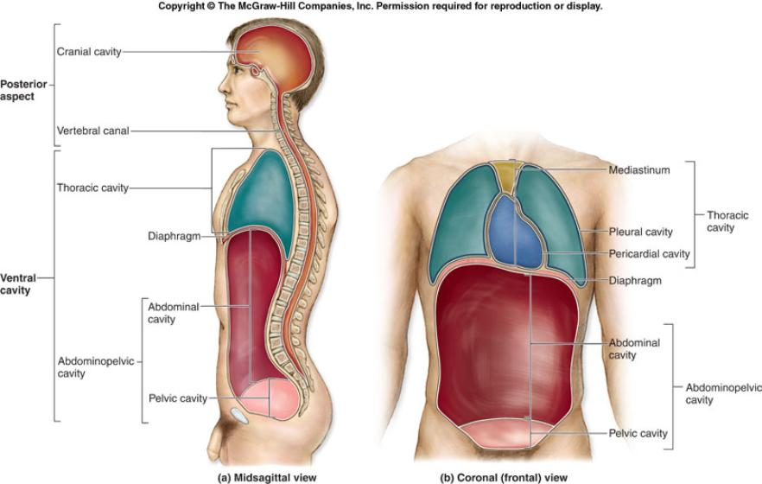

Slide 23
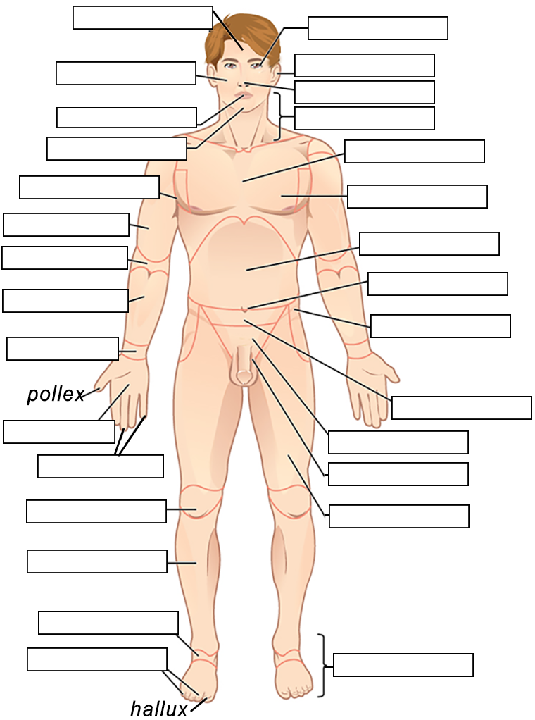
Body Regions - each area of the body has a name, which is used to label structures nearby
Example: Brachial region = the upper arm
The brachial artery is found in the center of the arm
Label the body regions using the descriptions provided.
Student Handout: https://www.biologycorner.com/anatomy/intro/bodyregions_label.html

Slide 24
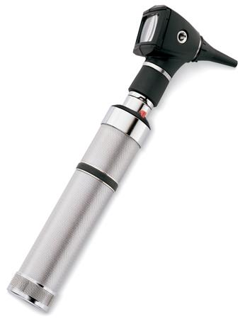
How to Learn the Body Regions
Try to associate the words with something you already know.
Brachial
Cervical
Femoral
Orbital
Pedal
Pectoral
Cephalic
This is an OTOSCOPE

Slide 25
MEMBRANES
Serous Membrane - two layers, covers organs
Outer layer = parietal
Inner layer = visceral (lines the organs)
Serous fluid – lubricating fluid

Slide 26
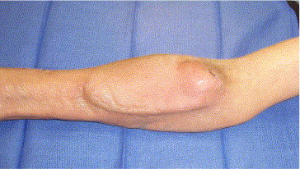
A seroma is a pocket of clear serous fluid that sometimes develops in the body after surgery. This fluid has seeped out of ruptured small blood vessels and fluid produced by the injured and dying cells.

Slide 27
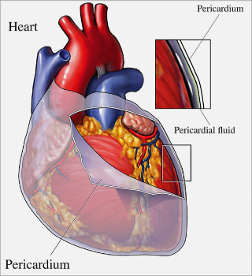
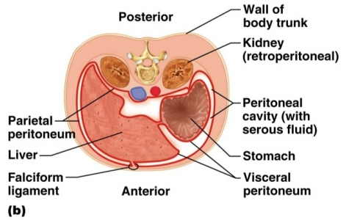
Other Membranes
Pleura = lungs
Pericardium = heart
Peritoneum = organs (abdominopelvic region)

Slide 28
Visceral and Parietal always mean the same thing.
Visceral points toward the guts Parietal points toward the outside
Visceral Pleura Parietal Pleura
Visceral Pericardium Parietal Pericardium
Visceral Peritoneum Parietal Peritoneum
LUNGS
HEART
INTESTINES

Slide 29
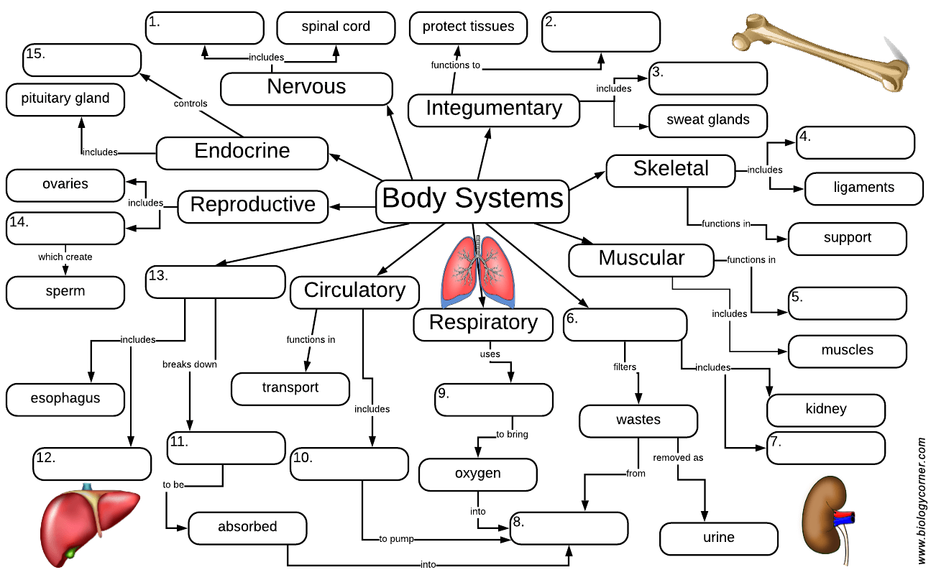
Organ Systems
1. Integumentary
2. Skeletal
3. Muscular
4. Nervous
5. Endocrine
6. Digestive
7. Circulatory
8. Lymphatic
9. Urinary
10. Reproductive 11. Respiratory
-How does each help maintain homeostasis?
-Which systems were involved in Katie’s problem?
Assignment: Organ Systems Concept Map

Slide 30
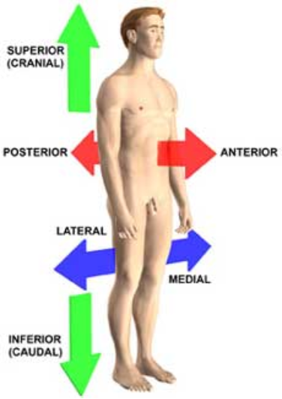
Anatomical Terminology Anatomical Position = standing erect, face forward, arms at side, palms facing forward
Superior / Inferior
Medial / Lateral
Proximal / Distal
Dorsal / Ventral
Anterior/ Posterior
Sagittal | Transverse | Frontal (coronal)
Superficial / Deep

Slide 31
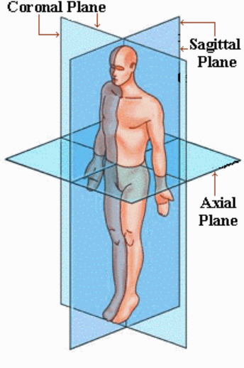
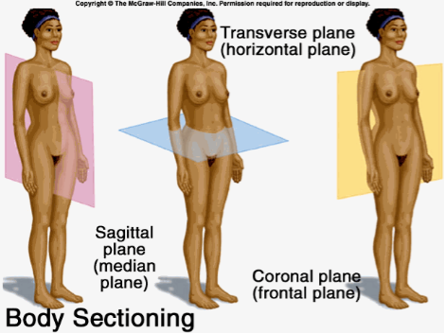

Slide 32
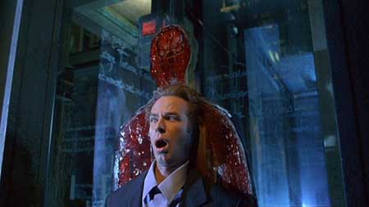
A really sharp pane of glass fell on this unfortunate character.
From the movie “Thirteen Ghosts” - What kind of cut is this?

Slide 33
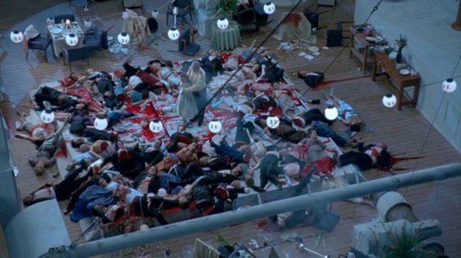
Unfortunate passengers on “Ghost Ship.”

Slide 34
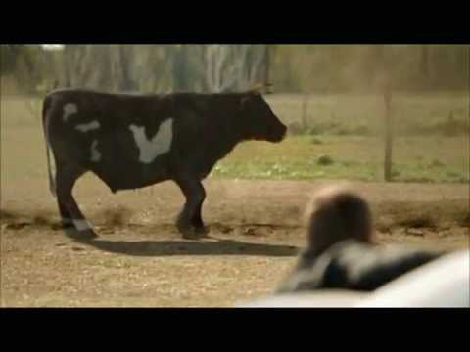
What kind of cut is this?

Slide 35
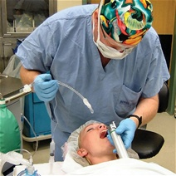
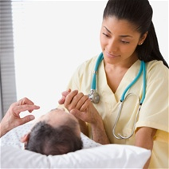
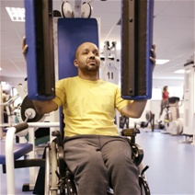
There are tons of careers, some of them only require a short term of training. What are your goals?
See Explore Health Careers
Homework: Medical and Applied Science

