Slide 1
2. Connective Tissue
-Most abundant tissue in your body, found throughout -Binds structures together -Provides support, protection, framework, fills space, stores fat, produces blood cells, fights infection
-Composed of more scattered cells within matrix -Made up of a ground substance and fibers -Most have a good blood supply -Cells can reproduce

Slide 2
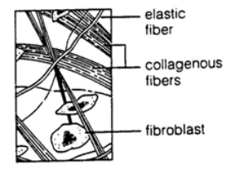
Types of Cells in Connective Tissue
Mast cells (prevents clots)
Macrophages (consumers)
Fibroblasts (produce fibers)
Main types of fibers
Collagenous = bones, ligaments, tendons
Elastic = ears, vocal cords

Slide 3
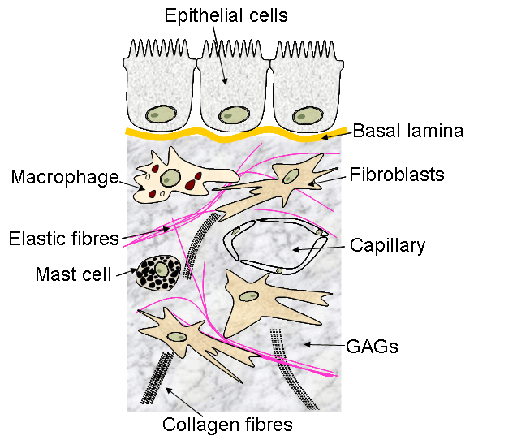
The MATRIX
Basement Membrane
Ground substance

Slide 4
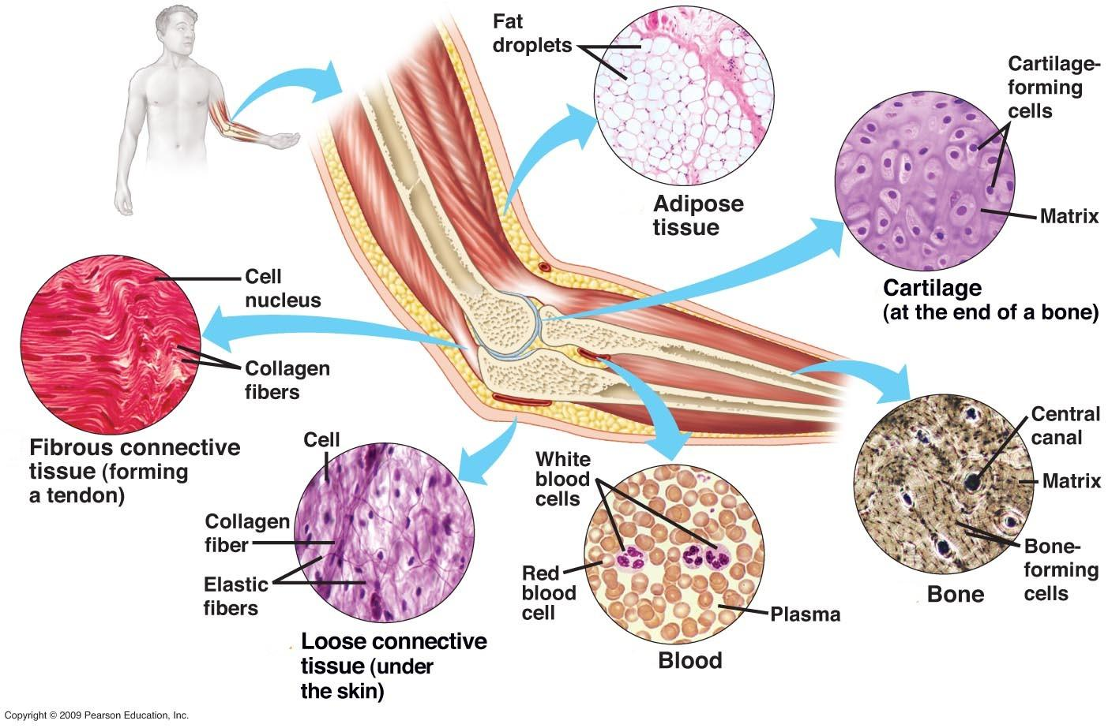
Categories of Connective Tissue

Slide 5
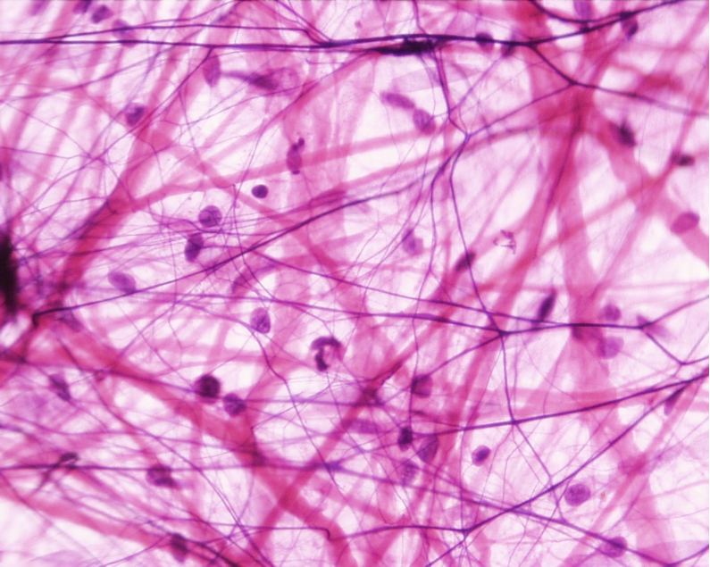
A. Loose Connective Tissue or Areolar Tissue
Binds underlying organs to skin and to each other
Forms delicate thin membranes throughout the body

Slide 6
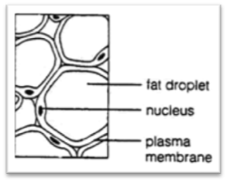
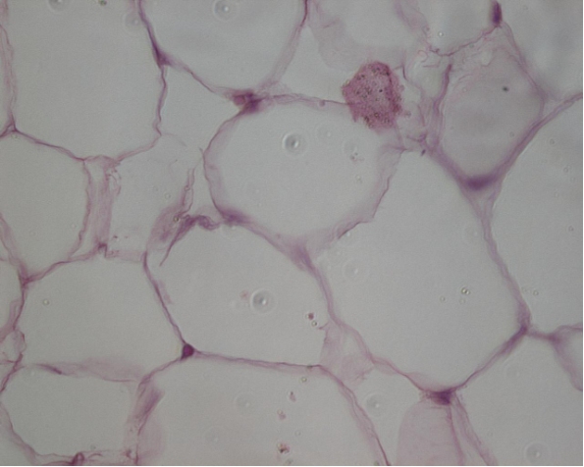
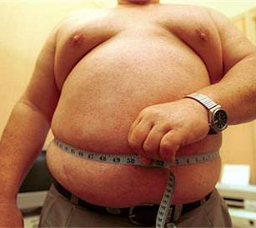
B. Adipose Tissue (fat)
Protective cushion
insulation to preserve body heat
Stores energy.

Slide 7
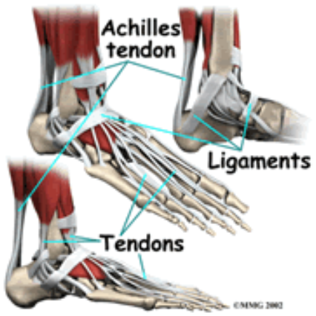
C. Fibrous Connective Tissue
Tendons = muscles to bones
Ligaments = bones to bones

Slide 8
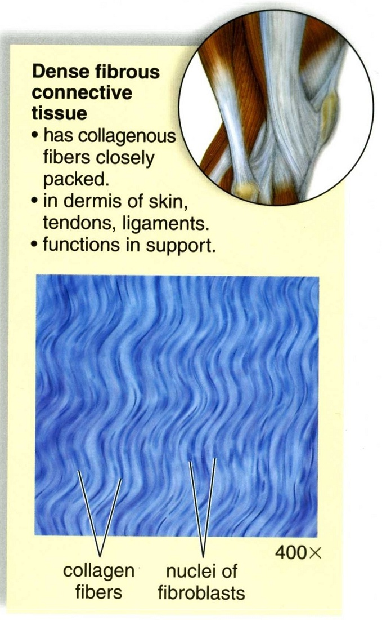
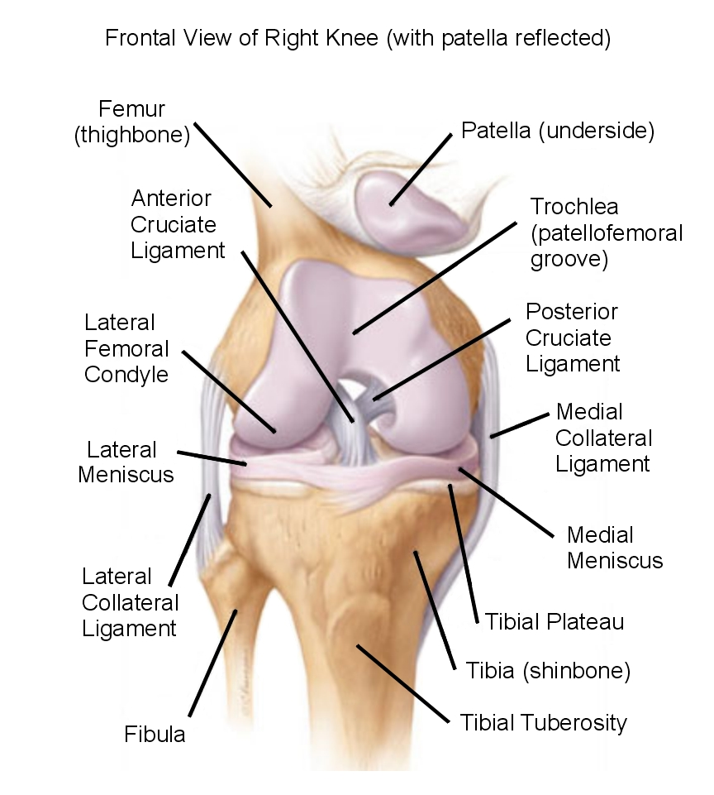

Slide 9
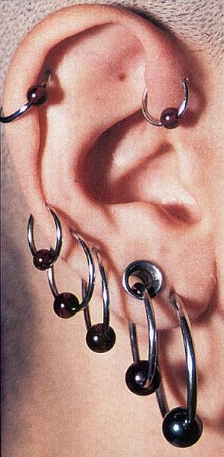
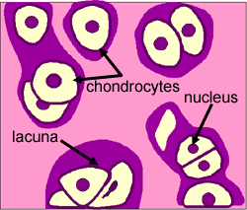
D. CARTILAGE
Cartilage cells are called chondrocytes
Cartilage is a type of “DENSE CONNECTIVE TISSUE”

Slide 10
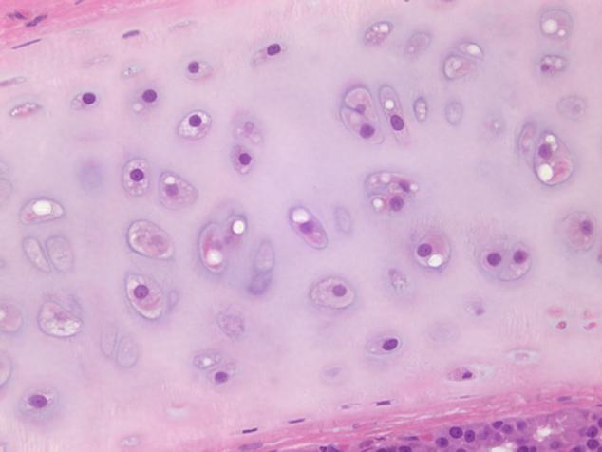
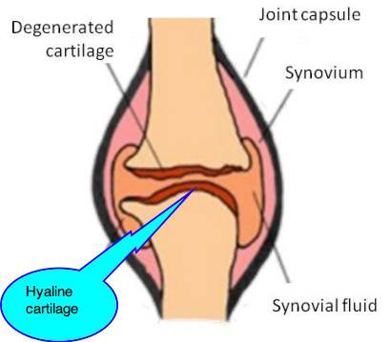
Hyaline Cartilage
Location: covers ends of joints, nose and respiratory passages, serves as padding

Slide 11
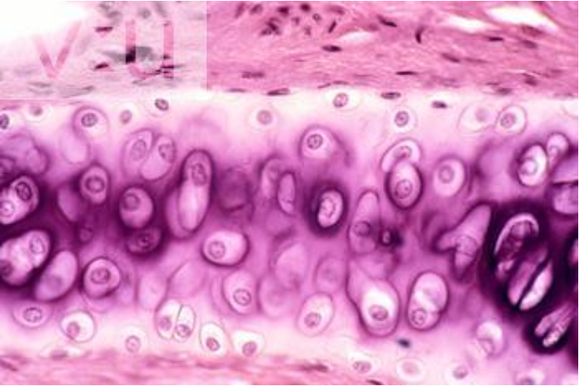
Hyaline cartilage

Slide 12
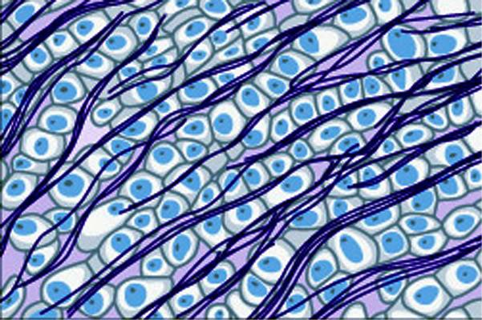
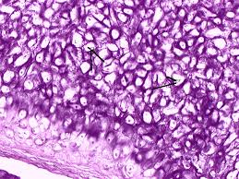
Elastic cartilage
Location:External Ear and Larynx

Slide 13
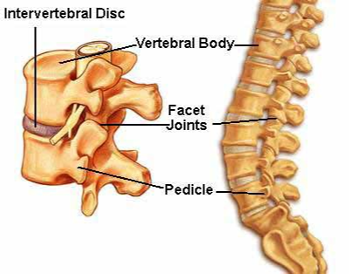
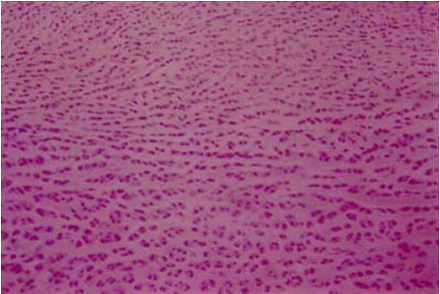
Fibrocartilage
Tough, shock absorbing Location: Between vertebrae

