Slide 1
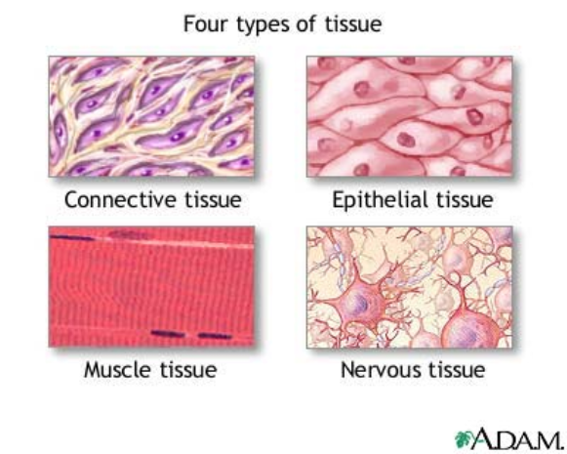
Tissues

Slide 2
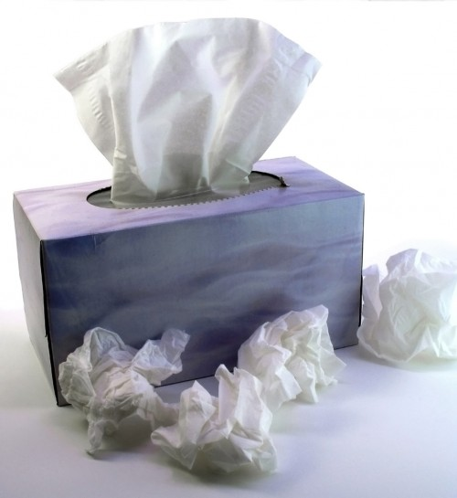
Tissue - a group or mass of similar cells working together to perform common functions.
And this type.....

Slide 3
Epithelial Tissue
- Covers all body surfaces both inside and out. - Main glandular (glands) tissue. - Attached to underlying connective tissue at the basement membrane - Usually has no vascular tissue - blood supply - Cells reproduce rapidly, results in rapid healing. - Cells tightly packed together
If a girl weighs 100 pounds. How much of her weight is skin?

Slide 4
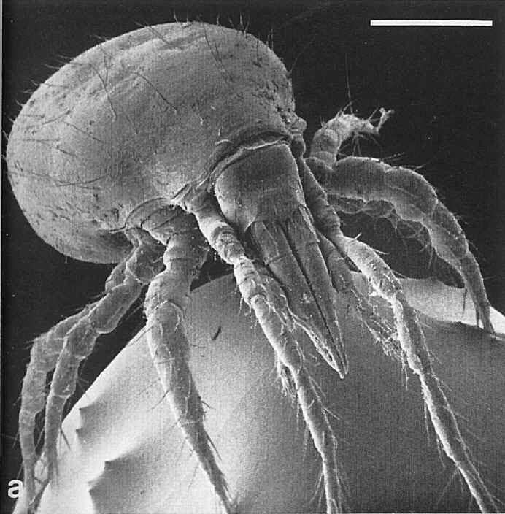
Where does all the dead skin you shed go?
It takes about 27 days for the outer layer of skin to shed and be replaced; that works out to 1.5 pounds of skin cells per year.
Notes:
DUST!!!!

Slide 5
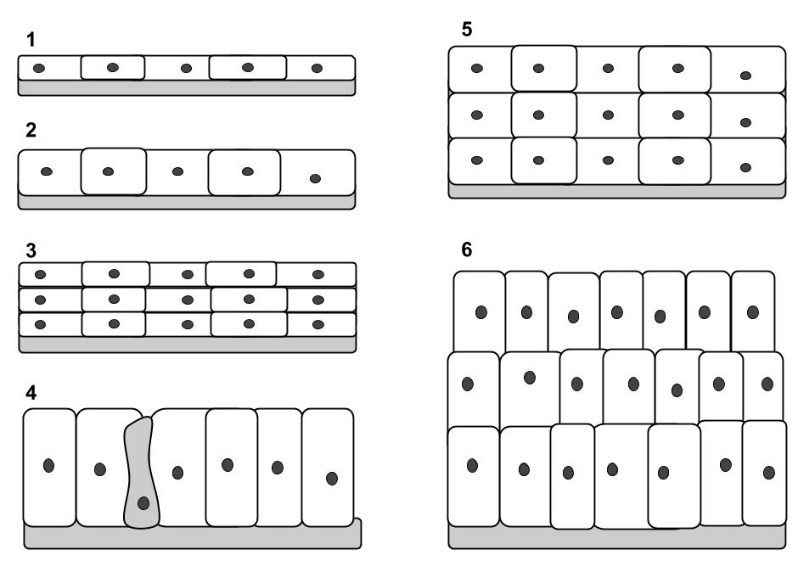
Epithelial Tissue
Functions:
Protection
Secretion
Absorption
Excretion
Sensory perception
Categorized based on the shape of the cells and the layers of cells.

Slide 6
Epithelial tissue
Naming is based on description
simple = single layer
stratified = multiple layers
squamous = flat
cuboidal = square
columnar = column (rectangle)
One type of tissue can be arranged in different forms, each form has a different function.

Slide 7
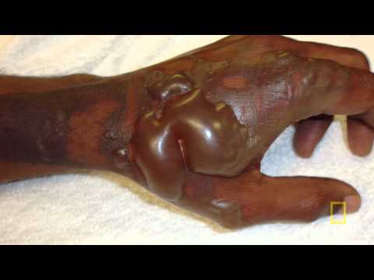
The skin is considered the largest organ of the body. Replacing it takes time, and burn victims are at risk of infection because they have no protection.

Slide 8
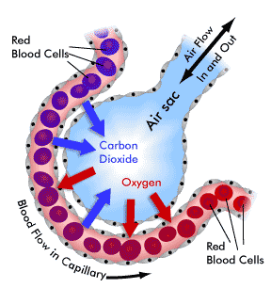
A. Simple Squamous
Simple Squamous
Tissue
All epithelial tissue has a layer at the bottom called the:
BASEMENT MEMBRANE
Form: Single layer, Flat and thin
Function: diffusion and filtration. Air sacs in lungs, capillaries

Slide 9
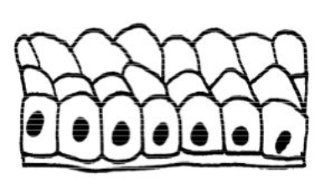
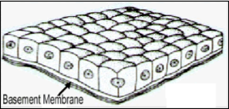
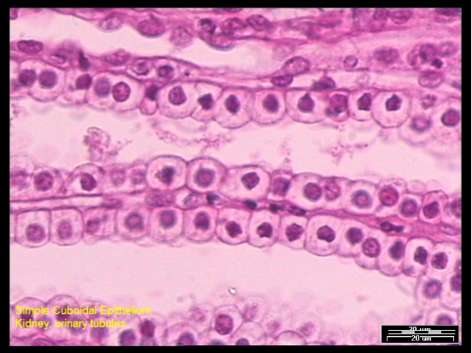
B. Simple Cuboidal
Function: Secretion and absorption
Found in kidneys tubules, ducts and covering the ovaries

Slide 10
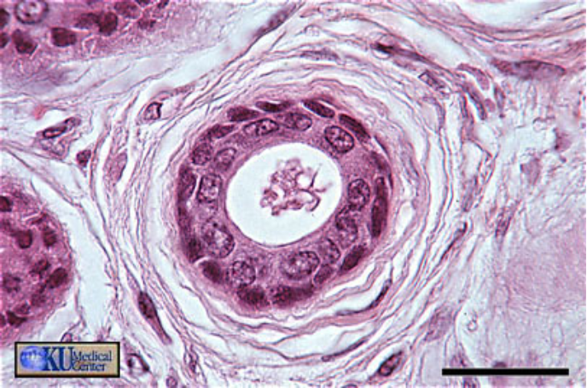
Stratified cuboidal epithelium

Slide 11
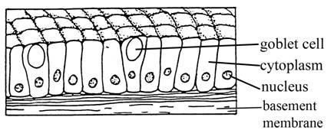
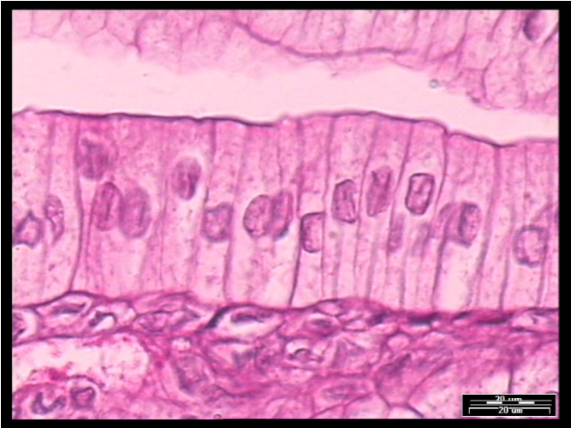
C. Simple Columnar
Function: Secretion and absorption
Found in digestive tract and uterus
*Contains scattered goblet cells to secrete mucus
*Can have microvilli to increase surface area

Slide 12
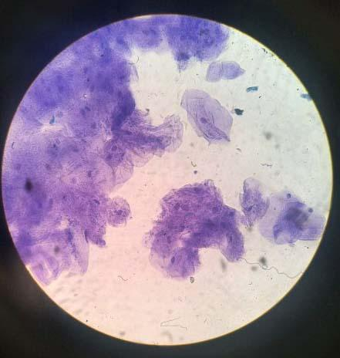
D. Stratified Squamous
Multi layer squamous, functions in protection
Found lining body cavities; skin and mouth

Slide 13
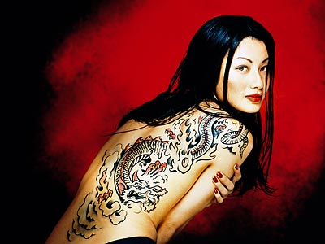
The ink of tattoos must be injected below the basement membrane.
Notes:
Tattoos are permanent because they must be inserted below the basement membrane

Slide 14
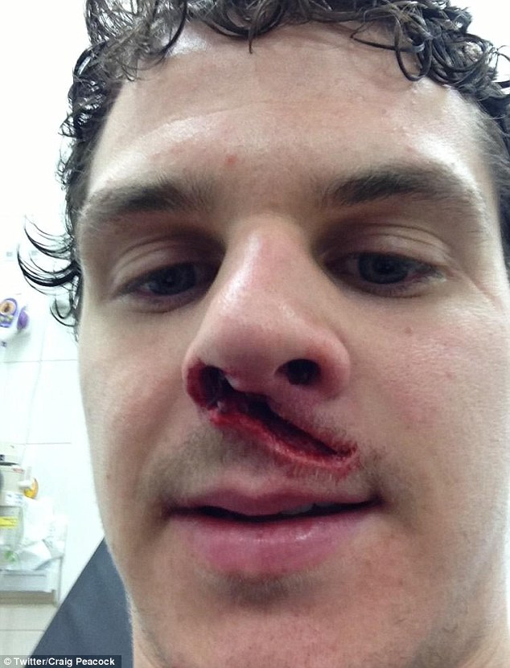
Tissues often come in layers on the body -
cuts on the skin may need to be stitched if they also go through the underlying tissue.
*This injury was caused during a hockey game, from a ice skate.

Slide 15
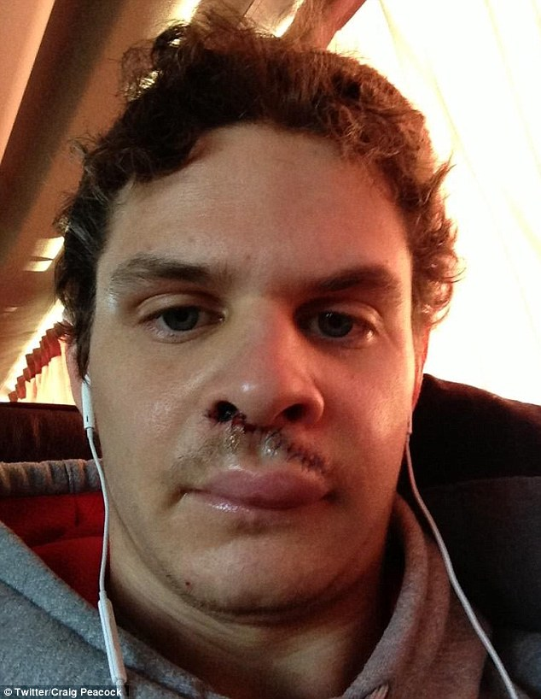
Stitches are also called SUTURES and they hold the tissue together while the body heals.
Alternatives to sutures:
Glue
Medical Tape
Staples
A British ice hockey star, Craig Peacock has made a miraculous recovery after suffering a gruesome facial injury when he took an ice-skate blade to the face.

Slide 16
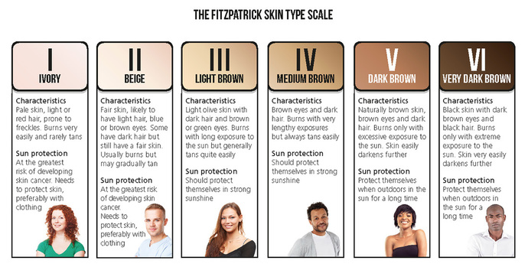
Skin also provides a barrier to UV radiation.
Take this test to determine your skin type.

Slide 17
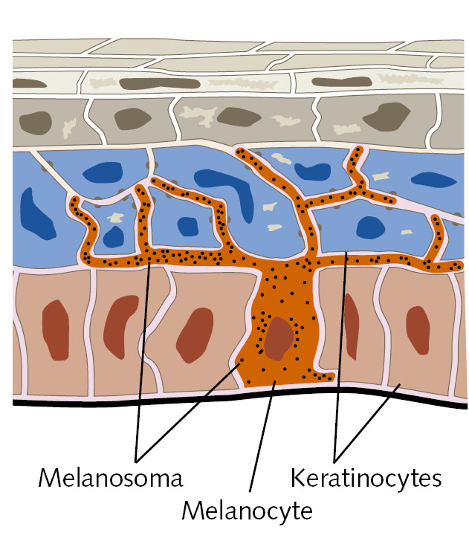
Check out this animation: (4 minutes)
How Do We Get Our Skin Color?
HHMI How We Get Our Skin Color (Interactive)
1. What are the three main layers of skin? 2. What are the two main cells found in the epidermis? 3. What is melanin? 4. How does melanin protect cells? 5. How does sunlight cause tanning?
Check out this video: HHMI: The Biology of Skin Color (18 min) which explains the evolution of skin color in human populations.
Notes:
Epidermis, Dermis, Hypodermis
Keratinocytes (frontline), Melanocyte (star shaped, produce melanin)
Skin Pigment, produced in Melanosomes in Melanocyte
By absorbing the UV radiation before it reaches the nucleus
The UV Radiation causes an increase in Melanin, which makes our skin darker.

Slide 18
https://www.hhmi.org/biointeractive/biology-skin-color
Follow along with your worksheet

Slide 19
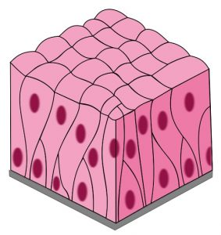
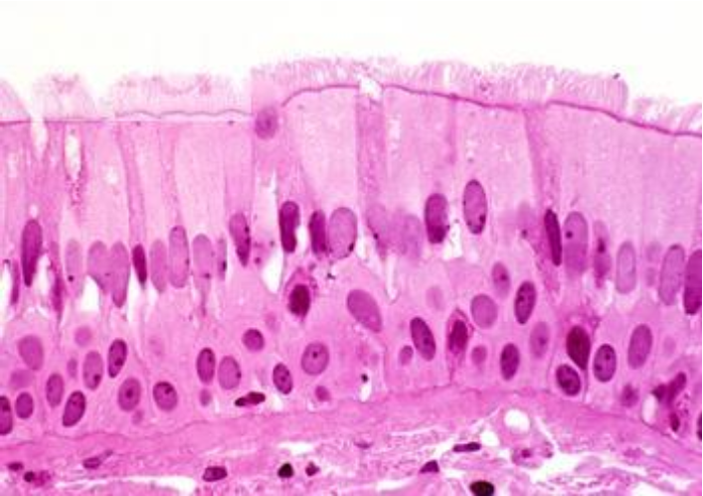
E. Pseudostratified Columnar
Appear stratified, but just a single layer of cells, nuclei at different levels
Can have cilia (hair-like projections)
And goblet cells, which secrete mucus
Function: Secretion and cilia-aided movement
Location: lining air passages and tubes of the reproductive system
What could happen if the cilia of this tissue doesn’t work properly?
Notes:
Remember McKenzie from chapter 2? If cilia aren’t functioning properly, is movement occurring properly? NO!

Slide 20
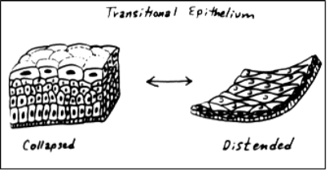
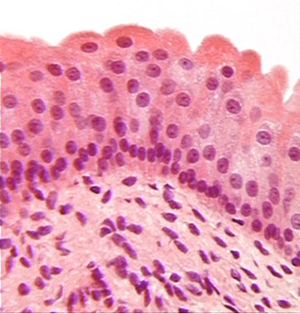
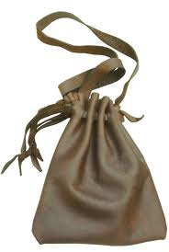
F. Transitional Epithelium
Stretchable
Blocks diffusion (no leaking)
Found in the urinary bladder

Slide 21
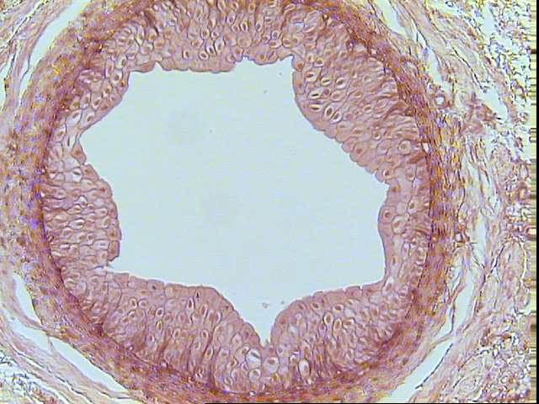
Urinary Bladder

Slide 22
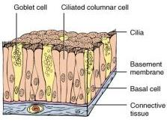
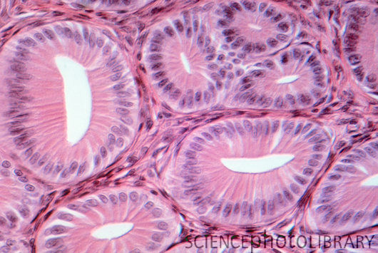
G. Glandular Epithelium
Cells are specialized to secrete substances
They make up the GLANDS
exocrine glands endocrine glands
Examples: salivary, sweat hormones

Slide 23
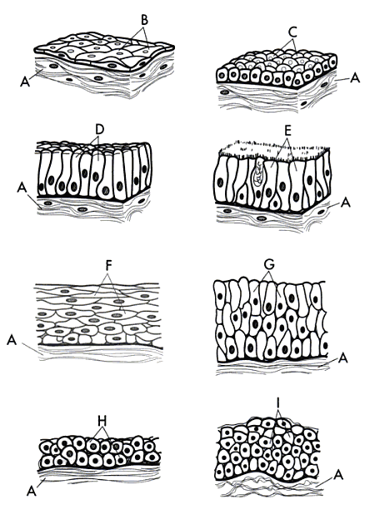
Identify the tissues
Notes:
A/B: Simple Squamos = Nucleus & Cytoplasm
A/C: Simple Cuboidal = Basement Membrane/ cytoplasm or nucleus
A/D: Simple Columnar = Basement Membrane/cytoplasm
A/E: PseudoStratified Columnar = Basement membrane/ cytoplasm
A/F: Stratified Squamos = Basement Membrane/Cytoplasm
A/G: Stratified Columnar
A/H: Strat. Cubodial
A/I: Transitional

Slide 24
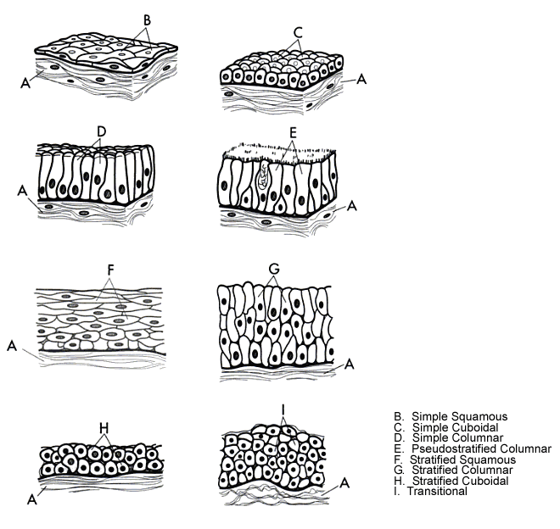

Slide 25
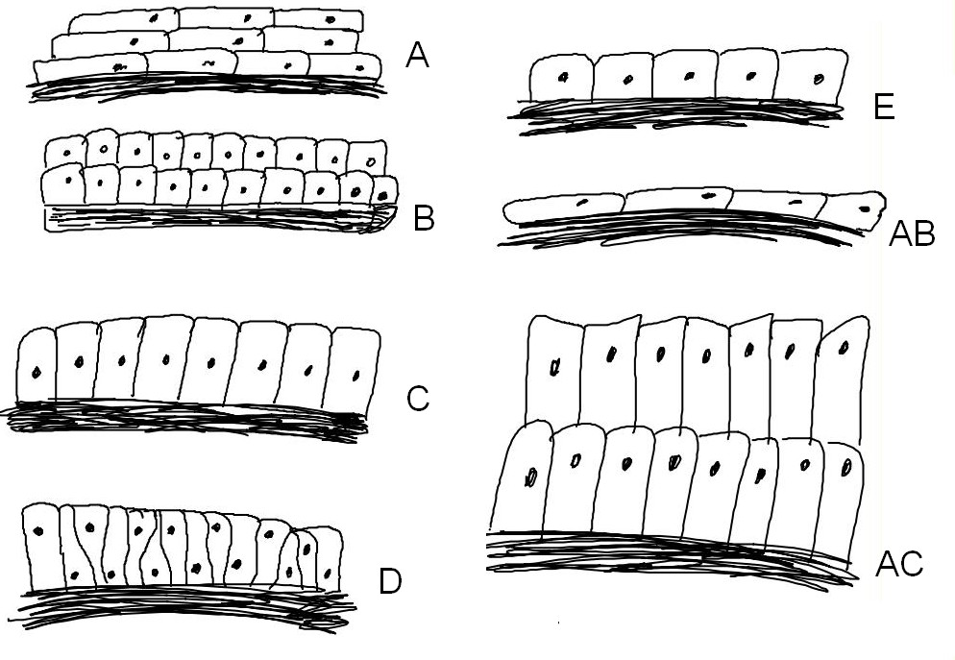
Notes:
A: Stratified Squamos
B: Stratified Cuboidal
AB: Simple squamos
C: Simple columnar
D: Pseudo stratified columnar
E: Simple cuboidal
AC: Stratified columnar

Slide 26
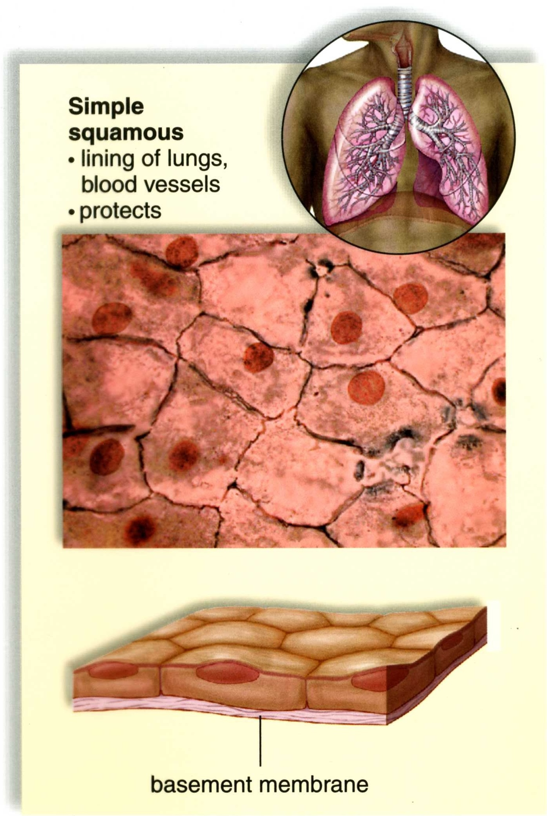
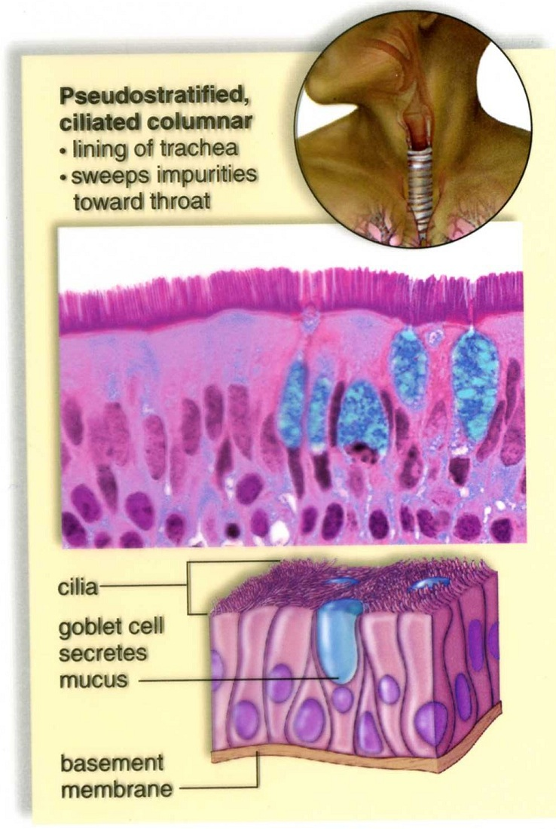

Slide 27
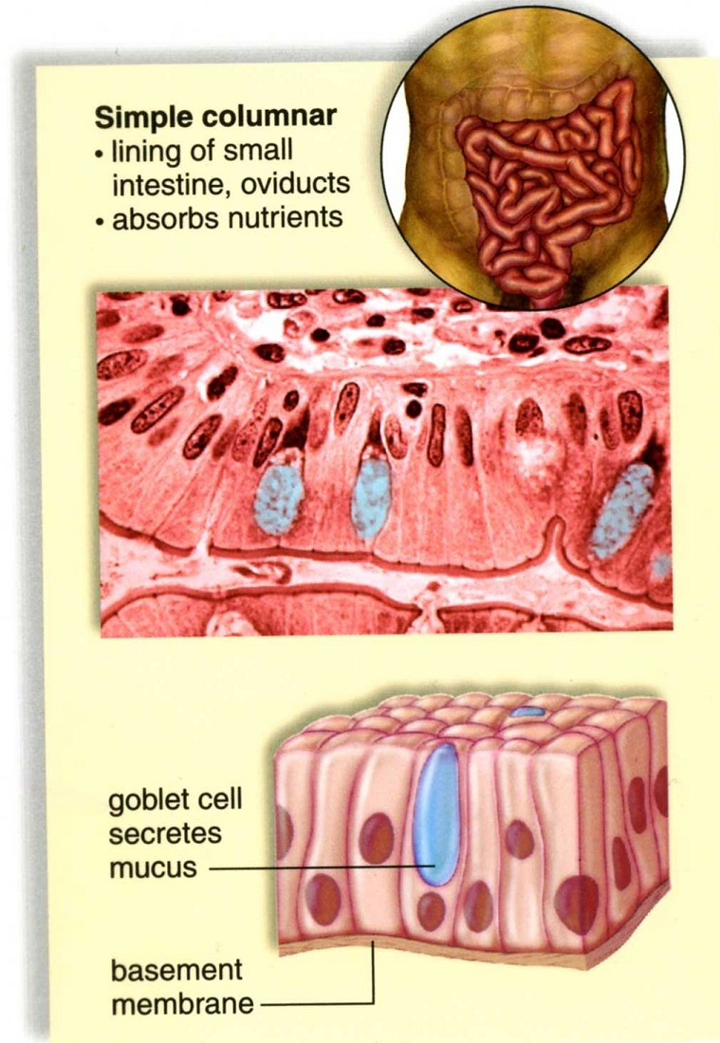
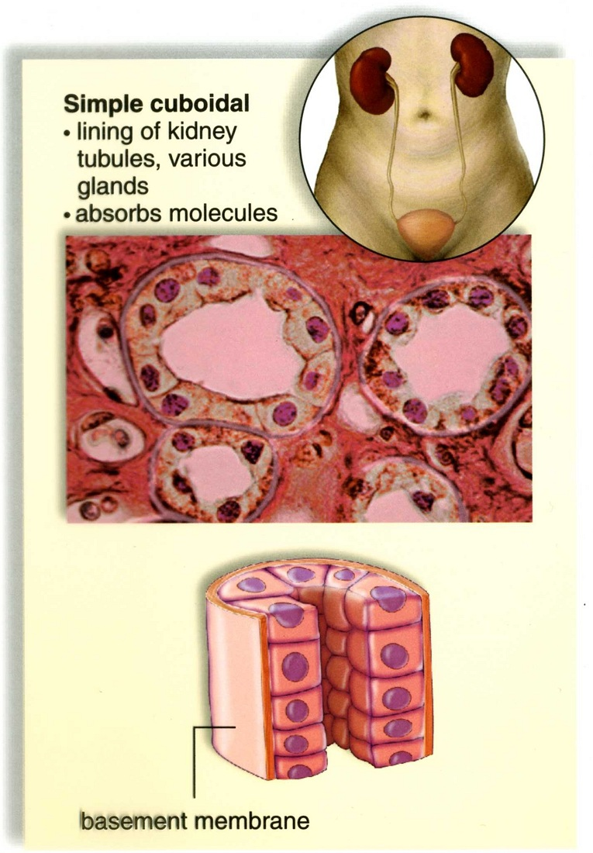

Slide 28
