Slide 1
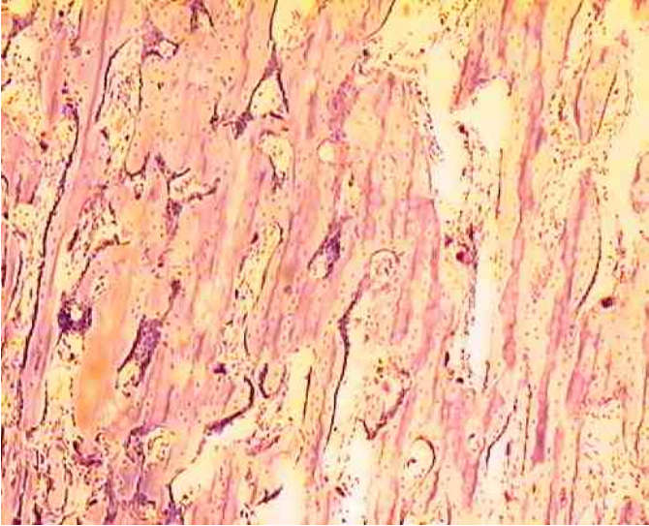
E. Bone Tissue (Osseous)

Slide 2
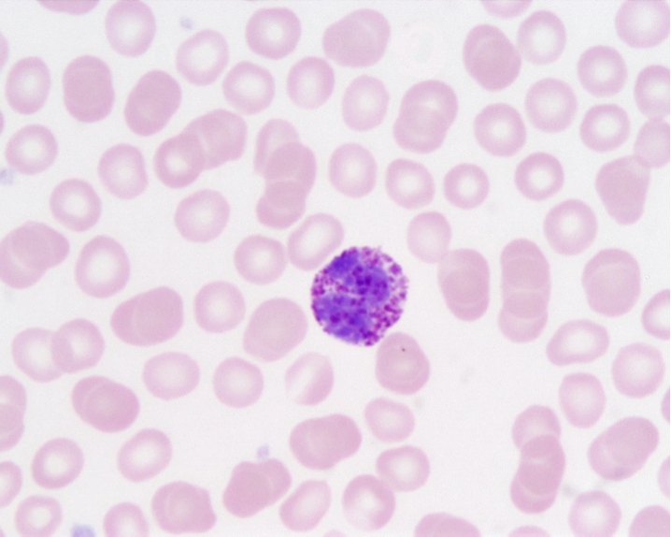
F. Blood Tissue

Slide 3
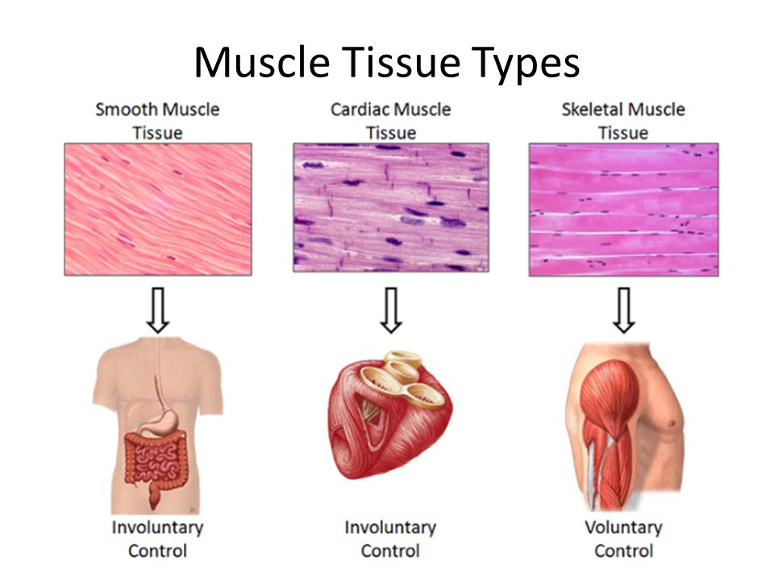
Muscle Tissue
STRIATED

Slide 4
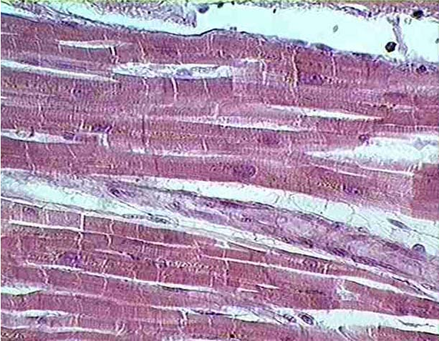
Cardiac muscle

Slide 5
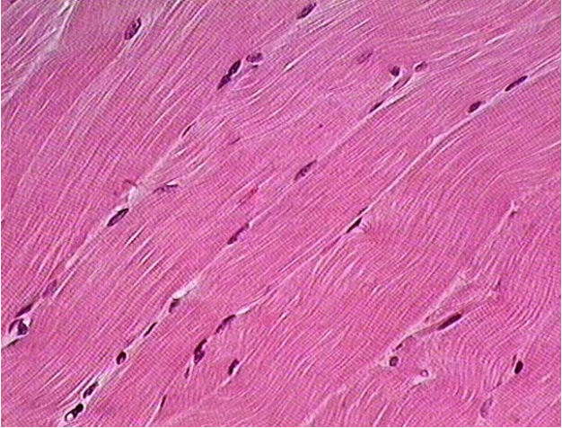
Skeletal muscle
(striated)

Slide 6
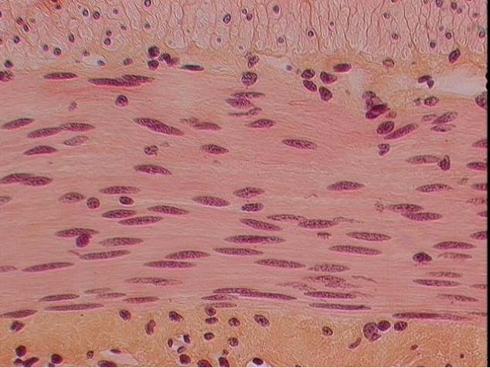
Smooth muscle

Slide 7
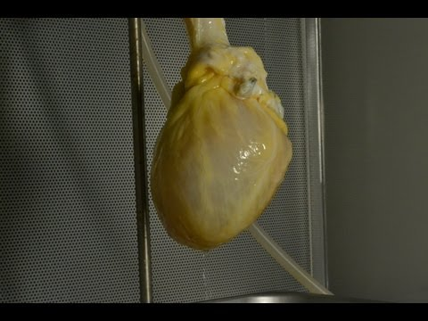
Vocabulary: Scaffolding | Decellularization | Matrix | Collagen | Antigens | Graft
What is the purpose of this technology?
Notes:
Video-Omit if not in class.

Slide 8
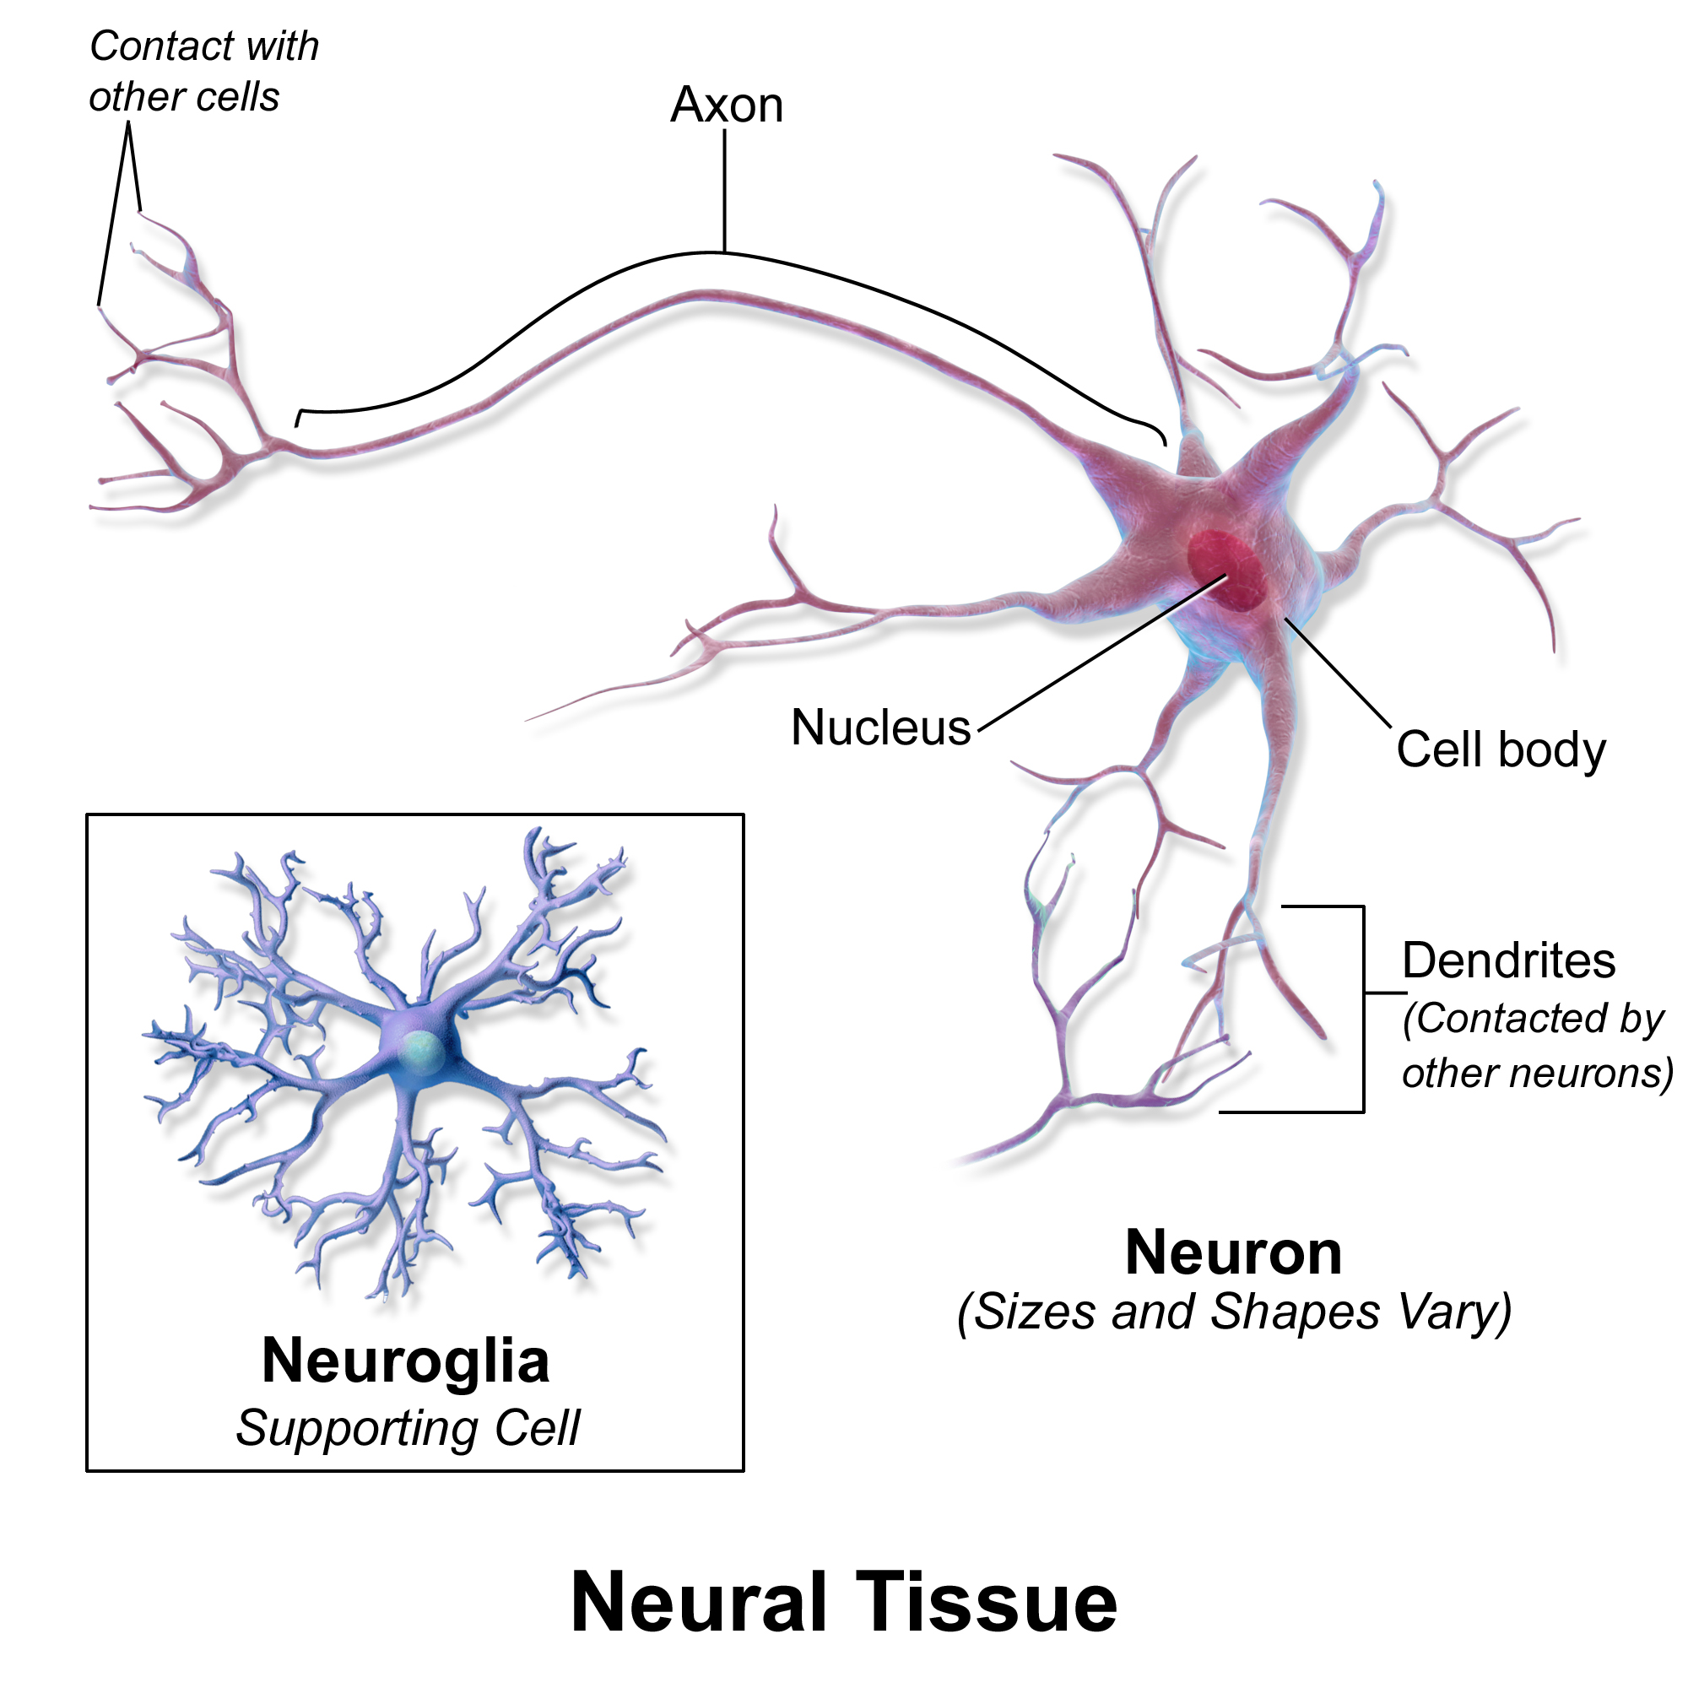
Nerve Tissue
Neurons - transmit signals
( Axons & Dendrites )
Neuroglia - support cells
DRAW ME

Slide 9
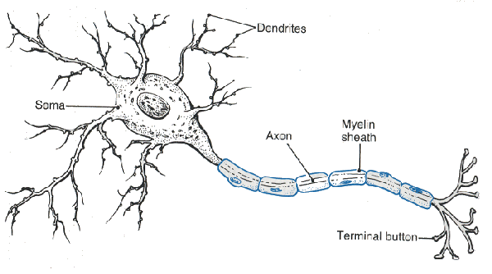
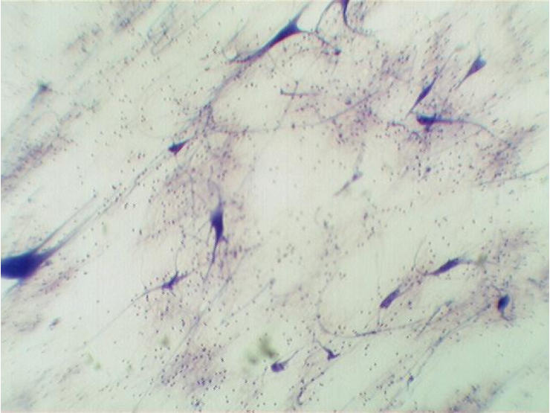
Nervous tissue (spinal cord)

