Slide 1
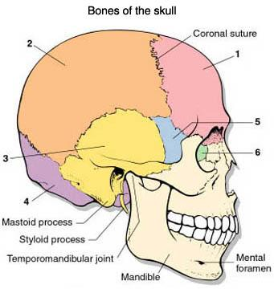
BONES OF THE SKULL
1. Frontal - 2. Parietal - 3. Temporal - 4. Occipital - 5. Sphenoid - 6. Ethmoid -
7. Maxilla -
8. Mandible -
9. Zygomatic -
7
9
8
Notes:
Anterior portion (forehead)
On each side of the top of skull
Side, above ear
Forms the back of the skull
With cranium, partly visible in eye socket
Nasal cavity, visible in eye socket
Upper jaws
Lower jaws, only moveable bone of skull
Cheek bones

Slide 2
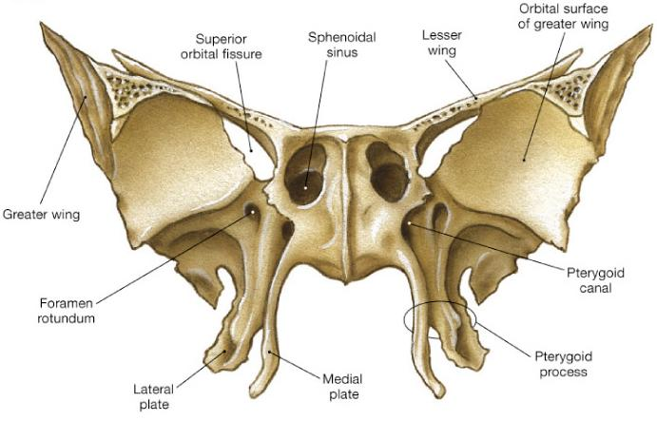
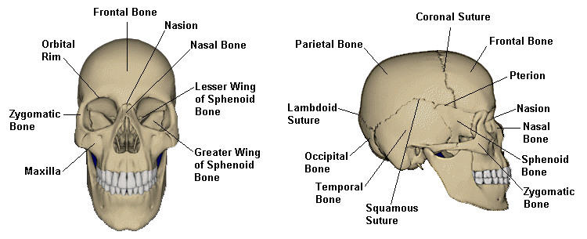
Sphenoid Bone
Names for its shape
a butterfly!

Slide 3
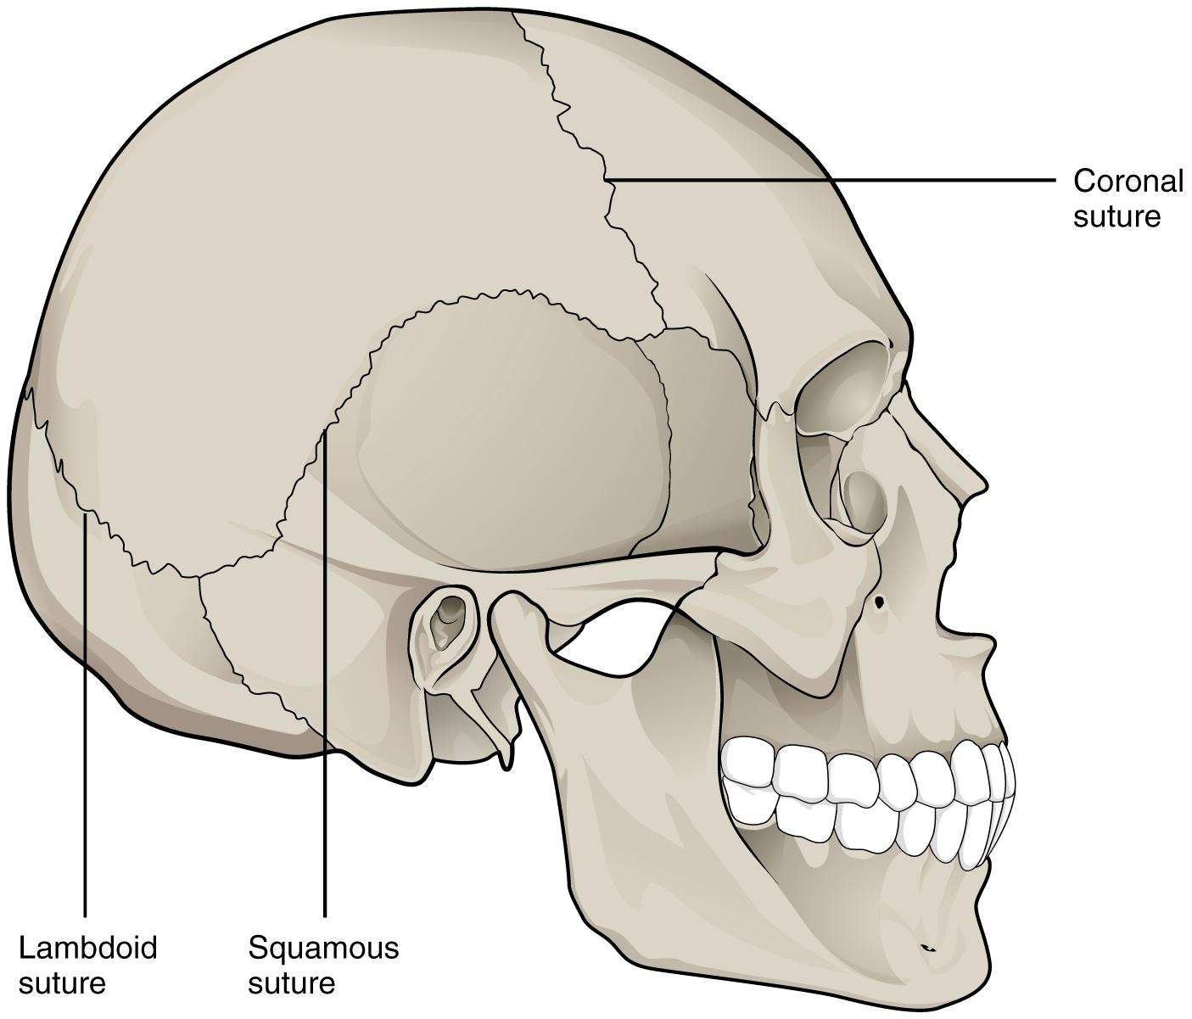
Sutures - connection points
Sagittal
1. Coronal - between frontal and parietal bones
2. Lambdoidal - between occipital and parietal bones
3. Squamosal - between temporal and parietal bones
4. Sagittal - between parietal bones

Slide 4
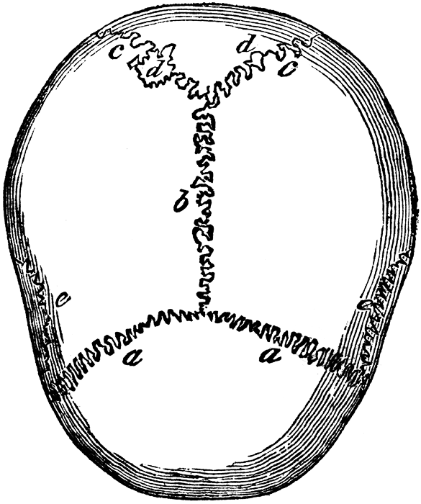
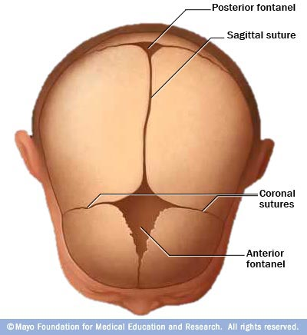
Suture - refers to any connection between large bones (in fetal skulls, these are called fontanels)
Fissure - any wide gap between bones

Slide 5
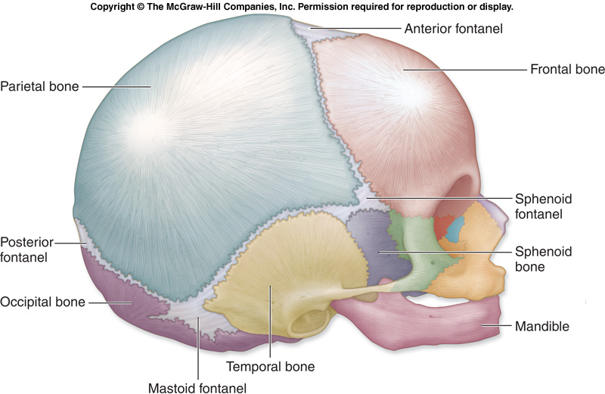
Fontanels are “soft spots” on an infant’s skull
Notes:
Forms sutures as you age

Slide 6
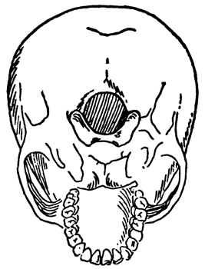
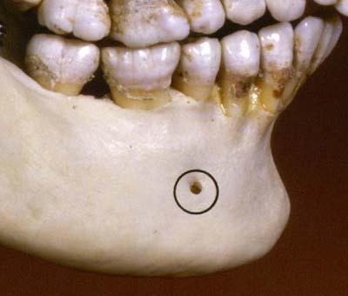
TOPOGRAPHY OF THE SKULL
Foramen - refers to any opening in the skull, nerves and blood vessels leave this opening to supply the face
Foramen Magnum
Mental Foramen

Slide 7
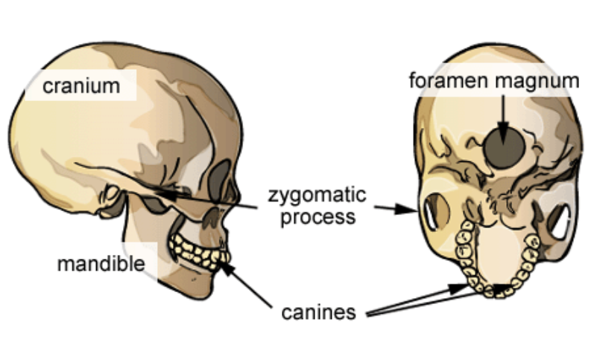
Foramen Magnum
* Assignment: Skull Labeling

Slide 8
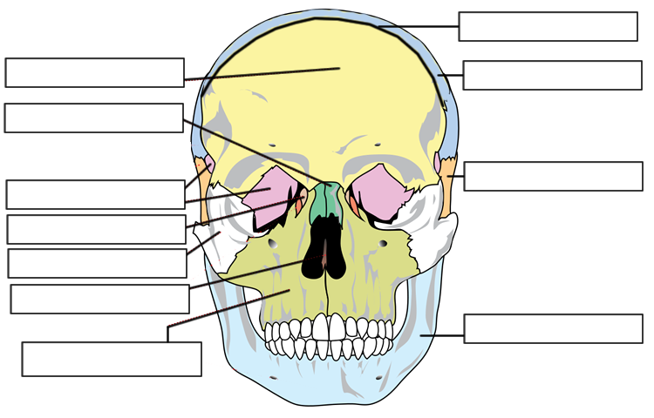
Coronal Suture
Frontal
Parietal
Nasal
Temporal
Sphenoid
Lacrimal
Zygomatic
Vomer
Mandible
Maxilla

Slide 9
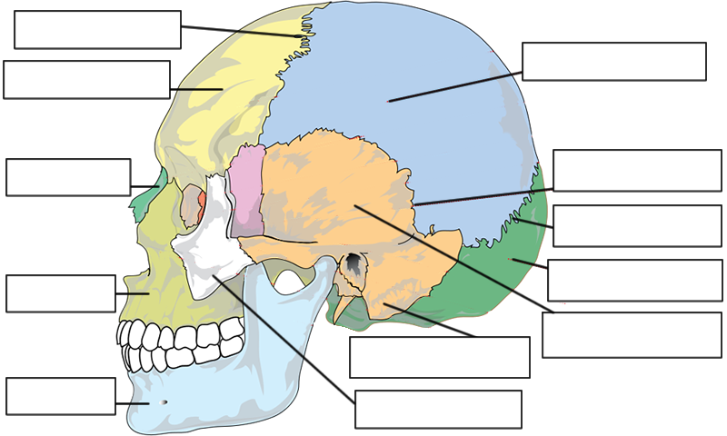
Coronal Suture
Parietal
Frontal
Nasal
Squamous Suture
Sphenoid
Lambdoid Suture
Occipital
Maxilla
Temporal
Mastoid Process
Mandible
Zygomatic

Slide 10
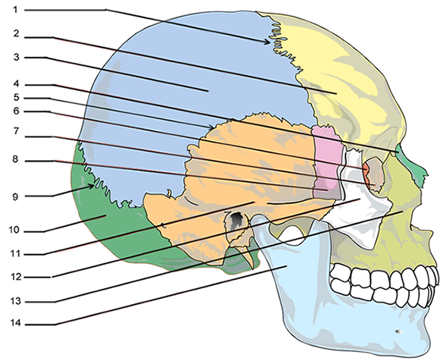
Notes:
1. Coronal Suture 2. Frontal 3. Parietal 4. Nasal 5. Squamosal Suture 6. Ethmoid 7. Lacrimal
8. Sphenoid 9. Lamdoidal Suture 10. Occipital 11. Temporal 12. Zygomatic 13. Maxilla 14. Mandible

Slide 11
1. Coronal Suture
2. Frontal
3. Parietal
4. Nasal
5. Squamosal Suture
6. Ethmoid
7. Lacrimal
8. Sphenoid
9. Lamdoidal Suture
10. Occipital
11. Temporal
12. Zygomatic
13. Maxilla
14. Mandible

Slide 12
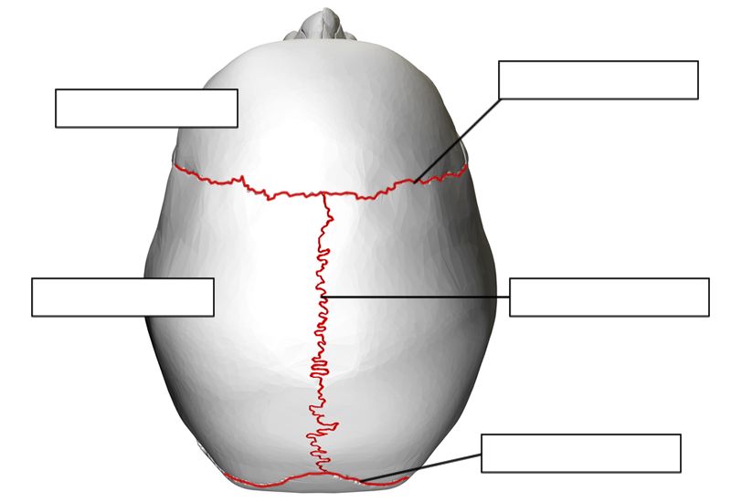
Coronal Suture
Frontal
Parietal
Sagittal Suture
Lambdoid Suture

Slide 13
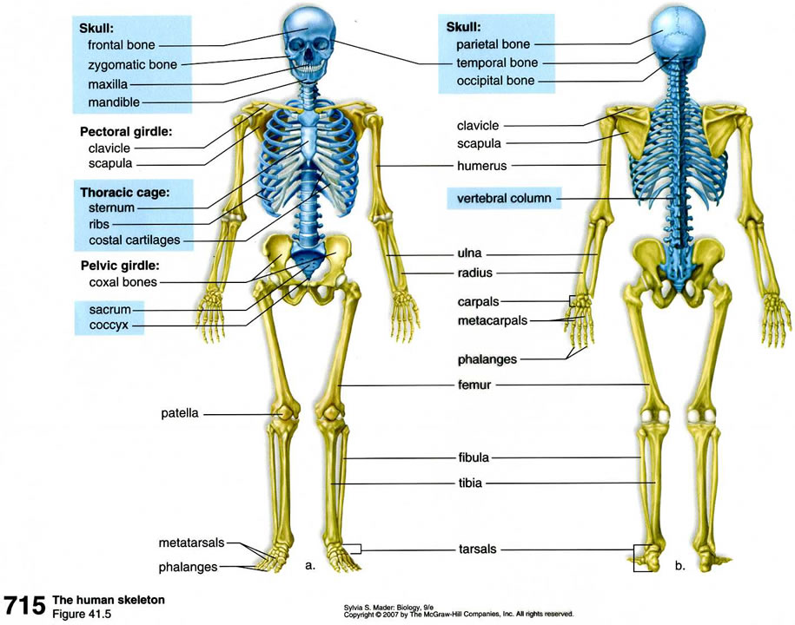
The Rest of the Bones

Slide 14
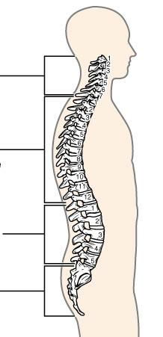
Vertebral Column
Cervical (C1-C7)
Thoracic (T1-T12)
Lumbar (L1-L5)
Sacrum and Coccyx

Slide 15
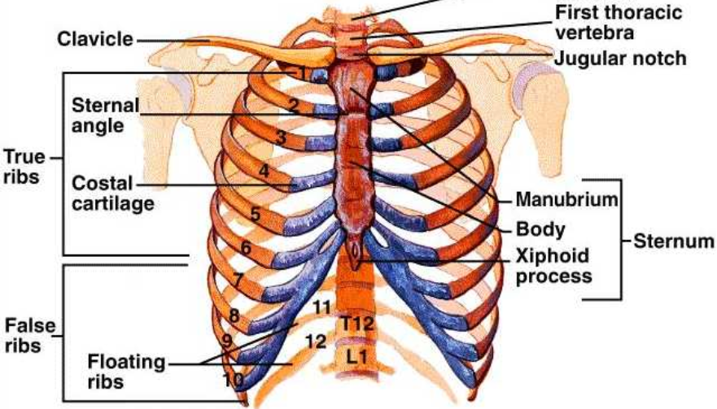
Thoracic Cage → 12 pairs of ribs
True Ribs = First seven
False Ribs = Next 3 pairs
Floating Ribs = Last two pairs

Slide 16
Pectoral Girdle
CLAVICLES
(collarbones)
HUMERUS (arm)
SCAPULAS
(shoulderblade

Slide 17
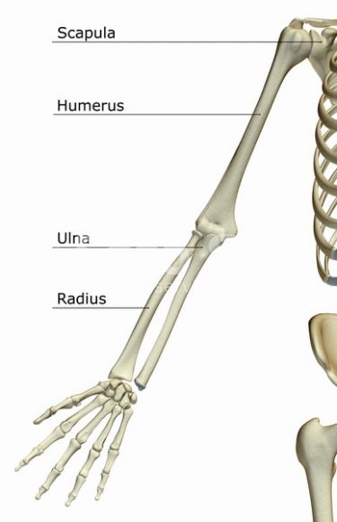
Bones of the Arm
Ulna goes to pinky (P-U)
Radius goes to thumb
HUMERUS
ULNA
RADIUS

Slide 18
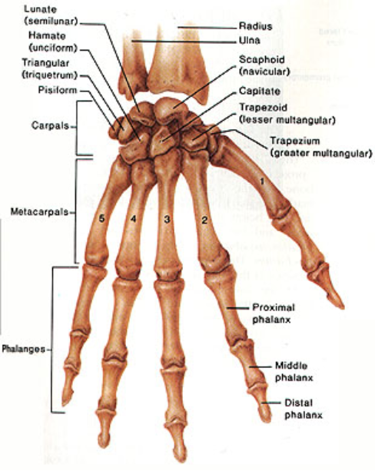
Wrist Bones
Wrist - 8 small bones called carpels
Metacarpals (hand)
Fingers: Phalanges
Notes:
You will need to label the carpals

Slide 19
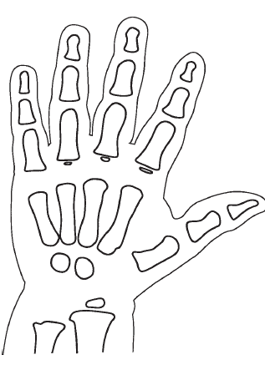
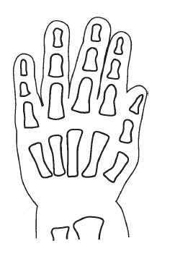
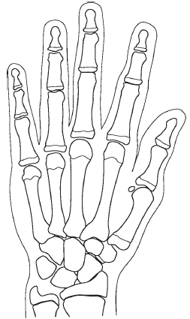
Notes:
Aging of the hand

Slide 20
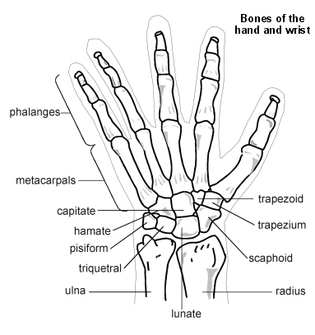

Slide 21
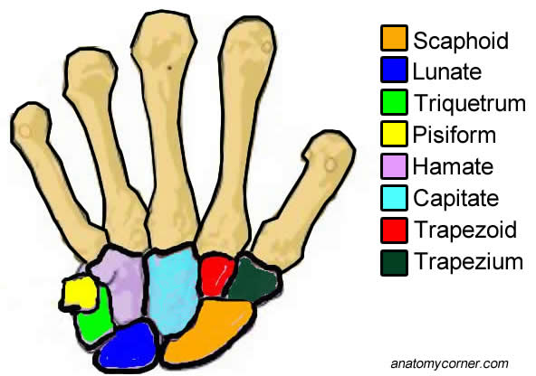
How to learn the carpals?
Some Lemurs Try Peanuts That They Can’t Handle
Notes:
Or: Some lovers try positions that they can’t handle.

Slide 22
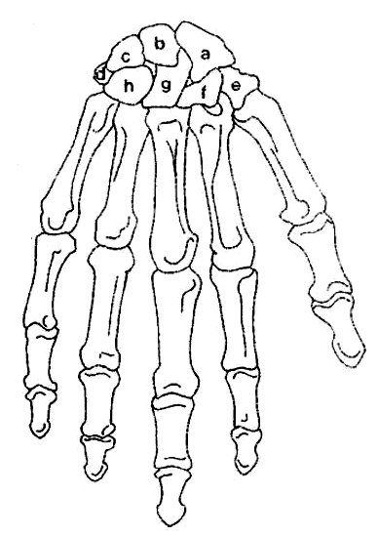
ANSWERS...
Scaphoid
Lunate
Triquetrum
Pisiform
Trapezium
Trapezoid
Capitate
Hamate
Notes:
Scaphoid
Lunate
Triquetrum
Pisiform
Trapezium
Trapezoid
Capitate
Hamate

Slide 23
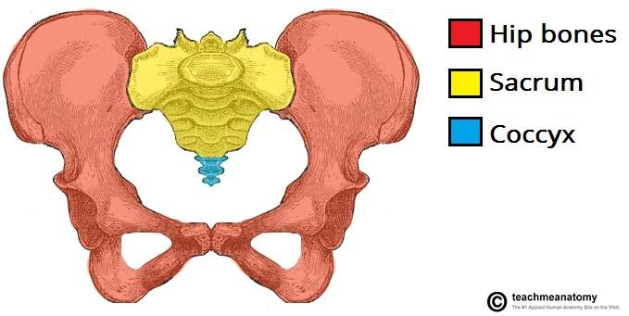
Pelvic Girdle
two large COXAL BONES

Slide 24
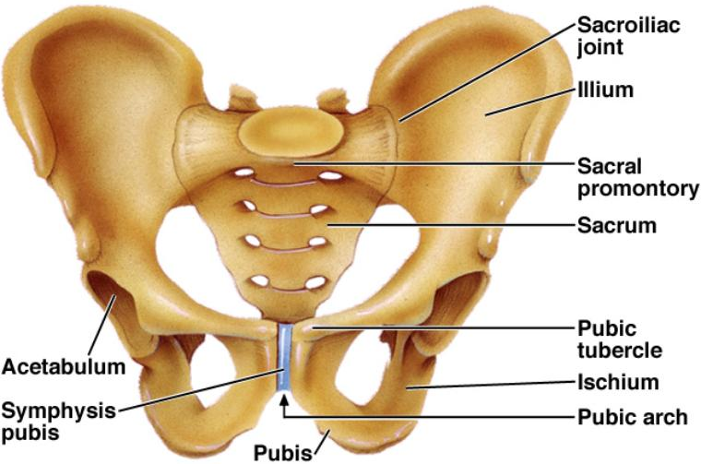
Pelvic Girdle
COXAL
COXAL
The SACRUM is between coxal bones, COCCYX is the tailbone

Slide 25
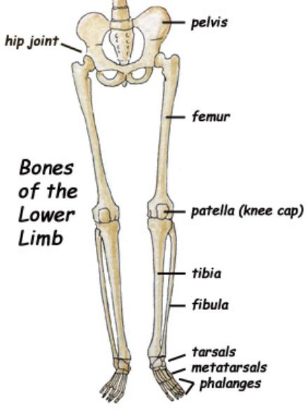
Bones of the Leg
Upper Leg - FEMUR
Kneecap - PATELLA
Lower Leg - TIBIA & FIBULA

Slide 26
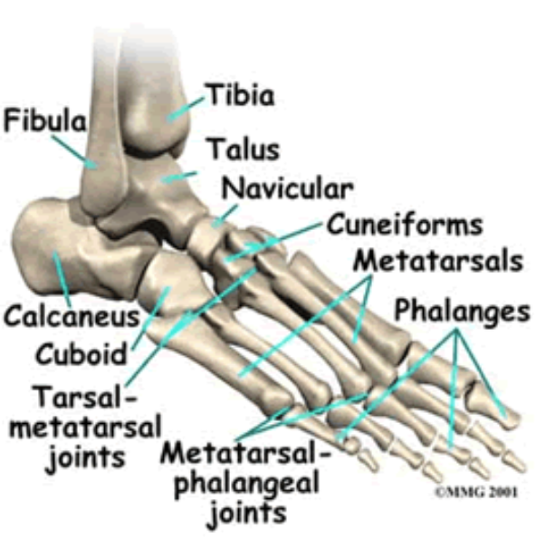
Bones of the Ankle
Ankle and Upper foot - 7 bones called Tarsals
Large heel bone is the calcaneous
Foot = metatarsals
Toes = phalanges

Slide 27
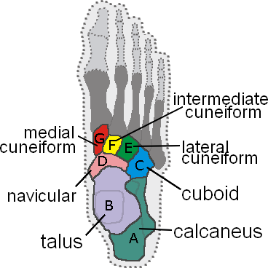
Assignment – Foot Coloring

Slide 31
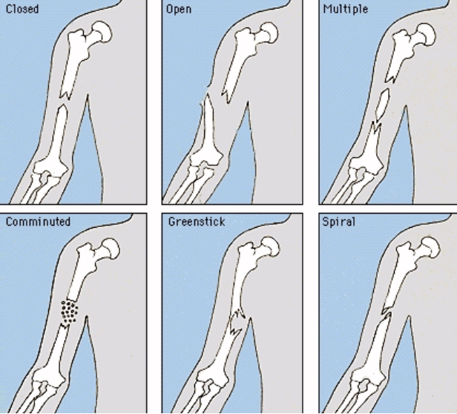
Broken Bones

Slide 32
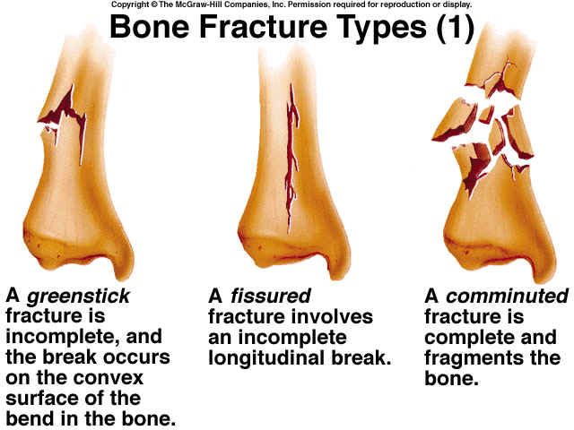

Slide 33
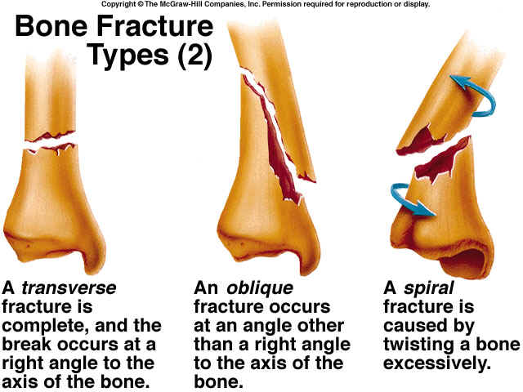
Warning: Next slide is graphic!

Slide 34
