Slide 1
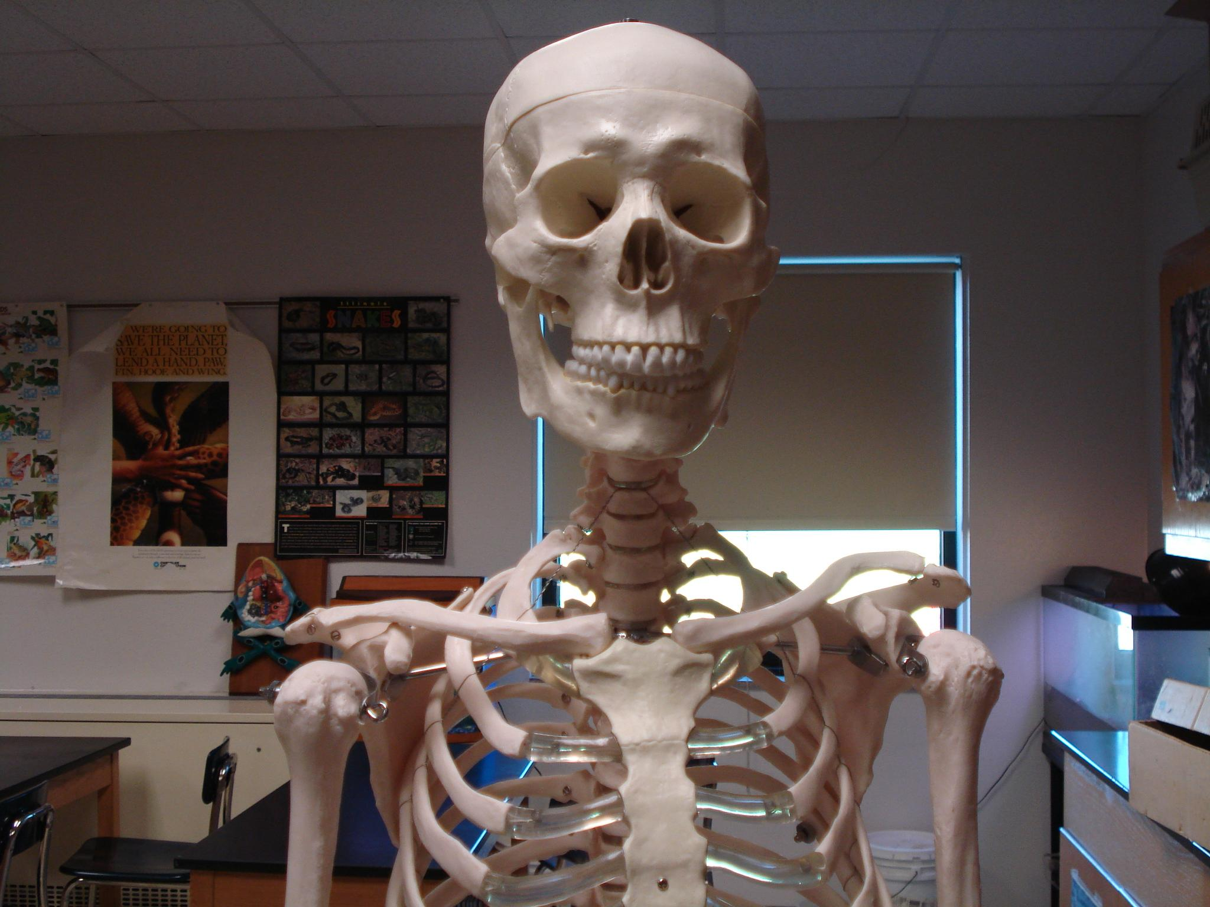
THE SKELETAL SYSTEM

Slide 2
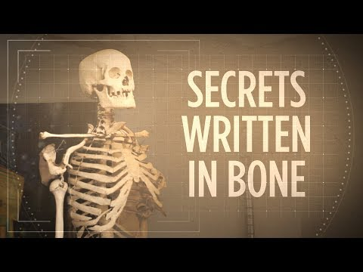

Slide 3
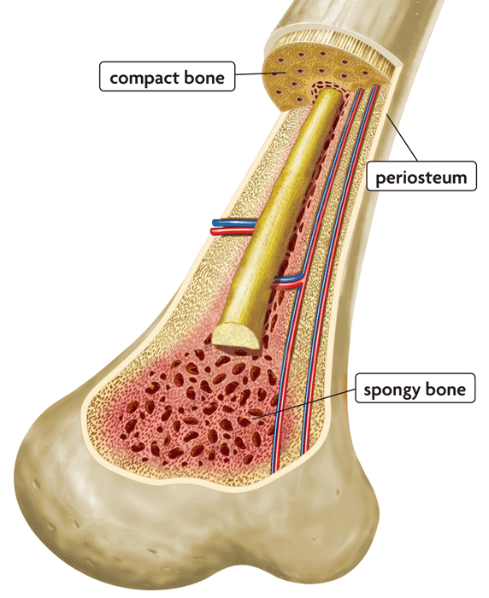
Functions of the Skeletal System
Support and protection
Body movement
Blood cell formation = hemopoiesis
(occurs in bone marrow)
Storage of inorganic materials
(salt, calcium, potassium….)

Slide 4
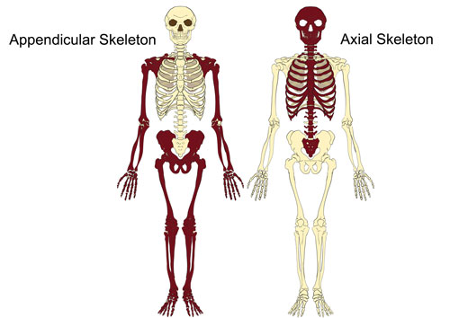
ORGANIZATION
About 206 bones
2 Main Divisions

Slide 5
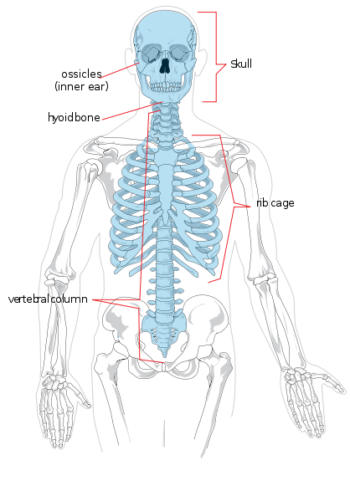
Axial Skeleton
Head, neck, trunk
Skull
Hyoid Bone
Vertebral Column
Thoracic Cage (ribs, 12 pairs)
Sternum

Slide 6
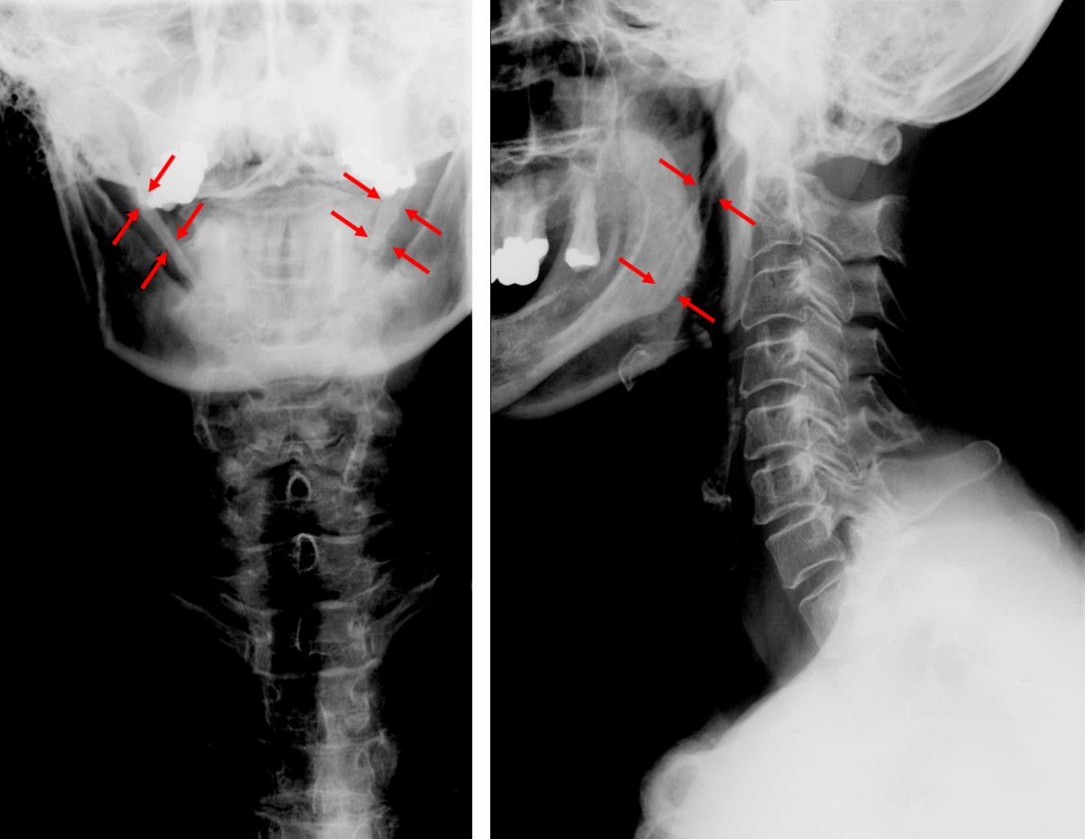
Hyoid Bone

Slide 7
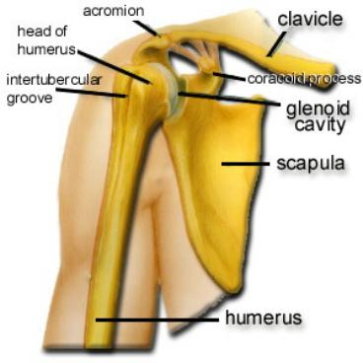
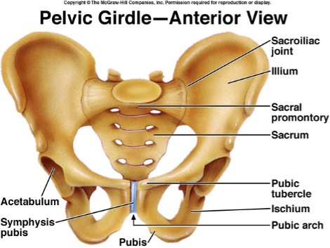
Appendicular Skeleton
Limbs & Bones that connect to the:
Pectoral Girdle (scapula, clavicle, arms)
Pelvic Girdle (coxal bones, legs)

Slide 8
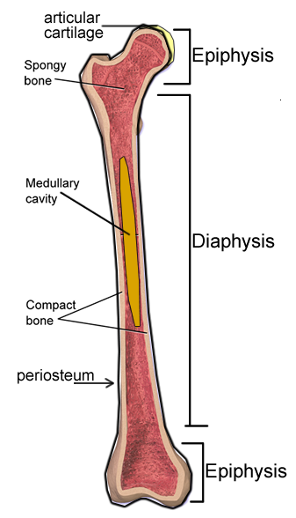
BONE STRUCTURE - Long Bone
1.Epiphysis (end)
2. Diaphysis (shaft)
3. Articular Cartilage
(hyaline cartilage, padding)
4. Periosteum
(membrane that covers entire bone)

Slide 9
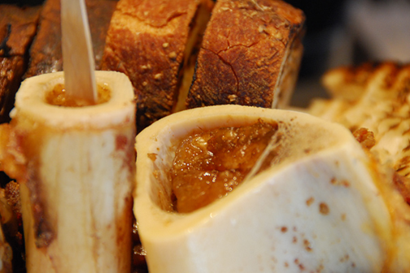
Inside the Long Bone
5. Medullary Cavity – hollow chamber filled with bone marrow
Red Marrow (blood)
Yellow Marrow (fat)
Endosteum
– lining of the medullary

Slide 10
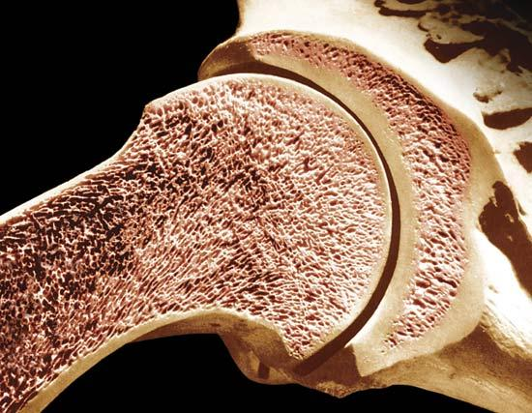
Types of Bone Tissue
Compact (wall of the diaphysis)
Spongy (cancellous, epiphysis) - red marrow

Slide 11
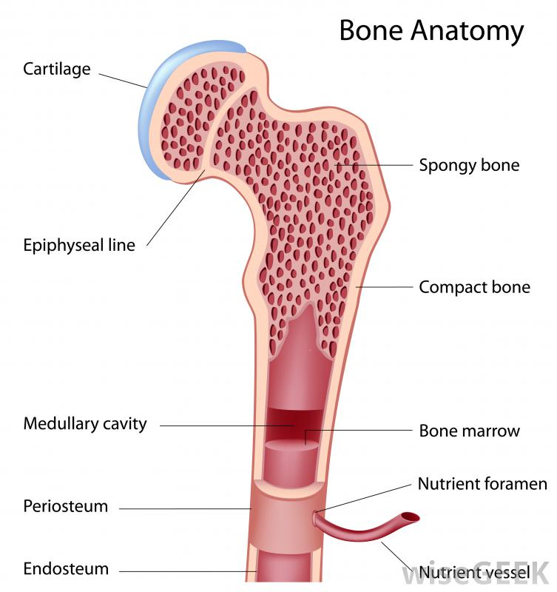
Notes:
LABEL

Slide 12
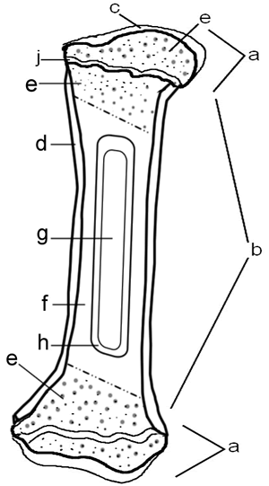
* Assignment
– Coloring of a Long Bone
Notes:
https://www.biologycorner.com/anatomy/skeletal/bone_coloring.html

Slide 13
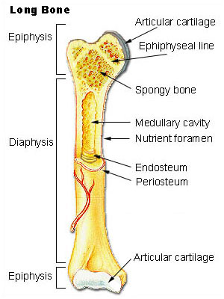
Review the Structure of a Long Bone
Matching quiz at http://www.mhhe.com/biosci/ap/holehaap/student/olc2/chap07matching01.html

Slide 14
Microscopic Structure
Bone tissue is called OSSEOUS tissue - the matrix is composed of collagen and inorganic salts
OSTEOCYTES - mature bone cells, enclosed in tiny chambers called LACUNAE
these form rings called lamella around a HAVERSIAN CANAL which houses blood vessels
CANALICULI - tiny canals that link osteocytes
Haversian and Volkmann canals provide passageways for blood vessels

Slide 15
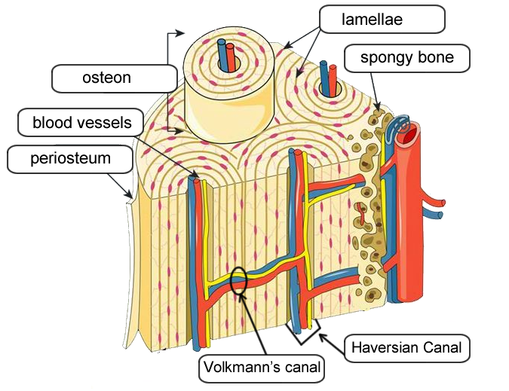
Osteocytes
Haversian Canal
Volkmann’s Canal

Slide 16
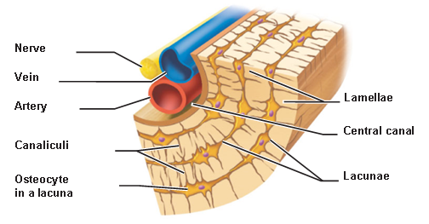

Slide 17
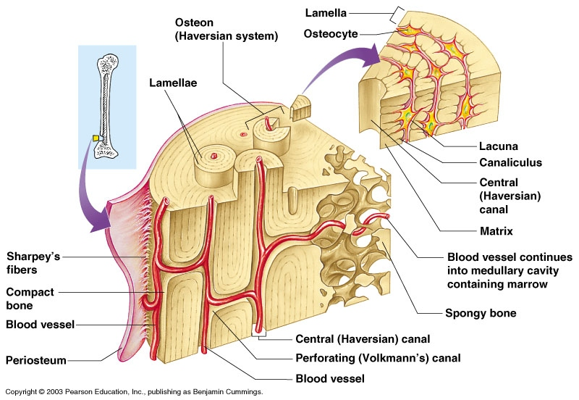
Notes:
https://www.biologycorner.com/worksheets/bone-matrix-color.html

Slide 18
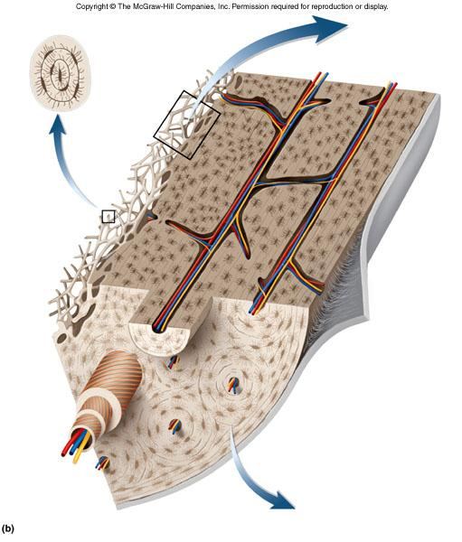
Test Yourself
Find the...
Haversian Canal
Volkman's Canal
Lamellae
Spongy Bone
Compact Bone

Slide 19
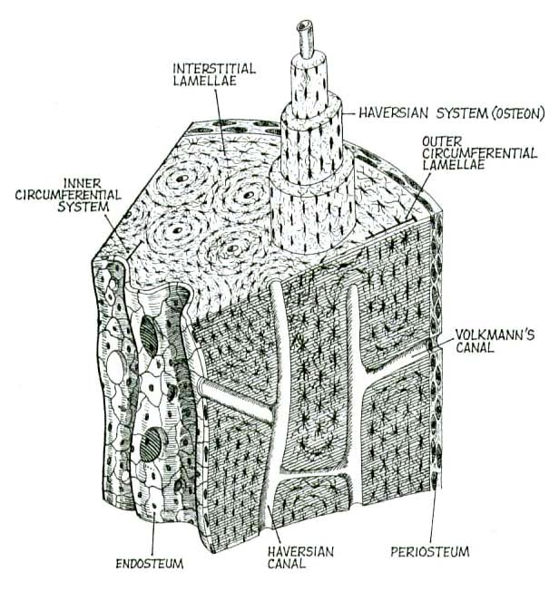

Slide 20
BONE DEVELOPMENT & GROWTH
Intramembranous bones – flat, skull
Endochondral bones – all other
Bones first form as hyaline cartilage. The cartilage then gradually changes into bone tissue - a process called OSSIFICATION
PRIMARY OSSIFICATION CENTER (shaft)
SECONDARY OSSIFICATION CENTER (ends)

Slide 21
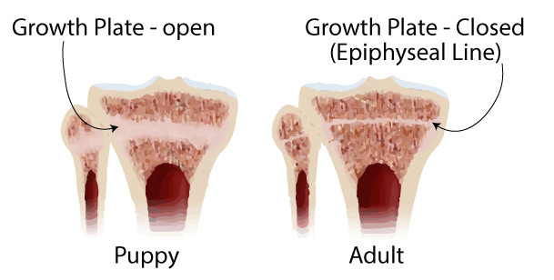
Bone Development & Growth
EPIPHYSEAL DISK (growth plate) is a band of cartilage between the epiphysis and diaphysis
These areas increase bone length as the cells ossify

Slide 22
OSTEOBLASTS produce cells called osteocytes.

Slide 23
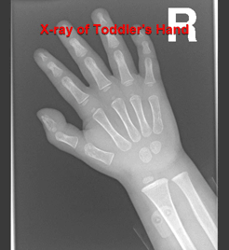
RESORPTION
OSTEOCLASTS - dissolve bone tissue to release minerals, process is called RESORPTION

Slide 24
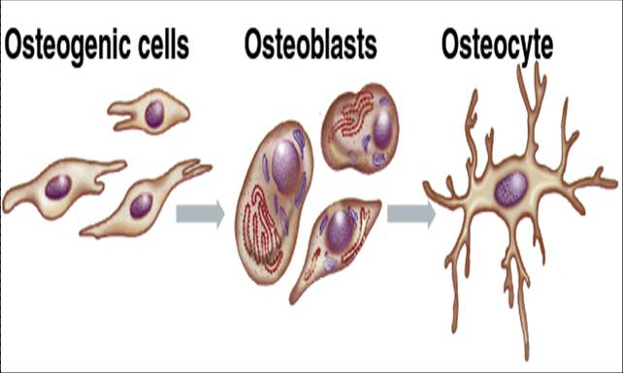
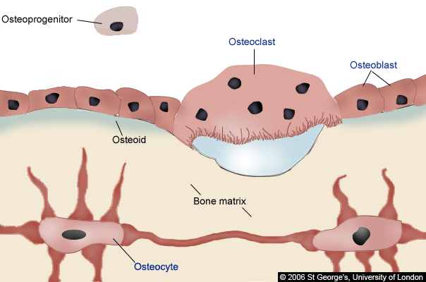

Slide 25
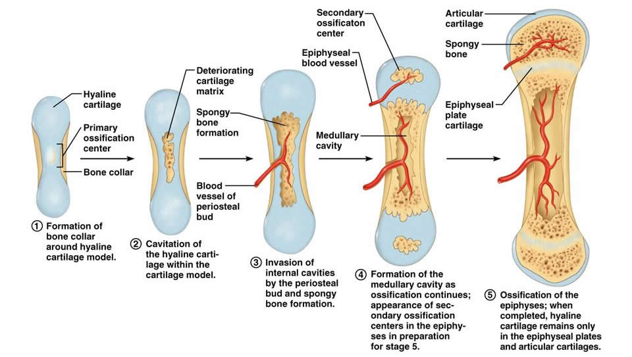
Bone Growth

Slide 26
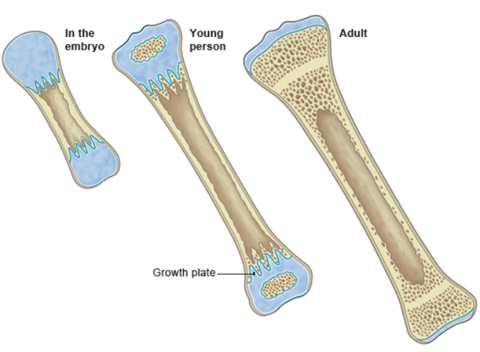
Bone Growth
* Assignment - Coloring of the Aging Hand

Slide 27
Types of Joints (articulations)
Synarthrotic (not moveable, aka sutures)
*skull
Amphiarthrotic (slightly movable)
*vertebrae
Diarthrotic (moveable joint )
*knees, elbows, wrist, shoulder..etc
*synovial fluid for lubrication

Slide 28
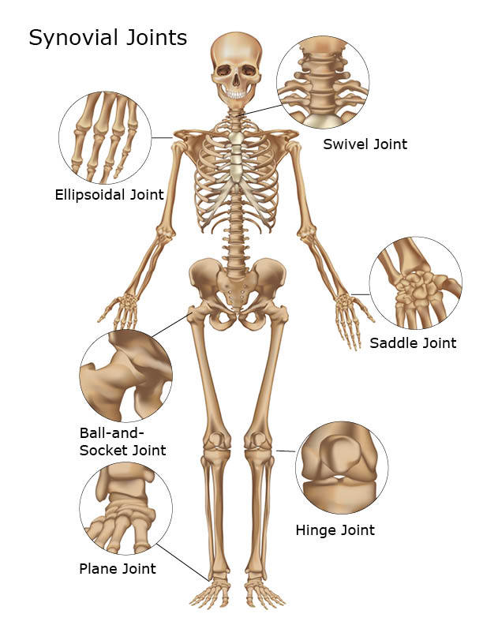
Types of Synovial Joints
1. Ball and Socket
(shoulder / hip)
2. Hinge (elbow, knee)
3. Pivot (lower arm)
4. Saddle (thumb)

