Slide 1
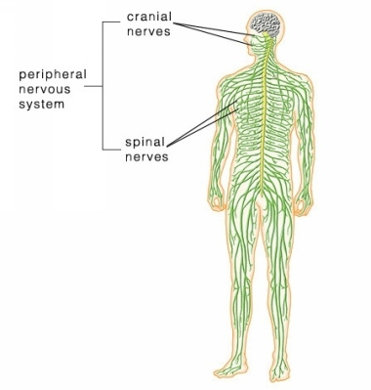
Notes: 9.14, 9.15
Peripheral Nervous System - consists of the nerves that branch out from the CNS and connect it to other body parts, also includes the cranial nerves
Somatic Nervous System (conscious activities) Skin, skeletal system
Autonomic Nervous System (unconscious activities); heart, viscera, glands

Slide 2
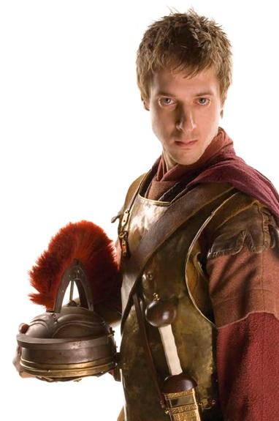
Peripheral Nervous System
The spinal nerves comes out of the spine, and the cranial nerves come out of the brain directly.
There are 12 pairs of cranial nerves
They are numbered with Roman numerals.

Slide 3
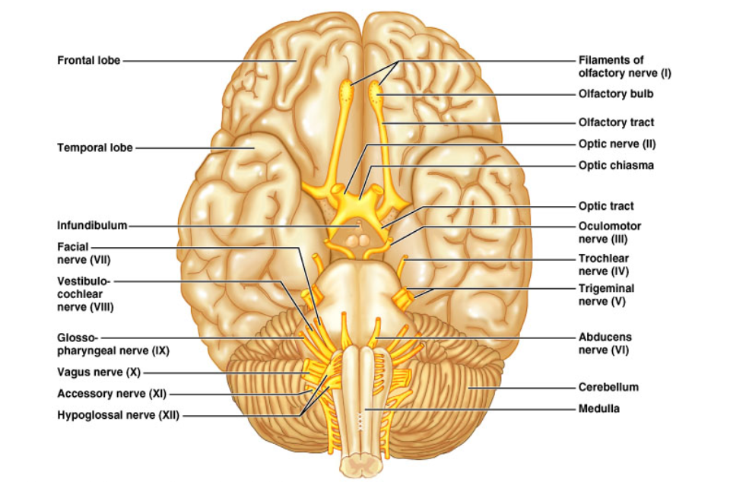
The 12 Pairs of Cranial Nerves
Figure 14.8

Slide 4
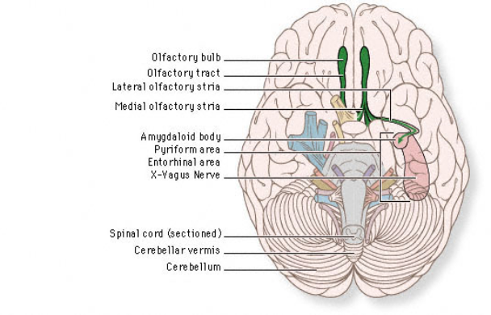
I. OLFACTORY
Sense of smell. Outside of the CNS they are called olfactory nerves, and inside of the CNS they are called the olfactory tract.

Slide 5
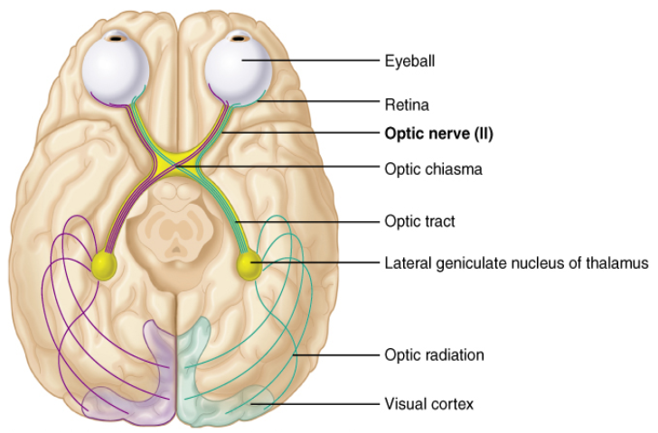
II. OPTIC NERVE
Transmits information from the eye’s retina. VISION

Slide 6
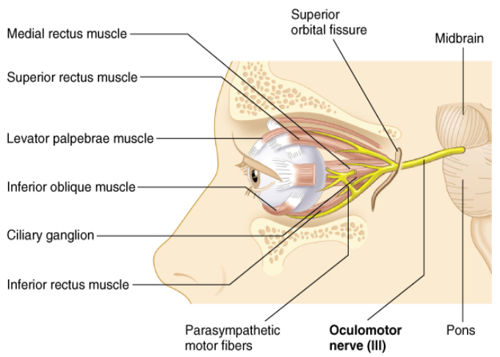
III. Oculomotor Nerve
Controls most of the muscles of the eye that move the eyeball.

Slide 7
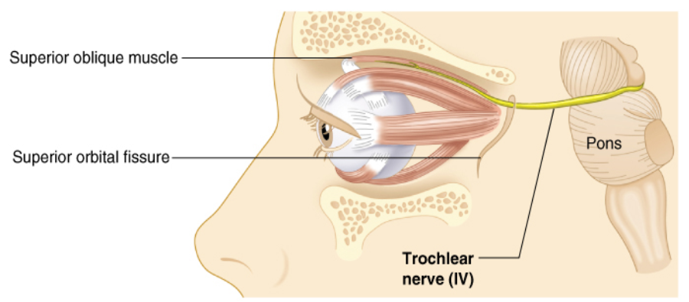
IV. Trochlear Nerve
Innervates an extrinsic eye muscle, eyelid

Slide 8
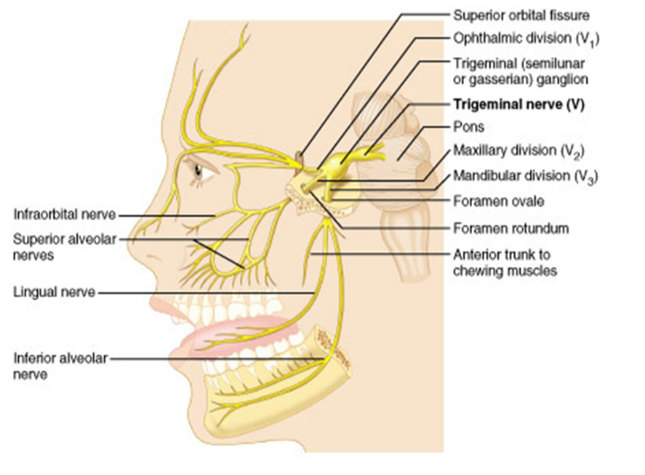
V. Trigeminal Nerve
This is the main sensory nerve of the face. It has a large branch that passes through the foramen of the skull. It has three parts.

Slide 9
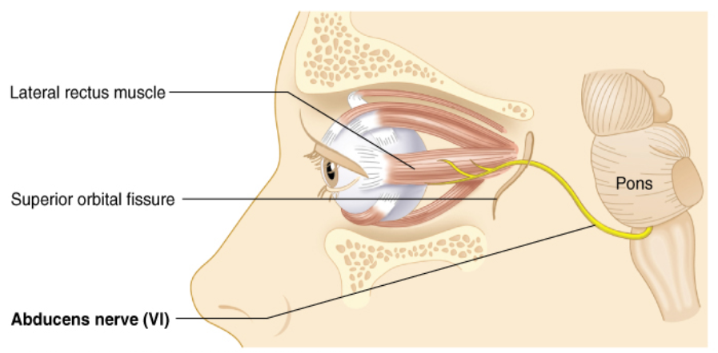
VI: Abducens
Controls one of the eye muscles (lateral rectus).

Slide 10
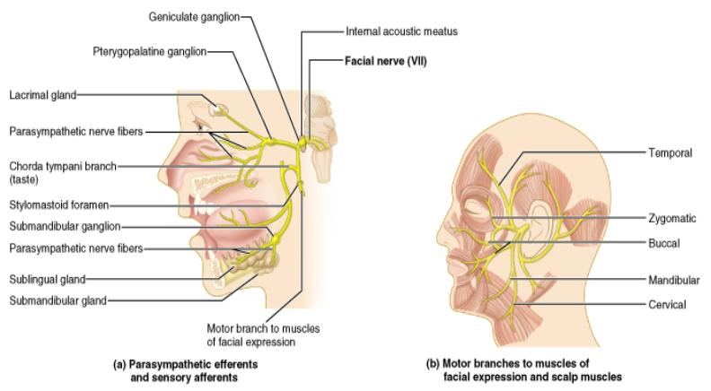
VII. Facial Nerve
Innervates the muscles of facial expression.
A person who cannot blink or smile may have damage to this nerve.
BELL’S PALSY is damage of the facial nerve causing paralysis on one side.

Slide 11
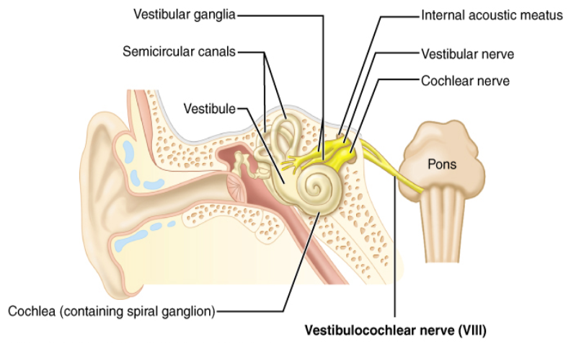
VIII. VESTIBULOCOCHLEAR
Hearing and balance. (also called Auditory nerve)

Slide 12
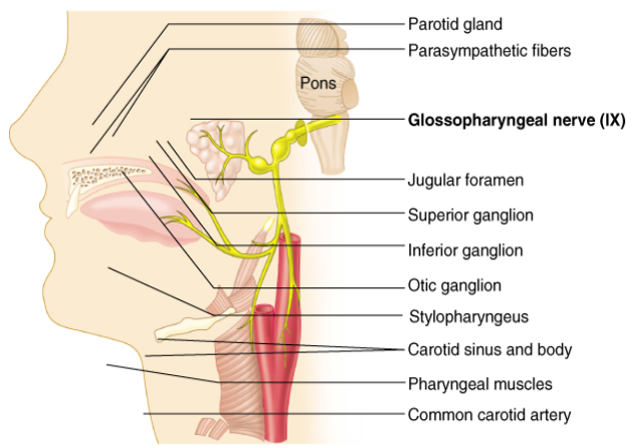
IX: GLOSSOPHARYNGEAL
pharynx, tongue
swallowing, speech, saliva

Slide 13
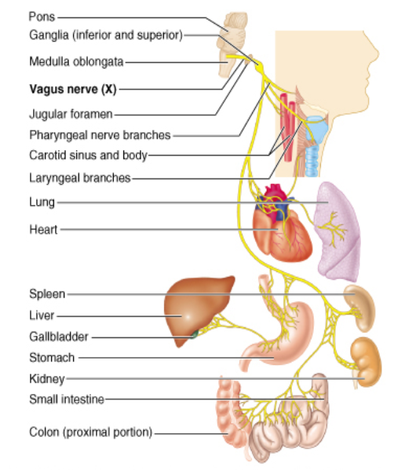
X. Vagus Nerve
(vagrant = “wanders”) - the only cranial nerve that travels into the abdomen.
This is the most important cranial nerve because it innervates all of the organs in the thoracic and abdominal cavities

Slide 14
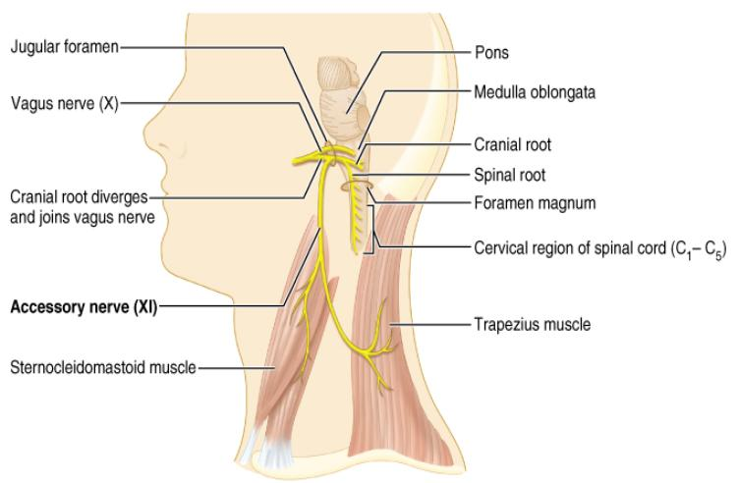
XI. ACCESSORY NERVE
Enters the skull through foramen magnum
It just supplies the shoulder muscles.

Slide 15
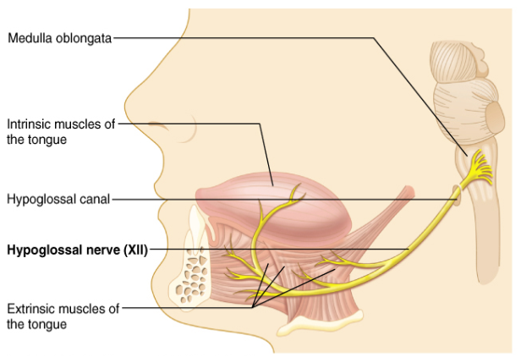
XII. HYPOGLOSSAL NERVE
Supplies the tongue.
Damage causes impairment of speech.

Slide 16
I. Olfactory | sense of smell
II. Optic | sight
III. Occulomotor | move eyelids
IV. Trochlear | move eyes
V. Trigeminal | face, jaw, chewing
VI. Abducens | eyes
VII. Facial | facial expressions
VIII. Vestibulocochlear (Auditory) | sense of equilibrium, hearing

Slide 17
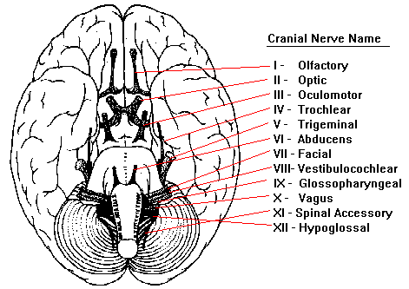
IX. Glossopharyngeal | pharynx, tongue
X. Vagus | major organs, viscera
XI. Accessory | shoulders
XII. Hypoglossal | tongue

Slide 18
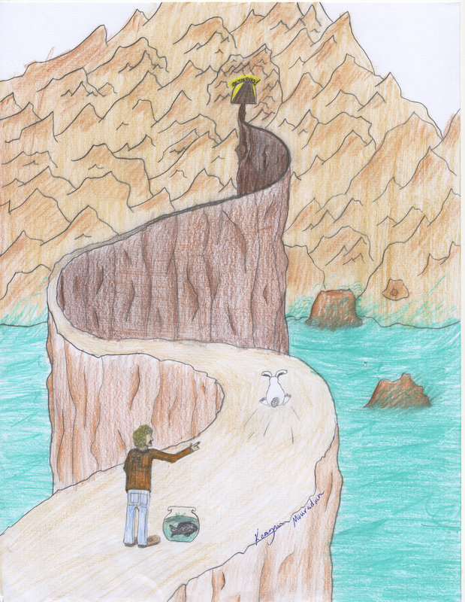
Need to know all of the cranial nerves ?
On Old Olympus Towering Top A Fin And German Viewed A Hop

Slide 19
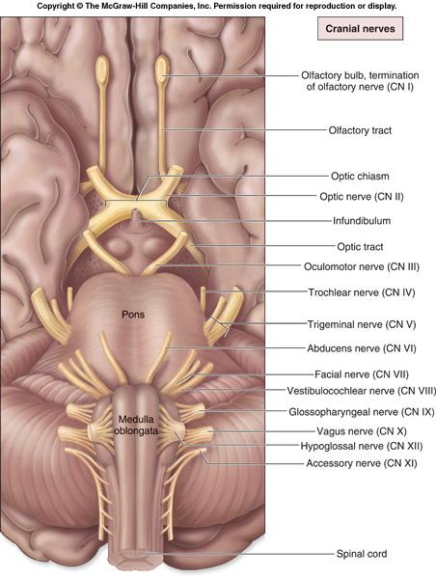
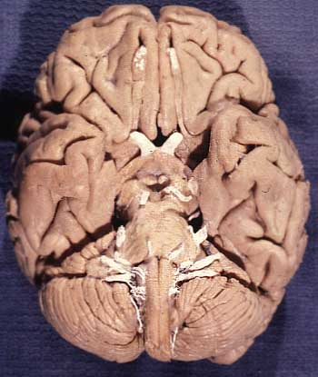

Slide 20
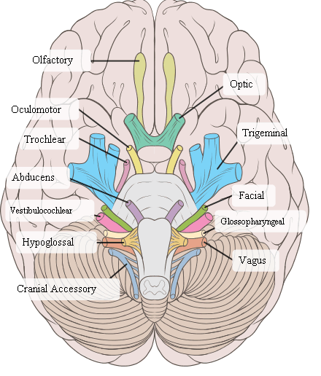

Slide 21
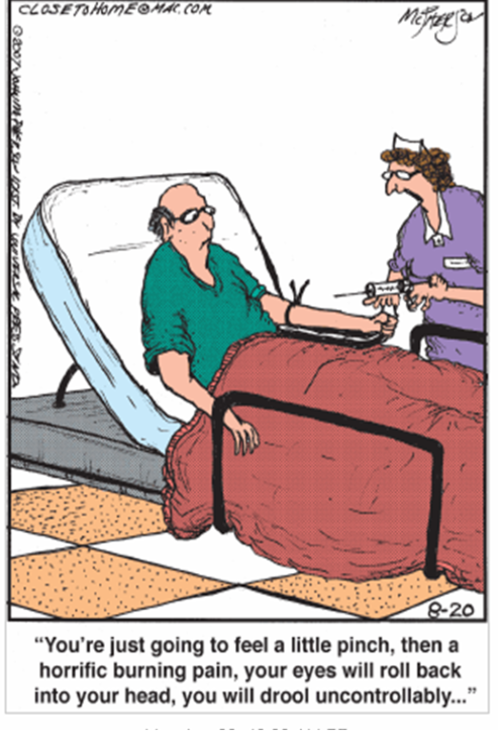

Slide 23
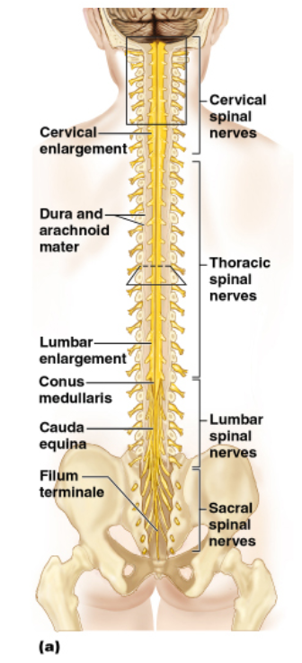
Spinal Nerves
8 pairs of cervical nerves (C1 - C8) 12 pairs of thoracic nerves (T1-T12) 5 pairs of lumbar nerves (L1-L5) 5 pairs of sacral nerves (S1-S5) 1 pair of coccygeal nerves (Co)
31 Total

Slide 24
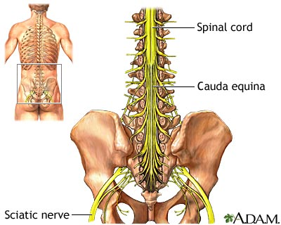
*Spinal cords ends at the level between the 1st and 2nd lumbar vertebrae
*The lumbar, sacral, coccygeal nerves descend from the end of the cord – CAUDA EQUINA (horse’s tail)

Slide 25
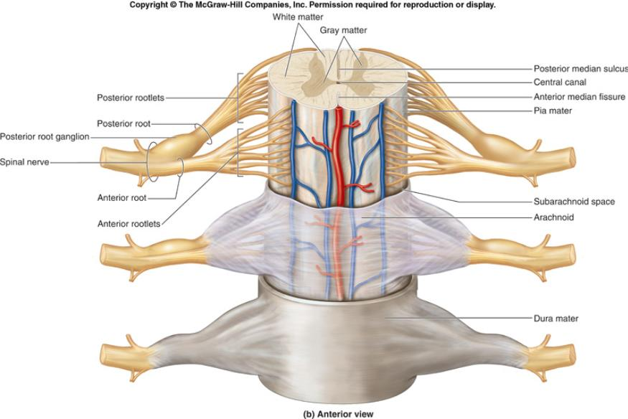
ROOTS

Slide 26
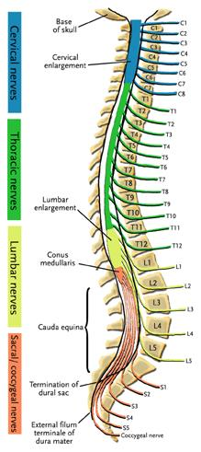
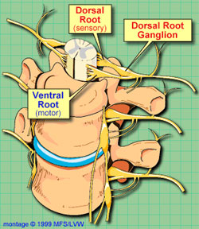
Each nerve emerges from the spinal cord at points called ROOTS
Dorsal Root Ganglion – from backside of spinal cord Ventral root ganglion – from the front side

Slide 27
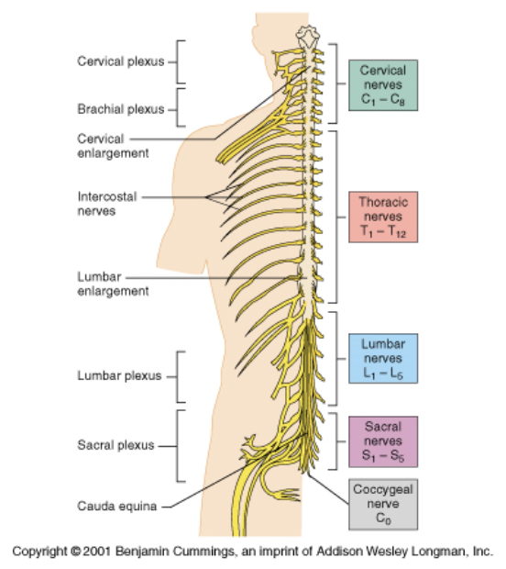
PLEXUSES
Main portions of the spinal nerves combine to form complex networks called PLEXUSES

Slide 28
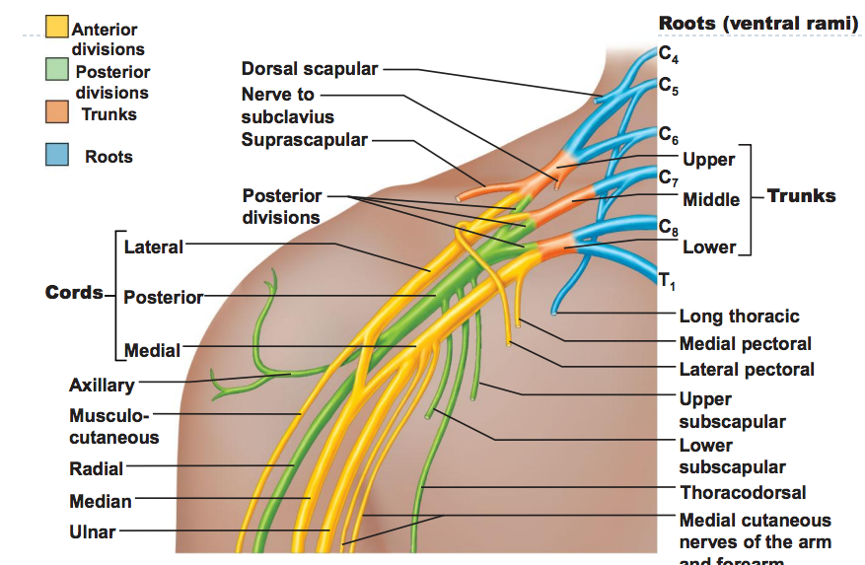
1. Cervical Plexus – phrenic nerves; neck
2. Brachial Plexus - shoulders, arms, hands
Ulnar, median, radial, axillary nerves

Slide 29
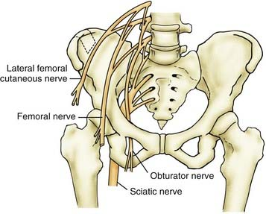
3. Lumbrosacral Plexus
Obturator nerve - obturator Sciatic - lower spine to buttocks (largest nerve) Femoral - femur, knee

Slide 30
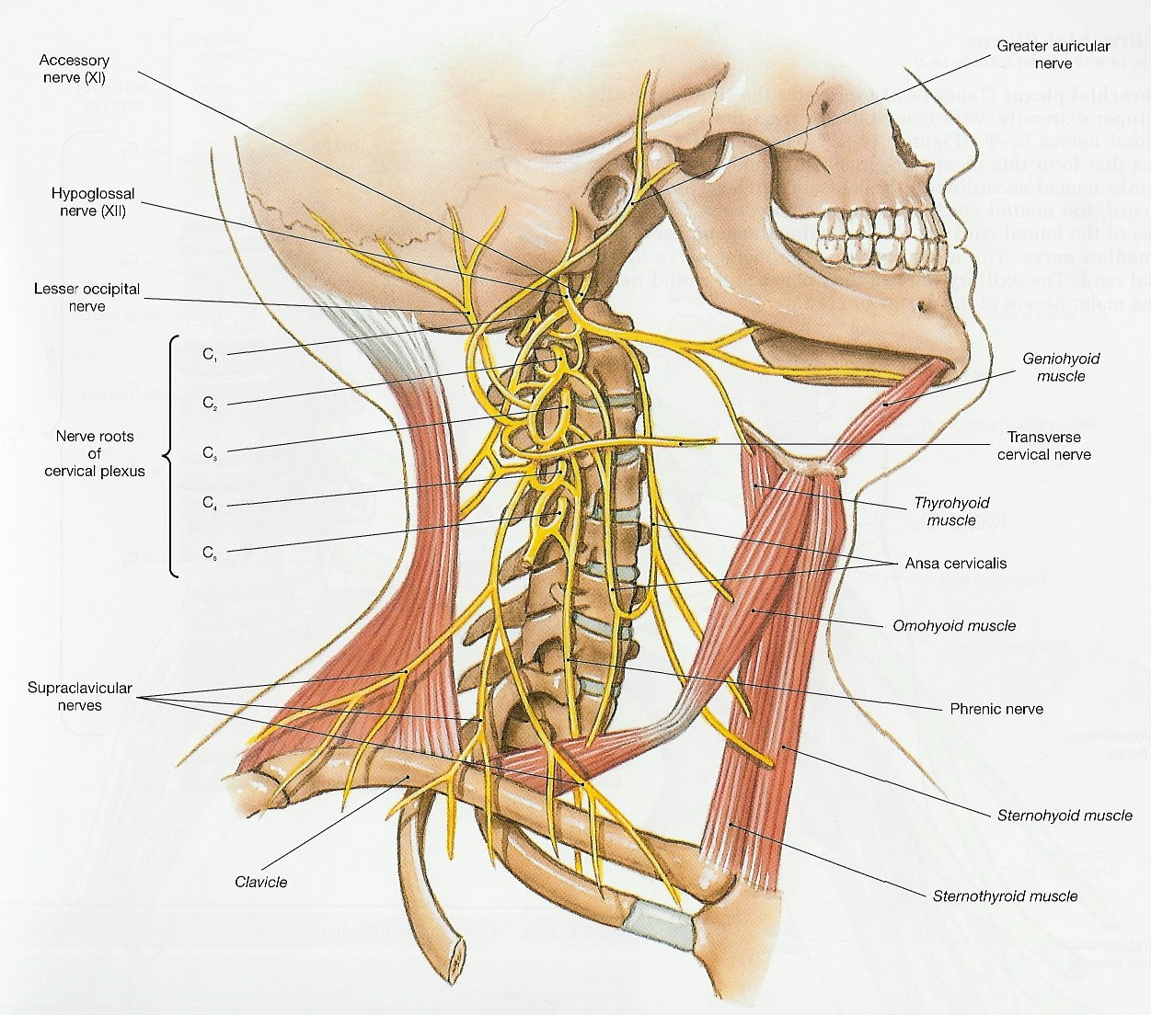

Slide 31
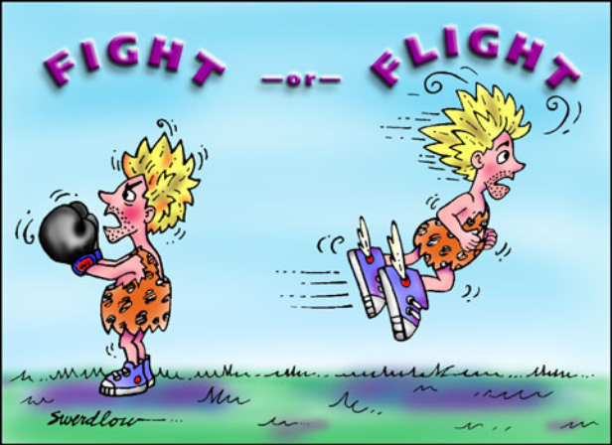
AUTONOMIC NERVOUS SYSTEM
Sympathetic (fight or flight)
Parasympathetic (resting)

Slide 32
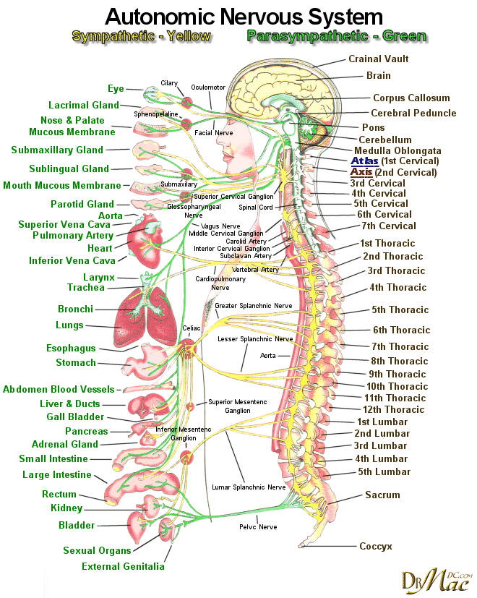
9.15 Autonomic Nervous System
Sympathetic - energy, high stress, emergency
Fight or Flight
Parasympathetic - resting, normal
Divisions act antagonistically - one is exhitatory, other inhibits
Notes:
Exhitatory (turns on); inhibits (turns off)

Slide 33
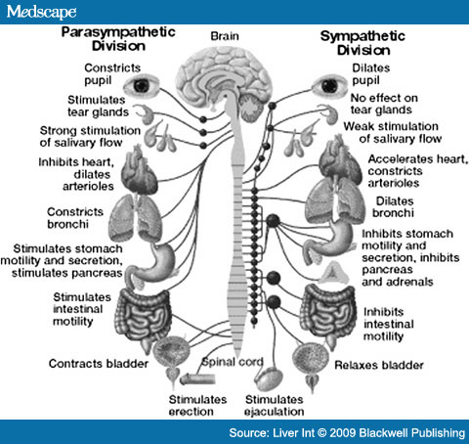

Slide 34
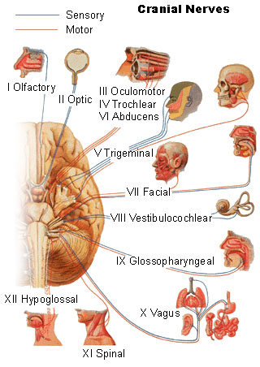
More Images of The Cranial Nerves

Slide 35
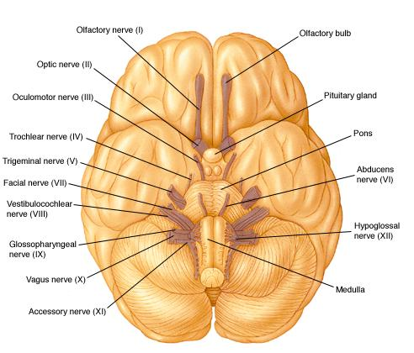

Slide 36
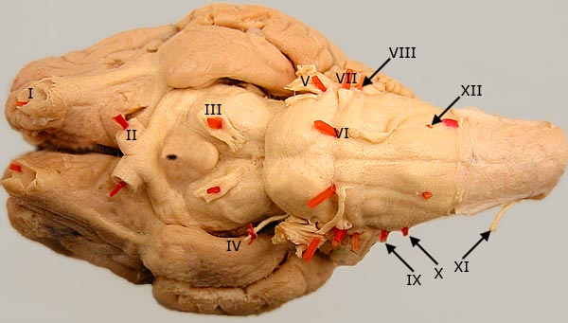
The sheep brain also has the 12 cranial nerves, but they can be difficult to find

Slide 37
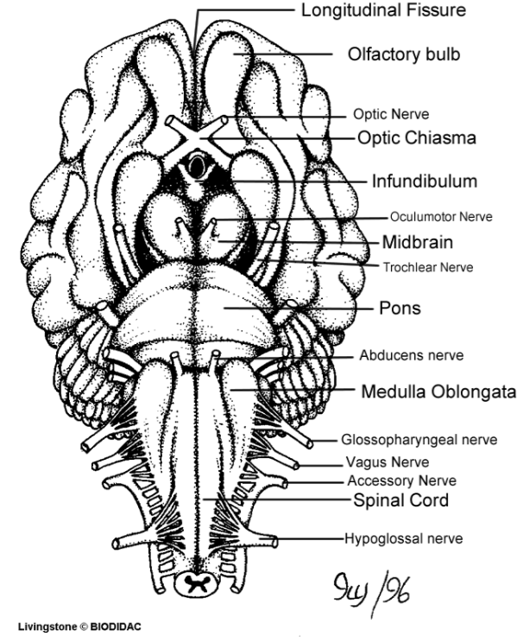
Assignment: Coloring of the Cranial Nerves

Slide 38
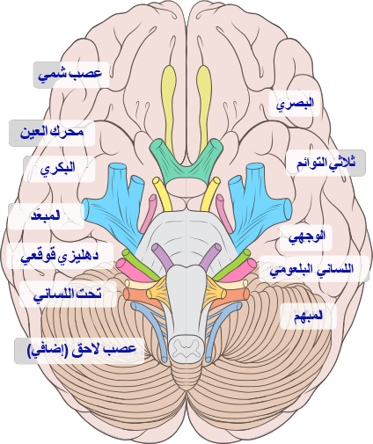

Slide 40
