Slide 1
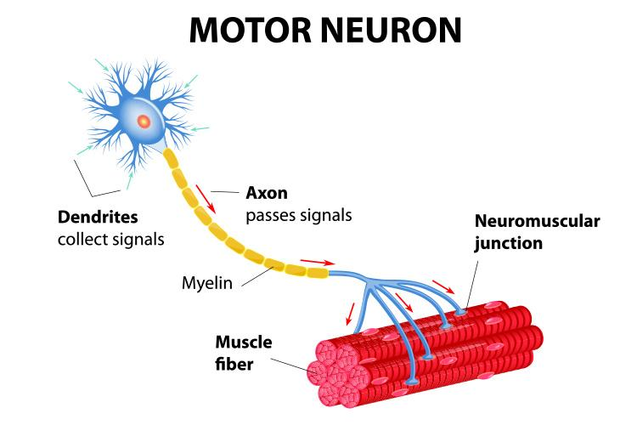
Nerve Impulse
Speed is proportional to the size of the axon
(greater diameter = faster impulse)
Myelinated axons conduct impulses faster than unmyelinated one

Slide 2
The Synapse
Synapse = junction between two communicating neurons
Nerve pathway - nerve impulse travels from neuron to neuron
Dendrite → cell body → along axon -> synapse (gap) → dendrite

Slide 3
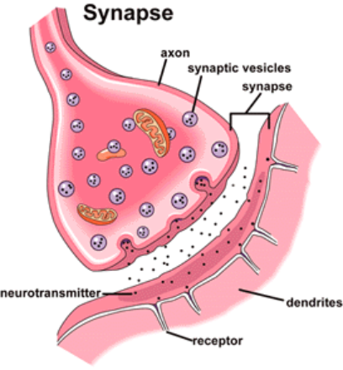
To complete the signal, a NEUROTRANSMITTER is released at the gap to signal the next neuron.
Receptors on the dendrite receive the chemical message
Notes:
What was our neurotransmitter in muscles? ACH!

Slide 4
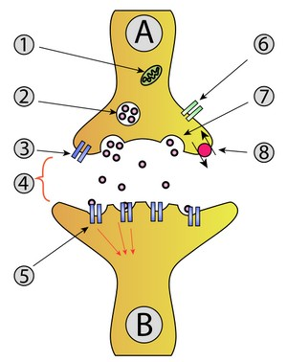
Anatomy of the Synapse
A: Neuron (axon) B: Neuron (dendrite)
Mitochondria
Vesicle
Receptor
Synapse
Receptor
Calcium Channel
Releases neurotransmitter
Re-uptake

Slide 5
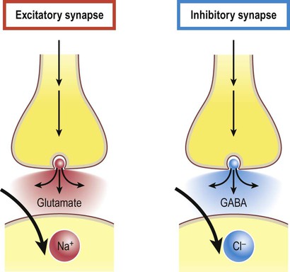
Types of Neurotransmitters
Excitatory - increase membrane permeability, increases chance for threshold to be achieved
Inhibitory - decrease membrane permeability, decrease chance for threshold to be achieved
Notes:
GABA = gamma-Aminobutyric Acid; main neurotransmitter in inhibitory synapse

Slide 6
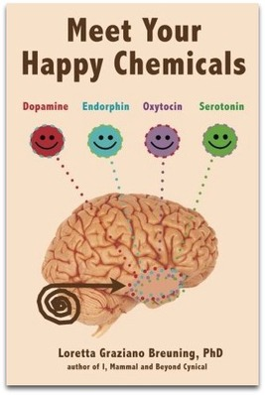
Examples of Neurotransmitters
Acetylcholine - stimulates muscle contraction
Dopamine - mood, happiness
Serotonin = sleepiness and mood
Endorphins = pain reduction, mood

Slide 7
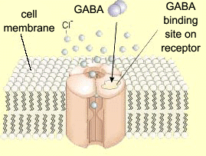
GABA
(gamma-aminobutyric acid)
Reduces the activity of the neurons to which it binds (inhibitor).
Most common type of receptor
40% of all synapses work with GABA
GABA has a tranquilising effect
Low levels of GABA associated with anxiety and phobia
Sedatives bind to GABA receptors
Notes:
Synthesized from – glutamate
It makes neuron less likely to fire
Makes the membrane hyperpolarize
Causes potassium to move out of cell

Slide 8
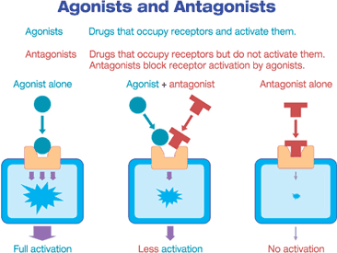
Agonist = molecule that has the same effect on the postsynaptic neuron as the neurotransmitter itself does.
Antagonist = molecule that blocks the effect that the neurotransmitter normally has on the postsynaptic neuron.

Slide 9
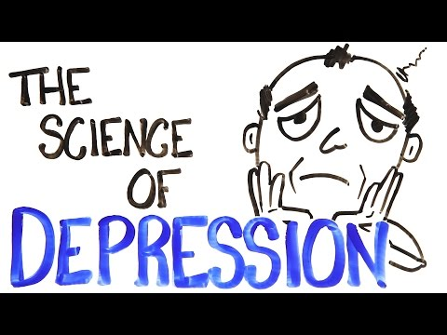
Notes:
Brain cell growth and connections. Brain of depressed persons hippocampus is smaller than average. Hippocampus controls memory and emotion – longer they are depressed, the smaller the hippocampus gets. The cells and networks literally deteriorate. Studies shown that when the neurons are stimulated to increase growth of hippocampus, the mood improves.

Slide 10
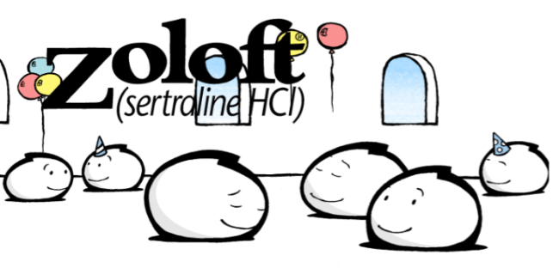
Antidepressants
Zoloft is part of a class of drugs called selective serotonin reuptake inhibitors
it inhibits the uptake of serotonin back into the cell, keeping mood elevated for a longer time.

Slide 11
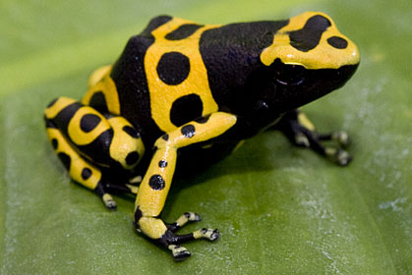
Drugs and Poisons that Affect Nerves
Curare - poison made from frog skin and causes paralysis by blocking Ach receptors at the neuromuscular junction.

Slide 12
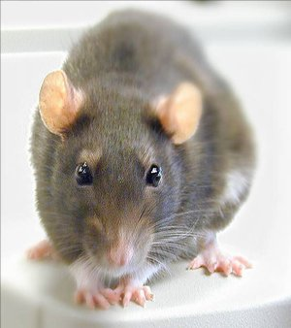
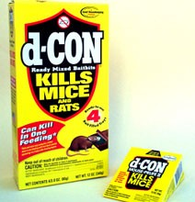
Strychnine poisoning can be fatal to humans and animals and can occur by inhalation, swallowing
It prevents the proper operation of the chemical that controls nerve signals to the muscles. The chemical controlling nerve signals works like the body's “off switch” for muscles. When this “off switch” does not work correctly, muscles throughout the body have severe, painful spasms.
Read about Strychnine Poisoning
Notes:
Strick nine

Slide 13
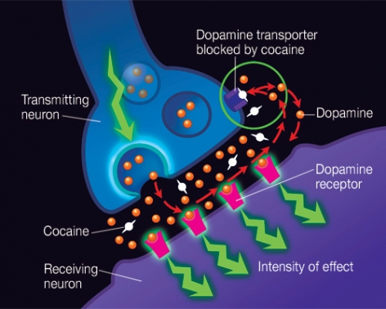
Cocaine
Dopamine binds to receptors and is eventually recycled back into the neuron.
If cocaine is present, it attaches to the dopamine transporter and blocks the normal recycling process, resulting in a buildup of dopamine in the synapse, which contributes to the pleasurable effects of cocaine.

Slide 14
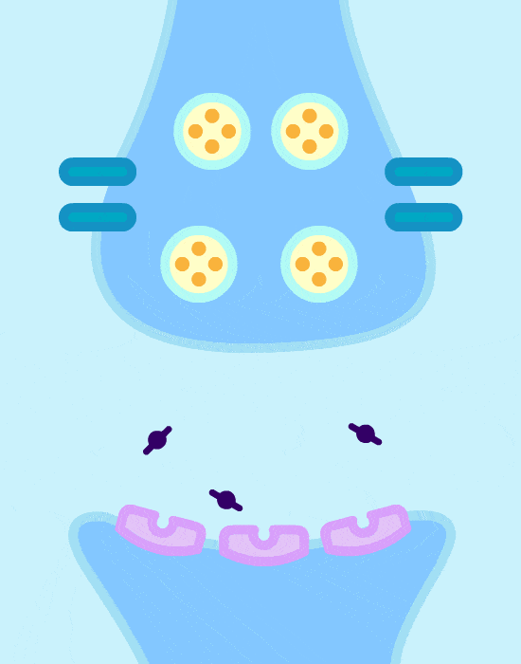
Your neurotransmitters on cocaine

Slide 15
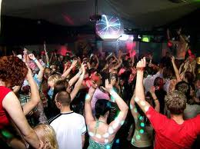
Ecstasy (MDMA)
The neurotransmitter serotonin is vital in regulating many of our basic functions. Serotonin is, among other things, the feel good neurotransmitter and helps to regulate body temp.
Our brain cells are recycle serotonin back into the cells and out of the synapse using serotonin reuptake transporters.
Ecstasy essentially takes these upkeep transporters and reverses their roles. This causes a massive flood of serotonin from the brain cells into the synapse.
The most common cause of Ecstasy-related death is overheating (hyperthermia).

Slide 16
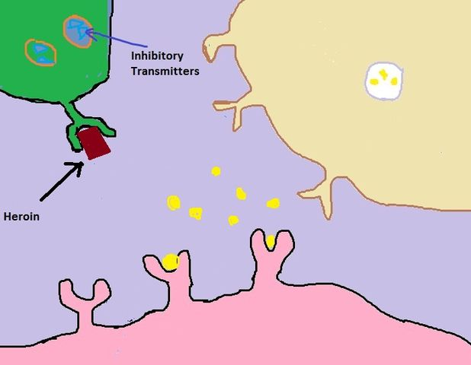
Heroin
Activates opiate receptors
Blocks release of GABA
More dopamine is released
DOPAMINE
Dopamine Receptors

Slide 17
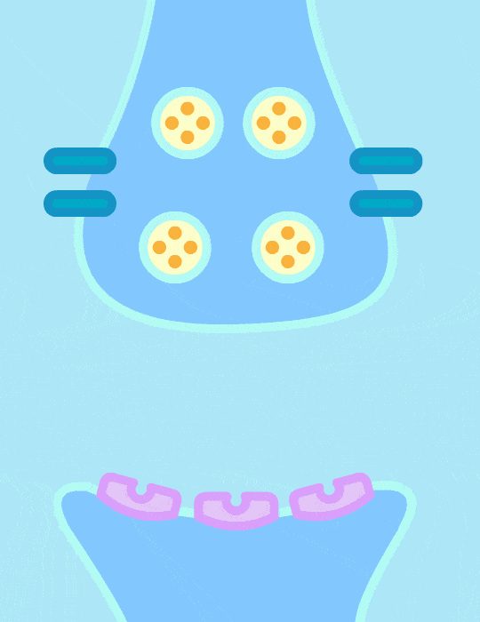
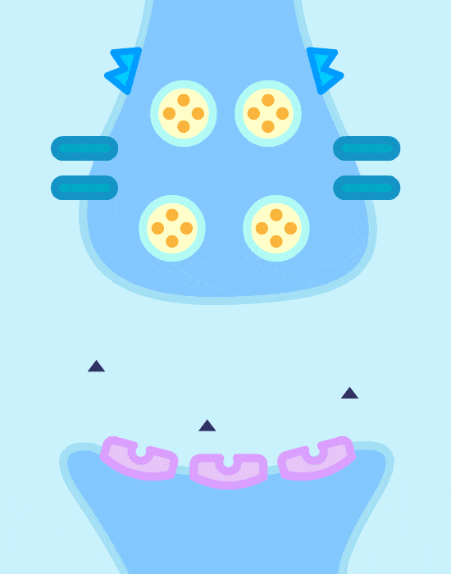
Notes:
Without drugs (1st animation) With opiates (2nd animation)
Source: https://www.buzzfeed.com/kellyoakes/this-is-how-drugs-work

Slide 18
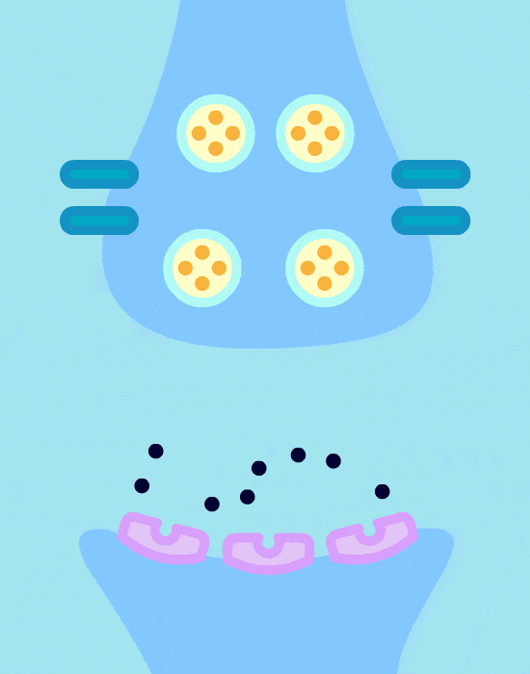
Amphetamines
Mimic dopamine - binding to receptors
Dopamine does not re-enter the cell, depleting the cell’s supply

Slide 19
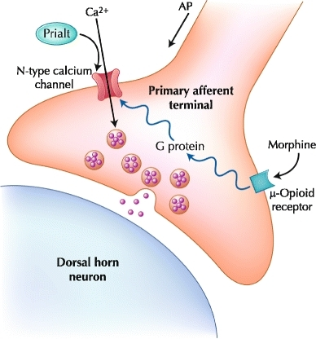
What Is PRIALT?
PRIALT is a calcium channel blocker that could be used to inhibit pain transmission from the spinal cord
PRIALT does not bind to opioid receptors
*Why might this be an important chemical for combating heroin addiction?
http://www.hhmi.org/biointeractive/prialt-blocks-pain-signaling-mice

Slide 20
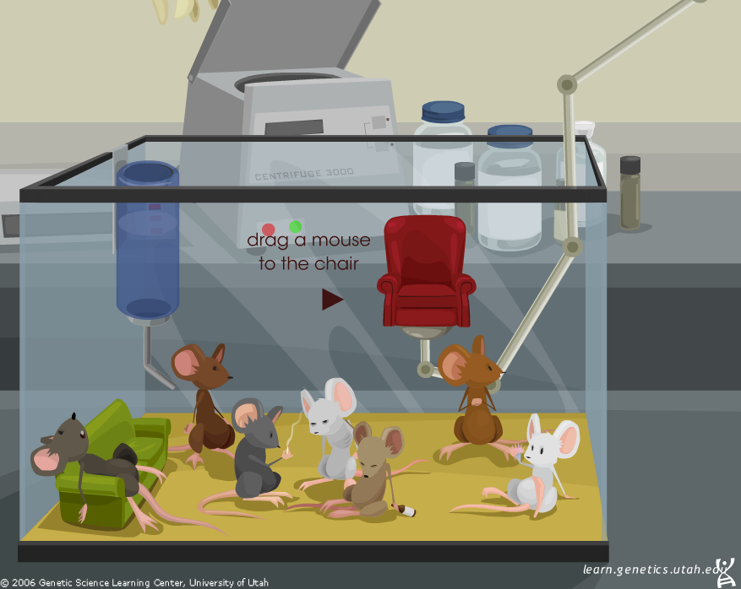
Check out Mouse Party!

Slide 21
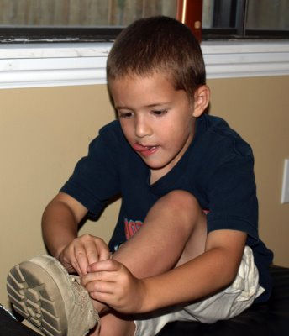
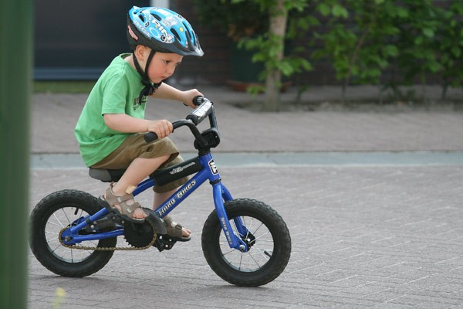
Impulse Processing
Neuronal pool - groups of neurons that make hundreds of synaptic connections and work together to perform a common function
These "pools" help us remember sequential tasks, like tying a shoe or riding a bike.

Slide 22
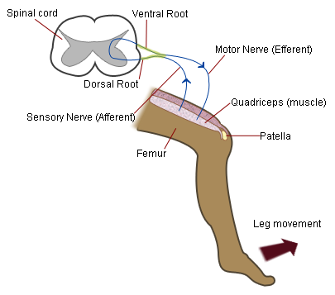
Nerve Pathways
Reflex arc = simple path, only includes a few neurons ( involuntary, instant)
Knee-jerk reflex = maintains uprightness
Withdrawal reflex = avoidance of painful stimuli

Slide 23
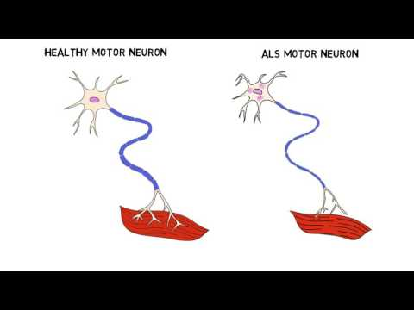
Disorders Related to Neurons
ALS - (Lou Gehrig’s Disease) Amyotrophic Lateral Sclerosis
Progressive degeneration of nerve cells in the spinal cord and brain
NEURODEGENERATIVE
- this means symptoms will get worse over time.
- most patients die within 5 years of diagnosis

Slide 24
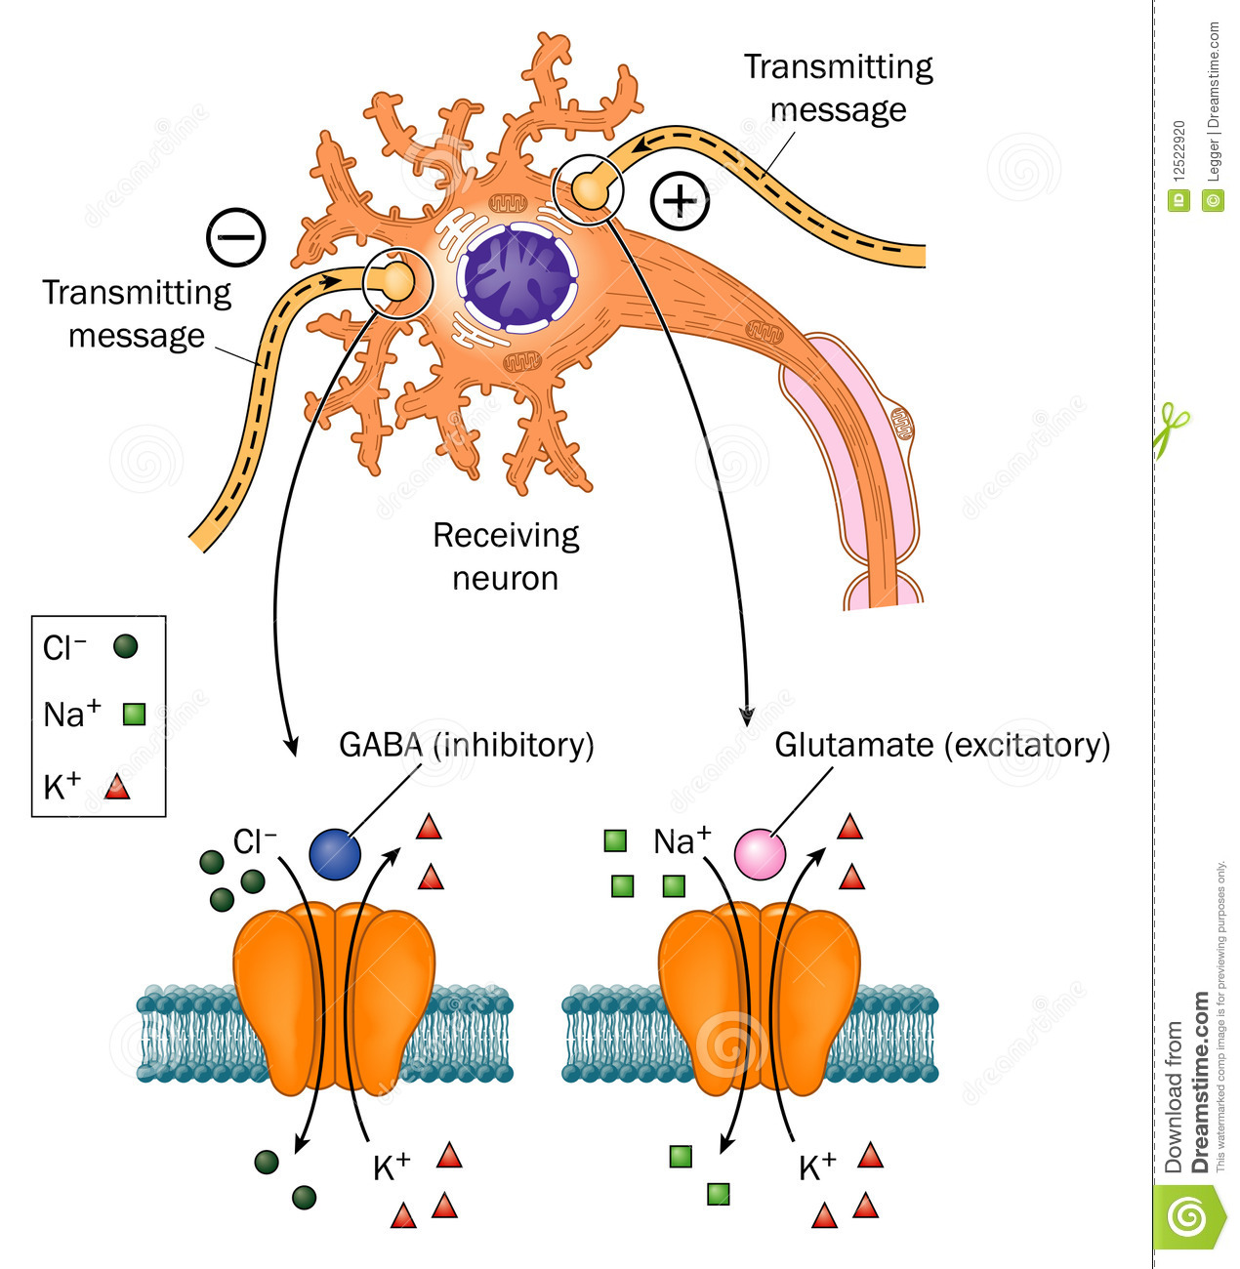
Epilepsy
Epileptic seizures are caused by excessive electrical activity within networks of neurons in the brain.
A fine balance between excitation and inhibition must be maintained in order for the brain to function normally.
If there is too much glutamate, neurons can become hyperexcitable and a seizure may result. Too little GABA (inhibitory) can also result in a seizure.
2 Minute Neuroscience - Epilepsy

Slide 25
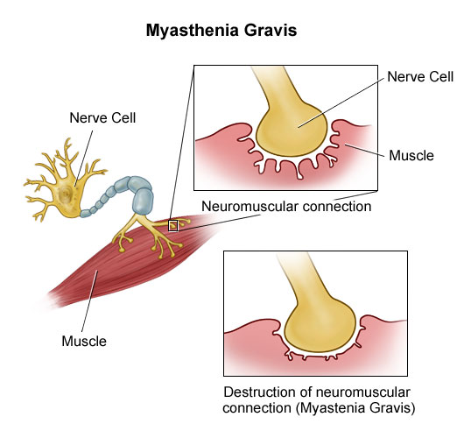
Myasthenia Gravis
autoimmune disorder in which antibodies destroy neuromuscular connections
We did a case study on this during the muscle chapter, do you remember it?

Slide 26
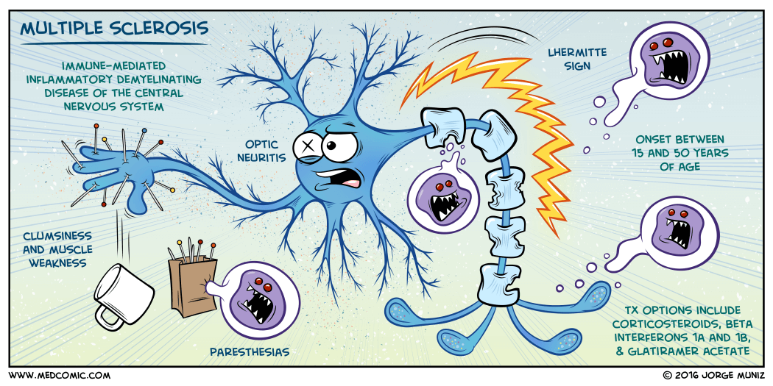
Multiple Sclerosis (MS)
Myelin around the nerve fibers is lost (autoimmune) and forms scar tissue called sclerosis. Nerves cannot conduct impulses to and from the brain.
Affects ability to walk, talk, swallow, and can affect vision.
Notes:
Cartoon link: https://www.kevinmd.com/blog/2016/03/learn-multiple-sclerosis-with-the-power-of-comics.html

