Slide 1
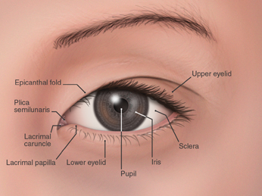
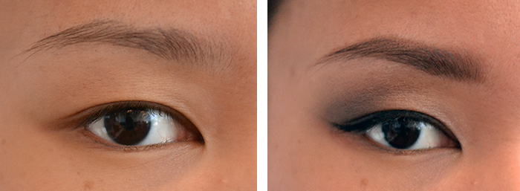
THE EYE
There are 4 cranial nerves: Optic (II), Oculomotor (III), Trochlear (IV), and Abducens (VI).
People of Asian descent have an EPICANTHIC FOLD in the upper eyelid; no functional difference.

Slide 2
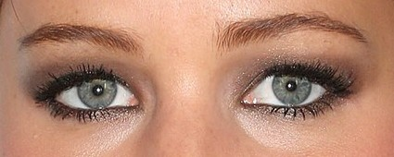
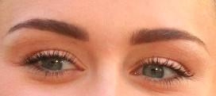
Visual Accessory Organs
Can You Guess the Celebrity Eyes?
These are organs that do not directly contribute to your sense of sight or vision, but do play a role in the health and functionality of the eye.
Notes:
Miley Cyrus, Kristen Stewart, Jennifer Lawrence

Slide 3
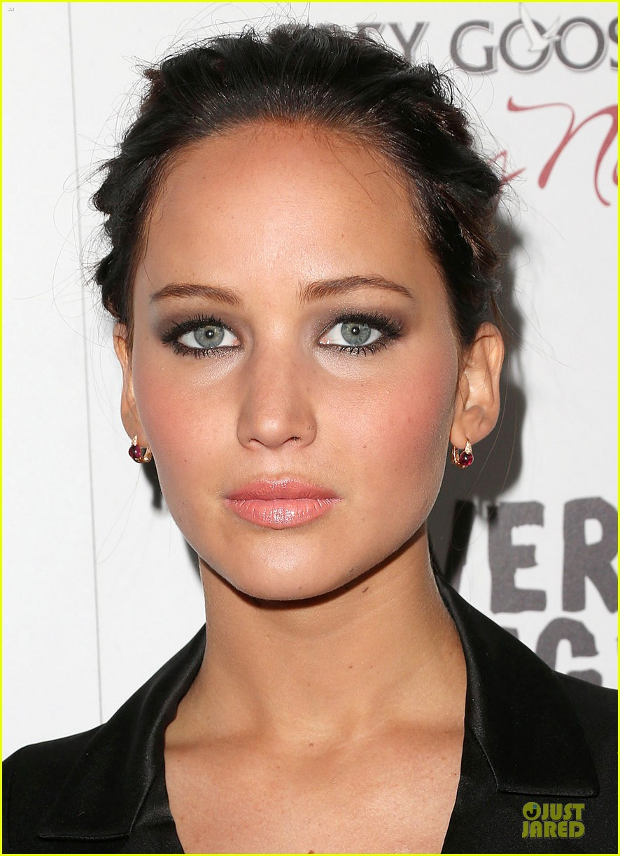

Slide 4
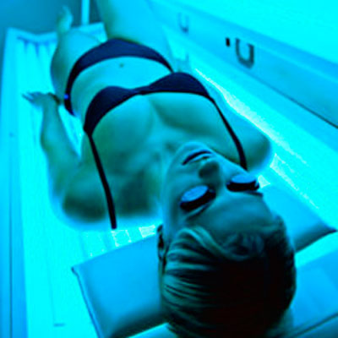
Eyelid
Covers and protects the eye, thin skin
Skin will not protect you from intense radiation, that’s why we use special goggles in a tanning bed

Slide 5
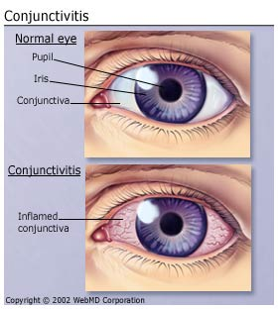
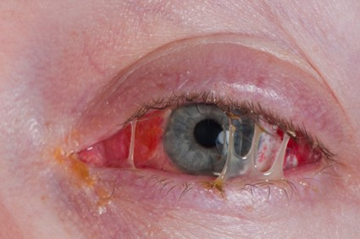
CONJUNCTIVA is a covering around the eye and under the eyelids.
PINK EYE - also known as CONJUNCTIVITIS
(from bacteria, very contagious)
Pink Eye Slide Show from Web MD

Slide 6
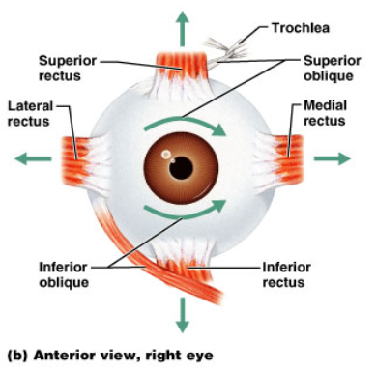
Extrinsic Eye Muscles
5
1
3
4
6
2

Slide 7
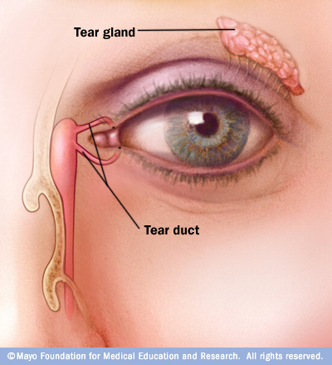
GLANDS OF THE EYE
LACRIMAL GLANDS are the largest set. They are on the superior lateral eyelid and they produce tears, which drain into the nasal cavity via the LACRIMAL DUCT.
The function is to moisten and lubricate the eye surface, and it has enzymes to kill bacteria (which thrive in warm, moist conditions).

Slide 8
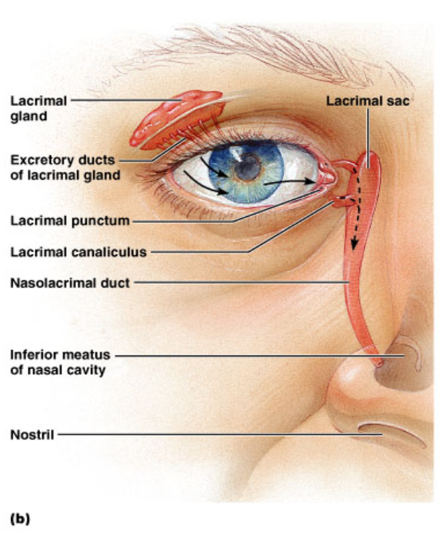
Figure 16.5b

Slide 9
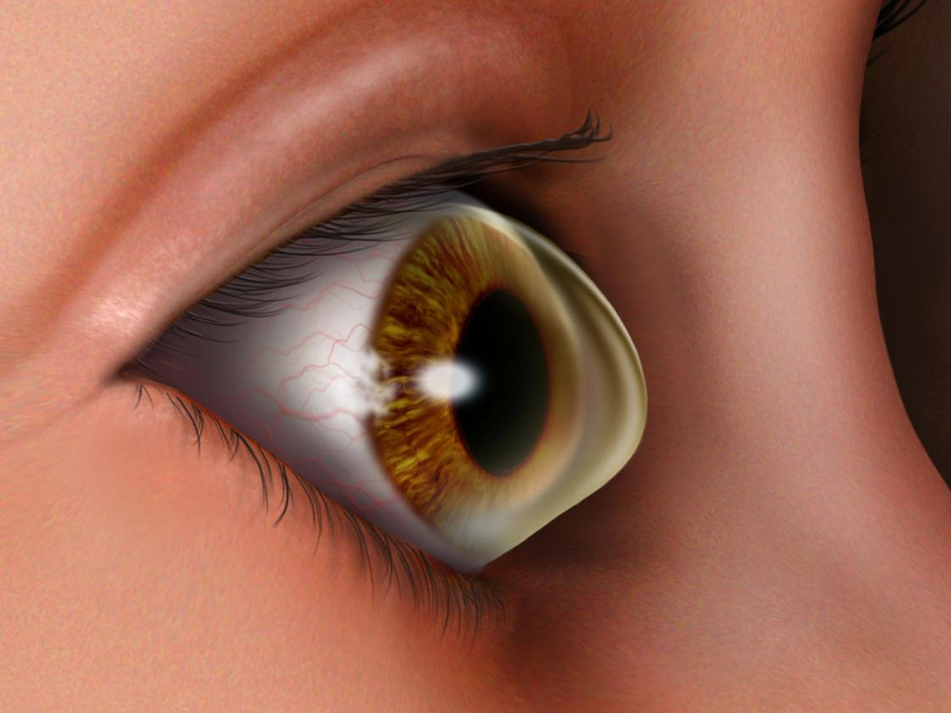
Outer Tunic
Cornea - transparent, focuses light rays
Sclera – continuation of cornea, going toward the back of the eye (white of the eye)
Optic Nerve – exits at the optic disk and transmits visual information from the eye to the brain.
Keratoconus is an eye condition in which the normally round cornea thins, causing a cone-like bulge to develop.
Source: NPR http://n.pr/1a1oSx6

Slide 10
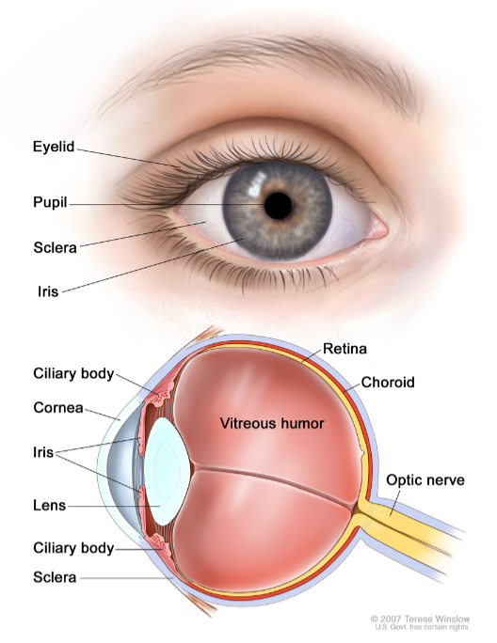
Middle Tunic
Choroid Coat – contains blood vessels
Ciliary Body – holds the lens in place
Lens – focusing
Iris – colored portion of the eye
Aqueous humor – liquid surrounding the lens
Pupil – opening for light to enter

Slide 11
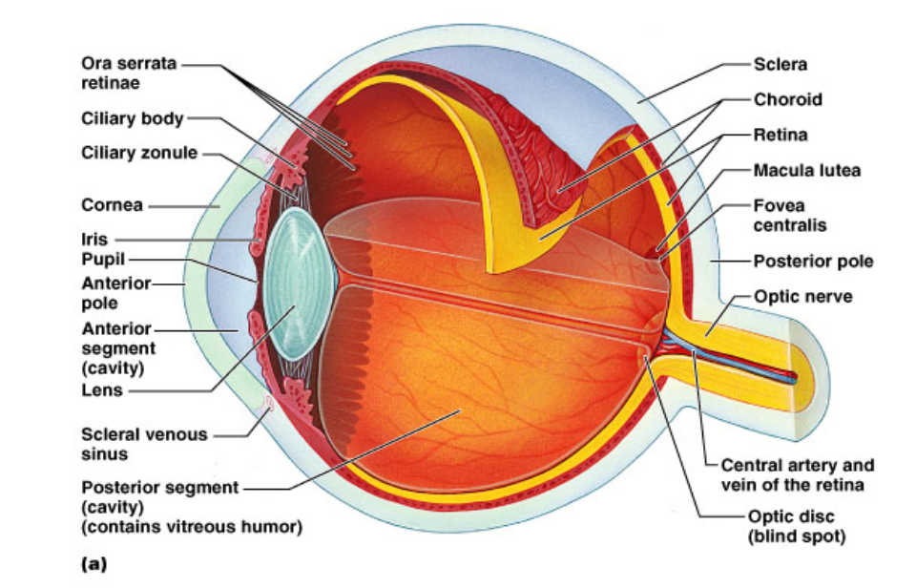
Figure 16.7a

Slide 12
Inner Tunic
Retina - visual receptor cells
Fovea Centralis - region of the sharpest vision (aka, macula)
Optic Disc – where nerve fibers leave the eye, creating the blind spot
Vitreous Humor – supports internal parts, fluid

Slide 13
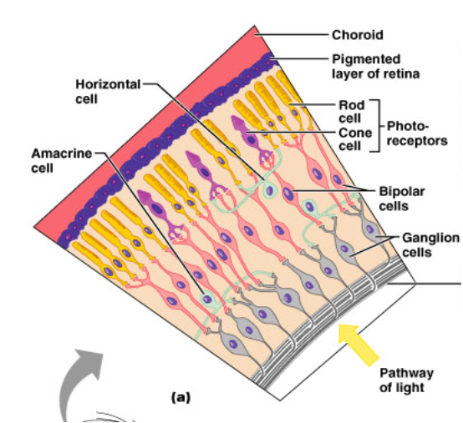
Retina
The retina is made up of PHOTORECEPTORS, which are sensors for light.

Slide 14
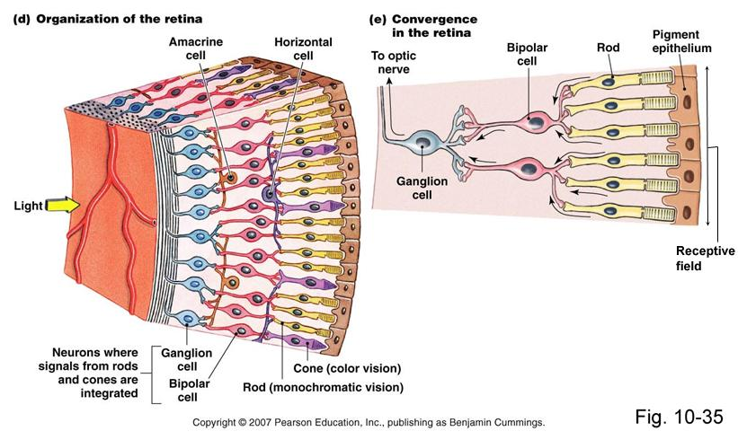
Rods = monochromatic (b&w)
Cones = color vision

Slide 15
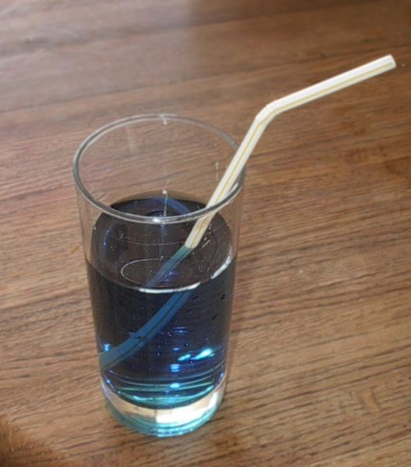
Light Refraction
Light bends around objects
Images viewed by the eye are upside down

Slide 16
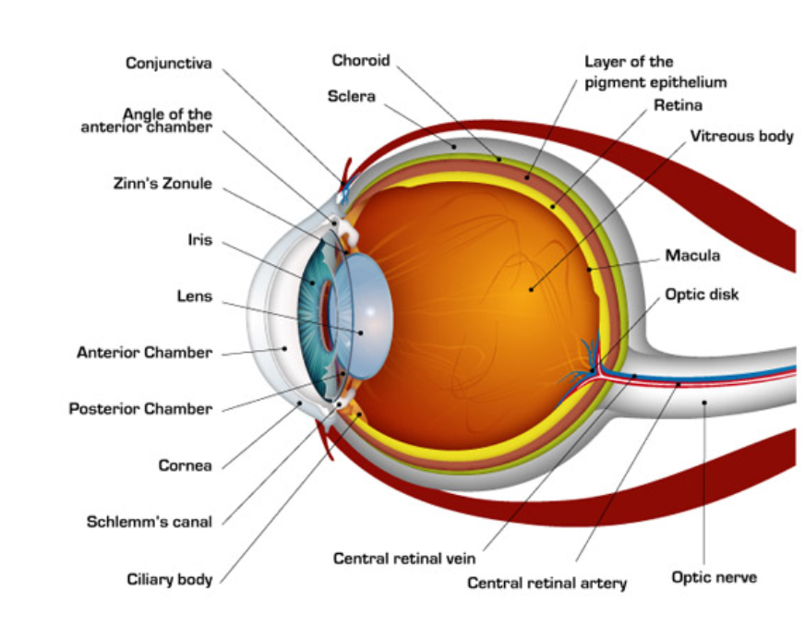
Vitreous Humor
fovea centralis
Aqueous Humor

Slide 17
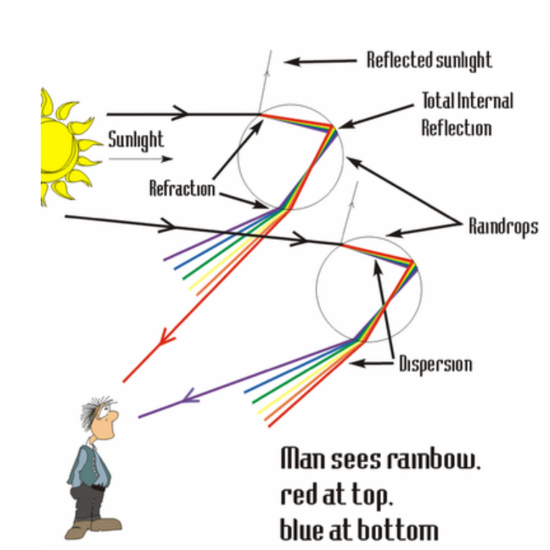
R.O.Y.G.B.I.V
Rainbows are seen after rain because light is passing through water droplets. This separates the white light into the individual colors of the spectrum

Slide 18
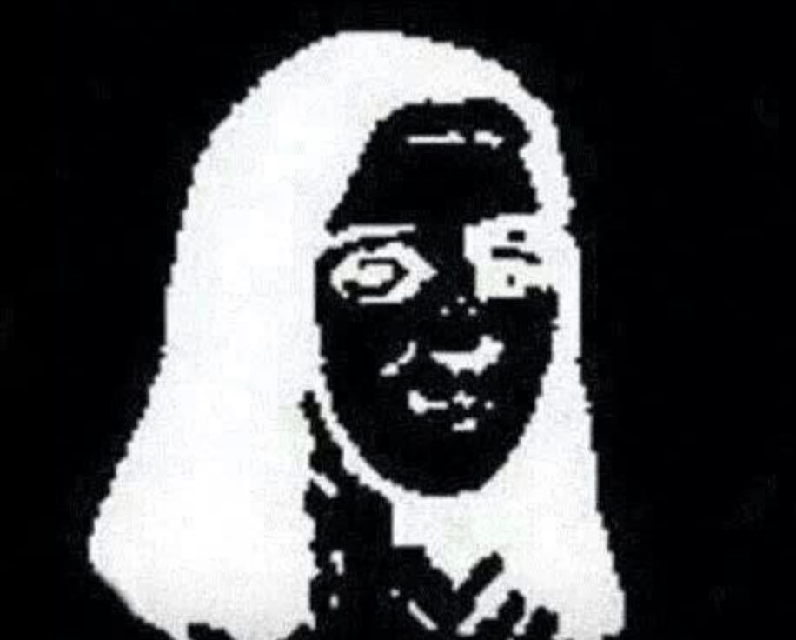
Stare at the 3 dots over her nose for 20 seconds. Then look at the wall or ceiling.

Slide 19
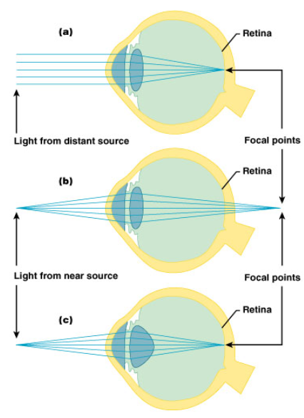
The Eye as an Optical Device

Slide 20
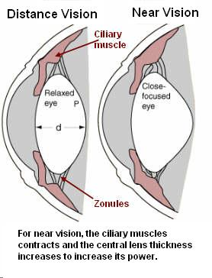
Accommodation
Lens changes shape to facilitate focusing
Shape change is dependent upon the suspensory ligaments

Slide 21
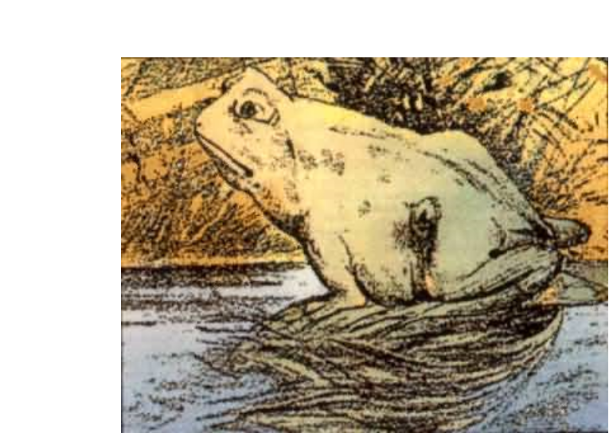

Slide 22
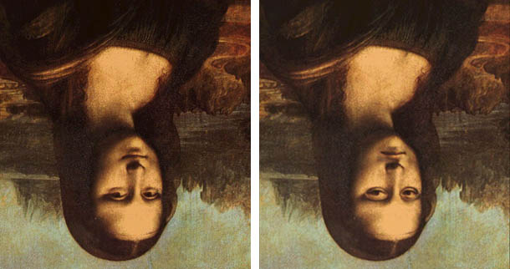
We have difficulty interpreting images that are upside down
Which one is the real mona lisa?

Slide 23
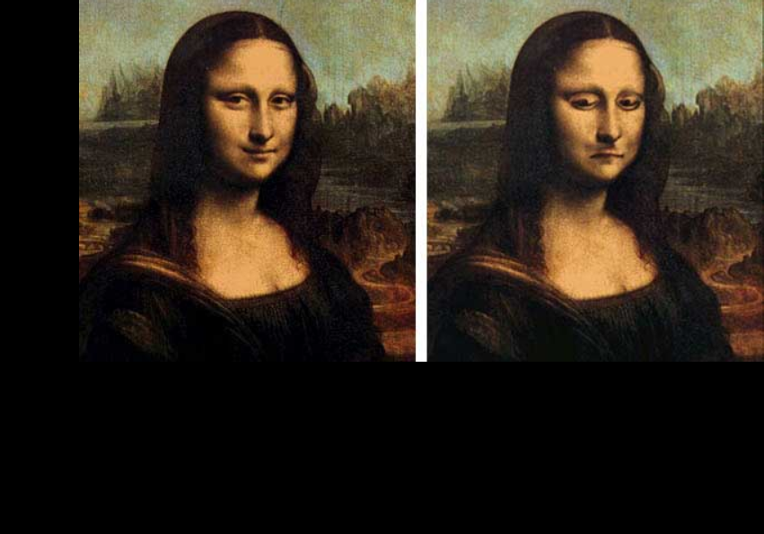

Slide 24
PUPILS
Fun Fact: -When you are looking at someone you love, your pupils dilate, and they do the same when you are looking at someone you hate.

Slide 25
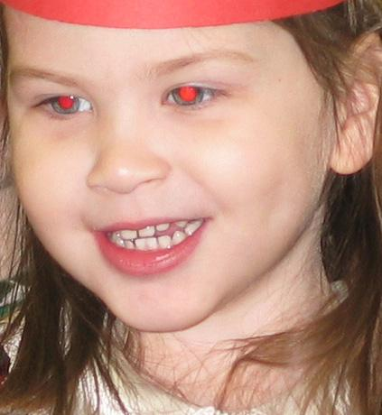
What causes red-eye?
The flash on a camera is bright enough to cause a reflection off of the retina -- what you see is the red color from the blood vessels. Many cameras have a "red eye reduction" feature. In these cameras, the flash goes off twice -- once right before the picture is taken, and then again to actually take the picture. The first flash causes people's pupils to contract, reducing "red eye"

Slide 26
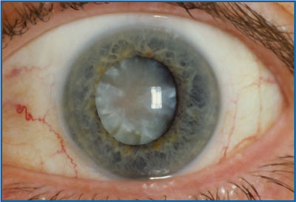
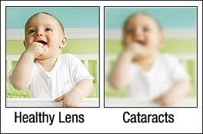
Problems with the Eyes Cataracts - Clouding of the lens leads to a clinical condition known as CATARACTS.

Slide 27
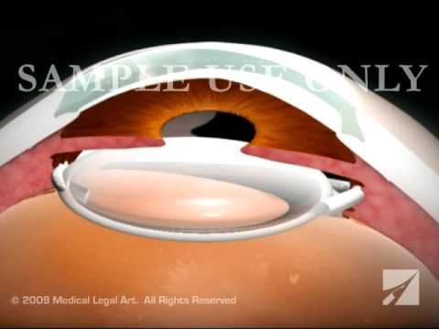
Treatment is to remove the lens and replace it with an artificial one.
Cataract Surgery in 6 minutes - Graphic | Cataract Surgery in 5 minutes

Slide 28
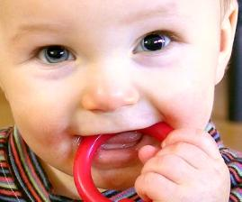
Problems with the IRIS and PUPIL
The function is to constrict or dilate the pupil (opening) to allow light in.
Therefore, it regulates the amount of light passing to the visual receptors of the eye.
ANIRIDIA = a condition
where a person is born without an iris

Slide 29
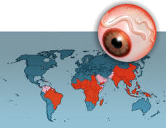
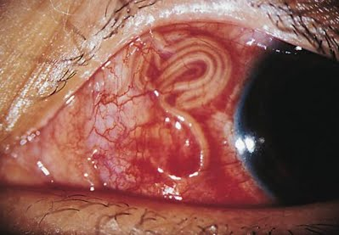
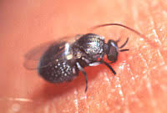
Onchocerciasis, also known as river blindness, is a disease caused by infection by a parasitic worm. Symptoms include severe itching, bumps under the skin, and blindness.

Slide 30
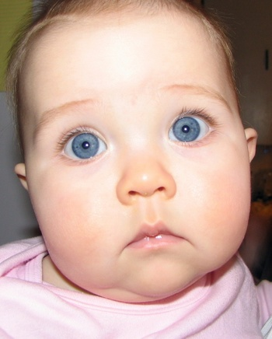
Why are babies born with blue eyes?
Melanin is a brownish pigment that adds color to your hair, eyes, and skin. At the time babies are born, melanin hasn't yet been "deposited" in the eyes' iris. Hence, they appear blue.
After about six months, eyes change color depending on the amount of melanin. If you have a lot of it, your eyes will turn dark brown. If you have little, they'll stay blue. And if you have no melanin, your eyes may appear pink (albino). .

Slide 31
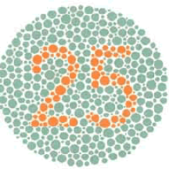
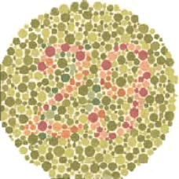
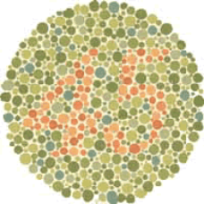
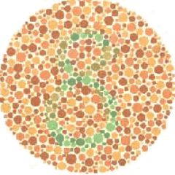
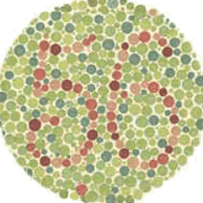
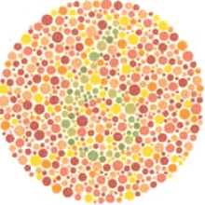
Colorblindness
A genetic trait that affects boys more than girls. The location of the gene is on the X chromosome

Slide 32
BLIND SPOT (optic disk)
The region where the optic nerve and blood vessels goes in and out of the eye has no photoreceptors = BLIND SPOT.
Hold your hands out at 45° and that’s the location of the blind spot.
You can still see your hands because the other eye sees it. Close your right eye and look for your right hand and you’ll find the blind spot.

Slide 33
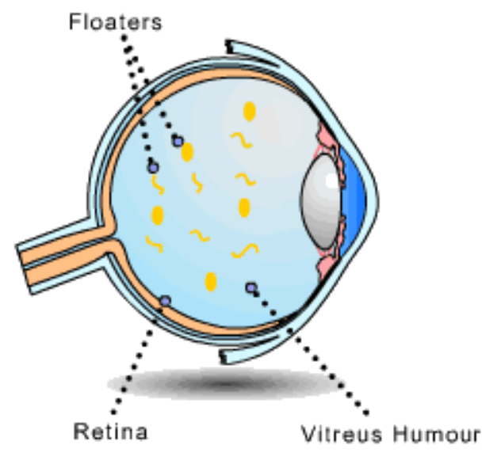
Problems with Vision
FLOATERS are when a capillary breaks and cells break off.
Floaters don’t actually move, the eye just tries to track them.

Slide 34
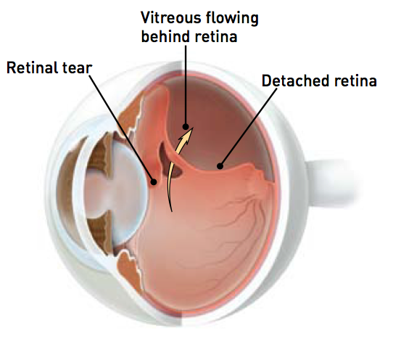
Retinal Detachment
A retinal detachment occurs when the retina is pulled away from its normal position. The retina does not work when it is detached. Vision is blurred, just as a photographic image would be blurry if the film were loose inside the camera.
A retinal detachment is a very serious problem that almost always causes blindness unless it is treated.
Symptoms
flashing lights;
new floaters;
a shadow in the periphery of your field of vision;
a gray curtain moving across your field of vision.

Slide 35
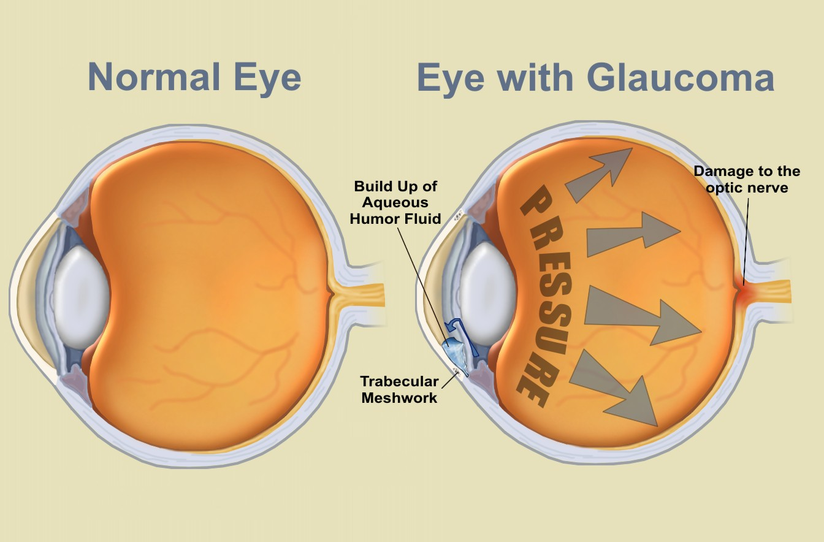
Glaucoma
Glaucoma is the second most common cause of blindness in the United States. Source: http://www.ncbi.nlm.nih.gov/pubmedhealth/PMH0002587/

Slide 36
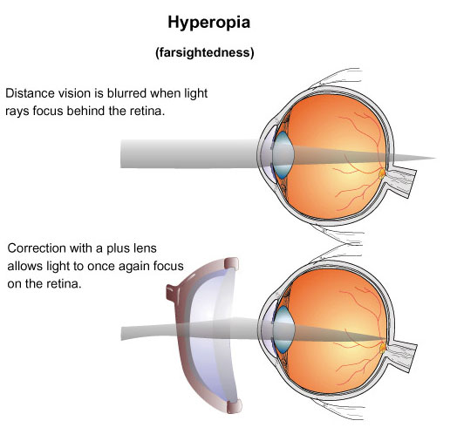
Hyperopia = farsightedness
You can see distant objects fine, but close objects appear blurry

Slide 37
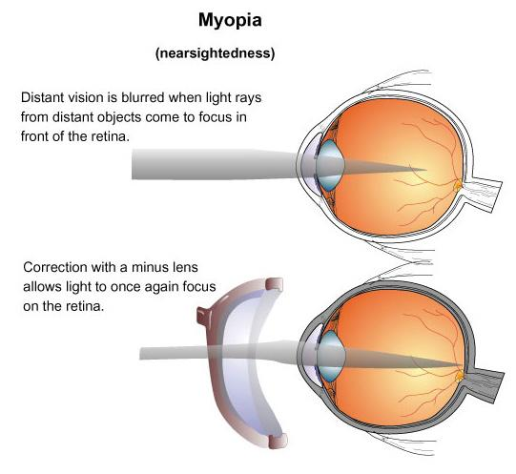
Myopia = nearsightedness
You can see near objects fine, but distant objects appear blurry

Slide 38
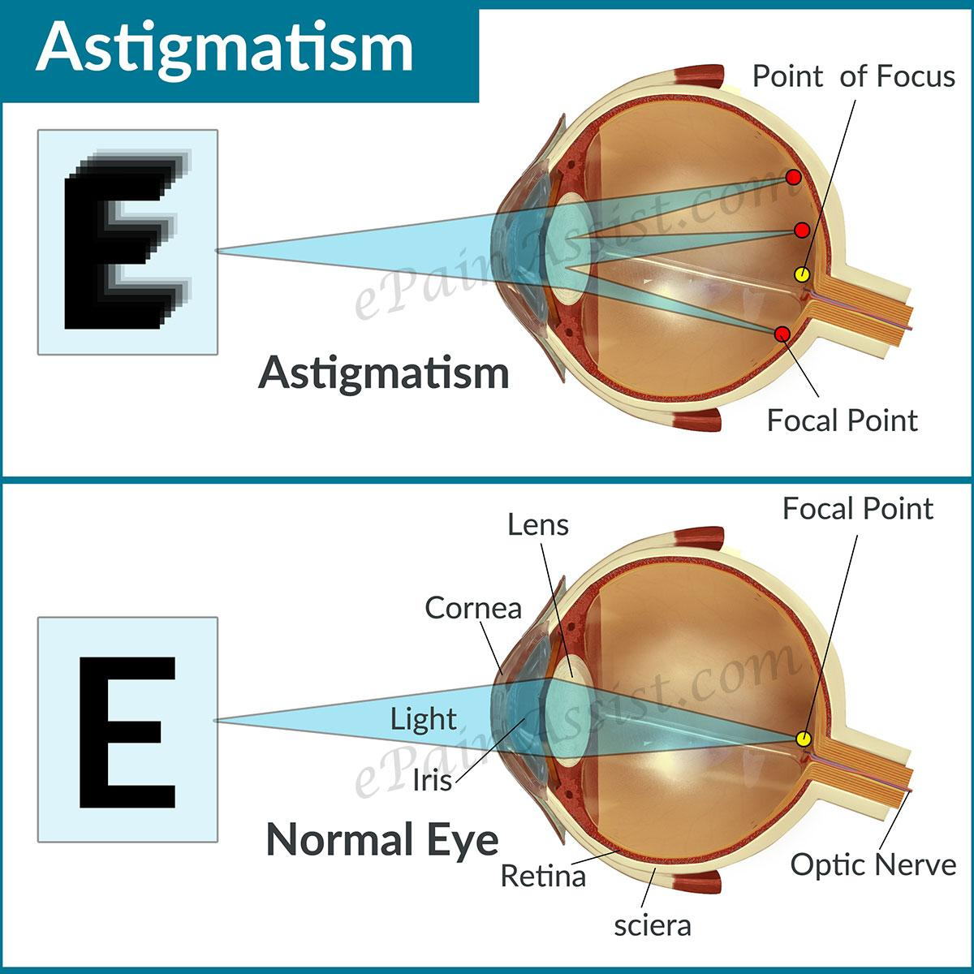
ASTIGMATISM is when the cornea has an irregular shape. ‘
Part of the field of view is out of focus.

Slide 39
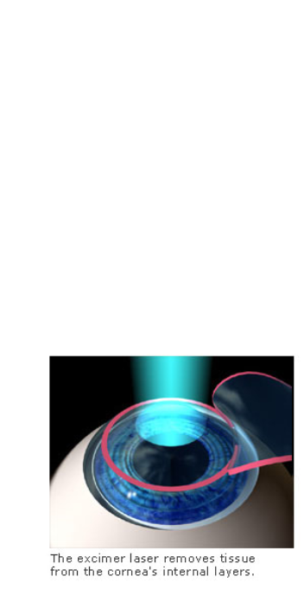
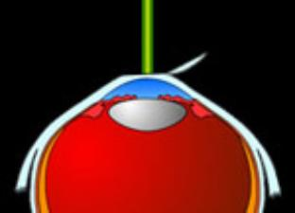
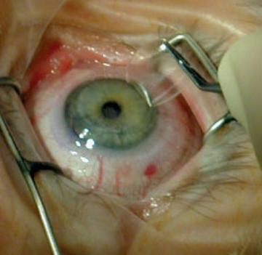
Lasik Surgery

Slide 40
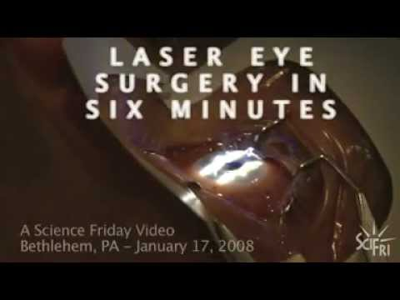
See a real LASIK surgery (not for the squeamish)

