Slide 1
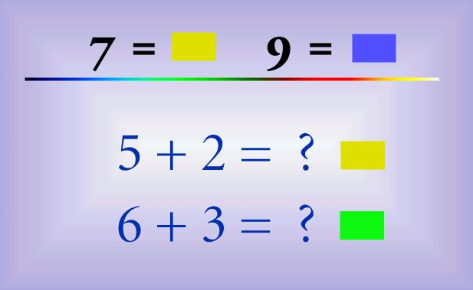
Chapter 10: The Senses
What if you could taste colors and see music?
Synesthesia is a perceptual phenomenon in which stimulation of one sensory or cognitive pathway leads to automatic, involuntary experiences in a second sensory or cognitive pathway.
Ideasthesia – Letters and numbers evoke colors
Notes:
Notes Handout at: https://docs.google.com/document/d/1dRjCM_6HGU72Zd17dILoBdvV6F3CC0C0u4_z67VvfPU/edit?usp=sharing

Slide 2
General Senses = receptors found throughout the body, including joints and organs
Special senses = specialized receptors found in the head (eyes, ears, mouth)

Slide 3
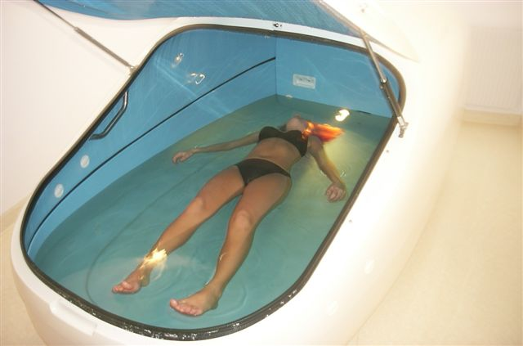
Sensations & Receptors
Sensation = feeling that occurs when a brain interprets a sensory nerve impulse
Projection = the brain causes a feeling to stem from a source
Sensory adaptation = sensory receptors stop sending signals when they are repeatedly stimulated
What do you think is going on in this picture?
Sensory Deprivation is a technique initially used by neuro-psychiatrists designed to deliberately reduce or completely remove stimuli from one or all of the senses.

Slide 4
Receptor cells in the PERIPHERAL NERVOUS SYSTEM are activated by stimuli in the environment
Receptor cells can be classified into types on the basis of three different criteria:
cell type, position, and function

Slide 5
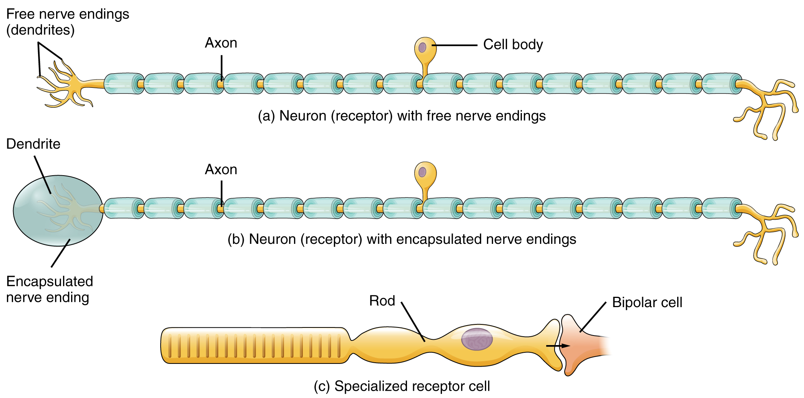
Structure Receptor Types
Free Nerve Endings - dendrites embedded in tissue as receivers
Respond to pain and temperature
Encapsulated - embedded in connective tissue to increase sensitivity (pressure and touch)
Specialized - receptors in the retina of the eye

Slide 6
Functional Receptor Types
Chemoreceptor - chemicals, mostly found in nose/mouth
Photoreceptors – by light energy
Thermoreceptor - temperature
Mechanoreceptor - pressure, vibration, body position
Pain receptors - tissue damage

Slide 7
Sense of Pain
Visceral Pain - occurs in visceral tissues such as heart, lungs, intestine
Referred pain - feels as though it is coming from a different part (heart pain may be felt as pain in arm or shoulder)
Acute Pain - originates from skin, usually stops when stimulus stops (needle prick)
Chronic Pain - dull aching sensation

Slide 8
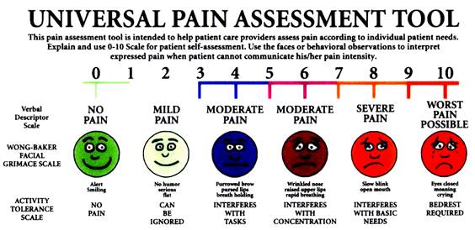

Slide 9
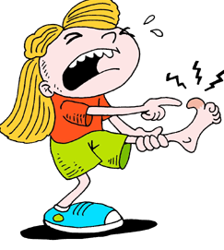
Use the universal pain assessment tool to assess the pain level for each event.
Stubbed toe
Burn from stove
Slamming finger in a door
Paper cut
Sprained ankle
Sore throat
Migraine

Slide 10
How can you measure pain in babies and young children?
Face, Legs, Activity, Cry, Consolability scale or FLACC scale

Slide 11
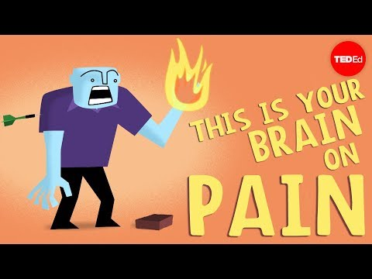

Slide 12
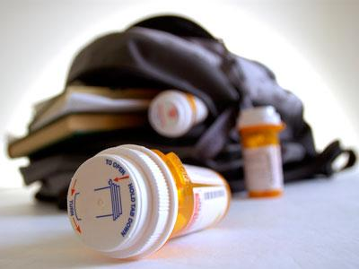
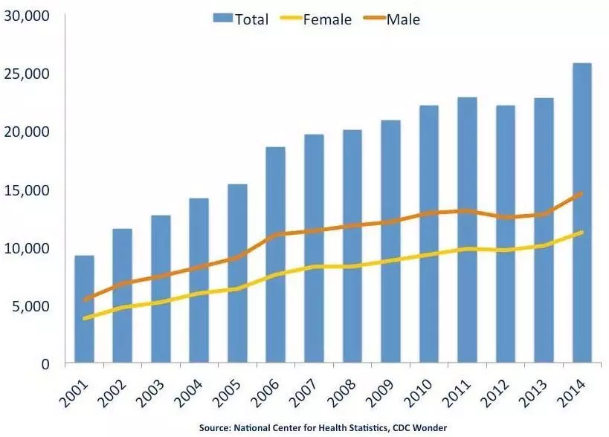
The Rising Tide of Prescription Abuse
2.6 million people nationwide now regularly use prescription pain pills for recreational purposes. Taken in small doses, painkillers produce feelings of euphoria with no hangover.

Slide 13
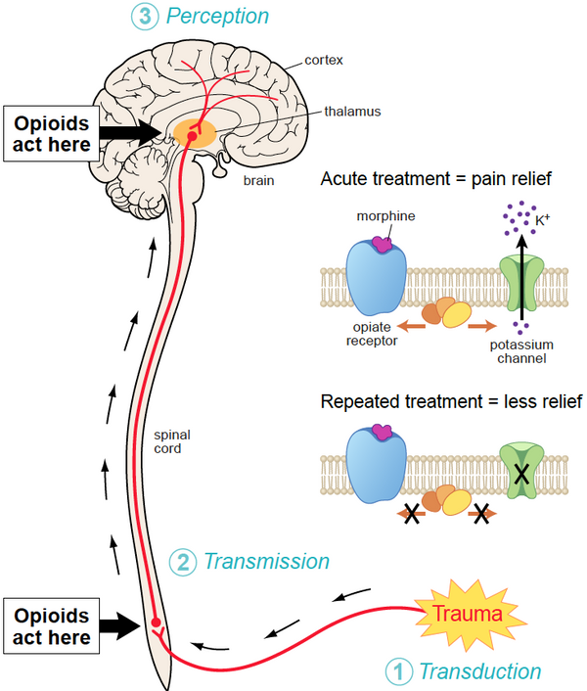
An overview of how opioids work to block pain and why they become less effective the longer you use them.
1. Nerve sends signal
2. Opioids slow/block signal
3. Limbic system (emotions) and reward pathway are stimulated

Slide 14
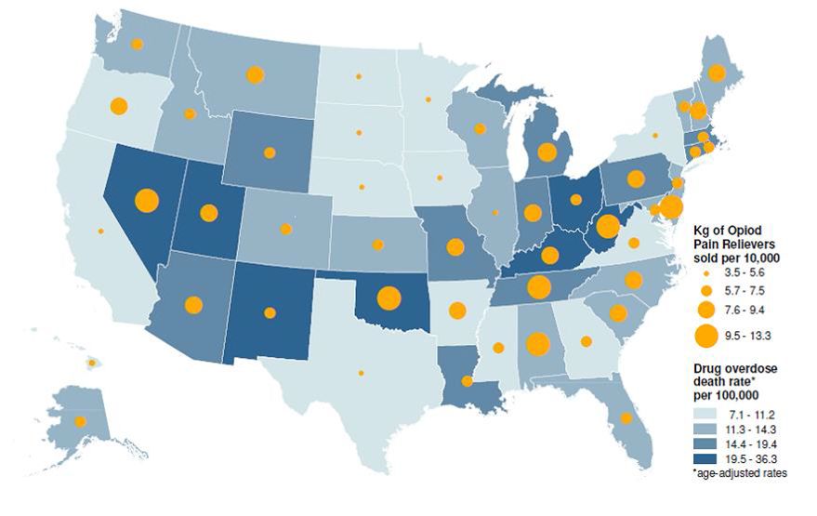
What is the responsibility of the government with regard to drug use and overdose? What strategies can reduce the number of overdose deaths?

Slide 16
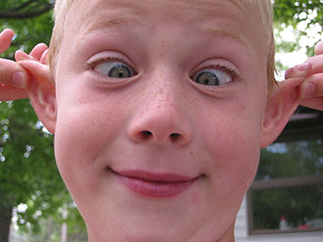
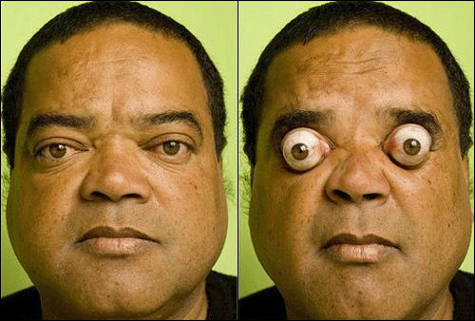
Special Senses
Olfactory (smell)
Taste buds (taste)
Hearing & Equilibrium (ears)
Sight
(eyes)

Slide 17
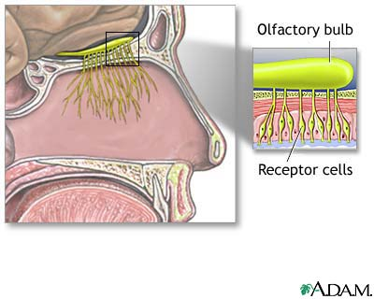
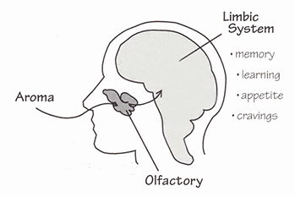
Sense of Smell (Olfactory)
Odor → Receptor Cell → Olfactory bulb → Olfactory Tract
→ LIMBIC SYSTEM

Slide 18
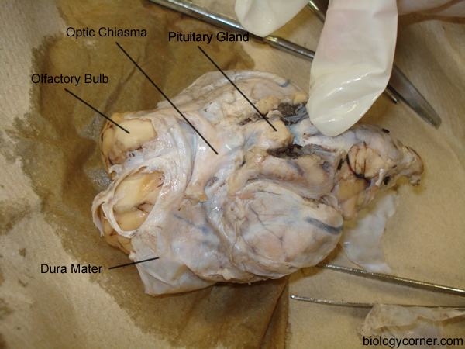
Olfactory Bulb on Sheep Brain

Slide 19
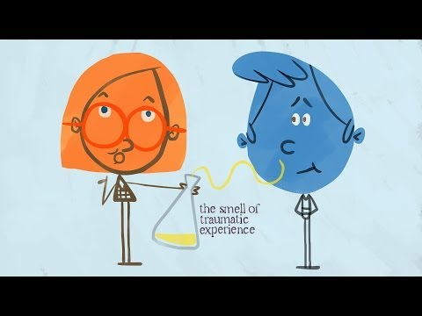

Slide 20
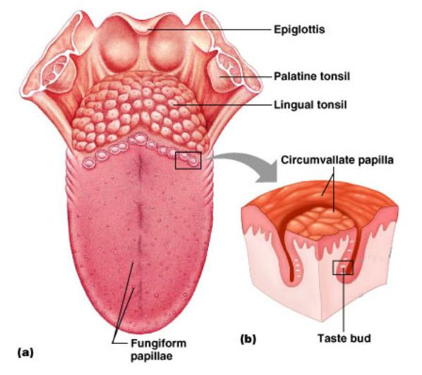
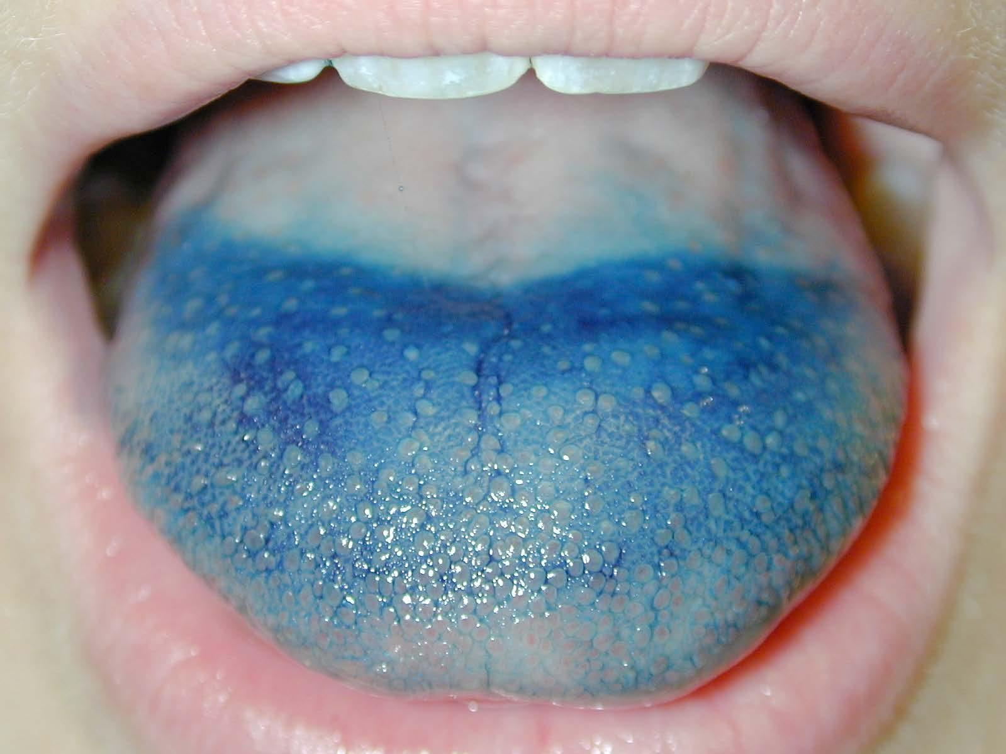
Sense of Taste (Gustatory)
Papillae = taste buds

Slide 21
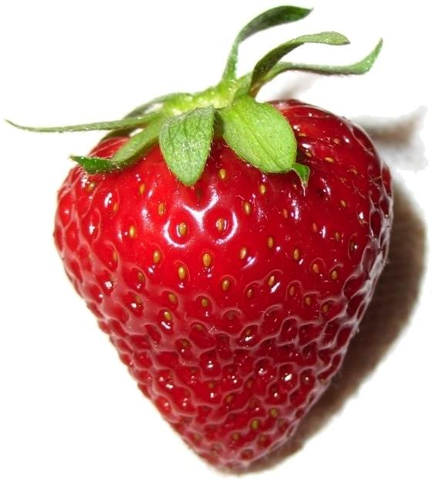
Taste Sensations
Imagine the taste of:
Strawberries
Cheetos
Banana
French Fries
Chocolate
Sweet
Sour
Bitter
Salty
Savory (Umami)

Slide 22
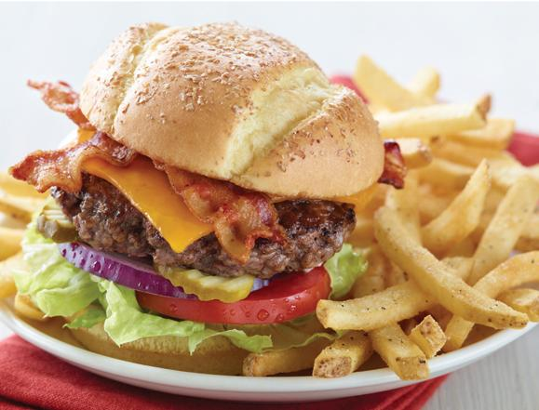
Umami - a savory taste, is one of the five basic tastes, together with sweet, sour, bitter and salty. A loanword from the Japanese umami can be translated "pleasant savory taste".
Bacon, cheddar and beef all have umami, and together they “synergize the umami effect.” Toss in sautéed mushrooms and you’ve struck an umami mother lode. Umami, he says, “alters our perception of other tastes, making salt, saltier, sweet sweeter, and bitter and sour less biting.” It is a taste that can’t be duplicated with any of the other four tastes.

Slide 23
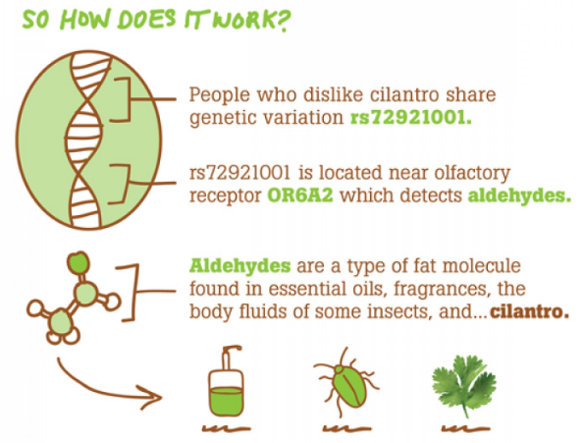
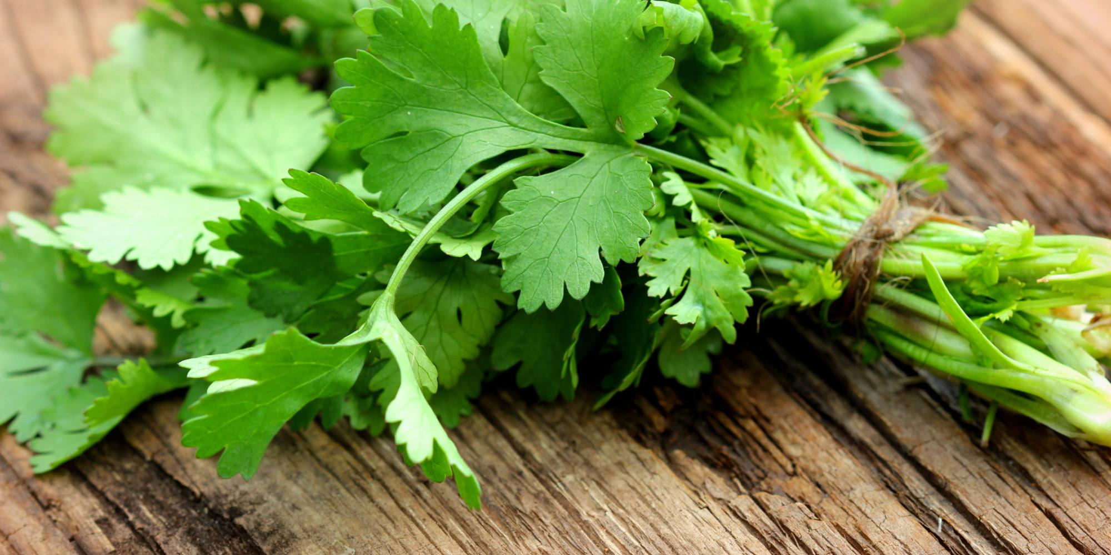
Do we all experience taste in the same way?
Genetics may play a role in whether you like certain foods.
Does cilantro taste like soap to you?

Slide 24
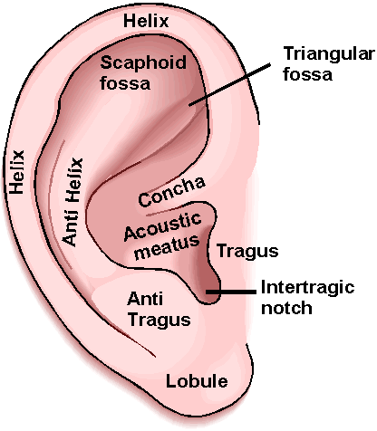
Sense of Hearing
External Ear
Auricle (pinna) - outer ear
Auditory Canal (external auditory meatus)
- opening to the eardrum

Slide 25
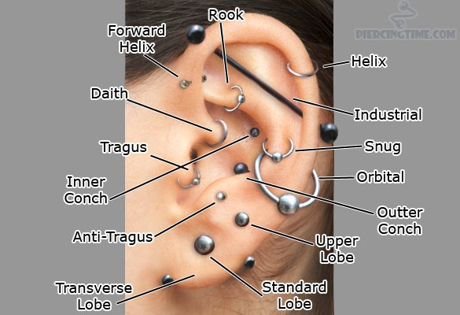

Slide 26
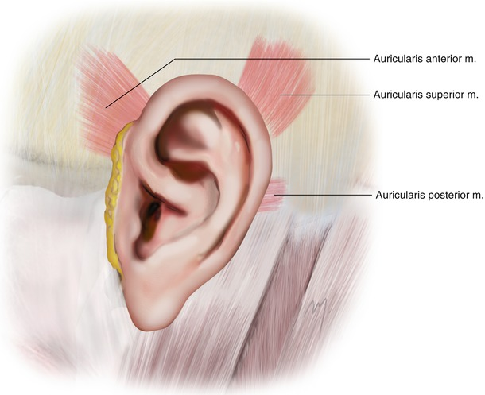
Ear movement is common in many mammals, including cats, dogs and horses, and usually serves to swivel the ear towards the direction of a sound. A group of muscles called the auriculares are responsible for this movement.
Ear wiggling is considered a VESTIGIAL trait - a trait that no longer functions but is part of our evolutionary past.

Slide 27
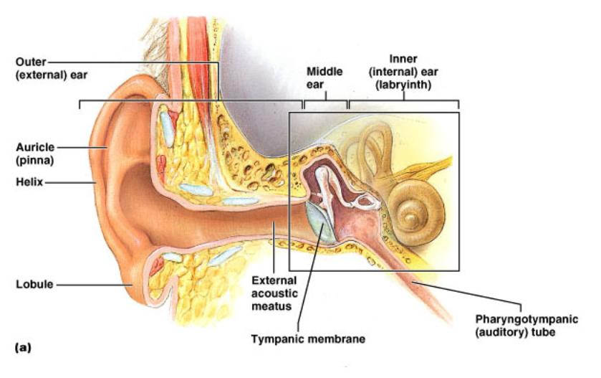

Slide 28
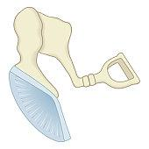
Middle Ear (tympanic cavity)
malleus
Eardrum (tympanum)
Auditory Ossicles – 3 small bones- malleus, incus, stapes - transmit vibrations and amplify the signal
incus
stapes
Auditory Tube (eustachian tube) - connects the middle ear to the throat - helps maintain air pressure

Slide 29
Why do children get tubes put in their ears?

Slide 30
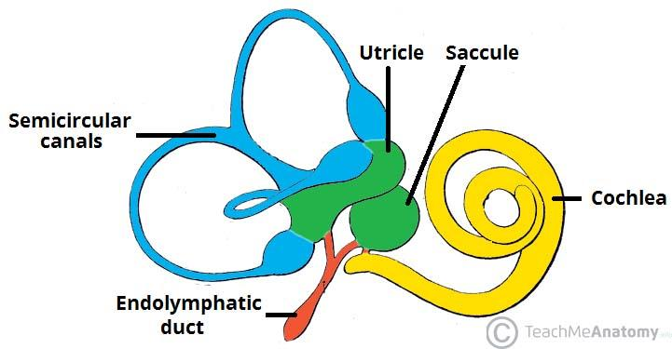
Inner Ear
Labyrinth - communicating chambers and tubes
2 parts: osseus labyrinth; membranous labyrinth

Slide 31
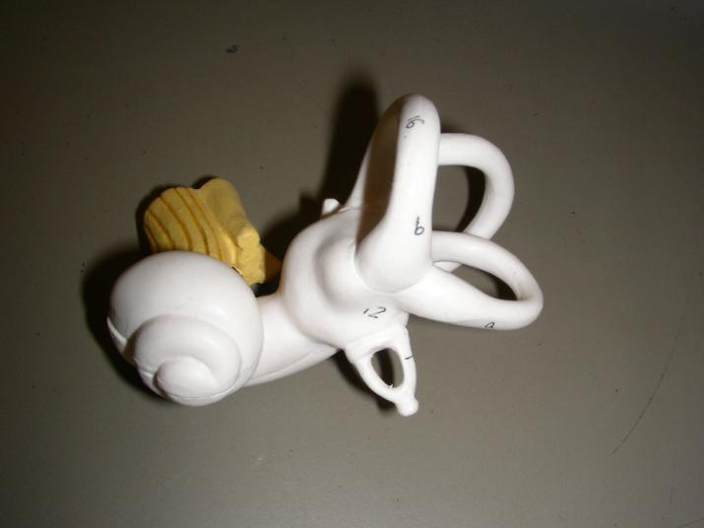
Inner Ear
Semicircular Canals - sense of equilibrium
Cochlea - sense or hearing
Organ of Corti - contains hearing receptors, hair cells detect vibrations

Slide 32
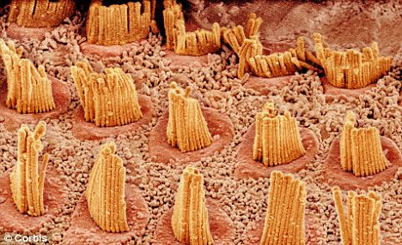
Why do we lose our hearing?
Inside the cochlea are special neurons called HAIR CELLS.
Loud noises damage these fibers.
As you age, hair cells become damaged (loud music can speed this process along). Older people usually can’t hear frequencies that younger people can hear. Try the hearing test!

Slide 33
Steps in Hearing
1. Sound waves enter external auditory canal 2. Eardrum vibrates 3. Auditory ossicles (malleus, incus, stapes) amplify vibrations 4. Stapes hits oval window and transmits vibrations to cochlea 5. Organs of corti contain receptor cells (hair cells) that deform from vibrations 6. Impulses sent to the vestibulocochlear nerve 7. Auditory cortex of the temporal lobe interprets sensory impulses 8. Round window dissipates vibrations within the cochlea

Slide 34
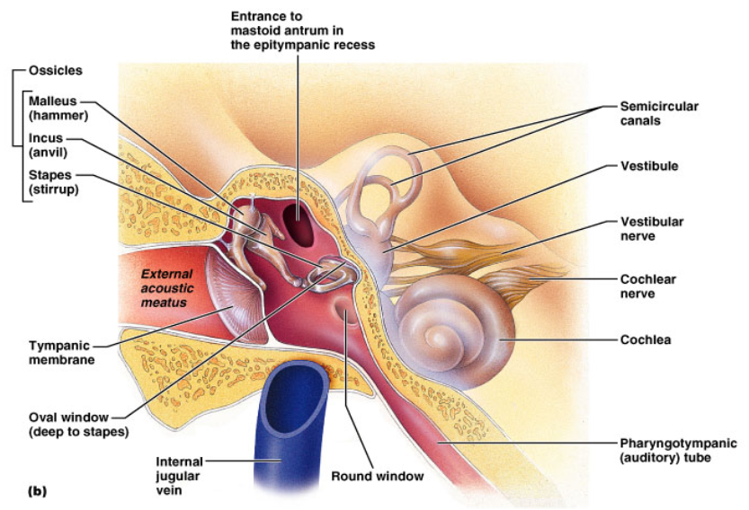
EXTERNAL MIDDLE INNER

Slide 35
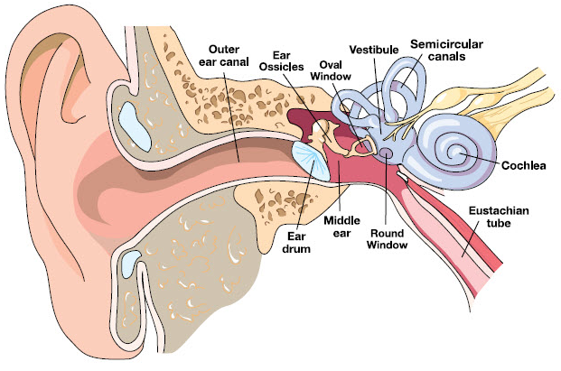
Malleus, Incus, Stapes
Vestibulocochlear nerve
Tympanic Cavity
Color the structures of the ear.

Slide 36
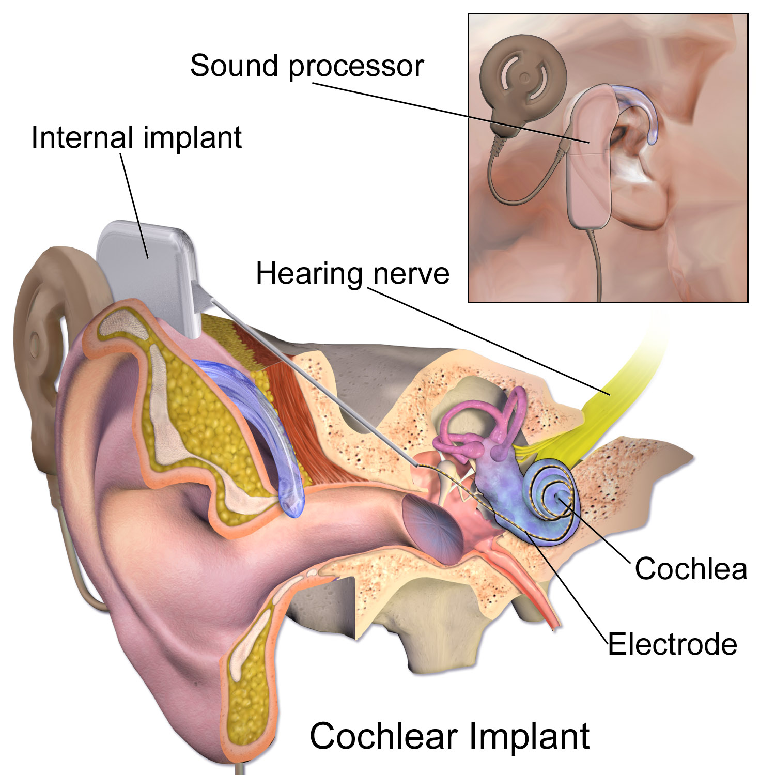
Cochlear Implants
A cochlear implant receives sound from the outside environment, processes it, and sends small electric currents near the auditory nerve.
The brain learns to recognize this signal and the person experiences this as "hearing".
8 month old reacts to cochlear implant

Slide 37
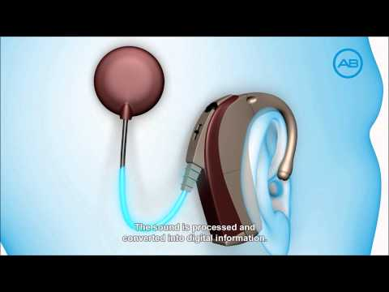

Slide 38
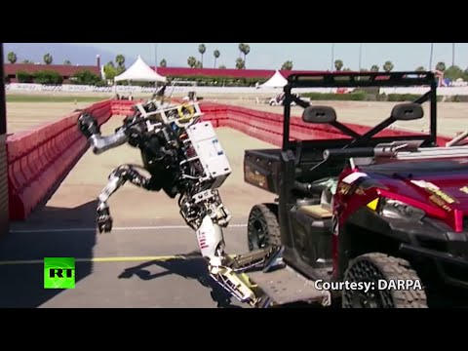
Sense of Equilibrium
Static Equilibrium - maintain stability and posture
Dynamic Equilibrium - balance during sudden movement
Cerebellum - interprets impulses from the semicircular canals and maintains overall balance
Walking on two legs is harder than you think…
Robot Fails

Slide 39
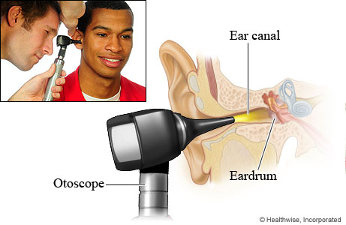
OTOSCOPE
Otolaryngology (pronounced oh/toe/lair/in/goll/oh/jee)
Otolaryngologists are physicians trained in the medical and surgical management and treatment of patients with diseases and disorders of the ear, nose, throat (ENT), and related structures of the head and neck. They are commonly referred to as ENT physicians.

Slide 40
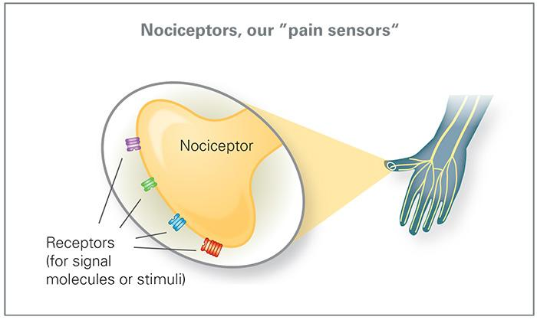
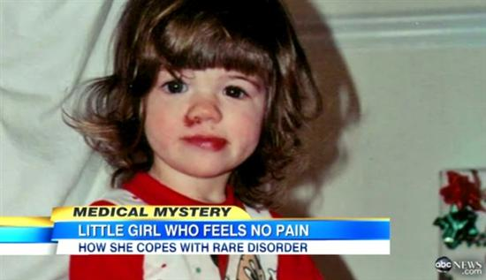
Disorders of Sensory Systems
1. Synesthesia
2. Anosmia
3. Tinnitus
4. Anhidrosis (inability to sweat)
5. Congenital Analgesia (CIP)
Mutations in genes prevents nerve impulses from pain receptors (nociceptors) from sending signals to the brain.
Notes:
Discuss: Why is the inability to feel pain a problem? Isn’t this like a superhero trait? … (Inability to feel pain does not mean inability to become injured)

Slide 41
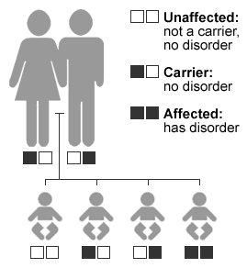
Hereditary (Congenital) Deafness
Occurs in 1 of every 1000 to 2000 newborns
Syndromic
Pendred Syndrome
Usher Syndrome
A SYNDROME is a disease that has more than one feature or symptom. A person with Usher syndrome also has vision problems

Slide 42
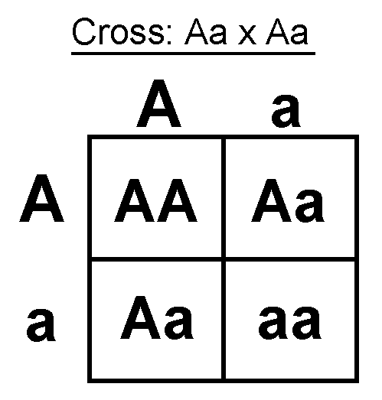
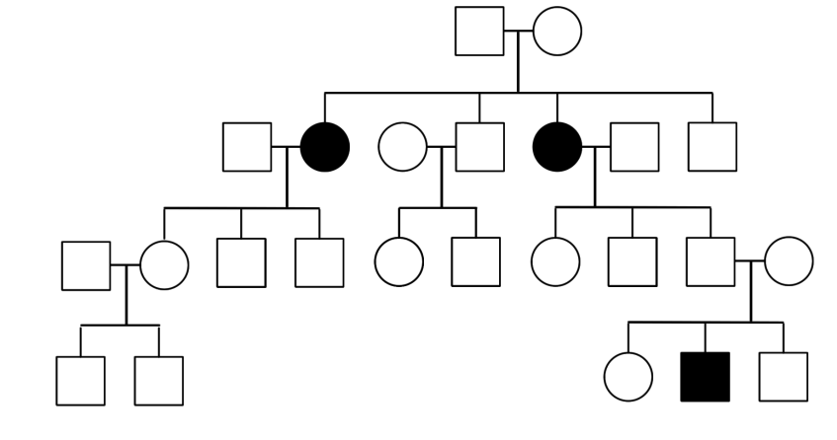
Hereditary (Congenital) Deafness
Non-syndromic
A specific mutation results in hearing loss; can be recessive (80%) or dominant (20%) .
Recessive inheritance, can you identify the “carriers?”

Slide 43
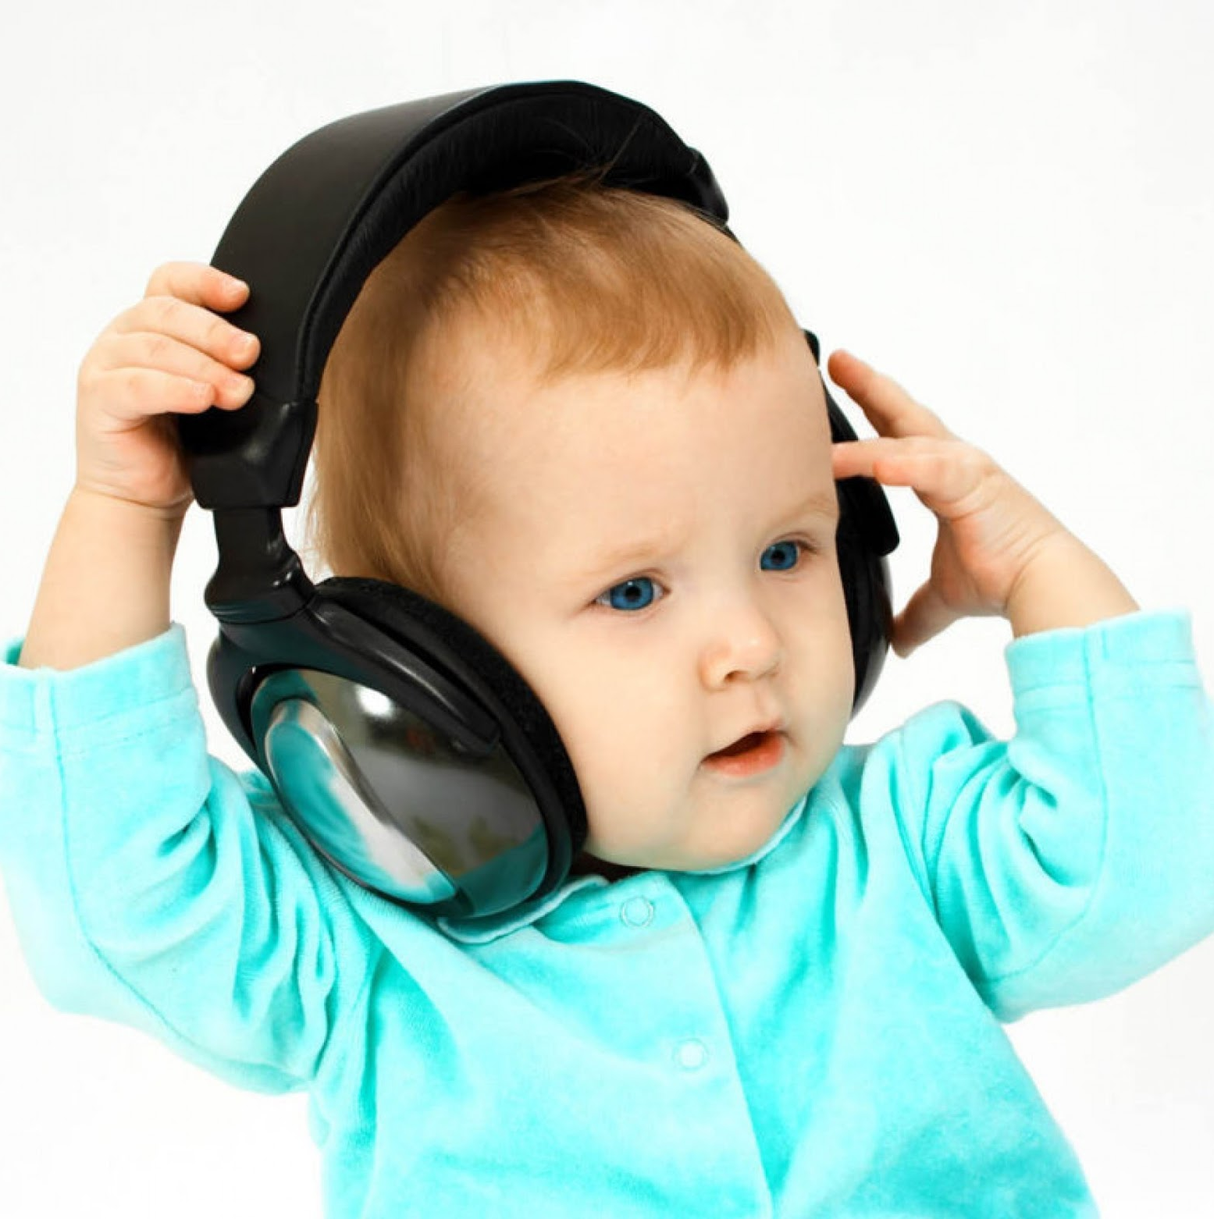
Deafness can also be caused by PRENATAL Infections from “ToRCH” organisms
Toxoplasmosis
Rubella
Cytomegalovirus (CMV)
Herpes
Postnatal infections can also cause deafness
Meningitis
Streptococcus
Listeria
Influenza

Slide 44
Presbycusis = age related hearing loss
-diminished hearing sensitivity
-poor speech comprehension in noisy environments
-slowed central processing of acoustic information
-high frequencies are more difficult to hear
Fun Fact: Many vertebrates such as fish, birds and amphibians do not suffer presbycusis in old age as they are able to regenerate their cochlear sensory cells, whereas mammals including humans have lost this regenerative ability.
It is estimated that 30-40% of people over the age of 65 have presbycusis

Slide 45
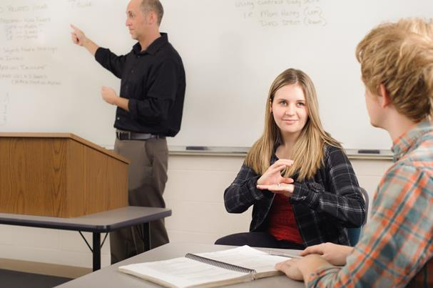
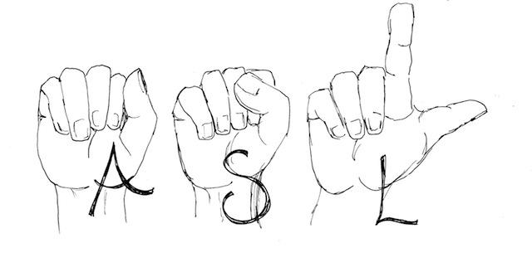
Careers Related to Hearing
Audiologist
Speech-Language Pathologist
Sign Language Interpreter
Teacher: Deaf & Hearing Impaired

