Slide 1
The Endocrine System
Objectives:
Identify the contributions of the endocrine system to homeostasis
Discuss the chemical composition of hormones and the mechanisms of hormone action
Summarize the site of production, regulation, and effects of the hormones of the pituitary, thyroid, parathyroid, adrenal, and pineal glands
Discuss several common diseases associated with endocrine system dysfunction

Slide 2
What is the system?
Made up of glands that produce and secrete hormones, chemical messengers
Regulation of growth, metabolism, sexual development
Responses to stress and injury
Maintains homeostasis
Glands are found in different areas of the body.

Slide 3
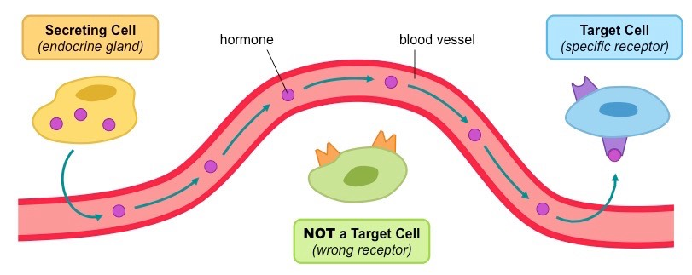
BIG IDEA:
HORMONES are chemical MESSENGERS that act on target cells

Slide 4
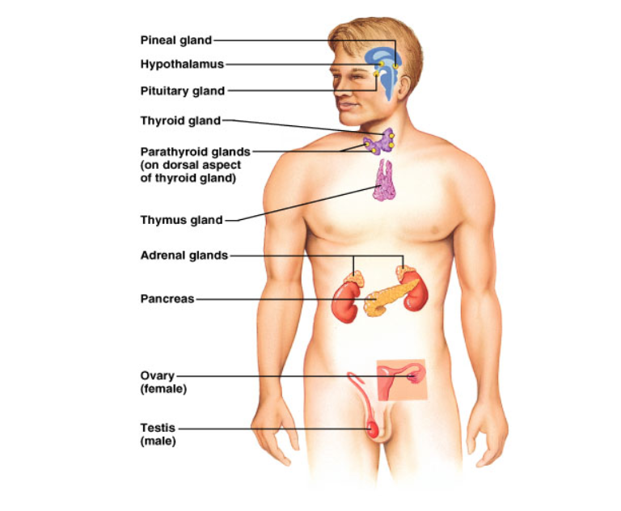
Major Structures of the Endocrine System
Write a short description of where each gland is located.
Pineal Hypothalamus Pituitary | Brain
Thyroid Parathyroid | Throat
Thymus | Above heart
Adrenal | Above kidneys
Pancreas | Under stomach
Ovary / Testes | Lower abdomen / Groin

Slide 5
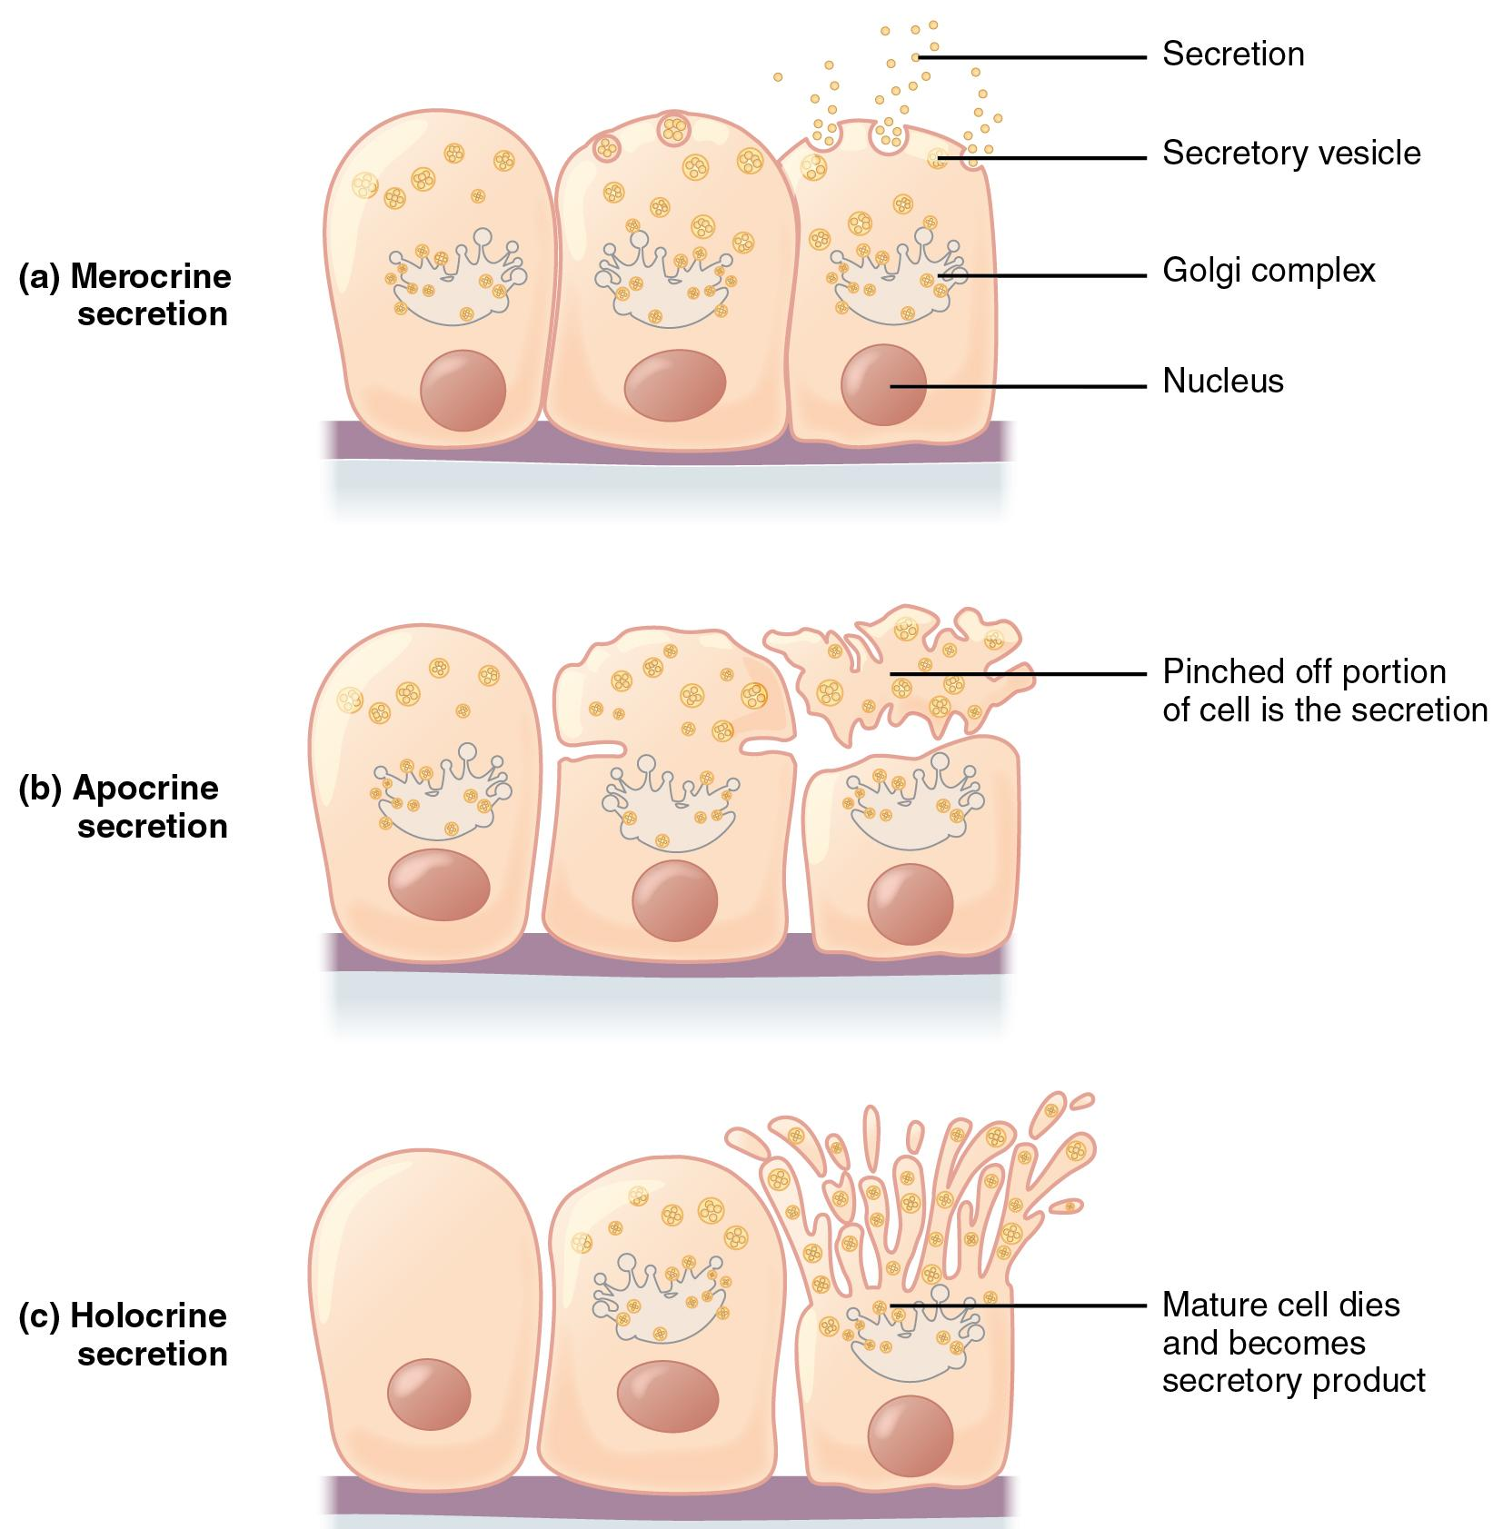
Endocrine – secretions inside the body
Exocrine – secretions outside the body (sweat)
Saliva
Breast Milk
Sweat

Slide 6
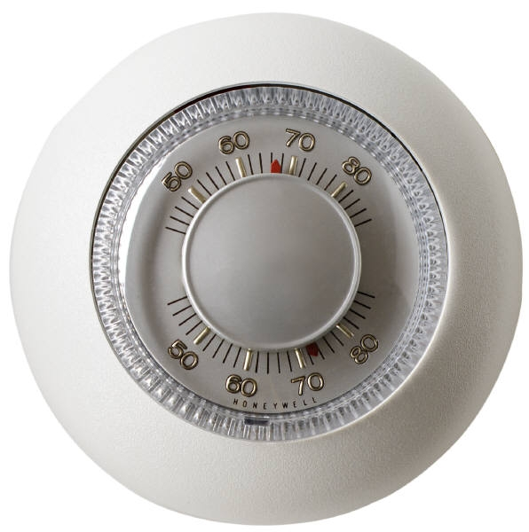
Control of Hormones
Negative feedback system
When the levels go above or below a SET POINT, the endocrine system secretes hormones to lower or raise the level.
Think of it like the thermostat of your house.

Slide 7
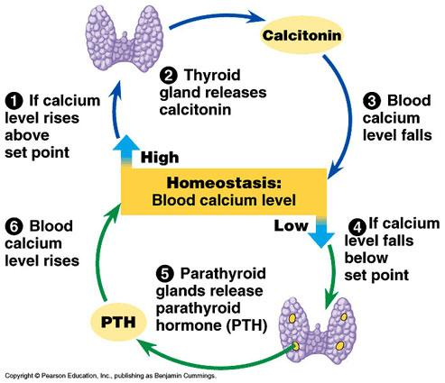
Example of Negative Feedback:
Calcium regulation by the thyroid / parathyroid

Slide 8
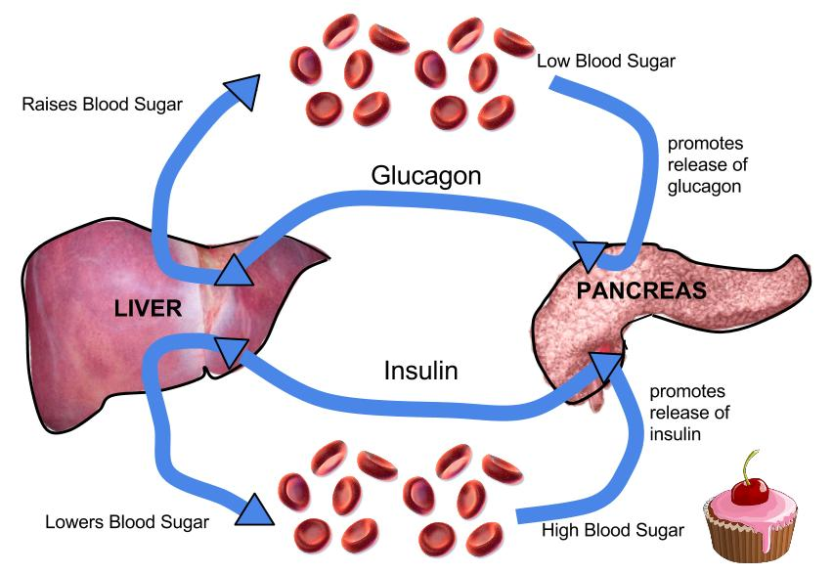
Example of Negative Feedback
Glucose levels rise - insulin is produced to cause sugar to be taken up by the cells (and out of the blood)

Slide 9
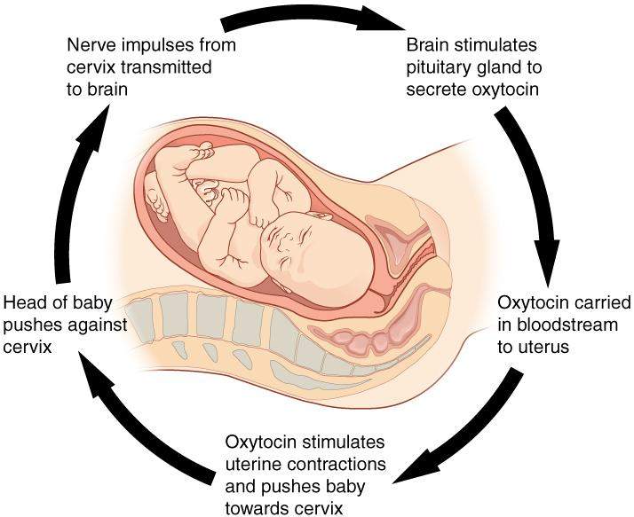
Positive Feedback System - contractions during labor

Slide 10
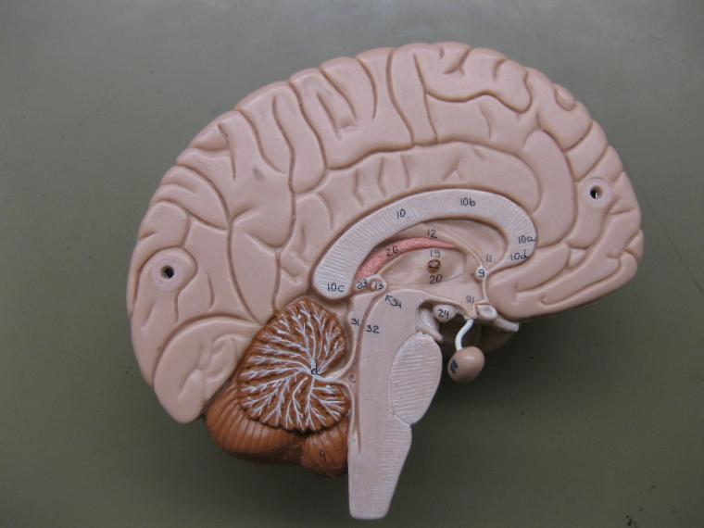
Pituitary Gland - located below brain
22 = Thalamus
24 = Hypothalamus

Slide 11
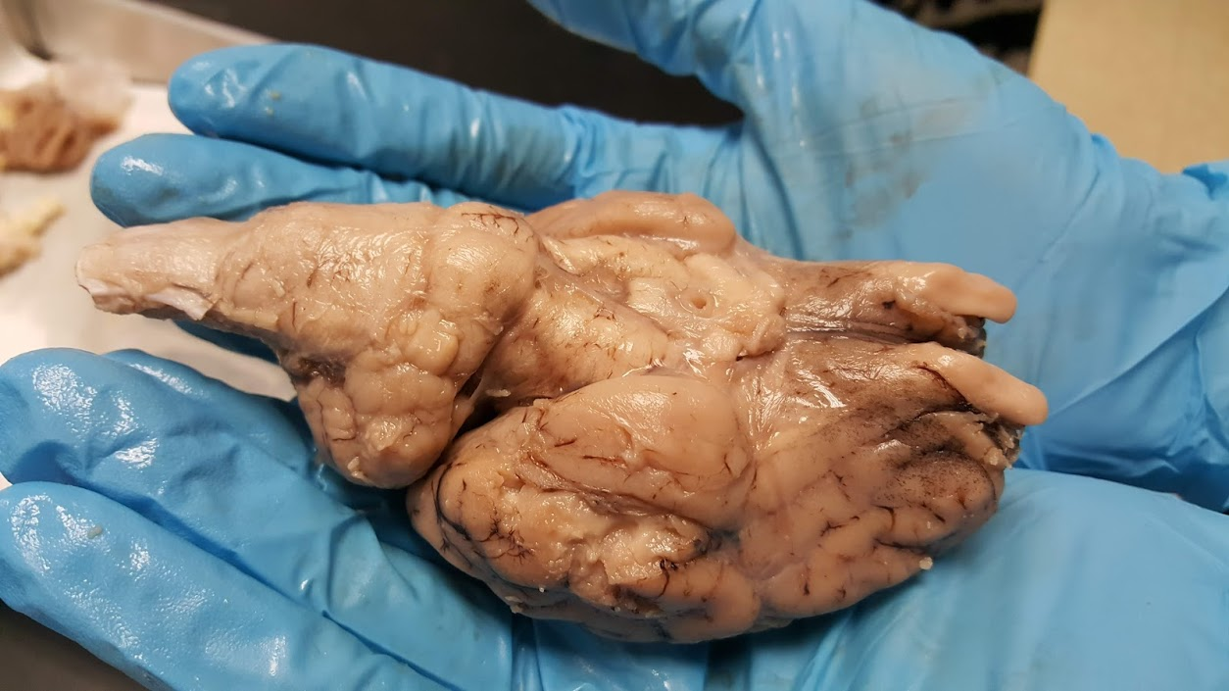
Where the pituitary was attached (infundibulum)

Slide 12
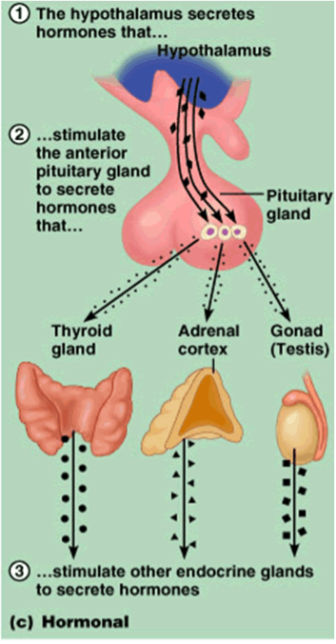
Hormone Control
The pituitary is often called the “master gland”
because it controls all of the other glands.
Its actions are controlled by the hypothalamus in the brain.

Slide 13
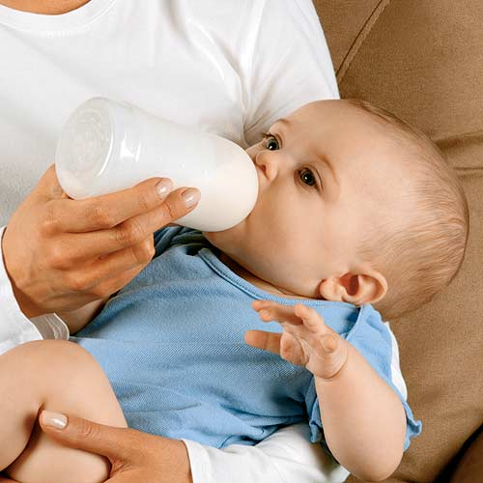
Anterior Pituitary Hormones
Prolactin or PRL - PRL stimulates milk production from a woman's breasts after childbirth and can affect sex hormone levels from the ovaries in women and the testes in men.
Risperdal (ADHD drug) can increase production of a hormone called prolactin, which stimulates breast growth, or gynecomastia
http://www.banderasnews.com/0905/hb-risperdal.htm

Slide 14
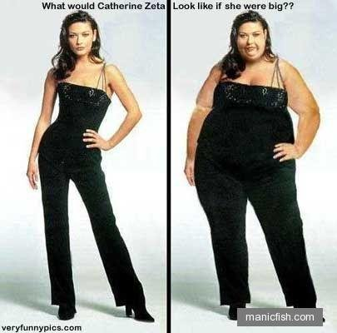
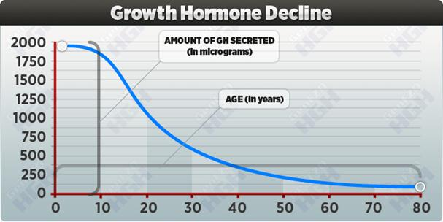
Growth hormone or GH - GH stimulates growth in childhood and is important for maintaining a healthy body composition. In adults it is also important for maintaining muscle mass and bone mass.
It can affect fat distribution in the body.

Slide 15
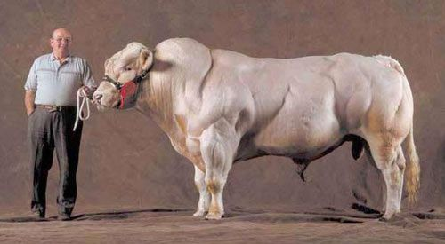
Myostatin that inhibits muscle growth
Myostatin inhibitor drugs are being developed with the intent of treating muscle-wasting diseases like muscular dystrophy in humans.
Belgian Blue breed bull, which has a genetic anomaly that suppresses the production of myostatin.

Slide 16
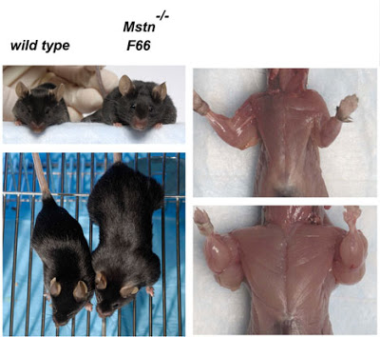
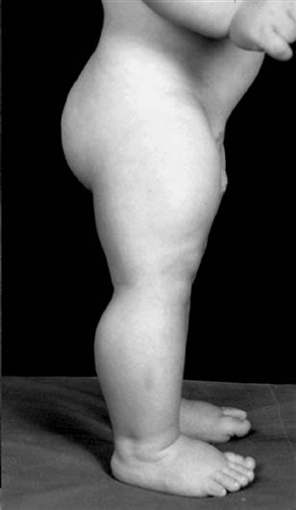
Question: Is this a negative or positive feedback system (myostatin and growth hormones)?

Slide 17
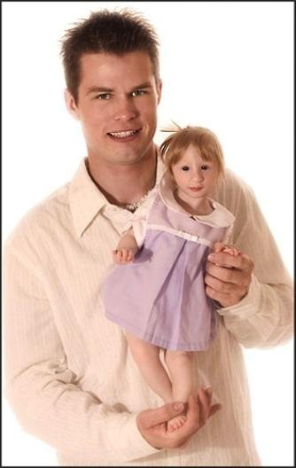
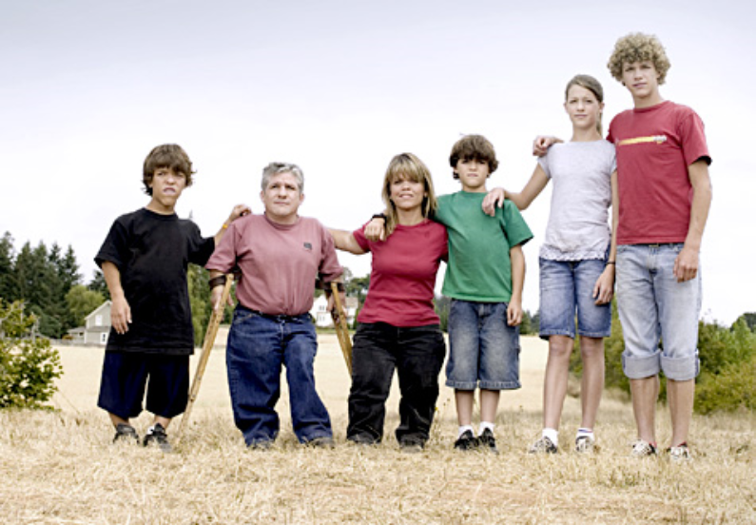
Problems with the pituitary gland can result in Dwarfism
Primordial Dwarfism

Slide 18
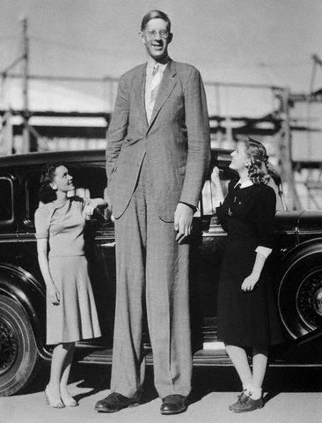
Or a person can grow too much. These are pictures of the man known as “The Alton Giant”, Robert Wadlow. Robert was 8’11”

Slide 19
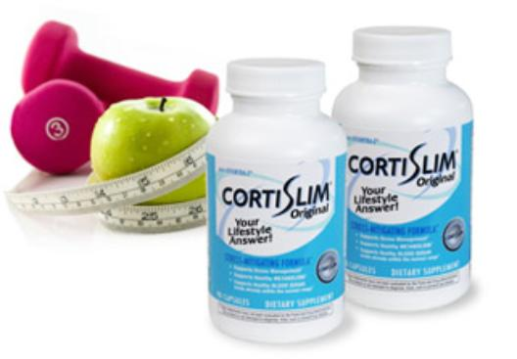
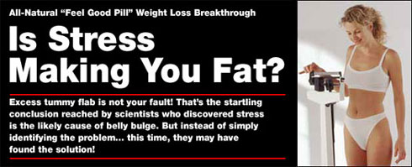
Adrenocorticotropin or ACTH - ACTH stimulates production of cortisol by the adrenal glands.
Cortisol, a so-called "stress hormone," is vital to survival. It helps maintain blood pressure and blood glucose levels.
Many diet aids claim that they block cortisol levels. Cortisol from stress may lead to fat deposits in the belly.

Slide 20
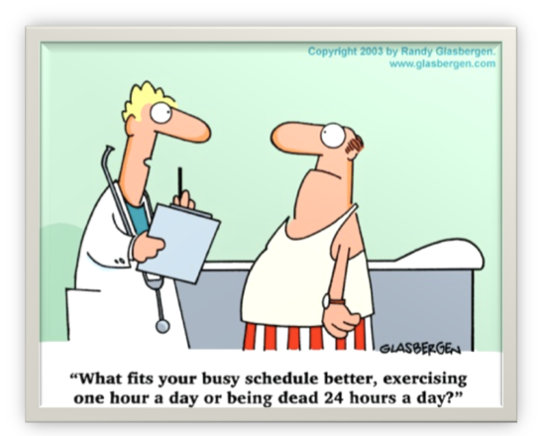
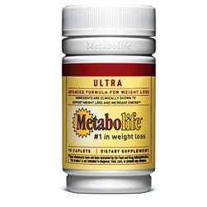
Thyroid-stimulating hormone or TSH - TSH stimulates the thyroid gland to make thyroid hormones, which, in turn, control (regulate) the body's metabolism, energy, growth and development, and nervous system activity.

Slide 21
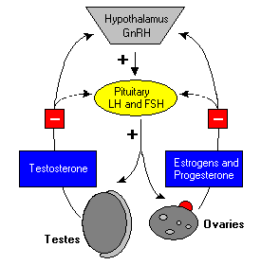
Luteinizing hormone or LH - LH regulates testosterone in men and estrogen in women. (gonadotropin)

Slide 22
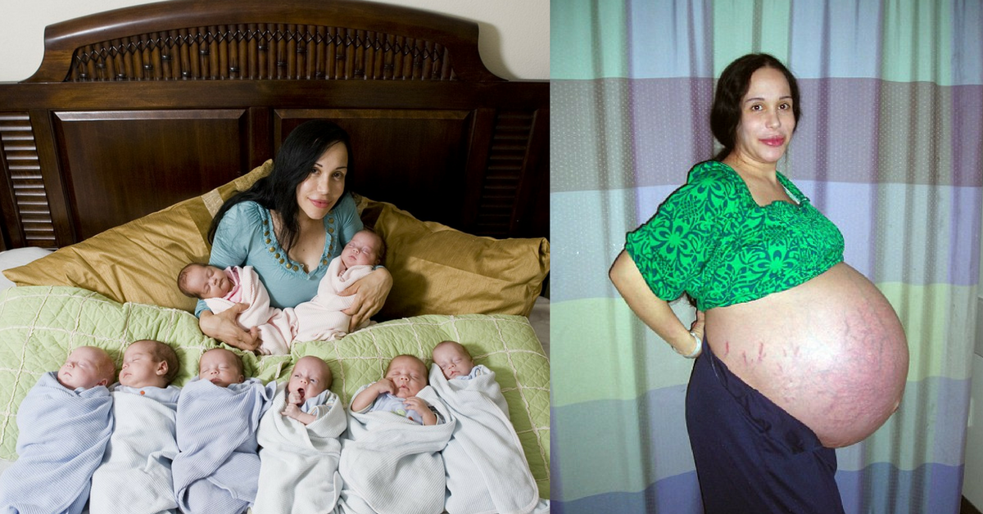
Follicle-stimulating hormone or FSH - FSH promotes sperm production in men and stimulates the ovaries to release eggs (ovulate) in women. LH and FSH work together to allow normal function of the ovaries or testes. (gonadotropin)

Slide 23
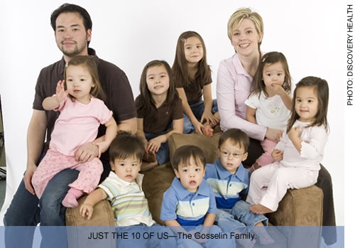

Slide 24
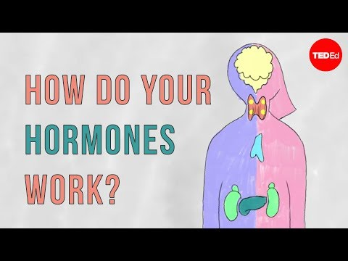

Slide 25
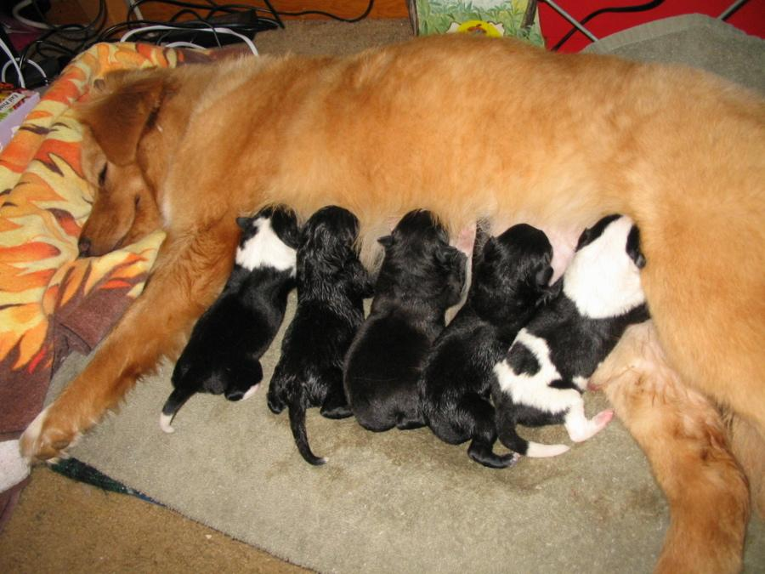
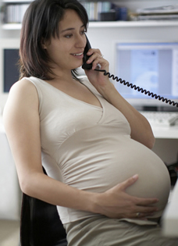
Posterior Pituitary Hormones
Oxytocin - Oxytocin causes milk letdown in nursing mothers and contractions during childbirth.

Slide 26
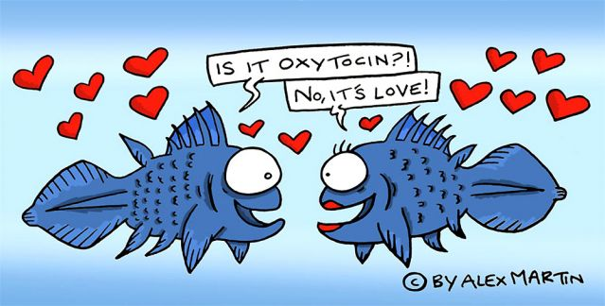
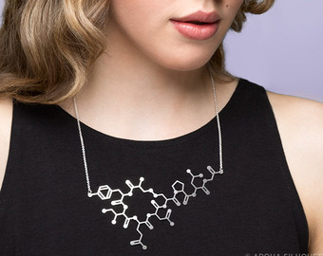
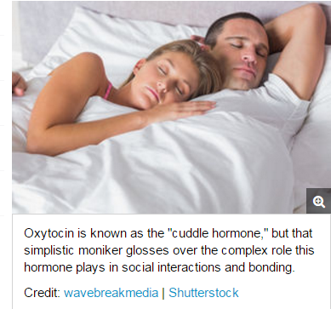

Slide 27
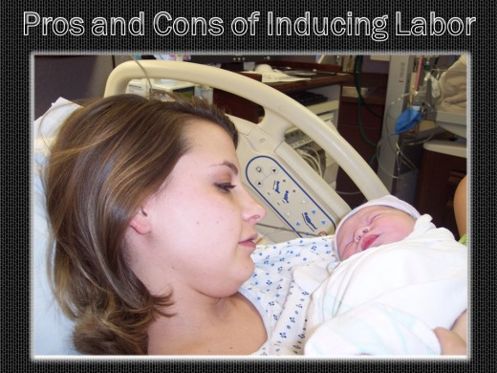
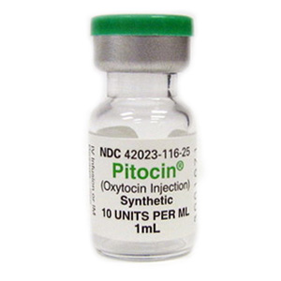
Pitocin is another very controversial topic in childbearing today.
Oxytocin is a natural hormone produced by a woman's body that cause uterine contractions. Pitocin is the synthetic form of oxytocin.
Pitocin is generally used in two ways: 1) to induce labor, and 2) to augment (speed up) labor.

Slide 28
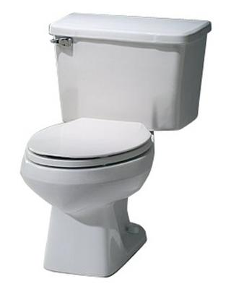
Antidiuretic hormone or ADH - ADH, also called vasopressin, is stored in the back part of the pituitary gland and regulates water balance.
Too much urination can lead to dehydration. When the body is dehydrated, ADH will cause the kidneys to conserve water.

Slide 29
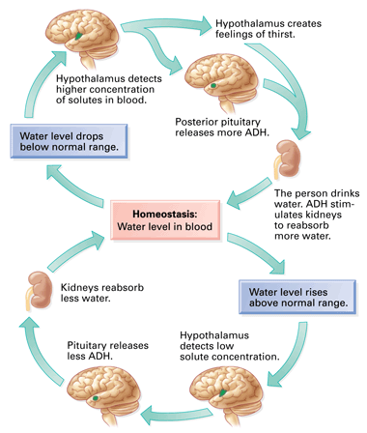
Hormones in Action
Why do you feel thirsty?
Is this positive or negative feedback?

Slide 30
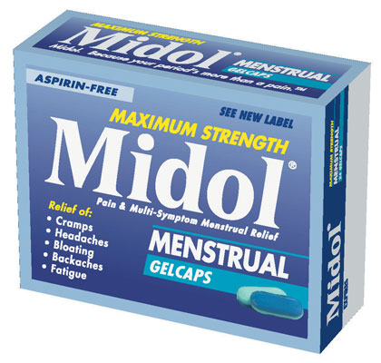
Diuretics – increase urine production
Many common foods and drinks contain chemicals that are diuretics (alcohol)
Midol relieves symptoms of bloating because it contains a diuretic that will make you urinate more
Active Ingredients: (in each caplet): Acetaminophen (500 mg) (Pain Reliever), Caffeine (60mg) (Diuretic, Stimulant), Pyrilamine Maleate (15 mg) (Diuretic) Inactive Ingredients: Carnauba Wax, Croscarmellose Sodium, FD&C Blue 2, Hypromellose, Magnesium Stearate, Microcrystalline Cellulose, Pregelatinized Starch, Propylene Glycol, Shellac, Titanium Dioxide, Triacetin

