Slide 1
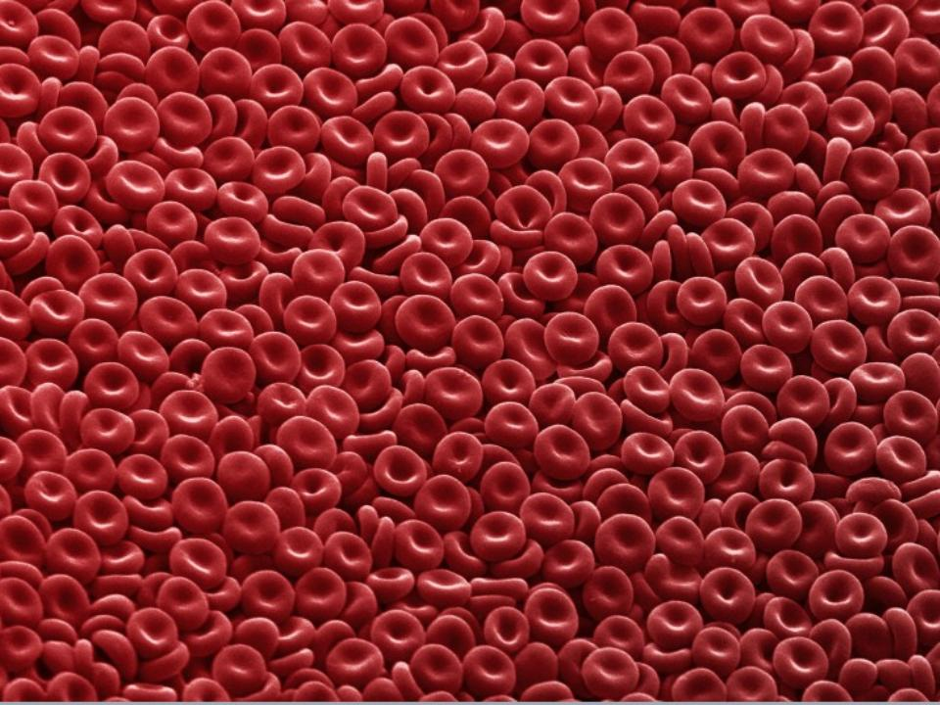
BLOOD TYPES

Slide 2
On a cold day in 1667, a renegade physician named Jean Denis transfused calf's blood into one of Paris's most notorious madmen. In doing so, Denis angered not only the elite scientists who had hoped to perform the first animal-to-human transfusions themselves, but also a host of powerful conservatives who believed that the doctor was toying with forces of nature that he did not understand. Just days after the experiment, the madman was dead, and Denis was framed for murder.
From: Blood Work: A Tale of Medicine and Murder in the Scientific Revolution

Slide 3
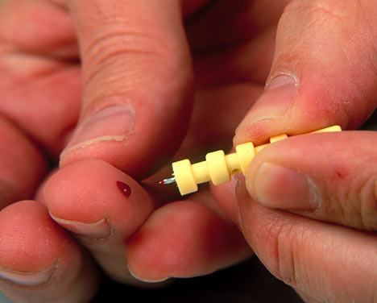
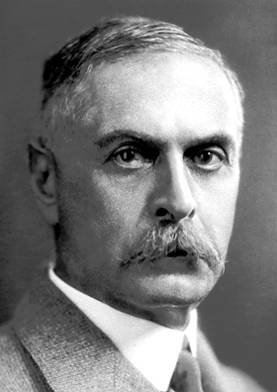
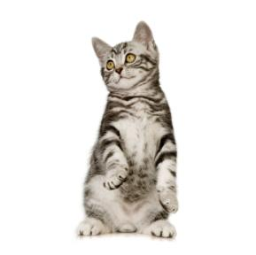
1901 - Austrian Karl Landsteiner discovered human blood groups
Even animals have blood types

Slide 4
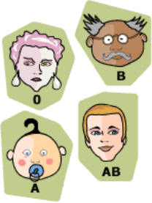
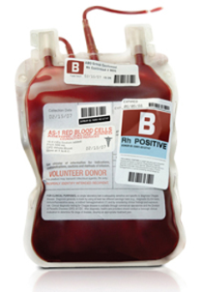
Blood Type is Controlled by 3 Alleles
4 Possible Blood Types
Alleles: A, B, O
A & B are codominant
O is recessive

Slide 5
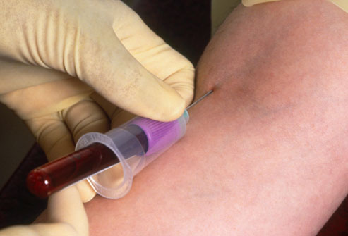
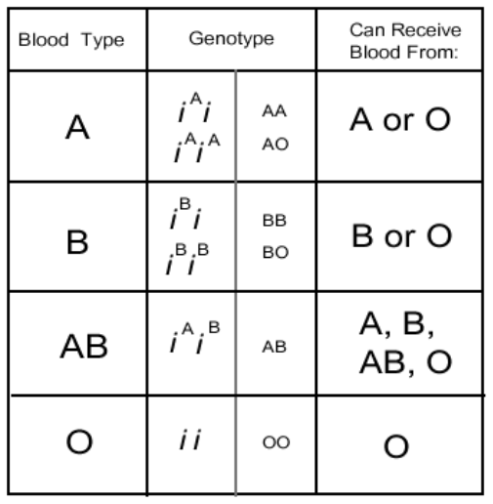
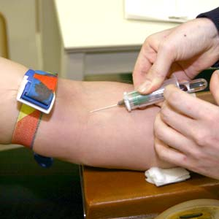
Genotypes

Slide 6
Consider Both Parents
Type A (genotype AA) x Type O (genotype OO)

Slide 7
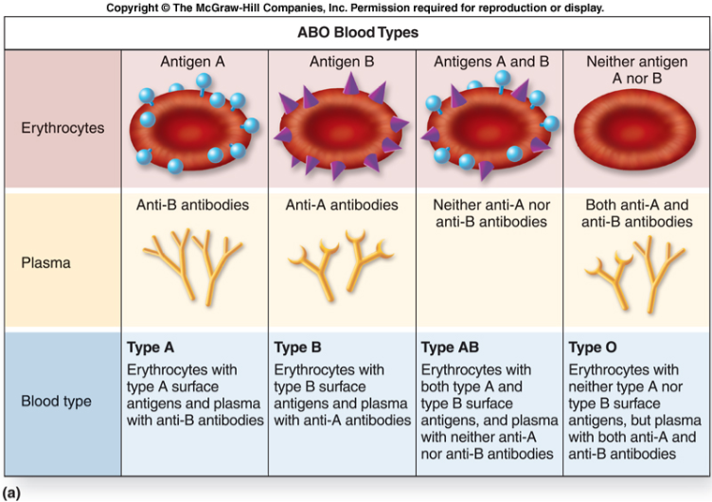
Blood Type Antigens

Slide 8
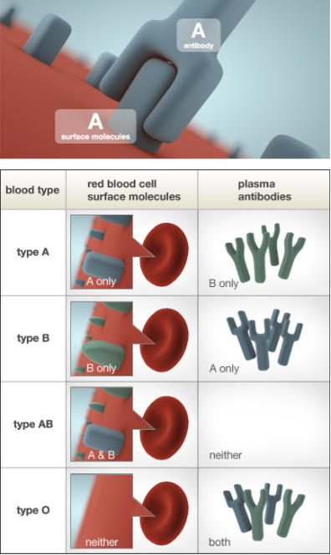
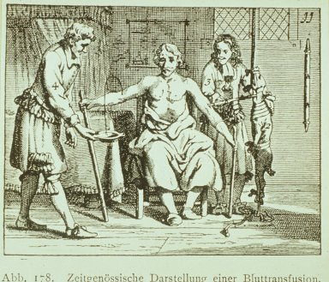
Blood that has antibodies on it that is not recognized by the body will be attacked by your immune system
AB is the Universal Acceptor
O is the Universal Donor
Notes:
AB is universal acceptor because there are no antibodies; O is universal donor because of Anti-A and Anti-B present

Slide 9
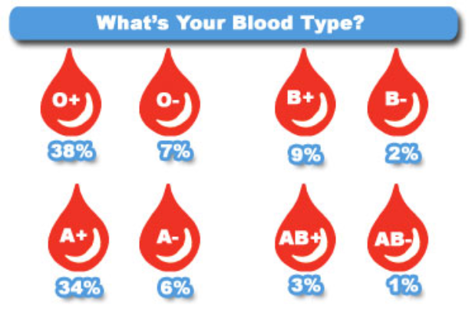
Rh Factor
A person can either be Rh + or Rh –
(positive is dominant)

Slide 10
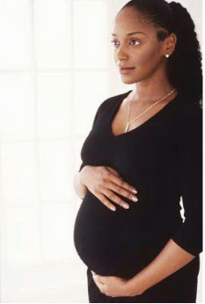
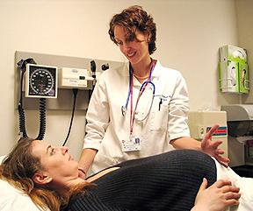
Rh Factor and Pregnancy
*Problem: When a fetus is Rh+ and the mother is Rh-, this can cause the mother’s immune system to attack the fetus. There are drugs that will suppress this reaction.

Slide 11
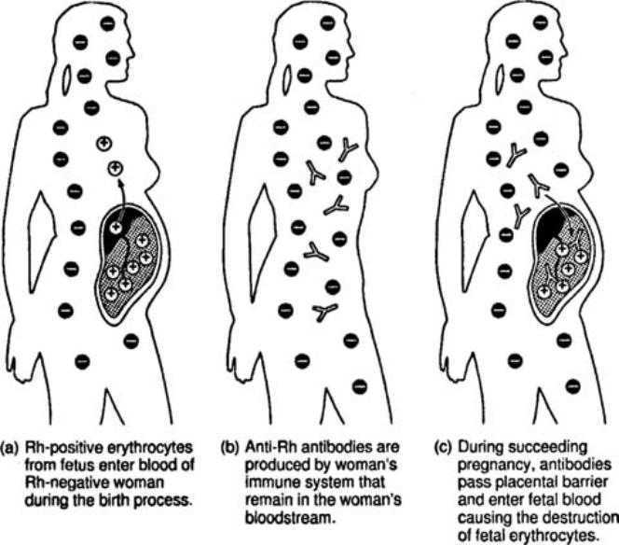

Slide 12
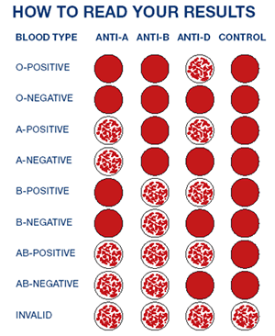
Blood Type Test

Slide 13
Blood Safety
EXAMPLES OF BLOODBORNE PATHOGENS
HEPATITIS B (HBV)
HEPATITIS C (HCV)
Other NON A, NON B HEPATITIS
HUMAN IMMUNODEFICIENCY VIRUS (HIV)
MALARIA
OTHER POTENTIALLY INFECTIOUS MATERIALS

Slide 14
TRANSMISSION
HIV, hepatitis B virus, and hepatitis C virus are the viruses most likely to be transmitted via the following routes in an occupational setting:
needle stick / sharps injuries skin or eye contact mucous membrane and non-intact skin exposure to contaminated blood or other potentially infectious materials ( scratches, cuts, bites, or wounds )

Slide 15
Avoid Contact With Blood
Wear gloves
Dispose of items that have been contaminated (tissues, needles, bandaids) in biohazard containers
Do not “horse around”
Treat every person as if they may be carrying an infectious disease

