Slide 1
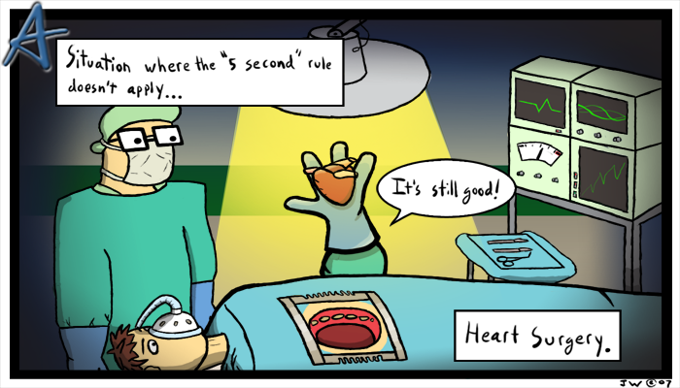
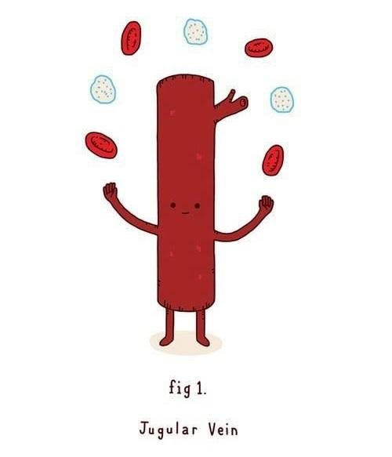
Cardiovascular (Circulatory) System
Notes:
Guided notes printable: https://docs.google.com/document/d/1TNMFfgw0NfyLOIRJ5YfQEulxbyuBYmlGMvpAfXhtqa8/

Slide 2
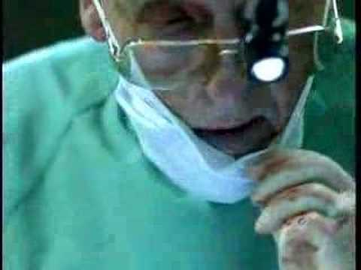

Slide 3
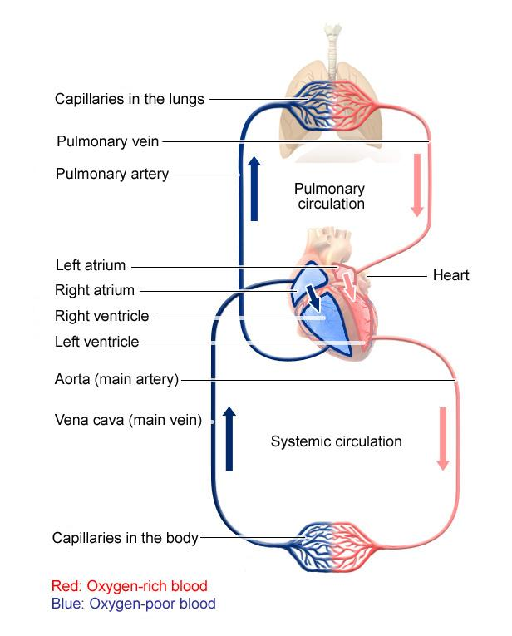
Systemic Circulation – delivers blood to all body cells and carries away waste
Pulmonary Circulation – eliminates carbon dioxide and oxygenates blood (lung pathway)

Slide 4
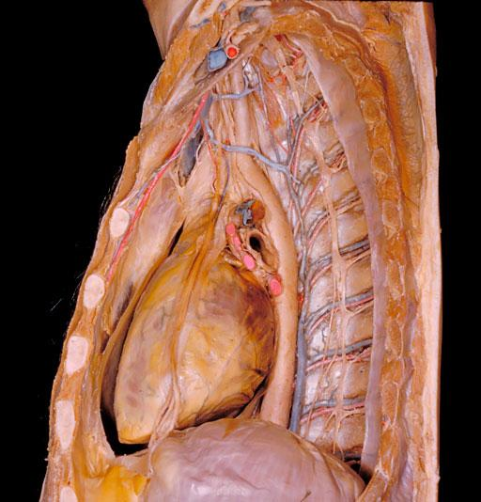
Structure of the Heart
Heart Size – about 14 cm x 9 cm (the size of a fist).
Located in the mediastinum , between the 2nd rib and the 5th intercostal space.
The distal end of the heart is called the apex.

Slide 5
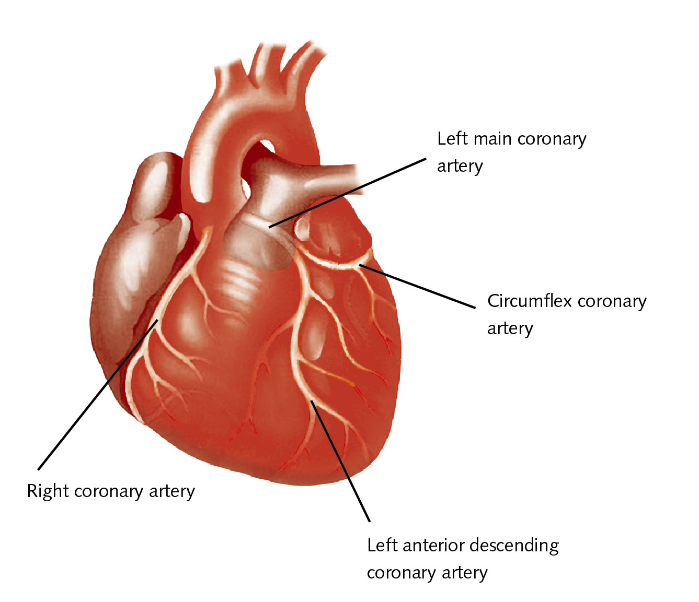
CORONARY ARTERIES

Slide 6
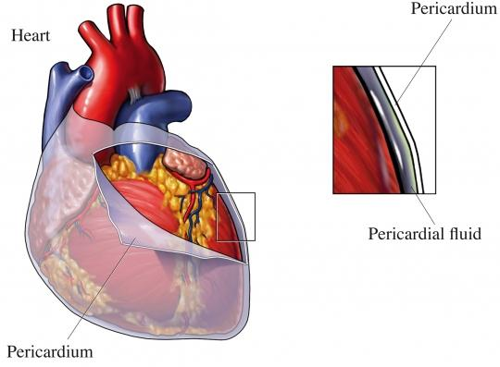
Fibrous Pericardium encloses the heart (like a bag) and has 2 layers
visceral pericardium (inner)
parietal pericardium (outer)
Pericardial cavity – contains fluid reducing friction

Slide 7
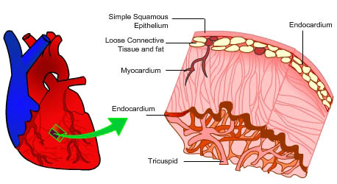
Wall of the Heart
Epicardium – outer layer, reduces friction
Myocardium – middle layer, mostly cardiac muscle
Endocardium – thin inner lining, within chambers of the heart

Slide 8
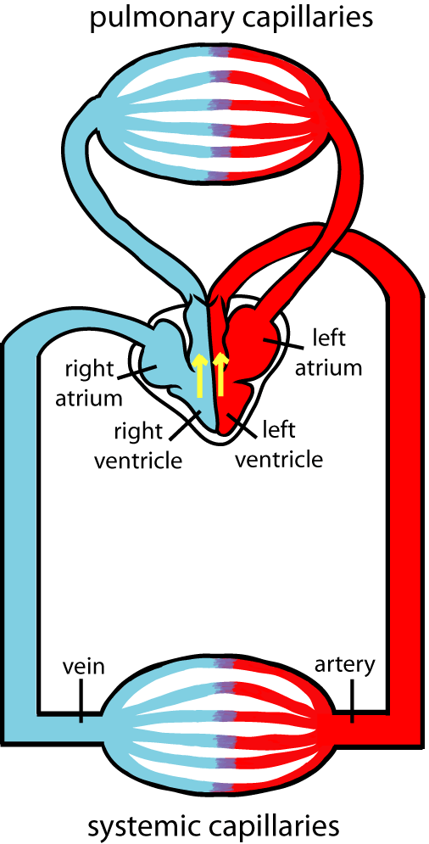
Blood Flow in the Heart
Your heart is a DOUBLE pump (double - loop circulation)
Pulmonary - blood travels to the lungs and then back
Systemic - blood travels to the body and then back to the heart

Slide 9
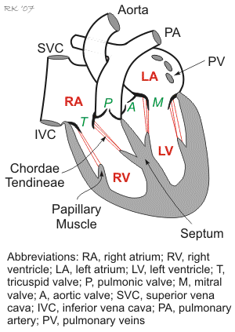
Heart has 4 chambers:
2 Atria – thin upper chambers that receive blood returning to the heart through veins
2 Ventricles – thick, muscular lower chambers. Pumps blood out of the heart through arteries (away).
Septum – separates the right and left sides of the heart

Slide 10
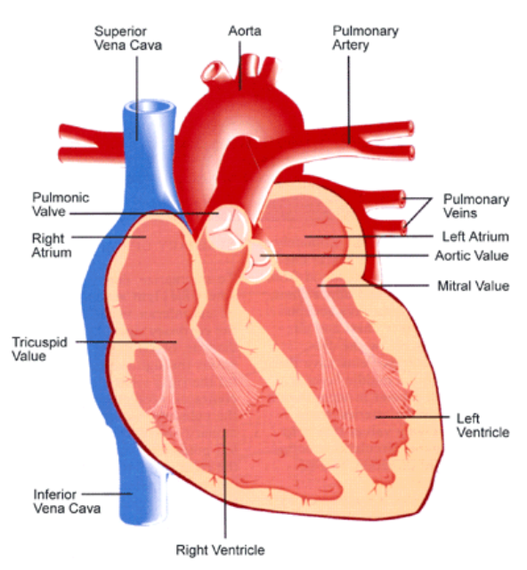

Slide 11
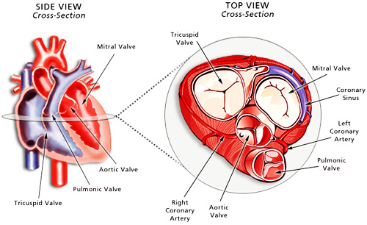
Valves of the Heart – allow one-way flow of blood. --- 4 total
2 Atrioventricular Valves (AV) & 2 Semilunar valves)
Left Atrioventricular valve – also called the bicuspid valve or mitral valve.
Right Atrioventricular valve – also called the tricuspid valve.
Notes:
Tri-it before you bi-it (blood comes thru tricuspid first then exits via bicuspid)

Slide 12
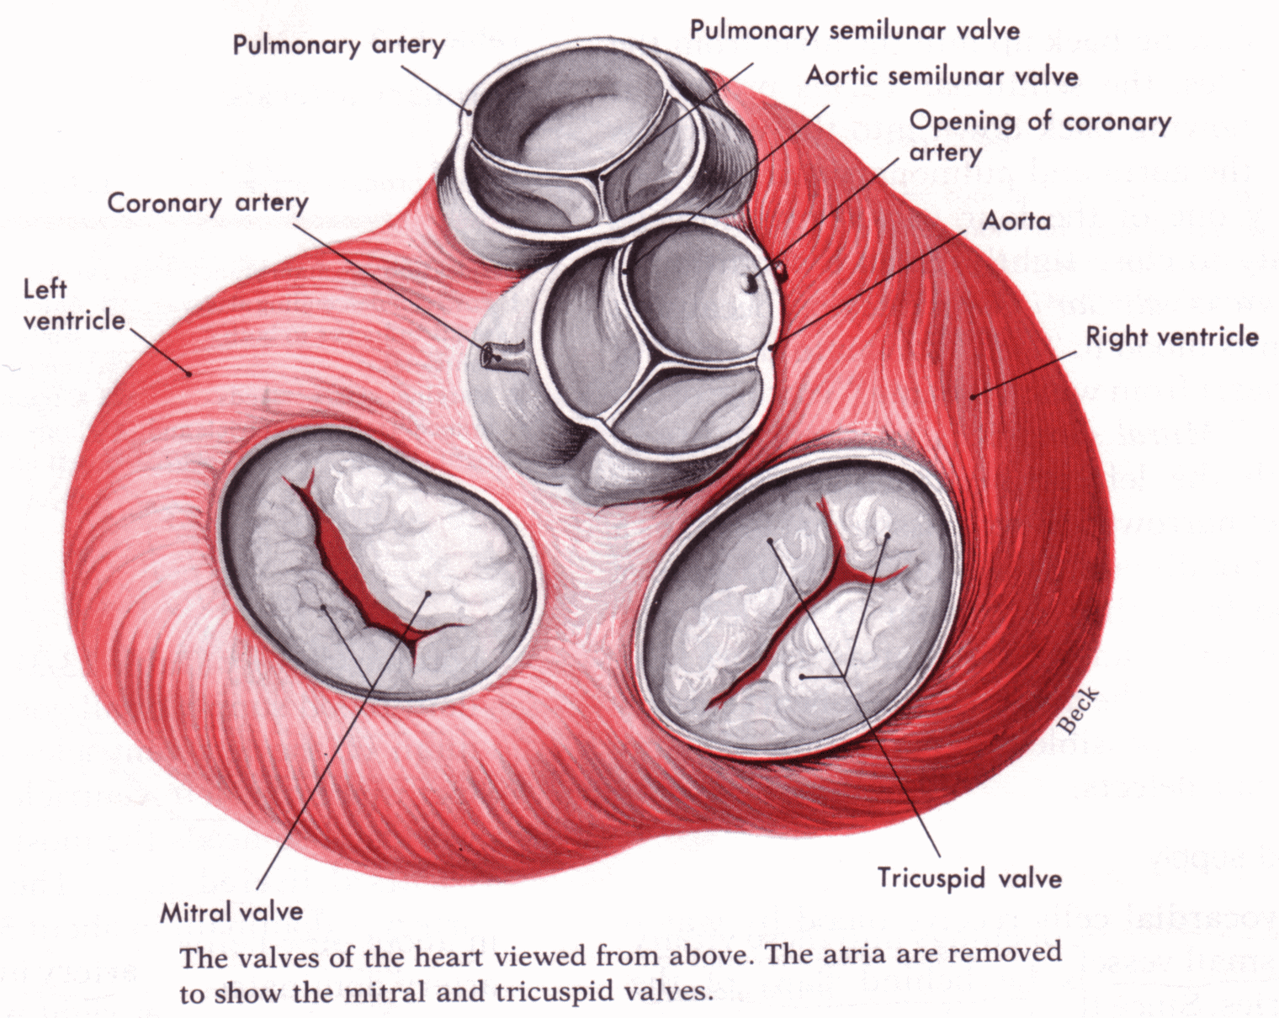
Aortic Semilunar – or just aortic valve. Between the left ventricle and the aorta
Pulmonary Semilunar, or just pulmonary valve. Between the right ventricle and the pulmonary artery

Slide 13
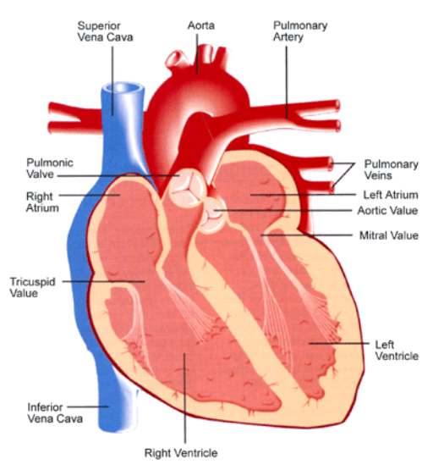
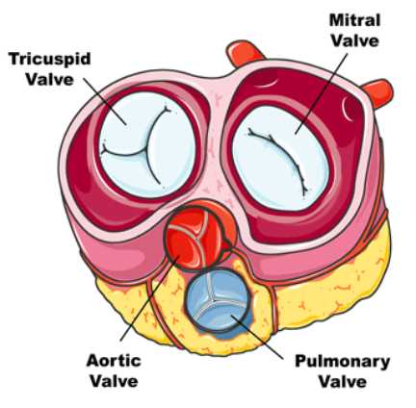
Mitral = bicuspid (left side) Tricuspid (right side)
Aortic and Pulmonary are both semilunar valves
Notes:
Semilunar = moon shaped

Slide 14
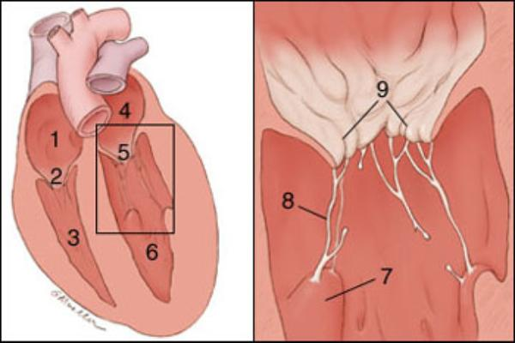
The cusps (flaps) of the bicuspid and tricuspid valves are anchored to the ventricle walls by fibrous “cords” called chordae tendineae, which attach to the wall by papillary muscles. This prevents the valves from being pushed up into the atria during ventricular systole.
Can you identify these parts?
Notes:
Right Atrium
Tricuspid valve
Right Ventricle
Left Atrium
Mitral Valve/Biscupid
Left Ventricle
papillary muslce
chordae tendineae
cusp of bicuspid

Slide 15
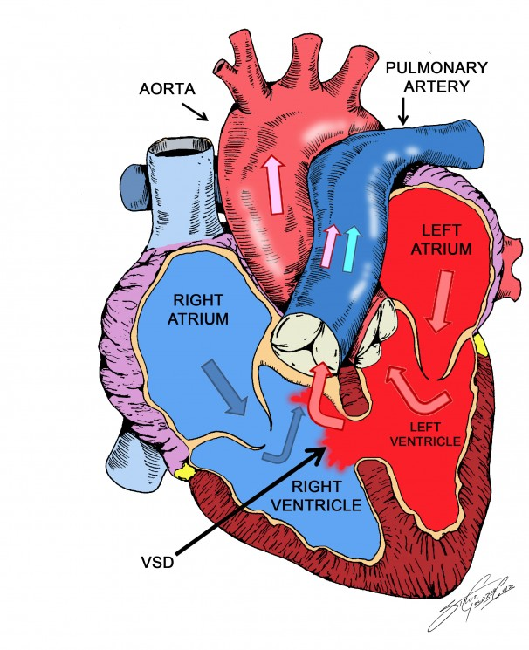
Septum - muscular wall that divides the left and right side of the heart
Ventricular or Atrial Septal Defect
Sometimes called a “hole in the heart”
Heart Tutorial at wisc-online

Slide 16
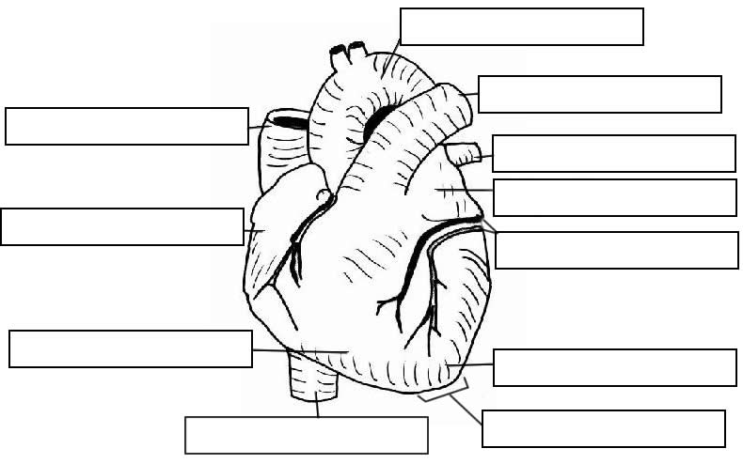

Slide 17
Aorta
Pulmonary Trunk
Superior Vena Cava
Pulmonary Vein
Left Atrium
Right Atrium
Coronary Vessels
Right Ventricle
Left Ventricle
Inferior Vena Cava
Apex
Notes:
1.

Slide 18
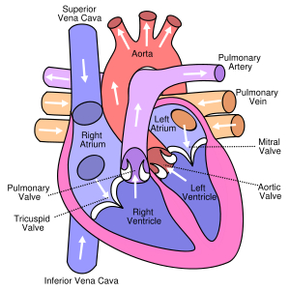

Slide 19
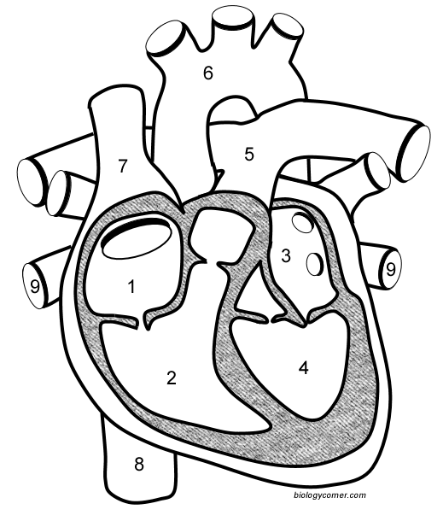
1. Right Atrium 2. Right Ventricle
3. Left Atrium 4. Left Ventricle
5. Pulmonary Artery 6. Aorta
7. Superior Vena Cava 8. Inferior Vena Cava 9. Pulmonary Vein

Slide 20
Try labeling these on your own.
Try labeling the valves too.

Slide 21
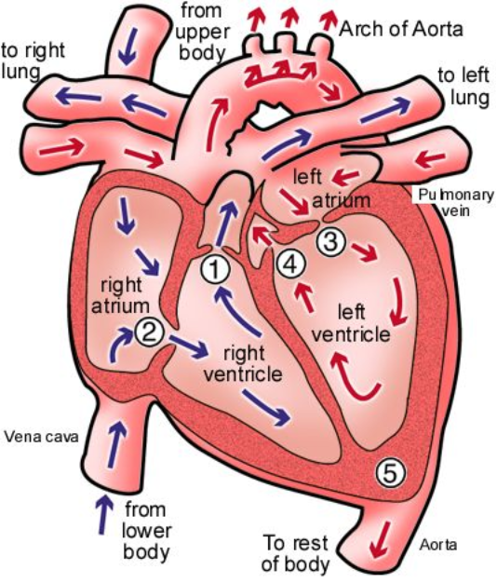
Name the valves
(#5 is not a valve)
Notes:
1 Pulmonary Valve 2 Tricuspid Valve 3 Mitral (Bicuspid) Valve 4 Aortic Valve 5 Heart Apex

Slide 22
1 Pulmonary Valve 2 Tricuspid Valve 3 Mitral (Bicuspid) Valve 4 Aortic Valve 5 Heart Apex

Slide 23
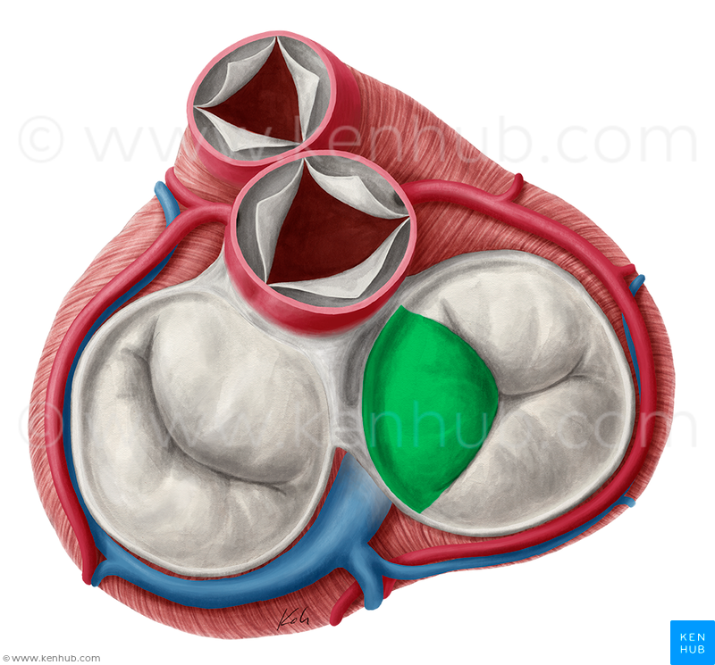
Can you name the valves?
1
1. Pulmonary valve
2. Aortic valve
3. Tricuspid
4. Bicuspid
2
3
4

Slide 24
