Slide 1
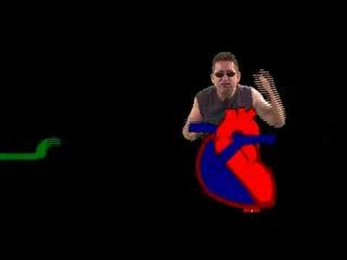
Heart Actions
Cardiac Cycle: One complete heartbeat. The contraction of a heart chamber is called systole the relaxation of a chamber is called diastole.
During ventricular systole, the aortic valve opens
During diastole, the aortic valve closes
Notes:
Sys-tall-e

Slide 2
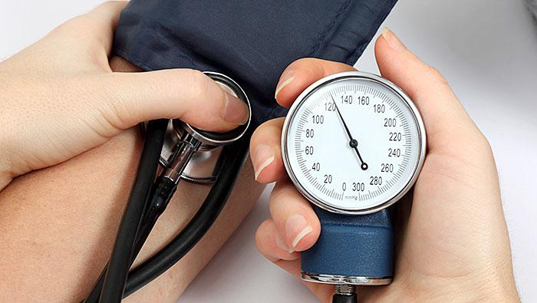
Blood pressure cuffs measure the force of the blood in the vessels. During systole, this force is the greatest, on a blood pressure reading, this is the first, larger number.
Diastole is the smaller number, when the ventricle relaxes.
Examples:
120/80 (Average)
105 /68
140 /90

Slide 3
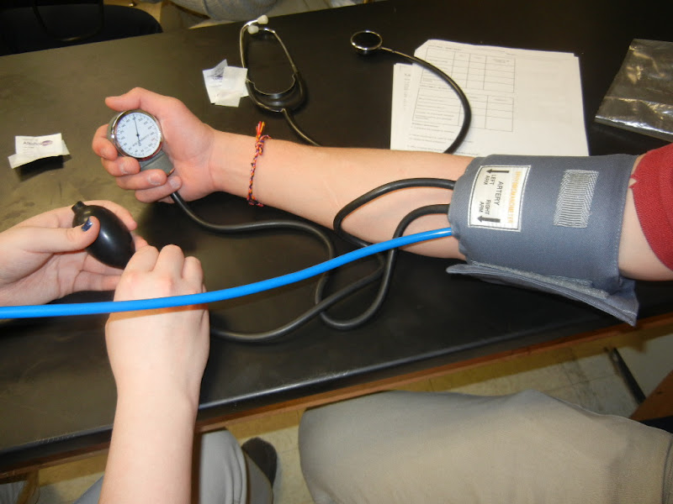
The average (normal) blood pressure for an adult is 120/80. This number varies by person and it is best if you know what is *normal* for you, so that you (or your doctor) recognize when something is not normal.
We will be doing a lab where you will learn to use a this device and check your own blood pressure.
Blood Pressure Cuff = SPHYGMOMANOMETER

Slide 4
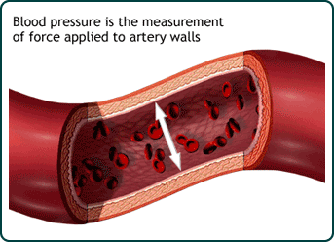
Blood pressure is the force of blood against the walls of arteries.
During contraction of the ventricle, pressure is very high (systole)

Slide 5
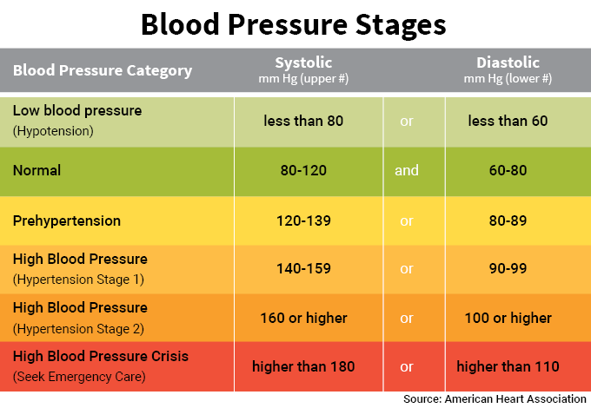

Slide 6
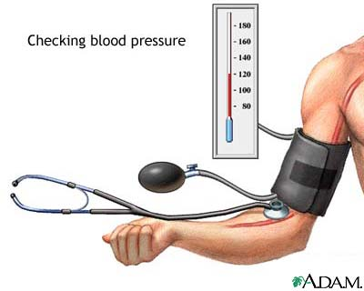
Factors affecting blood pressure:
1. Cardiac Output
2. Blood volume (5 liters for avg adult)
3. Blood Viscosity
4. Peripheral Resistance
Average is 120/80 (higher number is the systolic pressure)

Slide 7
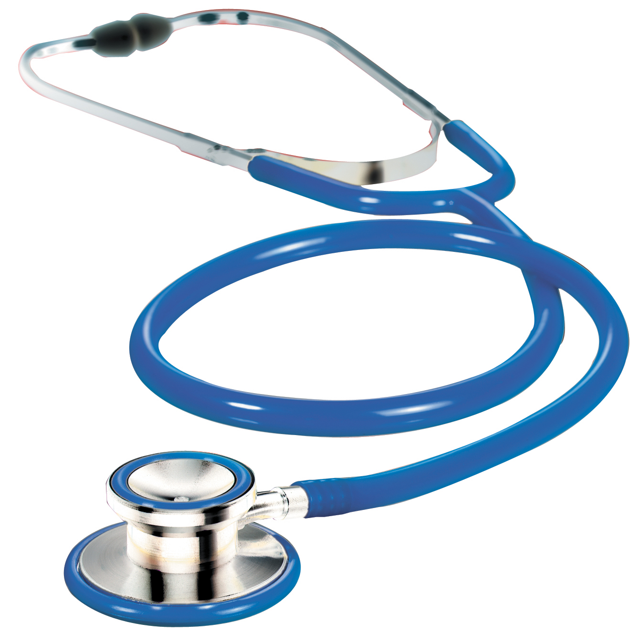
The “lub dub” sound of the heart is actually the closing of the valves
A normal resting heart rate for adults ranges from 60 to 100 bpm (beats per minute)
Check out this page to hear different sounds of the heart (murmurs, stenosis..etc)
Stethoscope - instrument to listen and measure heart sounds

Slide 8
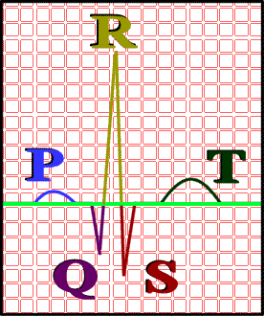
ECG – electrocardiogram – a recording of the electrical events (changes) during a cardiac cycle ; this is the same thing as an EKG
P Wave – depolarization of the atria (atrial contraction – systole)
QRS Complex – depolarization of the ventricles (ventricular contraction, systole)
T Wave – Repolarization of the ventricles

Slide 9
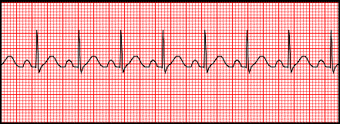
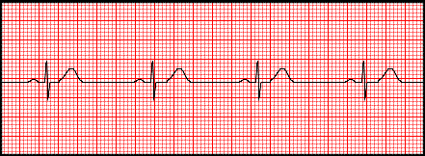
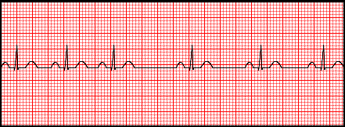
Analyze an ECG
Tachycardia = fast heart rate
Bradycardia = slow heart rate
Arrhythmia = irregular
Identify each.

Slide 10
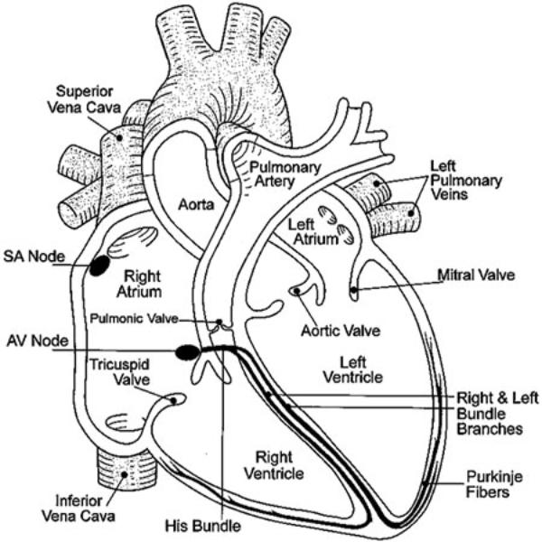
Cardiac Conduction System
S-A Node (pacemaker)
Junctional Fibers
A-V Node
A-V Bundle
Perkinje Fibers

Slide 11
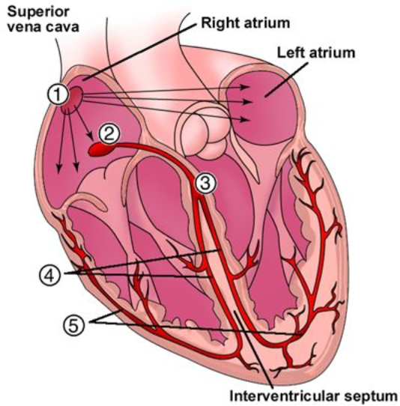
1 Sinoatrial node (Pacemaker) 2 Atrioventricular node 3 Atrioventricular Bundle (Bundle of His) 4 Left & Right Bundle branches 5 (Purkinje Fibers)

Slide 12
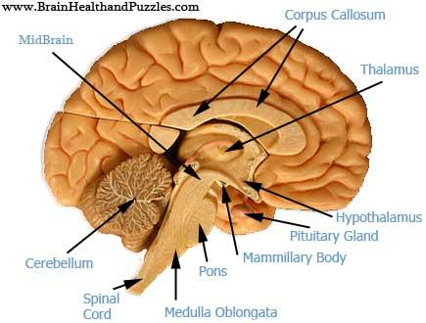
Regulation of Cardiac Cycle
Heart rate is controlled by the cardiac center within the medulla oblongata.
Increases/Decreases as a response to changes in state (HOMEOSTASIS)
Can your heart continue to beat even if your cerebrum is not functioning?

Slide 13
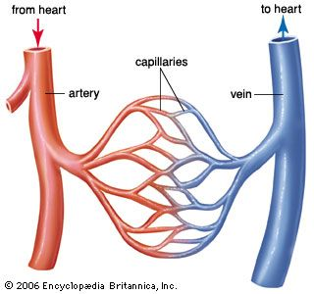
13.4 BLOOD VESSELS
Blood Vessels: arteries, veins, capillaries
ARTERIES : strong elastic vessels which carry blood moving away from the heart. Smallest ones are arterioles which connect to capillaries.
VEINS - Thinner, less muscular vessels carrying blood toward the heart.
Smallest ones are called venules which connect to capillaries. Contain valves.

Slide 14
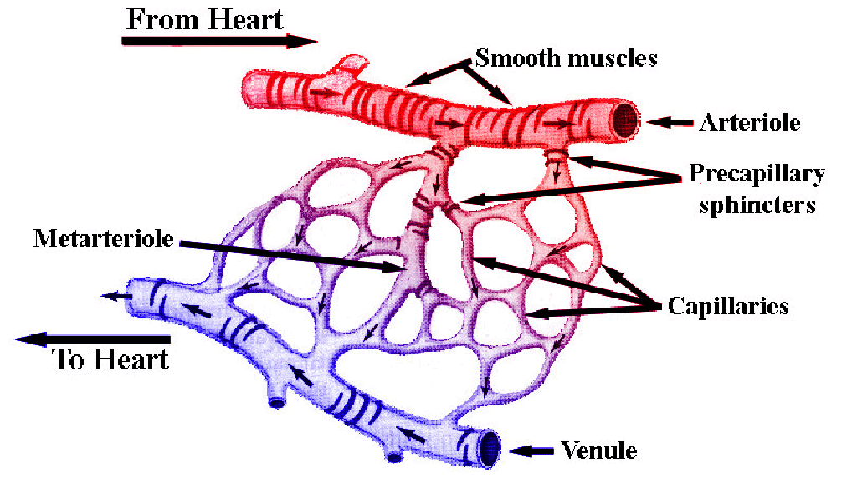
Capillaries: Penetrate nearly all tissues. Walls are composed of a single layer of squamous cells – very thin. Critical function: allows exchange of materials (oxygen, nutrients) between blood and tissues.

Slide 15
Control of Blood Flow:
Precapillary sphincters – circular, valve-like muscle at arteriole-capillary junction
Vasoconstriction – narrowing of vessel
Vasodilation –expanding blood vessel

Slide 16
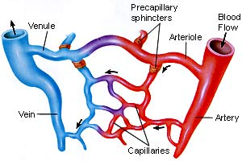
Sphincters open and close

Slide 17
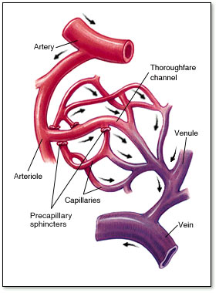
Blood flow through veins – not very efficient. Slow, weak, the following helps blood return to heart
1. Contraction of the diaphragm. 2. Pumping action of the skeletal muscles. 3. Valves in the veins.

Slide 18
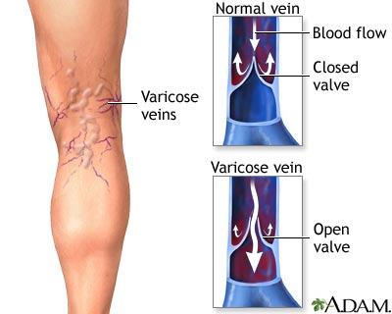
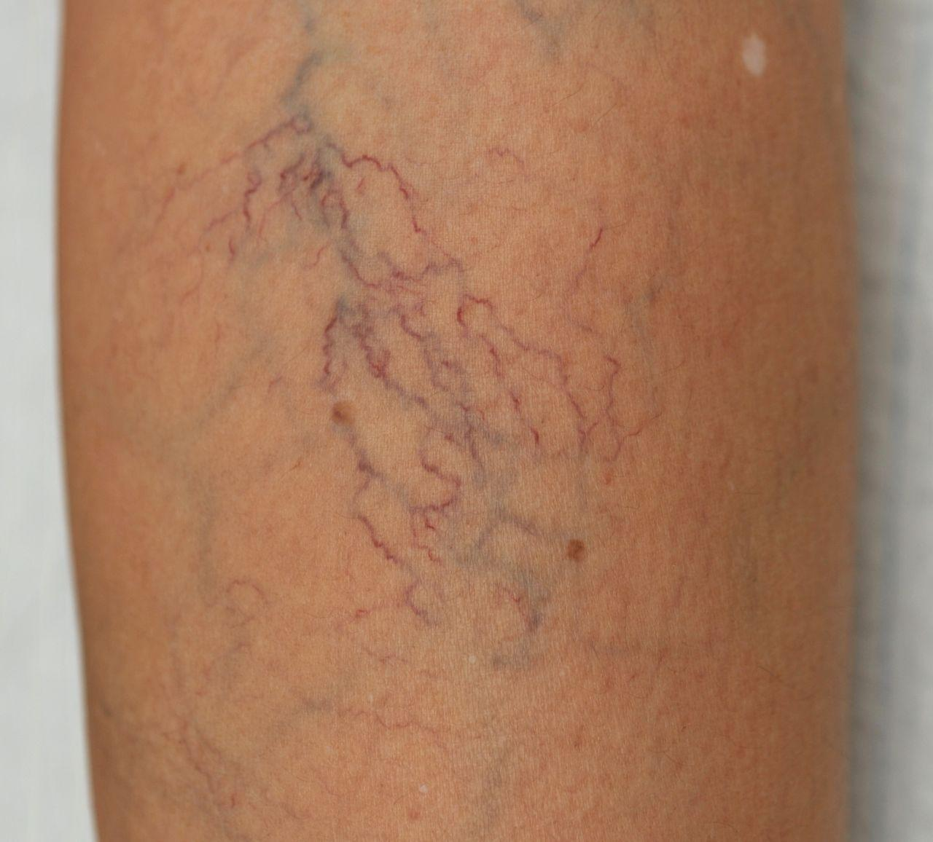
Varicose veins occur when blood pools in the veins.

Slide 19
Major Blood Vessels
Aorta - Ascending Aorta, Aortic Arch, Descending Aorta, Abdominal Aorta. The aorta is the largest artery. (leaves left ventricle)
Pulmonary Trunk – splits into left and right, both lead to the lungs (leaves left ventricle)
Pulmonary Veins – return blood from the lungs to the heart (connects to left atrium)
Superior and Inferior Vena Cava – return blood from the head and body to the heart (connects to right atrium)

Slide 20
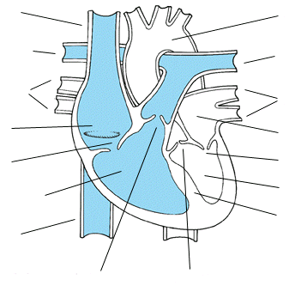

Slide 21
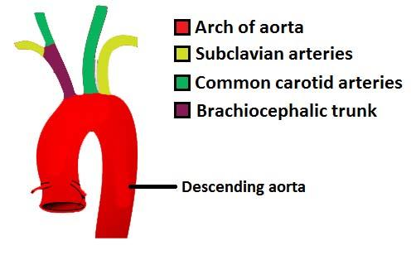
Branches of the Aorta
Coronary Arteries - supply blood to the heart itself
Brachiocephalic Artery branches into the
Right Subclavian ( supplies blood to the arms)
Right Common Carotid (bicarotid)
Left Common Carotid - to head
Left Subclavian Artery – supplies blood to the left arms
*Note that the vessels are not symmetrical.

Slide 22
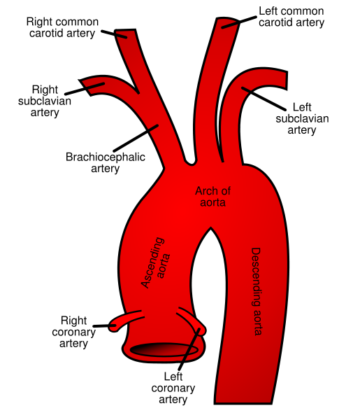
Aorta and Its Branches

Slide 23
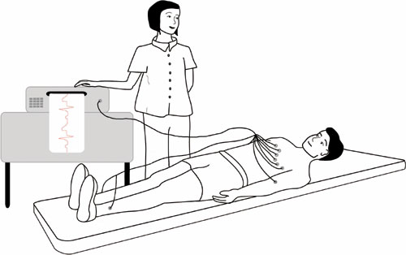
Heart Malfunctions SADS = (Sudden Arrhythmia Death Syndromes or Sudden Adult Death Syndrome)
Routine ECG Screening may help prevent deaths in young people

Slide 24
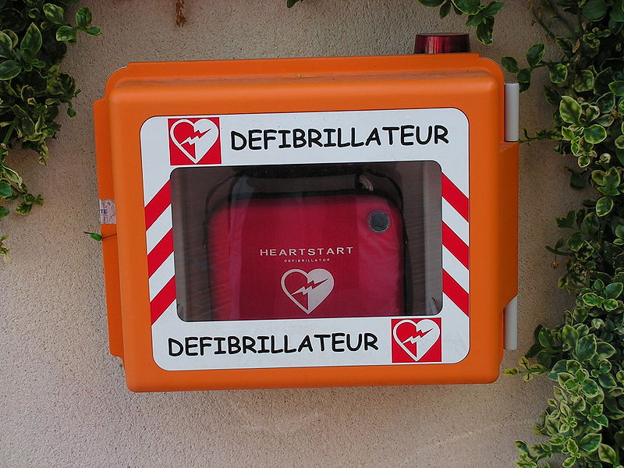
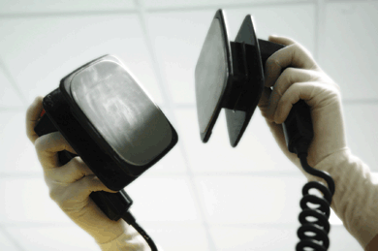
Defibrillator
common treatment for life-threatening cardiac arrhythmia
The device shocks the heart and allows it to re-establish its normal rhythm
The device can also be used to start a heart that has stopped.

Slide 25
CPR = cardiopulmonary resuscitation.
Notes:
You can also do CPR to the beat of “Another One Bites the Dust”

Slide 26
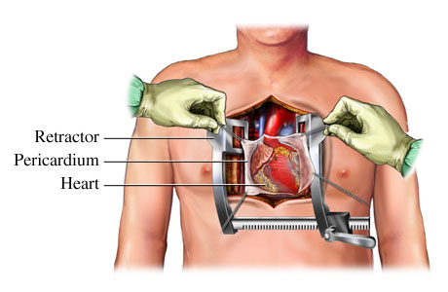
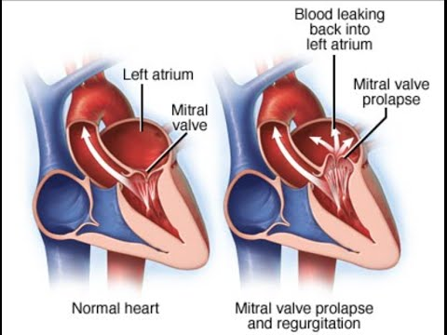
Disorders of the Circulatory System
1. Heart Murmurs – A heart murmur is an unusual sound heard during a heartbeat Sometimes they sound like a whooshing or swishing noise.
*may or may not be a valve problem
2. MVP - mitral valve prolapse, valve shifts out of place; this creates a clicking sound at the end of a contraction.
Notes:
Write on exact space of paper

Slide 27
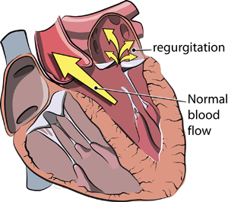
3. Mitral or aortic regurgitation: Regurgitation (backward flow) of blood can occur with mitral valve prolapse or mitral valve or aortic stenosis. To counteract this back flow, the heart must work harder to force blood through the damaged valve. Over time, this can weaken and/or enlarge the heart and can lead to heart failure.

Slide 28
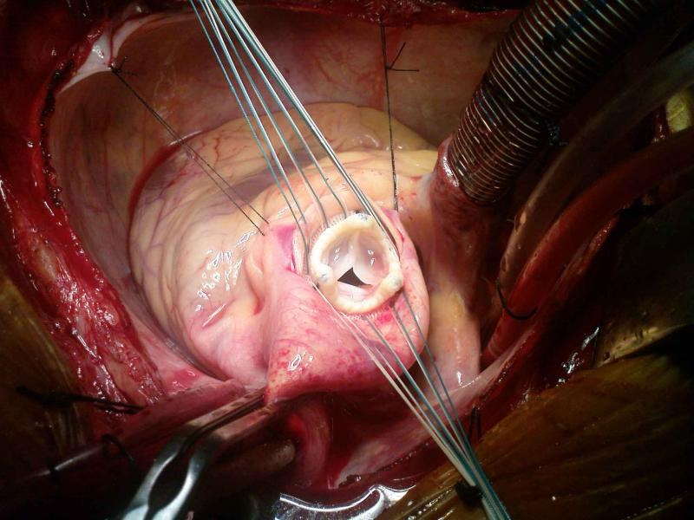
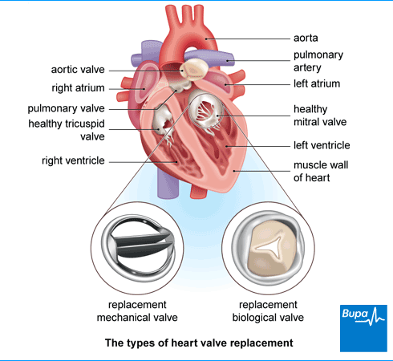
Valve Replacement Surgery
-replaced with biological tissue or with mechanical valves
See video of an aortic valve replacement (13 minutes) Protip - speed up video

Slide 29
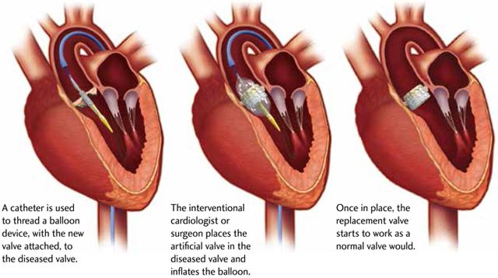
Transcatheter Aortic Valve Replacement (TAVR)
During a TAVR procedure, a very small incision is made in the groin to access the femoral artery or the chest (transapical approach). The cardiologist uses catheters and wires to place the balloon-expandable valve across the old diseased native valve, with the heart still beating. Crimped to the balloon device is the collapsed replacement valve. The surgeon then deploys the new valve within the diseased valve by expanding the balloon together with the new valve. He then secures it into place inside the old valve, displacing the old valve out of the way. In addition, the new valve starts to work as a normal valve should as soon as the balloon is deflated. Most of the time, the patients feel immediately better

Slide 30
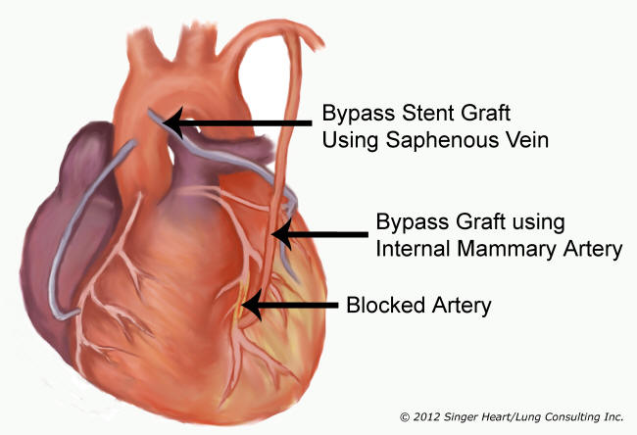
4. Myocardial Infarction (MI) - an obstruction to the coronary artery, commonly called a “heart attack”
Treatment can involve a bypass graft to restore blood flow to the heart.
Double or Quadruple refers to how many vessels have been bypassed.

Slide 31
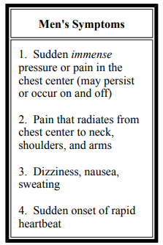
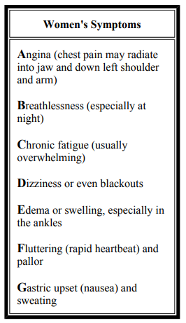

Slide 32
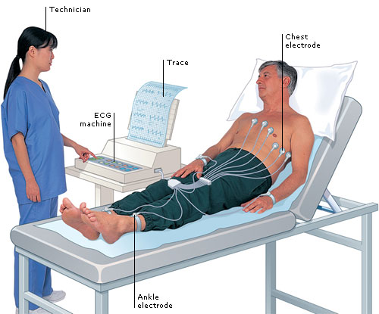
How is a Heart Attack Diagnosed?
Electrocardiogram (ECG) -injured heart muscles don’t conduct electrical impulses normally, the ECG may show that a heart attack has occurred or is in progress.
Blood tests - certain heart proteins slowly leak into your blood after heart damage from a heart attack. Emergency room doctors will take samples of your blood to test for the presence of these enzymes.

Slide 33
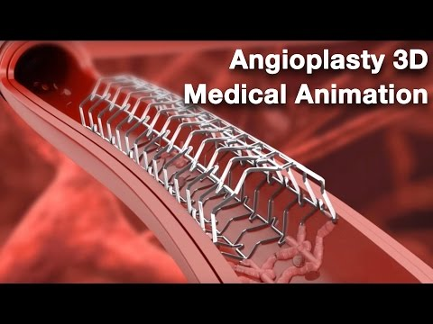
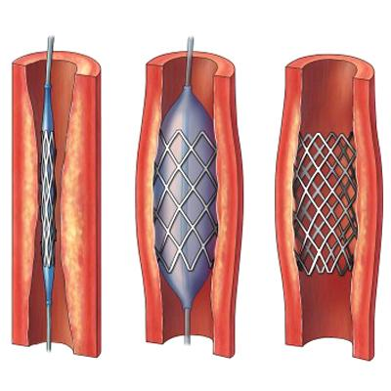
5. Atherosclerosis (Arteriosclerosis) – deposits of fatty materials such as cholesterol form a “plaque” in the arteries which reduces blood flow.
Treatment: Angioplasty, where a catheter is inserted into the artery and a balloon is used to stretch the walls open, a stent may be placed
Video

Slide 34
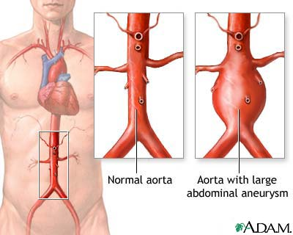
6. Hypertension – high blood pressure, the force within the arteries is too high. A sphygmomanometer can be used to diagnose hypertension
7. An aneurysm or aneurism is a localized, blood-filled balloon-like bulge in the wall of a blood vessel

Slide 35
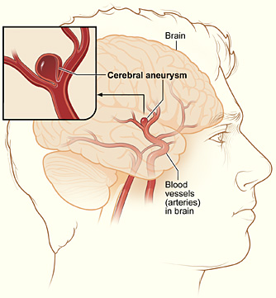
8. Stroke - blood flow to the brain is cut off
Hemorrhagic Stroke - caused by an aneurysm, blood vessel breaks or leaks
Ischemic Stroke -
Blood vessel is blocked

Slide 36
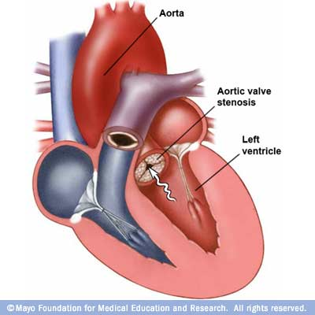
9. Aortic Stenosis
- valve or aorta is narrowed, limiting blood flow.
10. Ventricular or Atrial Septal Defect
a hole exists between the two sides of the heart
(septum)

