Slide 1
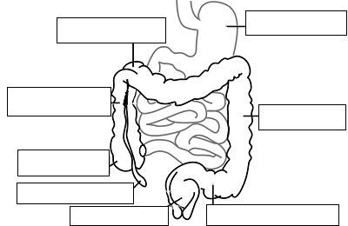
Stomach
Transverse Colon
Ascending Colon
Jejunum
Descending Colon
Ileum
Cecum
Appendix
Rectum
Sigmoid Colon

Slide 2
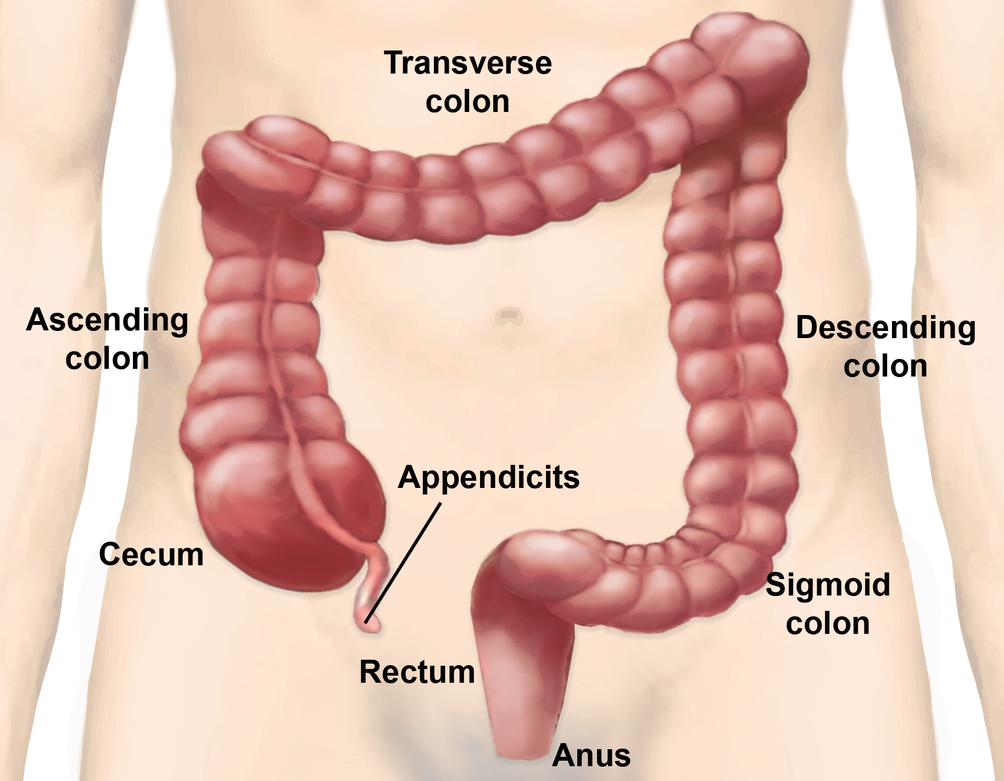
Function of Large Intestine
Secretes mucus, reabsorbs water, contains bacteria to aid in digestion (intestinal flora)
Mass Movements (defecation) - removes undigested food
The main job is
WATER REABSORPTION..

Slide 3
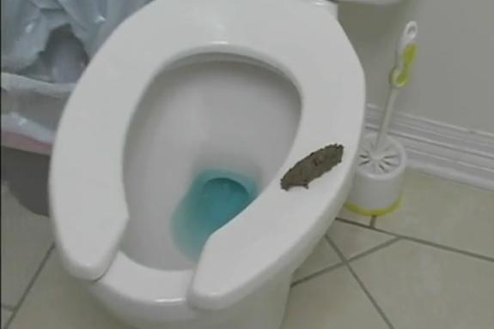
How to Make Fake Poop...

Slide 5
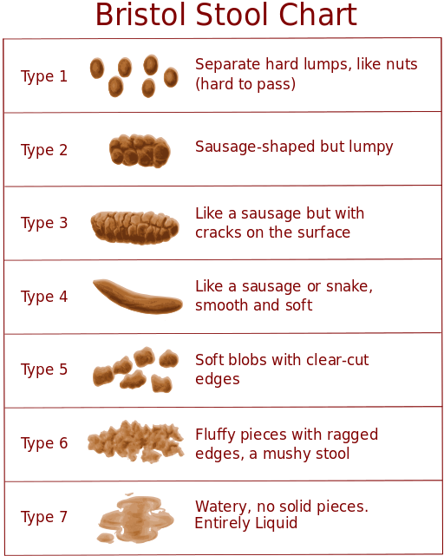
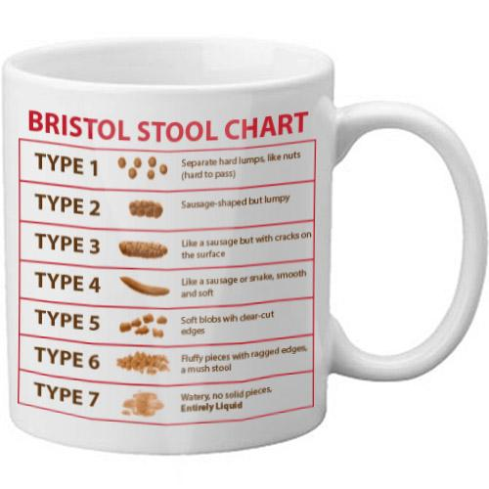
Types 1–2 indicate constipation, with 3 and 4 being the ideal stools (especially the latter), as they are easy to defecate while not containing any excess liquid, and 5, 6 and 7 tending towards diarrhea.

Slide 6
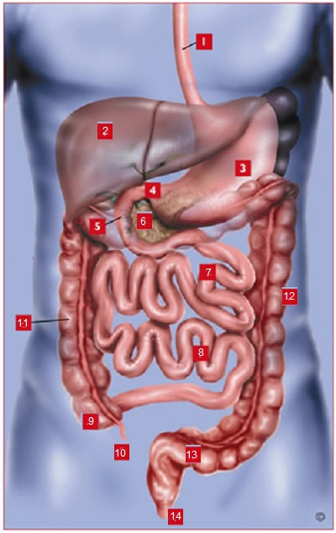
1. esophagus
2. liver
3. stomach
4. pyloric sphincter
5. duodenum
6. pancreas
7. jejunum
8. ileum
9. cecum
10. appendix
11. ascending colon
12. descending colon
13. sigmoid colon
14. anus

Slide 7
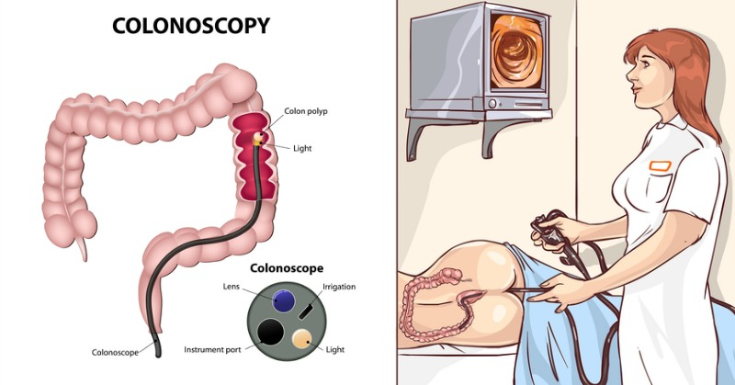
Disorders of the Digestive System
A Gastroenterologist is a physician with dedicated training and unique experience in the management of diseases of the gastrointestinal tract and liver.

Slide 8
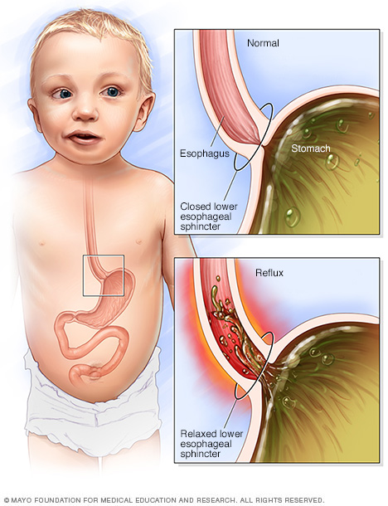
GERD
Gastroesophageal reflux disease (acid reflux)

Slide 9
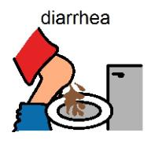
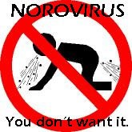
Dysentery or Diarrhea
Failure to reabsorb water in the large intestine, which leads to watery stool. Dehydration can lead to death.
Causes Include:
Parasitic Infection (Ameba, Cryptosporidium)
Bacterial Infection (Cholera, E. coli, Salmonella)
Viruses (Norovirus and other stomach bugs) Food allergy or intolerance
Gastroenteritis is a generic name used to describe vomiting and diarrhea

Slide 10
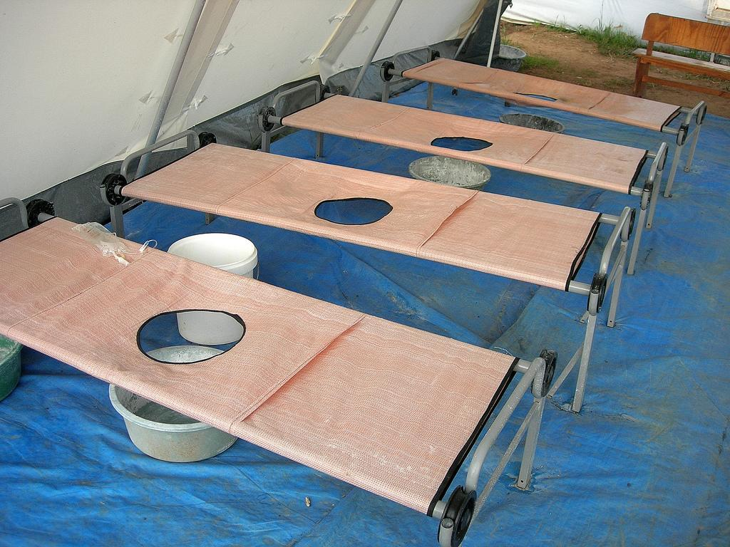
Cholera
Cholera bacteria causes diarrhea, leading to massive loss of water that can be fatal.
Bacteria is transmitted through unclean water sources and contaminated food.

Slide 11
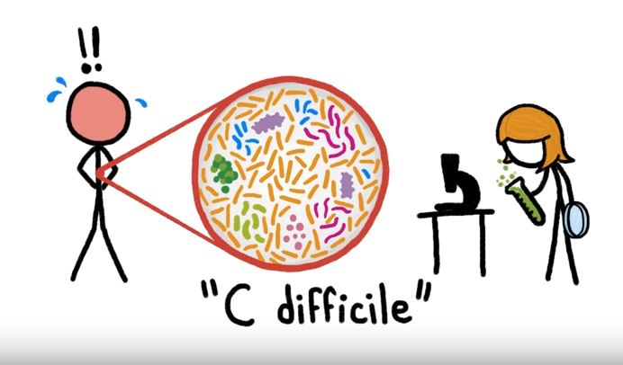
The MICROBIOME
The average human digestive tract is home to as many as 1,000 species of microorganisms When something upsets the balance of these organisms in your gut, otherwise harmless bacteria can grow out of control and make you sick.
One of the worst offenders is a bacterium called Clostridium difficile(or C. diff).
Become a Stool Donor at OPENBIOME.org

Slide 12
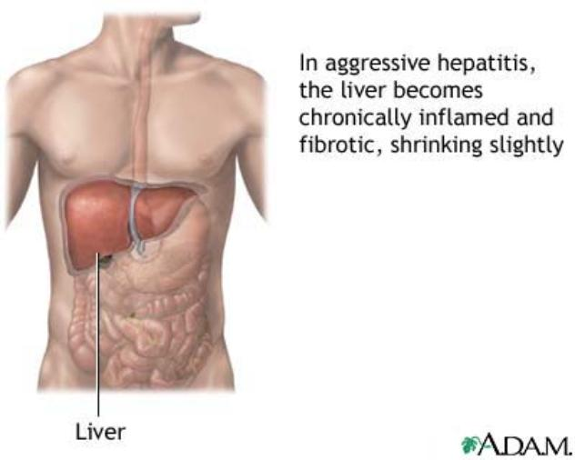
HEPATITIS A, B, C
Hepatitis A
-caused by eating food or water infected with a virus called HAV.
While it can cause swelling and inflammation in the liver, it doesn't lead to chronic disease. Almost everyone who gets hepatitis A has a full recovery, some may need hospitalization.
There is a vaccine!

Slide 13
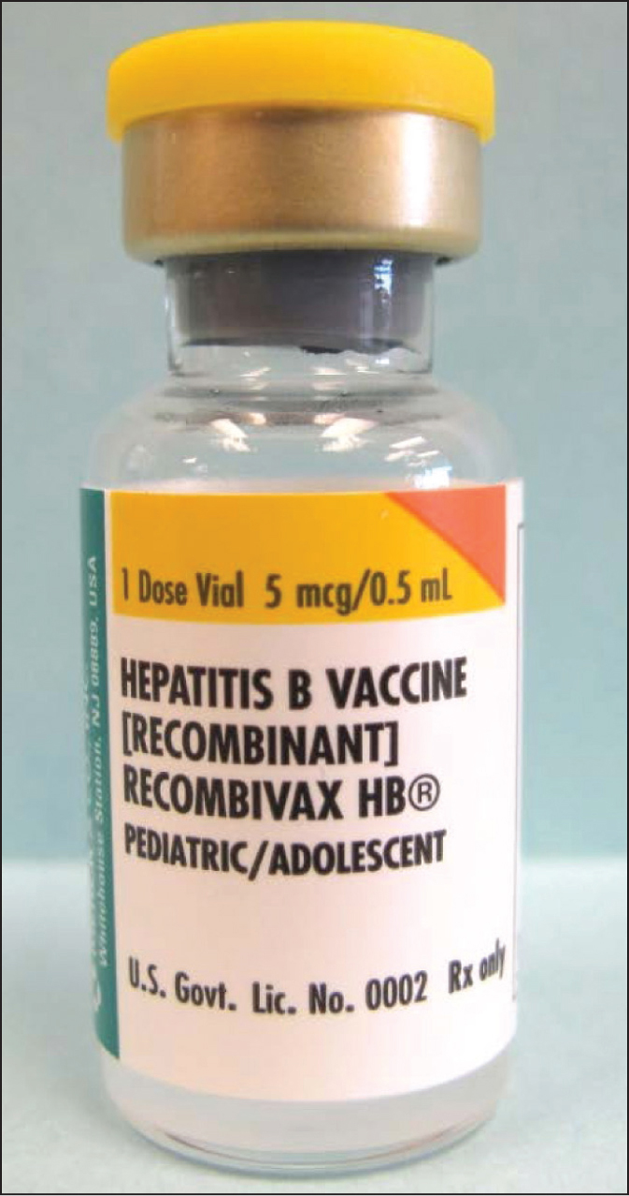
Hepatitis B is spread by contact with an infected person's blood, semen, or other body fluid.
Some people never develop symptoms, others develop chronic symptoms that stay with them their whole life.
There is a vaccine!

Slide 14
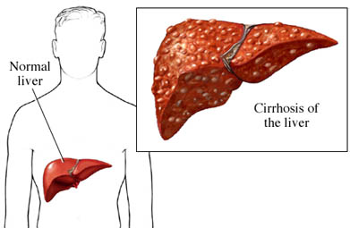
Hepatitis C is caused by the virus HCV. It is spread the same way as hepatitis B, through contact with an infected person's blood, semen, or body fluid.
Like hepatitis B, hepatitis C causes swelling of the liver and can cause liver damage that can lead to cancer. Most people who have hepatitis C develop a chronic infection. This may lead to a scarring of the liver, called cirrhosis.

Slide 15
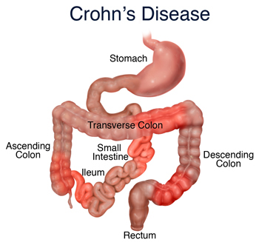
Crampy abdominal pain
Fatigue
Loss of appetite
Pain with passing stool (tenesmus); bloody stool
Persistent, watery diarrhea
Weight loss
Constipation

Slide 16
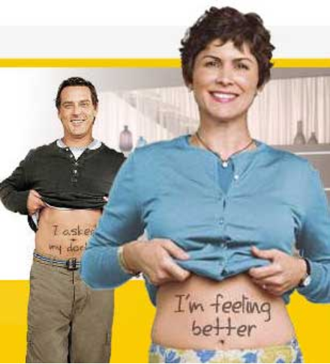
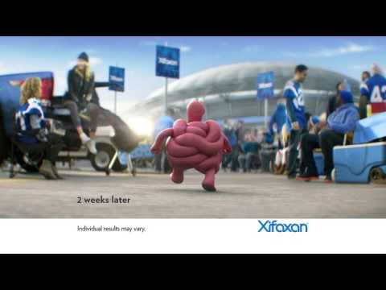
IBS - Irritable Bowel Syndrome
The muscles in the bowel wall may contract too forcefully or too weakly, too slowly or rapidly at certain times.

Slide 17
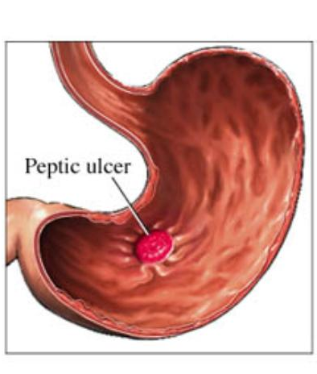
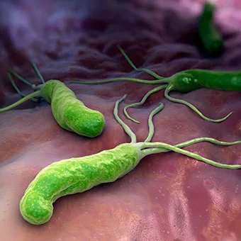
STOMACH ULCERS
Burning upper abdominal pain, particularly between meals, early in the morning, or after drinking orange juice, coffee, or alcohol,
Treated with antibiotics to kill H. pylori bacteria.

Slide 18
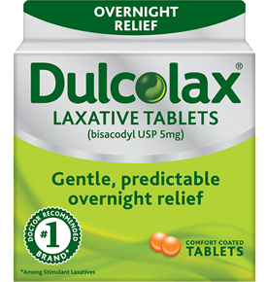
Constipation
difficulty in emptying the bowels, usually associated with hardened feces.
symptoms of chronic constipation include:
Passing fewer than three stools a week
Having lumpy or hard stools
Straining to have bowel movements
Feeling as though you can't completely empty the stool from your rectum

Slide 19
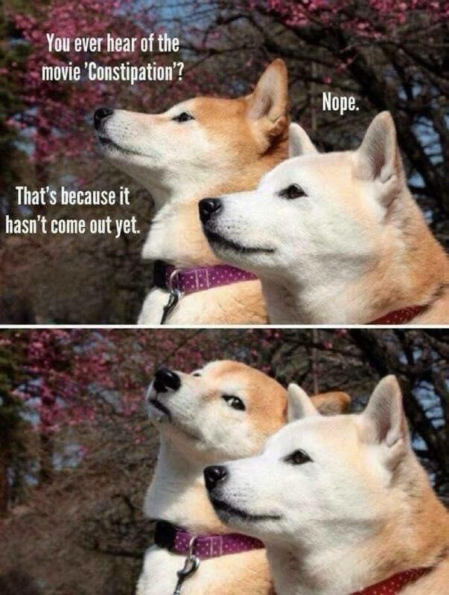

Slide 20
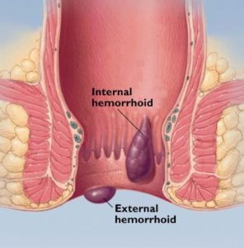
Hemorrhoids
swollen veins in your anus and lower rectum
may result from straining during bowel movements or from the increased pressure on these veins during pregnancy
Can cause pain, itching, and minor bleeding during bowel movements

Slide 21
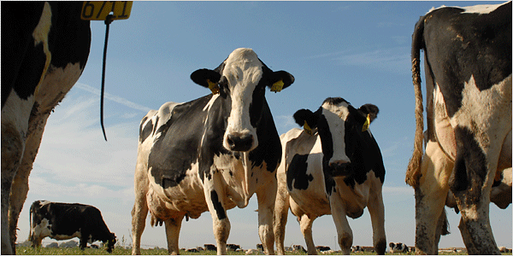
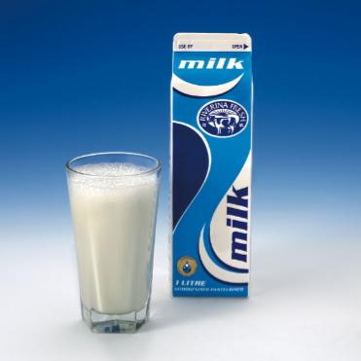
Lactose Intolerance
Inability to digest milk, can cause stomach upset

Slide 22
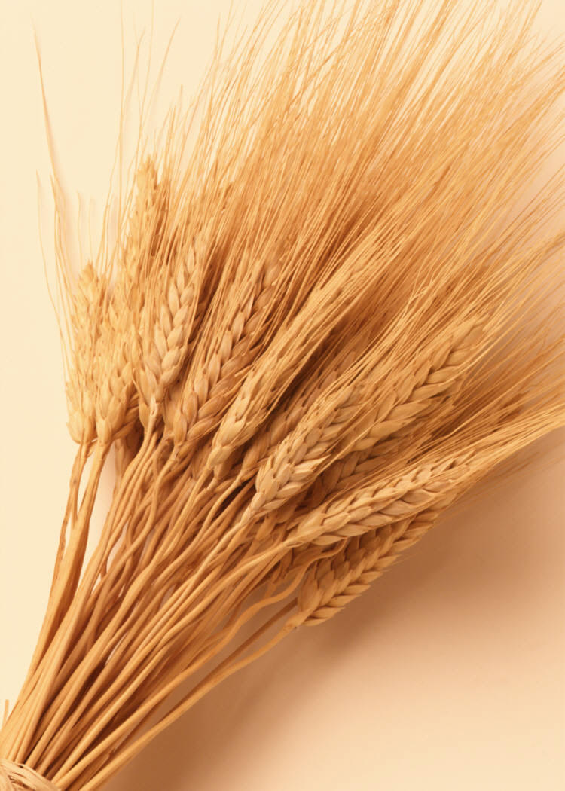
When people with celiac disease eat foods containing gluten, their immune system responds by damaging villi
Without healthy villi, a person becomes malnourished, no matter how much food one eats.

Slide 23
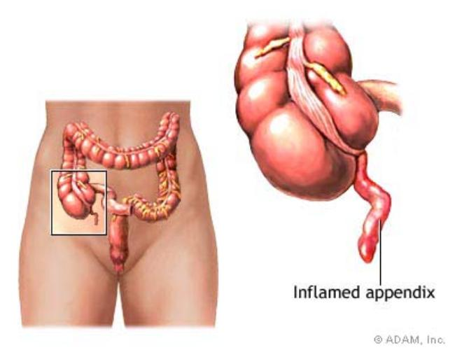
Appendicitis
Recent news on the function of the appendix.
The appendix acts as a storehouse for good bacteria, “rebooting” the digestive system after diarrheal illnesses.
ScienceDaily Article

Slide 24
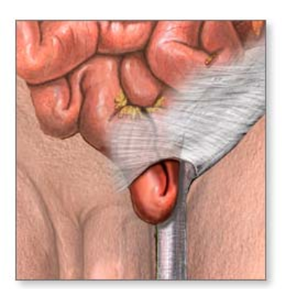
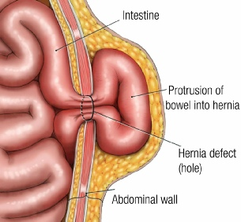
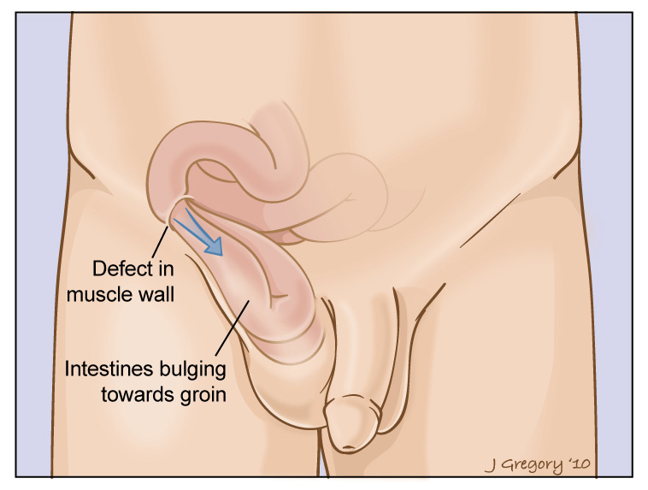
Hernia
intestines poke through abdominal muscles

Slide 25
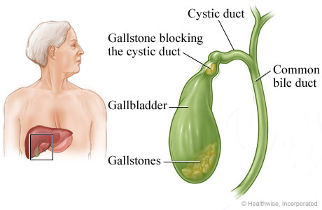
Gallstones (Cholelithiasis)
Gallstones are made from cholesterol and other things found in the bile. They can be smaller than a grain of sand or as large as a golf ball.

Slide 26
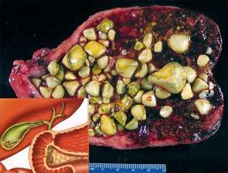
Gallstones within the gall bladder

Slide 27
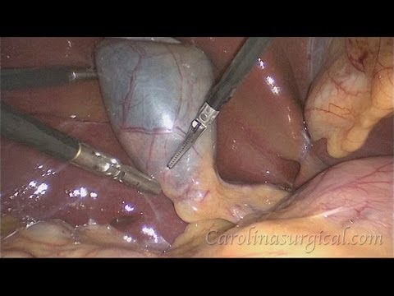

Slide 28
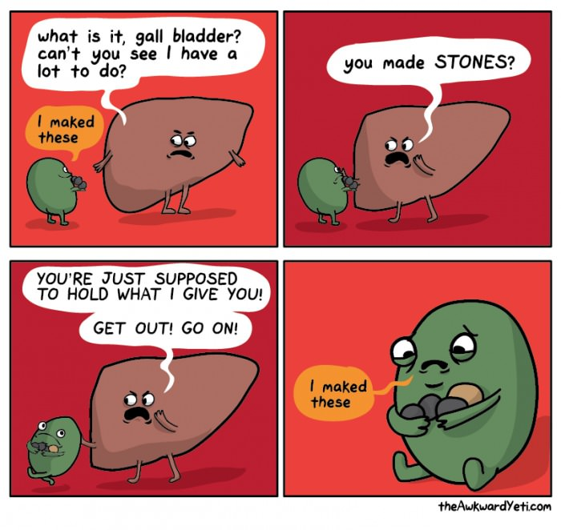

Slide 29
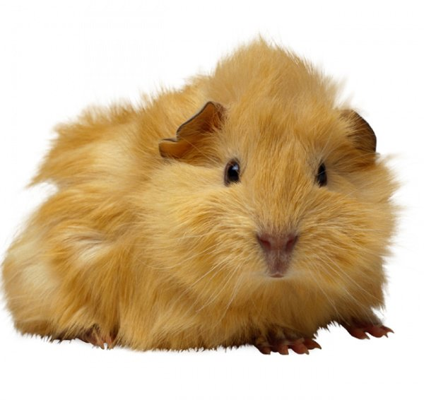
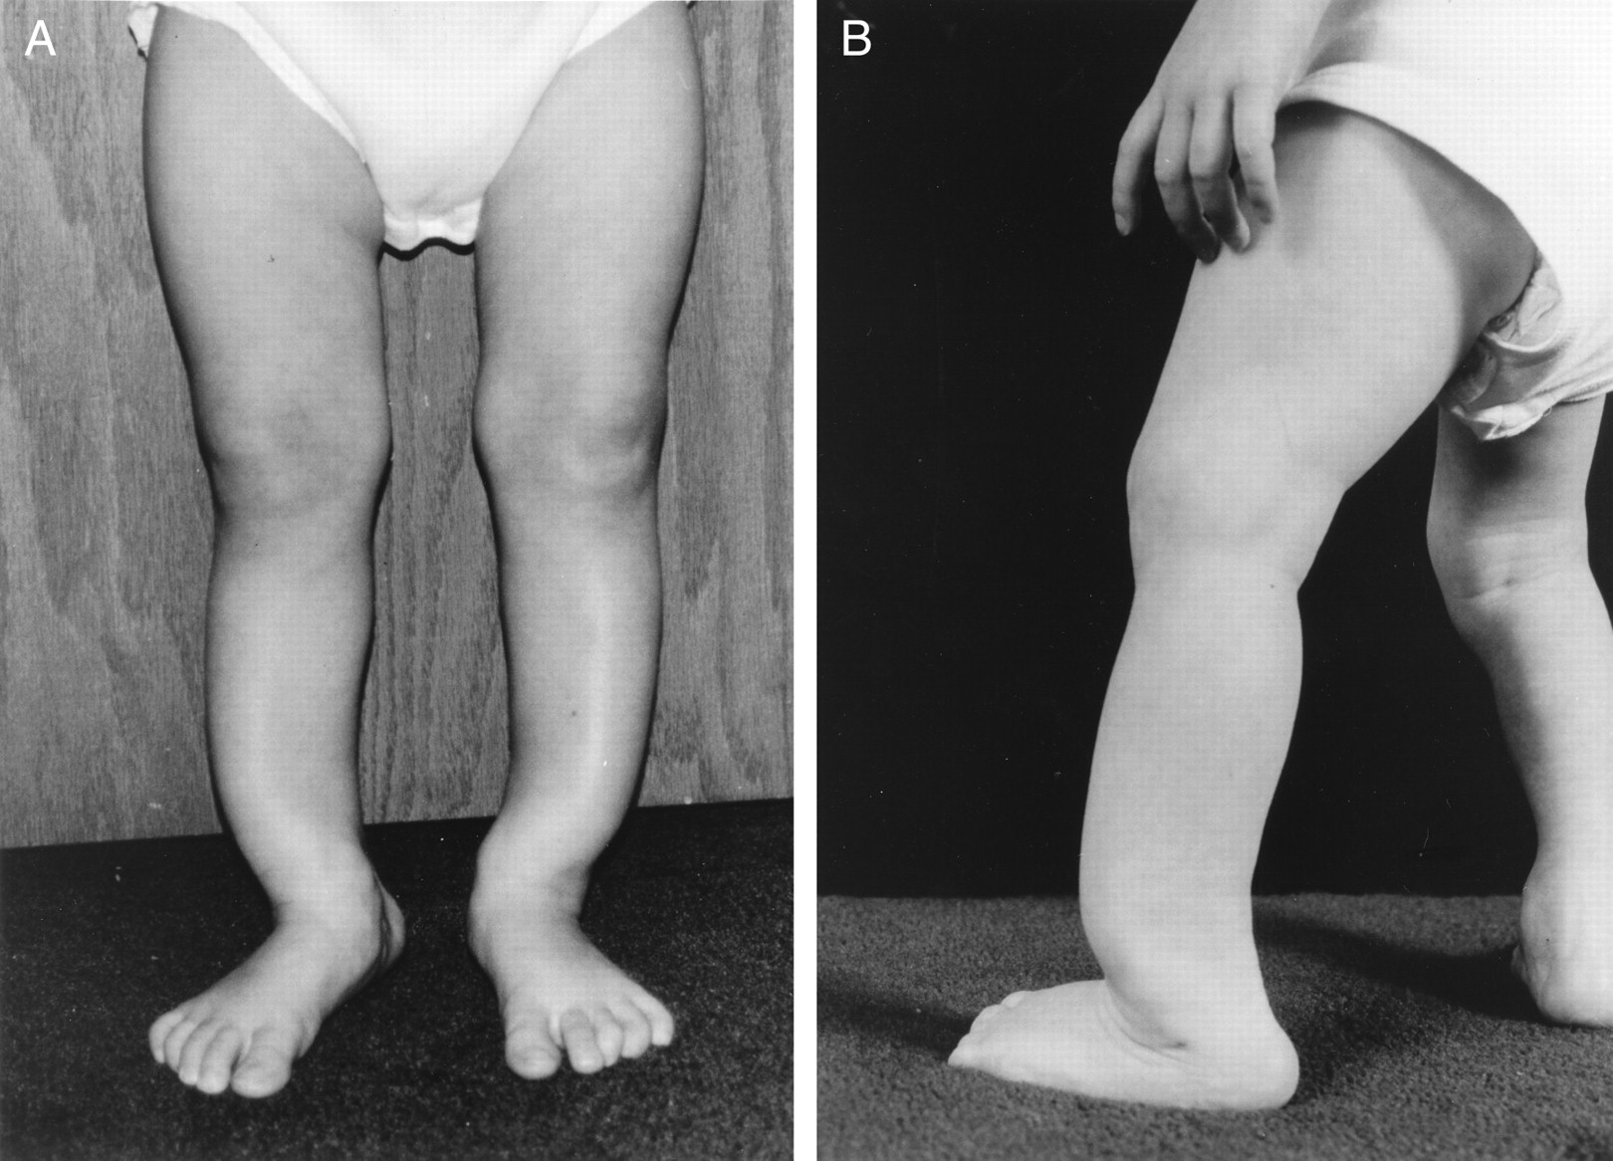
Malnutrition
lack of proper nutrition, caused by not having enough to eat, not eating enough of the right things, or being unable to use the food that one does eat
- Scurvy (lack of vitamin C) - Rickets (lack of vitamin D)
An essential nutrient is a nutrient required for normal body functioning that can not be synthesized by the body.
Most animals can synthesize their own vitamin C, so they don’t need it in their diet.
Exceptions: primates, guinea pigs, fruit bats
*What do these animals have in common?
Assignment: Read “Broken Genes” by Nathan Lents, Excerpt from Human Errors

Slide 30
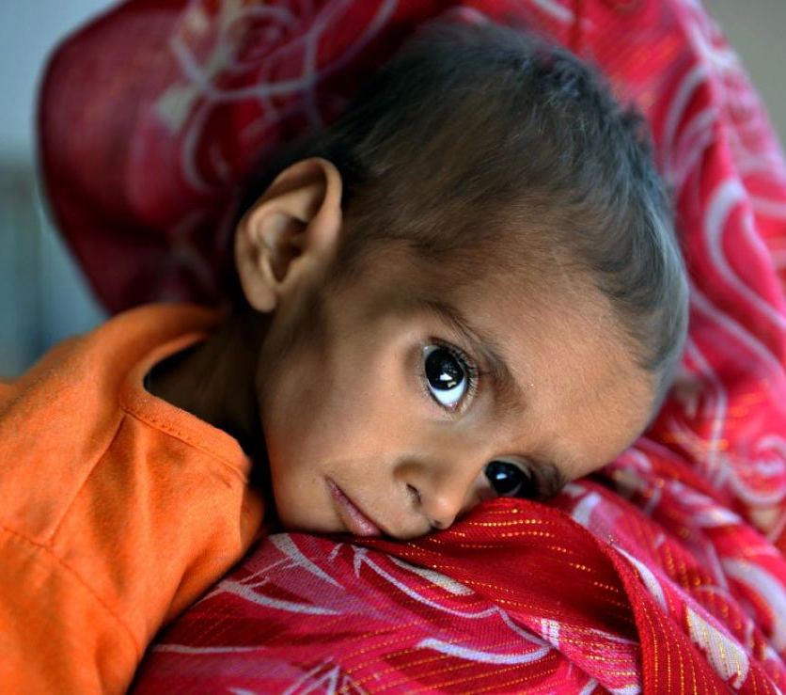
Malnutrition is often associated with general lack of food or famine.
An estimated 85,000 children might have died of hunger since the bombings began in Yemen in 2015.

Slide 31
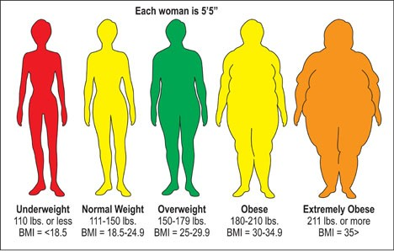
Obesity = BMI is 30 or more
Body Mass Index is based on height and weight

Slide 32
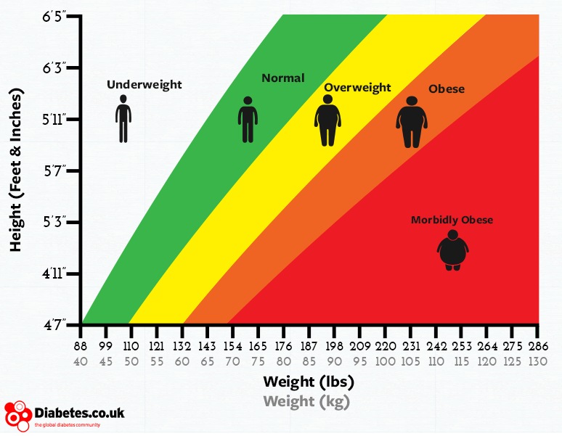

Slide 33
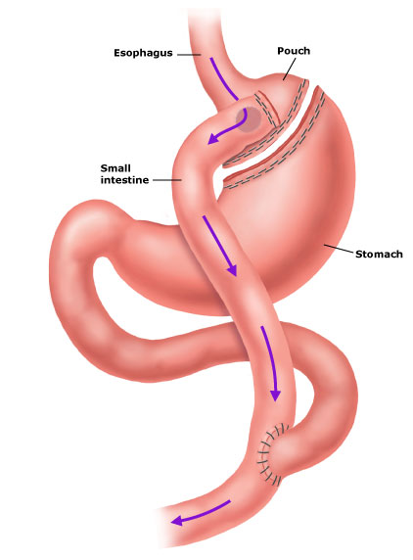
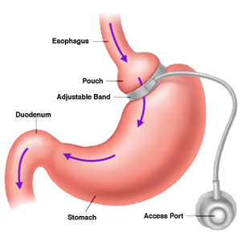
Treatments (extreme) for obesity
Gastric Bypass
Lap Band

Slide 34
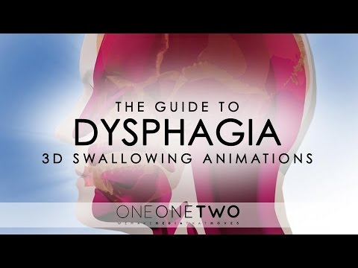
Dysphagia - problems with swallowing
Aspiration - when food or other objects enter the airway.
Can result in aspiration pneumonia

Slide 35
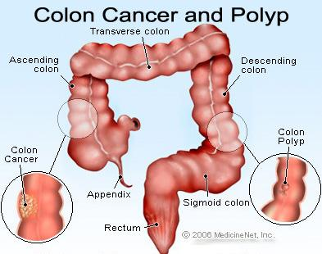
Colon Cancer
Colonoscopy is a screening technique to detect cancer.
See Katie Couric's Colonoscopy

Slide 36
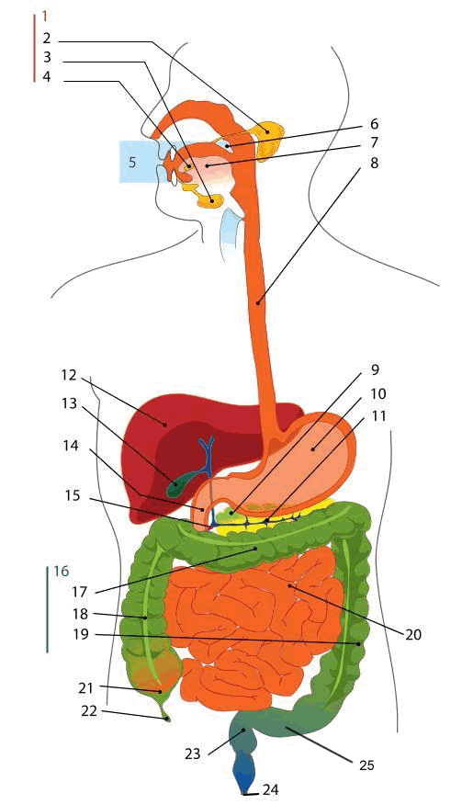
LABEL THIS!

Slide 37
