Slide 1
Clearblue Pregnancy Test

Slide 2
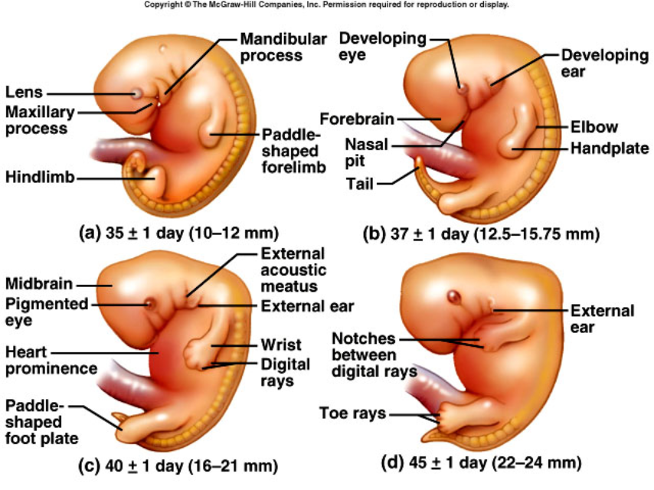
Fetal Development

Slide 3
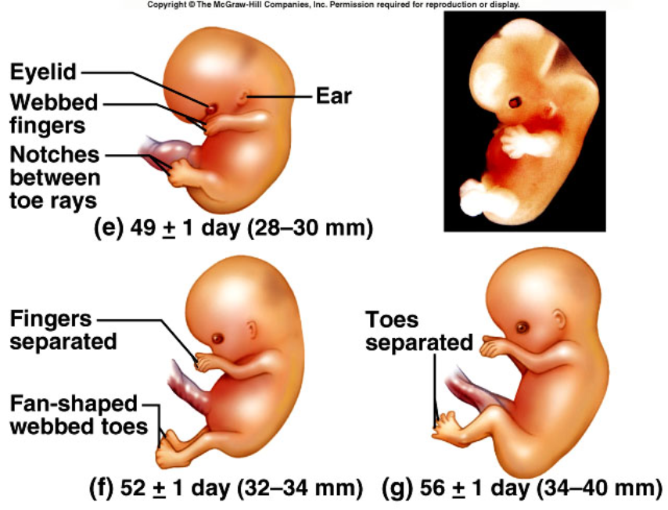
Fetal Development

Slide 4
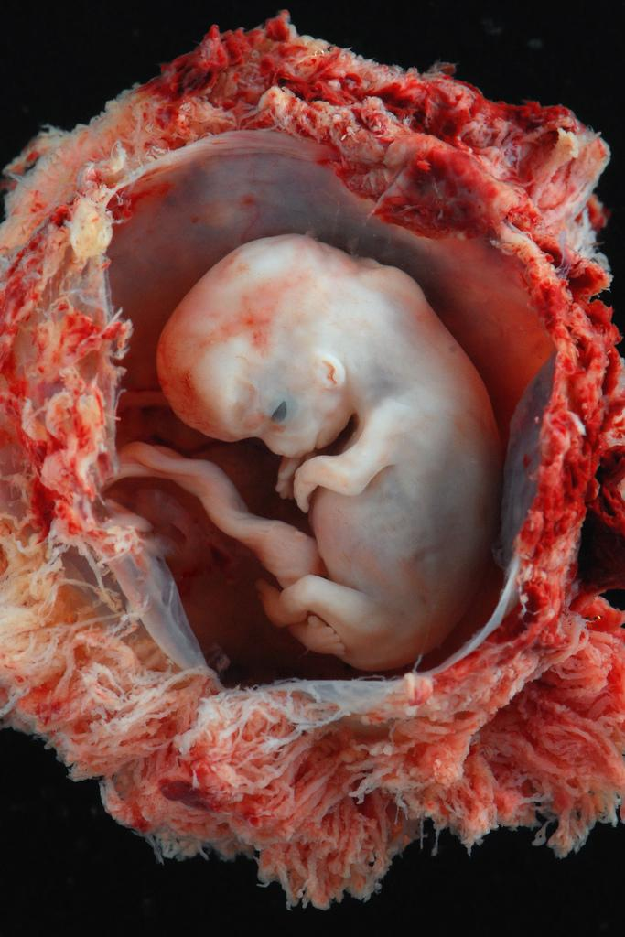
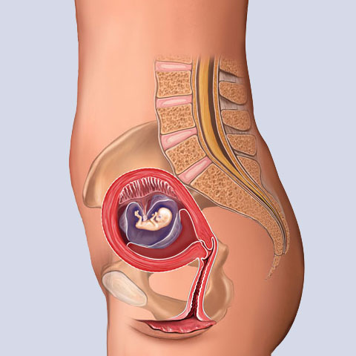
At the 8th week, the embryo is called a FETUS
At 8 weeks
Embryo, approximately 8 weeks from conception
http://www.flickr.com/photos/lunarcaustic/3385925240/

Slide 5
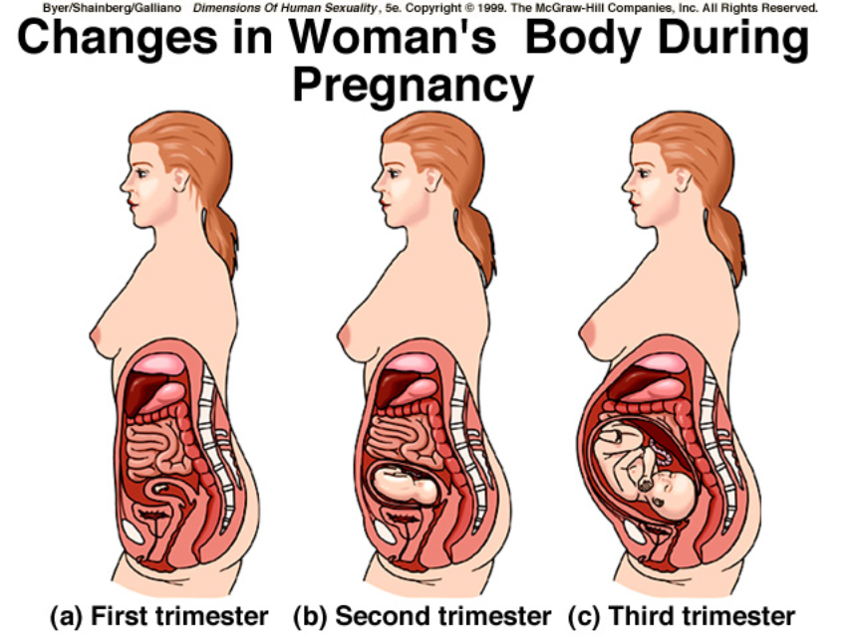

Slide 6
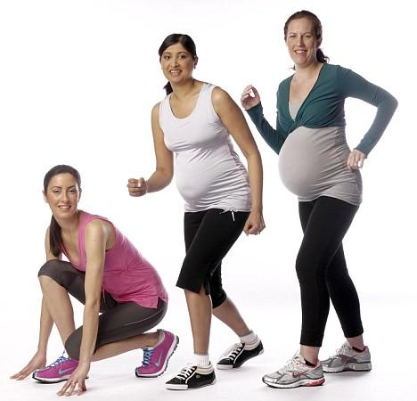
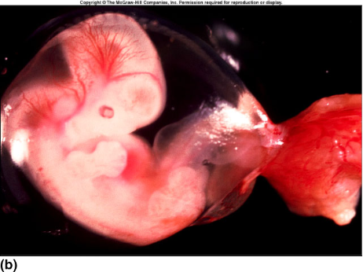
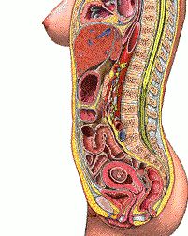

Slide 7
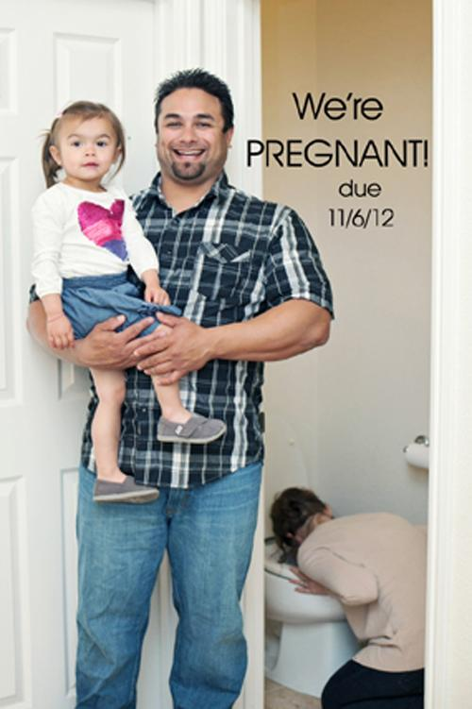
What Causes Morning Sickness?
It is likely hormones that rise rapidly with most incidents occurring in the first trimester
Human chorionic gonadotropin (hCG): This hormone rises rapidly during early pregnancy. No one knows how hCG contributes to nausea, but it's a prime suspect because the timing is right: Nausea tends to peak around the same time as levels of hCG. What's more, conditions in which women have higher levels of hCG, such as carrying multiples, are associated with higher rates of nausea and vomiting.

Slide 8
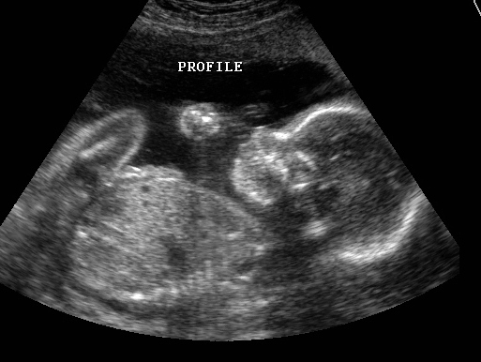
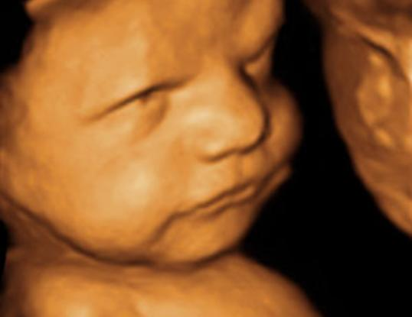
Fetal Tests
Ultrasound - sound waves produce an image of the baby
You can tell the sex of the baby and its position
3D ultrasound uses a computer to render the image.

Slide 9
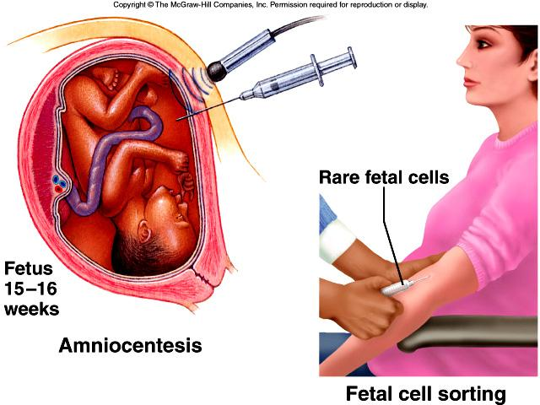
Amniocentesis
Tests fetal cells for abnormalities, such as chromosome numbers

Slide 10
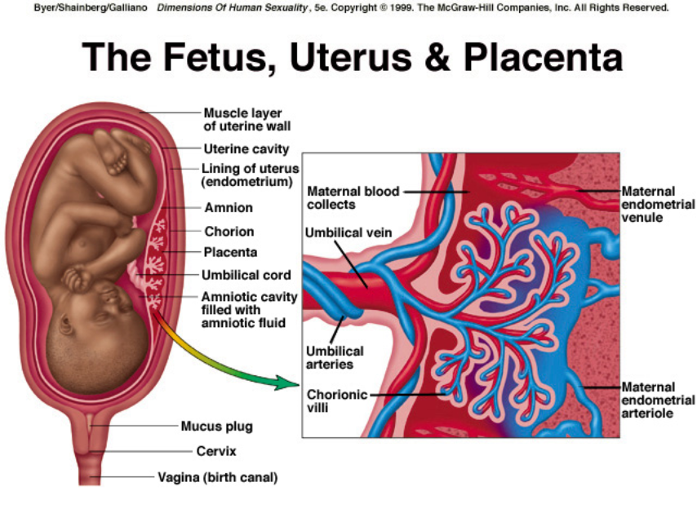

Slide 11
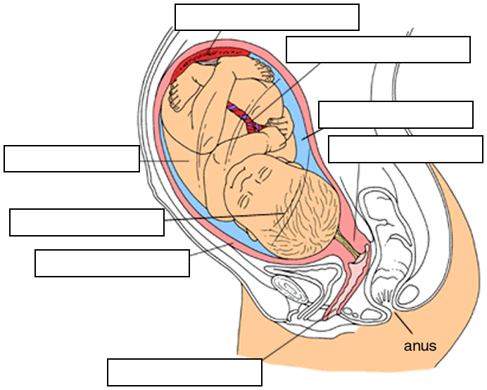

Slide 12
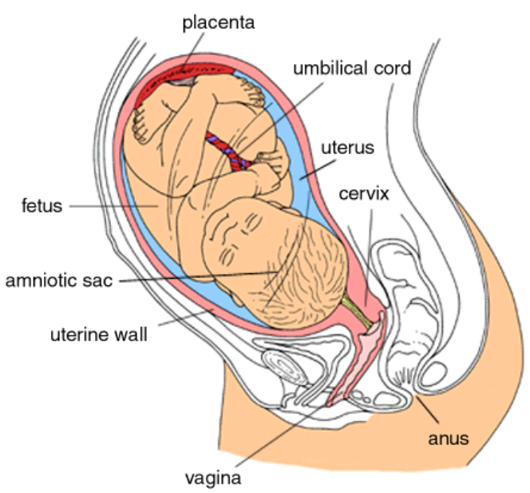

Slide 13
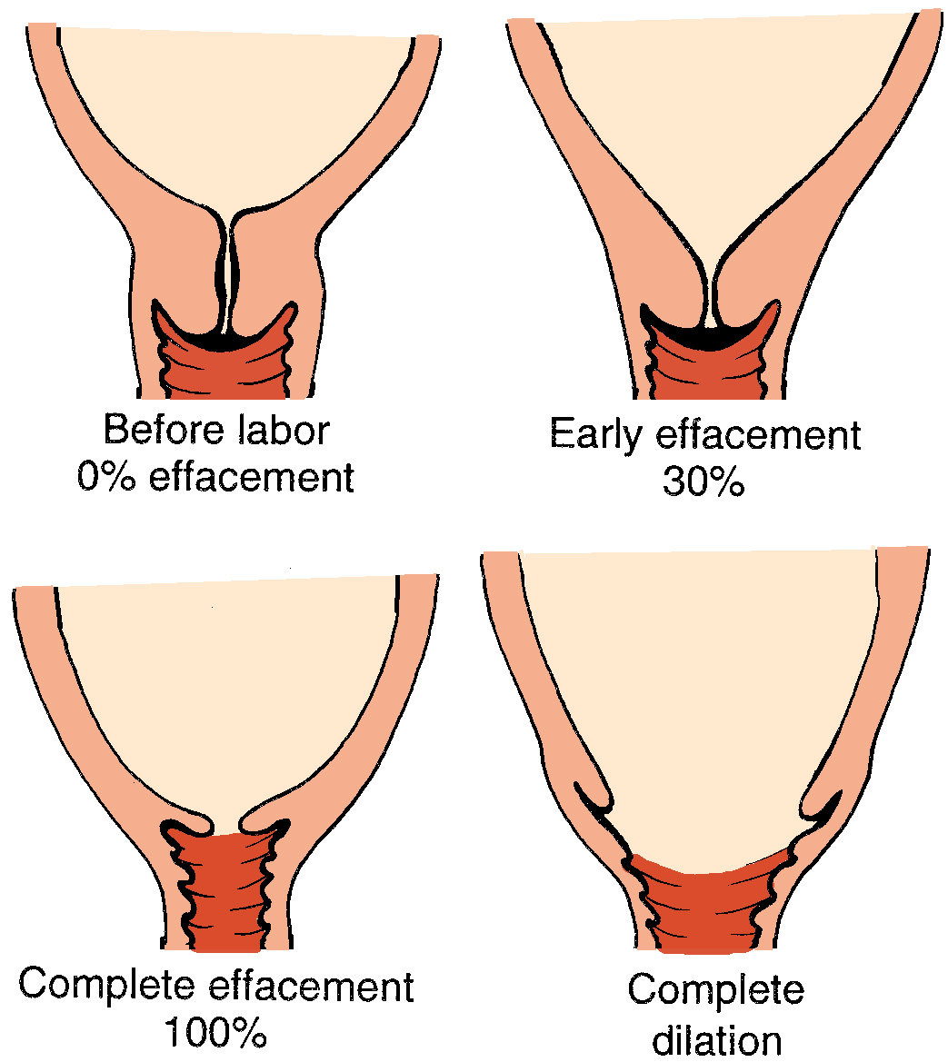
Labor
Contractions of muscles occur and become faster and faster, this timing can be used to predict the progression of the labor.
Braxton Hicks contractions can occur throughout pregnancy, but probably more frequent at the end
Dilation of the cervix allows for baby to pass through, the amount of dilation also is a good clue for how close baby is.

Slide 14
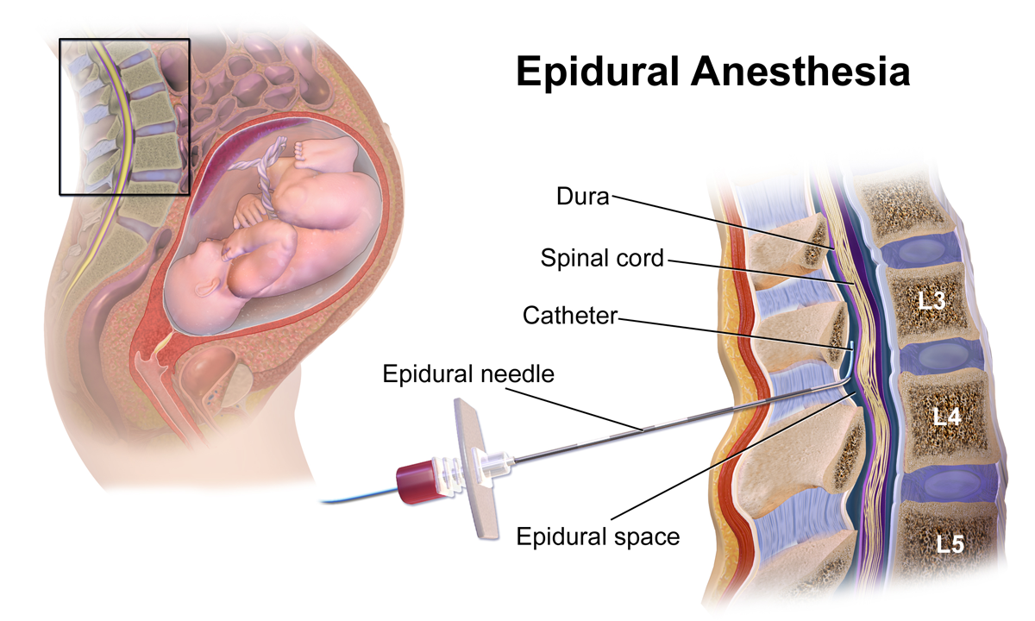
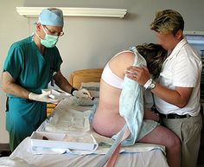
An epidural can be used to manage pain of labor.
Epi + dura = upon the dura
Drug is injected into the space (dura) near the spinal cord.

Slide 15
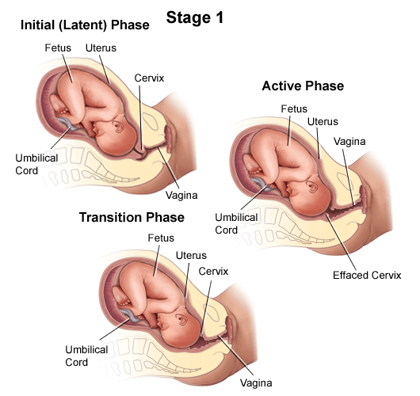

Slide 16
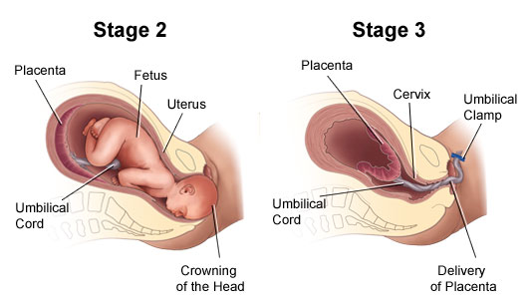

Slide 17
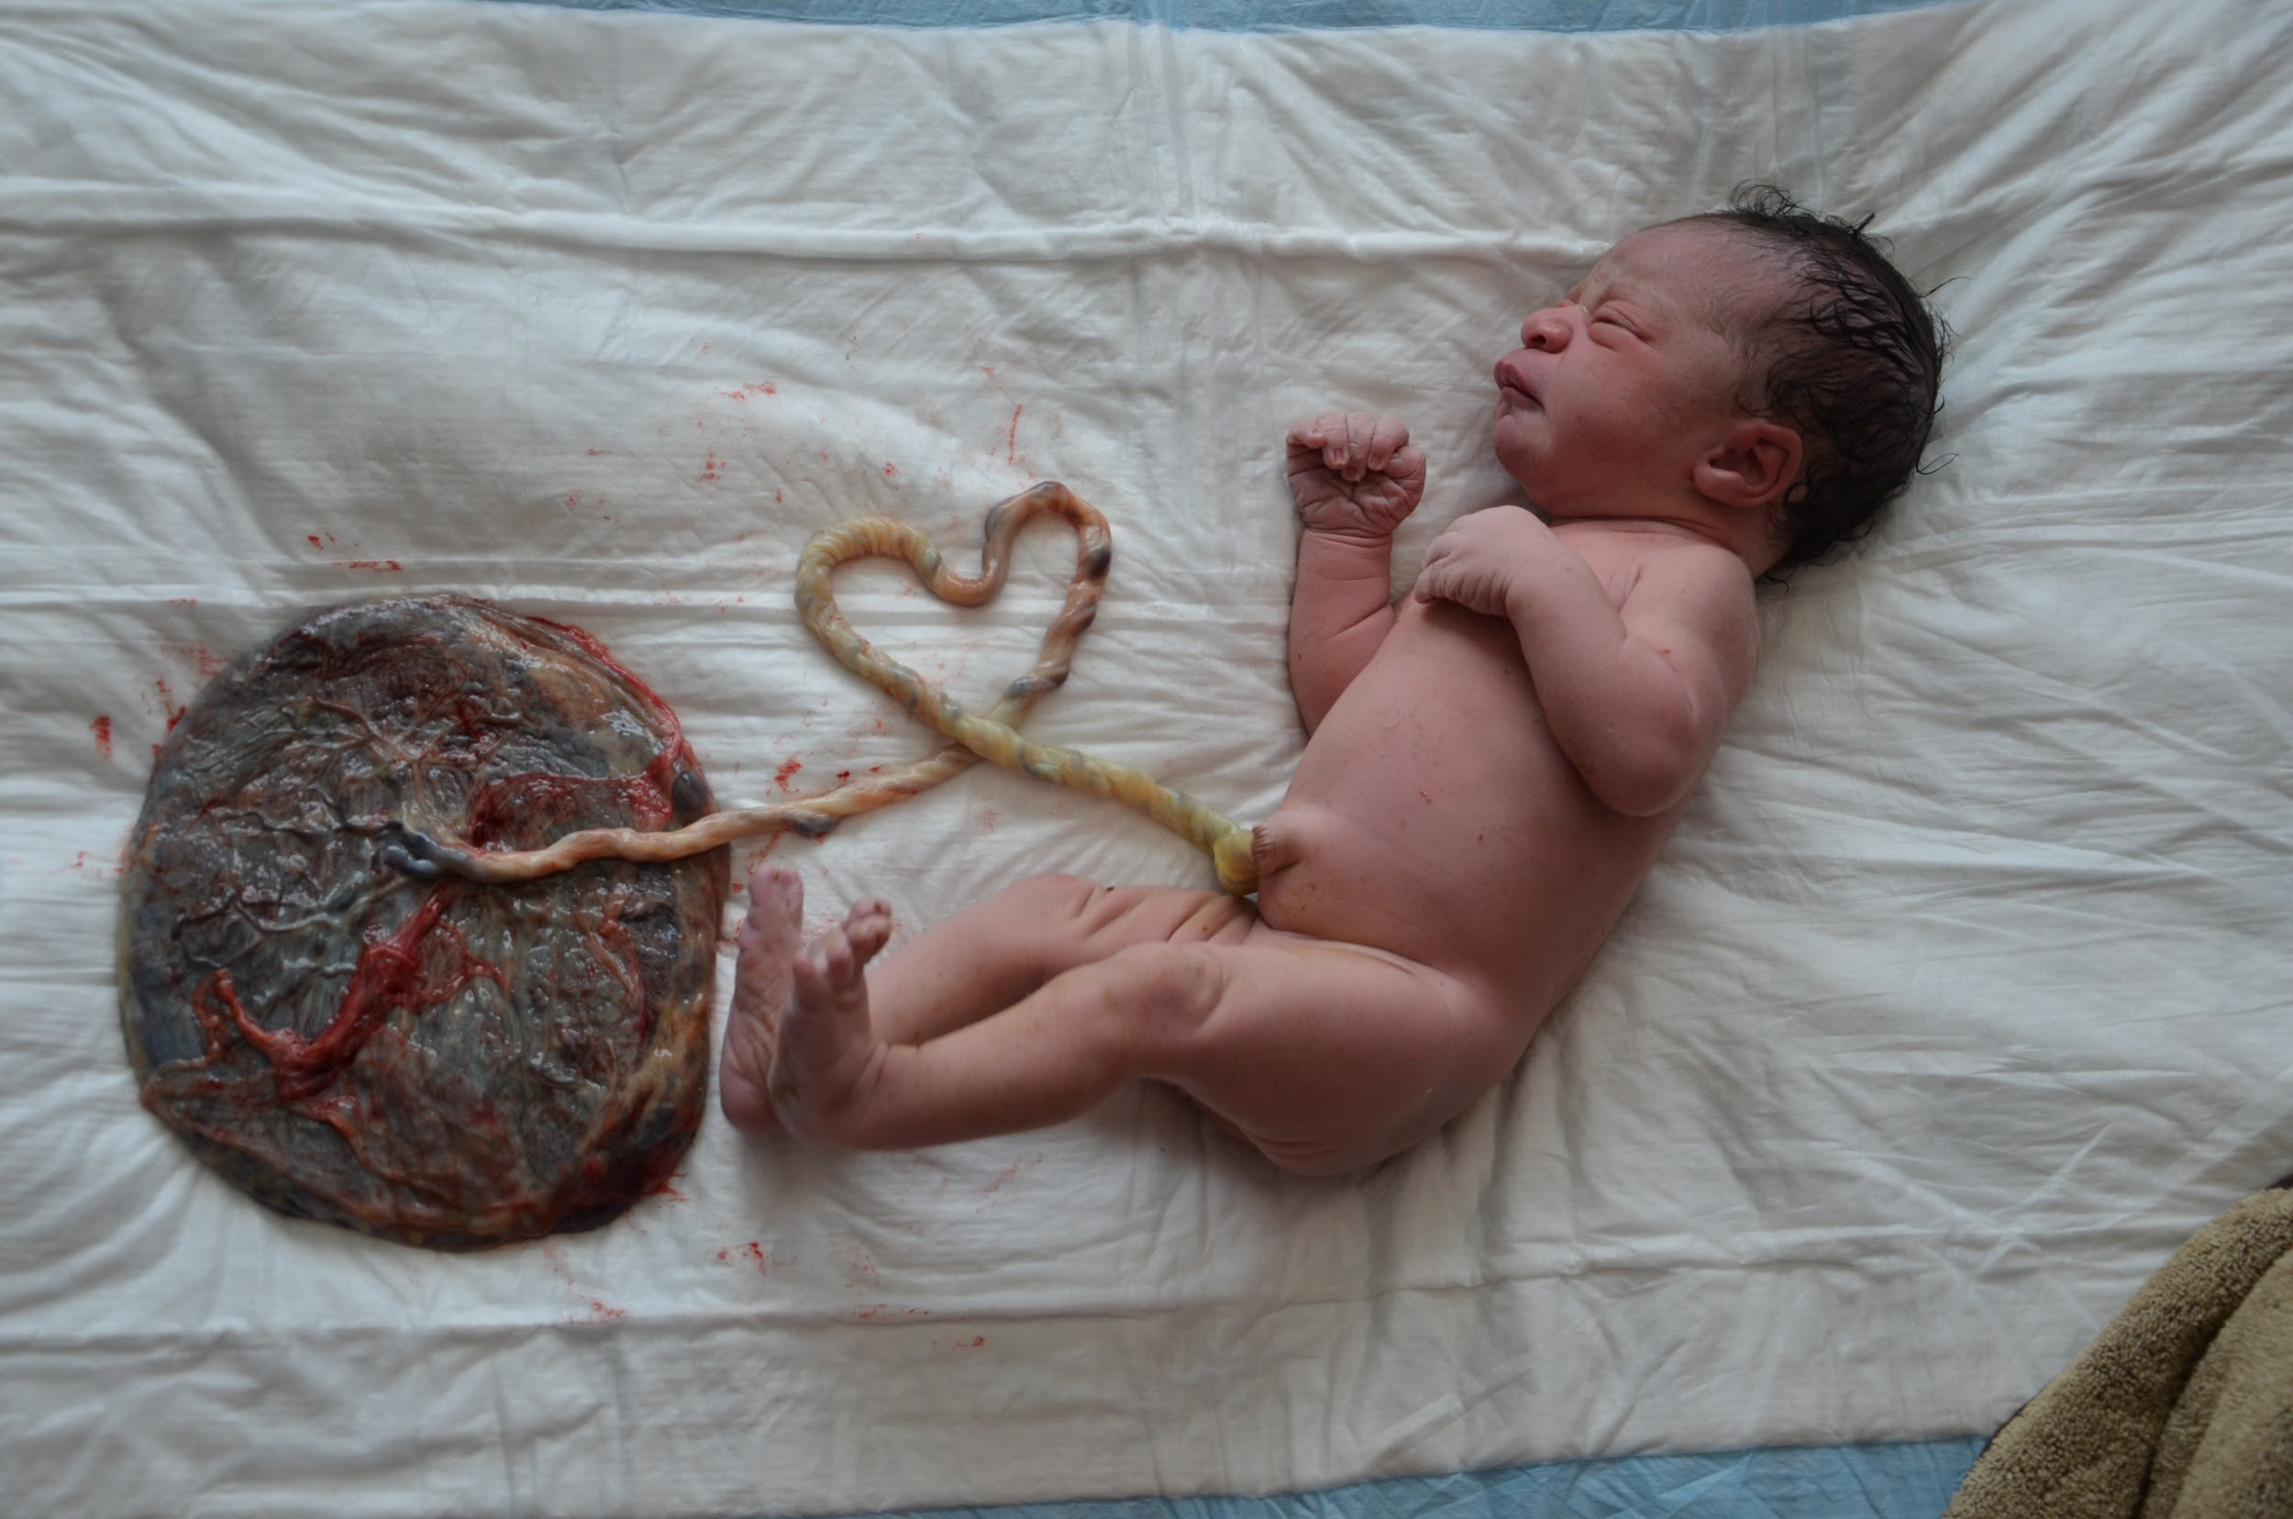
Placenta - attaches to the fetus via the umbilical cord, supplies nutrients to the fetus during pregnancy. It is expelled after the baby is born.

Slide 18
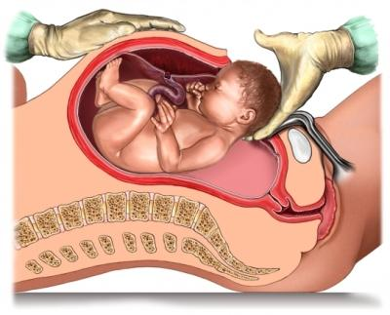
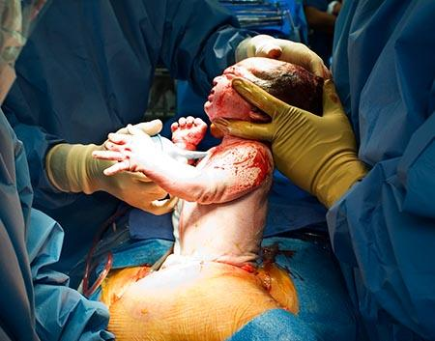
Caesarean Section - baby is surgically removed from the mother
Performed when complications make vaginal delivery risky

Slide 19
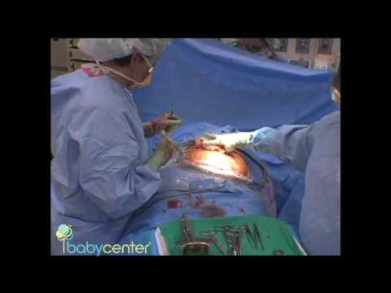

Slide 20
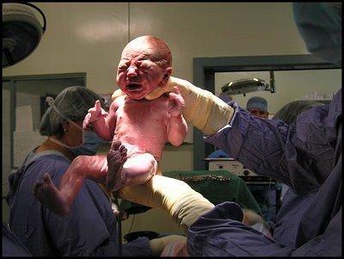
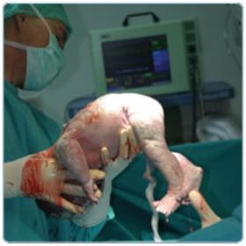
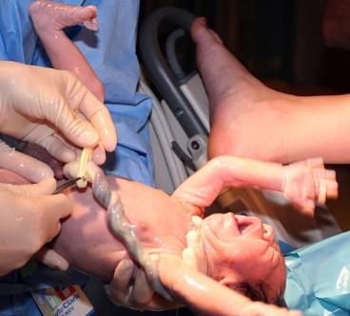
Babies aren’t so cute when they’re born – it’s a rough road to leave the womb
Some women advocate for home births using midwives.

Slide 21
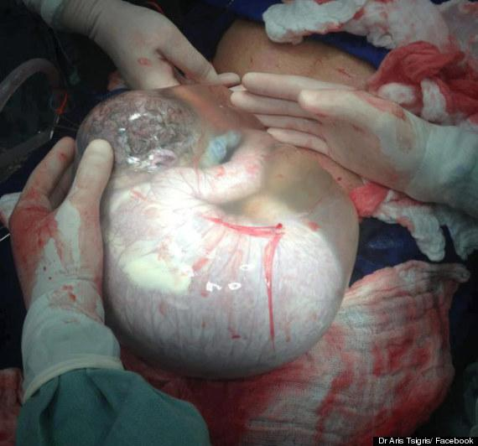
Most of the time, the amniotic sac breaks before the baby is born, in this photo, the baby is shown still inside it.

Slide 22
Some women opt to give birth in water.
This woman was waiting on the midwife and delivered when her husband went to answer the door.
Epidural live birth - graphic video by Baby Center

Slide 23
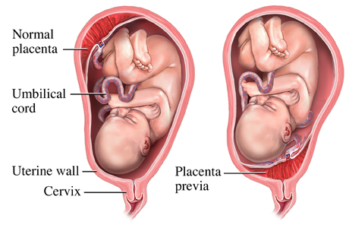
Complications During Birth
Placenta Previa
placenta is not attached to the top of the uterus, partially or fully blocks the cervix, this can cause bleeding during pregnancy
Solution: C-Section

Slide 24
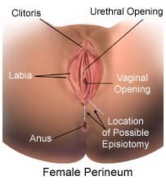
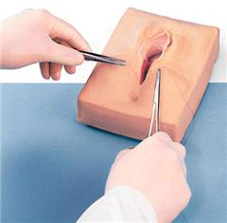
What Is An Episiotomy?
It is a surgical incision to open the perineum - the tissue between the anus and vagina. It is performed during the second stage of labor when the baby is being pushed through the vagina. The purpose of the procedure is to avoid tearing the delicate perineal tissue.

Slide 25
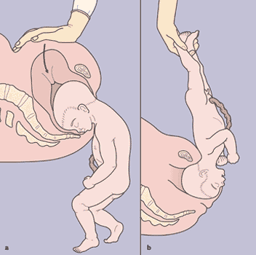
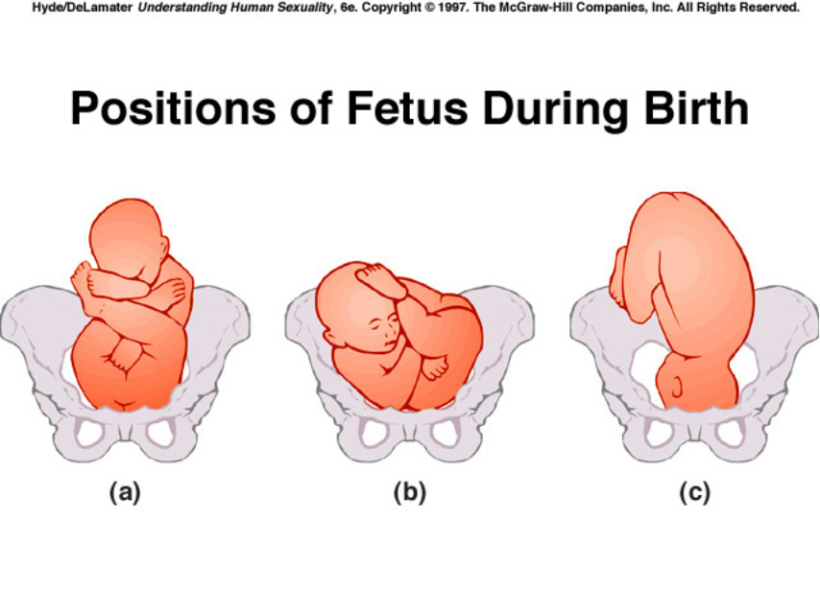
BREECH BIRTH (Footling)
If the baby is rear or feet first, it is called a BREECH BIRTH. Doctors will attempt to turn the baby or even do an emergency C section. Breech births are dangerous for baby because the head can get stuck or umbilical cord gets tangled.
Solution: turning the baby before delivery, C-section

Slide 26
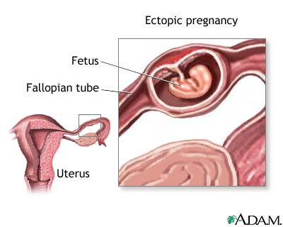
Ectopic Pregnancy
Fertilized egg attaches (or implants) someplace other than the uterus, most often in the fallopian tube. (sometimes called a tubal pregnancy.)
The pregnancy cannot continue to term, usually embryo is removed.
Can be very dangerous for woman.

Slide 27
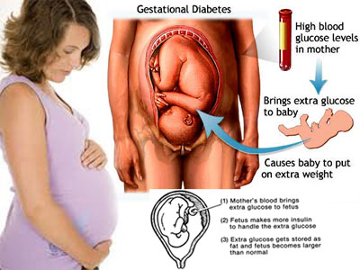
Gestational Diabetes
Pregnancy hormones can block insulin from doing its job. When this happens, glucose levels may increase in a pregnant woman's blood.

Slide 28
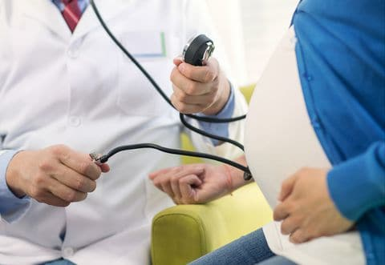
Pre-eclampsia
Preeclampsia is a pregnancy complication characterized by high blood pressure and signs of damage to another organ system, most often the liver and kidneys.
Left untreated, preeclampsia can lead to serious — even fatal — complications for both you and your baby. If you have preeclampsia, the only cure is delivery of your baby.
Symptoms:
-high blood pressure -severe headaches
- loss of vision - nausea and vomiting - decreased urine output
- swelling
- seizures

Slide 29
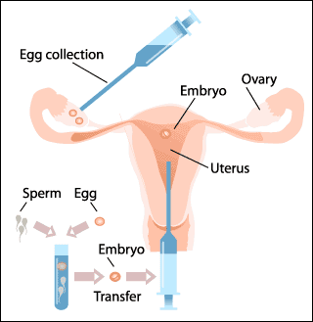
Problems with Getting Pregnant
Fertility clinics can assist with family planning
In Vitro Fertilization (IVF) involves the removal of egg and fertilization in a petri dish, then transferring one or more fertilized eggs back into the uterus
(once called test-tube babies)
Specialists can also offer advice with improving fertility without invasive procedures

Slide 30
Artificial Womb
How could this technology help humans?

Slide 31
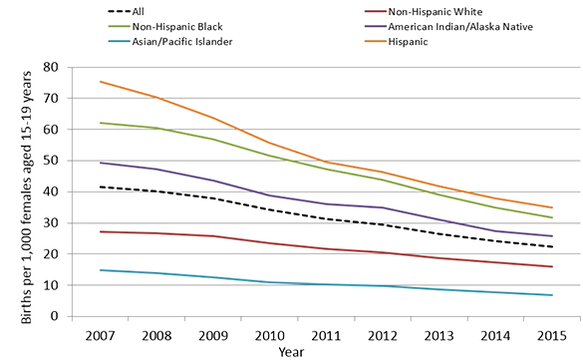
What if you don't want to have a baby?
Teen Pregnancy Statistics

Slide 32
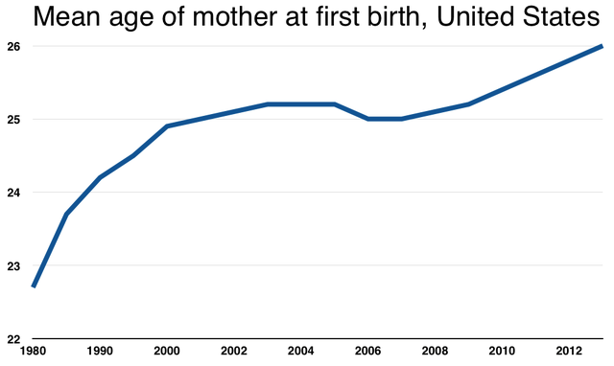
The average age of American women having their first child reached a record high of 26 years old in 2013, according to the Centers for Disease Control.
What are the benefits to delaying motherhood?
What are the drawbacks?
Notes:
Source: http://www.businessinsider.com/why-delaying-parenthood-and-having-kids-later-is-a-big-deal-2015-6

Slide 33
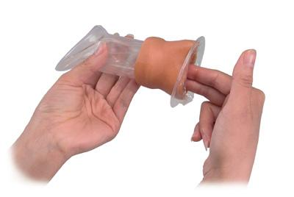
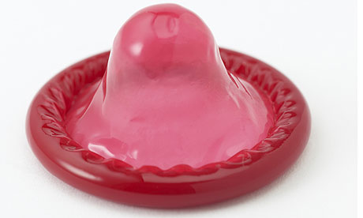
Methods of Birth Control
Barrier Methods
Condom (male & female)
Sponge
Diaphragm

Slide 34
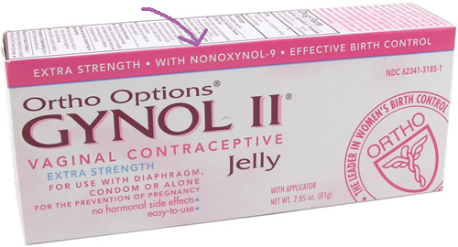
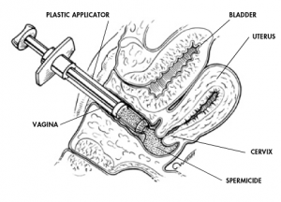
Spermicides or Contraceptive Gel

Slide 35
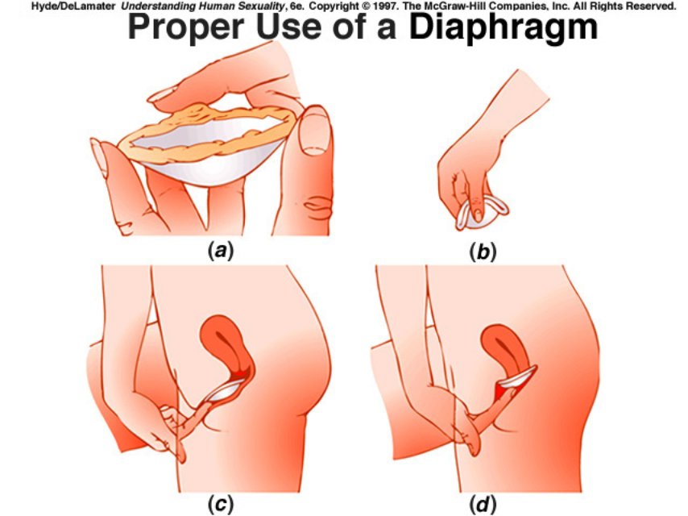

Slide 36
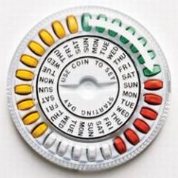
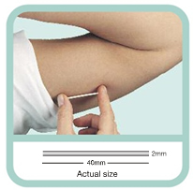
Hormone Methods
Females only (for now)
Using estrogen and progesterone prevent release of an egg.
Delivery system varies.

Slide 37
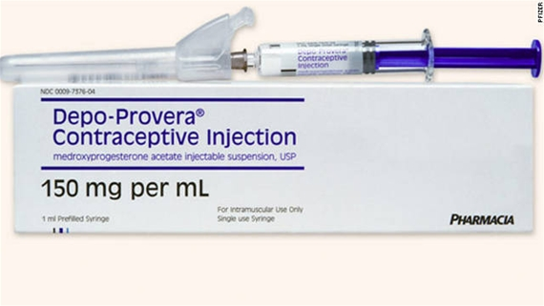
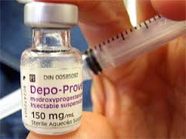
DEPO PROVERA SHOT

Slide 38
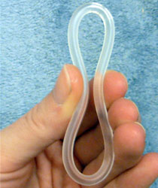
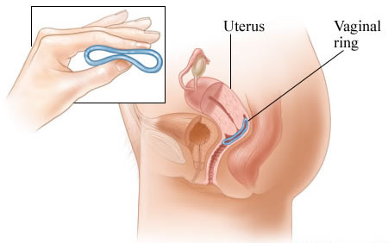
Nuva Ring
Provides estrogen and progesterone that prevents a woman from becoming pregnant - the same as used oral contraceptive pills. Remove the ring after 3 weeks. During the fourth week, the body will continue with a menstrual period as usual. After 7 days, insert a new ring to begin a new cycle. When used as directed, NuvaRing is a 99% effective method of birth control.

Slide 39
Birth Control Implant
- a thin, flexible plastic implant about the size of a cardboard matchstick. It is inserted under the skin of the upper arm.
- It protects against pregnancy for up to three years.
The implant is available under the brand names Implanon and Nexplanon

Slide 40
Intrauterine Device - semi permanent, can last up to 5 years

Slide 41
Permanent Options…
Vasectomy
Tubal Ligation

Slide 42
Hysterectomy - removes the woman’s entire uterus

Slide 43
What about the morning after pill - also known as Plan B
Plan B must be taken within 72 hours of unprotected sex, it prevents the egg from releasing.
Plan B does NOT work on women who are already pregnant.
It can be bought from pharmacies, though some states have age restrictions.
ALSO CALLED EMERGENCY CONTRACEPTION.

Slide 44
What about abortion?
Regardless of your political views on the subject, abortion is legal in the U.S.
Most procedures must be done early and involve removing the fetus from the uterus.
In 2014, 652,639 legal induced abortions were reported to CDC from 49 reporting areas. The abortion rate for 2014 was 12.1 abortions per 1,000 (1.2%) women aged 15–44 years.
Notes:
https://www.cdc.gov/reproductivehealth/data_stats/abortion.htm

Slide 45
Abortion Pill
Misoprostol for medical abortion works best in the first 12 weeks of pregnancy. After that, there is an increased risk of a complication and need for medical attention.
Misoprostol causes contractions of the womb which expels the fetus. A woman can get painful cramps, vaginal blood loss that is more than a normal menstruation, nausea, vomiting and diarrhea. There is a risk of heavy bleeding for which a woman will have to be treated by a doctor.

Slide 46
New Developments
Cats and Dogs may have a nonsurgical spaying and neutering option soon. An injection that causes permanent infertility could be used to control feral cat populations.
http://www.sciencealert.com/a-one-off-injection-could-replace-the-need-to-spay-and-neuter-your-pets
Could that be an option for humans someday?

