Slide 2
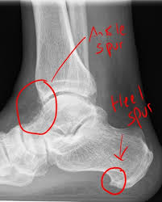
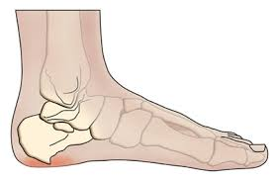
Bone Disorders
BONE SPURS, also known as osteophytes, occur when the body grows small projections on the edges of bones

Slide 3
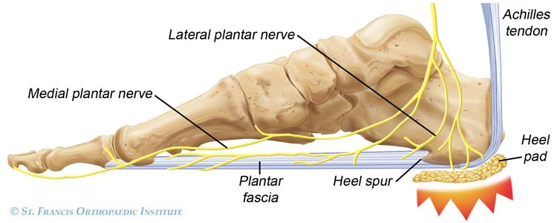
2. Plantar fasciitis
- common cause of heel pain.
-inflammation of the plantar fascia
- walking can be painful
Graphic Video of Plantar Fasciitis Surgery

Slide 4
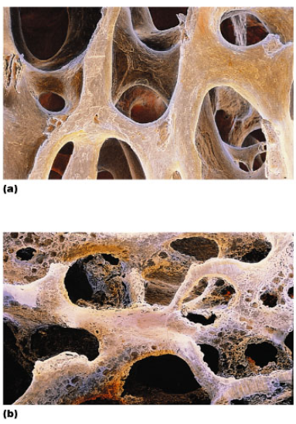
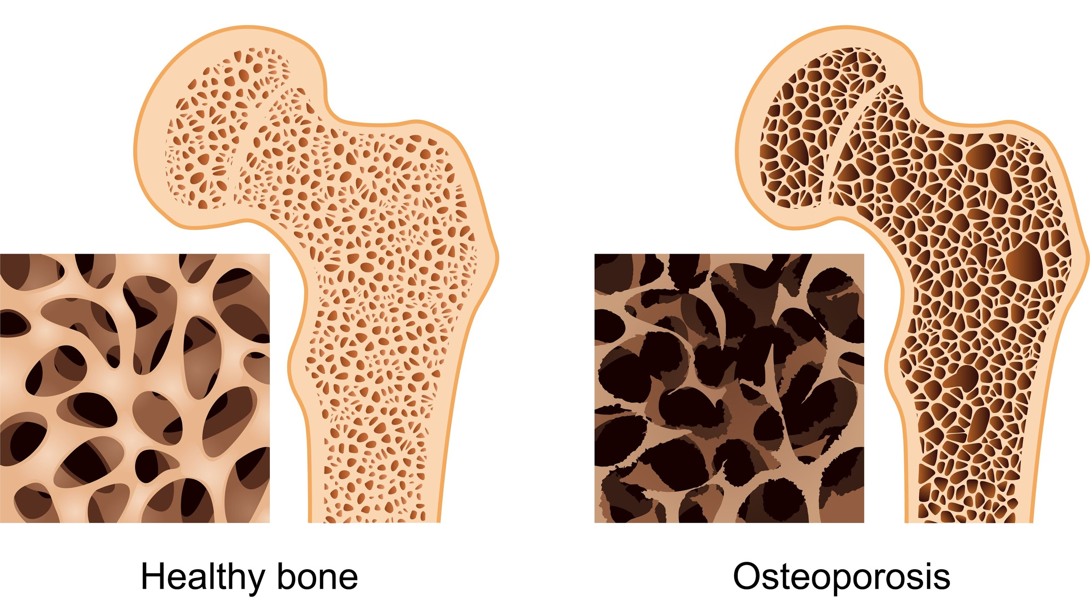
3. OSTEOPOROSIS: Increased activity of osteoclasts cause a break down bone, bones become more fragile
The spongy bone especially becomes more porous.

Slide 5
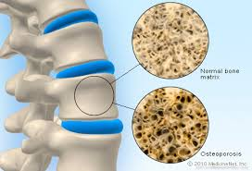
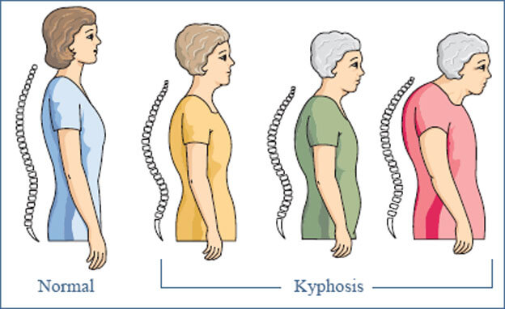
Causes of Osteoporosis:
1. Lack of exercise
2. Poor diet
3. Genetics
4. Ethnicity
5. Gender

Slide 6
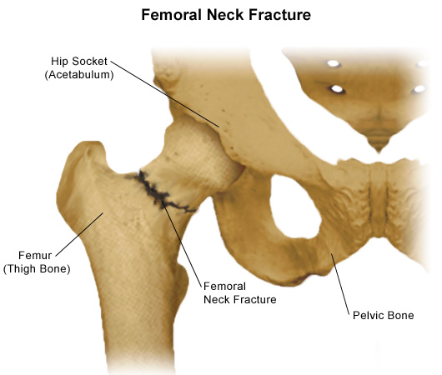
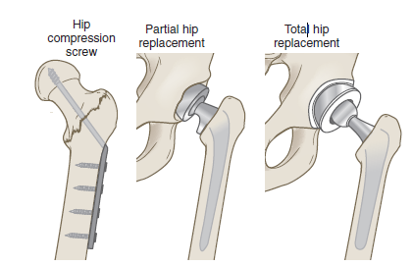
Why do older people break their hips?
A femoral neck fracture is common among older adults and can be related to osteoporosis. This type of fracture may cause a complication because the break usually cuts off the blood supply to the head of the femur.

Slide 7
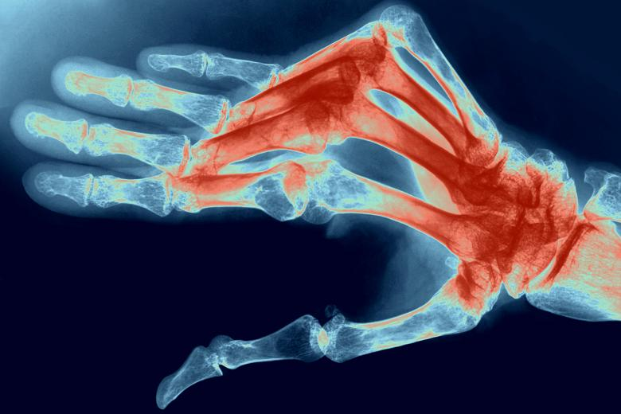
4. Rheumatoid arthritis is an autoimmune disease which causes joint stiffness and bone deformity
Source: http://www.thetimes.co.uk/tto/public/article3233439.ece

Slide 8
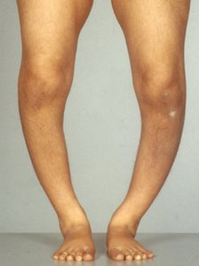
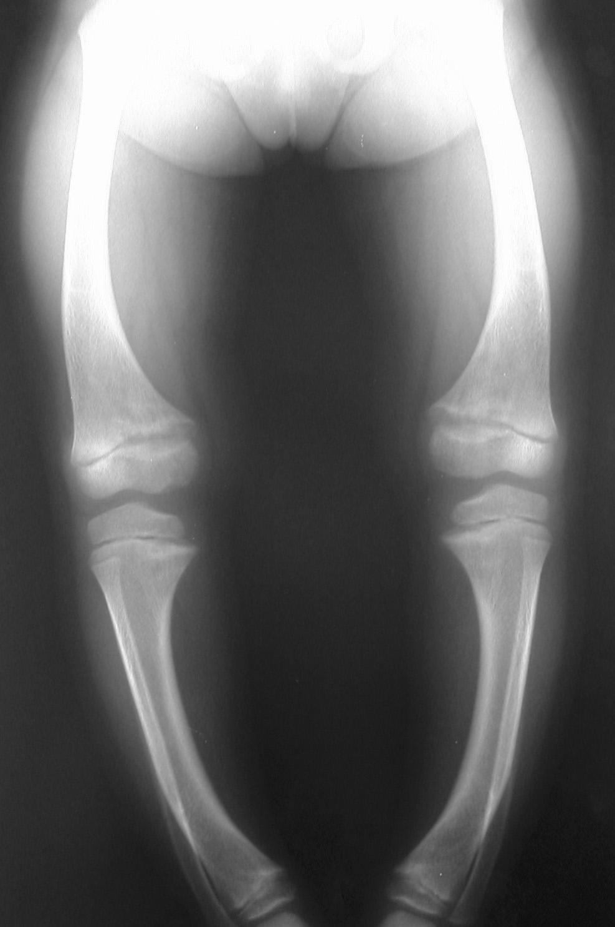
5. Rickets
This preventable bone disease affects young children and is caused by a deficiency of the nutrient vitamin D. Rickets causes weak, brittle bones that fracture easily and bone and muscle pain.

Slide 9
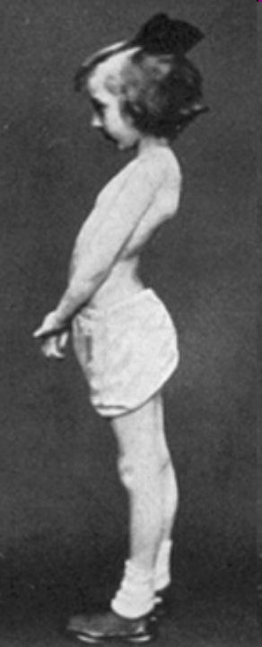
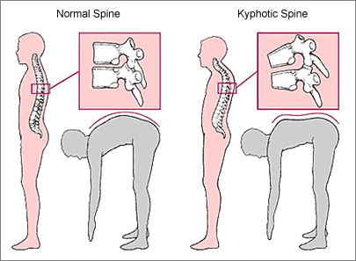
6. ABNORMALITIES OF THE SPINE
a)KYPHOSIS is a hunchback curve
b)LORDOSIS is a swayback in the lower region.

Slide 10
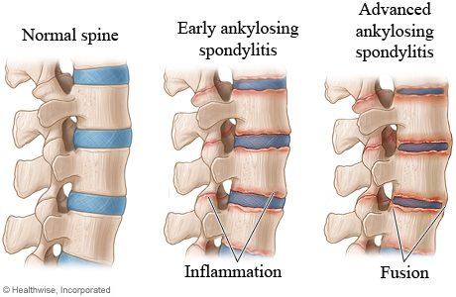
c) ANKYLOSIS is severe arthritis in the spine and the vertebrae fuse.

Slide 11
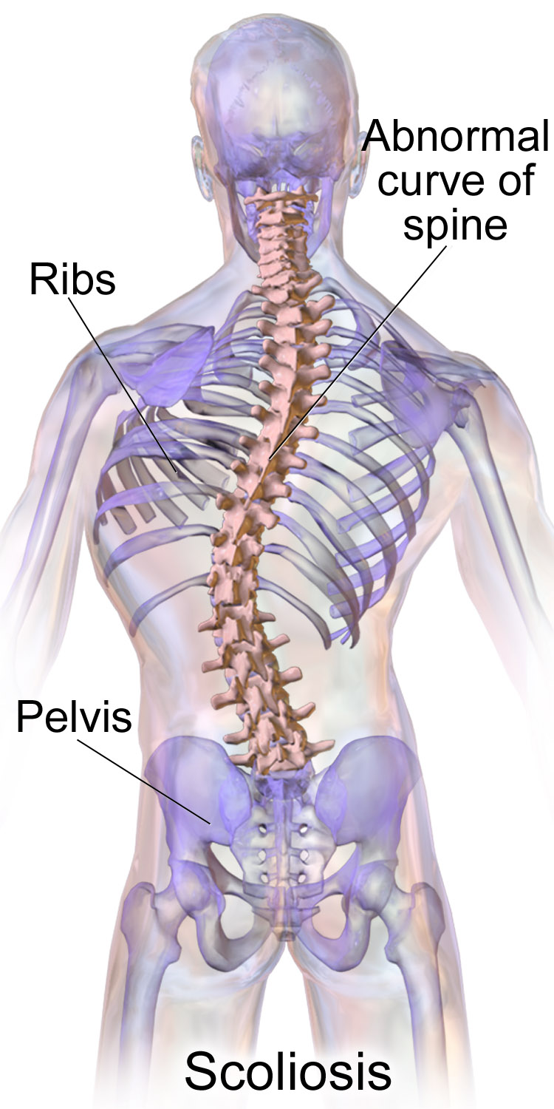
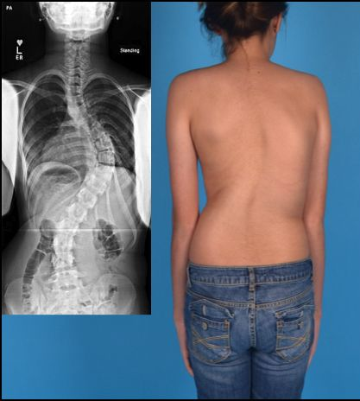
d) SCOLIOSIS
Notes:
Curvature of spine

Slide 12
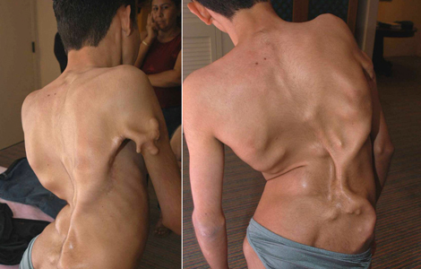
7. Fibrodysplasia ossificans progressiva (FOP) → soft tissue regrows as bone. Sufferers are slowly imprisoned by their own skeletons.
Munchmeyer disease" or "stone man syndrome"

Slide 13
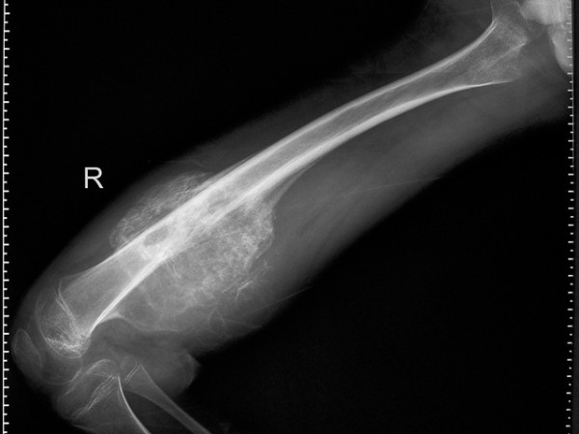
8. Osteosarcoma
Most common bone cancer, primarily affecting the long bones, particularly those in the knee, hip, or shoulder regions. Most commonly affects teenagers and young adults.

Slide 14
FUN FACTS ABOUT BONES Bone is made of the same type of minerals as limestone.
Babies are born with 300 bones, but by adulthood we have only 206 in our bodies.
The giraffe has the same number of bones in its neck as a human: seven in total.
The long horned ram can take a head butt at 25 mph. The human skull will fracture at 5 mph.

Slide 15
