Slide 1
Faults and Earthquakes
Fault zone- large expanses of rock where movement has occurred.
Epicenter- the exact point on the surface of Earth directly above the location where the rock ruptures.
Richter scale- a measure of the largest ground movement that occurs during an earthquake. The scale increases by a factor of 10, so an earthquake of 7 is 10 times greater than an earthquake of 6.

Slide 2
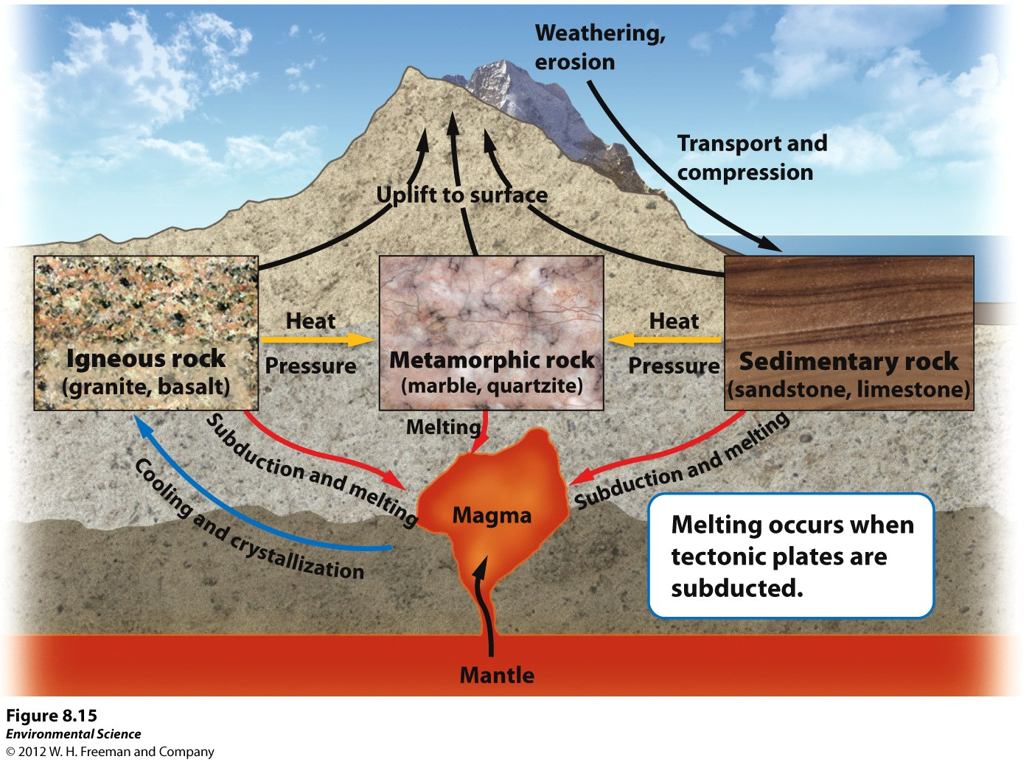
The Rock Cycle
Rock cycle- the constant formation and destruction of rock.

Slide 3
The Rock Cycle
Igneous rocks- rocks that form directly from magma.
Intrusive igneous- form from within Earth as magma cools. -larger
Extrusive igneous- from when magma cools above Earth. (ex. A volcano that ejects magma out will form this) -smaller
Sedimentary rocks- form when sediment such as mud, sands, or gravels are compressed by overlying sediments.
Metamorphic rocks- form when sedimentary, igneous or other metamorphic rocks are subjected to high temperatures and pressures.

Slide 4
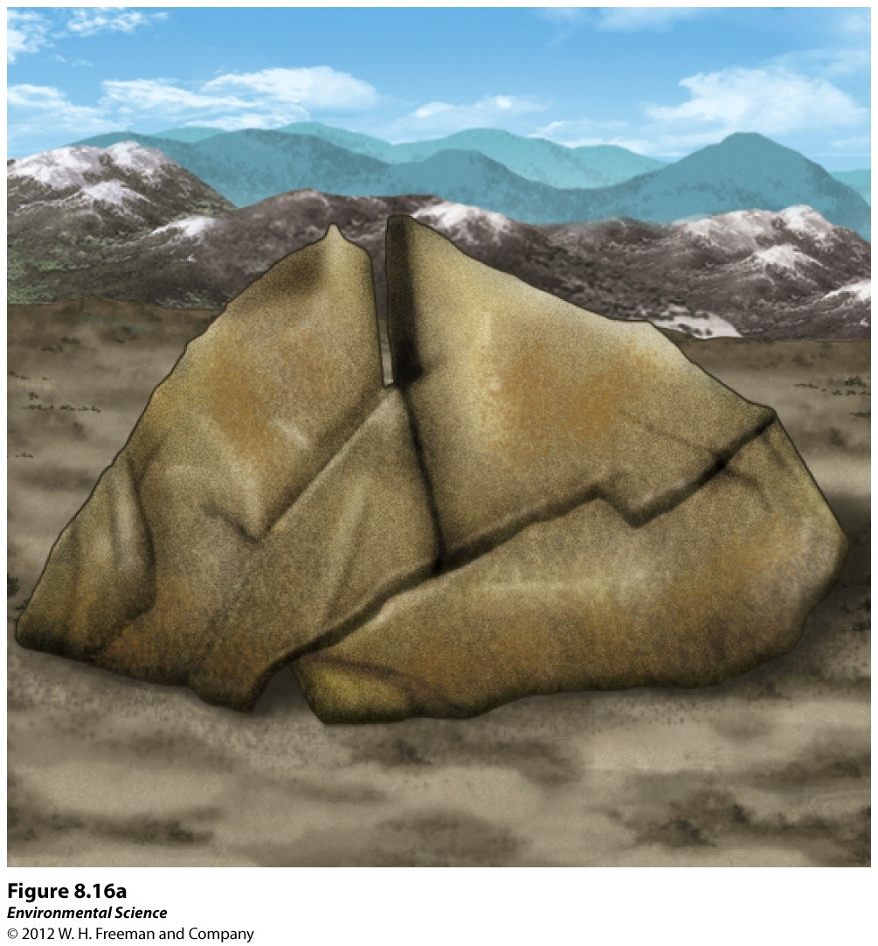
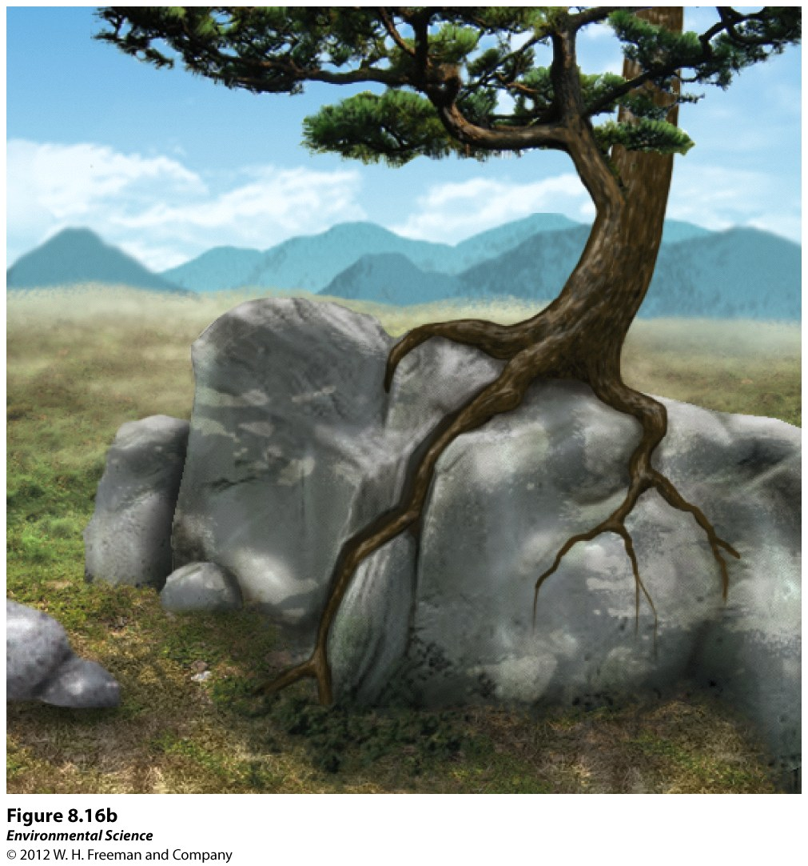
Weathering and Erosion
Weathering- when rocks are exposed to air, water, certain chemicals or biological agents that degrade the rock.
Physical weathering- the mechanical breakdown of rocks and minerals.

Slide 5
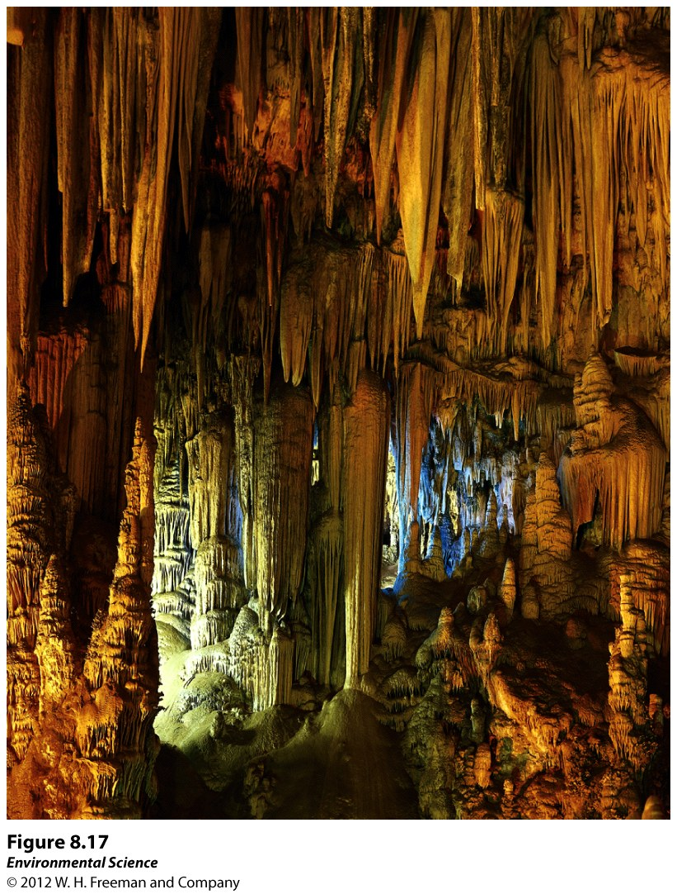
Weathering and Erosion
Chemical weathering- the breakdown of rocks and minerals by chemical reactions.

Slide 6
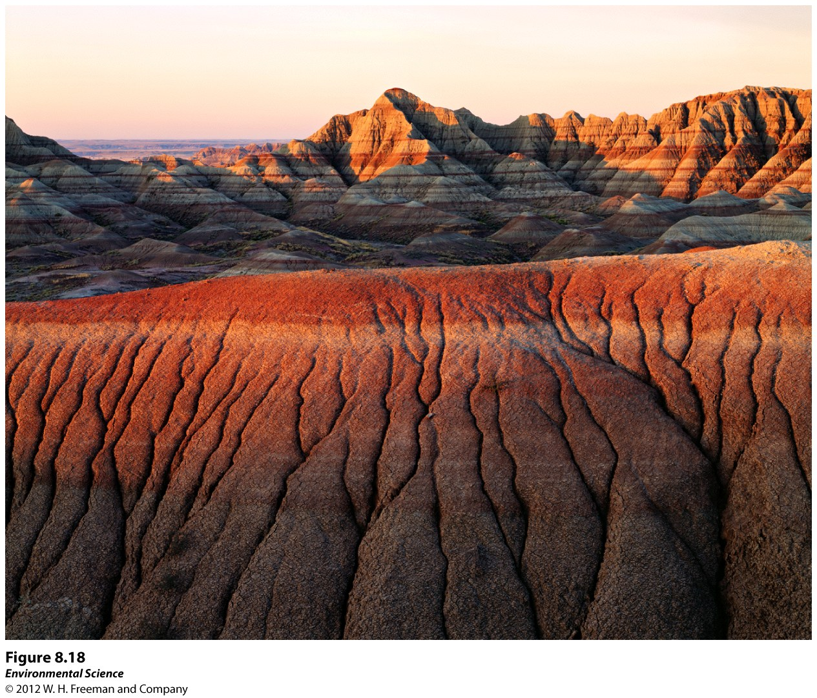
Erosion
Erosion- the physical removal of rock fragments from a landscape or ecosystem. Wind, water, ice transport and living organisms can erode materials.
Deposition- the accumulation or depositing of eroded material such as sediment, rock fragments or soil.

Slide 7
Weathering and Erosion
Precipitation high in sulfuric acid and nitric acid = acid precipitation
It is important to distinguish between erosion and weathering – erosion describes the physical movement of rock fragments, while weathering is the breakdown of rock.
The mechanisms that drive erosion include water, wind, and ice that move soil and other materials. Living organisms that burrow or disturb soil are also mechanisms.

Slide 8
Hoomans
How have humans increased erosion rates?
Notes:
Poor land use (deforestation, overgrazing, unmanaged construction, activity, and road building.

Slide 9
Soil
Soil is important because it
Is a medium for plant growth
Serves as a filter for water
A habitat for living organisms
Serves as a filter for pollutants

Slide 10
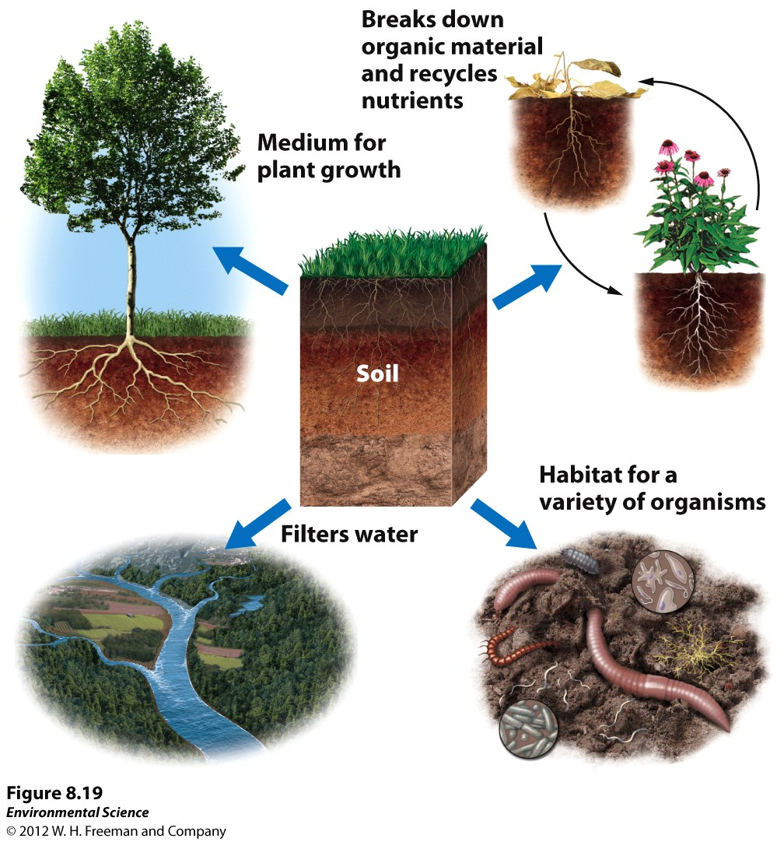

Slide 11
The Formation of Soil
Factors that determine the formation of soil:
Parent material- what the soil is made from influences soil formation
Climate- what type of climate influences soil formation
Topography- the surface and slope can influence soil formation
Organisms- plants and animals can have an effect on soil formation
Time- the amount of time a soil has spent developing can determine soil properties.

