Slide 1
Chapter 1 Studying the State of Our Earth

Slide 2
Essential Question: What is fracking?
Environment- a sum of all the conditions surrounding us that influence life.
Environmental science- the field that looks at interactions among humans and nature.
System- a set of interacting components that influence one another by exchanging energy or materials.
Ecosystem- the living and non-living components of a particular place on earth.
Notes:
Fracking is a method of oil and gas extraction that uses high-pressure fluids to force open cracks in rocks deep underground.

Slide 3
Example of a system:
Fracking in a particular geologic formation can cause changes throughout the entire system, such as in a nearby well that supplies drinking water.

Slide 4
In 1 minute, write down as many conditions surrounding this rainforest frog that you can. This should include living and nonliving components.
This Photo by Unknown Author is licensed under CC BY-SA
Notes:
Leaves, ants, wasps, snakes, vines, soil, rocks, water, trees, spiders…

Slide 5
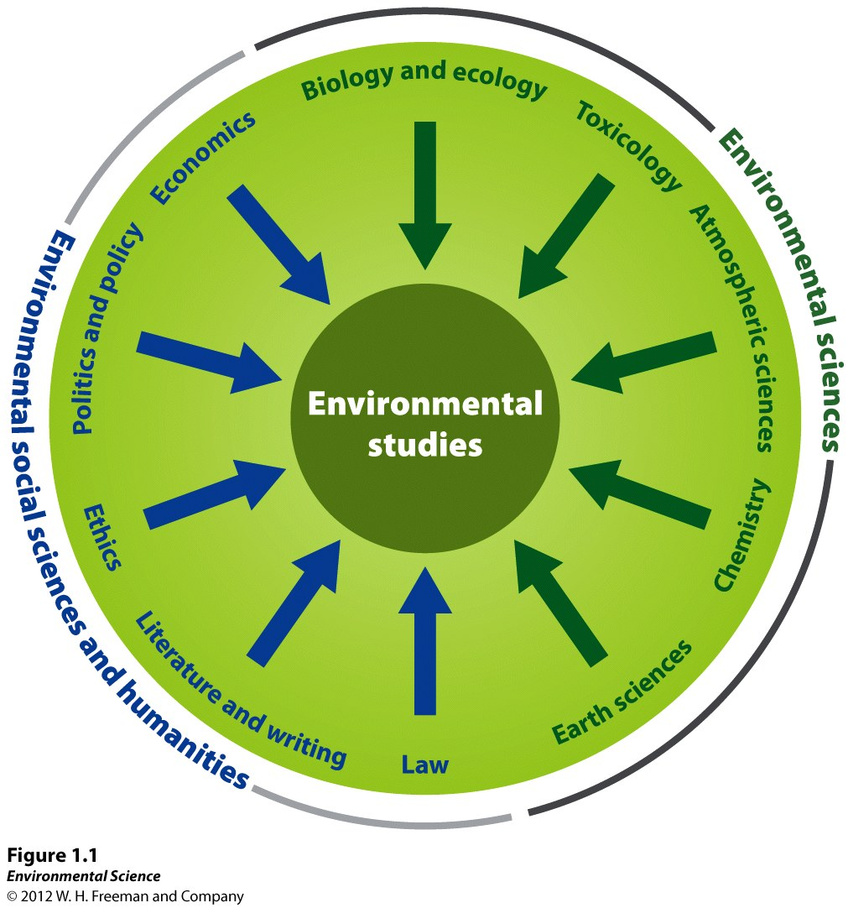
Notes:
Biology & Ecology, Toxicology, Atmospheric sciences, Chemistry, Earth Sciences, Law, Literature and Writing, Ethics, Politics and Policy, Economics.

Slide 6
Biotic- the living part of the Earth (animals, plants)
Abiotic- the non-living part of the Earth (soil, air, water)
Environmental studies- includes environmental science, the study of interactions among human systems and those found in nature along with other subjects such as environmental policy, economics, literature and ethics.
INTERDISCIPLINARY FIELD
Notes:
EQ: 8/31 What is fracking?

Slide 7
Environmentalist: A person who participates in environmentalism, a social movement that seeks to protect the environment through lobbying, activism, and education.

Slide 8
Environmental Scientist
Environmentalist
Notes:
Es: Researcher, Scientific method, objective. Both: educator, cares about enviro. Enviro: political, lobbyist, activist, subjective.

Slide 9
Humans Alter Natural Systems
Essential Q: Why is dry wood on a forest floor harmful?
Notes:
Increase in dry wood makes the forest more vulnerable to intense wildfires

Slide 10
Notes:
Boundaries of an environmental system may be defined by the researcher’s point of view. Physiologists, marine biologists, oceanographers, and fishery managers would all describe the North Atlantic Ocean fisheries system differently.

Slide 11
Humans manipulate their environment more than any other species.
Through the evolution of man, we know that they have caused the extinction of many species due to overhunting/harvesting.
More recently, hunting in North America led to the extinction of the passenger pigeon and nearly caused the loss of the American Bison.

Slide 12
BUT WAIT…
Human activities have also created opportunities
For thousands of years, Native Americans on the Great Plains used fire to capture animals for food. The fires they set kept trees from encroaching on the plains, which in turn created a window for an entire ecosystem (the tall grass prairie) to flourish.

Slide 13
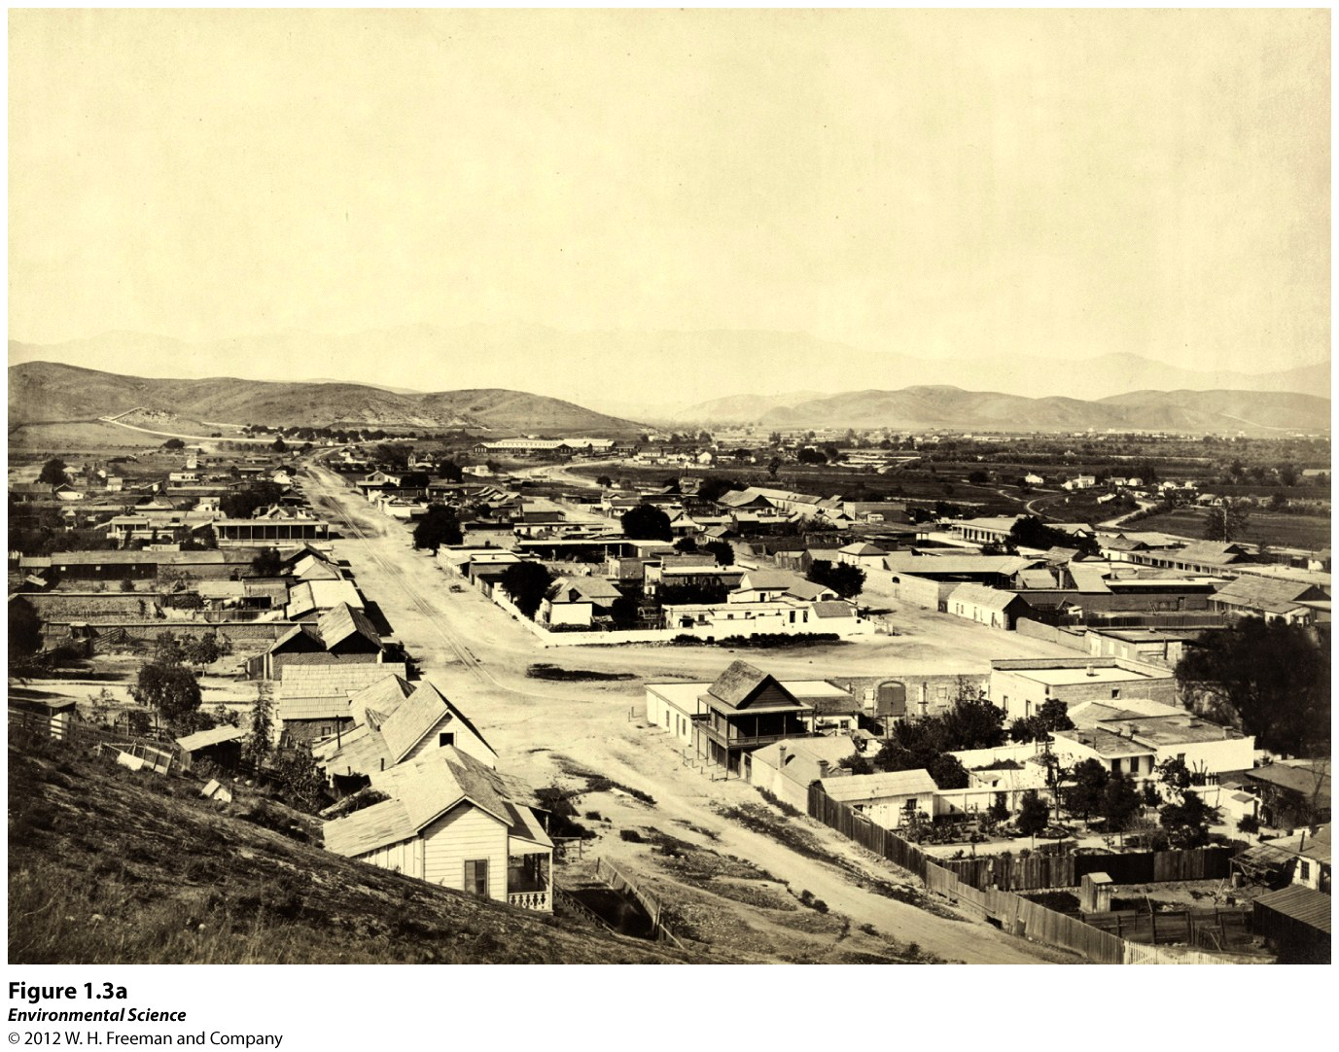
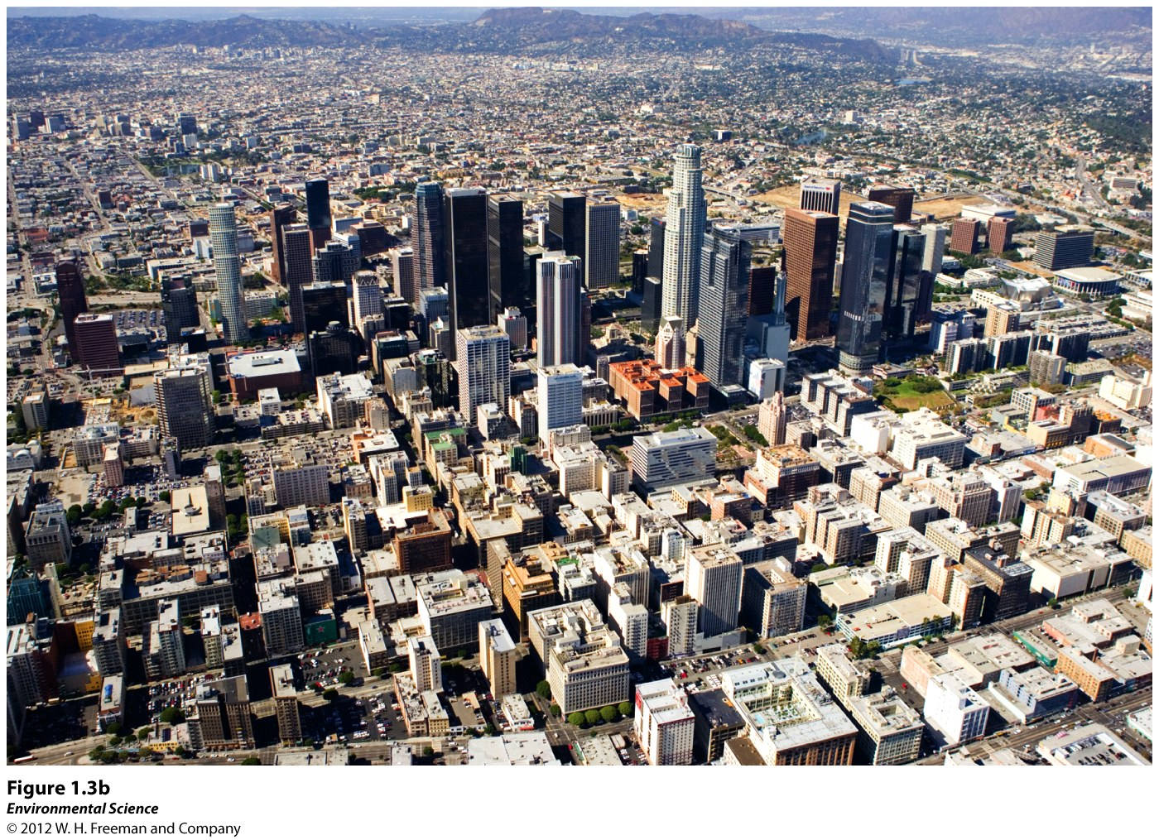
Internet connections and public transportation systems have improved our well-being, but at what cost?
6,000 people can live in a relatively small area with minimal environmental effects. However, in large cities like LA, with over 13 million people, their activities are detrimental to the environment.
Notes:
The stripping of land from native species- relocate or die (i.e. extinction); Human-induced climate change- affect the health of natural systems on a global scale.

Slide 14
Environmental Scientists Monitor Natural Systems for Signs of Stress
Ecosystem services- environments provide life supporting services such as clean water, timber, fisheries, crops.
Environmental indicators- describe the current state of the environment.
Sustainability- living on the Earth in a way that allows us to use its resources without depriving future generations of those resources.

Slide 15
