Slide 1
Environmental indicators help us describe the current state of an environmental system. The five global environmental indicators are: 1) Biological diversity 2) Food production 3) Average global surface temperature and carbon dioxide concentrations in the atmosphere 4) Human population 5) Resource depletion

Slide 2
Biodiversity- the diversity of life formed in an environment
Biological diversity includes genetic, species and ecosystem diversity.

Slide 3
Genetic Diversity
A measure of the genetic variation among individuals in a population.
Populations with high genetic diversity are better able to respond to environmental change than populations with lower genetic diversity.

Slide 4
Genetic Diversity cont…
A greater number of fish, leads to an increase in genetic diversity. This increased in genetic diversity leads to an increased resistance to disease. Why is a resistance to disease important?
Notes:
Increase rate of survival with a disease outbreak! Page 9

Slide 5
Species Diversity
The number of species in a region, habitat, or ecosystem.
Species- a group of organisms that is distinct form other groups in form, behavior or biochemical properties. Individuals in a species can breed and produce fertile offspring.
Environmental scientist focus on this as a critical environmental indicator. (next slide)

Slide 6
FROGS
From page 9: The number of frog species is used as an indicator for environmental health because frogs are exposed to both water and air in their ecosystem.
A decrease in the # of frog species in a particular ecosystem may be an indicator of a problem.

Slide 7
HOWEVER
Not all species loses are indicators of environmental problems!
Extinction can be a part of a natural process known as….. speciation!
Notes:
Reminder: I will not always include all vocabulary words in the presentation! It is up to you to gather all vocab from your textbook.

Slide 8
Ecosystem Diversity
A measure of the diversity of ecosystems or habitats that exist in a particular region.
As you are reading chapter 1, you should utilize the do the math examples. Specifically, page 11 for this chapter.

Slide 9
Food Production
What is food production?
Our ability to grow food to nourish the human population.
We use science and technology to increase the amount of food we can produce on a given area of land.
Example: in 2008, food shortages worldwide led to an increase in food prices.
WHY couldn’t production keep up with demand? Pg. 11 Some areas of agriculture productivity has decreased due to soil degradation, crop diseases, drought or flooding. What are some other reasons?
Notes:
-Our ability to grow food to nourish the human population.
-Population increase makes reaching demand harder
Government- some policies discourage food production by making it more profitable for land to remain uncultivated.

Slide 10
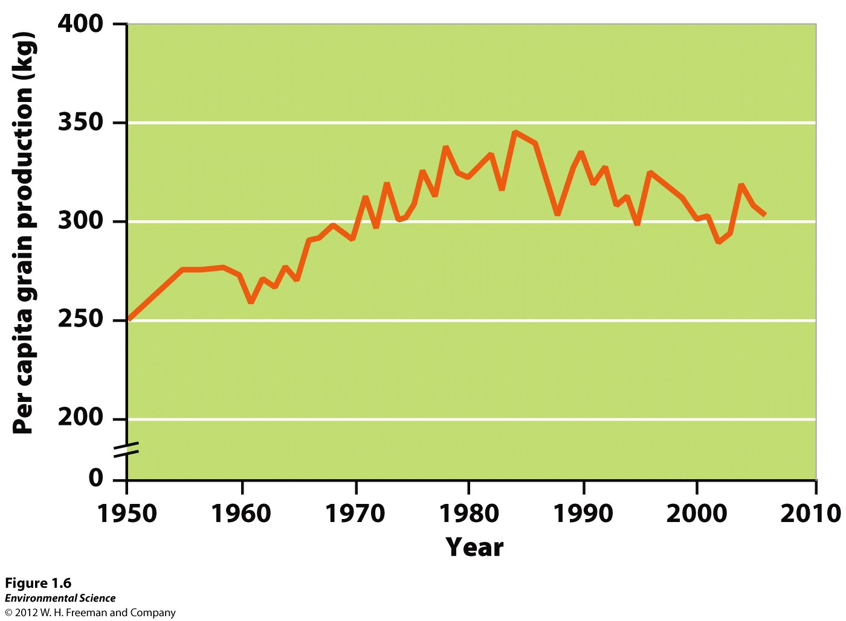

Slide 11
Average Global Surface Temperatures and Carbon Dioxide Concentrations
Greenhouse gases- gases in our planets atmosphere that act like a blanket, trapping heat near Earth's surface.
The most important greenhouse gas is carbon dioxide.
Anthropogenic- caused by human activities. Combustion of fossil fuels and the loss of other habitats leads to a decreases in CO2 storage
A stable climate will ultimately lead to greater biodiversity and food sources.

Slide 12
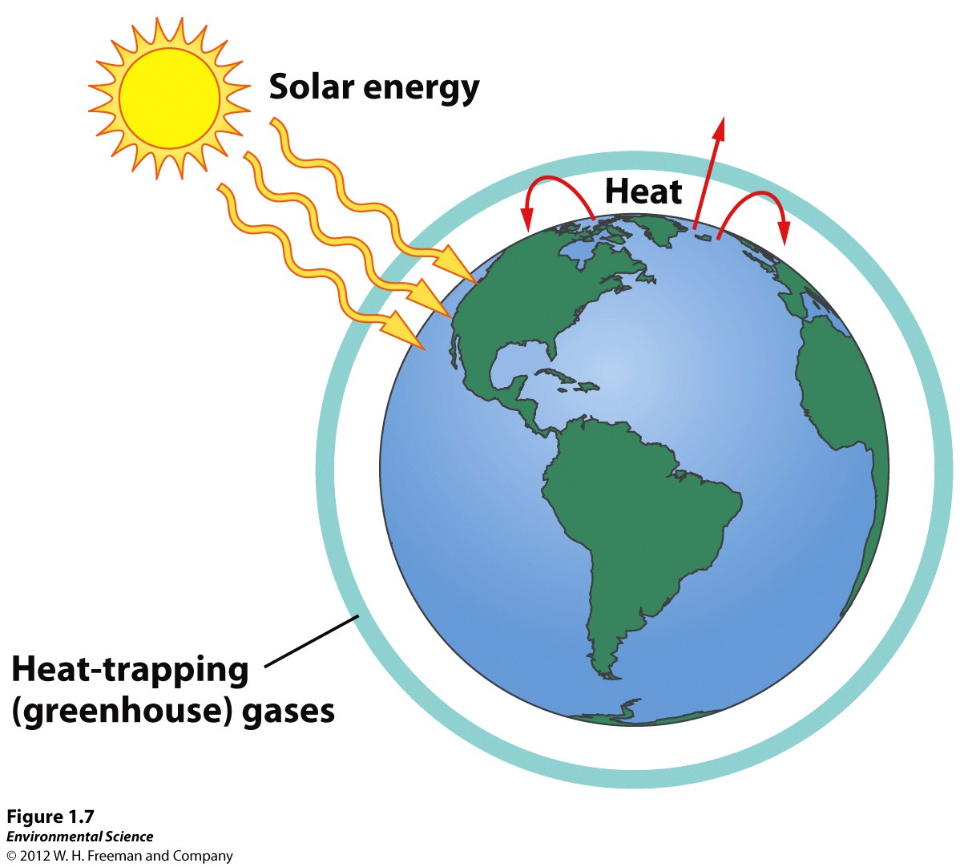
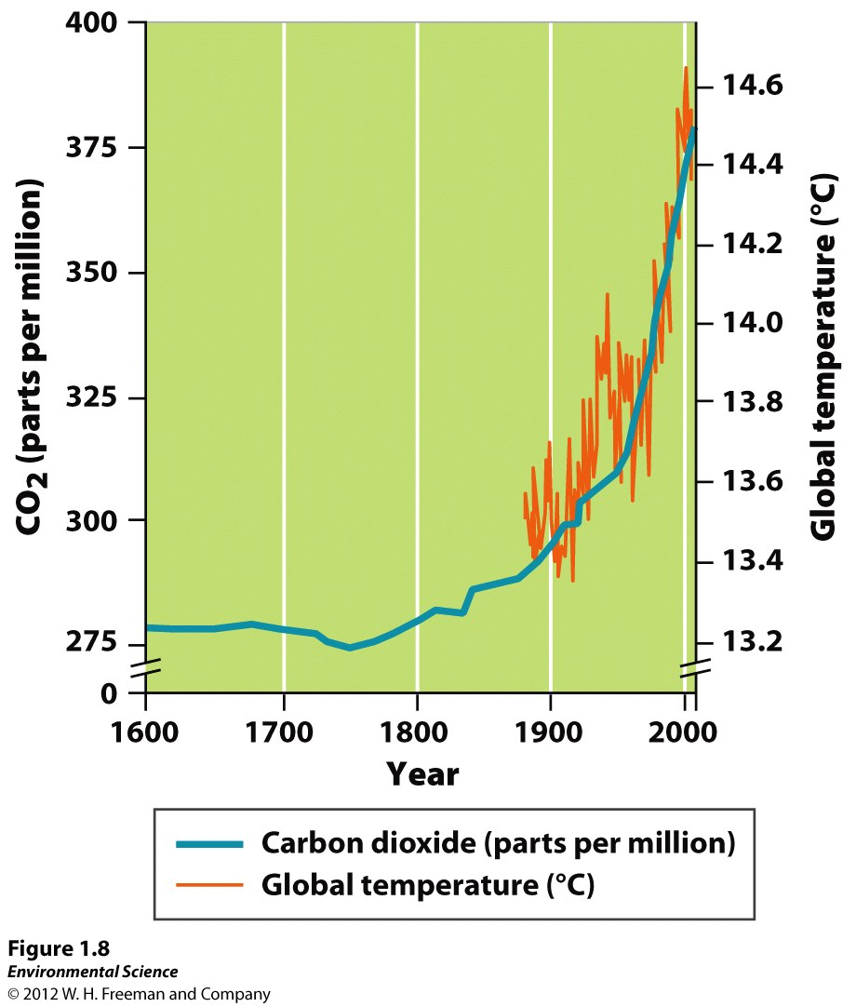
Without these greenhouse gases, Earth would be muuuuuuuch cooler

Slide 13
Human Population
The current human population is 7.2 billion.
With birth and deaths, over 232,000 people are added to our population every day
Notes:
That is over 1 million EVERY 5 DAYS!!!

Slide 14
Resource Depletion
As the human population grows, the resources necessary for our survival become increasingly depleted.
Some natural resources such as coal, oil and uranium are finite and cannot be renewed or reused. So… they are what?!
Other natural resources like aluminum or copper, also exist in finite amounts but can be recycled.
Timber is renewable, but is being excessively used…
Notes:
They are non-renewable!
WE can eventually run out of timber.

Slide 15
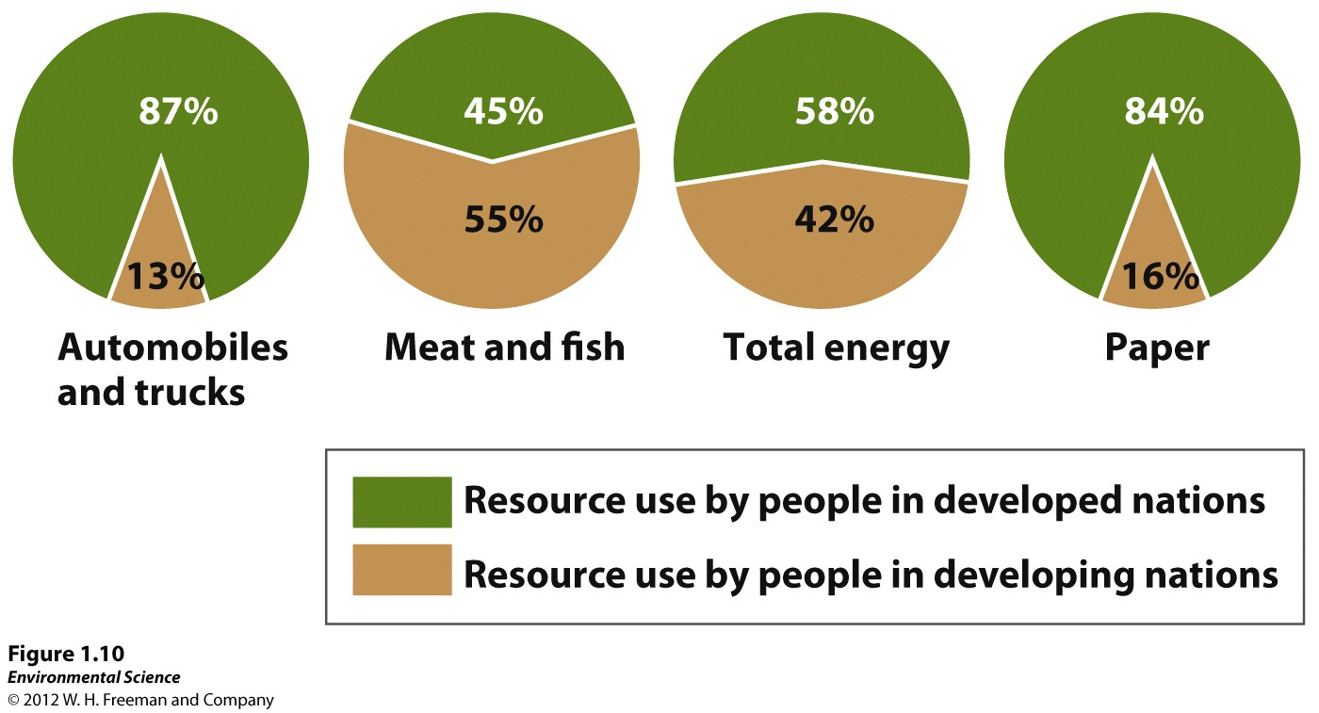
Resource Depletion
Development- improvement in human well-being through economic advancement. As economies develop, resource consumption also increases.
Notes:
What are we? A DEVELOPED NATION.

