Slide 1
The Nature of Science
Chapter 1
EQ: How will you succeed in this class?

Slide 2
Section 1: Earth Science
Earth Science can be broken into 5 major areas of specialization:
Astronomy: The study of objects beyond the Earth’s atmosphere
Meteorology: The study of forces and processes that cause the atmosphere to change and produce weather
Geology: The study of materials that make up earth, the processes that form and change these materials, and the history of the planet and its life-forms since its origin
Oceanography: The study of the Earth’s oceans
Environmental Science: The study of the interactions of organism and their surroundings

Slide 3
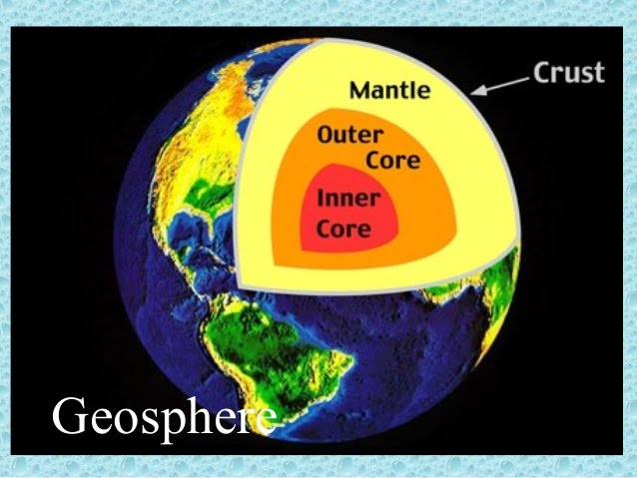
Earth’s Systems
There are FOUR main Earth systems. These systems are interdependent. The first is the geosphere.
Geosphere (lithosphere): area from the surface of the Earth down to the center (crust, mantle, and core)

Slide 4
Atmosphere
The atmosphere is the blanket of gases that surrounds our plant. It is 78% nitrogen and 21% oxygen. The remaining 1% includes water vapor, argon, carbon dioxide, and other gases.
Protects organisms from harmful radiation from the Sun, regulates temperature, and provides oxygen
We’ll dive into the layers of the atmosphere later! ☺

Slide 5
Hydrosphere
All of the water on Earth, including the water in the atmosphere.
97% of the Earth’s water is salt water
3% is freshwater in rivers and lakes, groundwater, and glaciers
This Photo by Unknown Author is licensed under CC BY-NC-ND

Slide 6
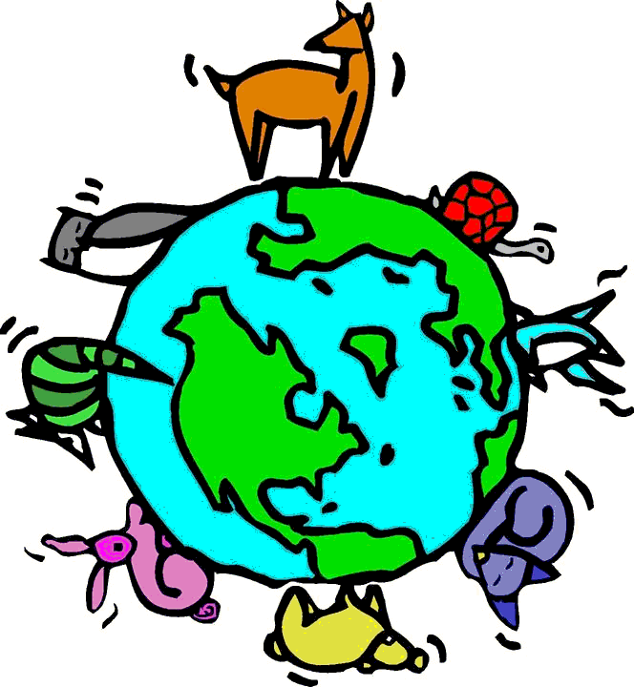
Biosphere
All the organisms that live on Earth and the environments in which they live
This Photo by Unknown Author is licensed under CC BY-NC-SA

Slide 7
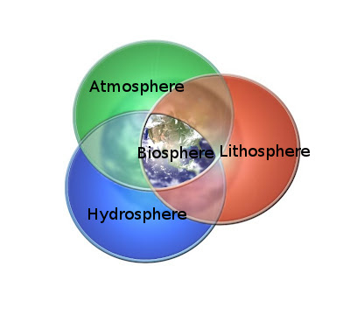
What does interdependent mean?
The systems work together!
The water from the hydrosphere enters the atmosphere (evaporation), falls on the biosphere (precipitation), and soaks into the geosphere!
This Photo by Unknown Author is licensed under CC BY-SA

Slide 8
Technology
The application of scientific discoveries is called technology
Helps make life easier and safer (usually…)
What are 3 examples of technology YOU use on a daily basis?
Cell phone, elevator, computers, alarm system, electric toothbrush, etc.

Slide 9
Methods of Scientists
1.2

Slide 10
The Nature of Scientific Investigation
The scientific method is a series of problem-solving procedures that help scientists conduct experiments.
Steps included:
1. Define the Problem
2. Research the Problem
3. Form a Hypothesis: testable explanation of a situation that can be supported or disproved by careful procedures
4. Experimentation: (test the hypothesis)
5. Record results
6. Analysis and Conclusion

Slide 11
Experimentation
a. independent variable: what you are testing, the factor that is CHANGED by the experimenter
b. dependent variable: what you are measuring, the factor that is affected by changes in the independent variable.
c. control: allows you to determine the effect of the independent variable. DOES NOT CHANGE.

Slide 12
Control & Variable example
Homer Simpson notices that his shower is covered in a strange green slime. His friend Krusty tells him that coconut juice will get rid of the green slime. Homer decides to check this out by spraying half of the shower with coconut juice. He sprays the other half of the shower with water. After 3 days of “treatment” there is no change in the appearance of the green slime on either side of the shower.
What is the control? Water
What is the independent variable? Coconut juice
What is the dependent variable? Green slime

Slide 13
Measurement
A measurement includes both a number and a UNIT of measure.
Scientific investigations use the standard system of units called Le Systeme International d’Unites (SI).
This is the modern version of the metric system.
Common standard units include:
Length: meter
Mass: gram
Volume: Liters
Area: square meters
Time: seconds
Temperature: kelvin
Mass measures the amount of matter in an object
Weight measures the pull of gravity on an object

Slide 14
Look at the board! Ms. Norton will now draw the METRIC staircase… and you need to do the SAME!

Slide 15
Some metric measurements are a combination of other metric units and are called derived units.
DENSITY is derived from mass and volume.
If the mass of a cylinder is 50 grams and the volume is 10 mL. What is the density?
5 g/mL

Slide 16
What is the best unit for measuring EACH mass?
Mass of 5 pennies?
Your mass?
Amount of spices in a cookie?

Slide 17
Scientific Notation
A method used by scientists to express a number as a value of 1-10 multiplied by a power of 10.
If the mass of Earth is 5,973,600,000,000,000,000,000,000 kg… how would we write this in scientific notation?!
We want the main number to be between 1-10, so the number we are working with will be 5.97 X 10?
Look at the board to see how we find the power!!

Slide 18
Scientific Notation, cont.
Now, what is the decimal point needs to go to the RIGHT?!
The exponent of 10 will then be NEGATIVE.
The diameter of an atom in meters is approx. 0.0000000001.
How would we write this?!
We want a our first number to be between 1-10, so we would start with 1 x 10?
NOW WHAT?!

Slide 19
Communication in Science
1.3

Slide 20
Communicating Results
Lab reports are a written account of your laboratory experiment.
Graphing data is a great way to communicate.
We will use 3 types of graphs:
Circle graphs, line graphs, and bar graphs.
Scientists frequently use scientific models ( an idea picture, a system, or a mathematical expression that represents the concept being explained)

Slide 21
Theories and Laws
Scientific theory: an explanation based on many observations during repeated investigations
Scientific law: a principle that describes the behavior of a natural phenomena.

