Slide 1
Groundwater
Mrs. Johnson Earth Science
Notes:
Cave video Linville Cavern on Slide 16

Slide 2
Essential Question
Where do you think most of our water comes from that we use in our houses?
Recall: Hydrosphere. What is it?

Slide 3
Movement and Storage of Groundwater
Hydrosphere:
Comprised of water on Earth’s crust and in Earth’s crust
Hydros = Greek word for Water
97% is contained in oceans
3% of hydrosphere is contained in landmasses (freshwater)
Freshwater
Earth’s most abundant and important renewable resource
Of the 3%, between 70-80% is held in polar ice caps and glaciers
Rivers, streams, and lakes on Earth only represent a fraction of Earth’s freshwater

Slide 4
Table 1: World’s Water Supply, pg. 252

Slide 5
Groundwater and Precipitation
Ultimate source of all water on land—oceans!
Water cycle includes evaporation of saltwater from oceans, cloud formation, and precipitation
Infiltration: process by which precipitation that has fallen on land trickles into the ground and becomes groundwater
Only a small amount of precipitation becomes runoff and is returned directly to the oceans through streams/rivers.
Groundwater slowly moves through the ground, and eventually returns to the Earth’s surface via springs and seepage into wetlands and streams, and then flows back to the oceans

Slide 6
Zone of Saturation
Zone of saturation: region below Earth’s surface in which groundwater completely fills all the pores of a material; only the water in this zone is called “groundwater”
Water table: upper boundary of zone of Saturation
Zone of aeration: above the water table, materials are moist but not saturated, so air is present in the pores

Slide 7
Zone of Saturation and Aeration
Water movement
Water Table
Water in the zones is classified as:
Gravitational
Capillary
Gravitational: gravity pulls water downward
Capillary: water pulls upward through capillary action above water table and held in the pore spaces due to water tension
Ex. Dipping a paper towel into water, the water climbs up the paper towel
Depth of the water table varies due to local conditions
Depends on precipitation, and fluctuates with seasonal and other weather conditions (rises in wet seasons (spring) and drops during dry seasons (late summer)
Topography of weather table follows the general topography of the land above it

Slide 8
Groundwater movement
Permeability: the ability of a material to let water pass through it
Groundwater flows downhill in the direction of the slope of the water table.
Aquifers: permeable underground layer through which groundwater flows relatively easily
Permeable materials: fine-grained materials (sand)
Aquicludes: barriers to groundwater flow because are impermeable; examples: silt, clay, shale

Slide 9
Groundwater movement
Flow Velocity: depends on slope of water table and permeability of the material through which the groundwater is moving
Factors: gravity, and slope of water table surface (steep or shallow), and permeability of materials

Slide 10
Springs
Groundwater moves slowly and continuously through aquifers and eventually returns to Earth’s surface via springs
Springs are natural discharges of groundwater
Archaeological sites are often found adjacent to springs because they provide a source of water for humans and animals.

Slide 11
Geysers
Explosive hot springs.
Water is heated above boiling and is vaporized.
Water vapor causes pressure to build up which fuels eruptions

Slide 12
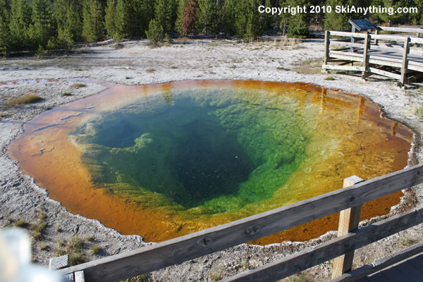
Old Faithful
Yellowstone National Park, Wyoming
Erupts every 44-125 min. reaching
Heights of 27-56 meters

Slide 13
Groundwater Weathering and Deposition

Slide 14
Carbonic Acid
Acids: aqueous solutions that contain hydrogen ions
Most groundwater is slightly acidic due to carbonic acid
Carbonic acid forms when carbon dioxide gas (CO₂) dissolves in water (H₂O) and combines with water molecules
In real life this occurs when: precipitation falls and interacts with CO₂ or when groundwater infiltrates the products of decaying organic matter in soil
Limestone can be slowly degraded as a result of slightly acidic groundwater

Slide 15
Dissolution by Groundwater
CO₂ + H₂O → H₂CO₃ →H⁺ + HCO₃⁻
CaCO₃ + H+ → Ca²⁺ + HCO₃⁻
These ions are carried away by groundwater and precipitate out of solution (become solids)
Precipitation occurs when groundwater evaporates or when CO₂ gas leaves the water
Dissolution-the process of dissolving
Dissolution and Precipitation of calcite →caves

Slide 16
Caves
Cave: an underground opening with a connection to Earth’s surface
Also known as a Cavern
Most formed when groundwater dissolves limestone
Begins at the zone of saturation just below the water table
Water table lowers and cave fills with air, creating new caves below the lowered water table
Commonly occurs where uplift has occurred due to tectonic forces

Slide 17
Groundwater Deposits
Dripstones
Most remarkable features made by groundwater
Built over time as water drips through caves
Each drop of water hanging on ceiling of a cave loses CO2 and precipitates calcite
Stalactite-hangs from ceiling like icicles and forms gradually, a form of dripstone
Stalagmites- mound-shaped dripstones slowly created by water dripping to the floor of a cave
Dripstone columns-created by the meeting of stalactites and stalagmites
Notes:
https://video.search.yahoo.com/search/video;_ylt=AwrJ6R6PRIFcaJYAYF5XNyoA;_ylu=X3oDMTEzZnNnMjV0BGNvbG8DYmYxBHBvcwMxBHZ0aWQDVUlDMV8xBHNlYwNwaXZz?p=linville+cavern+video&fr2=piv-web&fr=mcafee#id=2&vid=597b7a2af3eafe32914240d22e82f9f3&action=view

Slide 18
Groundwater Deposits
Hard Water
Water that contains high concentrations of calcium, magnesium, or iron
Common in areas where the subsurface rock is limestone.
Limestone is made of calcite, the groundwater in these areas contain significant amounts of dissolved
calcite.
Hard water in houses can cause: precipitation in pipes causing clogging and rendering electrical appliances useless

Slide 19
Groundwater Supply
Mrs. Johnson Earth Science

Slide 20
Wells
Holes dug or drilled into the ground to reach an aquifer.
Two Types:
Ordinary
Artisan
Ordinary Wells: dug or drilled below the water table, into “water-table aquifer” meaning level of water in well is same as level of water in the water table.4
As water is drawn out, it’s replaced by the surrounding water of the aquifer.
Cone of Depression: occurs when water is drawn out of the well at a faster rate than it’s replaced.

Slide 21
Figure 12, pg. 263
Recharge: water from precipitation replenishes the water content of an aquifer or, in some cases, wells.
Groundwater recharge from precipitation and runoff sometimes replaces the water withdrawn from wells.
However, if withdrawal of groundwater exceeds the aquifer’s recharge rate, the drawdown increases until all wells in the area become dry

Slide 22
Artisan Wells
Fountain of water that spurts above the land surface when a well taps a deep, confined aquifer containing water under pressure
Artisan spring-a spring that discharges water under pressure
Artisan=French province Artois where artisan wells were first drilled 900 years ago

Slide 23
Threats to the water supply
Freshwater=Earth’s most precious resource
Fig. 14
Demand for fresh water is HUGE because it’s essential for life
Used extensively in agriculture and industry
Groundwater supplies much of this water

Slide 24
Threats to Water Supply
Overuse: pumped out at greater rates than recharge rates; occurring at
Ogallala Aquifer
Subsidence: sinking of land due to withdrawal of groundwater; occurring in Gulf
Coast of Texas where heavy use of groundwater resulted in wide-scale drop in
ground level causing flooding hazards for coastal regions

Slide 25
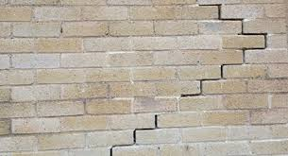
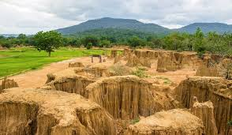
Subsidence Signs and Symptoms

Slide 26
Ogallala Aquifer under Great Plains; SD to Texas

Slide 27
Pollution of Groundwater
Sources of pollution=sewage from faulty septic tanks and farms, landfills, and other waste disposal sites.
Pollutants enter the ground above the water table, but eventually infiltrate to the water table. Higher permeability means faster occurrence of pollution.
Chemicals: dissolved chemicals can flow with groundwater through fine-grained sediments; ex. Arsenic can contaminate
any type of aquifer. Chemicals can move downslope from the source in the form of a pollution plume.
Pollution plume: a mass of contaminants that spreads through the aquifer
Chemicals aren’t easily removed
Chemicals can be leached (dissolved by infiltrating groundwater)
Aquifers are particularly vulnerable in humid areas where water table is shallow and can easily come into contact
with waste

Slide 28
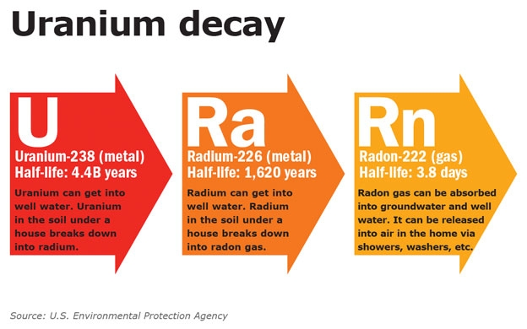
Pollution of Groundwater, con’t.
Salt: not toxic, but a contaminant because it causes water to be undrinkable. Over-pumping of wells cause infiltration of
saltwater into wells in coastal areas
Radon gas: natural groundwater pollution, leading cause of lung cancer in US. A product of radioactive decay of uranium
in rocks and sediment, and it usually occurs in very low concentrations in all groundwater.

Slide 29
Protecting our Water Supply
LOCATE, IDENTIFY, AND REMOVE POLLUTION SOURCES
FIND WATER SOURCES THAT AREN’T CONTAMINATED
BE AWARE OF HOW HUMAN ACTIVITIES INFLUENCE OUR RESOURCES SUCH AS WATER
CHEMICALLY TREAT WATER TO ELIMINATE POLLUTION
PROVIDE IMPERMEABLE BARRIERS TO PROTECT UNCONTAMINATED WATER

