Slide 1
Unit 4, Chapter 11
The Atmosphere

Slide 2
Atmosphere Basics
The atmosphere is combined with several gases
  About 99% of the atmosphere is composed of nitrogen and oxygen.
  The remaining 1% contains argon, hydrogen, carbon dioxide, water vapor, and other gases.
2. The amount of water vapor in the atmosphere changes constantly. It can be as high as 4%, or as little as 0%.
3. The level of carbon dioxide and water vapor are important because they play a role in the amount of energy the atmosphere absorbs.
- The recent increase in the amount of CO2 is due to the human combustion of fossil fuels

Slide 3
Atmosphere Composition
Water Vapor is the source of clouds, rain, and snow.
The atmosphere also contains solids in the form of tiny particles of dust and salt.
  Dust is carried into the atmosphere by wind.
  Fungi and bacteria can also be found in the atmosphere.

Slide 4
OZONE
Another component of the atmosphere, ozone (O3) is a gas formed by the addition of a 3rd oxygen atom to an oxygen molecule.
It is crucial in the stratosphere LAYER because it absorbs ultraviolet radiation from the sun (protection for humans)
The concentration of ozone varies with seasons.

Slide 5
Atmospheric Layers #1: Troposphere
The atmosphere is made up of several different layers.
The layer closest to the Earth’s surface is the TROPOSPHERE.
  Troposphere is where weather takes place and most air pollution collects.
  As the altitude increase (get closer to space) the temperature decreases in the troposphere.
    There is an area in the Troposphere where the temperature STOP decreasing. This area is known as the Tropopause.
  9-16 km above Earth’s SURFACE.

Slide 6
#2: The Stratosphere
The TropoPAUSE separates the TropoSPHERE from the STRATOSPHERE layer.
Air temperatures increase as the altitude increases.
Contains the Ozone layer to PROTECT us from Sun UV Rays- This causes the temperature to INCREASE.
Contains the “stratopause“ – a location in the Stratosphere where the temperature stops increasing with altitude.
About 50 KM above Earths surface.

Slide 7
#3 – The Mesosphere
The StratoPAUSE separates the Stratosphere from the MESOSPHERE.
Air temp decreases with altitude because there is very little heat absorbed here.
Like the other layers, the Mesosphere contains an area where the temperature stops. This is known as the Mesopause.
About 50km to 85 km above Earth Surface.

Slide 8
#4: Thermosphere
Temperatures in this area increase due to low density.
Contains the Ionosphere – electrically charged particles.
About 85 km – 600 km above Earth’s Surface

Slide 9
#5 – Exosphere
OUTERMOST LAYER of Earth’s atmosphere
Outer Space!
Extends from 600km to more than 10,000km above Earth’s Surface (no clear boundary at top

Slide 10
Remember THIS mnemonic device:
The
Sun
Meets
The
Earth
Notes:
https://video.search.yahoo.com/search/video?fr=mcafee&p=layers+of+the+atmosphere+video#id=1&vid=8d8c6795a9375811e8acfe77c244ac5c&action=click

Slide 11
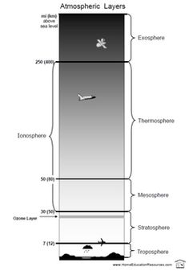

Slide 12
Energy Transfer in the Atmosphere
Random Motion: When particles move in all directions
Kinetic Energy: Energy in motion
Thermal energy: total energy of the particles in an object
Heat is the transfer of thermal energy

Slide 13
Energy Transfer
3 way Energy is transferred:
Radiation
Conduction
Convection

Slide 14
~Radiation~
Radiation is the transfer of thermal energy by electromagnetic waves.
Most of the solar energy that reaches Earth is in the form of visible light waves and infrared waves.
Most Visible Light goes straight through the atmosphere and hits Earth’s surface where it gets absorbed.
IR (infrared) waves get absorbed in the atmosphere.

Slide 15
Radiation
~30% solar radiation is reflected into space by the Earth’s surface, atmosphere, or clouds.
~20% is absorbed by the atmosphere and clouds
~50% of solar radiation is absorbed in Earth’s surface and keeps it warm

Slide 16
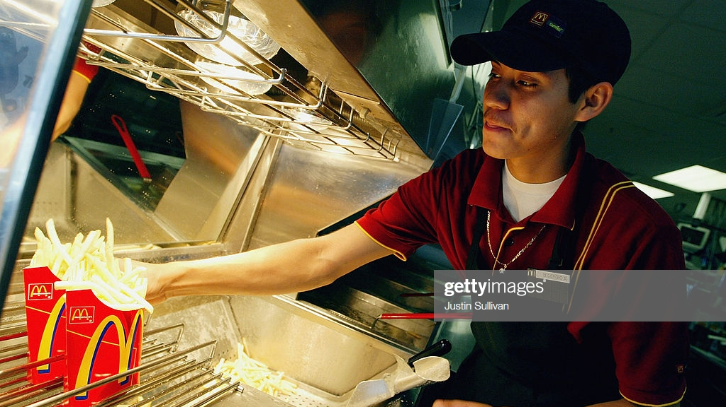
Notes:
Radiation heating fries

Slide 17
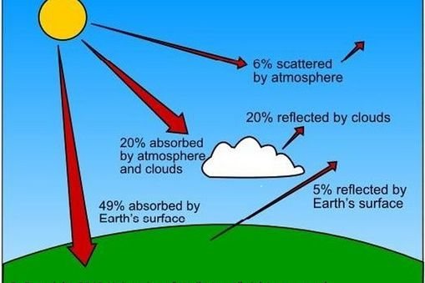

Slide 18
Conduction
The transfer of thermal energy between objects when their atoms or molecules collide
Occurs more easily in solids and liquids, where particles are close together, unlike gases.
In the atmosphere, conduction occurs between Earth’s surface and the Troposphere.

Slide 19
Convection
Transfer of thermal energy by the movement of heated material from one place to another.
Mainly in liquid and gases.
Hm… Where have we talked about convection currents once before?
MANTLE CONVECTION!
Convection is the process of heat rising and cold sinking.
So, particles in the atmosphere near the surface of Earth heat up, become less dense and RISE. As it rises, it cools down, becomes more dense, and sinks again!

Slide 20
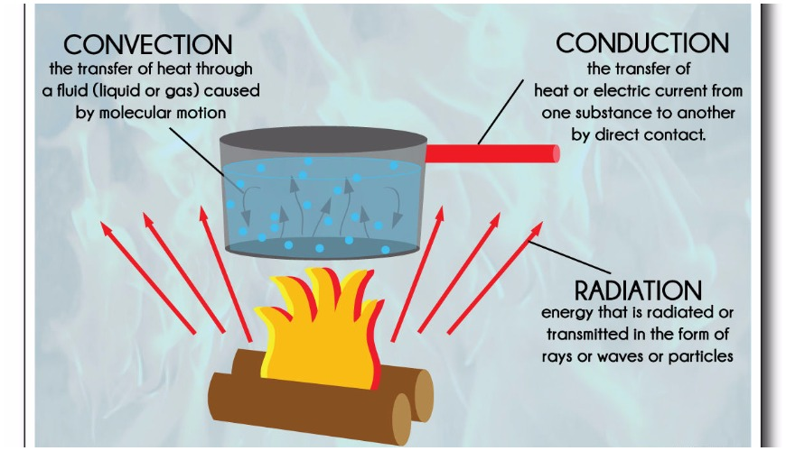

Slide 21
Properties of the Atmosphere
11.2

Slide 22
Temperature
Temperature is the measurement of how rapidly or slowly molecules move around.
More molecules moving faster = higher temperature
Use Fahrenheit ( F), Celsius (C), and the SI unit: Kelvin (K)
Fahrenheit and Celsius are based on “freezing” and “boiling” points.
Kelvin scale begins at “absolute zero” – the lowest temperature that any substance can have.
0 Kelvin = -273 degrees Celsius = -459 Fahrenheit

Slide 23
Air Pressure
As you go higher in the air, the air pressure decreases .
Density of air decreases with an increase in altitude

Slide 24
Pressure – Temperature – Density
Relationship
(in a container)
Air Pressure and Temperature:
When particles move faster due to an increase in temperature, they exert a greater force when they collide with sides of container. The air pressure inside the container increases.

Slide 25
Relationship continued
Air Pressure and Density
We all remember the formula for DENSITY. D=M/V
So, if we pump more gas particles into the container, the mass is going to increase, but not the volume. Therefore, the Density will change.
Now, there are MORE gas particles colliding with the walls of the container, so the air pressure is going to increase again!

Slide 26
Relationship….. again
Temperature and density
Heating a balloon causes the air inside to move faster, causing the balloon to expand and increase in volume. As a result, the air density inside the balloon decreases.

Slide 27
Temperature Inversion
Temperature Inversion: an increase in temperature with height in an atmospheric layer.
Warmer air is on top of cooler air
Can worsen air pollution

Slide 28
Humidity
Humidity is the amount of water vapor in the atmosphere at a given location on Earth’s surface
Relative Humidity is expressed as a percentage.
It is the amount of water vapor in a volume of air relative to the amount of water vapor needed for that volume of air to reach saturation.

Slide 29
Humidity
Saturation is the maximum amount of water vapor the air can hold.
If a weather forecaster says that the relative humidity is 50%, that means that the air contains 50% of the water vapor needed for the air to be saturated.

Slide 30
Humidity
Dew Point: the temperature to which air must be cooled at constant pressure to reach saturation
Latent Heat: extra thermal energy contained in water vapor compared to liquid water
Notes:
Lab on page 295?

Slide 31
Clouds and Precipitation
11.3

Slide 32
Cloud Formation
Clouds form when warm, moist air rises, expands and cools in a convection current. As the air reaches its dew point, the water vapor in the air condense around condensation nuclei.
(Condensation nuclei are tiny particles in the atmosphere which cloud droplets can form. Droplets can be liquid water or ice, depending on temperature)

Slide 33
Cloud Formation
Clouds can also form when wind encounters a mountain and the air has no place to go but up.
This method of cloud formation is called orographic lifting.

Slide 34
Types of Clouds
Clouds are generally classified according to a system originally developed by English naturalist Luke Howard in 1803.

Slide 35
Cloud Types
Low Clouds:
Cumulus: puffy, lumpy looking clouds that usually occur below 2,000 m.
Stratus: layered sheet-like clouds below 2,000 m
“Nimbostratus” clouds produce precipitation

Slide 36
Cloud Types
Middle Clouds:
“Altocumulus” and “Altostratus” clouds form between 2,000-6,000 meters. Consist of ice crystals due to colder temperatures.
Altostratus clouds are grey in appearance.
Altocumulus can be grey or white.

Slide 37
Cloud Types
High Clouds:
Made up of ice crystals 6,000 meters above surface.
Cirrus clouds have thin, wispy appearance.
Cirrostratus form as a continuous layer in the sky, from almost transparent to dense.
Cirrocumulus have a rippled appearance

Slide 38
Vertical Clouds
If the cloud is warmer than the surrounding air, it will continue to grow upward. As it rises, water vapor condenses and the air continues to increase in temperature due to latent heat release. The result is a cumulonimbus.
Cumulonimbus have a characteristic anvil head on top

Slide 39
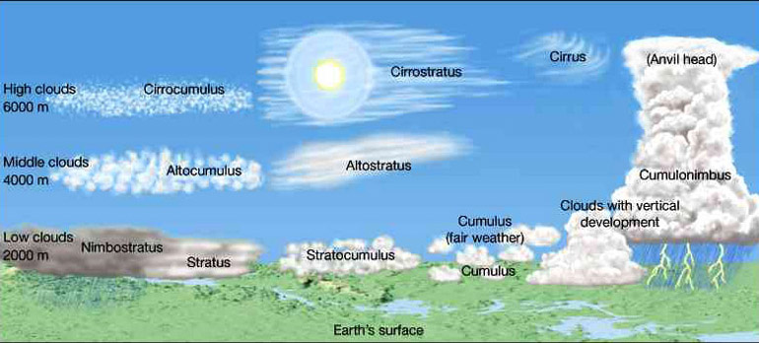

Slide 40
Precipitation
All forms of water that fall from the clouds to the ground are known as precipitation.
Rain, snow, sleet, hail are the 4 main types of precipitation
Depends on the size of water droplet

Slide 41
Precipitation
One way that cloud droplets can increase in size is by coalescence.
Coalescence occurs when cloud droplets collide and join together to form a larger droplet.
These collisions occur as larger droplets fall and collide with smaller droplets. As this process continues, they eventually become to heavy for the cloud and fall to the Earth as precipitation.
The types of precipitation that reaches the Earth depends on the temperature in the atmosphere.

Slide 42
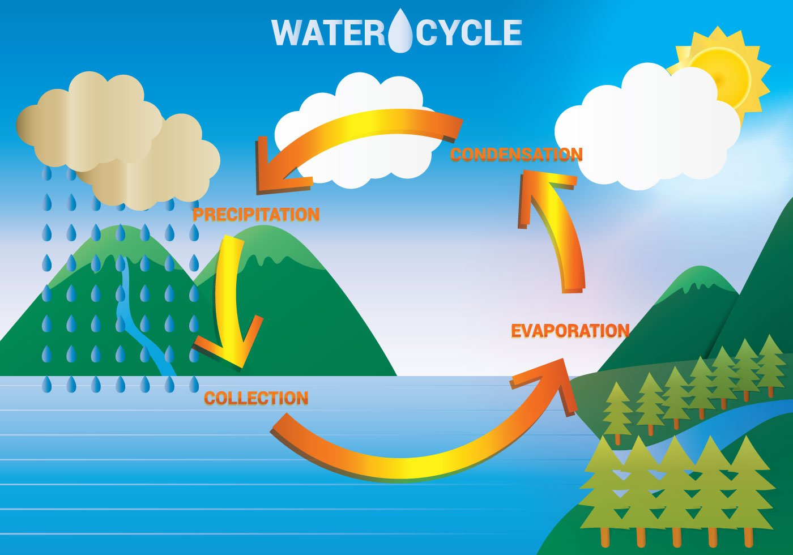
The Water Cycle

