Slide 1
Climate
Chapter 14
Main idea: climate is affected by several factors including latitude and elevation

Slide 2
Section 1: Defining Climate
What is climatology?
→The study of Earth’s climate and the factors that causes past, present, and future climate changes
2) What is climate?
→ long-term weather patterns of an area
3) What are three main factors that climate describes about an area?
→ Temperature, Precipitation, Wind

Slide 3
Weather vs. Climate
It’s rainy and warm today!
Weather!
Greensboro has 4 seasons with a moderate amount of rain and wind.
Climate!
Normal: the standard value for a location

Slide 4
Factors that affect climate
Latitude
Recall that different parts of the world receive different amounts of solar radiation
The area between 23.5 degrees S and 23.5 degrees N is known as the tropics.
These areas receive the most amount of solar radiation
The temperate regions are located between 23.5 degrees and 66.5 degrees N and S.
The polar zones are locations from 66.5 degrees to the North and South poles, respectively.

Slide 5
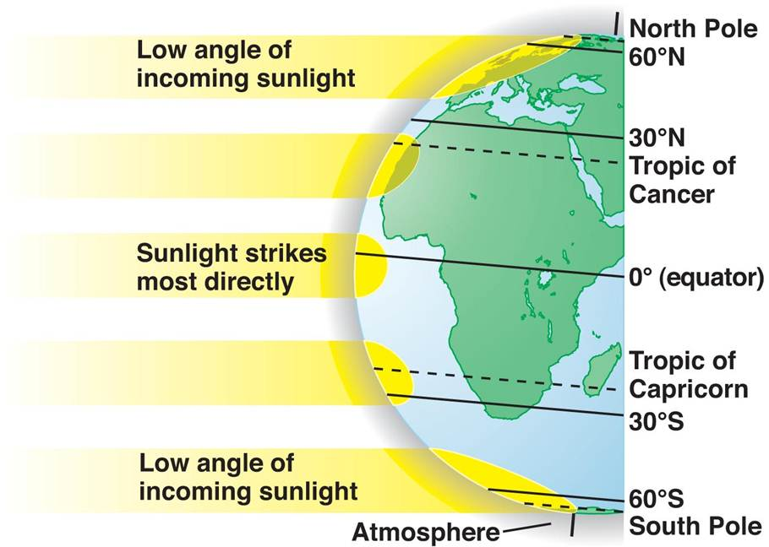

Slide 6
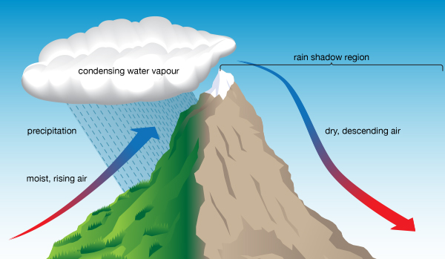
Topographic Effects
Large bodies of water heat up and cool down slower than land
Deserts are common on leeward side of the mountain. Why?
Air rises up one side of the mountain due to orographic lifting.
Rising air cools, condenses, and falls as moisture.
This is the windward side of the mountain; usually wet and cold.
On the opposite side, the leeward side, the air is drier and warmer.

Slide 7
Climate Factors: Air Masses
What were the 5 types of air mases that we talked about?
Maritime Tropical
Maritime Polar
Arctic
Continental Tropical
Continental Polar

Slide 8
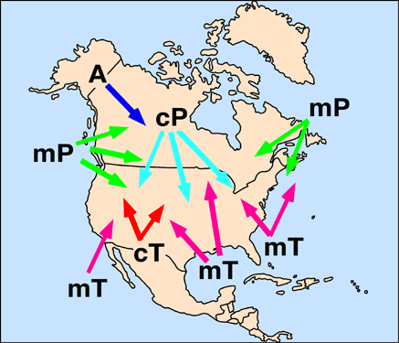

Slide 9
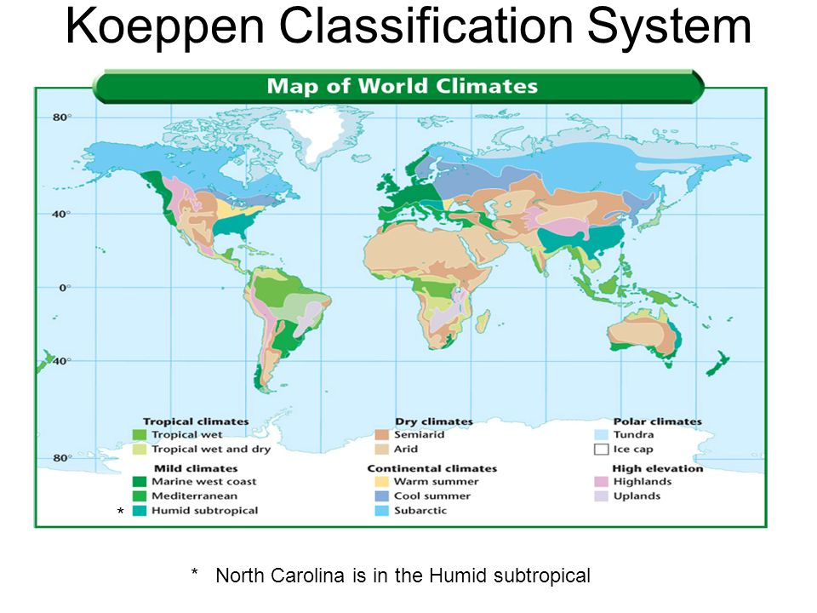
13.2: Climate Classification
Koppen Classification System: a system used for climates that is based on average monthly values of temperature and precipitation.
Tropical Climates: Constant high temperatures; Up to 600 cm of rain; Dramatic vegetation and high biodiversity
Dry Climates: Dry (arid or semi-arid); cT air mass dominates; Low precipitation; Vegetation is scarce
Mild Climates: The North Atlantic (Gulf Stream); Marine West Coast; Mediterranean
Continental Climates: Clashing tropical and polar air masses; Rapid, violent changes in weather; Summer and winter temps can be extreme
Polar Climates: Tundra; very cold no trees, little precipitation.

Slide 10
Microclimates
= A localized climate that differs from the main regional climate.
Heat islands: where the climate is warmer in an urban environment
Why? The “concrete” jungle contains minimal vegetation and a lot of asphalt
Asphalt absorbs more energy (solar radiation)
This causes the air to heat up.

Slide 11
13.3: Climatic Changes
Ice Ages: periods of extensive glacial coverage.
Glaciers have advanced and retreated over the past 2 million years.
Short-term Climatic Changes:
- Seasons
El Nino: warm ocean temperatures that occasionally develop off the western coast of S. America. For reasons generally unknown, the shift in ocean currents causes brief climatic changes.
Natural Causes of Climatic Changes:
Solar Activity
Earth’s Orbit, Tilt, and Wobble.
Volcanic Activity

Slide 12
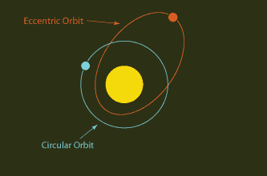
Earth’s Orbit, Tilt, and Wobble
Orbit: Scientists speculate that a more elliptical/eccentric orbit around the Sun could produce significant changes in Earth’s climate.
Tilt: If the angle of the tilt of the Earth is increased, the temperature changes would increase… and vice versa.
Wobble: Earth’s wobbling could cause it to shift focus from North Star Polaris to Vega star. This would cause colder winters.
Notes:
1) Notice how much closed the Earth gets to the Sun.

Slide 13
13.4: Impact of Human Activities
The process of the absorption and radiation of energy in the atmosphere results in the greenhouse effect – the natural heating of Earth’s surface caused by certain atmospheric gases called greenhouse gases.
Primarily carbon dioxide and methane
An increase in global temperatures is known as global warming
Global Warming: temperatures have been on an upward trend over the last 200 years. Polar ice caps and mountain glaciers can melt and cause a rise in sea level, thus flooding of coastal areas.
Burning of fossil fuels (coal, oil, natural gas) adds atmospheric carbon dioxide.
Automobiles, heat homes and business, power factories, etc.
Methane and nitrous oxide are also released from fossil fuels
Deforestation – massive removal of trees. During photosynthesis, trees remove CO2 from the atmosphere.

