Slide 1
Earth’s Oceans
Chapter 15

Slide 2
15.1: Overview of Oceans
The study of the Earth’s oceans is called oceanography.
The science of oceanography is considered to have started with the work of the British research ship Challenger in the late 1800’s.
Investigated:
Ocean currents
Water temperature and chemical composition
Seafloor sediments and topography
Marine life

Slide 3
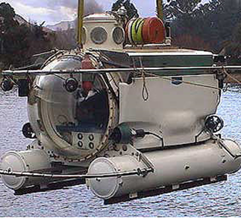
Data Collection & Analysis
Sonar has been used to map the topography of the ocean floor
Ocean depth is calculated by sending the sonar signal to the ocean floor and timing how long it takes for the sound to reach the bottom and return to surface as an echo
Sonar = Sound Navigation and Ranging
Modern technology like satellites and submersibles are used today to monitor changes in temperature and currents.

Slide 4
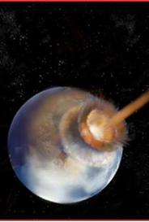
Origin of the Oceans
It is now believed that most of the water on the earth arrived on comets and meteorites. Volcanic eruptions also released water trapped beneath the Earth’s surface.

Slide 5
Distribution of Earth’s Water
Today 97% of the water on the planet is salty and found in oceans. The other 3% is freshwater located in ice caps, lakes, rivers, and under the ground (groundwater).
Throughout geologic time the sea level has risen and fallen as a result of the melting and freezing of glaciers. It is rising today due to global climate change.
Approximately 71% of the surface of the Earth is covered with water and the average depth of the oceans is about 3800 meters. The water on the earth forms one vast interconnected body of water.

Slide 6
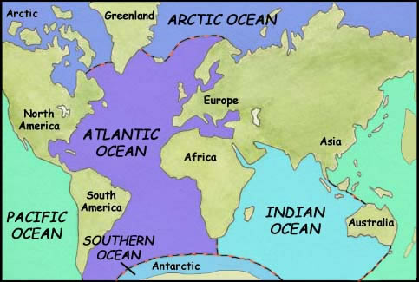
Major Oceans
Humans have divided this water into oceans and seas for historical reasons.
1. Pacific (Largest)
2. Atlantic
3. Indian (Mostly in the southern hemisphere)
4. Arctic (north pole, mostly ice)
5. Antarctic/Southern (south pole, mostly ice)

Slide 7
Do “Scavenger Hunt for 15.2”

Slide 8
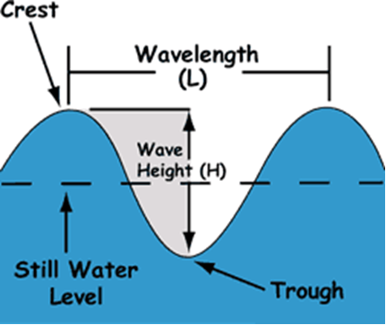
15.3: Ocean Movements –Waves
Oceans are never motionless. Waves are the most familiar movement and are mostly caused by wind blowing across the surface of the water.
Waves have the following features to the left

Slide 9
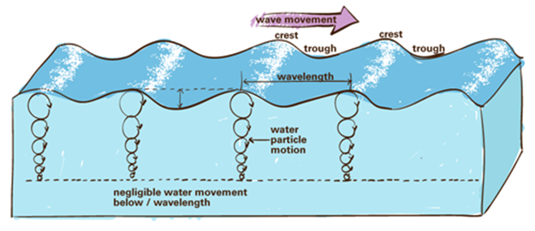
Ocean Movements – Waves
Particles in ocean waves move in circles before returning to their original position.
As waves approach the shore they slow down and build up with waves behind them until the “break” upon the shore.

Slide 10
Ocean Movements – Tides
Tides are the regular rise and fall of the sea visible along the shoreline.
Tides are caused by the gravitational pull of the moon (mostly) and Sun on the oceans.
When the Sun and moon are pulling in the same direction tides are especially high (Spring Tides) and low.
When the Sun and moon are at right angles to each other the high and low tides are not quite as extreme (Neap Tides)

Slide 11
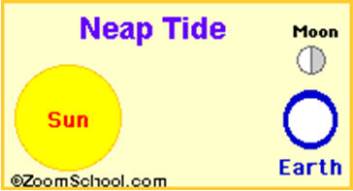
Tides

Slide 12
Ocean Movements – Currents
Large horizontal movements of water are called currents. Surface currents affect the top few hundred meters of water and can move as fast as 100 km per day. Surface currents are caused by winds that flow in the same direction as trade winds.
As currents come in contact with continents they are deflected. These currents move in patterns called Gyres which flow clockwise in the northern hemisphere and counter clockwise in the southern hemisphere.
Vertical currents (water moving upward) are called upwelling. These vertical movements bring nutrients to the surface and support abundant populations of marine life. Because they come from the bottom of the oceans these currents are always cold.
Notes:
Gy-er

Slide 13
Major Ocean Gyres
Red arrows = warm ocean water
Blue = cool ocean water

Slide 14
Page 423
Data Analysis Lab
Graph the data on your paper and answer the corresponding questions

