Slide 1
Plate Tectonics
Chapter 17

Slide 2
Launch Lab
Obtain a map from Ms. Norton
Use a ruler and the map scale to determine the actual distance between San Francisco to Low Angeles.
Read the insert “Is California moving?” on page 466
At the current rate of movement, when will these two cities be next to each other?
Based off of what we are about to talk about, what do you think might be causing the motion of these large pieces of land?
Notes:
Make copy of page for Mrs. Kelley and I.

Slide 3
17.1: Drifting Continents
Main Idea- the shape and geology of the continents suggests that they were once joined together.

Slide 4
Early Observations
With the exception of events such as earthquakes, volcanic eruptions, and landslides, most of Earth’s surface appears to remain relatively unchanged during the course of a human lifetime.
On the geologic time scale, however, Earth’s surface has changed dramatically.
In the late 1500s, Abraham Ortelius, a Dutch cartographer (map maker), noticed the apparent fit of continents on either side of the Atlantic Ocean.
•He proposed that North America and South America had been separated from Europe and Africa by earthquakes and floods.

Slide 5
Early Observations, continued
The first time that the idea of moving continents was proposed as a scientific hypothesis was in the early 1900s.
In 1912, German meteorologist Alfred Wegener presented his ideas about continental movement to the scientific community.

Slide 6
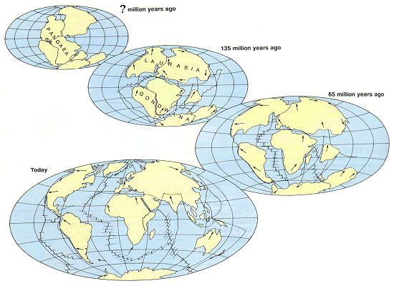
Continental Drift
Wegener developed a hypothesis that he called continental drift.
He proposed that Earth’s continents had once been joined in a single landmass, a supercontinent called Pangaea (Meaning The Earth), that broke apart about 200 mya (million years ago) and sent the continents adrift.

Slide 7
Continental Drift – Evidence from Rock Formations
Wegener observed that many layers of rocks in the Appalachian Mountains in the United States were identical to layers of rocks in similar mountains in Greenland and Europe.
These similar groups of rocks, older than 200 million years, supported Wegener’s idea that the continents had once been joined.
Map
Notes:
Look at locations of east coast and Greenland

Slide 8
Continental Drift – Evidence from Fossils
Wegener gathered evidence of the existence of Pangaea from fossils.
Similar fossils of animals and plants that once lived on or near land had been found on widely separated continents.

Slide 9
Continental Drift – Climatic Evidence
Fossils of the plant Glossopteris had been found on many parts of Earth, including South America, Antarctica, and India.
Wegener reasoned that the area separating these fossils was too large to have had a single climate.
Wegener argued that because Glossopteris grows in temperate climates, the places where the fossils had been found had been closer to the equator.
This led him to conclude that the rocks containing these fossils had once been joined.
Notes:
Go back to previous page

Slide 10
Continental Drift – Climatic Evidence: Coal Deposits
Coal forms from the compaction and decomposition of accumulations of ancient swamp plants.
1
Wegener used the existence of coal beds in Antarctica to conclude that Antarctica must have been much closer to the equator sometime in the geologic past.
2

Slide 11
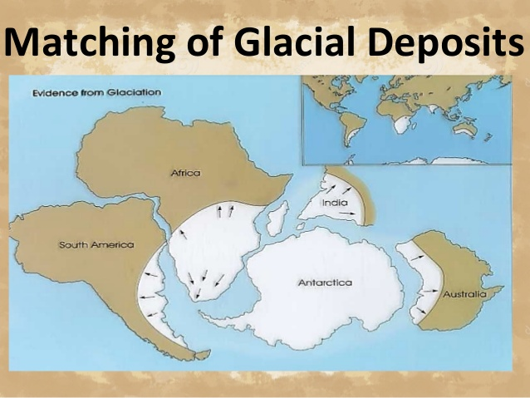
Continental Drift – Climatic Evidence: Glacial Deposits
Glacial deposits nearly 300 million years old on several continents led Wegener to propose that these landmasses might have once been joined and covered with ice.
The extent of the ice is shown in white.

Slide 12
A Rejected Notion
Although Wegener had compiled an impressive collection of data, the hypothesis of continental drift was not accepted by the scientific community.
Two unanswered questions:
What forces could cause the movement?
How could continents move through solids?
~Main reasons that continental drift was rejected. ~
It was not until the early 1960s, when new technology revealed more evidence about how continents move, that scientists began to reconsider Wegener’s ideas.
Seafloor mapping & Earth’s magnetic field provided necessary evidence to show how continents move.
https://www.youtube.com/watch?v=JmC-vjQGSNM

Slide 13
17.2 - Seafloor Spreading
Oceanic crust forms at ocean rides and becomes part of the seafloor.

Slide 14
Mapping the Ocean Floor
Until the mid-1900s, many scientists thought that the ocean floors were essentially flat and that oceanic crust was unchanging and was much older than continental crust.
Advances in technology during the 1940s and 1950s (Sonar & Magnetometer) showed that all of these widely accepted ideas were incorrect.
One technological advance that was used to study the ocean floor was the magnetometer, a device that can detect small changes in magnetic fields.
Towed behind a ship, it can record the magnetic field generated by ocean floor rocks.
Developments in sonar technology enabled scientists to measure water depth and map the topography of the ocean floor.
Recall that sonar uses SOUND waves!
Topography: changes in elevation of crust

Slide 15
Ocean- Floor Topography
Using the maps made from data collected by sonar and magnetometers, scientists discovered that vast, underwater mountain chains called ocean ridges run along the ocean floors around Earth much like seams on a baseball.
Earthquakes and Volcanoes are common along these ridges
Maps generated with sonar data revealed that underwater mountain chains had counterparts called deep-sea trenches.
The deepest trench, the Mariana Trench, is more than 11 km (6.3 miles) deep.
Mount Everest, the world’s tallest mountain, stands at 9 km (5.9 miles) above sea level, and could fit inside the Mariana Trench with six Empire State buildings stacked on top.

Slide 16
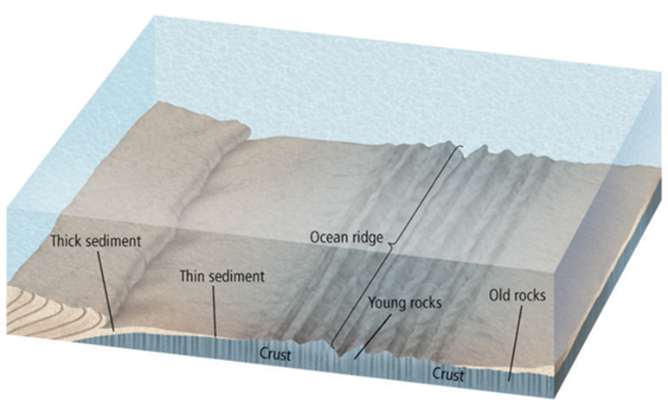
Ocean Rocks and Sediments
The ages of the rocks that make up the seafloor vary across the ocean floor, and these variations are predictable.
The age of oceanic crust increases with distance from a ridge.
Ocean-floor sediments are typically a few hundred meters thick.
Large areas of continents, on the other hand, are blanketed with sedimentary rocks that are as much as 20 km thick.
Observations of ocean-floor sediments revealed that, like the age of ocean crust, the thickness of ocean-floor sediments increases with distance from an ocean ridge.

Slide 17
Magnetism
Earth has a magnetic field generated by the flow of molten iron in the outer core. This field is what causes a compass needle to point to the North.
A magnetic reversal happens when the flow in the outer core changes, and Earth’s magnetic field changes direction.
A magnetic field that has the same orientation as Earth’s present field is said to have normal polarity.
A magnetic field that is opposite to the present field has reversed polarity.

Slide 18
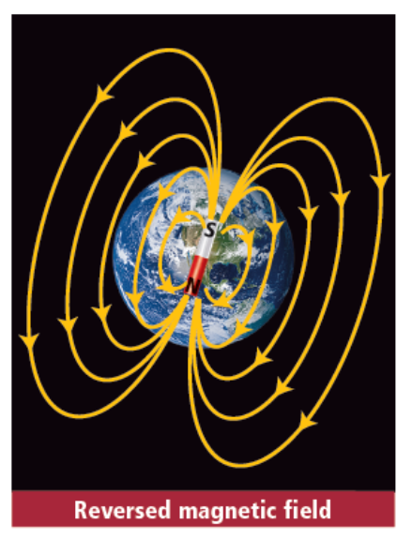
Magnetism

Slide 19
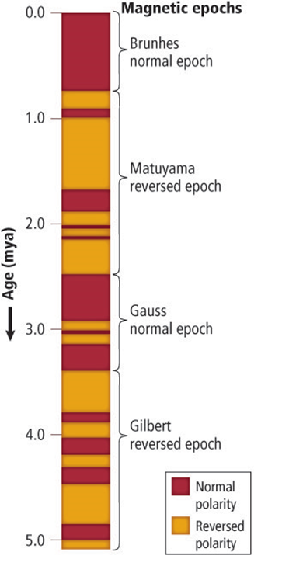
Magnetic Polarity Time Scale
Paleomagnetism is the study of the history of Earth’s magnetic field.
When lava solidifies, iron-bearing minerals such as magnetite crystallize.
As they crystallize, these minerals behave like tiny compasses and align with Earth’s magnetic field.
Periods of normal polarity alternate with periods of reversed polarity.
Long-term changes in Earth’s magnetic field, called epochs
Short-term changes are called events.

Slide 20
Magnetism: Magnetic Symmetry
Regions of normal and reverse polarity form a series of stripes across the ocean floor parallel to the ocean ridges.
The ages and widths of the stripes match from one side of the ridges to the other.
By matching the magnetic patterns on the seafloor with the known pattern of magnetic reversals on land, scientists were able to determine the age of the ocean floor from magnetic recording and to create isochron maps of the ocean floor.
An isochron is an imaginary line on a map that shows points that have the same age—that is, they formed at the same time.

Slide 21
Seafloor Spreading
Data from topographic, sedimentary, and paleomagnetic research led scientists to propose seafloor spreading.
Seafloor spreading is the theory that explains how new ocean crust is formed at ocean ridges and destroyed at deep-sea trenches.
During seafloor spreading, magma, which is hotter and less dense than surrounding mantle material, is forced toward the surface of the crust along an ocean ridge.
As the two sides of the ridge spread apart, the rising magma fills the gap that is created.
When the magma solidifies, a small amount of new ocean floor is added to Earth’s surface.

Slide 22
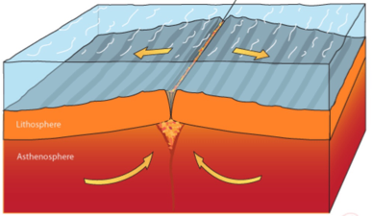
Seafloor Spreading…
As spreading along an ocean ridge continues, more magma is forced upward and solidifies.
The cycle of spreading and the intrusion of magma continues the formation of ocean floor, which slowly moves away from the ridge.
Draw the arrows on your sheet

Slide 23
Seafloor Spreading links & Review
http://video.yahoo.com/watch/1595570/5390151
https://www.youtube.com/watch?v=GyMLlLxbfa4
https://www.youtube.com/watch?v=6CsTTmvX6mc
New oceanic crust forms as _______________ rises at ridges and solidifies.
As new oceanic crust forms, the older crust gets ____________________ from the ridges.
Notes:
Magma
Farther away

Slide 24
17.3 Plate Boundaries
Main idea – Volcanoes, mountains, and deep-sea trenches form at the boundaries between the plates.

Slide 25
Theory of Plate Tectonics
Tectonic Plates are huge pieces of crust and rigid upper mantle that fit together at their edges to cover Earth’s surface
Plate Tectonics is the theory that describes how tectonic plates move and shape Earth’s surface.
They move in different directions and at different rates relative to one another, and they interact with one another at their boundaries.

Slide 26
Divergent (divide) Boundaries
Regions where two tectonic plates are moving apart are called divergent boundaries.
Most divergent boundaries are found along the seafloor rift valleys.
The formation of new ocean crust at most divergent boundaries accounts for the high heat flow, volcanism, and earthquakes associated with these boundaries.
Some divergent boundaries form on continents. When continental crust begins to separate, the stretched crust forms a long, narrow depression called a rift valley.

Slide 28
Convergent Boundaries
At convergent boundaries, two tectonic plates are moving toward each other.
When two plates collide, the denser plate eventually descends below the other, less-dense plate in a process called subduction.
There are three types of convergent boundaries.
Classified according to the type of crust involved.
Notes:
What does descend mean?

Slide 29
Convergent Boundaries
In the oceanic-oceanic convergent boundary, a subduction zone is formed when one oceanic plate, which is denser as a result of cooling, descends below another oceanic plate. The process of subduction creates an ocean trench.
In an oceanic-oceanic convergent boundary, water carried into Earth by the subducting plate lowers the melting temperature of the overlying mantle, causing it to melt.
The molten material is less dense so it rises back to the surface, where it often erupts and forms an arc of volcanic islands parallel to the trench.

Slide 30
Convergent Boundaries
When an oceanic plate converges with a continental plate, the denser oceanic plate is subducted. Oceanic-continental convergence produces a trench and volcanic arc.
The result is a mountain range with many volcanoes.
Continental-continental boundaries form when two continental plates collide, long after an oceanic plate has converged with a continental plate.
This forms a vast mountain range, such as the Himalayas.

Slide 31
Transform Boundaries
A region where two plates slide horizontally past each other is a transform boundary.
Transform boundaries are characterized by long faults, sometimes hundreds of kilometers in length, and by shallow earthquakes.
Most transform boundaries offset sections of ocean ridges.
Sometimes transform boundaries occur on continents.

Slide 32
17.4 – Causes of Plate Motions
Main idea: Convection currents in the mantle cause plate motions

Slide 33
Convection
Many scientists now think that large-scale motion in the mantle – Earth’s interior between the crust and the core- is the mechanism that drives the movement of tectonic plates.

Slide 34
Convection Currents
Convection is the transfer of thermal energy by the movement of heated material from one place to another.
The cooling of matter causes it to contract slightly and increase in density.
The cooled matter then sinks as a result of gravity.
Warmed matter is then displaced and forced to rise.
This up-and-down flow produces a pattern of motion called convection current.

Slide 35
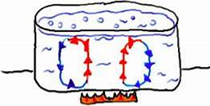
Convection Currents
Water cooled by the ice cube sinks to the bottom where it is being warming an then it rises. The process continues as the ice cube cools the water again.

Slide 36
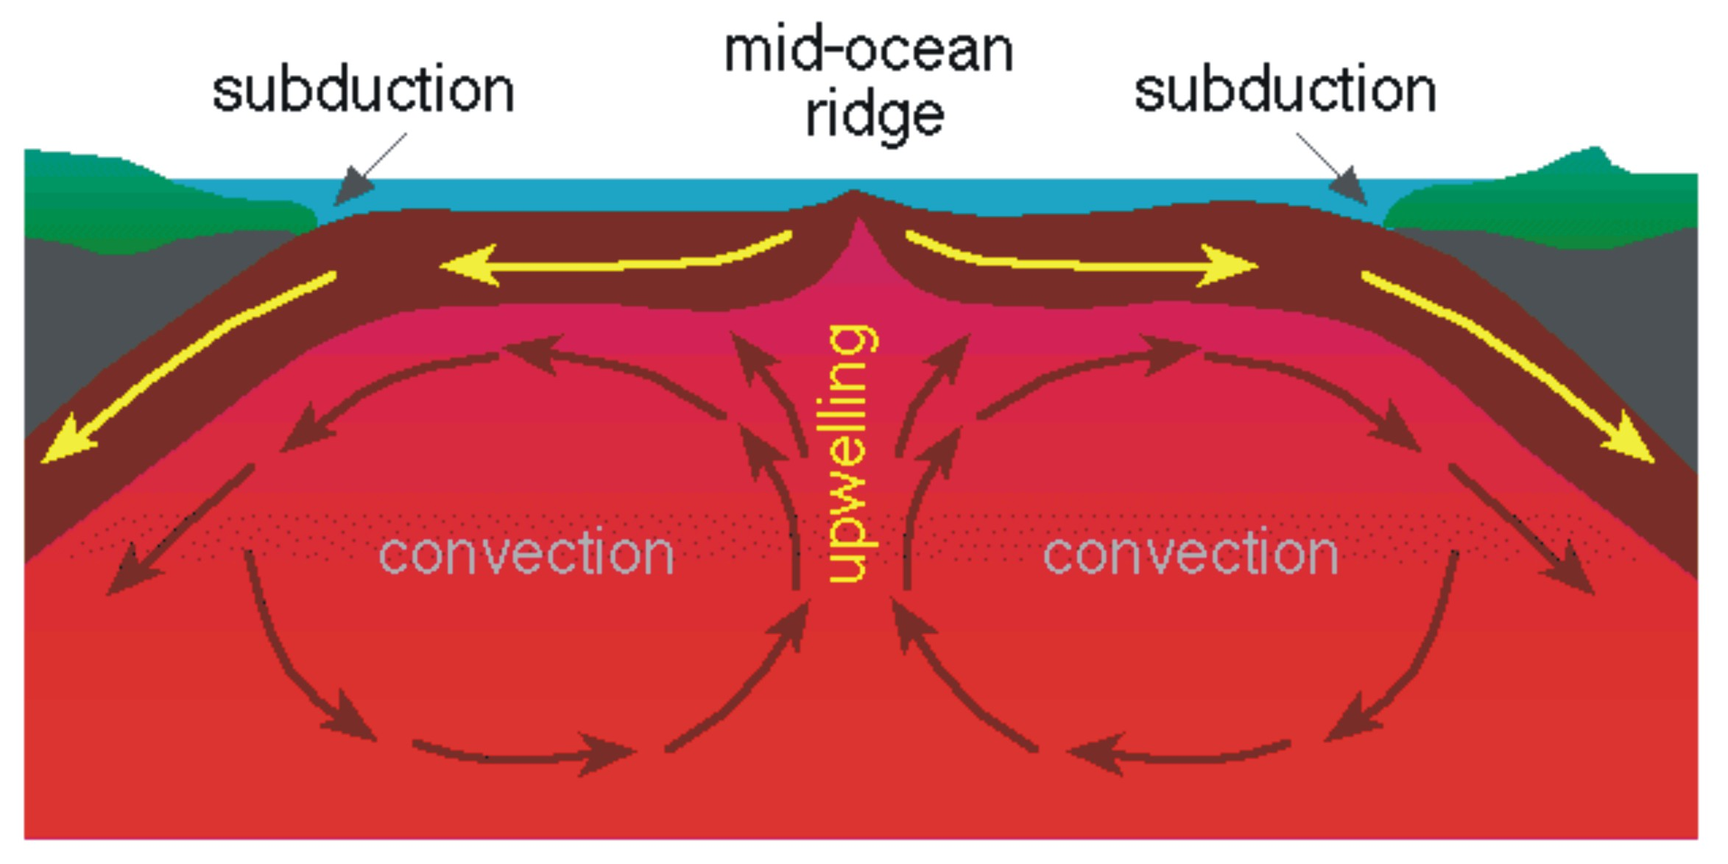
Convection in the Mantle
Convection currents develop in the mantle, moving the crust and outermost part of the mantle and transferring thermal energy from Earth’s interior to its exterior.

Slide 37
Plate Movement
The rising material in a convection current spreads out as it reaches the upper mantle and causes both upward and sideways forces, which lift and split the lithosphere at divergent plate boundaries
The downward part of convection current occurs where a sinking force pulls tectonic plates downward at convergent boundaries.

Slide 38
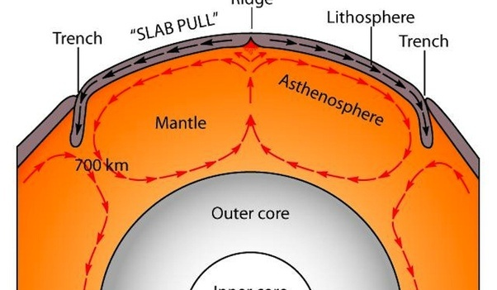
Push and pull
Ridge push is the tectonic process associated with convection currents in Earth’s mantle that occurs when the weight of an elevated ridge pushes an oceanic plate toward a subduction zone.
Slab pull is the tectonic process associated with convection currents in Earth’s mantle that occurs as the weight of the subducting plate pulls the trailing lithosphere into a subduction zone.

Slide 39
Draw with me!
Let’s pull all of this knowledge together to draw these concepts!

Slide 40
Jeopardy Review
https://www.superteachertools.us/jeopardyx/answerkey.php?game=459248

