Slide 1


Slide 2
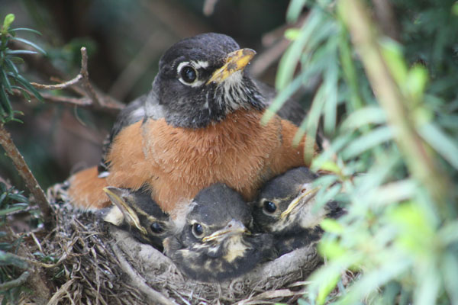

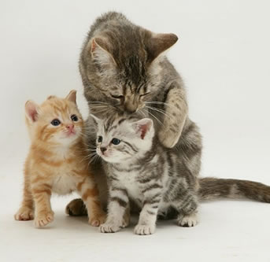
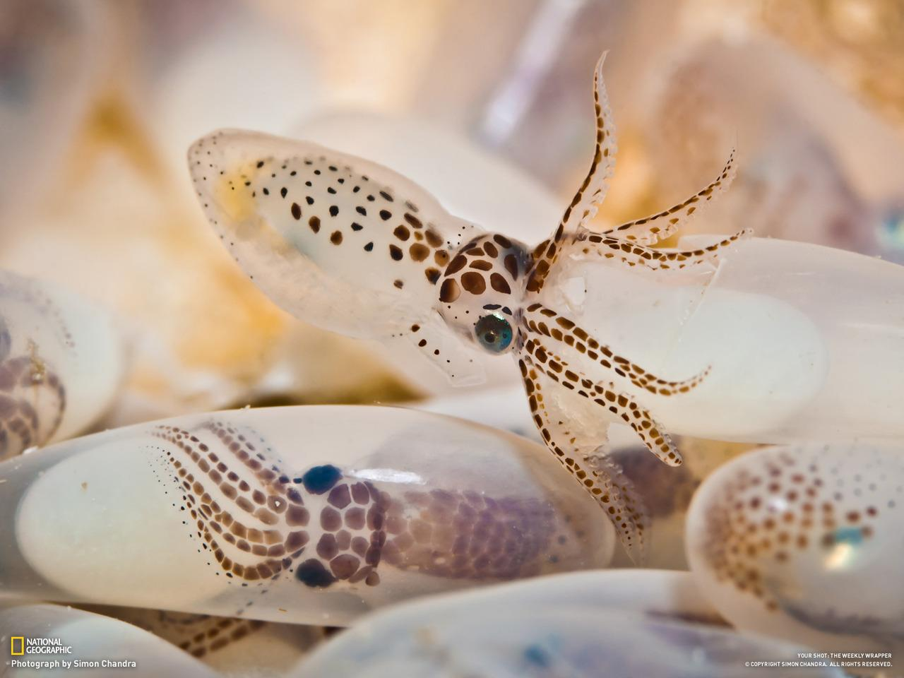
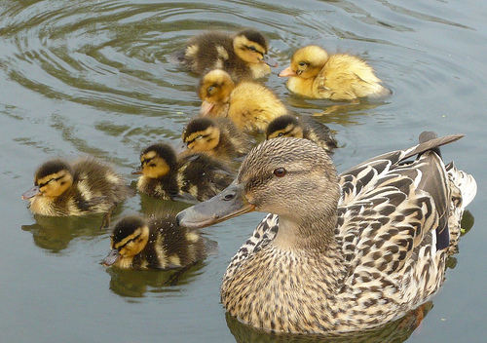
All Living Things Can Reproduce......

Slide 3
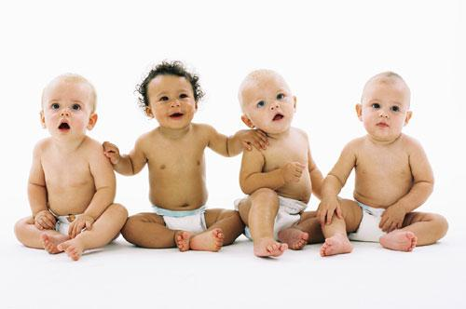
The Reproductive System
A Practical Guide
Unlike other animals, humans can CHOOSE when they want to reproduce.

Slide 4
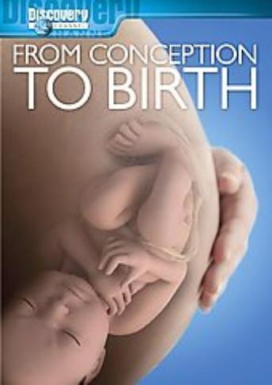
In this chapter, we will only focus on the more practical aspects of human reproduction.
Your book may be a resource, but we will not be following it closely.
Here, you will get an overview of both the male and female reproductive system as well as a general idea of how the process of pregnancy and birth occur.
We will also be watching the video – “From Conception to Birth”

Slide 5
Male Reproductive System
Major Structures:
Testes
Vas Deferens
Prostate
Penis

Slide 6
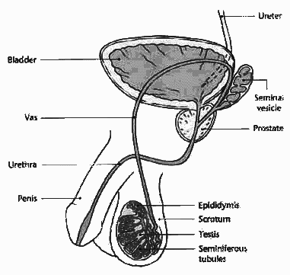
Testes - make sperm via meiosis. The testes also produce testosterone, the male hormone.
They are enclosed in the scrotum
Testosterone is responsible for many of the male characteristics.

Slide 7
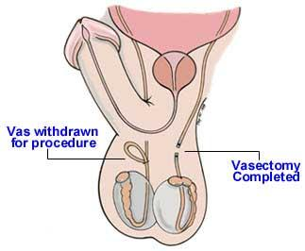
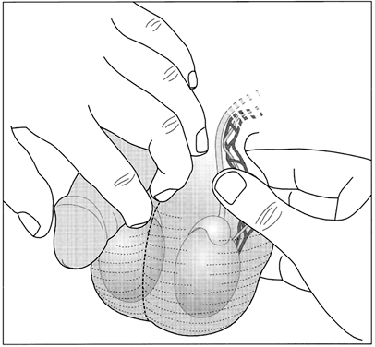
Epididymus - collects mature sperm which is eventually propelled through the vas deferens
Vas deferens -sperm travel through this tube, joins with urethra
Vasectomy - the tube is cut to prevent sperm leaving (and fertilizing an egg)
This procedure can be done right in the doctor's office
Notes:
Good Mythical Morning Hosts Share their vasectomy: https://youtu.be/A8f_aHL1ALI - no parts shown, but they talk as the procedure is taking place. May not be appropriate for all audiences.

Slide 8
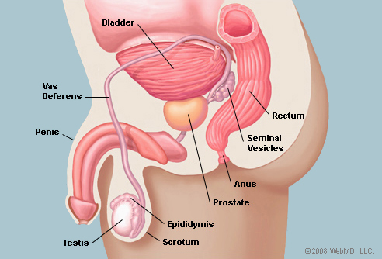
What is the difference between the urethra and a garden hose?
There is a vas deferens....

Slide 9
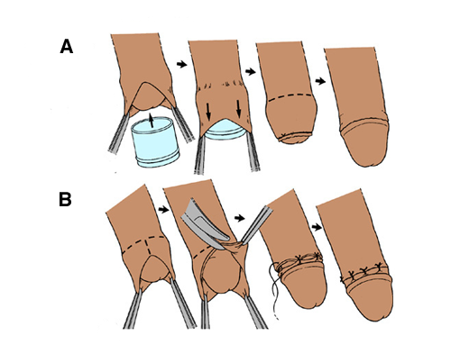
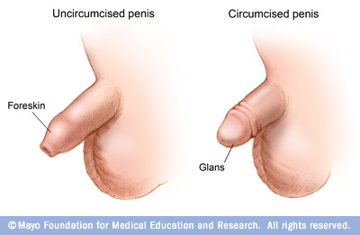
Circumcision
Boys are born with a hood of skin, called the foreskin, covering the head (also called the glans) of the penis. In circumcision, the foreskin is surgically removed, exposing the end of the penis.

Slide 10
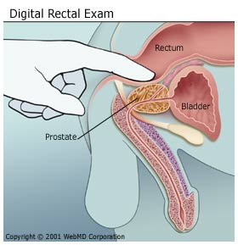
Prostate - gland that produces a fluid that carries sperm during ejaculation. It surrounds the urethra
Doctors use the digital rectal exam (DRE) as a relatively simple test to check the prostate
BPH = benign prostate hypertrophy, prostate enlarges with age, slowing the flow of urine

Slide 11
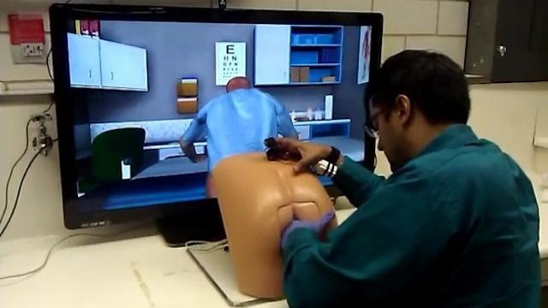
A robotic butt and virtual patient software allows medical students to receive feedback on the prostate exams they administer.

Slide 12
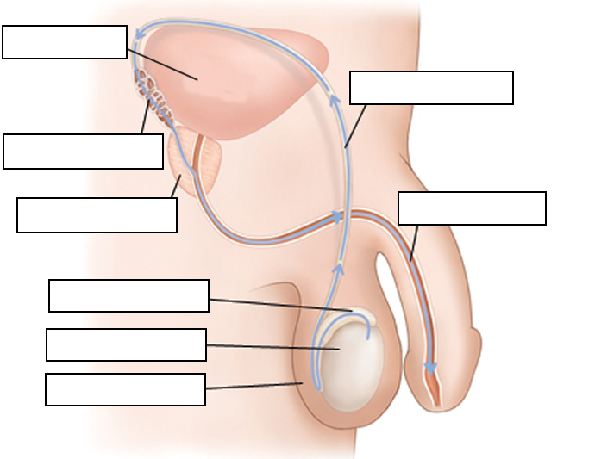
WORD BANK
Bladder
Vas deferens
Vas deferens
Scrotum
Urethra
Seminal Vesicle
Urethra
Prostate
Prostate
Epididymus
Epididymus
Bladder
Teste
Scrotum
Teste
Seminal Vesicle
See also: Kidshealth Male Reproductive

Slide 13
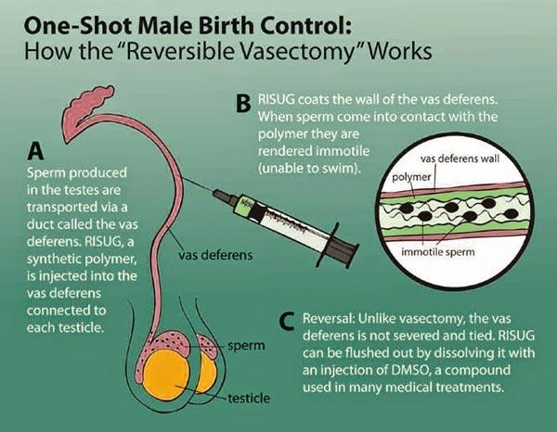
Male Contraception - not yet approved
Vasalgel -The procedure is similar to a vasectomy, except a gel is injected into the vas deferens, rather than cutting the vas.
Another injection can remove the polymer and restore fertility (maybe).
This technique is still being studied and has not been approved for use.
RISUG (Reversible Inhibition of Sperm Under Guidance)
Also See http://www.wired.com/magazine/2011/04/ff_vasectomy/ for full story and VIDEO!

Slide 14
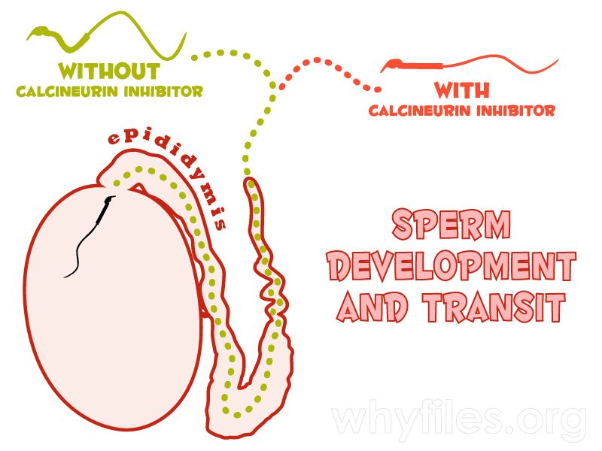
In a study in mice published in October 2015, a protein called Calcineuron was found to be crucial in helping sperm swim and break through the membrane of a female egg.
When the genes behind this protein were blocked, the mice became infertile. Effects were seen in the mice within four to five days after treatment. The effects were also reversible as fertility was restored one week after treatments were stopped.
The midpiece of the sperm tail (flagella) contains the sperm’s mitochondria and operates the movement of the tail. When sperm are deprived of the chemical calcineurin, the midpiece becomes more rigid and adopts a hook-like shape that constricts the tail’s range of motion.

Slide 15
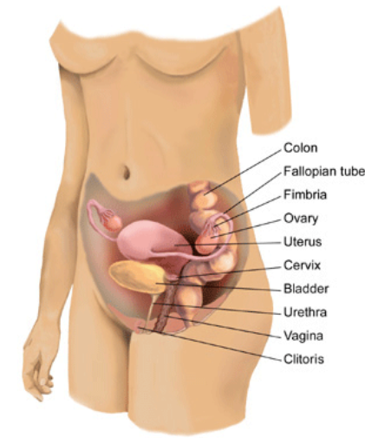
FEMALE REPRODUCTION
Main Structures
Ovary
Uterus
Fallopian Tubes
Vagina
Cervix

Slide 16
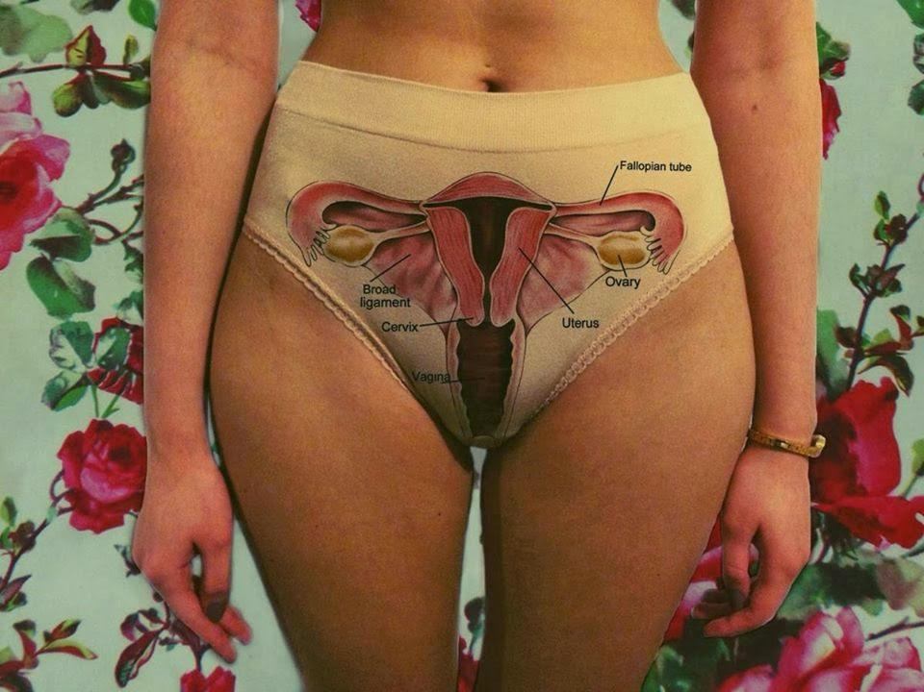

Slide 17
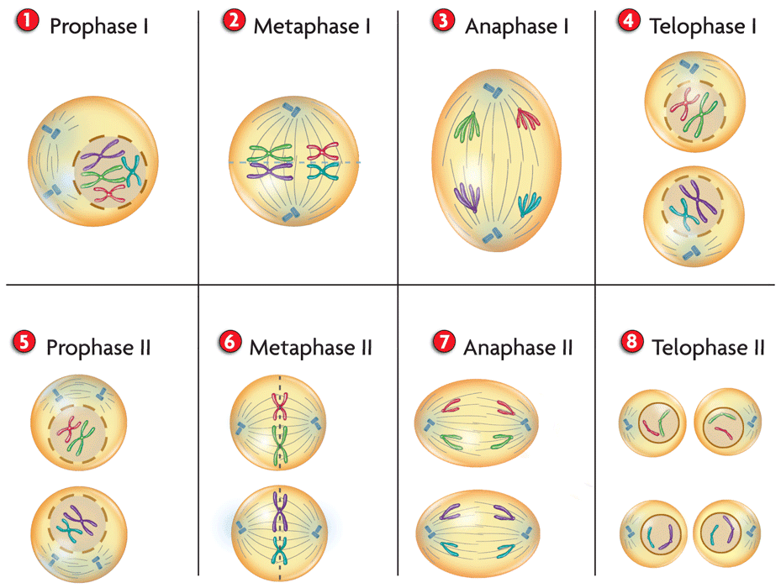
OVARY - this is where the eggs are produced through cell division (MEIOSIS)
Meiosis results in four daughter cells being produced that have HALF the number of the original cell.
Human body cells = 46 chromosomes
Human sex cells = 23 chromosomes

Slide 18
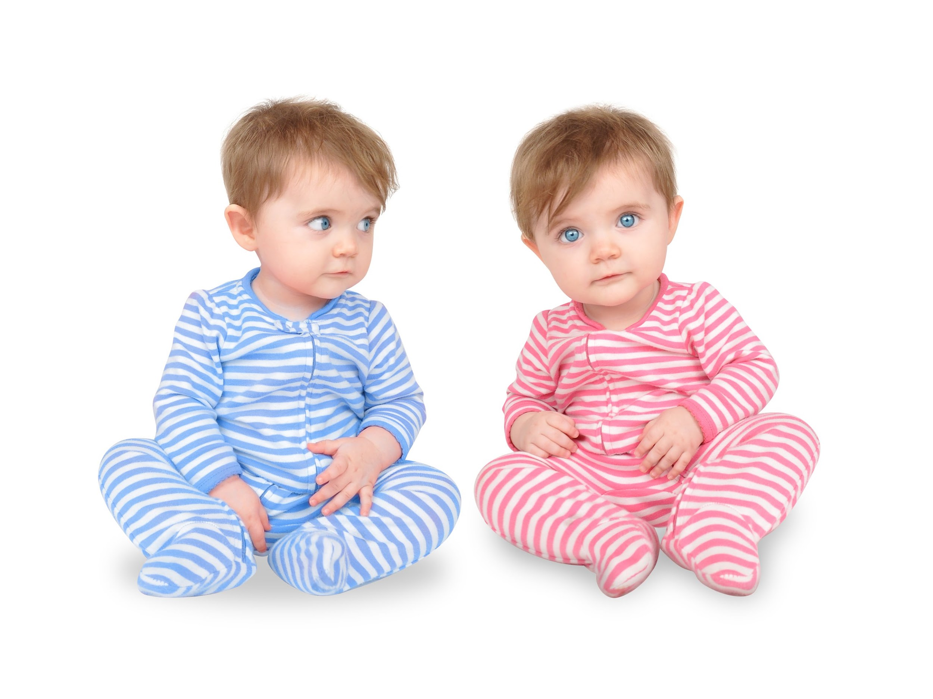
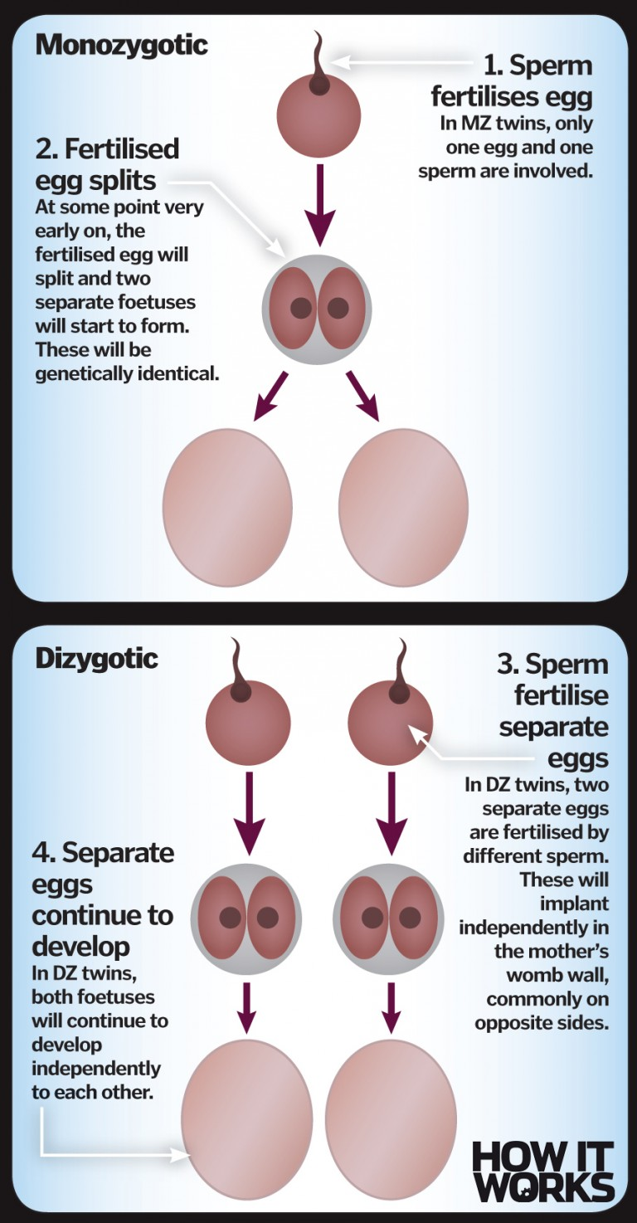
Twins
Identical twins develop when a single zygote splits
The babies are genetically identical. They also share one placenta.
Fraternal twins develop from the fertilization of two individual eggs.
The babies are not the same.

Slide 19
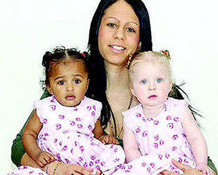
Can twins have different fathers?
Dutch couple Wilma and Willem Stuart used in vitro fertilization to get pregnant. When twins were born, Koen came out with blue eyes and pink skin, and Tuen had dark eyes and brown skin. The hospital made a “deeply regrettable mistake,” and it turned out that Koen was their child, but Tuen was not Willem’s son. A utensil had been used twice, and another man’s sperm was mixed with Willem’s.
Bipaternal twins.

Slide 20
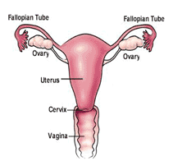
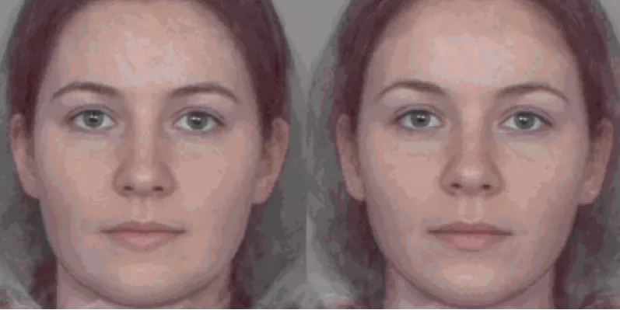
Ovaries secrete hormones:
Estrogen is responsible for the appearance of secondary sex characteristics of females
Progesterone regulates menstruation
Estrogen reduces the size of the nose and chin, and leads to large eyes, increased thickness of lips and fat deposition in the cheek area, along with hips and buttocks, features that announce that a woman is fertile.
Studies show that higher levels of estrogen may correlate with increased attractiveness.
Notes:
https://io9.gizmodo.com/5848614/the-more-feminine-you-look-the-more-children-you-want-wait-what, the second face has higher estrogen levels

Slide 21
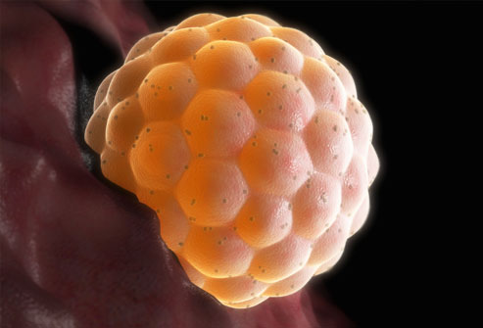
A fertilized egg is called a ZYGOTE.
An egg is usually a few days old before it implants in the uterus. At this point, it has already divided several times and is called a blastula.

Slide 22
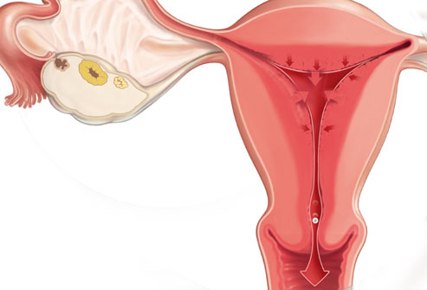
The uterus consists of a body and a cervix. The cervix protrudes into the vagina.
The uterus maintains an environment for accepting a fertilized egg.
The fertilized ovum becomes an embryo, attaches to a wall of the uterus, creates a placenta, and develops into a fetus (gestates) until childbirth.
If no fertilized egg reaches the uterus, the lining is shed monthly in a process known as menstruation

Slide 23
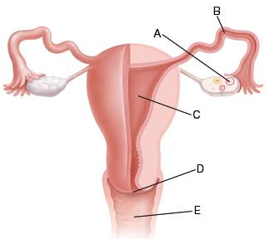
Fallopian Tubes
Ovary
Uterus
Cervix
Vagina

Slide 24
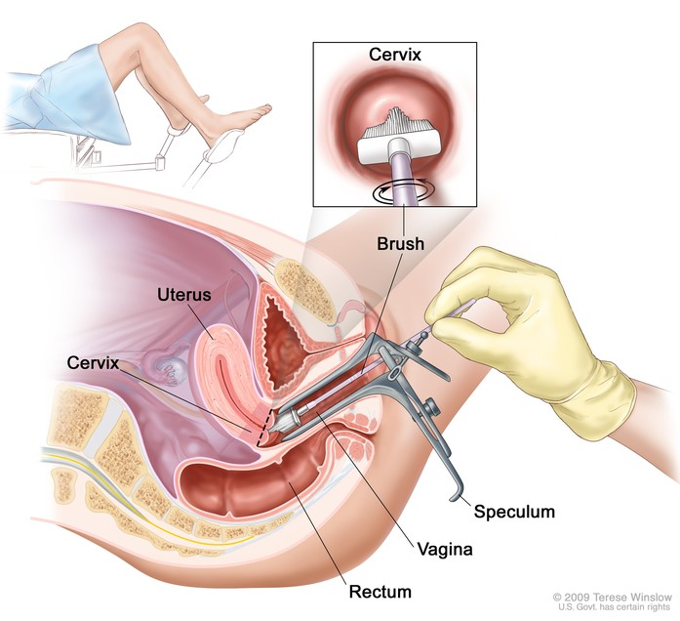
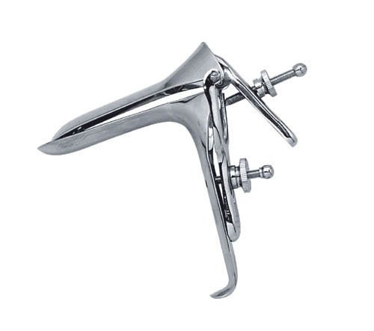
Women should receive an annual PAP test. A doctor removes cells from around the cervix and a lab checks them for abnormalities.
A gynecologist performs this procedure.

Slide 25
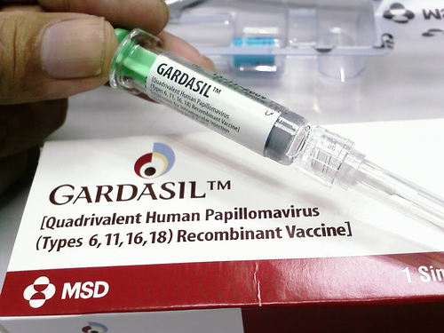
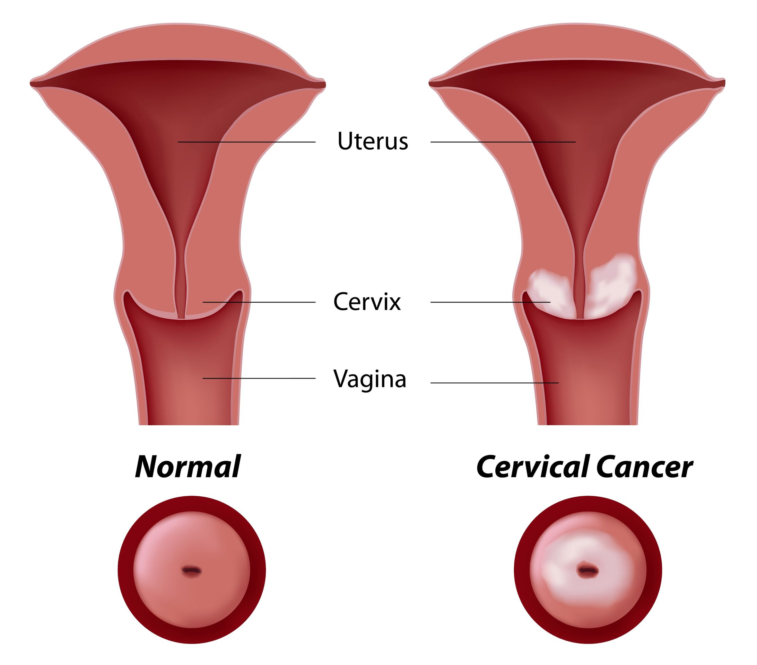
Because HPV infection is so common, most people get HPV infections shortly after becoming sexually active for the first time.
Fortunately, there is a VACCINE, recommended for young girls before they become sexually active.
Source: Cancer.gov
Cervical cancer: Virtually all cases of cervical cancer are caused by HPV, human papillomavirus.

Slide 26
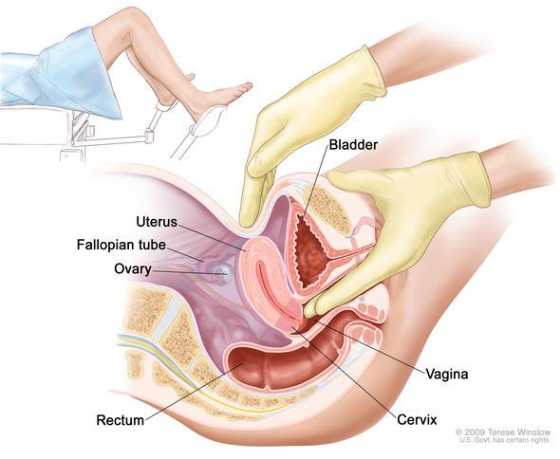
The doctor can also check for abnormalities with the uterus and the bladder.

Slide 27
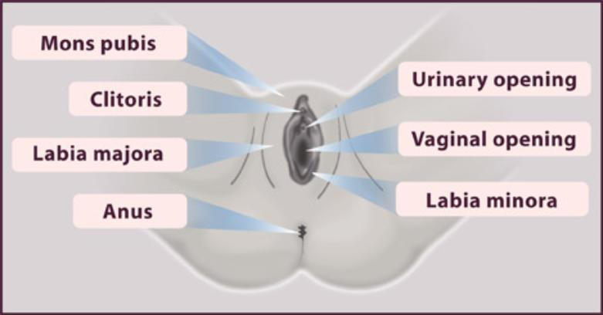
Female External
The hymen is tissue that partially covers the opening of the vagina, often associated with “virginity.” The tissue actually thins and disappears over time and may have stretched during activities other than sex. See “6 Things You Never Knew About Your Hymen” and Adam Ruins Everything
Notes:
https://www.seventeen.com/beauty/a13060975/6-things-you-never-knew-about-your-hymen/

Slide 28
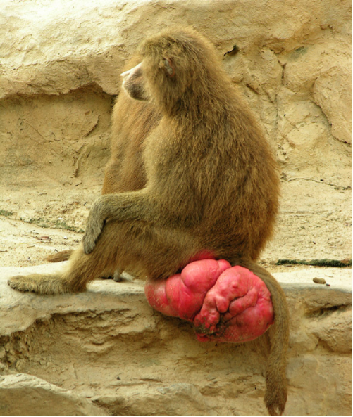
Female Cycles
*Interesting fact – humans are one of the few animals that do not have some kind of visible obvious display of fertility.
Evolutionary biologists suggest this trait evolved as a way to keep males interested for more than just the fertile period, increasing the likelihood of male parental care of offspring.

Slide 29
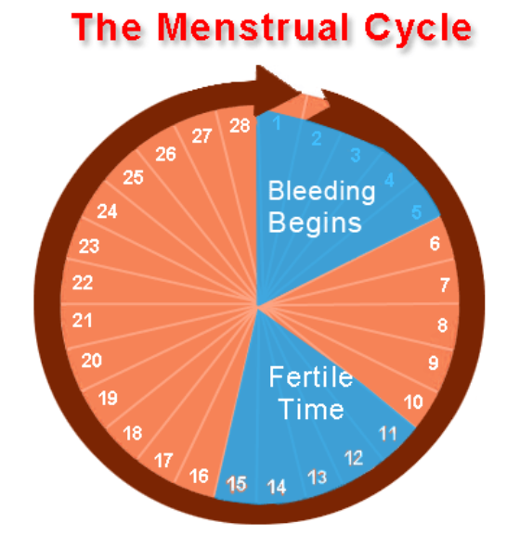
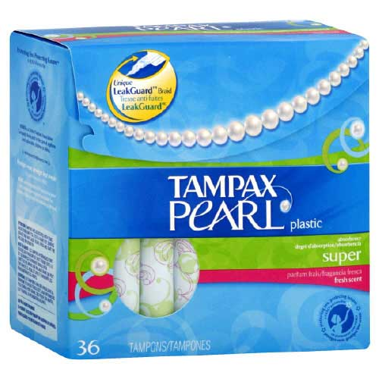


Slide 30
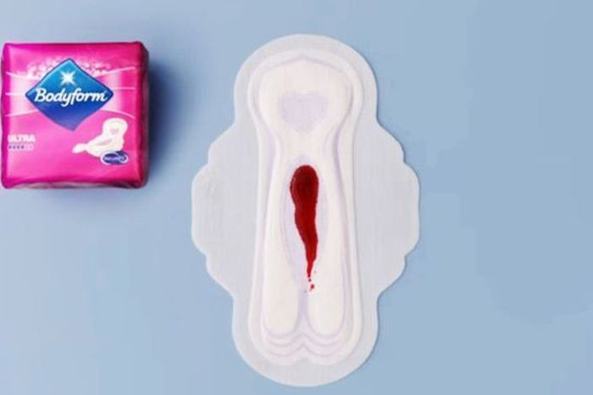
How much blood is normal for a cycle?
Flow of more than 80 ml (or 16 soaked sanitary products) per menstrual period is considered menorrhagia.
the most common amount of menstrual flow (measured in a laboratory from all collected tampons and pads) was about two tablespoons (30 ml) in a whole period -
Some fun words….
Menarche = the start of the menstrual cycle
Menopause = the end of the cycle
Notes:
http://www.cemcor.ubc.ca/resources/very-heavy-menstrual-flow#sthash.wjcJVMdO.dpuf

Slide 31
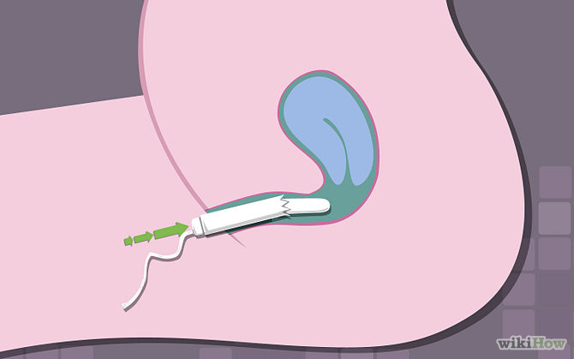
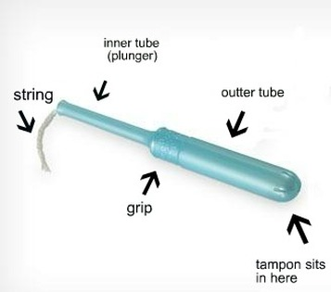
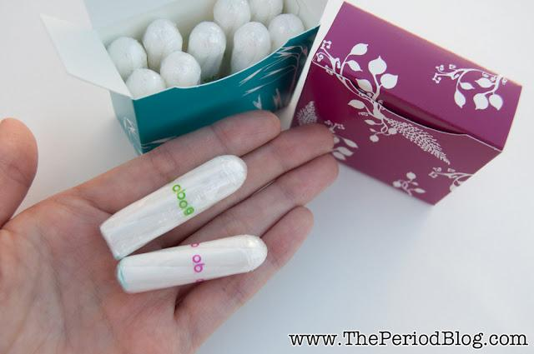

Slide 32
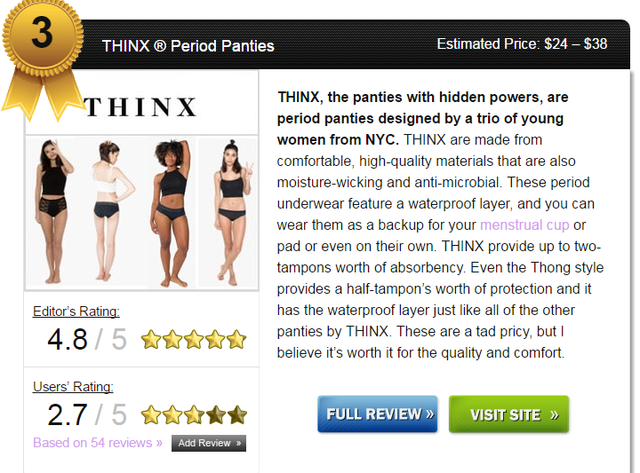
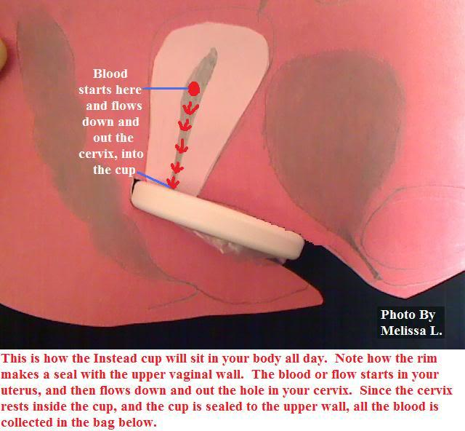
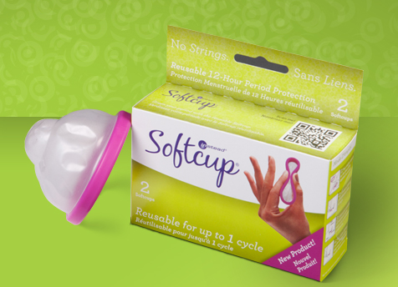
Period panties have an absorbent core. No need for pads or tampons!

Slide 33
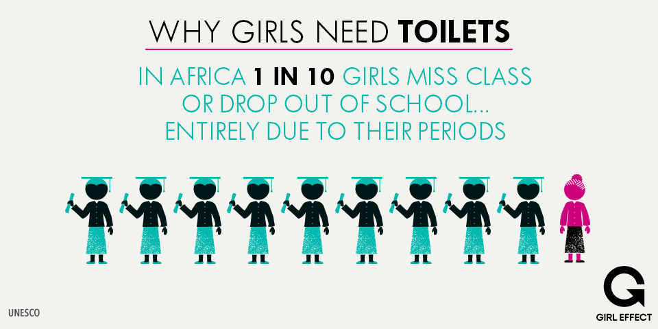
Think about this….

Slide 34
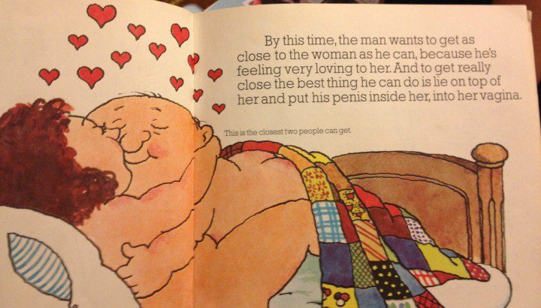

How Are Babies Made?
Excerpt from a 1970’s CHILDREN’s book called “Where Did I come From?”

Slide 35
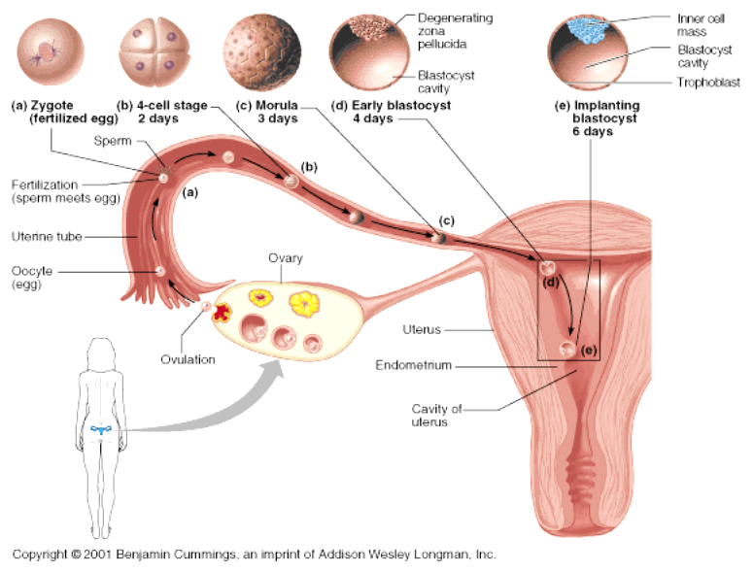
FERTILIZATION normally occurs in the Fallopian Tubes
The fertilized egg (zygote) implants in the uterus

Slide 36
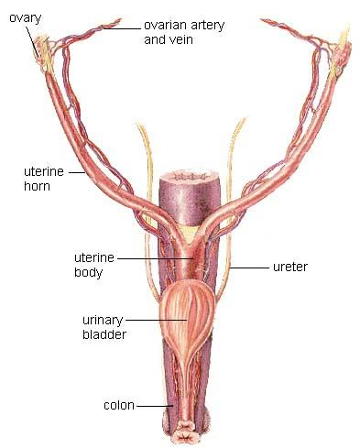
In animals that have a large number of offspring (like cats) the uterus is divided into two uterine horns (the fallopian tubes in humans). Gestation of embryos occurs in these tubes.

Slide 37
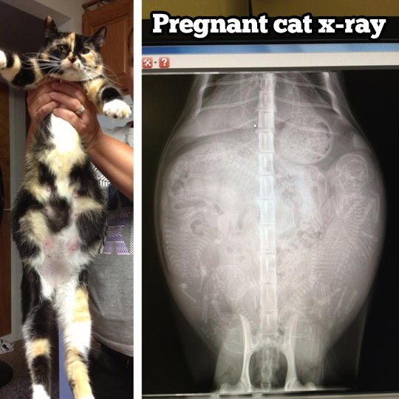
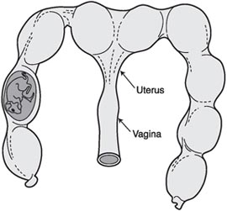

Slide 38


FERTILIZATION & PREGNANCY
Sperm must travel to the egg and penetrate to combine the DNA from both parents -- this creates the first cell after fertilization: the ZYGOTE
23 chromosomes from each parent; zygote has a total of 46 chromosomes

Slide 39

CONCEPTION
Refers to the point at which the egg is fertilized
*Some believe life begins at conception*
Conception can also be a verb
Jane did not have trouble conceiving her first child.
Bob could not conceive of a situation where he would need a parachute.
What does MISCONCEPTION mean?

Slide 40




SEX DETERMINATION

Slide 41


If the zygote has the incorrect number of chromosomes, it may never start growing. An extra chromosome #21 will result in the baby having Down Syndrome.

Slide 42


How does a woman know she is pregnant?
Missed period
Changes in body, tenderness in breasts, nausea…etc
Pregnancy test – tests urine for hormone levels

