Slide 1
Minerals
Chapter 4
Review: What is the formula for density?
Notes:
D=M/V

Slide 2
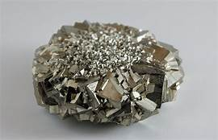
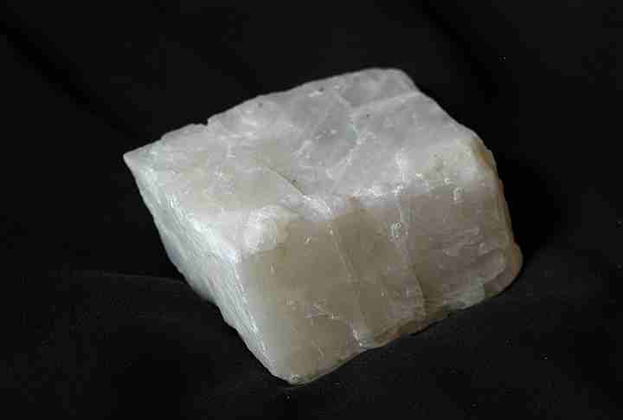
What is a mineral?
A mineral is a naturally occurring, inorganic solid, with a specific chemical composition and a definite crystalline structure.
Earth’s crust is composed of about 3,000 minerals.
Mineral on top is pyrite
Mineral on bottom calcite

Slide 3
Naturally occurring and inorganic
All minerals are inorganic.
They are NOT alive and never WERE alive.
Based on this thought, salt is a mineral, but sugar is not.
WHY?
Because sugar is harvested from a plant! PLANTS are ALIVE!
What about coal? Coal is NOT a mineral either! Because millllllions of years ago it was formed from organic materials.

Slide 4
Definite Crystalline Structure
Atoms in minerals are arranged in regular geometric patterns that are repeated.
This regular pattern results in the formation of a crystal
A crystal is a solid in which the atoms are arranged in repeating patterns.

Slide 5
Solids with specific compositions
The 4th characteristic of minerals is that they are solids.
Reminder: solids have a definite shape and volumes, which liquids and gasses to do not. Therefore, no gas or liquid can be a mineral.
Every minerals chemical composition is unique to each mineral.
Can be single elements or compounds!
Remember our periodic table from chapter 3? Those are elements! Copper, silver, sulfur are all minerals that are composed of only 1 element!

Slide 6
Check in: What are the 4 characteristics of minerals we have discussed so far?
Naturally occurring
Solids with specific compositions
Definite Crystalline Structure
Inorganic

Slide 7
Rock-Forming Minerals
8-10 of the 3,000 minerals in earth’s crust are referred to as rock-forming minerals because they make up most of the rocks in Earth’s crust.

Slide 9
Minerals from magma
The type and number of elements present in the magma determine the size of the mineral crystals.
If the magma cools slowly within Earth’s heated interior, the atoms have time to arrange themselves into larger crystals.
If the magma reaches Earth’s surface, comes in contact with air and water, and cools quickly, the atoms do not have time to arrange themselves into large crystals.
Therefore…
slow cooling magma = large crystals
fast cooling magma = small crystals

Slide 10
Identifying minerals
It is best to use a combination of tests to determine the identity of materials
Crystal form: some minerals form a very distinct crystal shape that they are immediately recognizable. However, perfect crystals are not always formed so we rely on other methods to identify them.
Luster: The way that a mineral reflects light from its surface.
Two types of luster: metallic luster (shiny) and nonmetallic (dull or waxy) luster.

Slide 11
Identifying minerals:
Hardness: a measure of how easily a mineral can be scratched.
One of the most useful and reliable tests for identifying minerals.
Mohs Sale of Hardness is used to rank hardness of minerals.
A mineral that can be scratched by your fingernail has a rating of 2.5 or less. A mineral that scratches glass has a hardness greater than 5.5.

Slide 12
Identifying mineralS:
A mineral that splits relatively easily and evenly along one of more flat places is said to have cleavage.
Minerals break along planes where atomic bonding is weak.
Minerals that break with rough or jagged edges have fractures.
Streak is the color of a mineral when it is broken up and powdered. The streak of a nonmetallic mineral is usually white. This is helpful when identifying metallic minerals. Sometimes streak does not match the minerals external color.
The streak test can only be done on minerals that are softer than a porcelain plate.

Slide 13
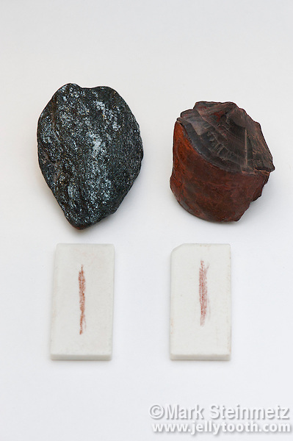
Streak example: Hematite. Both of these minerals are the same – Hematite.
Using your text book, turn to page 93 and tell me why there is a difference in appearance, but the streak is the same. Explain below:
Notes:
Hematite occurs in 2 diff forms. Hematite that forms from Weathering and Exposure to air and water is a rusty red color and has an earthy feel. Hematite that forms from crystallization of magma can be silver and metallic in appearance. However, they both create a reddish-brown streak when tested.

Slide 14
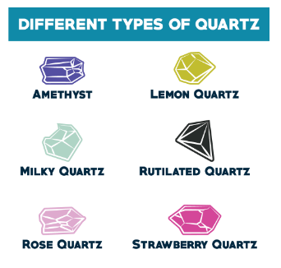
Identifying Minerals:
Color is one of the most noticeable characteristics of a mineral. Color is sometimes caused by the presence of trace elements or compounds within a mineral.
Example: Quartz. Different colors = different trace elements.

Slide 15
Identifying minerals:
Special properties can also be used to identify minerals.
Magnetism, iridescence, double refraction, etc.
Texture describes how a mineral feels to the touch.
This method, like luster, is a subjective viewpoint.
Descriptive words for texture include: greasy, rough, smooth, ragged, soapy.
Density and specific gravity:
Sometimes two minerals that are the same size have different weights. Differences in weight are a result of differences in density. What is the formula for density?
Most common measure of density is specific gravity (the ratio of the mass of a substance to the mass of an equal volume of water at 4 degrees C).

Slide 16
Review:
What are the ways to identify a mineral?
Notes:
Luster, cleavage and fracture, texture, density/specific gravity, special properties, streak, color, hardness, crystal form.

Slide 17
Homework: Questions 1 & 2 from pg. 95 in complete sentences

Slide 18
Section 2: Types of minerals

Slide 19
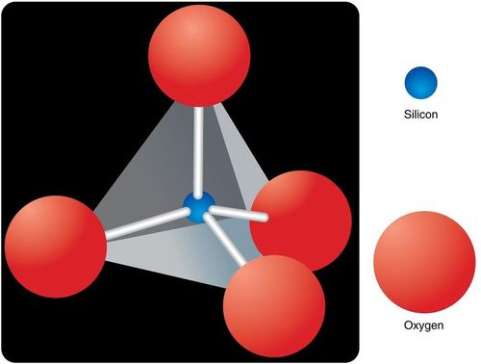
Mineral groups
In order to study minerals, scientists have classified them into different groups.
Silicates: Minerals that contain silicon and oxygen and usually one or more additional element
96% of minerals in Earth’s crust
Feldspar and Quartz are silicates
Silicon-oxygen tetrahedron = building block
Tetrahedron: a geometric solid having four sides that are equilateral triangles, resembling a pyramid.

Slide 20
Mineral Groups:
Carbonates: minerals composed of one or more metallic elements and the carbonite ion.
Examples: calcite and dolomite
Primary minerals found in rocks such as limestone and marble.
Oxides: compounds of oxygen and a metal
Examples: Hematite and magnetite
Other groups: Other major mineral groups are sulfides, sulfates, halides, and native elements.

Slide 21
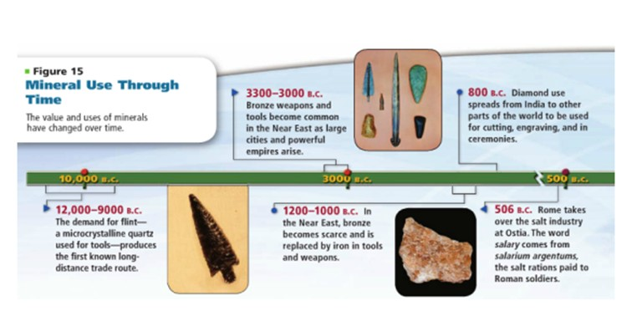
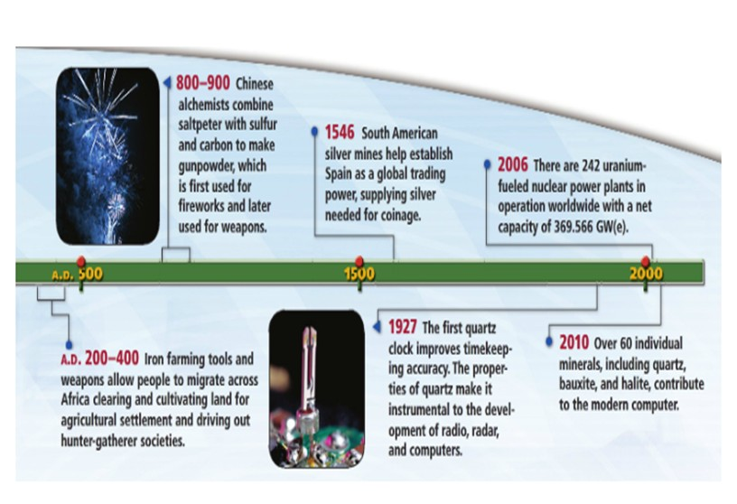
History of mineral use
Notes:
Draw your own timeline in your notes on page 98

Slide 22
Economic Minerals
Ore: a mineral that contains a valuable substance that can be mined for profit.
Example: the graphite in your pencil –lead!
The classification of a mineral as an ore can vary depending on supply and demand.
Ores are located deep within earth’s crust and are removed via underground mining. Ores that are near Earth’s surface are obtained from open-pit mines.
Gems are valuable minerals that are prized for their rarity and beauty.
Hard and scratch resistant
Because of their rareness – rubies and emeralds are more valuable than diamonds!

