Slide 1
Tundra
Cold, treeless biome with low-growing vegetation. In winter, the soil is completely frozen.
The tundra's growing season is very short, usually only about 4 months during summer.
The underlying subsoil, known as permafrost is an impermeable, permanently frozen layer that prevents water from draining and roots from penetrating.

Slide 2
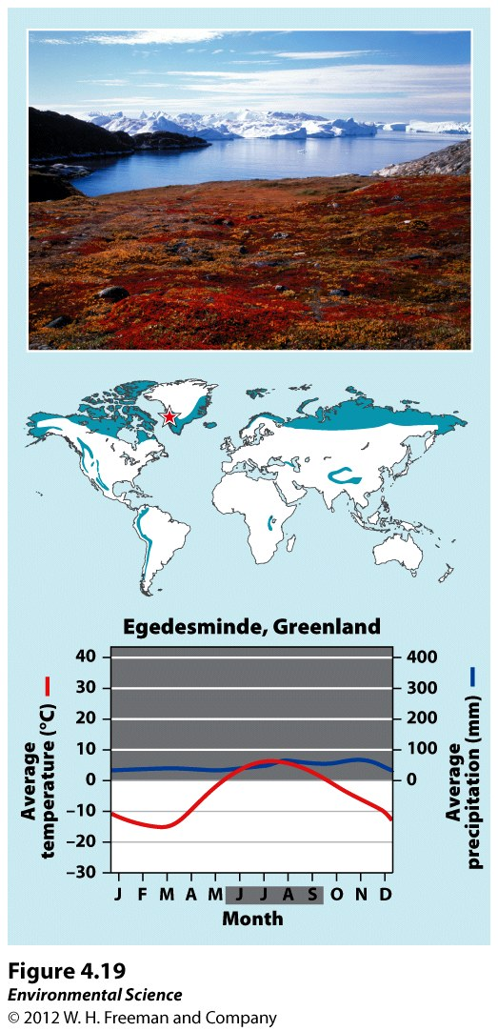
Tundra

Slide 3
Boreal Forest
Forests made up primarily of coniferous (cone-bearing) evergreen trees that can tolerate cold winters and short growing seasons.
Boreal forests are found between about 50˚ and 60˚ N in Europe, Russia and North America.
This subarctic biome has a very cold climate, and plant growth is more constrained by temperature than precipitation.
The soil is nutrient-poor due to slow decomposition.

Slide 4
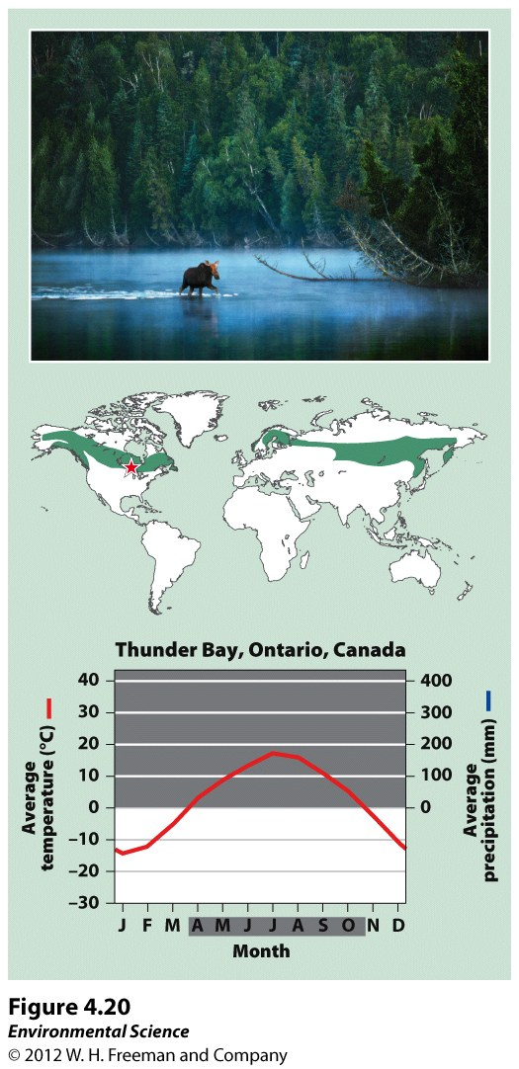
Boreal Forest

Slide 5
Temperate Rainforest
Moderate temperatures and high precipitation typify the temperate rainforest.
The temperate rainforest is a coast biome and can be found along the west coast of North America from northern California to Alaska, in southern Chile, on the west coast of New Zealand, and on the island of Tasmania.
The ocean currents help moderate temperature fluctuations and provide a source of water vapor.
This biome has a nearly 12-month growing season where winters are rainy and summers are foggy.
The mild temperatures and high precipitation supports the growth of very large trees.

Slide 6
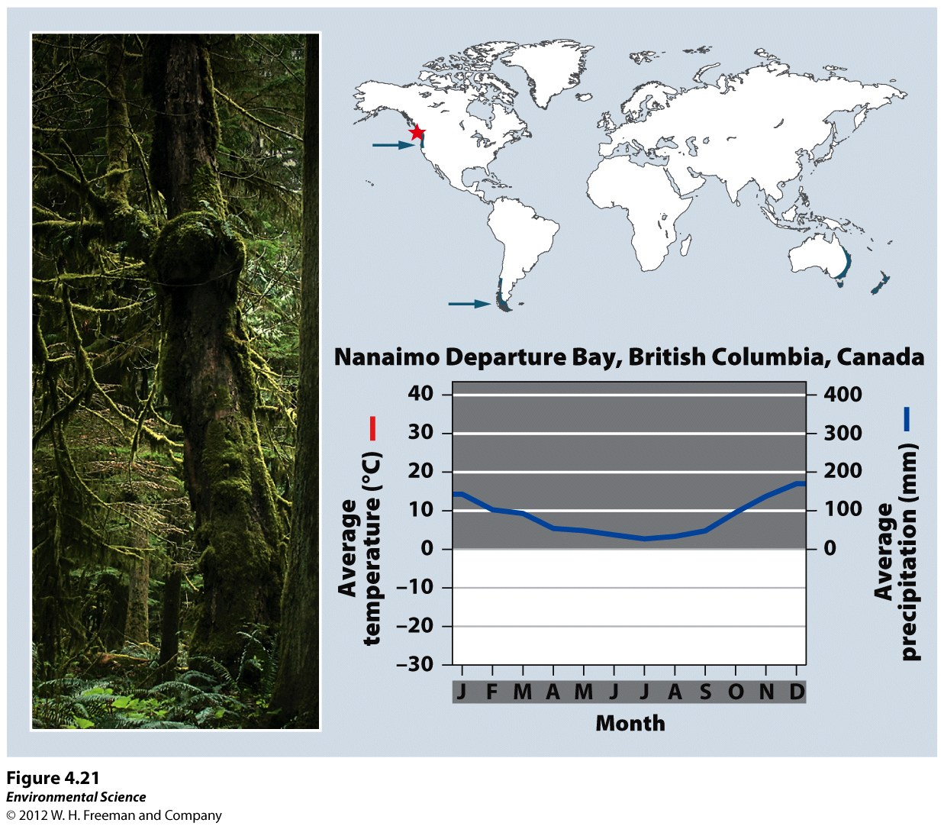
Temperate Rainforest

Slide 7
Temperate Seasonal Forest
Receive over 1 m (39 inches) of precipitation annually.
Found in the eastern United States, Japan, China, Europe, Chile and eastern Australia.
Dominated by broadleaf deciduous trees such as beech, male, oak and hickory.
Warmer summer temperatures favor decomposition so soils generally contain more nutrients than those of boreal forests.

Slide 8
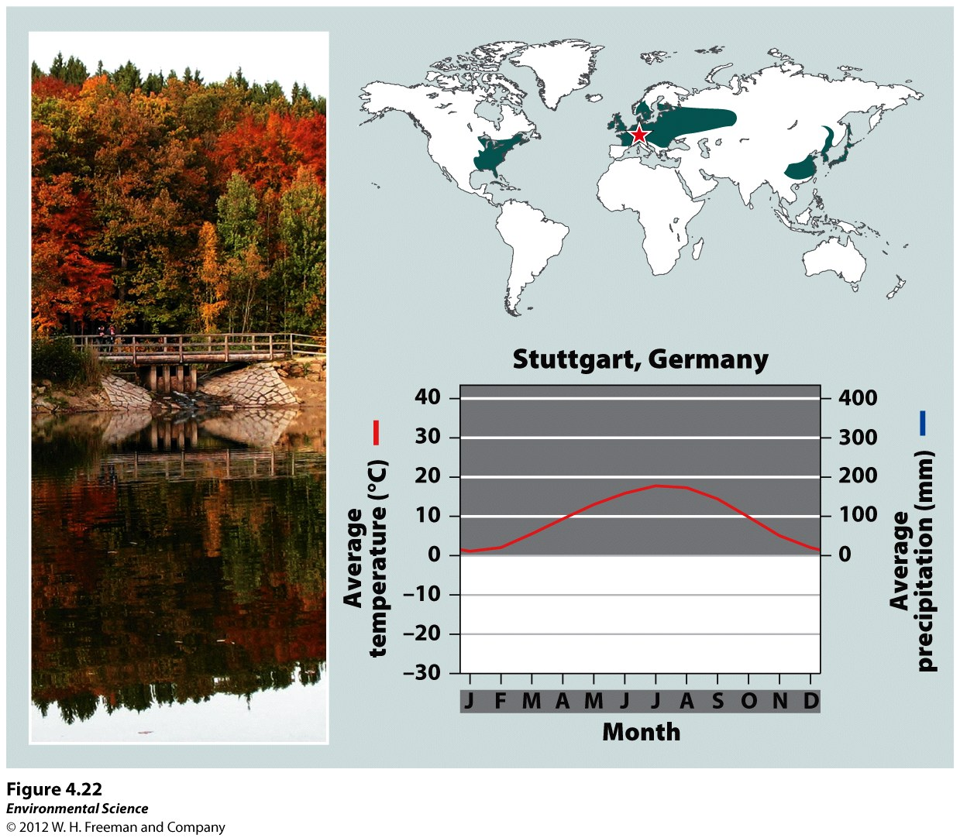
Temperate Seasonal Forest

Slide 9
Woodland/Shrubland
Found on the coast of southern California, southern Australia, southern Africa and in the area surrounding the Mediterranean Sea.
Hot, dry summers and mild, rainy winters are characteristic of this biome.
There is a 12-month growing season, but plant growth is constrained by low precipitin in summer and by relatively low temperatures in winter.
Wildfires are common and plants of this biome are well adapted to both fire and drought.

Slide 10
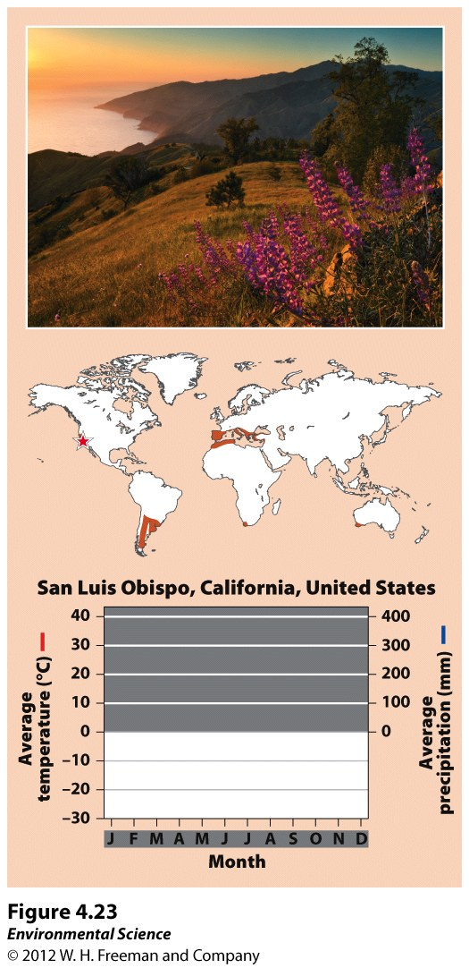
Woodland/Shrubland

Slide 11
Temperate Grassland/Cold Desert
This biome has the lowest average annual precipitation of any temperate biome.
These are found in the Great Plains of North America, in South America, and in central Asia and eastern Europe.
Cold, harsh winters and hot, dry, summers characterize this biome.
Plant growth is constrained by both insufficient precipitation in summer and cold temperatures in winter.
Plants include grasses and non woody flowering plants that are well adapted to wildfires and frequent grazing by animals.

Slide 12
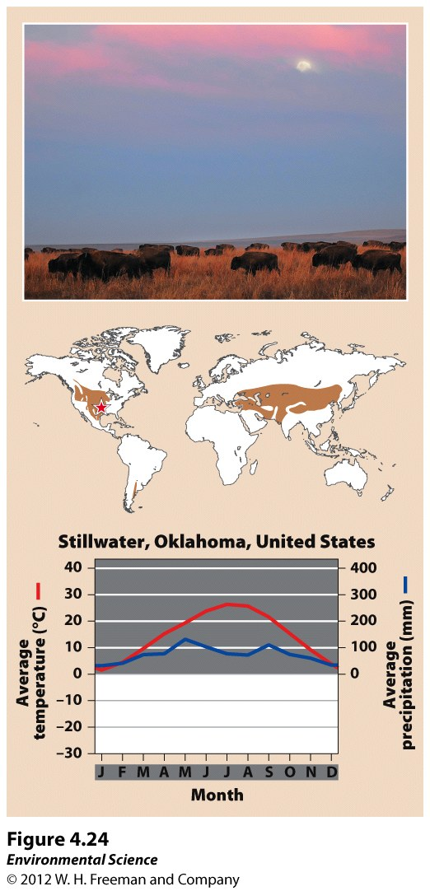
Temperate Grassland/Cold Desert

Slide 13
Tropical Rainforest
In the tropics, average annual temperatures exceed 20˚C.
This biome is located approximately 20˚ N and S of the equator.
They are found in Central and South America, Africa, Southeast Asia, and northeastern Australia.
Precipitation occurs frequently and this biome is warm and wet with little temperature variation.
Tropical rain forests have more biodiversity per hectare than any other terrestrial biome and contain up to two-thirds of Earth's terrestrial species.

Slide 14
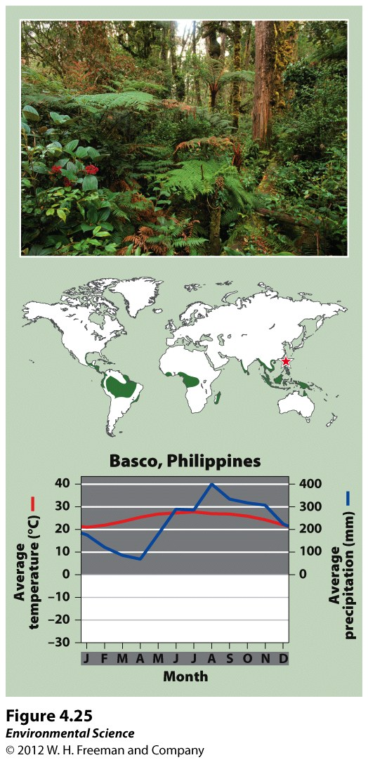
Tropical Rainforest

Slide 15
Tropical Seasonal Forest/Savanna
Warm temperatures and distinct wet and dry seasons characterize this biome.
Tropical seasonal forests are common in much of Central America, on the Atlantic coast of South America, in southern Asia, in northwestern Australia, and in sub-Saharan Africa.
Soil in this biome is fairly fertile and can be farmed due to high decomposition rates, but the low amount of precipitation constrains plants from using the soil nutrients that are released.
Grasses and scattered deciduous trees are common.

Slide 16
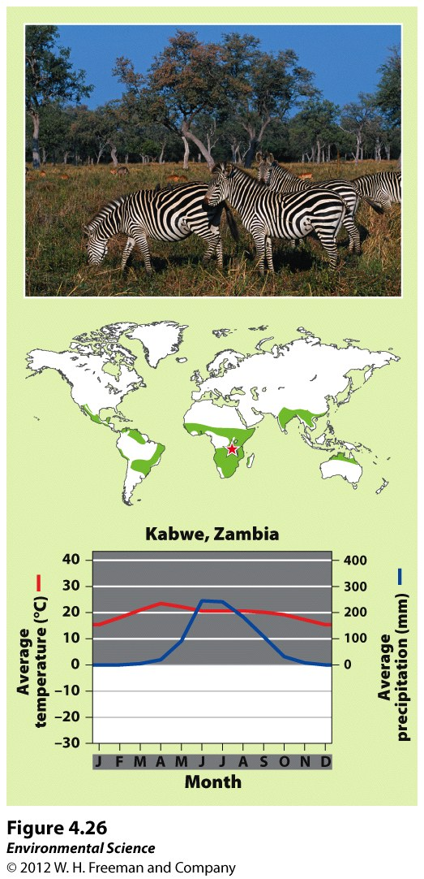
Tropical Seasonal Forest/Savanna

Slide 17
Subtropical Desert
This biome is found at 30˚ N and S with hot temperatures and extremely dry conditions.
The Mojave Desert in the southwestern United States, the Sahara in Africa, the Arabian Desert of the Middle East and the GReat Victoria Desert of Australia are all subtropical deserts.
Cacti, euphorbs and succulent plants are well adapted to this biome.

Slide 18
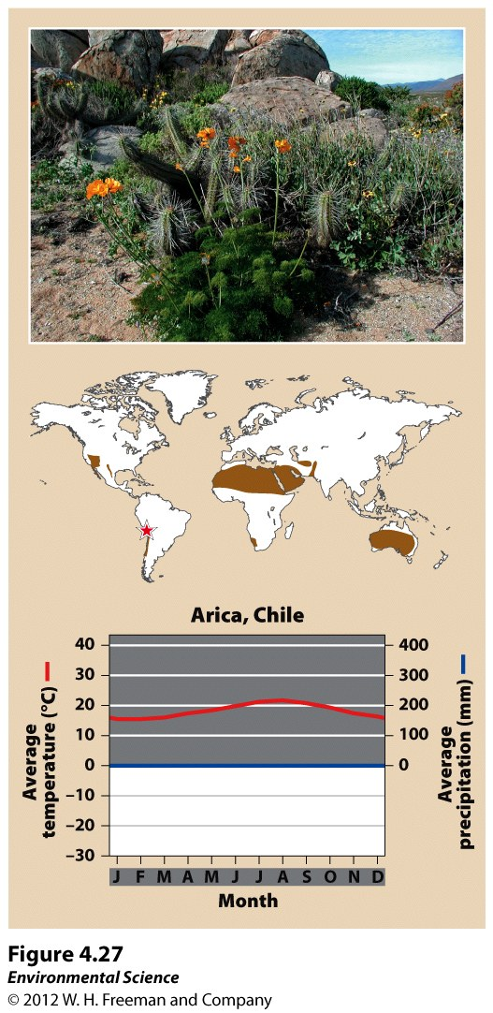
Subtropical Desert

