Slide 1
Igneous Rocks
Igneous comes from the Latin word, ignis, meaning fire

Slide 2
Igneous Rocks
Rocks that form when molten material (lava or magma) cools & crystallizes.

Slide 3
Lava vs. Magma
Lava: molten rock that flows out onto Earth’s surface.
Magma: molten rock below Earth’s surface

Slide 4
Magma Composition
Type of igneous rock that forms depends on composition of magma
Magma is often a slushy mix of molten rock, dissolved gases, and mineral crystals.
Common elements in magma: Oxygen, silicon, Aluminum, Iron, magnesium, calcium, potassium, and sodium.
Silica (SiO₂) is the most abundant & has the most effect on magma characteristics. It affects melting temperature & how quickly it flows.

Slide 5
Table 1 on page 112
Classification of Magma
Group | Silica Content | Example Location

Slide 6
Partial Melting
Not all parts of rock melt at the same temperature.
The process where some minerals melt at relatively low temperatures while other minerals remain solid is know as partial melting.
Can change magma composition

Slide 7
Fractional Crystallization
Similar to partial melting, since the composition of magma can change.
When magma cools, it crystallizes in the reverse order of partial melting. That is, the first minerals to crystallize from magma are the LAST to melt.

Slide 8
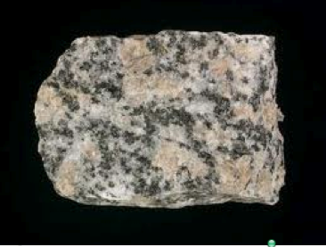
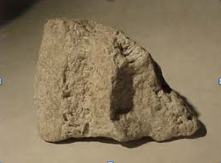
Classification of Igneous Rocks
Intrusive Rocks: magma cools &
crystallizes below Earth’s surface
-Crystals are generally large enough to see without magnification
2. Extrusive Rocks: Magma that cools
and crystallizes on Earth’s surface
-Crystals that form in these rocks are small & difficult to see without magnification

Slide 9
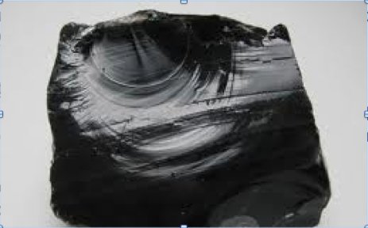
Texture of Igneous Rocks
Texture refers to the size, shape, & distribution of the crystals or grains that make up a rock.
Crystal Size & Cooling Rates:
When lava flows on Earth’s surface, it cools quickly & there is not enough time for large crystals to form.
Sometimes cooling occurs so quickly that crystals do not form. The result is volcanic glass (ex. obsidian).
When magma cools slowly beneath Earth’s surface, there is sufficient time for large crystals to form.

Slide 10
Porphyritic Texture
Characterized by large, well-formed crystals surrounded by finer-grained crystals of the same mineral or different minerals.
Started to cool quickly, but then it sped up.
Basalt is a great example

Slide 11
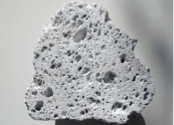
Vesicular Texture
Spongy appearance (ex. Pumice)
Magma contains dissolved gases that escape; however, quickly cooled lava contains trapped gases. When the lava hardens, the spaces (or vesicles) that remain are from the previously trapped air bubbles.

Slide 12
Igneous Rocks as Resources
Pegmatites: vein deposits of extremely large-grained minerals that can contain rare ores
Used in the construction of Mt. Rushmore.
Kimberlites: rare, ultramafic rock that can contain diamonds and other minerals formed only under very high pressures.
Contains diamonds!

Slide 13
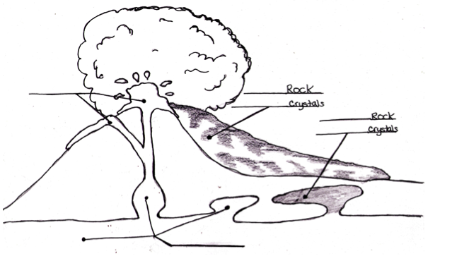
Label & color-code your diagram
Magma
Lava
Intrusive Rock
Extrusive Rock
Large slow forming crystals
Small crystals/no crystals

