Slide 1
Evolution by Random Processes
Mutation- occur randomly and can add to the genetic variation of a population.
Genetic drift- change in the genetic composition of a population over time as a result of random mating.
Bottleneck effect- a reduction in the genetic diversity of a population caused by a reduction in its size.
Founder effect- a change in a population descended from a small number of colonizing individuals.
Gene Flow: The process by which individuals move from one population to another and therefore alter the genetic composition of both populations.
Notes:
P 159 (my book) Make a concept map.
Separate into 5 groups.
Each group make a concept map of random processes; 1 term is assigned per group to explain the significance of the process.
Everyone needs to write it down.
Have other groups fill in the random processes

Slide 2
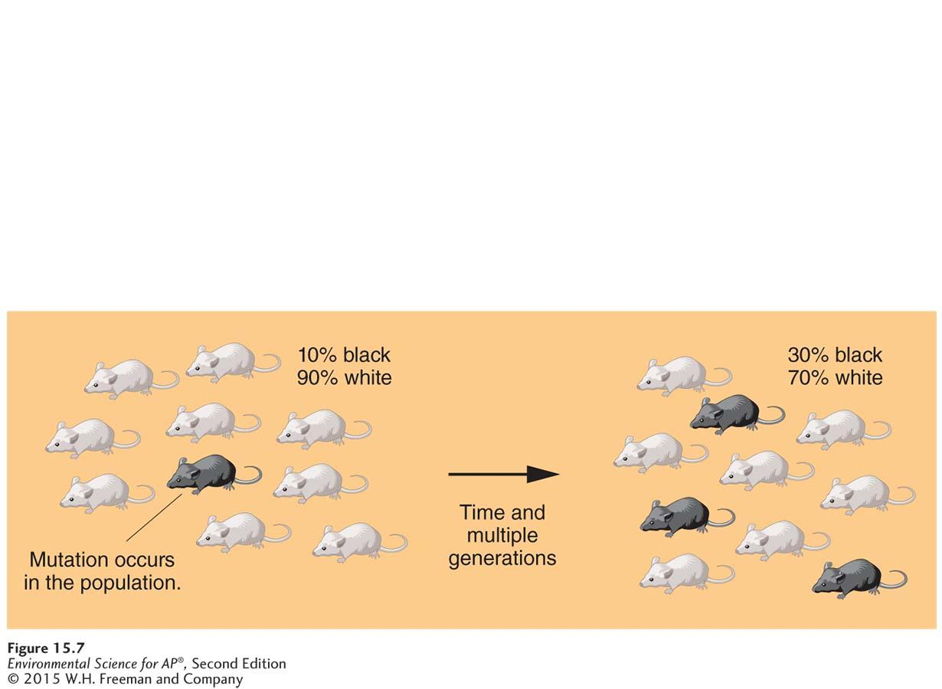
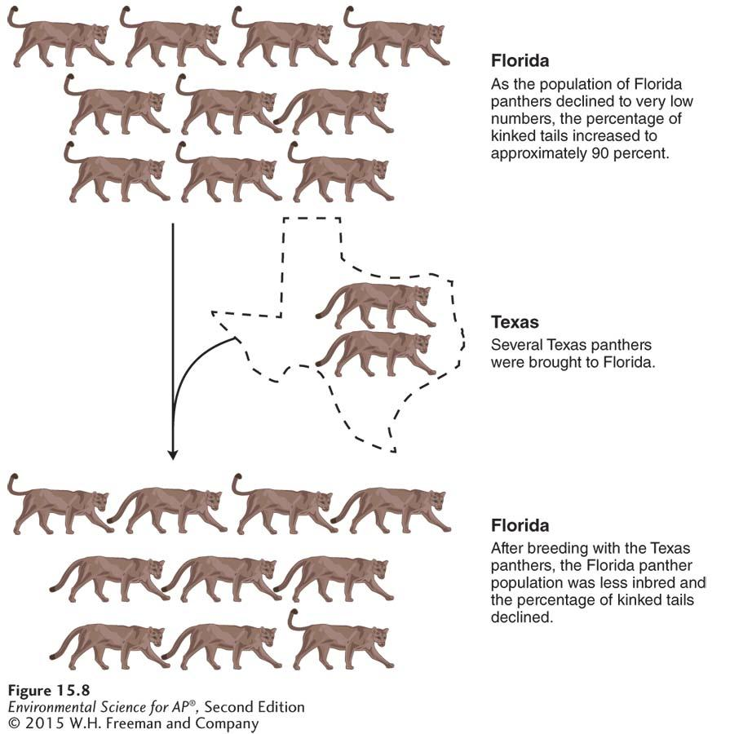
If a mutation is not lethal, it can add to genetic variation.
Gene Flow. As the Florida panther declined in population size, the animals experienced low gene flow. Which led to inbreeding and health defects. USF&WS introduced 8 panthers from Texas to Florida. The defects decreased and the population increased from 30 to 160.

Slide 3
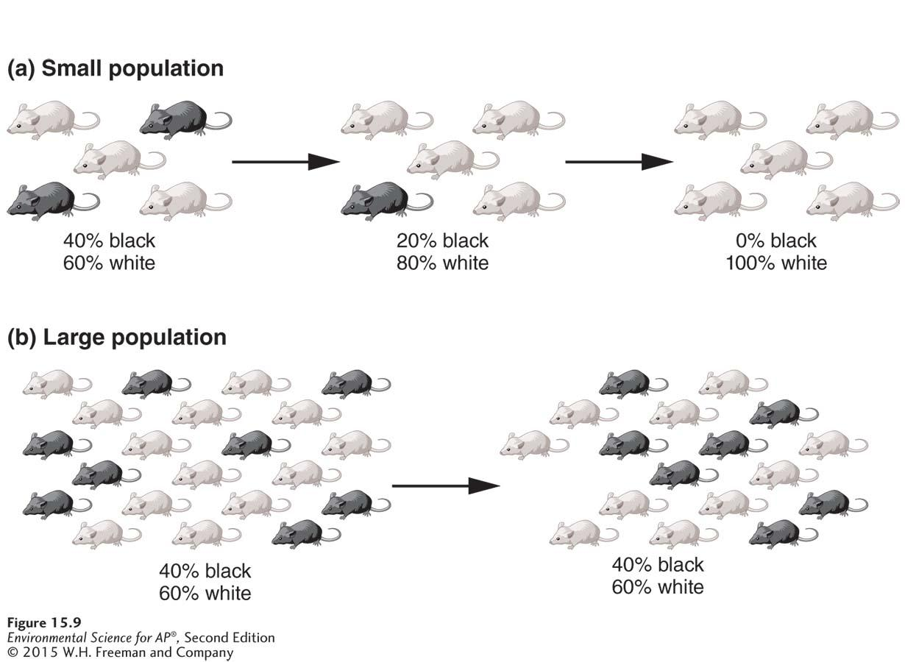
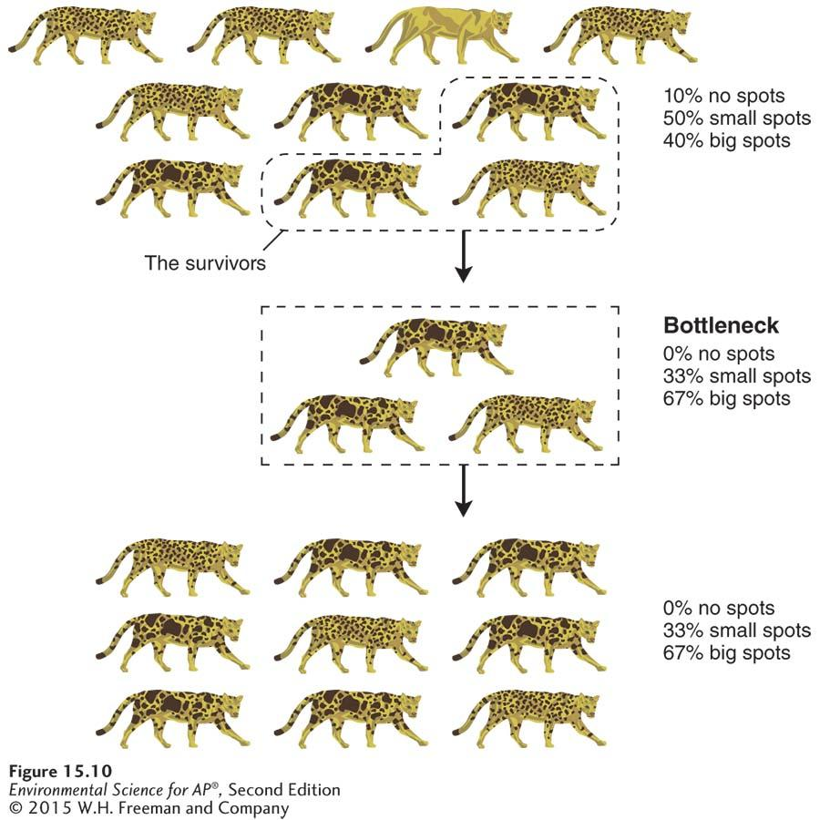
Genetic Drift
In small populations, less-common genotypes can be lost by random mating. Therefore, the genetic composition can change over time. In a large population (B) it is more difficult for less-common genotypes to be lost
Bottleneck Effect
If a population experiences a drastic decrease, some genotypes will be lost & genetic composition of survivors will be different from originals.

Slide 4
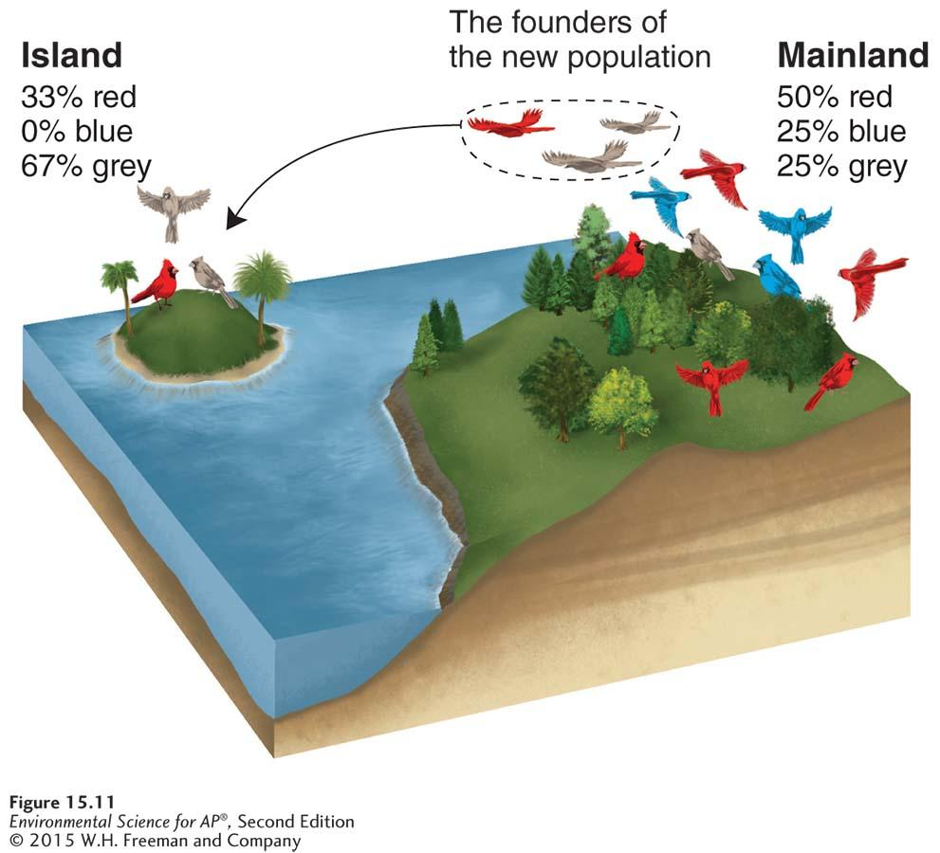
Founders Effect
If a few individuals from a mainland population colonize an island, the genotypes on the island will represent only a subset of the genotypes present in the mainland population.

Slide 5
Module 15 review
Which evolutionary effect results in reduce genetic variation in a community?
  Mutation, gene flow, artificial selection, the founder effect, or natural selection

Slide 6
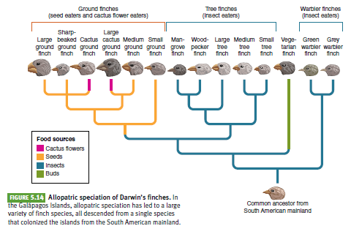
Speciation and extinction determine biodiversity
Allopatric speciation- when new species are created by geographic or reproductive isolation.

Slide 7
Sympatric speciation- the evolution of one species into two species in the absence of geographic isolation, usually through the process of polyploidy, an increase in the number of sets of chromosomes.

Slide 8
Most organisms are diploid- they have 2 sets of chromosomes. In polyploidy, the # of chromosomes increases to 3, 4 or 6 sets.
Generally with polyploid organisms, they cannot breed with their diploid ancestors. They become reproductively isolated and are therefor distinct species.

Slide 9
The pace of evolution

Slide 10
Evolution occurs rapidly in genetically modified organisms.
Why?
Notes:
Inserting genes into an organisms is a much faster way to produce desired traits than traditional plant and animal breeding, which can only select from the naturally available variations in a population. Page 167

Slide 11
Module 16 review
What is the cause of sympatric speciation?
Notes:
-polyploidy

Slide 12
Evolution shapes ecological niches and determines species distributions
Range of tolerance- all species have an optimal environment in which it performs well. The limit to the abiotic conditions they can tolerate is known as the range of tolerance.
Fundamental niche- the abiotic conditions under which a species can survive, grow, and reproduce.

Slide 13
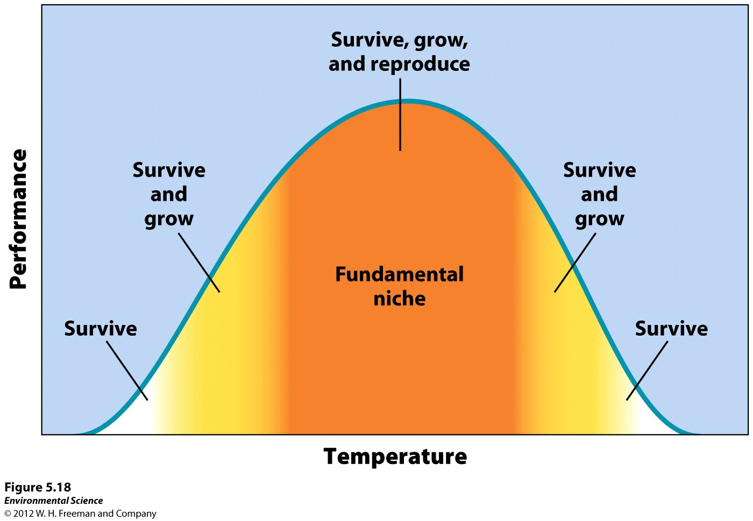
Notes:
Range of tolerance

Slide 14
Niches
Realized niche- the range of abiotic and biotic conditions under which a species lives. This determines the species distribution, or areas of the world where it lives.
Niche generalist- species that live under a wide range of conditions.
Niche specialist- species that live only in specific habitats.

Slide 15
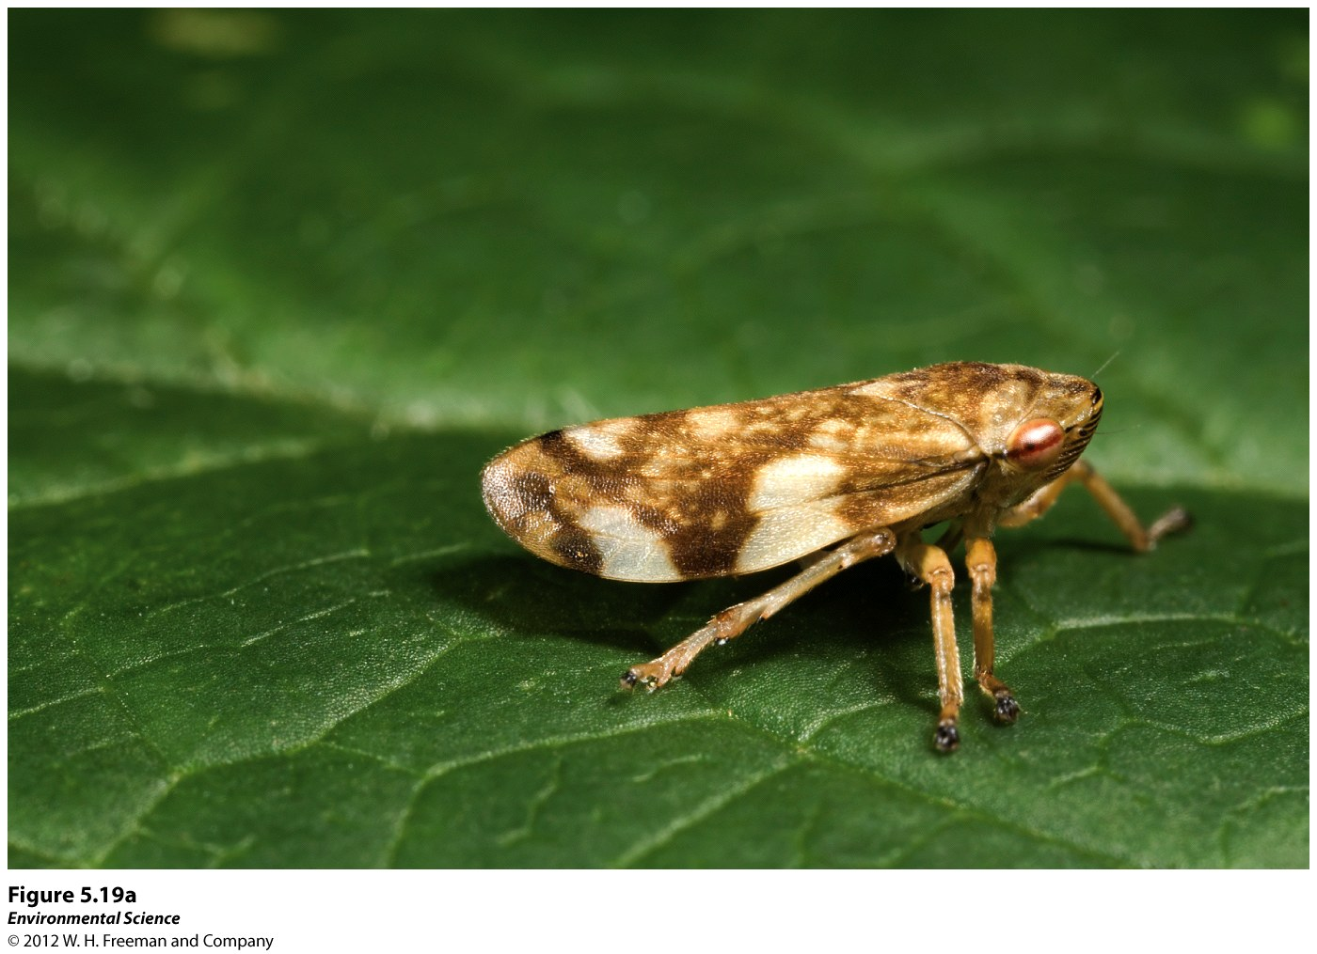
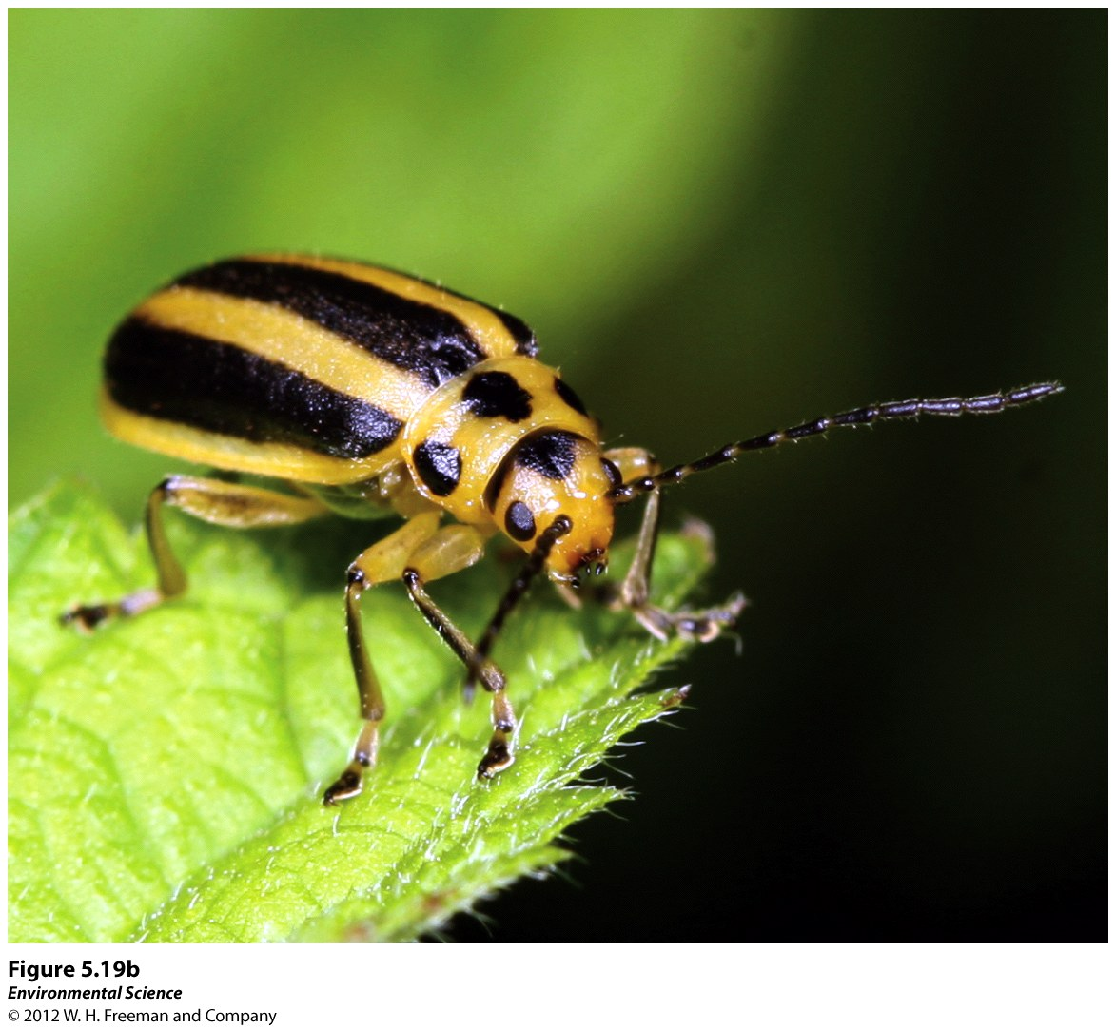
Notes:
Page 170
(left) the meadow spittlebug is a niche generalist that has a broad diets and habitat preference
(right) the skeletonizing leaf beetle, niche specialist with narrow diet and highly specific habitat

Slide 16
Environmental change can cause species extinction
If a species cannot adapt to the changes, they will die
Even if there is another alternative environment for the species to move to, it may already be occupied by a competitor or predator.

Slide 17
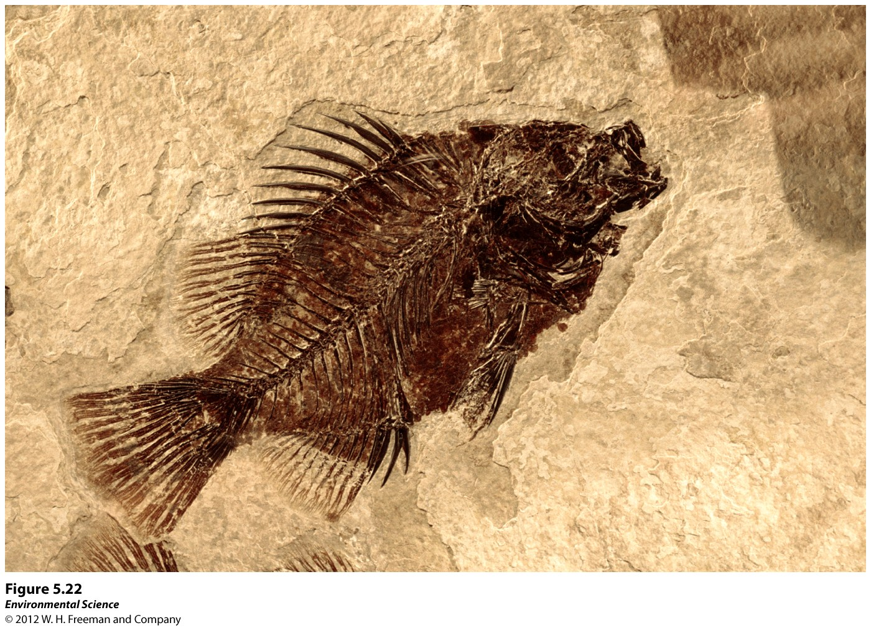
The Fossil Record
Fossils- remains of organisms that have been preserved in rock. Much of what we know about evolution comes from the fossil record.

Slide 18
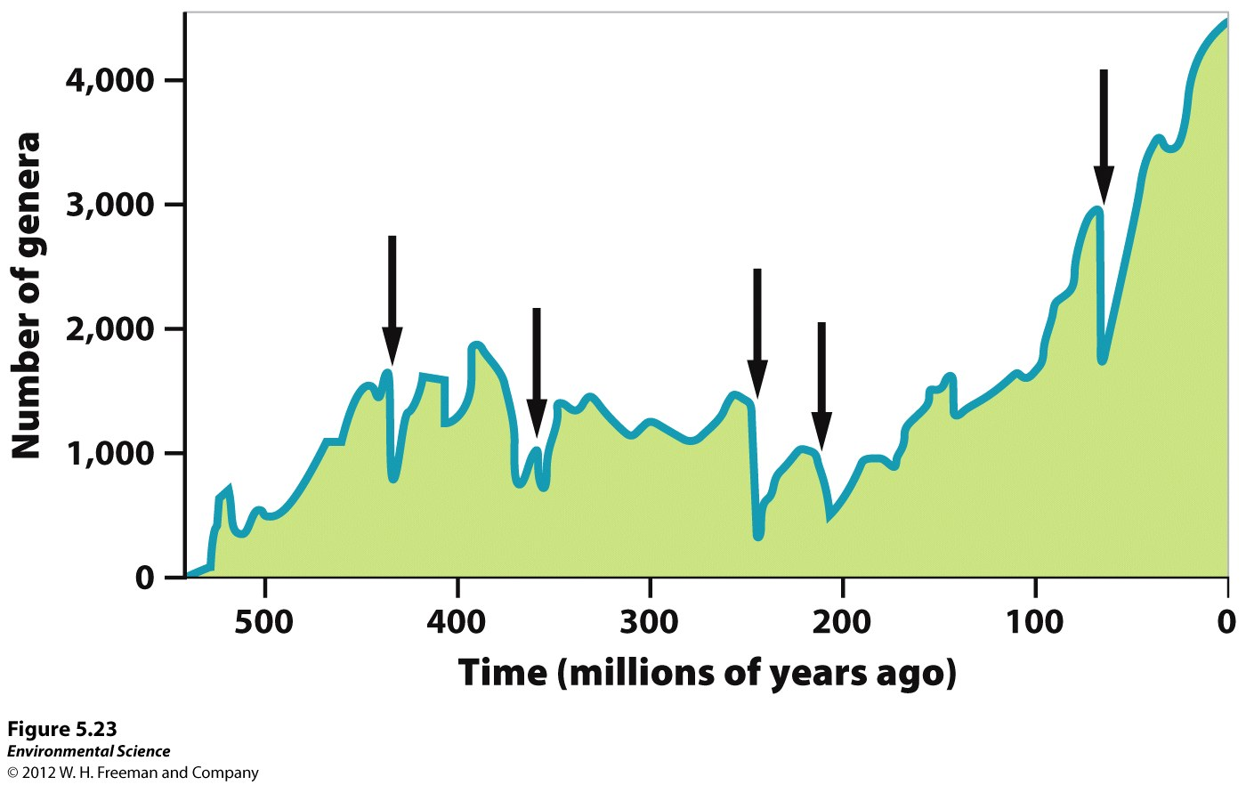
The Five Global Mass Extinctions
Mass extinction- when large numbers of species went extinct over a relatively short period of time.

Slide 19
The Sixth Mass Extinction
Scientists feel that we are in our sixth mass extinction, occurring in the last two decades.
Estimates of extinction rates vary widely, from 2 % to 25% by 2020.
In contrast to previous mass extinctions, scientists agree that this one is caused by humans.
Notes:
What human activities have lead to this 6th mass extinction?
Habitat destruction, overharvesting, climate change, introduction of invasive species, and emergent diseases.

Slide 20
REVIEW
What is the abiotic conditions under which a species can survive and reproduce is what?
Notes:
Fundamental niche

Slide 21
IUCN Red List
https://www.iucnredlist.org/
Create a poster or presentation describing an animal from the “red list” – endangered or critically endangered
  Include picture, where it lives, what it eats and why it is on the list
  List 5 actions that could help protect this animal.
  Due Friday November 30th

