Slide 1
Chapter 8
Mass Movements, Wind, and Glaciers

Slide 2
8.1 Mass Movements
Mass movement is the downward transportation of weathered materials by gravity
Most of the Earth’s surfaces are sloped, therefore “mass movements” occur almost everywhere.

Slide 3
Factors that influence mass movement
Climate
Composition of the earth material
Weight of the material
Friction
Triggers (an earthquake, for example, that can shake material loose)
Water/rainfall: increases weight and decreases friction

Slide 4
Types of Mass Movements
Creep
Flows
Slides
Slumps
Falls

Slide 5
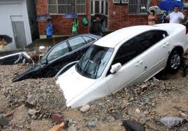
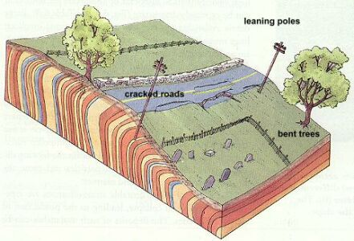
Creep
slow and steady movement of soil down a slope—causes poles, fence posts to lean downhill.
Flows
Earthflow—a mass of weathered material that has been saturated with water flows downhill.
Mudflow—the rapid movement of water that contains large amounts of clay and silt.

Slide 6
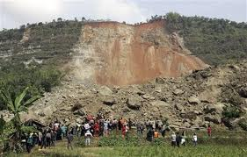
Slides A rapid, downslope movement of Earth materials that occurs when a relatively thin block of soil, rock, and debris separates from the underlying bedrock is called a landslide.

Slide 7
Types of Landslides
Slumps
Avalanches
When the mass of material in a landslide moves along a curved surface, a slump results.
Leave distinct crescent-shaped scars on hillsides
Landslides that occur in mountainous areas with thick accumulations of snow.
About 10,000 avalanches occur in the mountains each year in the western US.
Vibrations from a single skier can trigger an avalanche.
Most common at angles 30-45 degrees

Slide 8
Review
What is the main underlying force behind all mass movement?
Notes:
Gravity

Slide 9
8.2 WIND

Slide 10
Wind Erosion
Moving air can transport sediment
Suspension – when winds causes small particle to be air borne for long distances
Saltation - bouncing motion of sand particles
Precipitation limits wind erosion:
Precipitation promotes plant growth that anchors sediment
Moist soil is not carried as easily by wind

Slide 11
Wind Erosion
Abrasion:
The wearing away of materials through constant pounding of wind-driven sediments.
Ventifacts: rocks that have been shaped by windblown sediments.
Deflation:
The lowering of land surface that results from the removal of surface particles.

Slide 12
Abrasion and Deflation

Slide 13
Wind Deposition
When wind velocity decreases, particles are deposited.
Dunes: piles of windblown sand
Windward side is not as steep as the leeward side
Wind causes dunes to move (“migrate”)
Loess: thick windblown silt deposits.
Loess soils are very fertile due to abundant nutrients and minerals.
Notes:
On paper, there is a drawing of a dune. Students should use this time, and their textbook page 204 to label windward and leeward sides of dune.

Slide 15
Use page 205 to make a table describing the 4 types of dunes
Name | Description
Barchan Dunes
Transverse Dunes
Parabolic Dunes
Longitudinal Dunes

Slide 16
Wind Erosion occurs in areas of little vegetation coverage…

Slide 17
8.3 Glaciers

Slide 18
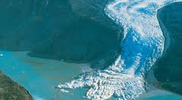
Glaciers
Large moving masses of ice
Currently, 10% of Earth’s surface is covered by glaciers
2 types
Valley glaciers (alpine glaciers)
Continental glaciers

Slide 19
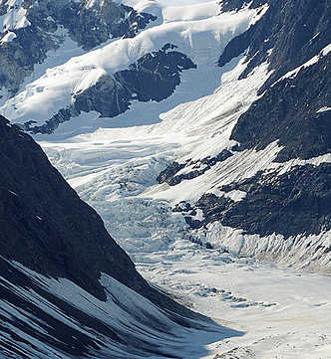
TWO TYPES OF GLACIERS
Valley glaciers—moves within valley walls
Long, slow-moving, wedge-like stream of ice
Also called alpine glaciers
Exist on all continents except Australia

Slide 20
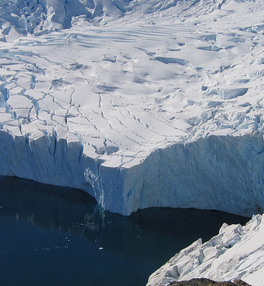
TWO TYPES OF GLACIERS
Continental glaciers—covers a large part of a continent
Occur in areas where all precipitation is snow.
Snow and ice build up and move outward in all directions
Can break off into chunks when it reaches the sea
Greenland glacier—size of Mexico
Antarctica glacier—bigger than U.S. and Mexico combined
A glacier that is less than 50,000 square meters is called an ice cap.

Slide 21
Glacial Erosion
Because of their size, weight, and density glaciers are the most powerful erosional agent.
When a valley glacier moves, it breaks off pieces of rock through a process called plucking.
As glaciers with rocks embedded in them move over bedrock, they act like sandpaper, grinding parallel scratches into the bedrock.
Small scratches are called striations
Larger ones are called grooves
These marking provide evidence of a glacier’s history and indicate its direction of movements

Slide 22
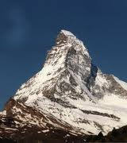
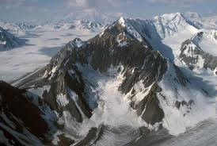
Glacial erosion, continued
Glacial erosion by valley glaciers creates features known as cirques, horns, and hanging valleys.
Cirques: deep, bowl-shaped depressions caused by valley glaciers
Where there are glaciers on 3 or more sides of the mountaintop, the carving action creates a steep, pyramid-shaped peak called a horn.
Hanging valleys are formed when higher glaciers converge with the lower primary glaciers and later retreat.
When the glaciers melt, the valley is left hanging

Slide 23
Glacial Deposition
Glacial till is the unsorted rock, gravel, sand, and clay that glaciers carry embedded in their ice and on their sides.
Glaciers deposit unsorted ridges of till called moraines when the glacier melts.
Terminal moraines are found along the edge where the retreating glacier melts
Lateral moraines are located parallel to the direction of a valley glacier flow
Outwash plain: the area at the leading edge of the glacier where the meltwater flows and deposits outwash.
Meltwater contains gravel, sand, and fine silt.
When the sediment is deposited by meltwater carried away from the glacier it is called outwash.
Outwash is always sorted by particle size, naturally.

Slide 24
Glacial Deposition, continued
Continental glaciers that move over older moraines form the material into elongated landforms called drumlins.
The drumlins steeper slope faces the direction from which the glacier came.
Stream flowing under melting glaciers leave long, winding ridges of layered sediments called eskers.
A kame is a mound of layered sediment that forms when till gets washed into depressions or openings in the melting ice.
When the ice finally melts, a cone-shaped hill or mound is left.

Slide 25
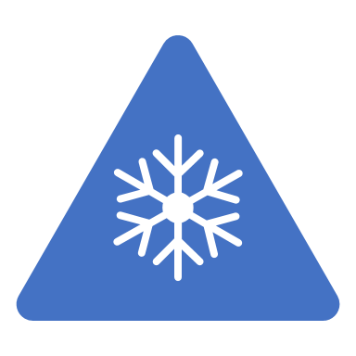
Glacial Lakes
Sometimes a large block of ice breaks off a continental glacier and the surrounding area is covered by sediment. When the ice block melts, it leaves behind a depression called a kettle hole. After the ice block melts, the kettle hole fills with water from precipitation and runoff to form a kettle lake.

Slide 26
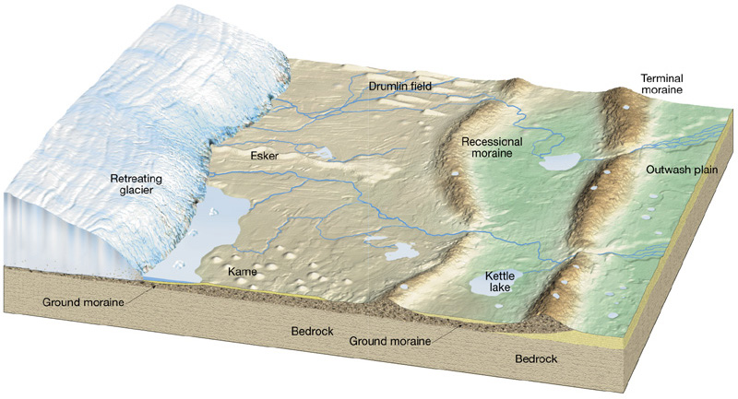
Glacial Deposition

Slide 27
Chapter Summary:
8.1
Mass movements are classified in part by how rapidly they occur
Mass movements are natural processes that can affect human life and activities
Human activities can increase the potential for the occurrence of mas movements
8.2:
Wind is a powerful erosional agent
Wind can transport sediment in several ways including suspension and saltation
Dunes form when wind velocity slows down and windblown sand is deposited
Dunes migrate as long as wind continues to blow
8.3:
Glaciers are large moving masses of ice that form near Earth’s poles and in mountain areas.
Glaciers can be classified as valley or continental
Glaciers modify landscape via erosion and deposition

