Slide 2
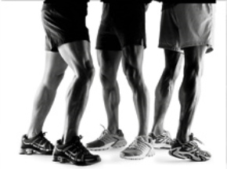
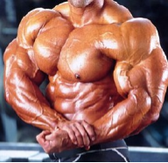
Muscular System
Notes:
Printable (guided notes) at https://docs.google.com/document/d/1dMD792hJn_Icwy7JrMuWdbdqZWlL23ccwKbhVvUL7sw/edit?usp=sharing

Slide 3
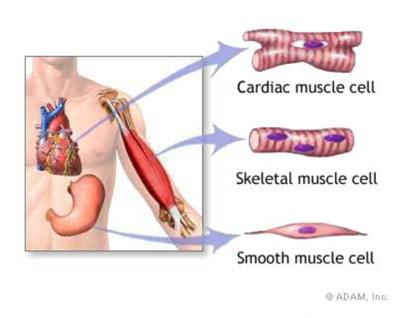
Types of Muscle
Skeletal – striated & voluntary
Smooth – involuntary
Cardiac - heart
The word “striated” means striped. Skeletal muscle appears striped under a microscope.

Slide 4
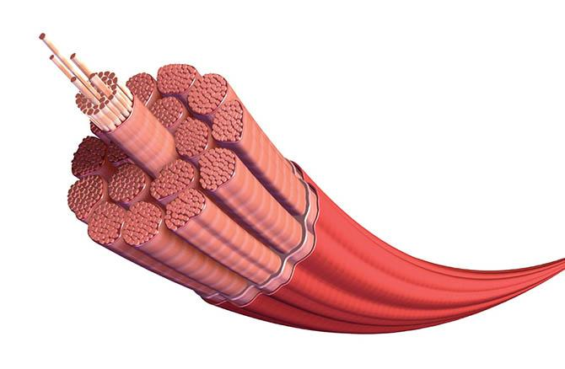
Muscles and Muscle Fiber Structure
Muscles are composed of many FIBERS that are arranged in bundles called FASCICLES

Slide 5
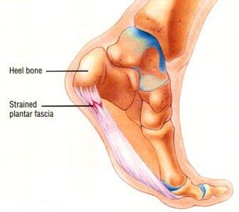
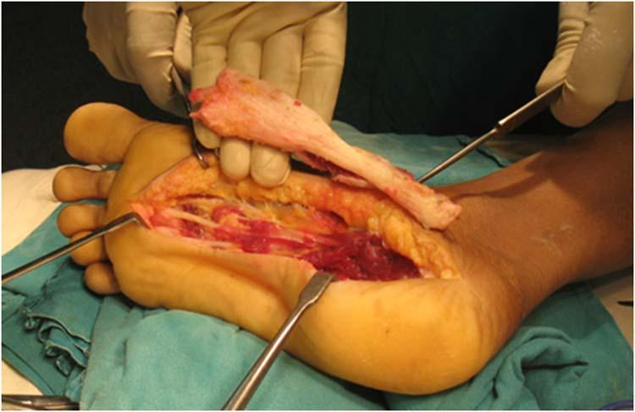
Individual muscles are separated by FASCIA, which also forms tendons
Notes:
Plantar fasciitis is the inflammation of the thick band of fascia

Slide 6
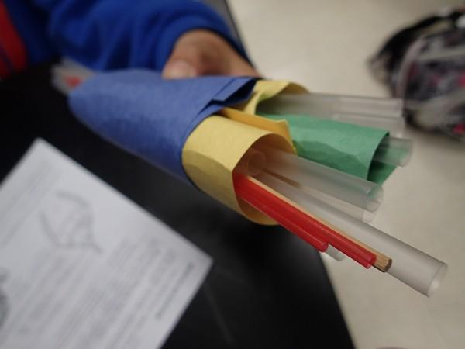
EPIMYSIUM = outermost layer, surrounds entire muscle.
PERIMYSIUM = separates and surrounds fascicles (bundles of muscle fibers)
ENDOMYSIUM = surrounds each individual muscle fiber
This model of the muscles uses straws to represent fibers.
Green = endomysium Yellow = perimysium Blue = epimysium

Slide 7
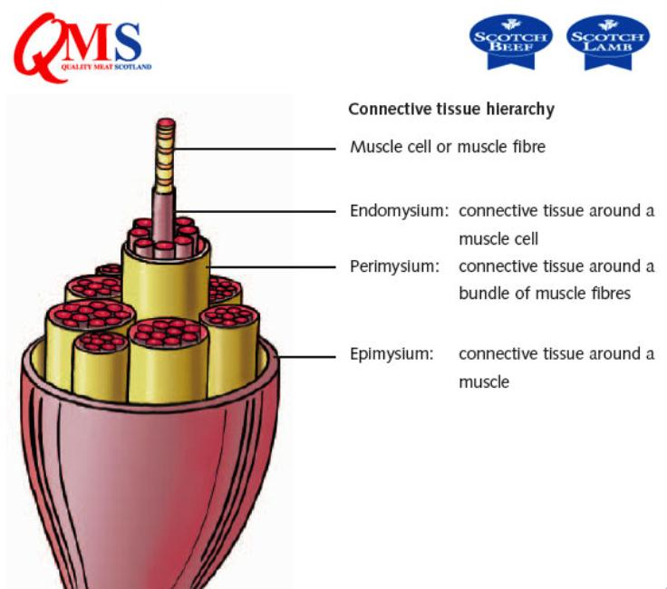
Muscle Layers
Muscle Fiber
Endomysium
Perimysium
Epimysium

Slide 8
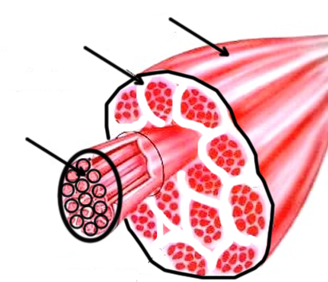
Epimysium
Perimysium
Endomysium

Slide 9
Muscles / Cells
Sarcolemma = muscle fiber membrane
Sarcoplasm = inner material surrounding fibers (like cytoplasm)
Sarcoplasmic Reticulum - transport
Myofibrils = individual parallel muscle fibers, within sarcoplasm

Slide 10
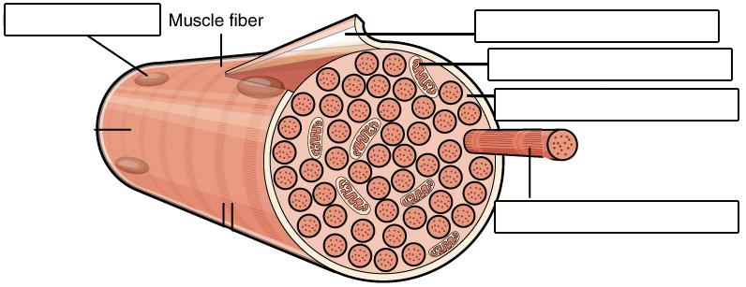
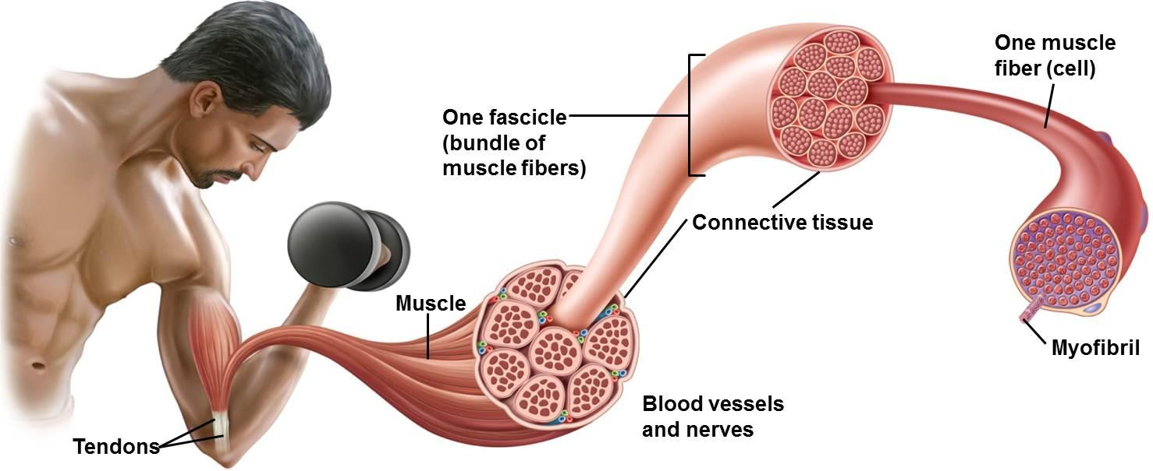
Nucleus
Sarcolemma
Mitochondrion
Sarcoplasm
Myofibril

Slide 11
Myofibrils are made of
ACTIN = thin filaments
MYOSIN = thick filaments

Slide 12
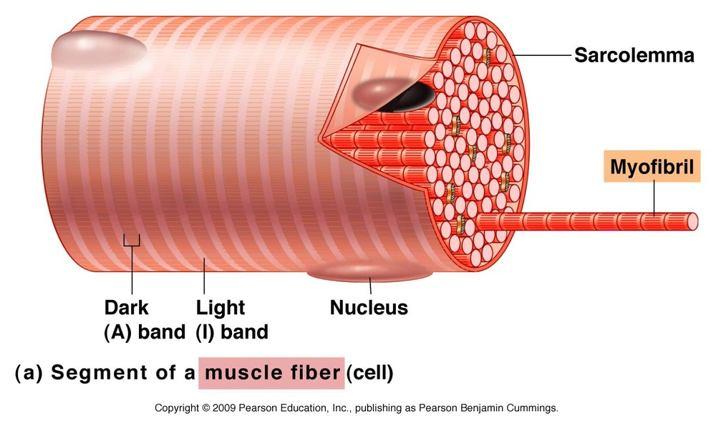
Myofilaments ACTIN (thin) and MYOSIN (thick)
-- form dark and light bands
A band = dArk • thick (myosin)
I band = lIght • thIn (actin)

Slide 13
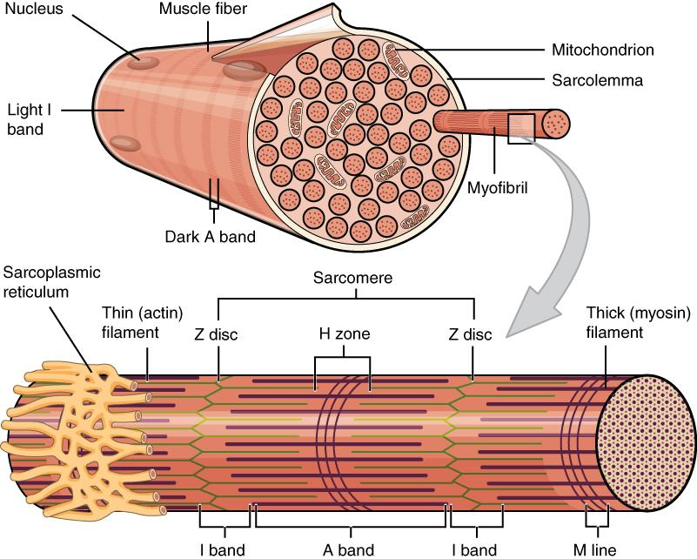

Slide 14
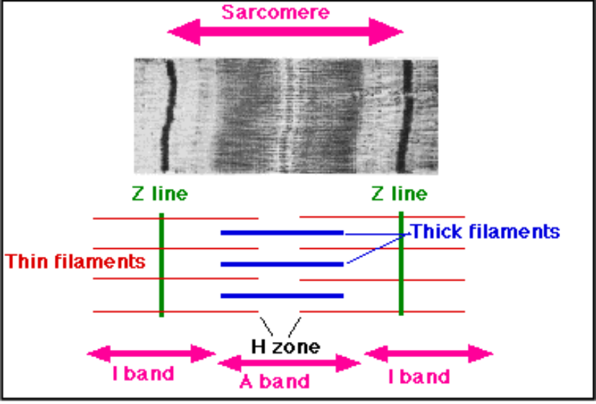

Slide 15
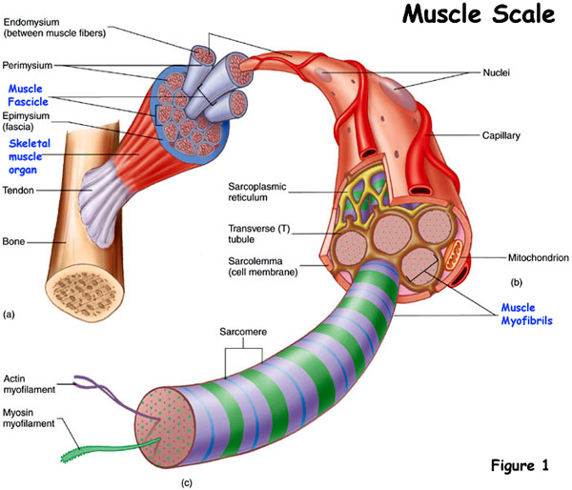
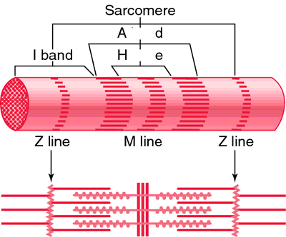

Slide 16
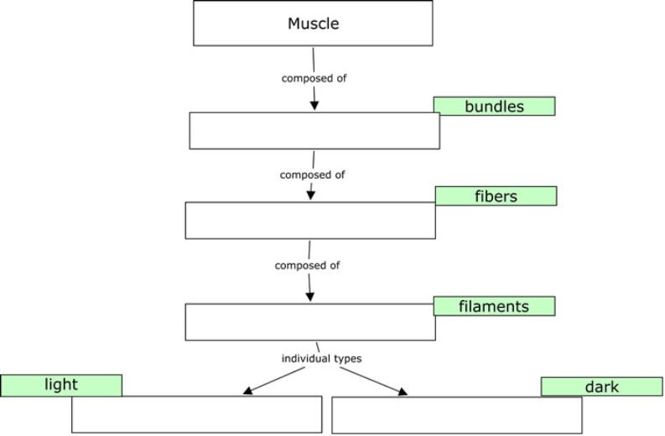
It is important to remember the hierarchy
fasicles
myofibrils
myofilaments
actin
myosin

Slide 17
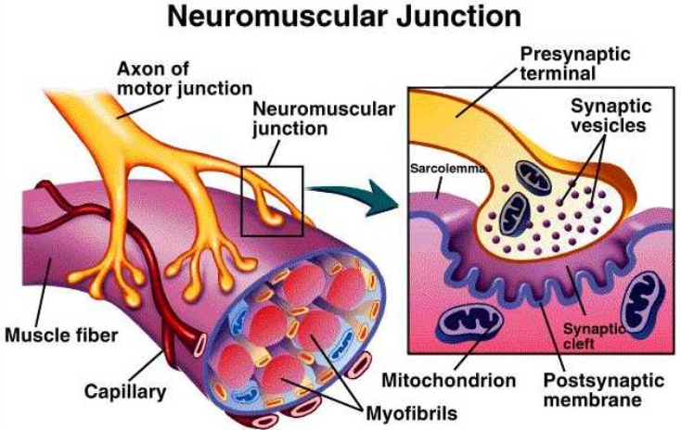
How Muscles Work with the Nervous System

Slide 18
NEUROMUSCULAR JUNCTION - where a nerve and muscle fiber come together
MOTOR END PLATE - folded area where muscle and neuron communicate
SYNAPTIC CLEFT - gap between the neuron and motor end plate
SYNAPTIC VESICLES - where neurotransmitters are stored
*these are released into the cleft and tell the muscle to contract

Slide 19
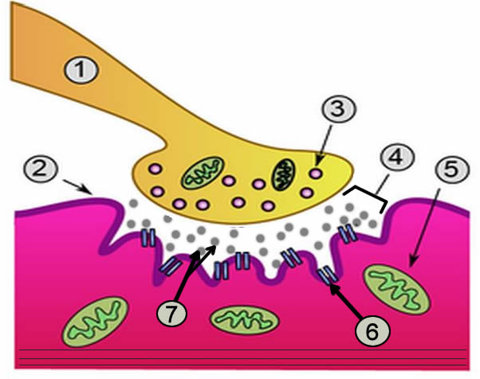
Motor Unit or Neuromuscular Junction
1. Neuron 2. Sarcolemma (or motor end plate)
3. Vesicle 4. Synapse 5. Mitochondria 6. Receptors 7. Acetylcholine

Slide 20
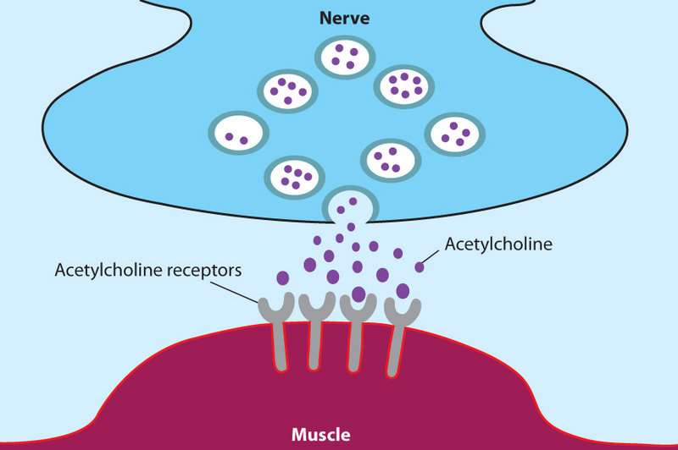
The neurotransmitter that cross the gap is ACETYLCHOLINE
ACH is broken down by CHOLINESTERASE

Slide 21
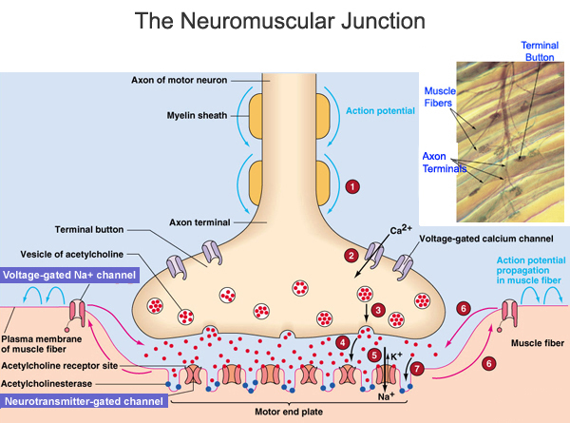
The neurotransmitter that crosses the gap is ACETYLCHOLINE.
This is what activates the muscle.
Acetylcholine is stored in vesicles

Slide 22
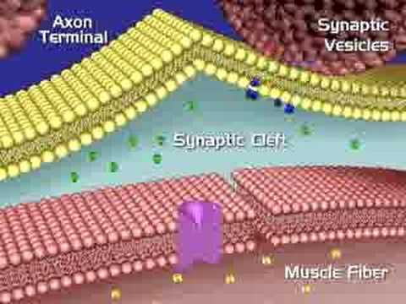

Slide 23
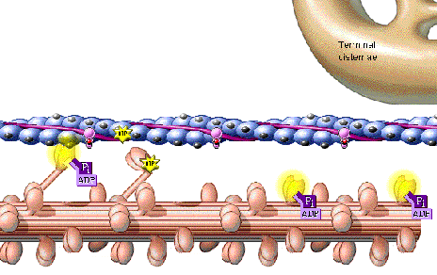
SLIDING FILAMENT THEORY (MODEL)
The theory of how muscle contracts is the sliding filament theory. The contraction of a muscle occurs as the thin filament slide past the thick filaments.
What is needed:
ATP
Calcium
Myosin & Actin
Acetylcholine
Cholinesterase
Sliding Filament Handout (additional)

Slide 24
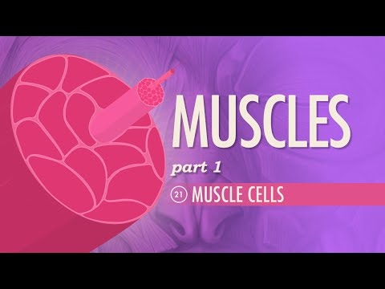
Hank explains muscles and the sliding filament model.

Slide 25
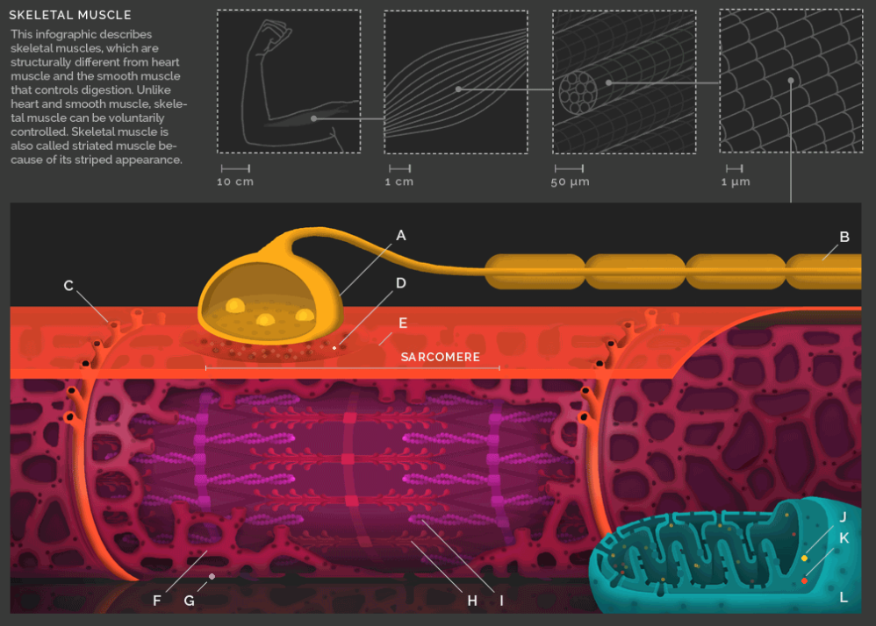
Sliding Filament (TabletopWhale)
Check out the animation at http://tabletopwhale.com/2014/08/12/a-users-guide-to-muscles.html -

Slide 26
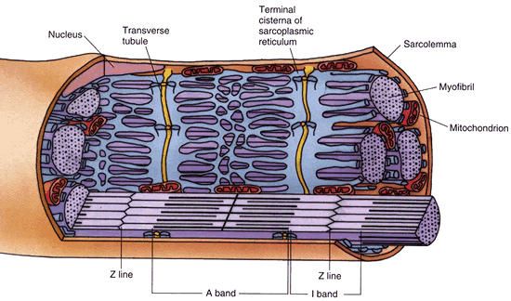
Energy Source
-ATP is produced by CELLULAR RESPIRATION
which occurs in the mitochondria
-Creatine phosphate increases regeneration of ATP
* Only 25% of energy produced during cellular respiration is used in metabolic processes - the rest is in the form of HEAT.
maintains body temperature.

Slide 27
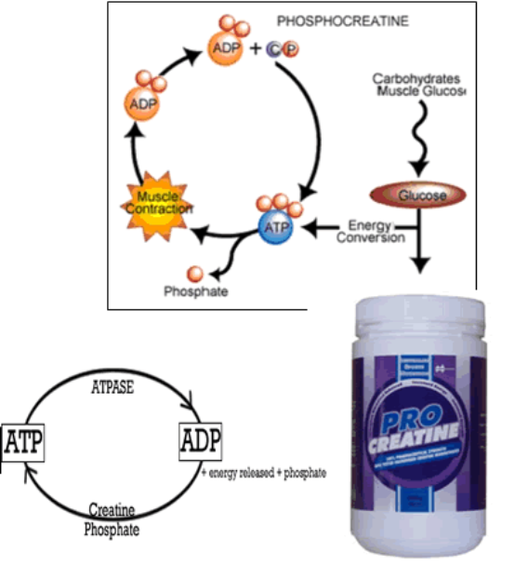
Why might products like pro-creatine claim to increase energy?
ATP = adenosine triphosphate
ADP = adenosine diphosphate

