Slide 1
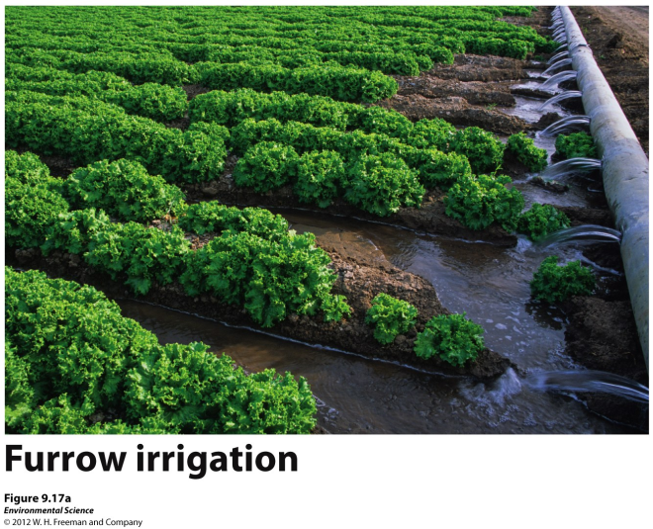
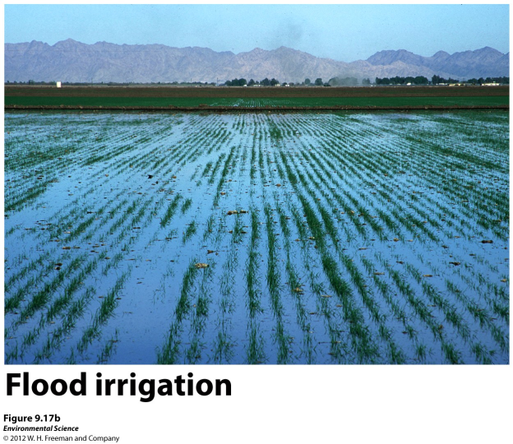
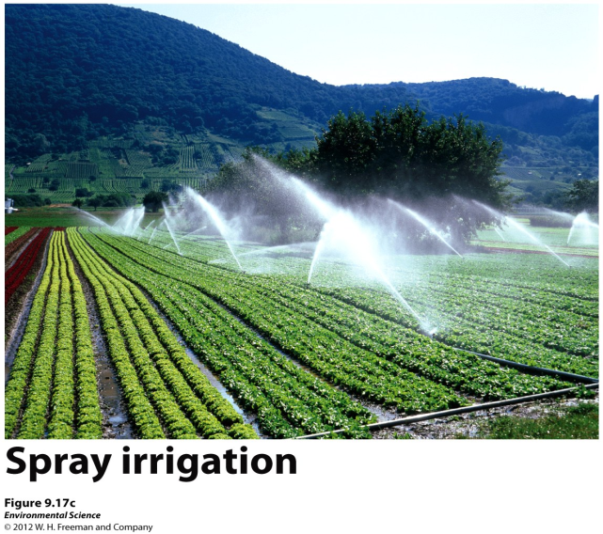
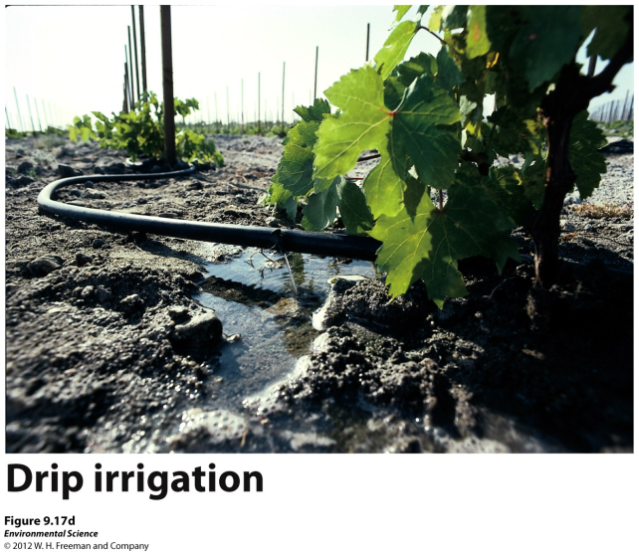
Agriculture, Industry and Household Needs
Agriculture- the largest user of water around the world.

Slide 2
Agriculture, Industry and Household Needs
Irrigation techniques-
Furrow irrigation- a trench that is flooded with water; ~35% of water runs off or is evaporated
Flood irrigation- the entire field is flooded with water; ~20% run off or evaporated
Spray irrigation- an apparatus that sprays water across a field; more efficient than furrow or flood, but is more expensive and requires a fair amount of energy to pump water into apparatus
Drip irrigation- using a slow dripping hose that is laid on or buried beneath the soil; the MOST efficient method of irrigation.
Hydroponic agriculture- crops grown in fertilized water and no soil. ($$$)
Notes:
Water calculator

Slide 3
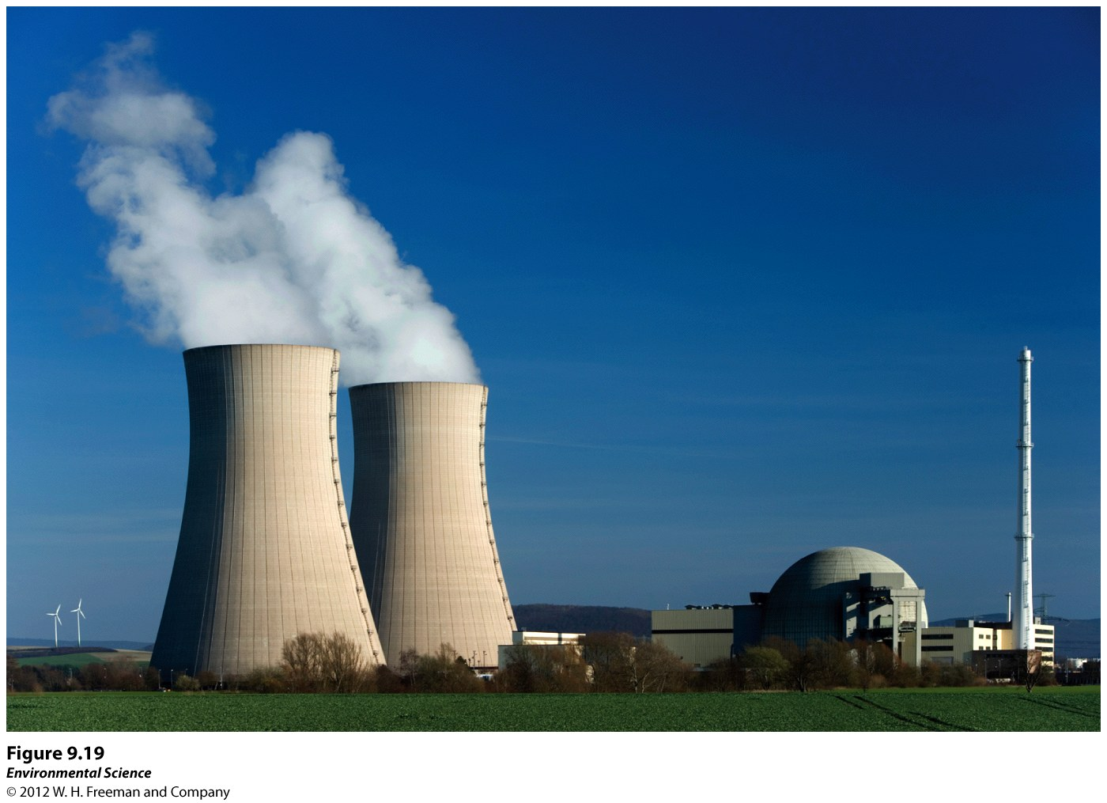
Agriculture, Industry and Household Needs
Industry- the second largest user of water worldwide. (generate electricity, cooling machinery, refining metals, making paper)

Slide 4
How is water lost when generating electricity in thermoelectric power plants?
Thermoelectric plants use heat to convert water into steam that turns a turbine, which then generate electricity.
The steam must be cooled before it is returned to its source.
Cooling takes place in cooling towers.
Most of the steam is condensed into water, but some of it is lost to the atmosphere.
Notes:
Cooling towers on previous slide

Slide 5
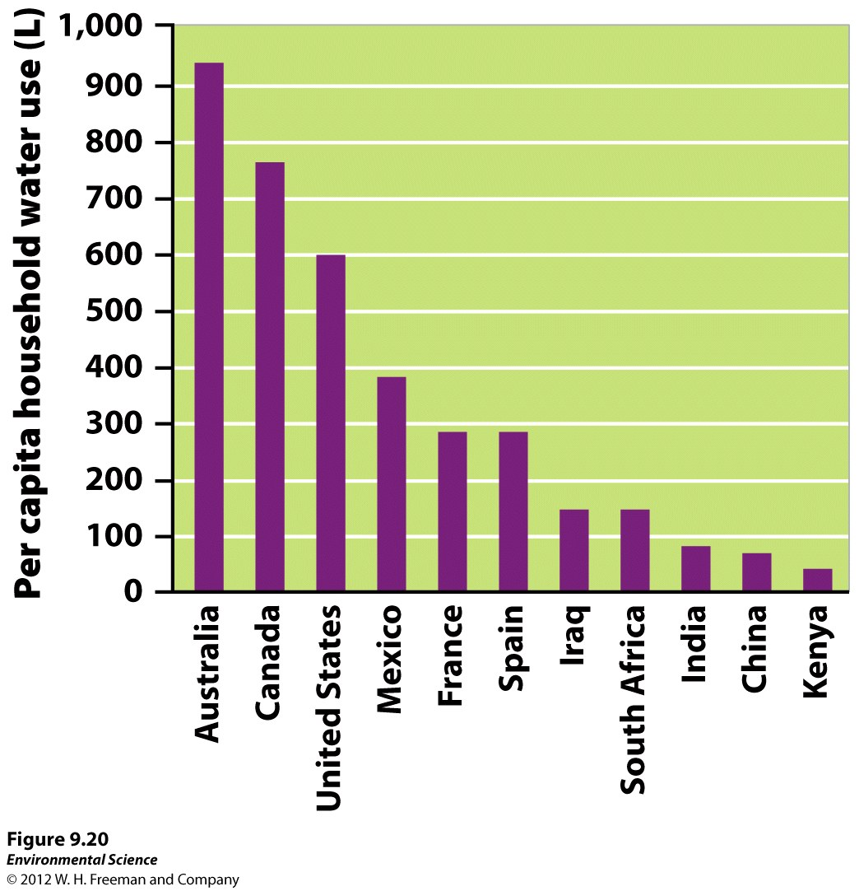
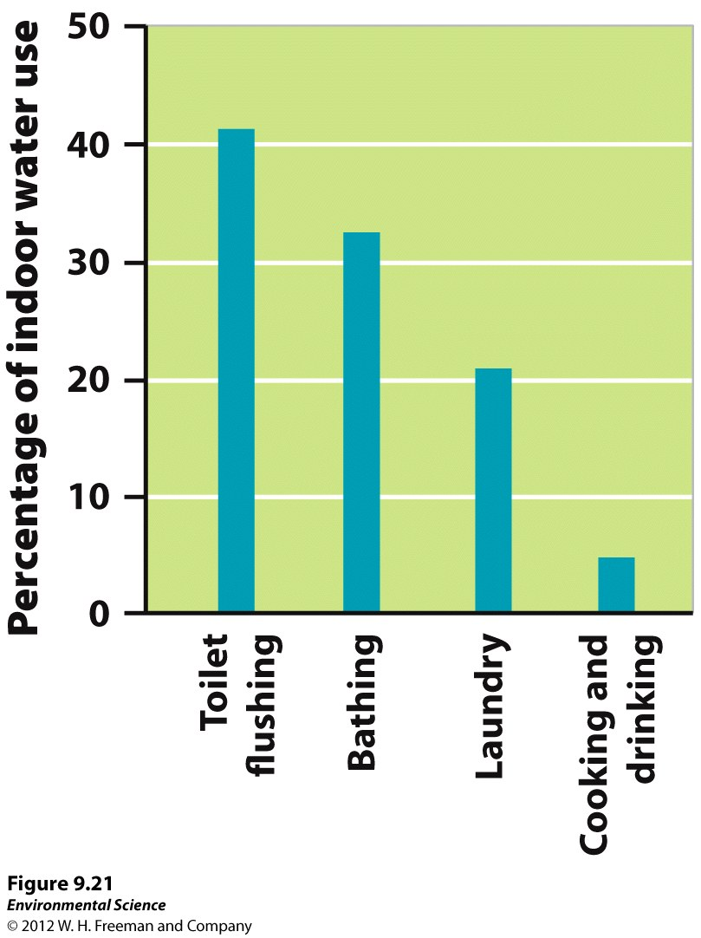
Agriculture, Industry and Household Needs
Households- the third largest user of water worldwide .

Slide 6
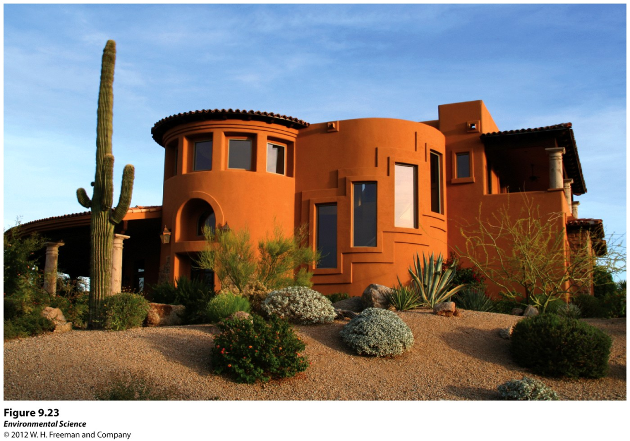
The Future of Water Availability
Water ownership- people can have rights to water use, but they do not own the water.
Water conservation- using techniques such as more efficient water fixtures, faucets and washing machines.

Slide 7
Assignment
Do The Math on page 314
Read Science Applied on page 324.
Answer Critical Thinking questions

