Slide 1
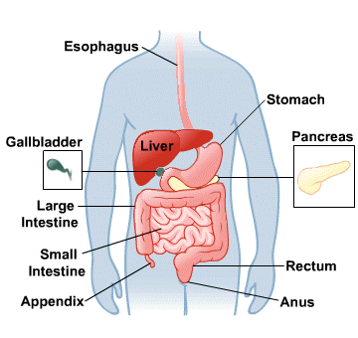
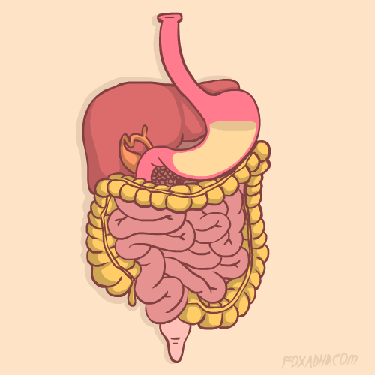
The Digestive System
Chapter 15

Slide 2
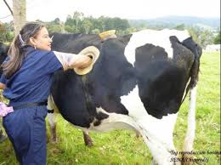
Essential Questions:
1. How do animals (and humans) obtain nutrients?
2. What happens when animals don’t get proper nutrients?
3. How is waste eliminated from the body?
4. What disorders can affect the working of the digestive system?
* Watch: Adam Ruins Everything - Nutrition
Notes:
https://steemit.com/animals/@ahmadbp/farmers-are-monitoring-cows-eat-using-window-in-their-sides - How would you study the digestive systems of humans?

Slide 3
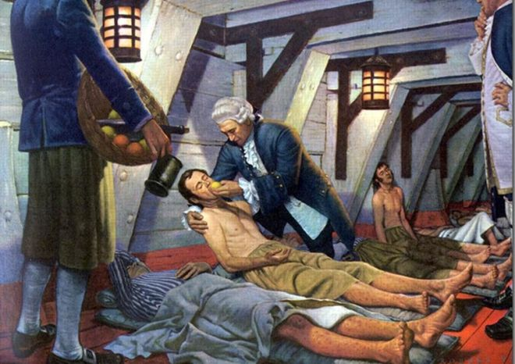
I noticed its first attack upon myself by the swelling and bleeding of the gums, followed by the swelling of the legs below the knee. I lay day after day enduring the most intense suffering of pain in limbs which had turned completely black.
What disease is described?
Scurvy
https://www.bbc.com/news/uk-england-37320399

Slide 4
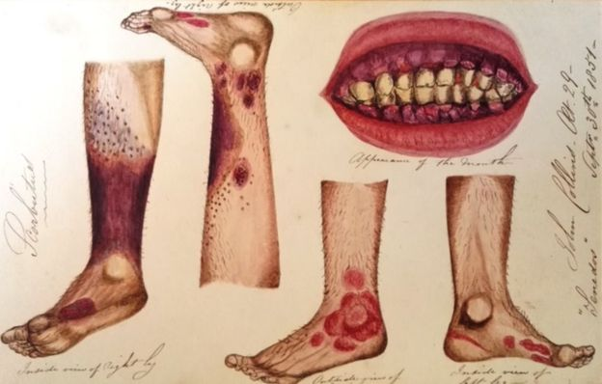
What is scurvy?
A condition caused by a lack of vitamin C.
A lack of vitamin C means that collagen, a protein found in body tissue such as skin and blood vessels, cannot be replaced, leading to tissue breakdown
Adult patients may suffer from fatigue, bleeding gums, swelling, slow-healing wounds, bruising.
Scurvy is a disease of malnutrition, often associated with sailors who were at sea for long periods and had no access to fresh fruits or vegetables.
Bleeding gums and tooth loss were some of the first symptoms.

Slide 5
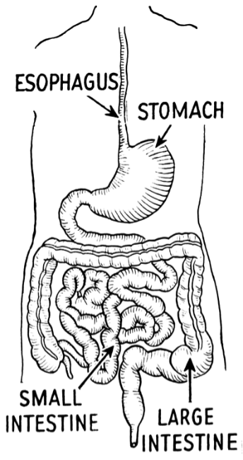
What is the function of the digestive system?
- mechanical and chemical breakdown of food and the absorption of nutrients
-Consists of alimentary canal and accessory organs
Notes:
Xifaxin mascot

Slide 6
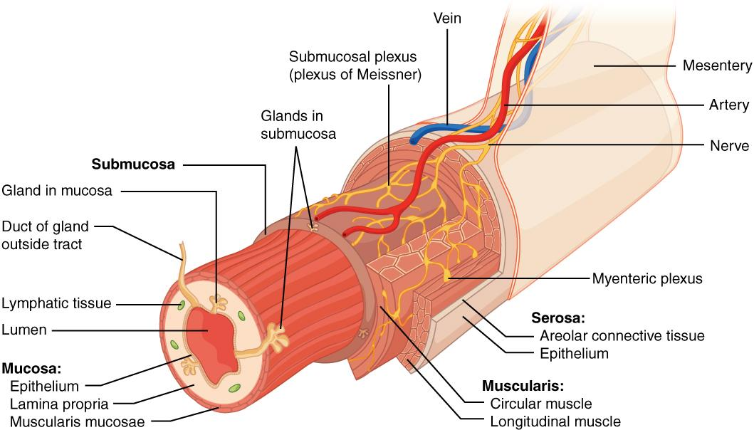
Characteristics of the Canal
1. Mucosa - protects tissues and carries absorption
2. Submucosa - glands, blood vessels, nerves
3. Muscular Layer - smooth muscle, pushes food (PERISTALSIS)
4. Serosa - lubricates surfaces
Notes:
Villi increase SURFACE AREA

Slide 7
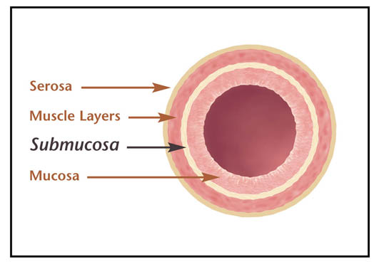
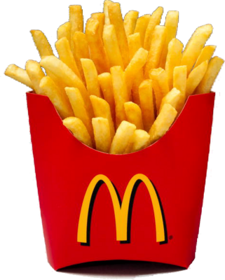
DRAW THIS!

Slide 8
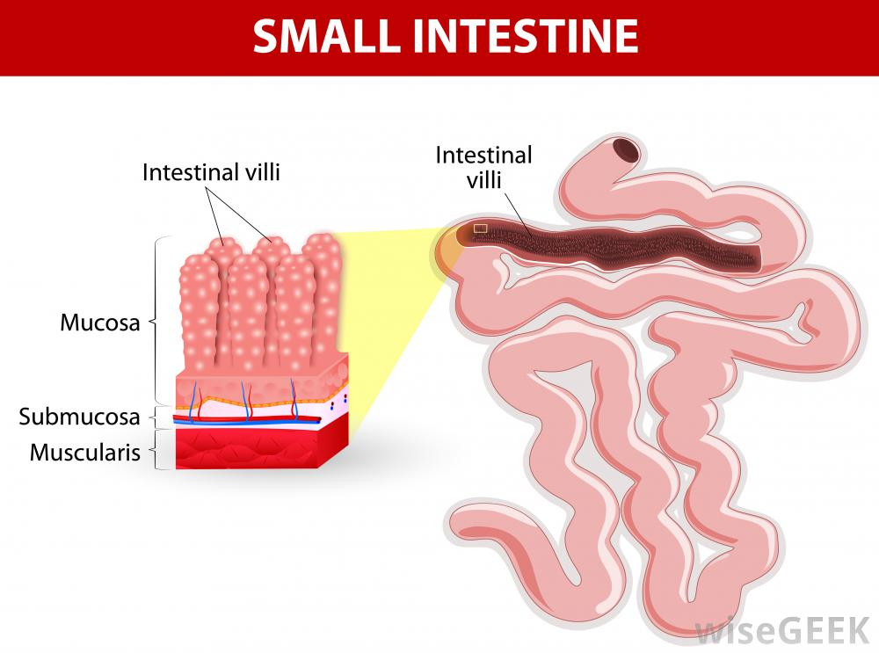
In the small intestine...
Villi increase surface area for absorption of nutrients.

Slide 9
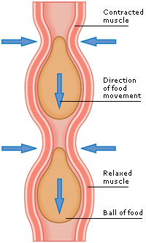
Mixing Movements
mix food with digestive juices
Propelling Movements
Peristalsis - pushes food down the tube

Slide 10
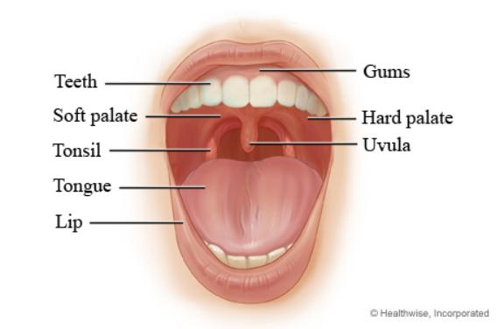
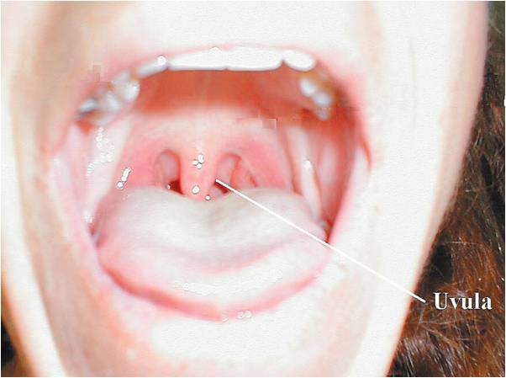
Anatomy of the Mouth - the first place of digestion
Mouth - begins digestion by chewing and mixing with saliva
Tongue - moves food, connects to floor of mouth via FRENULUM; has papillae
Palate - forms roof of oral cavity (hard and soft); Uvula - back of the mouth

Slide 11
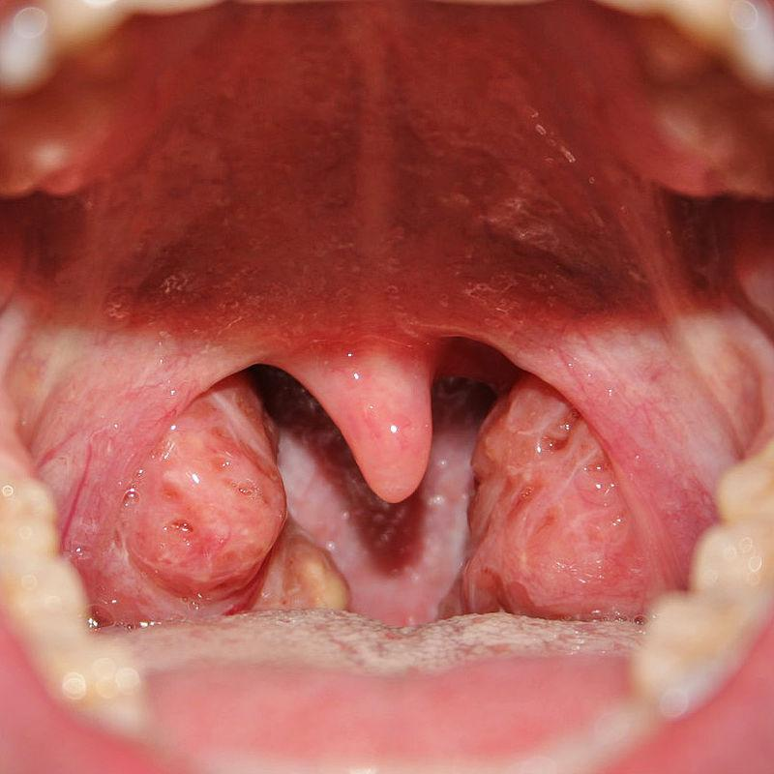
Palatine Tonsils - part of the immune system
Tonsillitis is an inflammation of the tonsils and will often, but not necessarily, cause a sore throat and fever. In chronic cases tonsillectomy may be indicated.

Slide 12
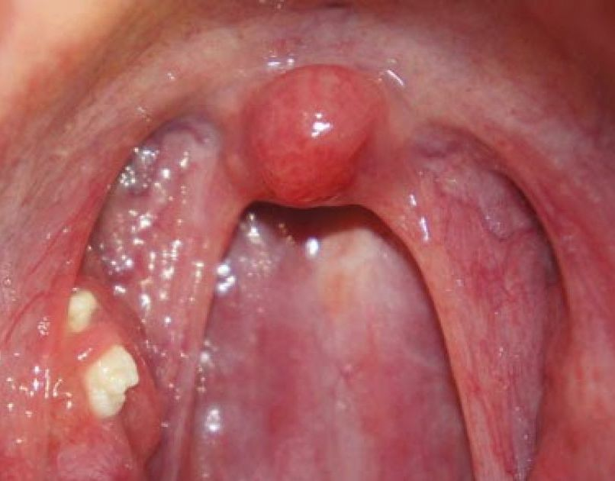
What are tonsil stones? Tonsilloliths, are hard white formations that are located on or within the tonsils.
What causes them?
Grooves and ridges on the tonsils can harbor bacteria and other debris. That debris eventually hardens, forming a stone.

Slide 13
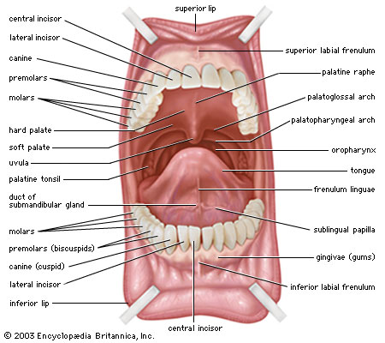

Slide 14
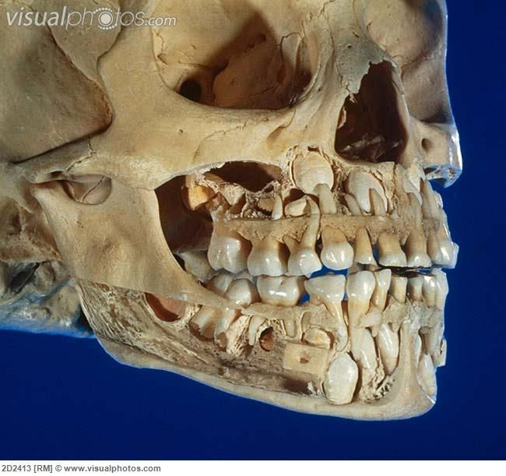
Teeth
Primary (baby) vs Secondary teeth

Slide 15
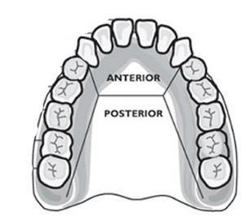
Teeth
INCISORS
CUSPIDS
BICUSPIDS
CANINES
1st, 2nd, 3rd Molars

Slide 16
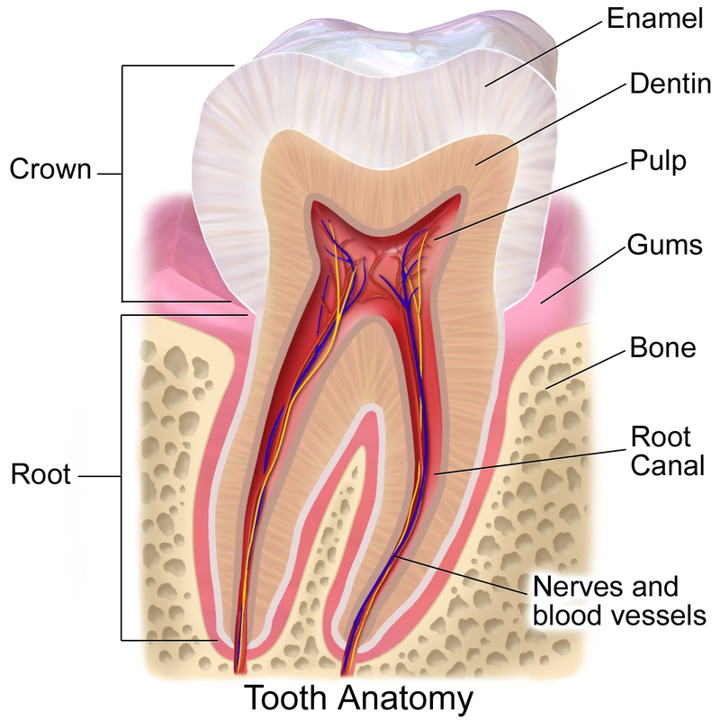
Anatomy of a Tooth

Slide 17
Anatomy of a Tooth
- Crown – projects above the gums - Root – anchored to the alveolar process of the jaw - Enamel – made of calcium salts, hardest substance in body (outer surface) - Dentin – similar to bone, surrounds tooth’s central cavity - Blood vessels and nerves extend through the tooth via the root canal

Slide 18
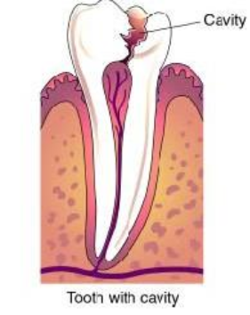
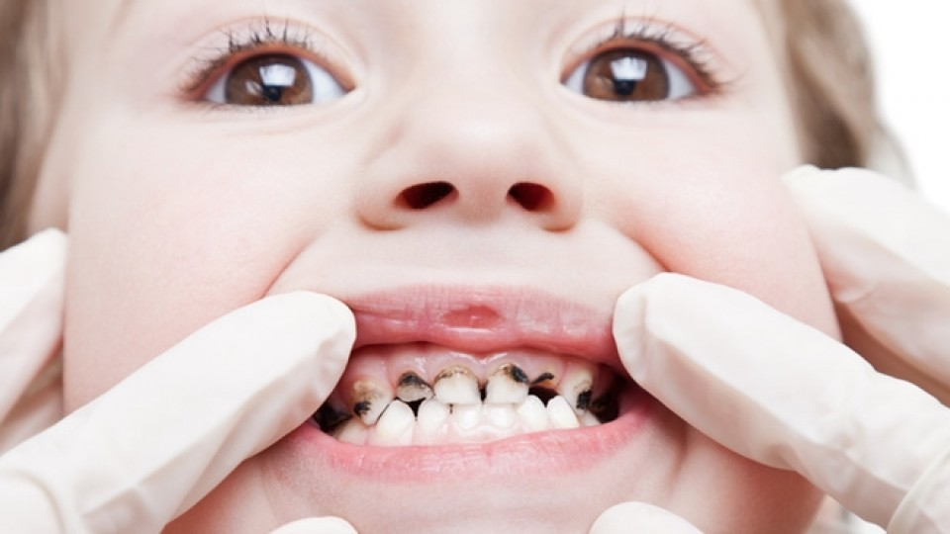
Tooth Decay

Slide 19
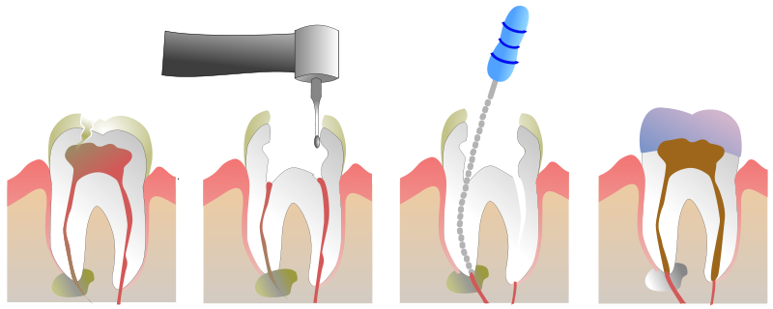
ROOT CANAL
- a treatment to repair and save a badly damaged or infected tooth instead of removing it.
- The term "root canal" comes from cleaning of the canals inside a tooth's root.
- A cap is put on the top of the tooth

Slide 20
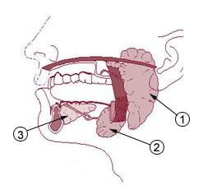
Salivary Glands
AMYLASE
- enzyme breaks down starch into sugars
Mucus cells also produce mucus for lubrication during swallowing
1.Parotid Gland
2. Submandibular Gland
3. Sublingual Gland

Slide 21
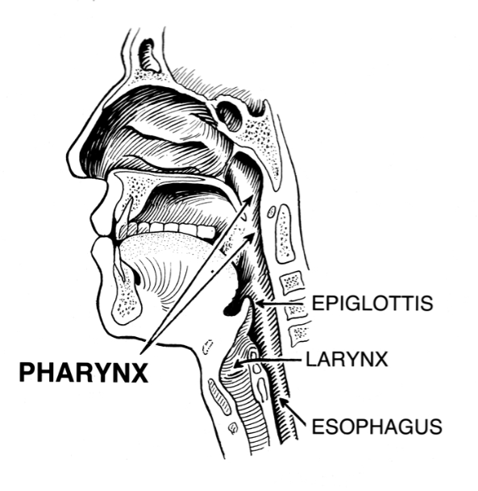
Pharynx
nasopharynx
oropharynx
laryngopharynx

Slide 22
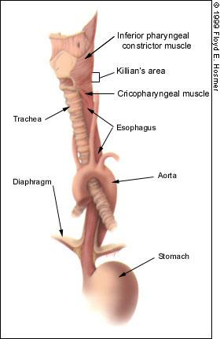
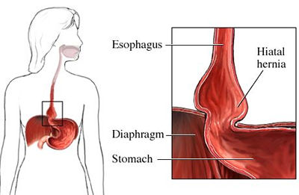
Esophagus - moves food to the stomach
esophageal hiatus is where it penetrates the diaphragm
cardiac (esophageal) sphincter at entrance to stomach

Slide 23
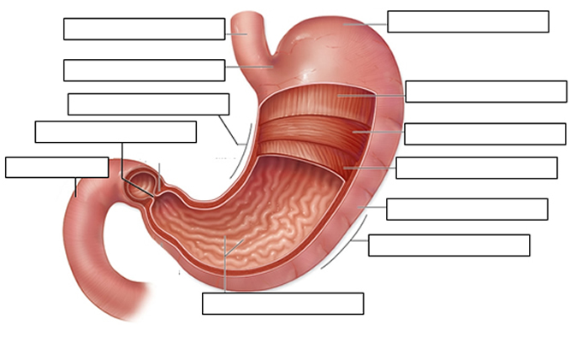
STOMACH MUSCLES: Longitudinal, Circular, Oblique
Cardiac sphincter
FUNDUS
ESOPHAGUS
CARDIAC REGION
Longitudinal muscles
LESSER CURVATURE
PYLORIC SPHINCTER
Circular muscles
DUODENUM
Oblique muscles
BODY of stomach
GREATER CURVATURE
RUGAE

Slide 24
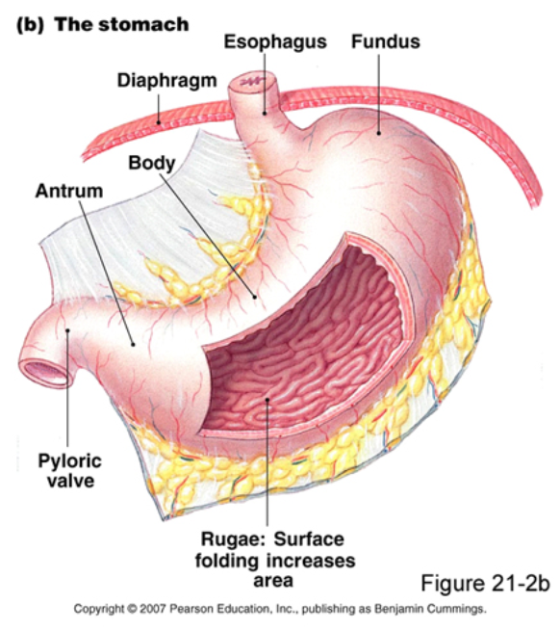
Stomach
Regions
Cardiac
Fundic
Body (greater and lesser curvature)
Pyloric

Slide 25
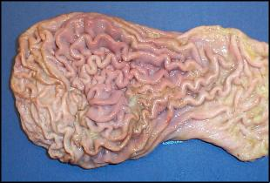
Stomach Lining
Mucus prevents stomach from digesting itself, small openings called gastric pits contain glands
Glands secrete gastric juices to breakdown food
PEPSIN - most important digestive enzyme for breaking down food

Slide 26
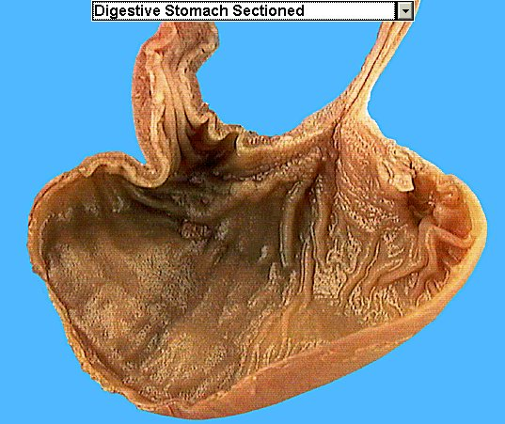
Chyme - paste, after food has been broken down, released then into the duodenum via the pyloric sphincter valve
Rugae - folds within stomach

Slide 27
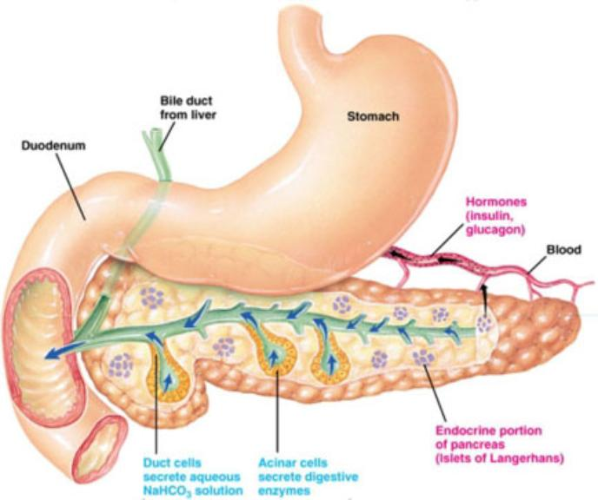
PANCREAS - secretes insulin which breaks down sugars
Pancreatic Juice also breaks down fat
Both Chemicals empty into the
DUODENUM

Slide 28
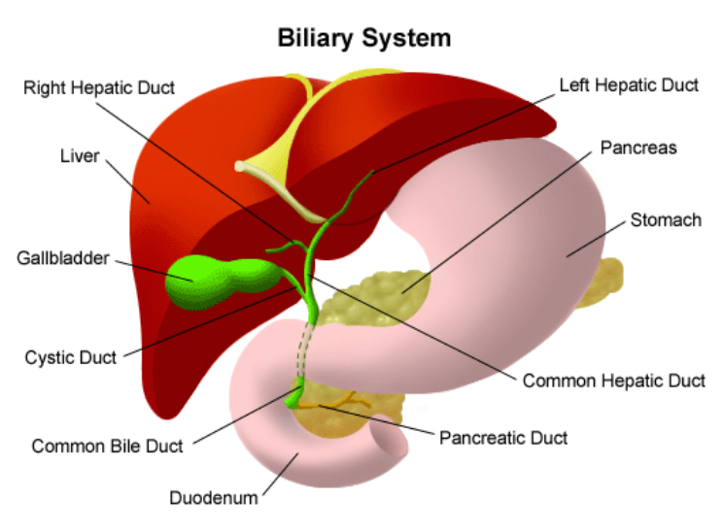
Liver 1 large right lobe | 1 smaller left lobe

Slide 29
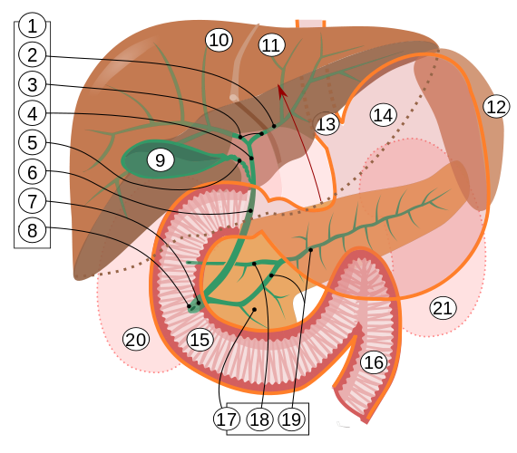
BILIARY SYSTEM
Consists of liver, gallbladder, ducts
Functions to create bile used in digestion
(5) Cystic Duct (gallbladder)
(4) Hepatic Duct (liver)
Join to form the
(6)COMMON BILE DUCT
Empties into the duodenum

Slide 30
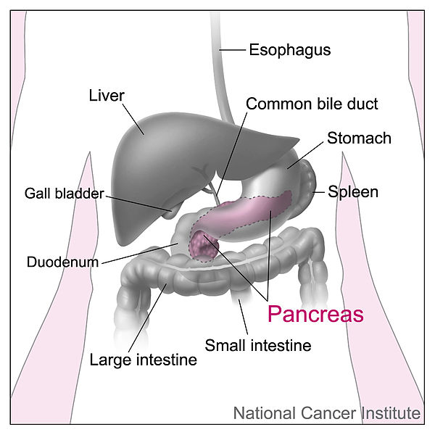
Liver Functions
1. blood glucose levels
2. breakdown of lipids and fats
3. protein metabolism
4. stores vitamins
5. recycles RBCs
6. removes toxins
7. secretes bile
Bile – yellowish-green liquid aids in digestion, breakdown of fat

Slide 31
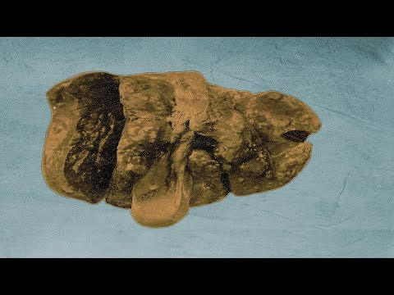

Slide 32
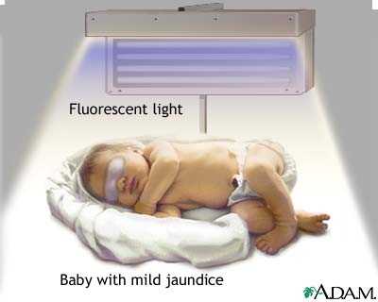
Remember Bili Lights?
Using bili lights is a therapeutic procedure performed on newborn or premature infants to reduce elevated levels of bilirubin. If blood levels of bilirubin become too high, the bilirubin begins to dissolve in the body tissues, producing the characteristic yellow eyes and skin of jaundice.

Slide 33
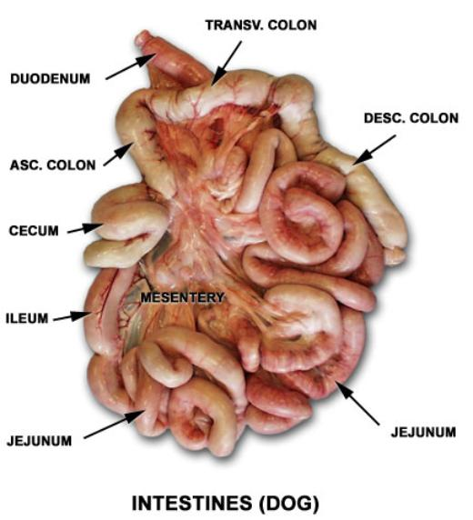
Small Intestine
Main function: absorption of nutrients
1. Duodenum
2. Jejunum
3. Ileum
MESENTERY - supports coils of small intestine and contains blood vessels

Slide 34
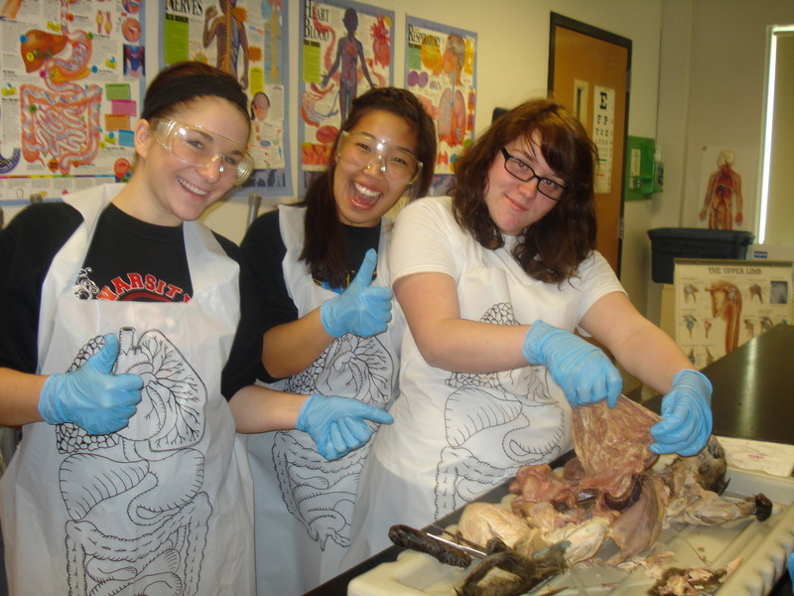
Greater Omentum (peritoneum)
a "curtain-like" membrane that covers the intestines, stores fat and lays like a drape

Slide 35
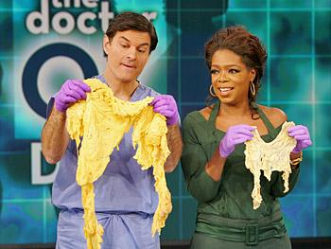
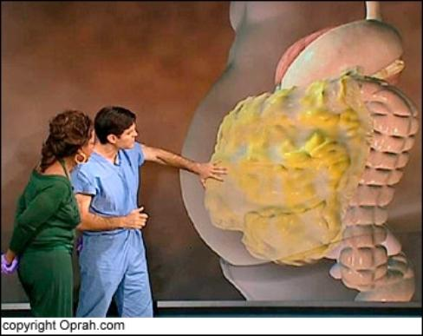
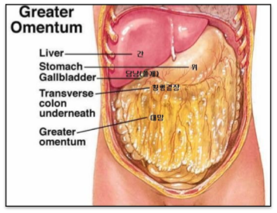
Greater Omentum

Slide 36
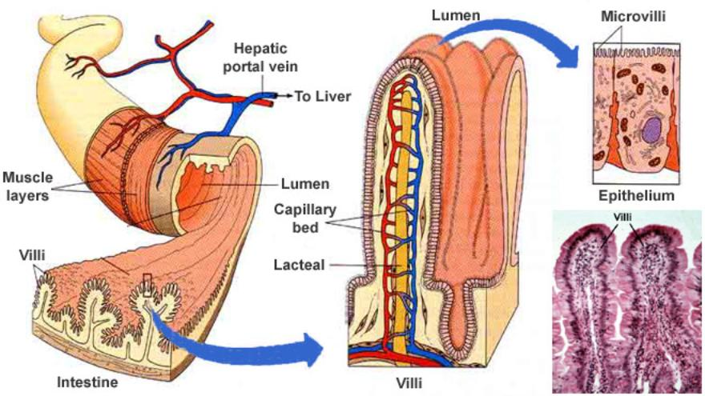
Intestinal villi - increase surface area for absorption of nutrients

Slide 37
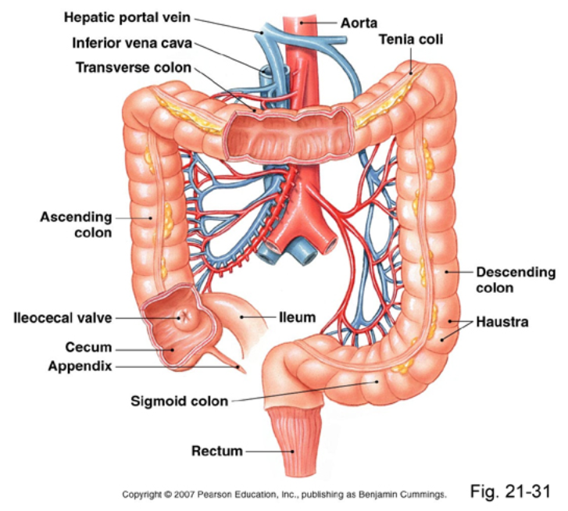
Large Intestine
Cecum = start of large intestine, has an attached appendix
2. Colon = 4 sections,
ascending / transverse / descending / sigmoid
3. Rectum – stores waste before it is expelled from the body
4. Anus -muscular sphincter which controls the exit of waste

