Slide 2
Chapter 19 - Earthquakes
2013

Slide 3
19.1 – Forces Within Earth
Faults form when the forces acting on rock exceed the rock’s strength.

Slide 4
Stress and Strain
Along the boundaries between two tectonic plates, rocks in the crust often resist movement.
Over time, stress builds up.
Stress is the total force acting on crustal rocks per unit of area.
Three kinds of stress that act on Earth’s rocks:
Compression
Tension
Shear

Slide 5
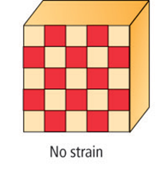
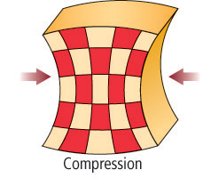
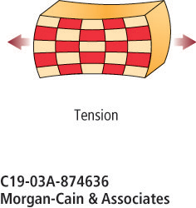
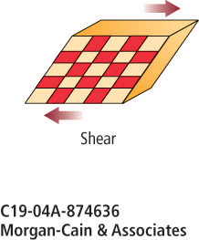
Stress and Strain
Compression causes a material to shorten.
Tension causes a material to lengthen.
Shear causes distortion of a material.
The deformation of materials in response to stress is called strain.

Slide 6
Stress and Strain
Even though rocks can be twisted, squeezed, and stretched, they fracture when stress and strain reach a critical point.
At these breaks, rocks can move, releasing the energy built up as a result of stress.
Earthquakes are the result of this movement and release of energy.

Slide 7
Elastic Deformation
Elastic deformation is caused under conditions of low stress when a material is compressed, bent, or stretched.
When the stress is removed, material returns to its original shape.

Slide 8
Plastic Deformation
When stress builds up past a certain point, called the elastic limit, rocks undergo plastic deformation.
This type of strain produces permanent deformation.
Most materials exhibit both elastic and plastic behavior.
As pressure increases, rocks require greater stress to reach the elastic limit.
At high enough temperatures, solid rock can also deform, causing it to flow in a fluid-like manner.
Reduces stress.

Slide 9
Faults
Crustal rocks fail when stresses exceed the strength of the rocks.
The resulting movement occurs along a weak region in the crustal rock called a fault, which is any fracture or system of fractures along which Earth moves.

Slide 10
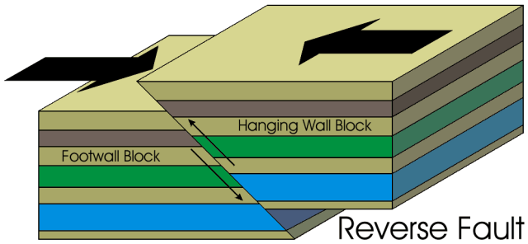
Reverse Fault
Reverse faults form as a result of horizontal and vertical compression that squeezes rock and creates a shortening of the crust. This causes rock on one side of a reverse fault to be pushed up relative to the other side.

Slide 11
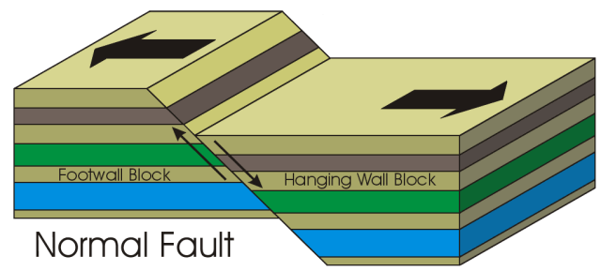
Normal Fault
Movement along a normal fault is partly horizontal and partly vertical.
The horizontal movement pulls rock apart and stretches the crust.
Vertical movement occurs as the stretching causes rock on one side of the fault to move down relative to the other side.

Slide 12
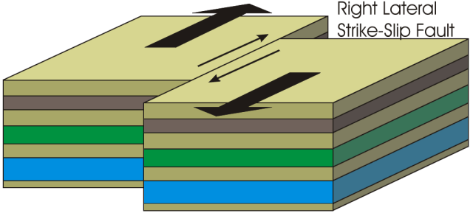
Strike-Slip Faults
Strike-slip faults are caused by horizontal shear.
The movement at a strike-slip fault is mainly horizontal and in opposite directions, similar to the way cars move in opposite directions on either side of a freeway.
Notes:
Use textbook and page 531 to fill in table on notes

Slide 13
Earthquake Waves
Irregular surfaces in rocks can snag and lock along faults when movement occurs.
As stress continues to build in these rocks, they undergo elastic deformation.
Beyond the elastic limit, they bend or stretch.
Before that limit, an earthquake occurs when they slip or crumble.

Slide 14
Types of Seismic Waves
The vibrations of the ground produced during an earthquake are called seismic waves.
Every earthquake generates three types of seismic waves:
Primary waves
Secondary waves
Surface waves
Also referred to as P-waves, primary waves squeeze and push rocks in the direction along which the waves are traveling.

Slide 15
Types of Seismic Waves
Secondary waves, called S-waves, are named with respect to their arrival times.
They are slower than P-waves, so they are the second set of waves to be felt.
S-waves have a motion that causes rocks to move perpendicular to the direction of the waves.

Slide 16
Types of Seismic Waves
The third and slowest type of waves are surface waves, which travel only along Earth’s surface.
Surface waves can cause the ground to move sideways and up and down like ocean waves.
Also known as Rayleigh Waves

Slide 17
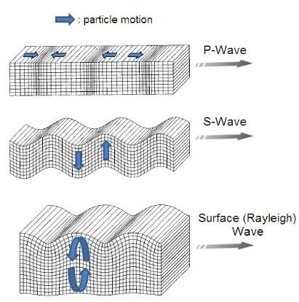

Slide 18
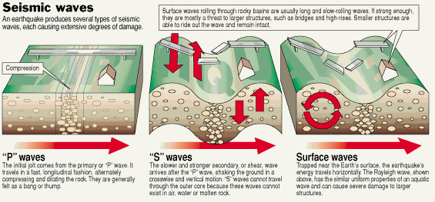

Slide 19
Generation of Seismic Waves
The focus of an earthquake is the point of initial fault rupture, which is usually several kilometers below Earth’s surface.
The point on Earth’s surface directly above the focus is the epicenter.
Notes:
Their picture is different.; look at concept map on page 533

Slide 20
19.2 – Seismic Waves & Earth’s Interior
Seismic waves can be used to make images of the internal structure of Earth.

Slide 21
Seismometers & Seismograms
Most of the vibrations caused by seismic waves cannot be felt at great distances from an earthquake’s epicenter, but they can be detected by sensitive instruments called seismometers, which measure horizontal or vertical motion during an earthquake.

Slide 22
Seismometers & Seismograms
The frame of a seismometer is anchored to the ground.
When an earthquake occurs, the frame moves but the hanging mass and attached pen do not.
The mass and pen record the relative movement as the recording device moves under them.

Slide 23
Seismometers & Seismograms
The record produced by a seismometer that can provide individual tracking of each type of seismic wave is a seismogram.

Slide 24
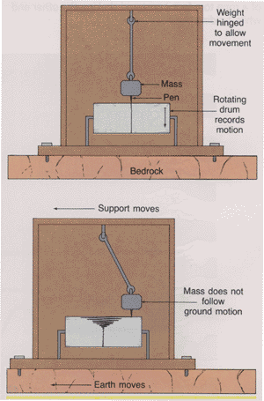

Slide 25
Travel-Time Curves
Travel-time curves provide the average time it takes for P- and S-waves to reach seismic stations located at different distances from an earthquake’s epicenter.

