Slide 2
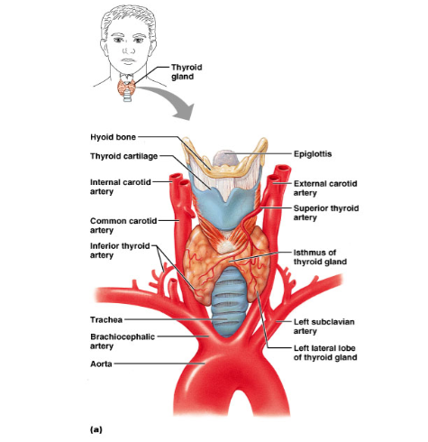
THYROID GLAND
The thyroid hormones control your metabolism, which is the body's ability to break down food and store it as energy and release of energy
TED-Ed Video on the Thyroid

Slide 3
THYROID HORMONES
Thyroxin (T4) & Tri-iodothyronine (T3) - both increase the rate at which cells release energy from carbohydrates
Calcitonin – regulates the blood concentration of calcium
BMR – basal metabolic rate : how many calories the body must consume to maintain life
BMR Calculator

Slide 4
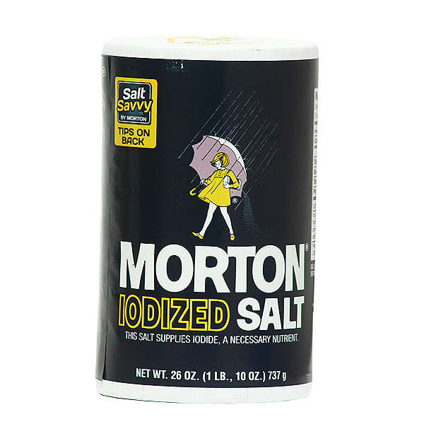
Problems with the Thyroid
Iodine is essential for the formation of thyroxine.
Lack of iodine causes a swelling of the thyroid → GOITER.
Iodine is only found in seafood, so if salt wasn’t iodized, a lot of people wouldn’t get enough iodine, and there would be a lot of goiters.

Slide 5
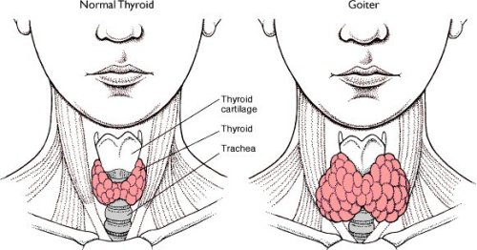
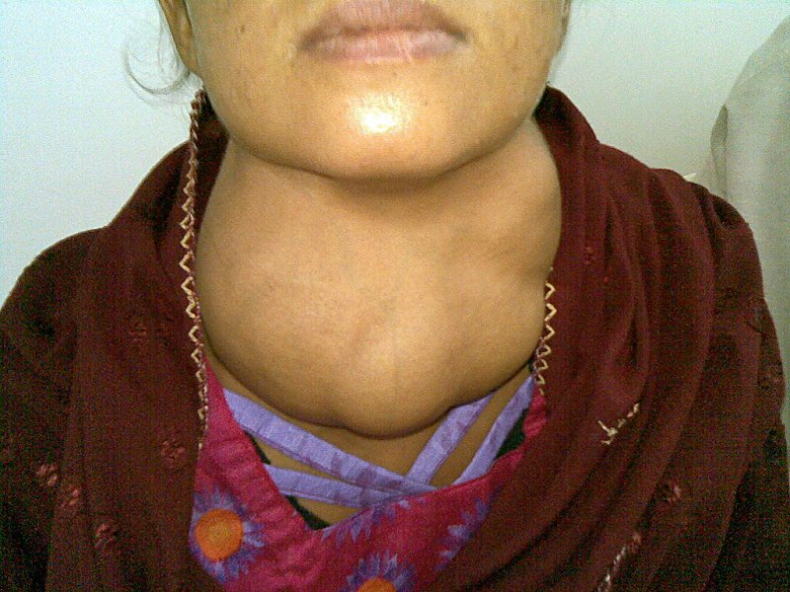
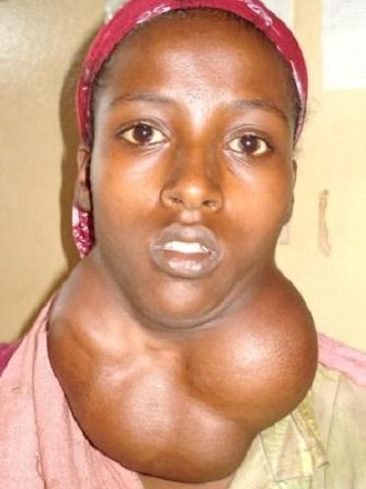
Goiter

Slide 6
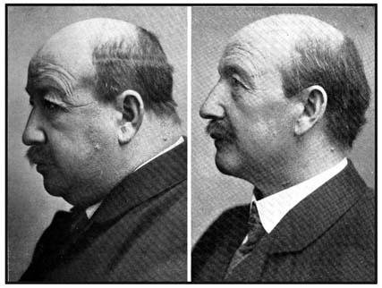
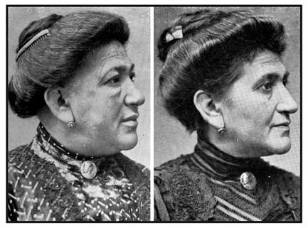
Hypothyroidism Before and After Treatment

Slide 7
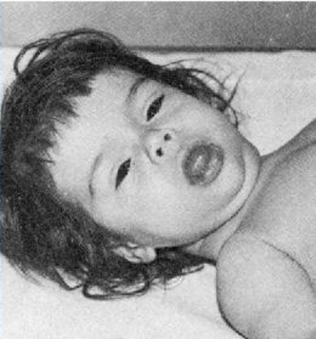
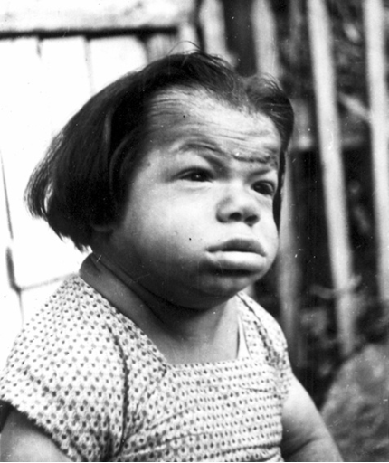
Cretinism (hypothyroidism in infants)

Slide 8
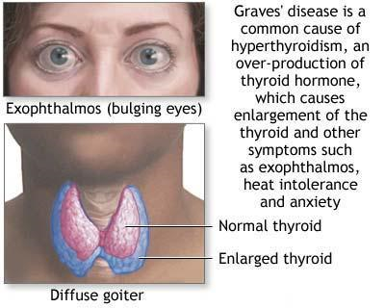
Hyperthyroidism (Grave’s Disease)

Slide 9
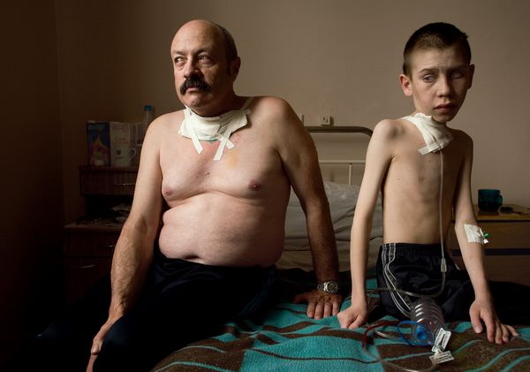
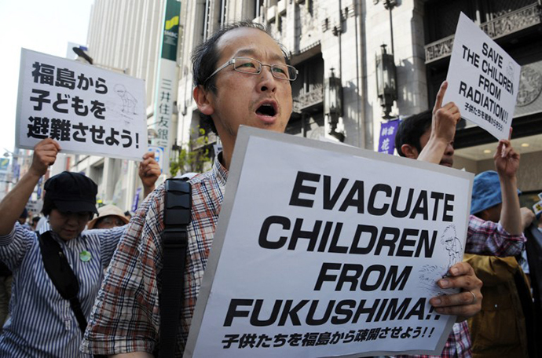
Exposure to radioactive iodine in childhood is also believed to be associated with thyroid cancer. Following the Chernobyl nuclear power plant explosion, there was an increase in thyroid cancer in children.

Slide 10
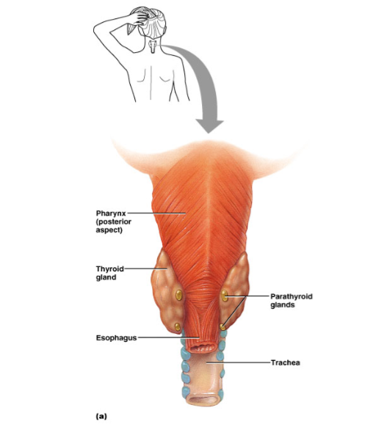
Parathyroid Glands
Located behind the thyroid, four tiny glands Parathyroid Hormone (PTH) - takes calcium from the bones to make it available in the blood

Slide 11
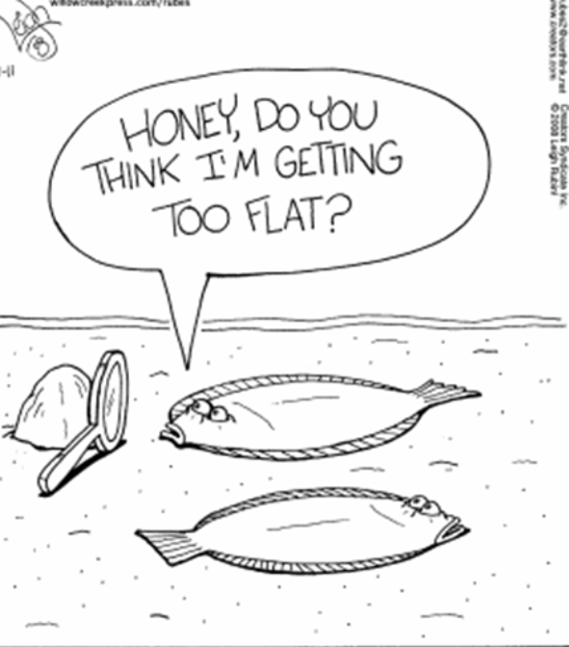
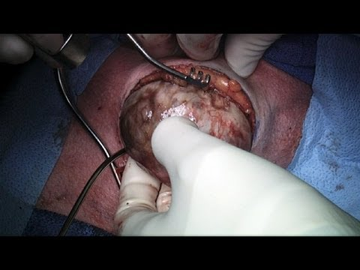
Removal of a mass and thyroid gland:
https://www.youtube.com/watch?v=zLaaIYtSXnk

Slide 12
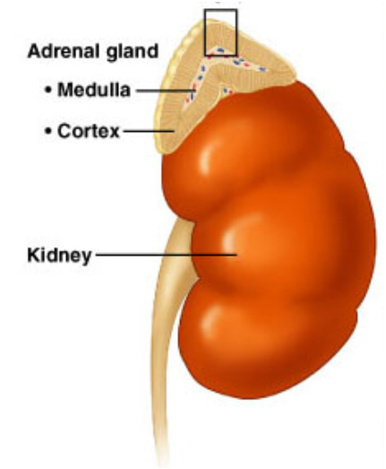
Adrenal Glands
Located at the top of the kidneys
Adrenal Cortex - outer area
Adrenal Medulla - inner area
Adrenal Glands produce adrenaline

Slide 13
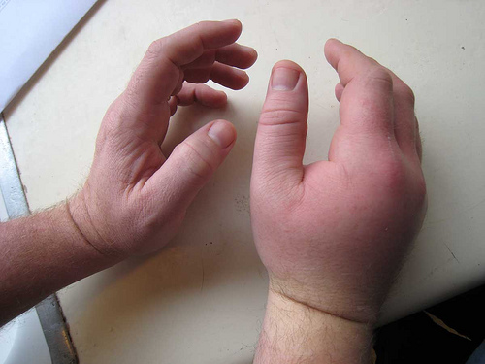
Adrenal Medulla
Epinephrine & Norepinephrine – increased heart rate, breathing rate, elevated blood pressure (fight or flight, response to stress)
People with severe life threatening allergies often carry injectors

Slide 14
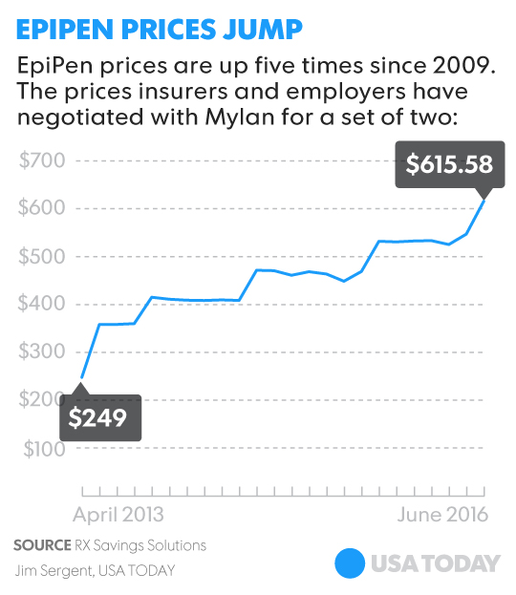
EpiPen, an epinephrine auto-injector used to treat allergy reactions that has seen its price rise from $57 in 2007 to about $500
The cost to manufacture the drug is about $1.00 (estimated)
Should the government enact laws to control the prices of drugs?

Slide 15
Adrenal Cortex
Aldosterone – helps kidneys conserve sodium and excrete potassium, maintaining blood pressure
Cortisol – keeps blood glucose levels stable, response to stress
Adrenal Sex Hormones - androgens (male) and estrogens (female)

Slide 16
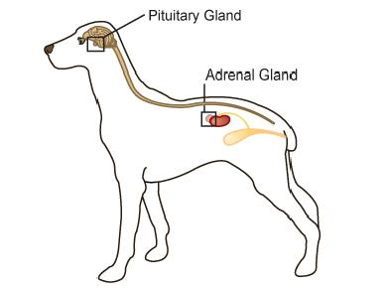
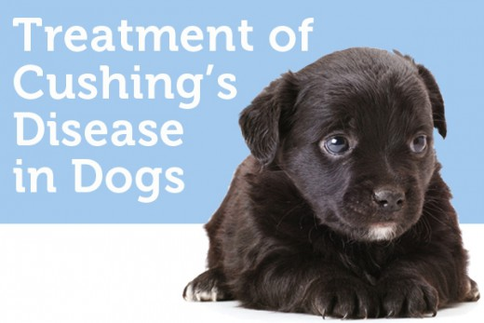
Adrenal Gland Disorders
Cushing’s Disease
Hyperadrenocorticism
Increased thirst and urination
Increased hunger
Increased panting
Pot-bellied abdomen
Obesity
Loss of hair
https://www.vetdepot.com/article-images/cushings-disease.gif
Cushing's syndrome happens when the adrenal glands makes too much cortisol.
Notes:
Cushings can be caused by a benign pituitary tumor (most common), a tumor on the adrenal glands, or overuse of steroids (often used to treat allergies or autoimmune disease)

Slide 17
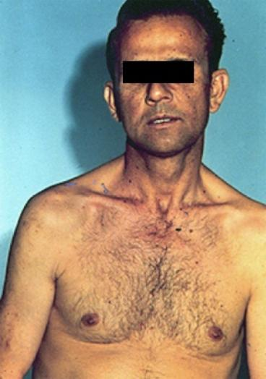
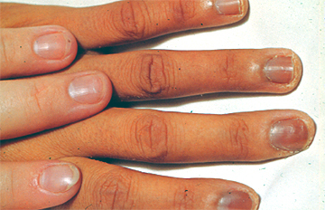
Addison’s disease
Hyposecretion of cortisol
Low blood pressure results
Increased pigmentation

Slide 18
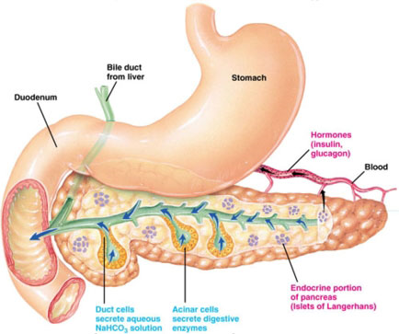
Pancreas
The pancreas is a large gland behind the stomach that helps the body to maintain healthy blood sugar (glucose) levels.
Contains islands of cells called the Islets of Langerhans which secrete glucagon and insulin

Slide 19
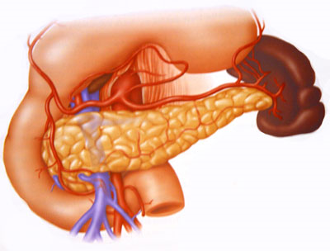
Glucagon – stimulates the liver to break down glycogen, raises blood sugar
Insulin – decreases blood sugar concentrations, affects the uptake of glucose by cells
*Both hormones work together to maintain a balance in the blood sugar

Slide 20
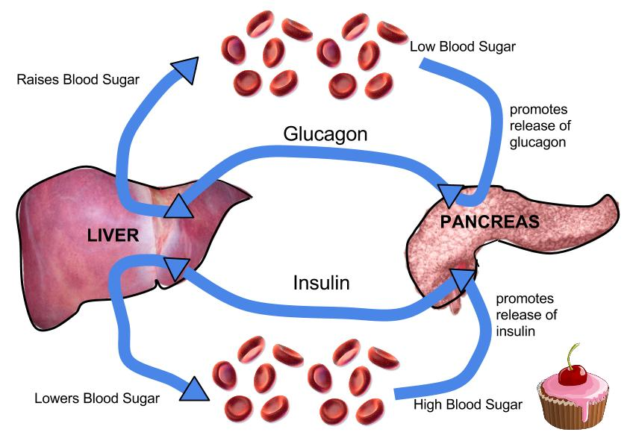

Slide 21
Diabetes
Diabetes Mellitus – results from an insulin deficiency, blood sugar rises (hyperglycemia) and excess is excreted in the urine.
Type I - insulin dependent diabetes mellitus or juvenile onset diabetes, often caused by inherited immune disorder that destroys pancreatic cells

Slide 22
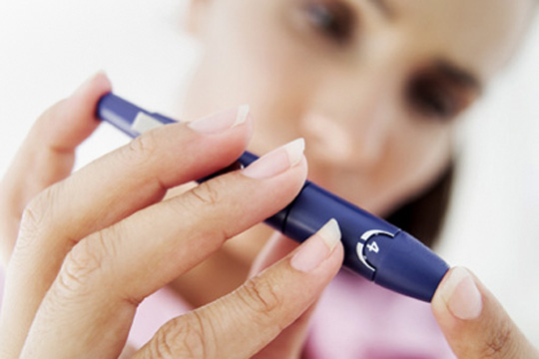
Type II – mature onset diabetes (usually after the age of 40), often individuals are overweight, can be controlled with diet and exercise
Blood sugar test, device pricks the finger and measures the amount of sugar in the blood

Slide 23
Hypoglycemia can occur if levels become too low, can be cured with direct injection of glucose or with eating something high in sugar. This is why diabetics often have candy.
Injection of insulin will lower the blood sugar levels

Slide 24
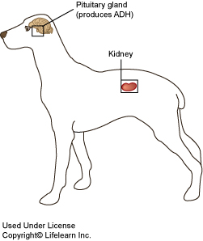
Diabetes Insipidus
Symptoms Excessive thirst ---May be intense or uncontrollable ----May involve a craving for ice water Excessive urine volume
Diabetes insipidus (DI) is an uncommon condition that occurs when the kidneys are unable to conserve water as they perform their function of filtering blood.
The amount of water conserved is controlled by antidiuretic hormone (ADH), also called vasopressin.
ADH is a hormone produced in a region of the brain called the hypothalamus.

Slide 25
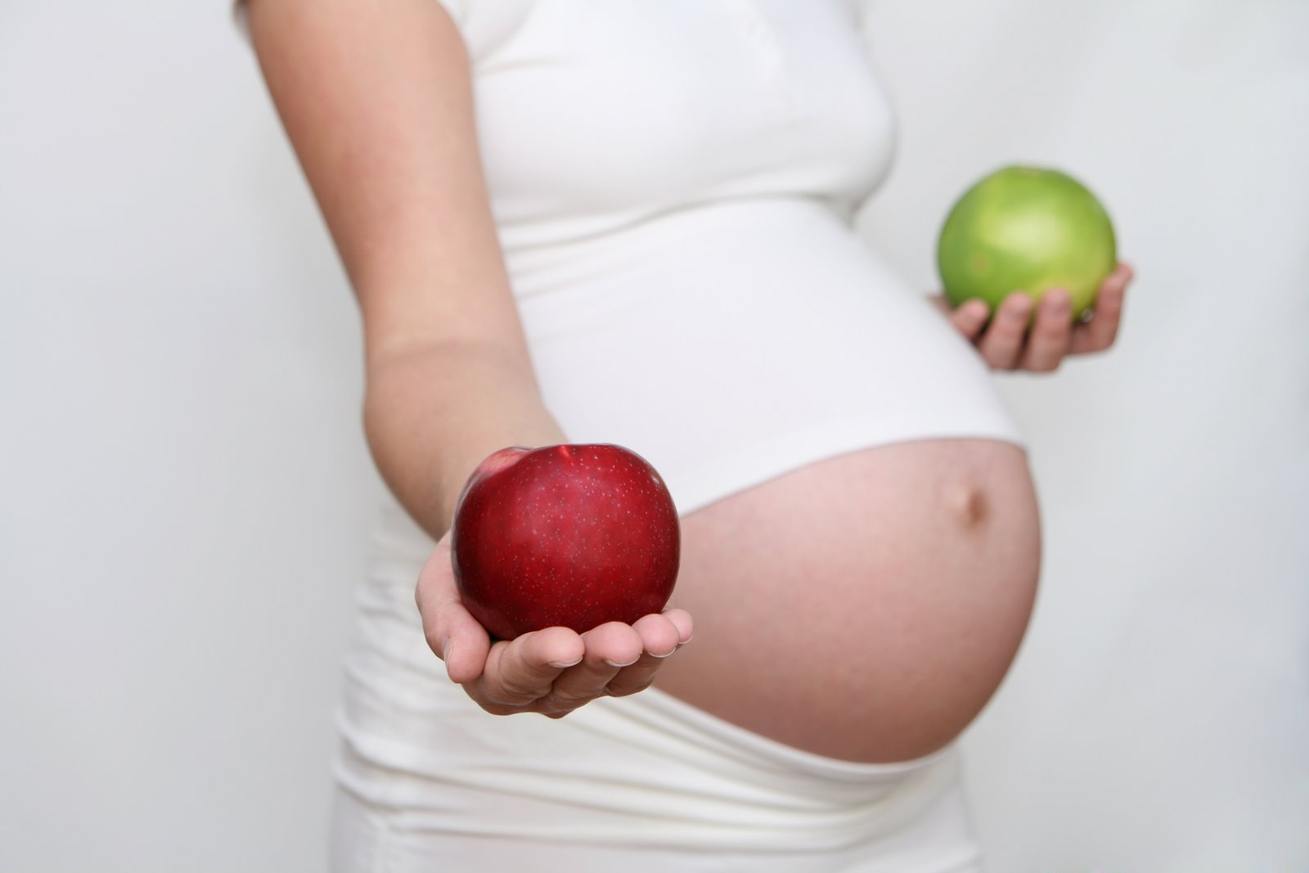
Gestational Diabetes
Pregnancy hormones can block insulin from doing its job. When this happens, glucose levels may increase in a pregnant woman's blood.
Gestational diabetes usually starts halfway through the pregnancy. All pregnant women should receive an oral glucose tolerance test between the 24th and 28th week of pregnancy to screen for the condition.

Slide 26
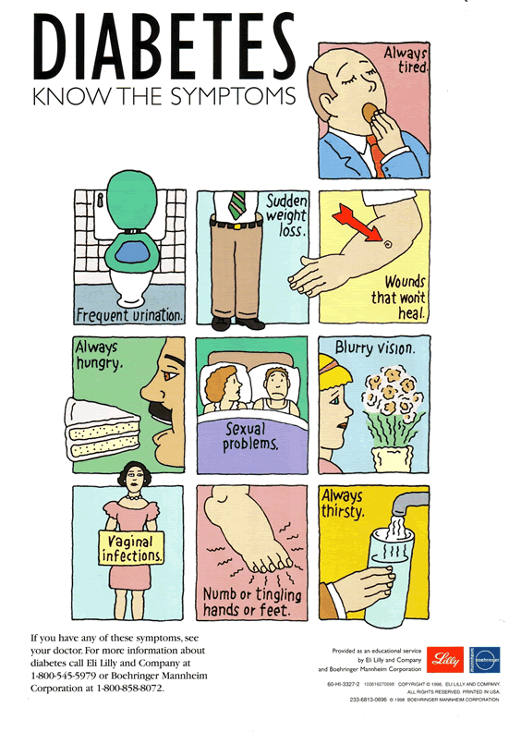
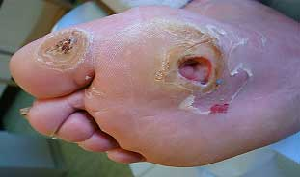
Diabetic neuropathies are a family of nerve disorders caused by diabetes. People with diabetes can develop nerve damage throughout the body. Symptoms include pain, tingling, or numbness-loss of feeling-in the hands, arms, feet, and legs. This can result in wounds that are slow to heal.

Slide 27
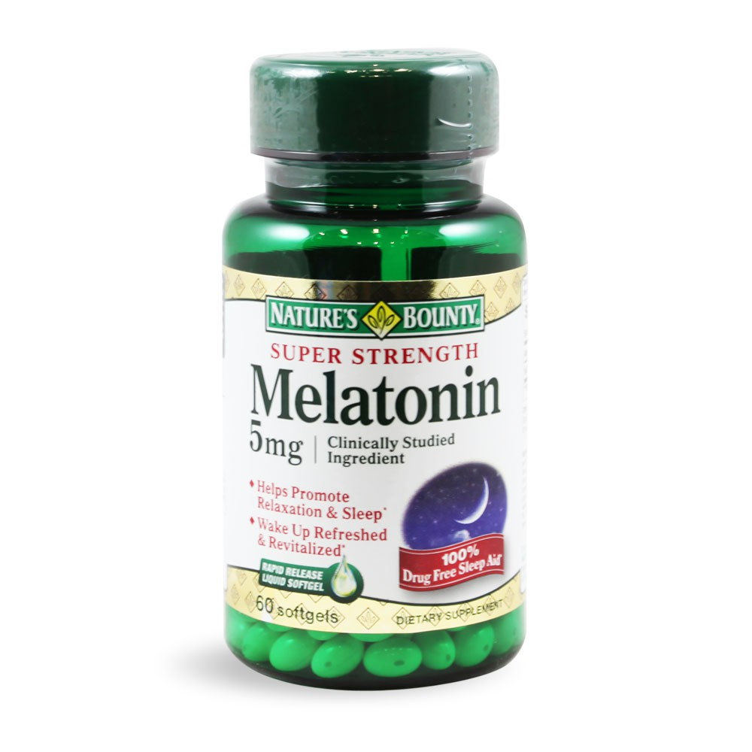
Other Endocrine Glands
Pineal Gland – located between the cerebral hemispheres,
secretes melatonin, maintains Circadian rhythms (light and dark activity)

Slide 28
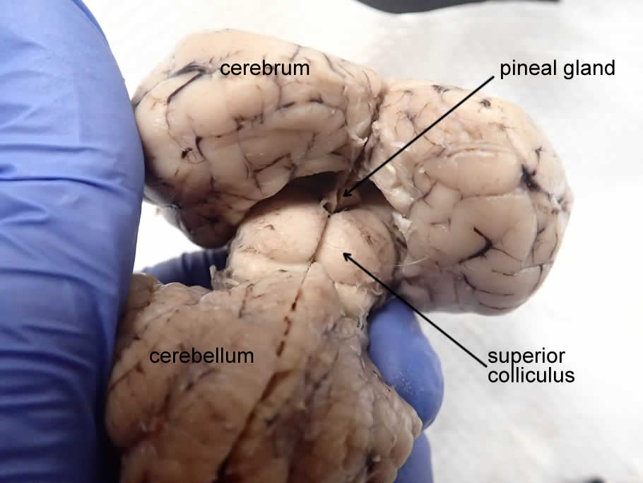
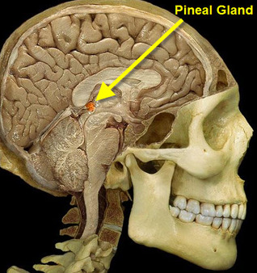
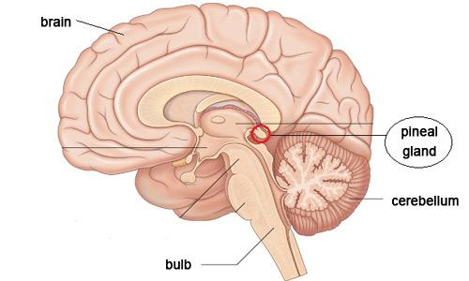
Can you find the hypothalamus? Pituitary?

Slide 29
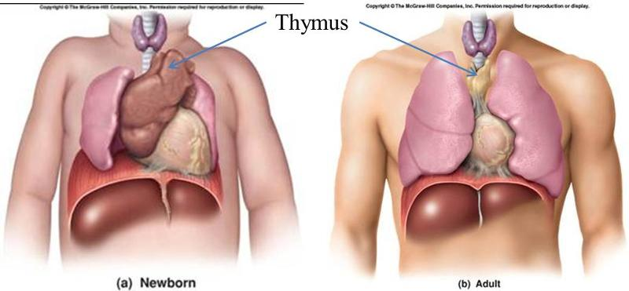
Thymus Gland – large in young children, gradually shrinks with age, secretes thymosins, important to immune function

Slide 30
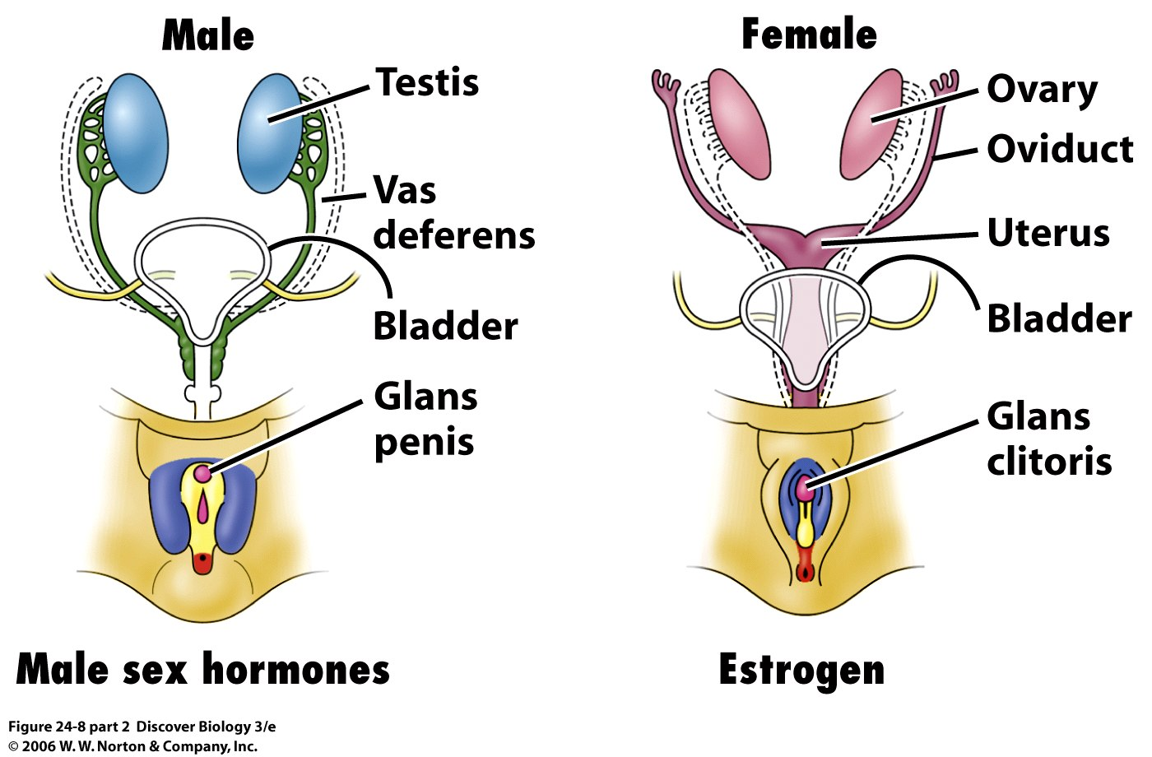
Reproductive Glands – testes and ovaries – testosterone, progesterone, estrogen
GONADOTROPINS - include any hormone that affect the gonads
Notes:
Image represents fetal condition, androgens will cause the development of a penis and the testes to drop into the scrotal sac

Slide 31
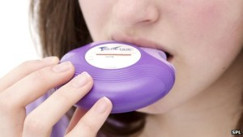
Steroids
Anabolic steroids are artificially produced hormones that are the same as, or similar to, androgens, the hormones in the body. There are more than 100 variations of anabolic steroids. The most powerful androgen is testosterone.
Corticosteroids are used to reduce inflammation that can result from injury or allergic reaction. Available by prescription.

Slide 32
