Slide 1
Earth Science Midterm Review
Norton

Slide 2
Electromagnetic Radiation
Is Sonar a type of Electromagnetic Radiation?!
Notes:
NO!

Slide 3
Section 1: Earth Science
Earth Science can be broken into 5 major areas of specialization:
Astronomy: The study of objects beyond the Earth’s atmosphere
Meteorology: The study of forces and processes that cause the atmosphere to change and produce weather
Geology: The study of materials that make up earth, the processes that form and change these materials, and the history of the planet and its life-forms since its origin
Oceanography: The study of the Earth’s oceans
Environmental Science: The study of the interactions of organism and their surroundings

Slide 4
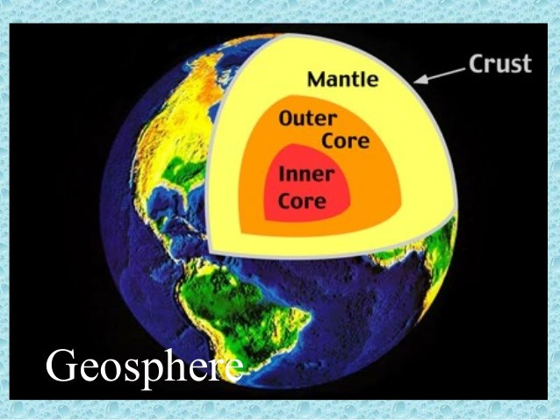
Earth’s Systems
There are FOUR main Earth systems. These systems are interdependent. The first is the geosphere.
Geosphere (lithosphere): area from the surface of the Earth down to the center (crust, mantle, and core)

Slide 5
Atmosphere
The atmosphere is the blanket of gases that surrounds our plant. It is 78% nitrogen and 21% oxygen. The remaining 1% includes water vapor, argon, carbon dioxide, and other gases.
Protects organisms from harmful radiation from the Sun, regulates temperature, and provides oxygen
We’ll dive into the layers of the atmosphere later! ☺

Slide 6
Hydrosphere
All of the water on Earth, including the water in the atmosphere.
97% of the Earth’s water is salt water
3% is freshwater in rivers and lakes, groundwater, and glaciers
This Photo by Unknown Author is licensed under CC BY-NC-ND

Slide 7
Biosphere
All the organisms that live on Earth and the environments in which they live
This Photo by Unknown Author is licensed under CC BY-NC-SA

Slide 8
The Nature of Scientific Investigation
The scientific method is a series of problem-solving procedures that help scientists conduct experiments.
Steps included:
1. Define the Problem
2. Research the Problem
3. Form a Hypothesis: testable explanation of a situation that can be supported or disproved by careful procedures
4. Experimentation: (test the hypothesis)
5. Record results
6. Analysis and Conclusion

Slide 9
Experimentation
a. independent variable: what you are testing, the factor that is CHANGED by the experimenter
b. dependent variable: what you are measuring, the factor that is affected by changes in the independent variable.
c. control: allows you to determine the effect of the independent variable. DOES NOT CHANGE.

Slide 10
Measurement
A measurement includes both a number and a UNIT of measure.
Scientific investigations use the standard system of units called Le Systeme International d’Unites (SI).
This is the modern version of the metric system.
Common standard units include:
Length: meter
Mass: gram
Volume: Liters
Area: square meters
Time: seconds
Temperature: kelvin
Mass measures the amount of matter in an object
Weight measures the pull of gravity on an object

Slide 11
Scientific Notation
A method used by scientists to express a number as a value of 1-10 multiplied by a power of 10.
If the mass of Earth is 5,973,600,000,000,000,000,000,000 kg… how would we write this in scientific notation?!
We want the main number to be between 1-10, so the number we are working with will be 5.97 X 10?
Look at the board to see how we find the power!!

Slide 12
Scientific Notation, cont.
Now, what is the decimal point needs to go to the RIGHT?!
The exponent of 10 will then be NEGATIVE.
The diameter of an atom in meters is approx. 0.0000000001.
How would we write this?!
We want a our first number to be between 1-10, so we would start with 1 x 10?
NOW WHAT?!

Slide 13
Latitude (parallels)
The science of mapmaking: Cartography!
The equator circles halfway between the North and South poles. This separates the world into two equal halves: northern and southern hemisphere.
The poles are located at 90 latitude.
Latitude is the distance in degrees north or south of the equator.
Each degree of latitude is about 111 km on Earth’s surface.
Run parallel to the equator (reference point)

Slide 14
Longitude (meridians)
Longitude: the distance in degrees east or west of the prime meridian, which is the reference point for longitude (0˚ longitude)
Lines of longitude are not parallel. They are large semi-circles that extend vertically from pole to pole.
The international date line is located at 180˚ meridian. This line is on the opposite side of the earth as the prime meridian.

Slide 15
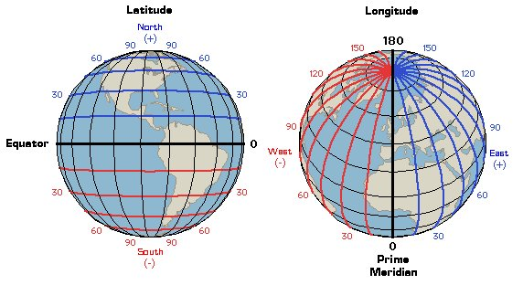
Latitude AND Longitude
Both latitude and longitude are necessary to precisely locate positions on Earth. Latitude ALWAYS comes first when writing coordinates.
Degrees of latitude cover relatively consistent distances, meaning they are relatively equal.
However, degrees of longitude are not parallel, they form semicircles, so their distances will vary.

Slide 16
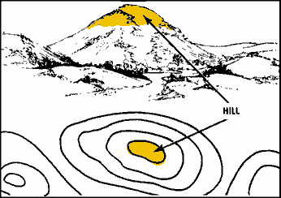
Topographic Maps
Show changes in elevation on Earth’s surface. They also show rivers, mountains, forests, bridges, etc.
Use lines, symbols, and colors to represent changes in elevation.
Elevation on a topographic map is represented by a contour lines.

Slide 17
Contour Lines and Contour Intervals
Contour lines connect points of equal elevation. These never cross. If they did, the point at which they cross would mean that point has 2 different elevations, which is impossible.
Contour interval: the difference in elevation between two side-by-side contour lines on a topographic map.
The closer an interval, the steeper it is.
Depression Contour Lines are used to represent land lower than the surrounding landscape. They look like regular contour lines, but contain short lines at right angles, known as hachures. The short lines point to the lower elevation.

Slide 18
This Photo by Unknown Author is licensed under CC BY

Slide 19
Map Legends and Map Scales
Map Legend: key that explains what the symbols on a map represent.
Map scale: ratio between the distances shown on a map and the actual distances on Earth’s surface.

Slide 20
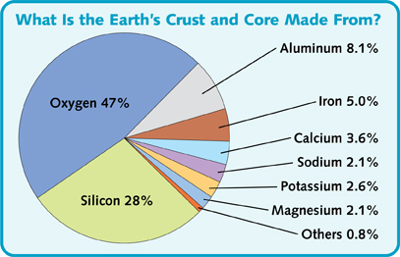
Atomic Mass= protons + neutrons
What is an electron? A negatively charged particle
Proton? A positively charged particle
Neutron? A NEUTRAL particle; has no electric charge.
What is an acid? A solution containing a substance that produces hydrogen ions (H+) in water. Anything below 7 on pH scale is considered acidic.
What is a base? A substance that produces hydroxide ions (OH-) in water. Anything above 7 on pH scale is considered basic.

Slide 21
Erosional Agents
Water
More power to move large particles than most winds.
Greater the volume of water, the more material that can be eroded.
The steeper the slope, the increase of erosional ability
Much erosion takes place every day within the ocean

Slide 22
Glacial Erosion
Although glaciers cover less than 10% of the Earth’s surface, their erosional effects are large-scale and dramatic.
They scrape out and gouge large sections of landscape.
They are so powerful, they have the ability to pick up large rocks and move them over great distances.

Slide 23
Wind Erosion
Major erosional agent in areas on Earth that experience limited precipitation and high temperatures.
As result, these areas have minimal vegetation cover, so there is little to hold soil in place.
This allows wind to easily pick up and transport these fine, dry particles.
The effects of wind erosion can be damaging and dramatic, although wind erosion is relatively insignificant to erosion by water and glaciers.

Slide 24
Early Observations
With the exception of events such as earthquakes, volcanic eruptions, and landslides, most of Earth’s surface appears to remain relatively unchanged during the course of a human lifetime.
On the geologic time scale, however, Earth’s surface has changed dramatically.
In the late 1500s, Abraham Ortelius, a Dutch cartographer (map maker), noticed the apparent fit of continents on either side of the Atlantic Ocean.
•He proposed that North America and South America had been separated from Europe and Africa by earthquakes and floods.

Slide 25
Early Observations, continued
The first time that the idea of moving continents was proposed as a scientific hypothesis was in the early 1900s.
In 1912, German meteorologist Alfred Wegener presented his ideas about continental movement to the scientific community.

Slide 26
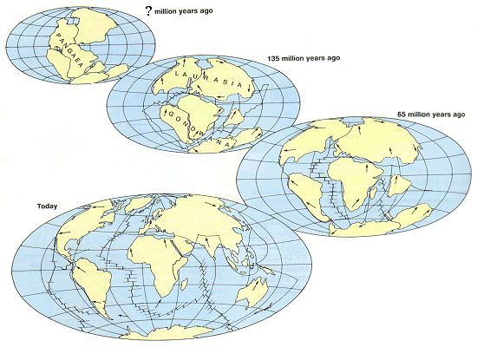
Continental Drift
Wegener developed a hypothesis that he called continental drift.
He proposed that Earth’s continents had once been joined in a single landmass, a supercontinent called Pangaea (Meaning The Earth), that broke apart about 200 mya (million years ago) and sent the continents adrift.

Slide 27
A Rejected Notion
Although Wegener had compiled an impressive collection of data, the hypothesis of continental drift was not accepted by the scientific community.
Two unanswered questions:
What forces could cause the movement?
How could continents move through solids?
~Main reasons that continental drift was rejected. ~
It was not until the early 1960s, when new technology revealed more evidence about how continents move, that scientists began to reconsider Wegener’s ideas.
Seafloor mapping & Earth’s magnetic field provided necessary evidence to show how continents move.
https://www.youtube.com/watch?v=JmC-vjQGSNM

Slide 28
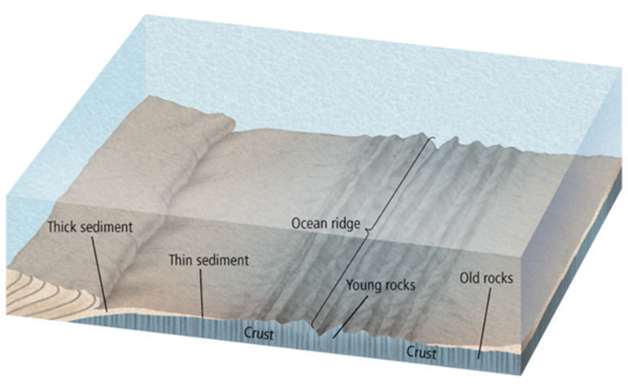
Ocean Rocks and Sediments
The ages of the rocks that make up the seafloor vary across the ocean floor, and these variations are predictable.
The age of oceanic crust increases with distance from a ridge.
Ocean-floor sediments are typically a few hundred meters thick.
Large areas of continents, on the other hand, are blanketed with sedimentary rocks that are as much as 20 km thick.
Observations of ocean-floor sediments revealed that, like the age of ocean crust, the thickness of ocean-floor sediments increases with distance from an ocean ridge.

Slide 29
Divergent (divide) Boundaries
Regions where two tectonic plates are moving apart are called divergent boundaries.
Most divergent boundaries are found along the seafloor rift valleys.
The formation of new ocean crust at most divergent boundaries accounts for the high heat flow, volcanism, and earthquakes associated with these boundaries.
Some divergent boundaries form on continents. When continental crust begins to separate, the stretched crust forms a long, narrow depression called a rift valley.

Slide 31
Convergent Boundaries
At convergent boundaries, two tectonic plates are moving toward each other.
When two plates collide, the denser plate eventually descends below the other, less-dense plate in a process called subduction.
There are three types of convergent boundaries.
Classified according to the type of crust involved.
Notes:
What does descend mean?

Slide 32
Convergent Boundaries
In the oceanic-oceanic convergent boundary, a subduction zone is formed when one oceanic plate, which is denser as a result of cooling, descends below another oceanic plate. The process of subduction creates an ocean trench.
In an oceanic-oceanic convergent boundary, water carried into Earth by the subducting plate lowers the melting temperature of the overlying mantle, causing it to melt.
The molten material is less dense so it rises back to the surface, where it often erupts and forms an arc of volcanic islands parallel to the trench.

Slide 33
Convergent Boundaries
When an oceanic plate converges with a continental plate, the denser oceanic plate is subducted. Oceanic-continental convergence produces a trench and volcanic arc.
The result is a mountain range with many volcanoes.
Continental-continental boundaries form when two continental plates collide, long after an oceanic plate has converged with a continental plate.
This forms a vast mountain range, such as the Himalayas.

Slide 34
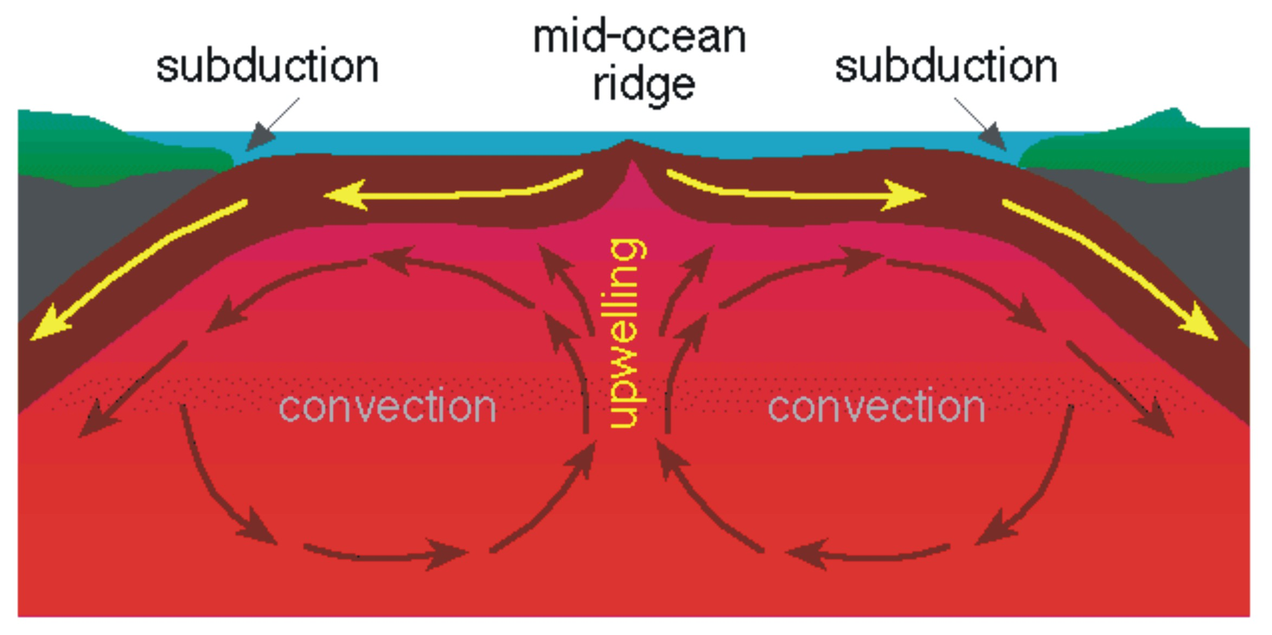
Convection in the Mantle
Convection currents develop in the mantle, moving the crust and outermost part of the mantle and transferring thermal energy from Earth’s interior to its exterior.

Slide 35
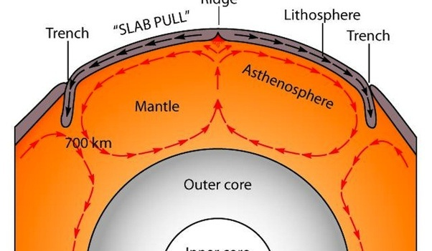
Push and pull
Ridge push is the tectonic process associated with convection currents in Earth’s mantle that occurs when the weight of an elevated ridge pushes an oceanic plate toward a subduction zone.
Slab pull is the tectonic process associated with convection currents in Earth’s mantle that occurs as the weight of the subducting plate pulls the trailing lithosphere into a subduction zone.

Slide 36
1) 200 º C and 300 MPa
a. lithification b. low grade c. intermediate grade d. high grade
2) 400 º C and 300 MPa
a. lithification b. low grade c. intermediate grade d. high grade
3) 600 º C and 500 MPa
a. lithification b. low grade c. intermediate grade d. high grade

Slide 38
“Fun” Fact
Magma with a high silica content will have a high (increased) viscosity.
What is viscosity? A materials resistance to flow.

