Slide 1
Muscle Labeling

Slide 2
Head/Neck
https://www.biologycorner.com/anatomy/muscles/head/head_muscles.html

Slide 3
Back
https://www.biologycorner.com/anatomy/muscles/torso/muscles_thoracic.html

Slide 4
Chest
https://www.biologycorner.com/anatomy/muscles/torso/muscles_chest.html

Slide 5
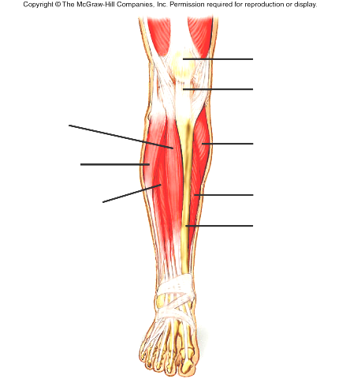
Legs
Quads:
https://www.biologycorner.com/anatomy/muscles/legs/front_legs.html
Hamstrings
https://www.biologycorner.com/anatomy/muscles/legs/back_legs.html

Slide 6
Arms
Extensors:
https://www.biologycorner.com/anatomy/muscles/arms/top_arm.html
Flexors:
https://www.biologycorner.com/anatomy/muscles/arms/bottom_arm.html

