Slide 1
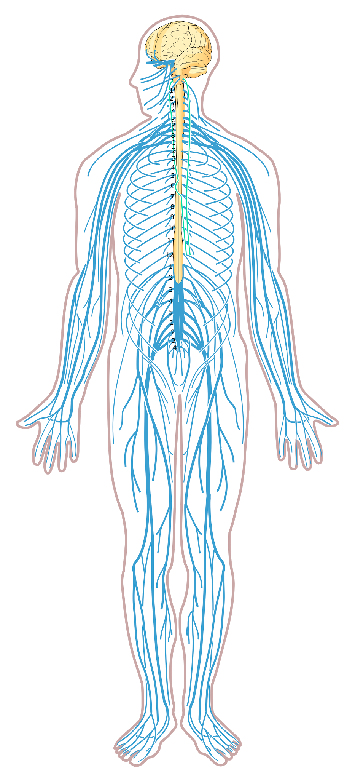
The Nervous System
Includes the brain, spinal cord and the nerves
What does it mean to be “brain-dead?”

Slide 2
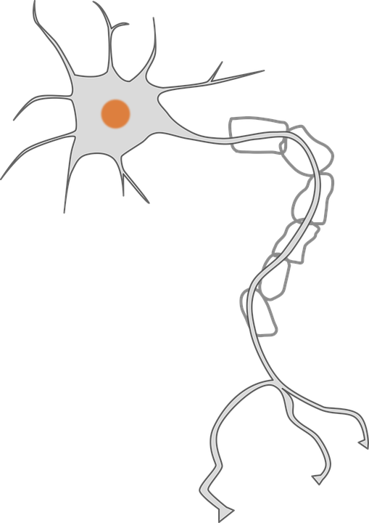
Neurons = masses of nerve cells that transmit information (functional unit of the system) 1. Cell Body - contains the nucleus and other cell organelles 2. Dendrites – shorter, more numerous, receive information 3. Axons - single long fibers, conducts information away from the cell
1
2
3

Slide 3
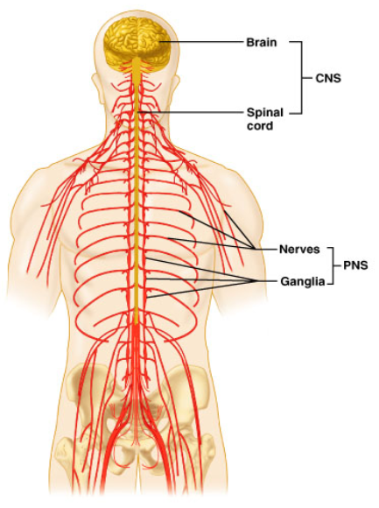
Two Divisions of the Nervous System
Central Nervous System (CNS)
Brain and spinal cord
Peripheral Nervous System (PNS)
Nerves throughout the body
31 pairs of spinal nerves 12 pairs of cranial nerves

Slide 4
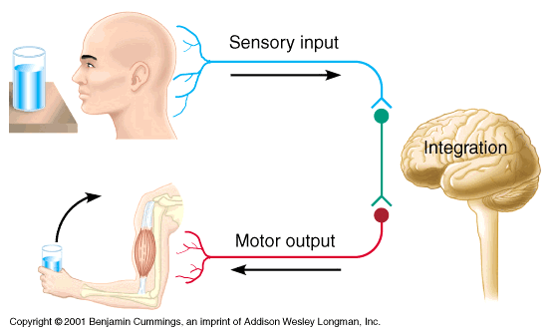
Overall function - coordinate the body’s systems by receiving and sending information; maintaining homeostasis
Sensory - gathers info from receptors in the body
Integrative - determines where information is sent
Motor - responds to signals, homeostasis

Slide 5
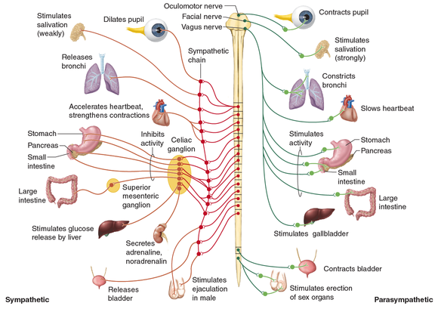
Motor Functions
Somatic Nervous System - skeletal; voluntary
Autonomic Nervous System
- smooth muscles, glands; involuntary

Slide 6
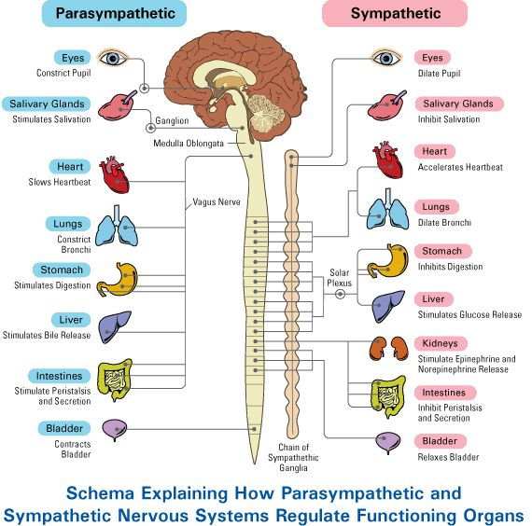
Autonomic Nervous System (2 branches)
Parasympathetic (rest and recover)
Sympathetic
(fight or flight)
*autonomic conflict

Slide 7
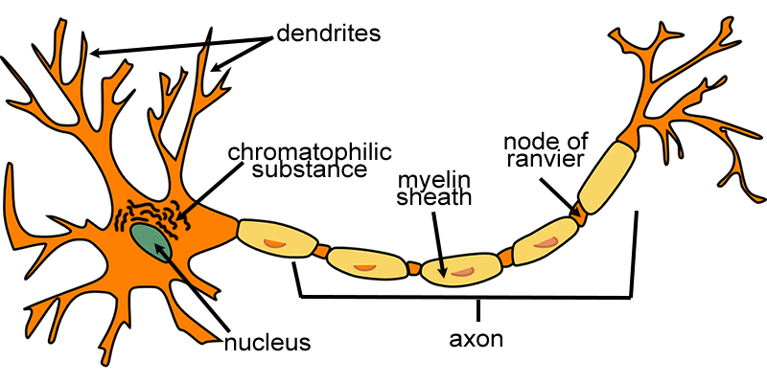
Chromatophilic substance (rough ER) - transport system
Myelin -insulation surrounding axons
Nodes of Ranvier - gaps in the insulation Neurofibrils - fibers within the axon
Notes:
Axon: conducts electrical impulses -sends
Dendrite: received stimulation for cell to react -receives

Slide 8
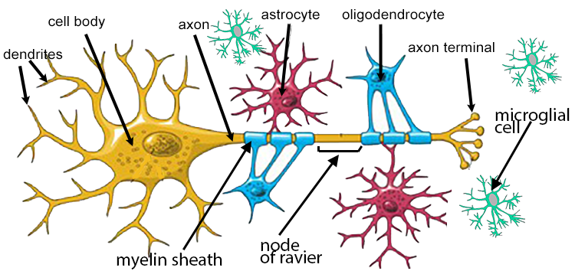
Neuroglial Cells - Support for neurons
node of ranvier

Slide 9
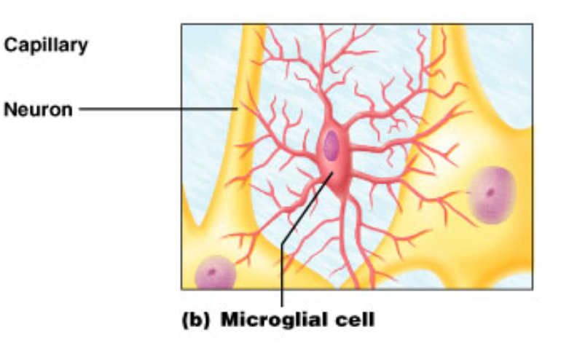
1. Microglial Cells - Immune function; digest debris, kills bacteria

Slide 10
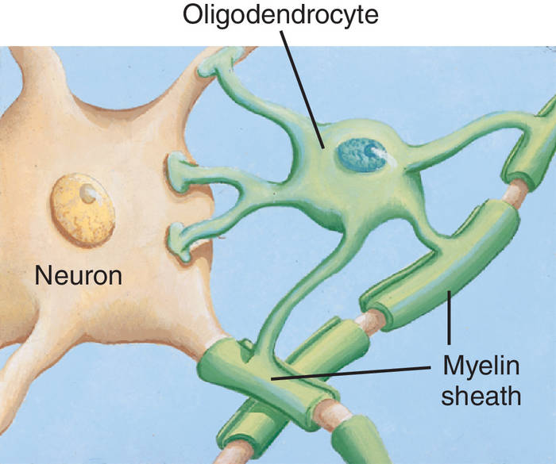
2. Oligodendrocytes - make myelin sheath that provides insulation around the axons

Slide 11
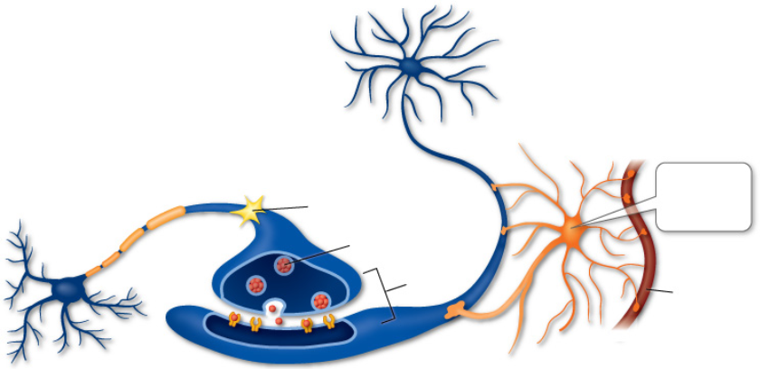
3. Astrocytes - connect blood vessels to neurons
I connect to blood vessels

Slide 12
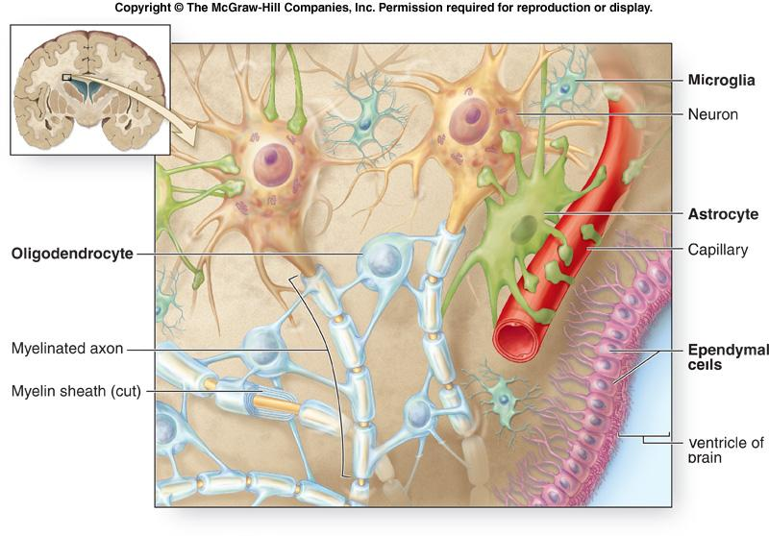
4. Ependymal Cells - forms membranes around tissue

Slide 13
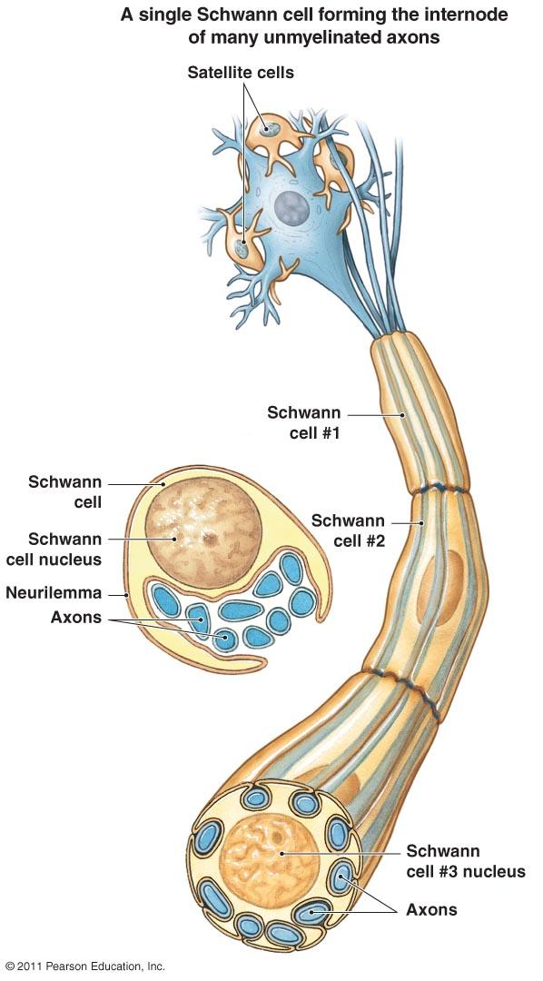
5. Schwann cells: form the insulating myelin sheath around the neurons in the PNS (same function as oligodendrocytes, which are found in the CNS)

Slide 14
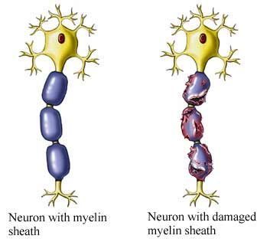
Myelin Sheaths - insulate axons
Schwann cells supply the myelin for peripheral neurons.
Oligodendrocytes myelinate the axons of the central nervous system.
Gaps in the sheath are called:
NODES OF RANVIER

Slide 15
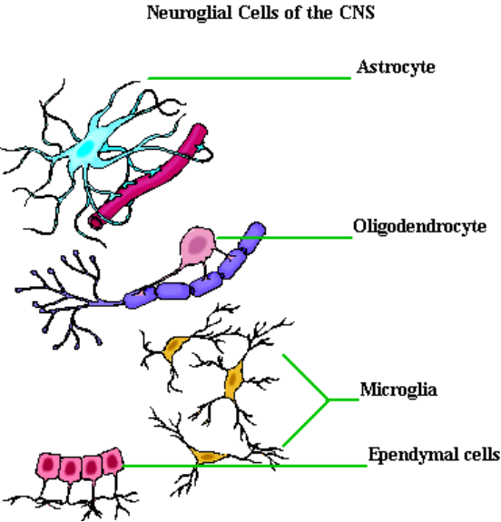
Which cell….
1. Creates myelin sheath
2. Has an immune function
3. Forms a membrane
4. Connects to a blood supply
Practice with neuroglia coloring!
Notes:
Oilgodendrocytes
Microglia
Ependylmal Cells
Astrocyte

Slide 16
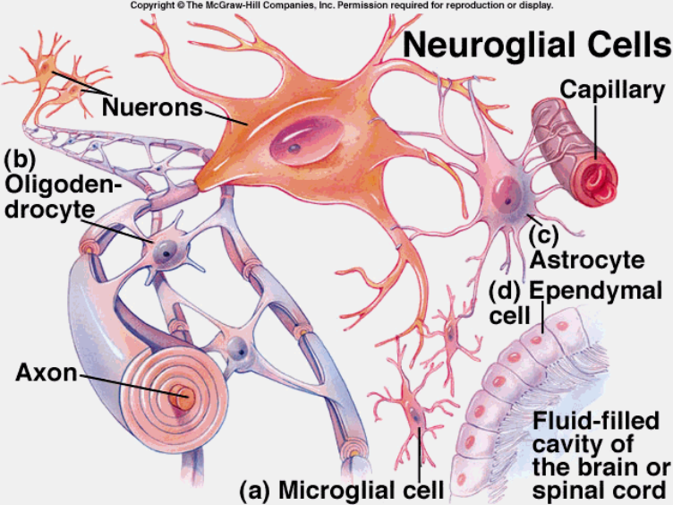

Slide 17
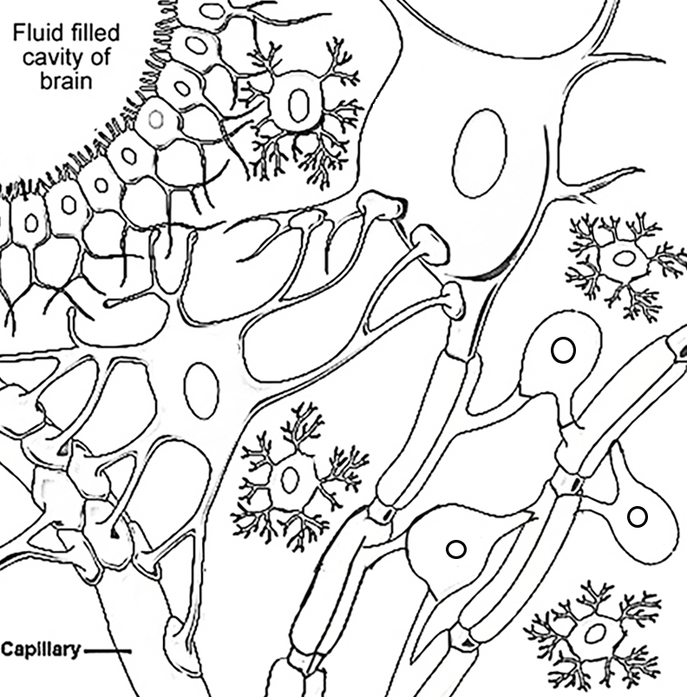
Notes:
Color on Board

Slide 18
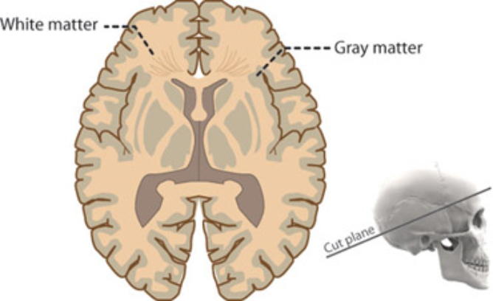
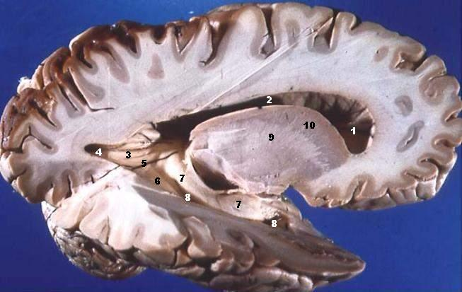
Myelinated (white matter) – myelinated axons
Unmyelinated (grey matter) - unmyelinated

Slide 19
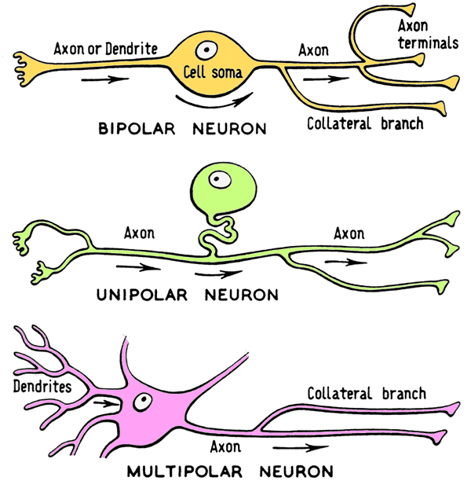
Functional:
Sensory / Motor / Interneurons
Structural -
Bipolar / Unipolar / Multipolar

Slide 20
Fun Facts about Neurons
-Longevity – can live and function for a lifetime
-Do not divide – fetal neurons lose their ability to undergo mitosis; neural stem cells are an exception
-High metabolic rate – require abundant oxygen and glucose
-The nerve fibers of newborns are unmyelinated - this causes their responses to stimuli to be coarse and sometimes involve the whole body. Try surprising a baby!

Slide 21
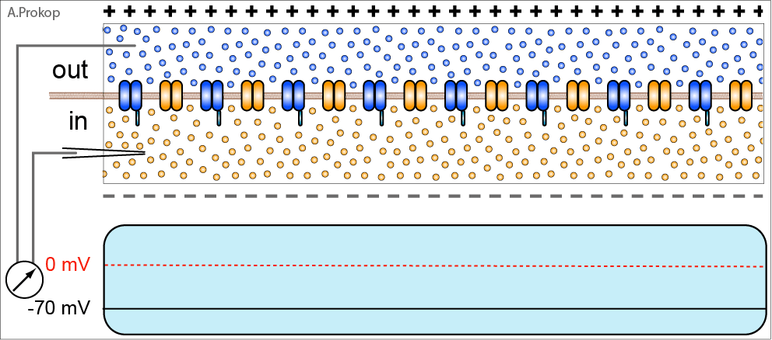
Cell Membrane Potential
Resting Potential / Threshold Potential / Action Potential
Nerve Impulse = weak electric current, like a wave

Slide 22
1. Neuron membrane maintains resting potential
2. Threshold stimulus is received
3. Sodium channels open
4. Sodium ions diffuse inward, depolarizing the membrane
5. Potassium channels open
6. Potassium ions diffuse outward, repolarizing the membrane

Slide 23
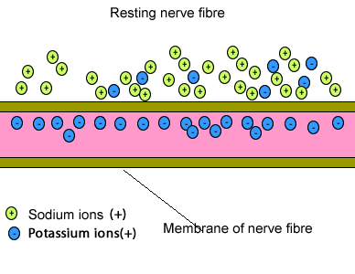
7. The resulting action potential causes a local bioelectric current that stimulates the membrane.
8. Wave of action potentials travel the length of the axon as a nerve impulse

Slide 24
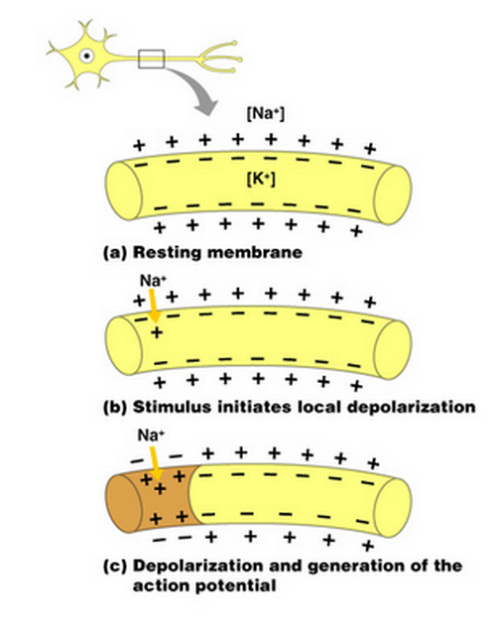
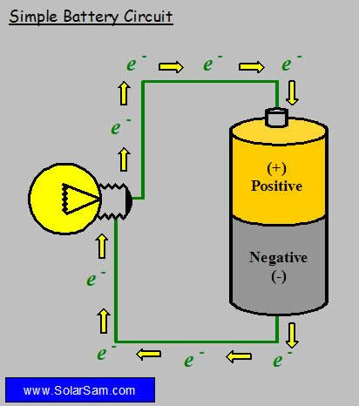
Ions in the cell and outside the cell create a positive and negative side, which produces an electric current.

Slide 25
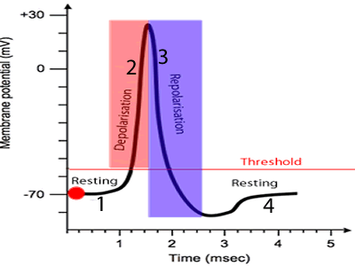
Depolarization:
loss of the difference in charge between the inside and outside of the plasma membrane of a muscle or nerve cell due to a change in permeability and migration of sodium ions to the interior

Slide 26
